Slide 1
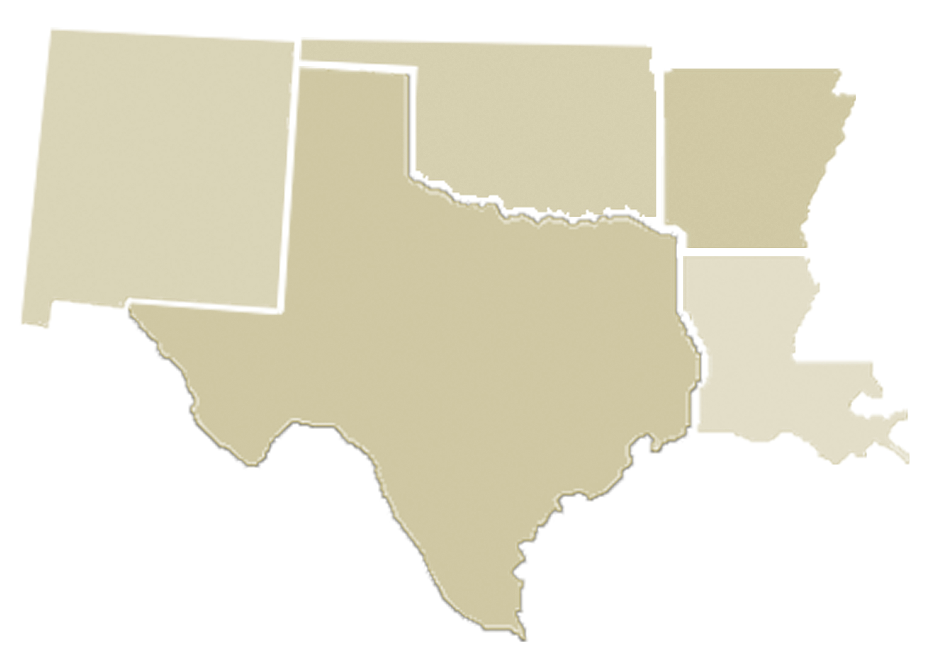
Intensive Site Map
Central Consolidated
Putnam City
Espanola
Marked Tree
Bernalillo
Crooked
Oak
Altus
Kinta
Grady
Hatch
Nova
Midland
Monroe
Madison
Elgin
Iberia
Lafourche

