Slide 1


Proposal to Evaluate
New Mexico's Reading First Initiative
Jen Beck, Ph.D., SEDL
Cori Groth, Ph.D., SEDL
Cheryl Brown-Kovacic, Ph.D. CESDP

Slide 2
SEDL
Non-profit corporation dedicated to improving teaching and learning for all children
37-year history supporting state improvement efforts in New Mexico and the Southwest
Reading evaluation, research, and development:
  Evaluating statewide professional development programs in reading literacy (ongoing)
  Evaluating systems-oriented school improvement project (ongoing)
  Development of Cognitive Foundations of Learning to Read in Bernalillo (2000)
  “Reading Tool Kit” (in development)
Solid reputation for conducting research and providing services in New Mexico
Robust, secure, interactive Web site with in-house staff experienced in
supporting online client communications

Slide 3
CESDP
Founded by NM Legislature in 1993 to assist NM communities in improving the quality of education by:
  Providing technical assistance to schools, districts, and NMSDE
  Disseminating research
  Supporting educational institutions with guidance
CESDP initiatives and focus areas include:
  Teacher quality
  Linguistic/cultural considerations
  Rural education
  Literacy
  School reform

Slide 4
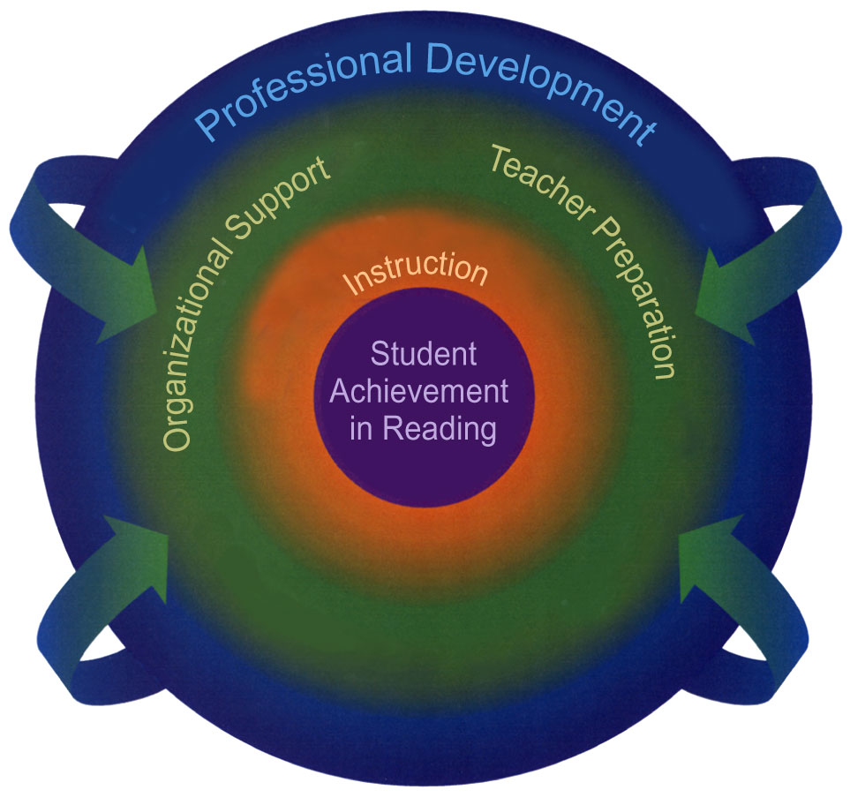
Evaluation Framework- The NM-RF System
Professional Development:
Ongoing professional development
for teachers, administrators, and education leaders
Organizational Support:
Changes in the state, district, and school level organizational structures and support for teaching reading
Teacher Preparation:
Changes in teacher preparation programs to support teachers’ use of Reading First strategies
Instruction:
Changes in the instructional approaches to teaching reading
Student Achievement:
All students reading well by 3rd grade
Notes:
Other talking points:
The NM-RF initiative is a comprehensive, complex system that involves several nested layers.
SEDL will collaborate with NM SDE and other key stakeholders to explicate the program logic in order to identify evaluation leverage points within this complicated system.

Slide 5

Reading Network
NM Reading First Activities
SEDL and CESDP collect evaluation data and generate findings
SEDL and CESDP share formative and summative findings with Reading Network
REA Network
Notes:
Formative information about each component in the comprehensive system ensures weak areas identified in sufficient time for improvements to be made and strengths replicated.
Summative information about the impact on students’ reading performance and other program goals.
Findings shared through executive summaries, detailed interpretive discussions, charts, graphs, tables, and other graphic displays.
SEDL will facilitate the integration of the NM-RF system through an ongoing feedback loop among members of the Reading Network.
We would like the state department to identify who needs to be members of the reading network. Most likely they will the ones listed.

Slide 6

SEDL & CESDP Strengths
Design and Methodological
Expertise
Client Relations
We have a proven track record of conducting evaluations of this scope and size in this topical area.
We have expertise in evaluation and research design, instrument development, and qualitative and quantitative data analysis.
We deliver evaluation findings that are scientifically sound and high in utility for both technical and non-technical audiences.
We are responsive to client needs.
We build clients’ capacity to accomplish goals.
We value a participatory approach and shared inquiry.

Slide 7
Additional Information
Thank you for considering SEDL in partnership with CESDP, for the evaluation of New Mexico’s Reading First Initiative.
For further information about SEDL and CESDP, please visit our Websites at www.cesdp.nmhu.edu/ and www.sedl.org/es/

