Slide 1

Back to School at SEDL
All SEDL Staff Meeting
August 20, 2004

Slide 2
Lesson Plan: Strategic Plan Update
Update and celebration of accomplishments.
Review SEDL mission and three goals.
Review progress on four topics under goals B and C.
  Needs Sensing
  Branding/Identity and Communications Plan
  Development and Accountability
  Information Systems
Homework: Where you fit and how you will be involved in future planning and development activities.

Slide 3
Needs Sensing
Subgoal B1. We will monitor the competitive landscape, modifying our plans accordingly.
  Annual needs sensing and competitive analysis
    Coordinate SEDL needs sensing activities
    Ongoing data collection
    Annual aggregation and compilation
    Annual reports by state/region and program areas
  Share and discuss findings with staff
    Explore opportunities and implications
    Develop & revisit plans

Slide 4
Gather information from multiple sources.
Needs Sensing
State/ region focus groups
Periodicals
Publications
Program/ topic focus groups
Funding Trends
Information pool
State/ federal legislative action
Field & program knowledge
Press releases
Conferences/ conventions
Competitor, Partner, and Peer Activity
Policy briefs
Statistics

Slide 5
Code information in a searchable database.
Needs Sensing
By state/region
By program area
By topic
Information pool

Slide 6
Create briefs, reports, and white papers by state/region, program area, and topic or issue.
Needs Sensing
Information pool
Briefs
Reports
White papers

Slide 7
Verify information, coding, and reporting.
Needs Sensing
Information pool
Briefs, reports, & white papers
DATABASE

Slide 8
Needs Sensing
and Competitive Analysis
Gather information
Verify
Information pool
Codify
Report

Slide 9
Needs Sensing: How You Can Help
Tell us what you hear.
Participate in focus groups.

Slide 10
Branding and Identity
Goal B. We will strengthen our presence with clients and education stakeholders.
The SEDL Branding and Identity Guidelines, the “BIG” site organizes branding guidelines and assets that you can use in your work: www.sedl.org/big
On the BIG site, you will find examples of print products (briefs, fliers, booklets, magazines and newsletters), stationary, Web sites, promotional items, presentations, and exhibits.
On the BIG site, you can download the SEDL logo, project art, and other assets to use in your work. For instance, you can download the standard SEDL PowerPoint template that you can use to make a presentation like this one.

Slide 11
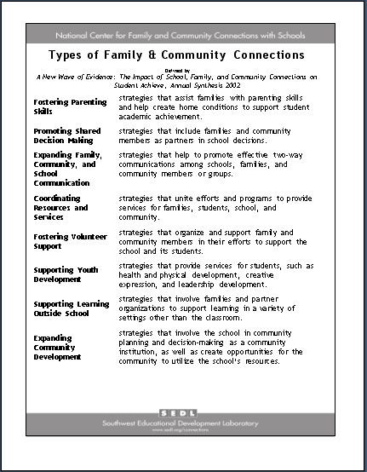
Branding for
Print Products
New print products are using
standard SEDL branding.
This is an example of a one-page flier for a SEDL project, the National Center for Family and Community Involvement.
Note the project branding at the top of the page and the SEDL branding at the bottom.

Slide 12

Branding for Web Sites
New Web sites
are using
SEDL branding.
Brand hierarchy
SEDL logo and company name are at top.
Project branding is within the “centerpiece” area.
SEDL contact links at the bottom of the page.

Slide 13
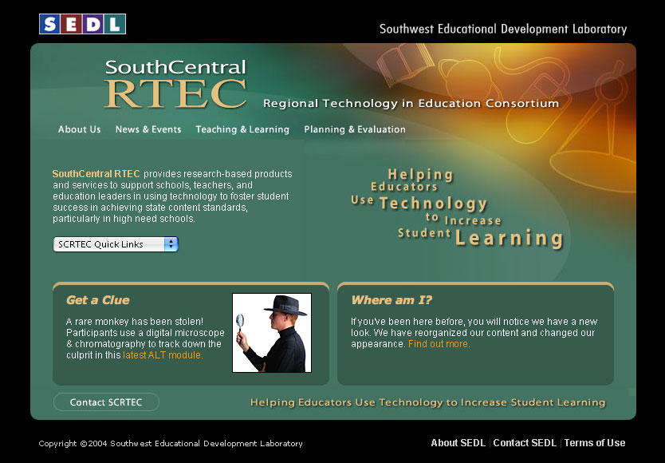

Branding for Web Sites
After branding...
Project sites have their own look and feel.
SEDL’s branding remains consistent across its Web presences.

Slide 14
Branding and Identity: How You Can Help
Review the BIG site and look for tools that would be useful to you.
  Is anything missing?
  Is anything unclear?
Share your feedback and questions with Joyce or Brian so we can add to the site and revise it as necessary.

Slide 15
Internal Communications Plan
Subgoal B2. We will engage in marketing, public relations, and
outreach to communicate with clients and stakeholders.
Develop internal communications plan
  Conduct communications audit
  Set up Web site
Where are we on the communications audit?
  About 30 percent of staff participated so far
  Completed focus group interviews, telephone interviews
What are next steps?
  Conduct online survey
  Complete report of findings
  Develop plan

Slide 16
External Media Relations Plan
Subgoal B2. We will engage in marketing, public relations, and outreach
to communicate with clients and stakeholders.
Develop positive relationships with key reporters and editors locally, in major markets, and trade press
Create and use tools, resources, and expertise to manage and monitor media opportunities and placements
Increase visibility with our publics
Contribute to coordinated communications plan (internal/external)
  Convened cross-organizational group
  Develop final plan

Slide 17
Internal and External Communications: How You Can Help
  Participate in online survey of audit
  Talk with Leslie and Debbie in OIC when your story ideas about your work

Slide 18
Development System
Subgoal C3. We will develop mechanisms and criteria for identifying
evaluating, and pursuing opportunities in support of our RD&D plans
as well as outside our current program areas as needed.
Create transparent decision-making.
Develop protocols for proposing & supporting.

Slide 19
Development Process
Do we pursue?
Is it a business
match for SEDL?

Slide 20
Development Process
Do we pursue?
Is it a business
match for SEDL?
Is is a technical or
programmatic match
for SEDL?

Slide 21
Development Process
Do we pursue? How we pursue
Is it a business
match for SEDL?
Proposals
Contracts
New Product or Service
Is is a technical or
programmatic match
for SEDL?
Partnership/MOU

Slide 22
Development System: How You Can Help
Listen for funding sources & opportunities.
Ultimately, propose new work.

Slide 23
Tools and Information Systems
Subgoal C5. We will acquire facilities and infrastructure that support
SEDL’s RD&D programs.
Improve infrastructure and systems to support our work (move toward a paperless office)
SEDL Information Management System (SIMS)
SIMS is
  a system of tools and modules designed to manage important business processes.
  a data management system designed to inform management decisions and workgroup planning.
  an information tool designed to inform institutional development and strategic planning.
  a way to increase efficiency, eliminate redundancy, and bridge silos.
  a plan to make things easier for you!

Slide 24
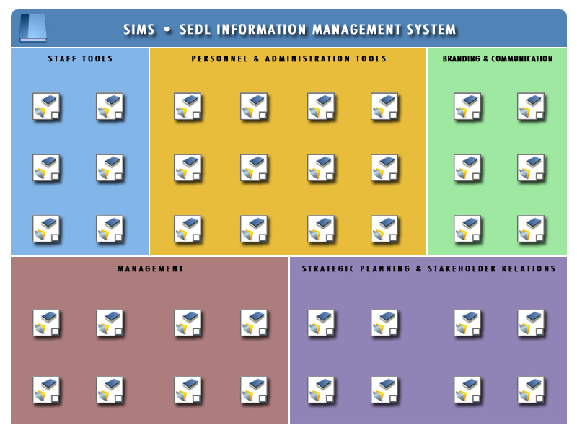
Timesheets
Leave
Requests
Planning
Agreements
Position
Descriptions
Job
Postings
Staff
Profiles
Institutional
Calendar
Sales &
Publications
Travel
Requests
Purchase
Requests
Travel
Auth.
Purchase
Auth.
Purchasing
Payroll
Print/Web
Production
IRC/
Circulation
VITA
Workgroup
Main Menu
Work
Orders
Timesheets
Budgets
SEDL
Red Book
Media
Relations
‘BIG’
Guidelines
Timesheet
Approval
Leave
Approval
Budget
Tracking
Performance
Appraisals
Funding
Opportunities
Organization
Profiles
Proposal
Development
SEDL
Contacts
QA Review
Perf. Ind.
Standards
Reports
Competitors
Partners
Needs
Sensing
Reports

Slide 25
Tools and Information Systems
Where are we in implementing SIMS functionality?

Slide 26
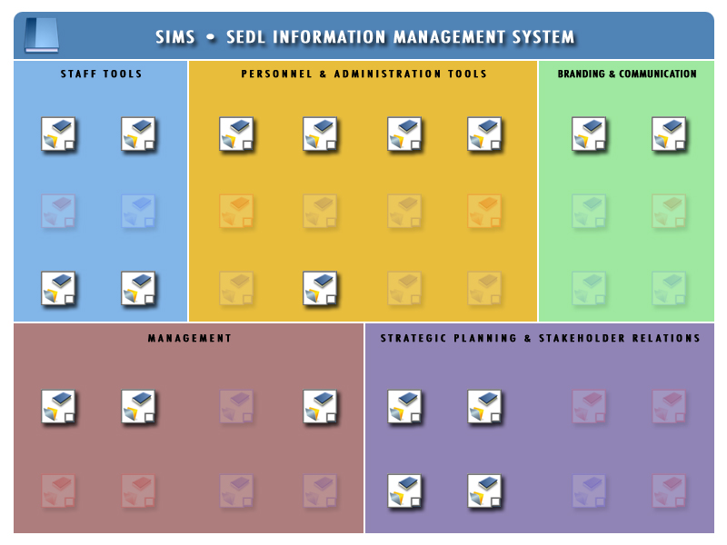
1. Completed or currently in use - 18 (45%)
Timesheets
Leave
Requests
Planning
Agreements
Position
Descriptions
Job
Postings
Staff
Profiles
Institutional
Calendar
Sales &
Publications
Travel
Requests
Purchase
Requests
Travel
Auth.
Purchase
Auth.
Purchasing
Payroll
Print/Web
Production
IRC/
Circulation
VITA
Workgroup
Main Menu
Work
Orders
Timesheets
Budgets
SEDL
Red Book
Media
Relations
‘BIG’
Guidelines
Timesheet
Approval
Leave
Approval
Budget
Tracking
Performance
Appraisals
Funding
Opportunities
Organization
Profiles
Proposal
Development
SEDL
Contacts
QA Review
Perf. Ind.
Standards
Reports
Competitors
Partners
Needs
Sensing
Reports

Slide 27
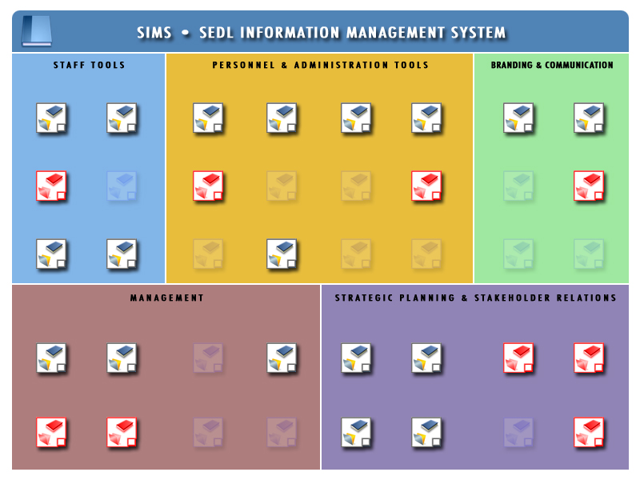
2. In progress or nearing completion - 9 (23%)
Timesheets
Leave
Requests
Planning
Agreements
Position
Descriptions
Job
Postings
Staff
Profiles
Institutional
Calendar
Sales &
Publications
Travel
Requests
Purchase
Requests
Travel
Auth.
Purchase
Auth.
Purchasing
Payroll
Print/Web
Production
IRC/
Circulation
VITA
Workgroup
Main Menu
Work
Orders
Timesheets
Budgets
SEDL
Red Book
Media
Relations
‘BIG’
Guidelines
Timesheet
Approval
Leave
Approval
Budget
Tracking
Performance
Appraisals
Funding
Opportunities
Organization
Profiles
Proposal
Development
SEDL
Contacts
QA Review
Perf. Ind.
Standards
Reports
Competitors
Partners
Needs
Sensing
Reports

Slide 28

3. Planned or under development - 13 (32%)
Timesheets
Leave
Requests
Planning
Agreements
Position
Descriptions
Job
Postings
Staff
Profiles
Institutional
Calendar
Sales &
Publications
Travel
Requests
Purchase
Requests
Travel
Auth.
Purchase
Auth.
Purchasing
Payroll
Print/Web
Production
IRC/
Circulation
VITA
Workgroup
Main Menu
Work
Orders
Timesheets
Budgets
SEDL
Red Book
Media
Relations
‘BIG’
Guidelines
Timesheet
Approval
Leave
Approval
Budget
Tracking
Performance
Appraisals
Funding
Opportunities
Organization
Profiles
Proposal
Development
SEDL
Contacts
QA Review
Perf. Ind.
Standards
Reports
Competitors
Partners
Needs
Sensing
Reports

Slide 29

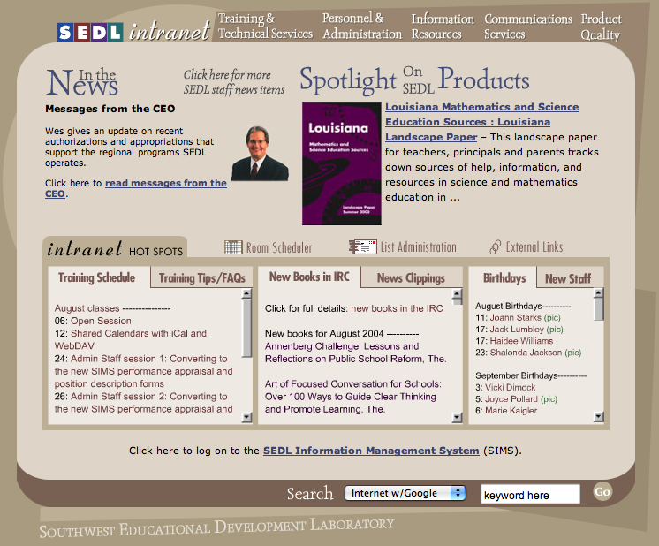
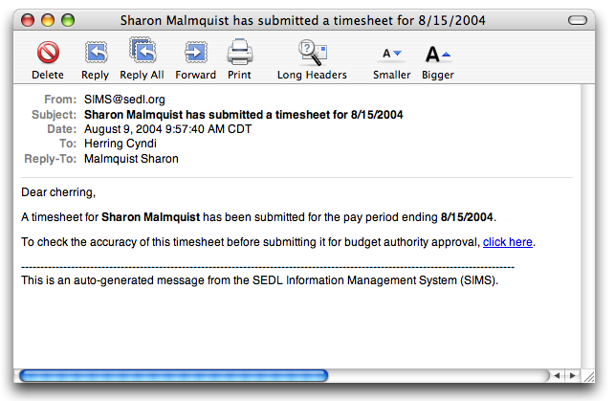
SIMS
How do I access SIMS?
SIMS Launcher (OSX Dock, OS9 DragStrip, Windows Taskbar)
Staff Home Page
SIMS E-mail Notification (Timesheets, Leave Requests, etc.)
1.
2.
3.

Slide 30
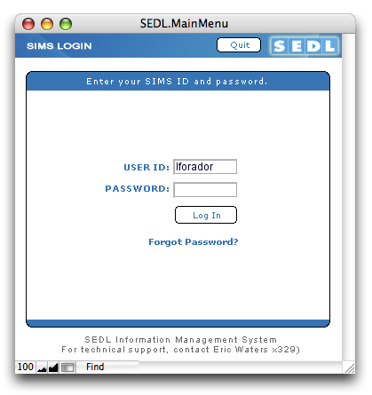
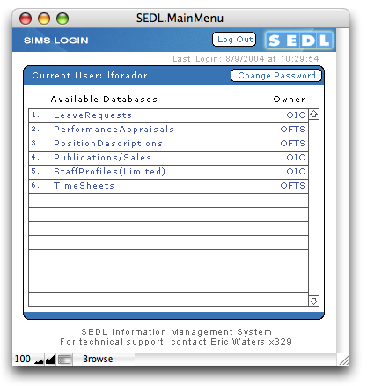
SIMS
Log In Screen and Main Menu

Slide 31
Tools and Information Systems
Summary
SEDL Information management System (SIMS)
Improve infrastructure (systems to support our work - paperless office)
  Gains in efficiency (Timesheet entry, Job postings, Staff directories, Calendar of events on multiple sites…etc.)
  Eliminate duplication of effort
  Reduce opportunity for error
  Make our work more transparent & promote flow of information
  Improve service to internal and external clients
  Inform important management and business processes with real-time information

Slide 32
Tools and Information Systems
How You Can Help
  Suggest new or refined functionality for SIMS to Eric Waters.
  Log on to SIMS and set your “password reminder hint” by clicking the “Change Password” button.
  Review your staff profile in SIMS.
  This data is used by a variety of other SIMS systems and generates your staff profile page and the online staff directory. You will be able to edit fields like: name, work hours, and phone extension. To update fields that you cannot modify, send updates to Brian Litke, Eric Waters, or Debbie Ritenour in OIC. Although there is an area for you to enter your vita, please do not do so yet. OID will pre-populate your vita with information on file so you don’t have to re-enter the information you’ve previously provided. You will soon be invited to review and update your vita in SIMS.

