Slide 1


PLANNING FOR DISSEMINATION
March 31, 2006
John D. Westbrook, Ph.D.
Disability Research to Practice Program

Slide 2


Myth #1: Dissemination = Distribution
Dissemination is not the physical movement of products from Point A to Point B.
B
A

Slide 3

Myth #2: Dissemination = Documentation
Dissemination is not the production of materials.

Slide 4
Working Definition of Dissemination
The purpose of dissemination activity is to assure that information/knowledge that can be useful in reaching decisions, making changes, or taking specific action is available to and used by those who can most benefit from it.

Slide 5
Thinking about developing SEDL’s definition
Utilization rate of expectation
  100%? . . . . 50%? . . . .10%?
Measurement
  Bean counting
  Impact evaluation
Content
  Evidence-based

Slide 6
Dissemination is a Process
Process is defined by Wikipedia as
“a sequence of operations or events, possibly taking up time, space, expertise or other resource, which produces some outcome.”
http://en.wikipedia.org/wiki/Process

Slide 7
Dissemination is a Tool
Outcomes
• Person-based
• System-based
Dissemination
• Workshops
•
•
•

Slide 8
Logic Modeling
plans abilities resources time outcomes
Planning Components
Situation
Inputs
Activities
•Research
•Development
•Dissemination
Outputs
Target
Systems
Outcomes

Slide 9
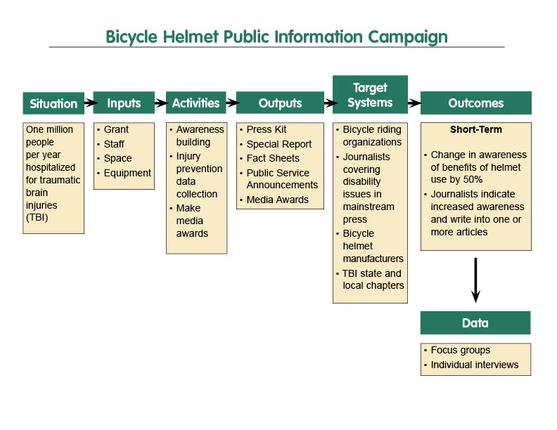
Highlights of Logic Model Example

Slide 10
What are the Elements of an Effective Dissemination Process?
?
?
?
? ?
DISSEMINATION
PROCESS
?
?
?
?
?

Slide 11
Elements of an Effective Dissemination Process (continued)
DISSEMINATION
PROCESS
Source
Where does it come from?

Slide 12
Elements of an Effective Dissemination Process (continued)
DISSEMINATION
PROCESS
Source
Content
What is your message?

Slide 13
Elements of an Effective Dissemination Process (continued)
DISSEMINATION
PROCESS
Source
Context
Content
How does it relate?

Slide 14
Elements of an Effective Dissemination Process (continued)
How can I get it?
Medium
DISSEMINATION
PROCESS
Source
Context
Content

Slide 15
Elements of an Effective Dissemination Process (continued)
• How can I benefit from it?
• Do I need this?
User
Medium
DISSEMINATION
PROCESS
Source
Context
Content

Slide 16
Elements of an Effective Dissemination Process
User
Medium
DISSEMINATION
PROCESS
Source
Context
Content

Slide 17
Ten Components of a Plan for Effective Dissemination
Goals - Determine and document the goals of your dissemination effort for your proposed project.
  Example Question (I of 3)
  In what ways will specific target audiences benefit from your efforts?

Slide 18
Ten Components of a Plan for Effective Dissemination (continued)
Objectives - Associate each goal with one or more objectives that clarifies what you are trying to accomplish through your dissemination activities.
Example Question (1 of 2)
  In terms of each goal, what major areas of accomplishments will be required?

Slide 19

Ten Components of a Plan for Effective Dissemination (continued)
Users - Describe the scope and characteristics of the "potential users" that your dissemination activities are designed to reach for each of your objectives.
  Example Question (I of 6)
  Have you collaborated with identified intended user group(s) to determine dissemination goals and activities?

Slide 20
Ten Components of a Plan for Effective Dissemination (continued)
Content - Identify the basic elements of the projected content you have to disseminate to each of the potential user groups identified.
  Example Question (I of 7)
  Is your content reviewed through a quality control mechanism to assure accuracy and relevance?

Slide 21
Ten Components of a Plan for Effective Dissemination (continued)
Source(s) - Identify the primary source or sources that each potential user group is already tied into or most respects as an information source. Consider ways to partner with these sources in your dissemination efforts.
  Example Question (I of 5)
  Do users regard your project staff as highly knowledgeable resources in the project’s topical area?

Slide 22
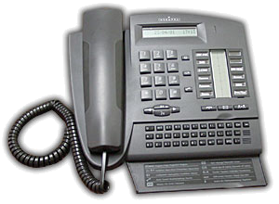

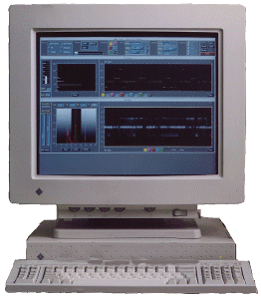

Ten Components of a Plan for Effective Dissemination (continued)
Medium or Media - Describe the medium or media through which the content of your message can best be best delivered to your potential users and describe the capabilities and resources that will be required of potential users to access the content for each medium to be used.
  Example Question (I of 5)
  Are you using media channels that are currently reaching your target audience(s)?

Slide 23
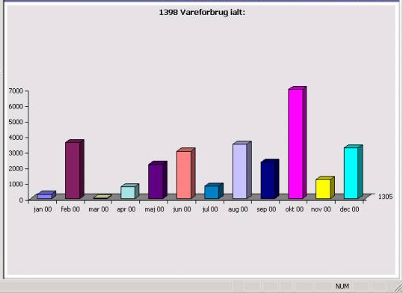
Ten Components of a Plan for Effective Dissemination (continued)
Success - Describe how you will know if your dissemination activities have been successful. If data are to be gathered, describe how, when, and who will gather the data.
  Example Question (I of 5)
  Does your project design clearly describe measurable outcomes to assess impact/use by each user group?

Slide 24
Ten Components of a Plan for Effective Dissemination (continued)
Access - Describe how you will promote access to your information and how you will archive information that may be requested at a later date. Consider that most people will use your project-related information when they perceive a need for it – not necessarily when you have completed your research project.
  Example Question (I of 8)
  Do you provide your project information in alternate formats that are accessible to all members of the intended user group(s)?

Slide 25
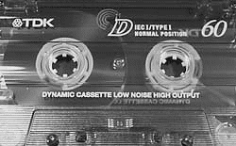

Ten Components of a Plan for Effective Dissemination (continued)
Availability - Identify strategies for promoting awareness of the availability of your information and the availability of alternate available formats.
  Example Question (I of 2)
  Do you have activities planned to inform targeted group(s) about the availability of your information?

Slide 26

Ten Components of a Plan for Effective Dissemination (continued)
Barriers - Identify potential barriers that may interfere with the targeted users’ access or utilization of your information and develop actions to reduce these barriers.
  Example Question (I of 10)
  Do you provide periodic feedback to your user groups regarding your dissemination-related impact evaluation data?

Slide 27
Potential Barriers
Users
Unclear current needs
Medium
Limited capacity to reach target system
Source
Limited credibility in area
Context
Competing knowledge
or products
Content
Non-user friendly format

