Slide 1
Case study on PM2.5
A project by :-
Aakash Pandey
Mohd Kamran Sultan
Utkarsh Bharal

Slide 2
Problem Statement
Predicting the PM2.5 level using factors like Dew, Temperature, Pressure, Combined Wind Direction, Cumulated Wind Speed (m/s) ,Cumulated hours of snow, Cumulated hours of rain.

Slide 3
Target audience who need this service the most?
Department of state.
To take required actions for controlling
pm 2.5 level in cities.
Citizen of the country.
To take required precautions before
exposing to the environment.
Scientist and researcher.
To perform further research on this matter and try
to get perfect measures to get control of it.
Department of State.
Citizen of nation
Scientist and researchers

Slide 4
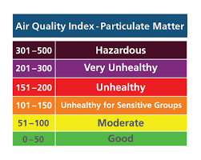
BACKGROUND
Air Quality Problem
Air pollution is one of the most serious negative side effects in the process of industrialization.
We are working on this project because we realized the importance of recognizing, identifying the air pollution.
In this project, we use data set of suspended particulate matter(PM2.5) to examine the patterns and identify the potential trend of air pollution in area.

Slide 5
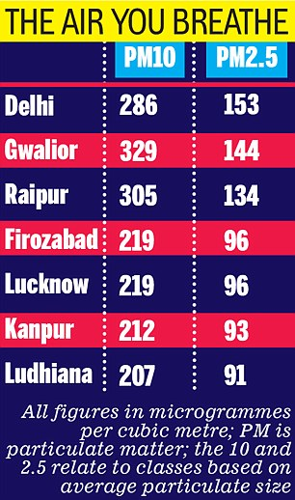
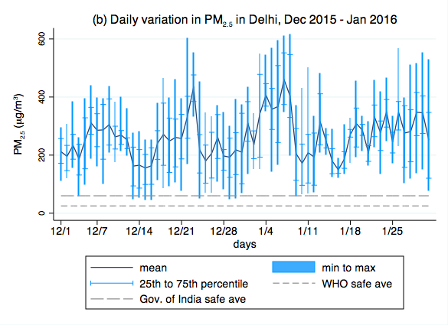
PM 2.5 level in different cities

Slide 6
Data Description
There are 13 variables and 43824 observation
13 variables are number, year, month, day, hour, pm2.5, dewp, temp, pres, cbwd, lws, ls, lr
Target variable is pm2.5
There are 2067 observations are missing which is 4.71% of the total data.
Missing observations can be removed.

Slide 7
Data Cleaning
2067 missing values are removed.
Change "cv" in ‘cbwd(cumulative wind direction)’ to "SW“.
Capping the outliers in ‘lws(cumulative wind speed)’ to the value which explains 99% of the data.
Removing the not required columns ‘number’ and ‘year’.
Changing the data type of columns as required.

Slide 8
Feature Engineering
Week1
Week2
Week3
Week4
Week5
wind_speed_0to50
dew_neg20_to_zero
dew_zero_and_above
Angle x
Angle y
Features created are:
first_quater_day
second_quater_day
third_quarter_day
fourth_quater_day
first_three_months
four_to_six_month
seven_to_nine_month
ten_to_twelve_month

Slide 9
Modelling
Different model used are:
Linear Regression(Gave accuracy of 35%)
Decision Tree (Gave accuracy of 33%)
Random Forest (Gave accuracy of 62%)
Random forest gave the most accurate model
Before tuning model gave accuracy of 59%.
After tuning the accuracy increased to 62%.
ntree i.e. total number of trees made by the model were taken to be 250.
mtry i.e. number of variables randomly selected at each split were taken to be 16.

Slide 10
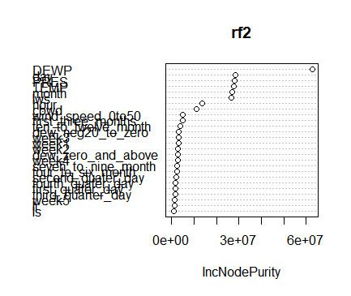
Importance of variables in the model
The most important variables for the model were:
Dew
Pres(Pressure)
Month
The least important variable for the model is:
ls(cumulative amount of snow)

Slide 11
Thank you

