Slide 1
Databricks
Rolls John

Slide 2
What is Databricks ?
Databricks is a unified open analytics platform.
A Cloud based Apache Spark cluster service
Offers scalable Spark clusters based on AWS
Developed by the same people who created Spark
Multiple cluster management
Job scheduling and library import
Offers access to all Spark modules

Slide 3
What is Databricks used for?
Used to process, store, clean, share, analyze, model, and monetize their datasets with solutions from BI to machine learning
Used to build and deploy data engineering workflows, machine learning models, analytics dashboards, and more
Data processing workflows scheduling and management
Data ingestion
Working in SQL
Generating dashboards and visualizations
Data discovery, annotation, and exploration
Compute management
Machine learning (ML) modeling and tracking
Source control with Git

Slide 4
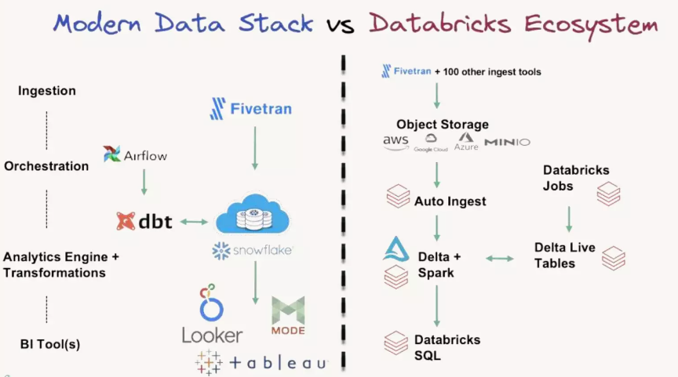

Slide 5
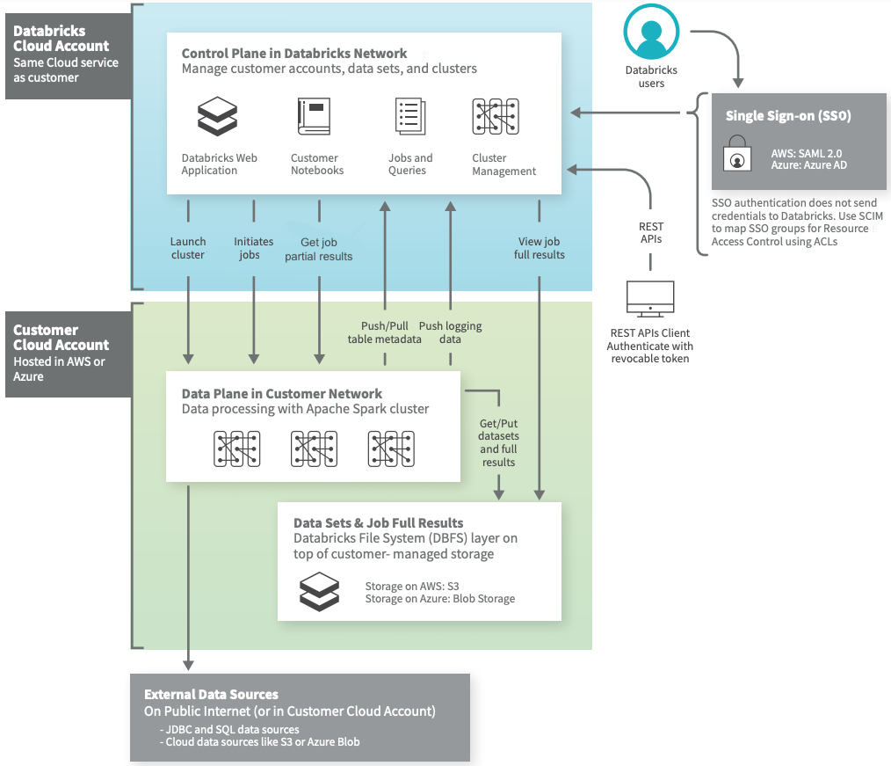
Databricks Architecture

Slide 6
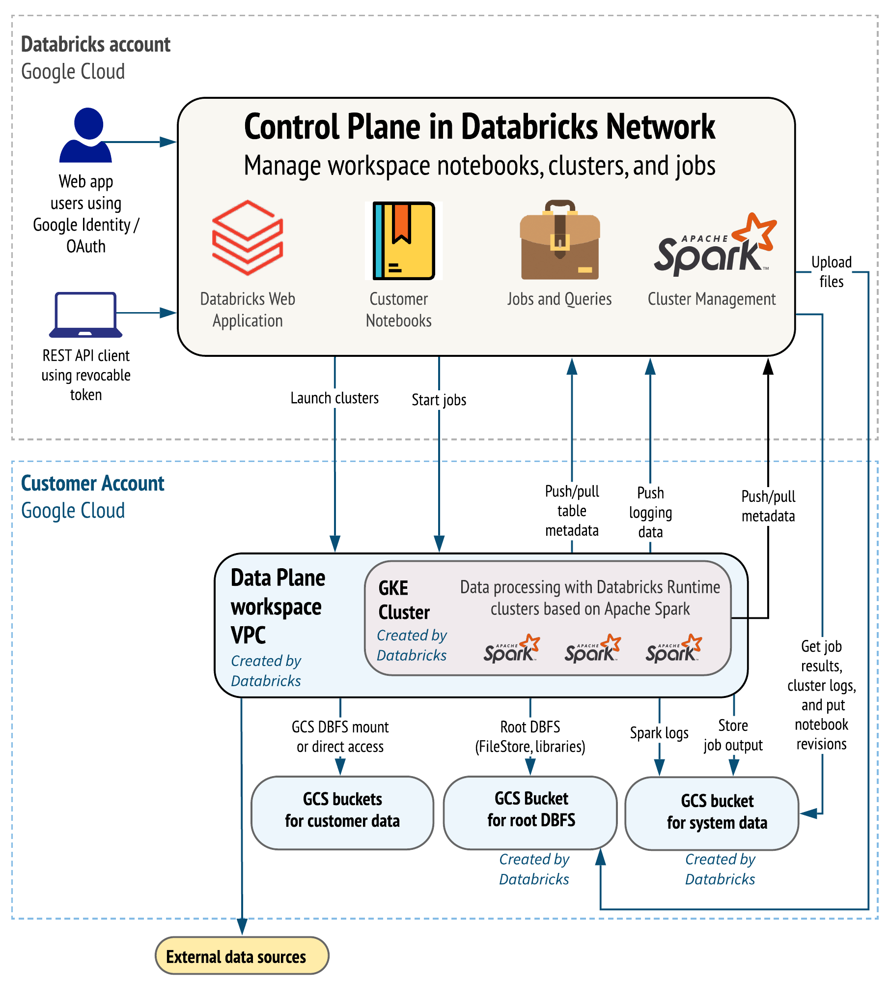

Slide 7
Databricks - Functionality
Architecture based on Notebooks and folders
Has a cluster manager for
Defined (min 54gb) clusters
Spot clusters
On Demand clusters
Has a job manager and scheduler
Has user management
Has full Spark functionality
Has strong data visualization capability
Can export reports and dashboards

Slide 8
Databricks - Languages
Can have Notebooks in
Scala
Python
SQL
SQL can be executed in non SQL Notebooks
Markdown comments can be placed in Notebooks
Notebooks can be shared by multiple sessions
Libraries can be imported and called in Notebooks

Slide 9
Databricks - Spark Usage
Latest Spark version available
i.e. DB 12.2 LTS uses Spark 3.3.2 at March 2023
All Spark modules available
SQL, GraphX, MlLib, Streaming
Strong integration between modules and visualisation
Extensive use of tables to import data
Tables available via SQL

Slide 10
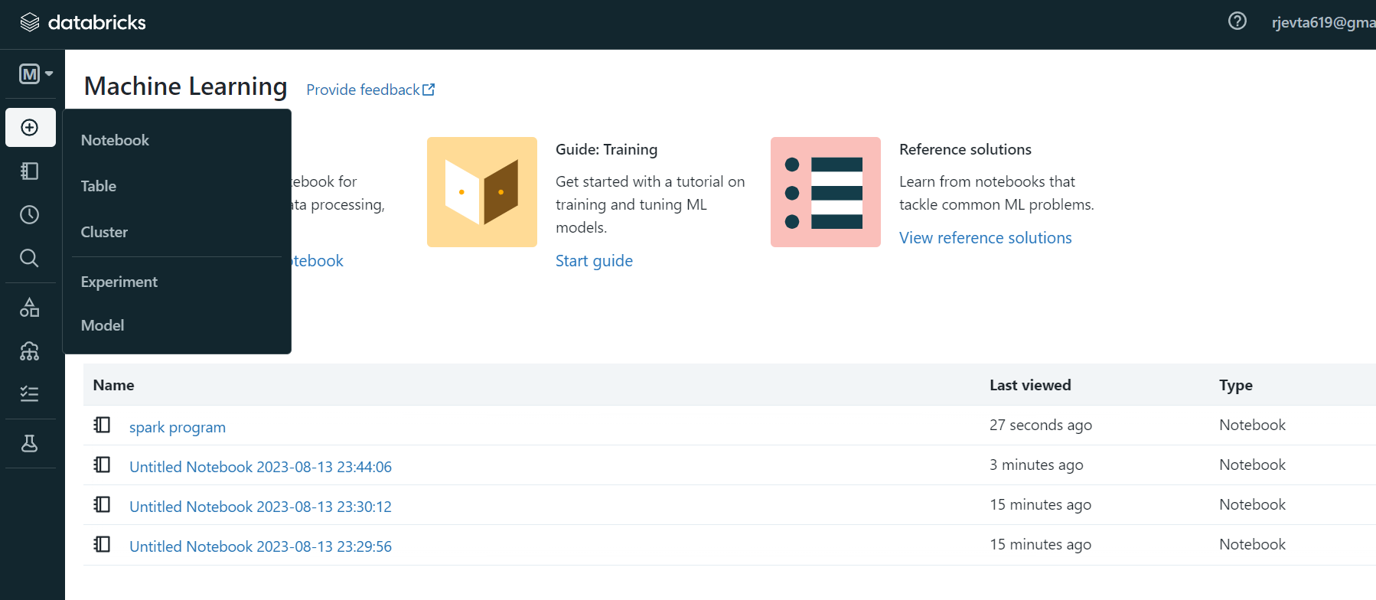
Databricks: workspace

Slide 11
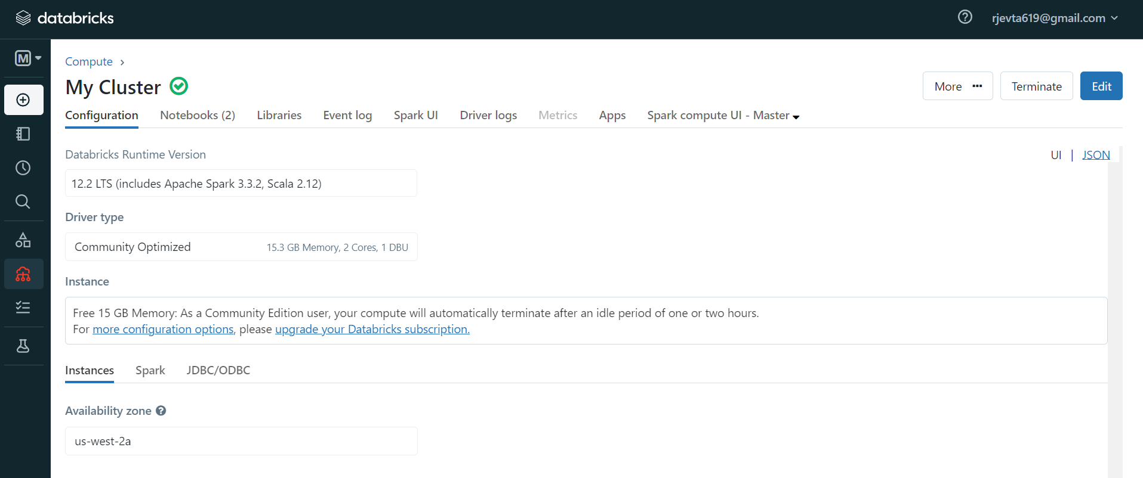

Slide 12
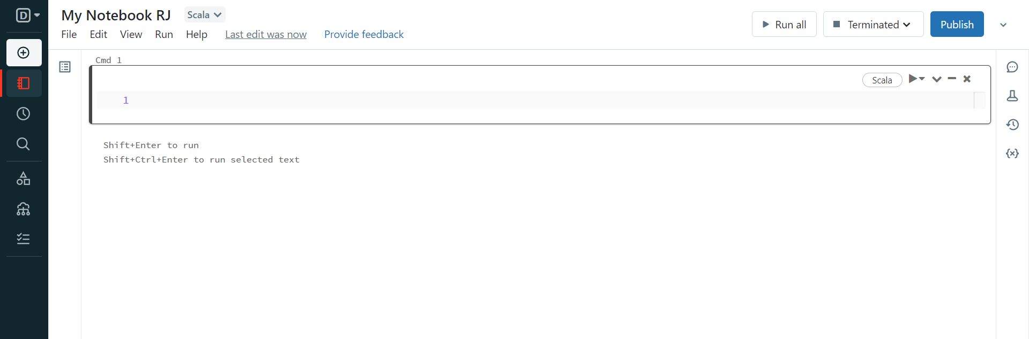

Slide 13
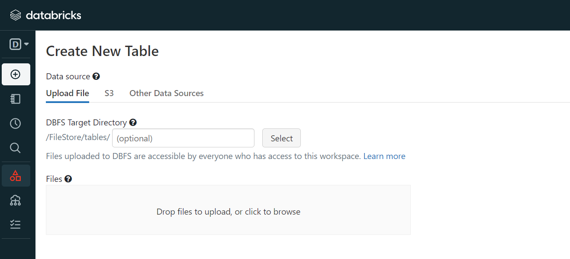

Slide 14
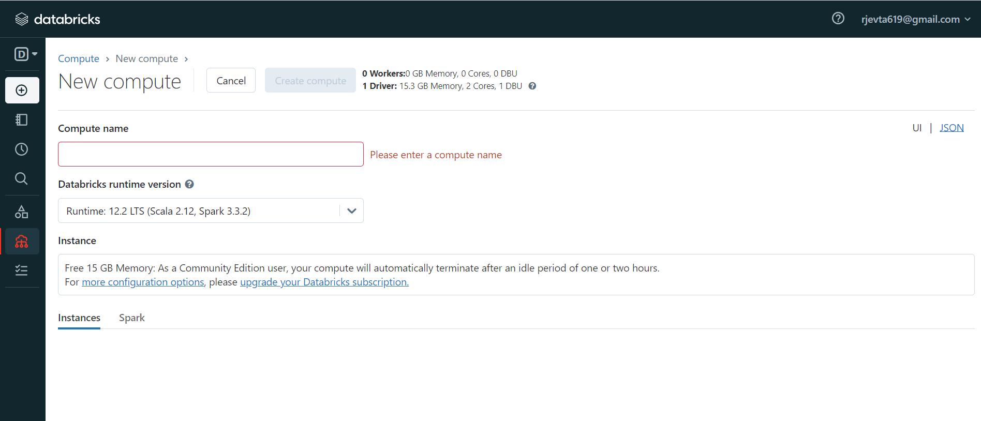

Slide 15
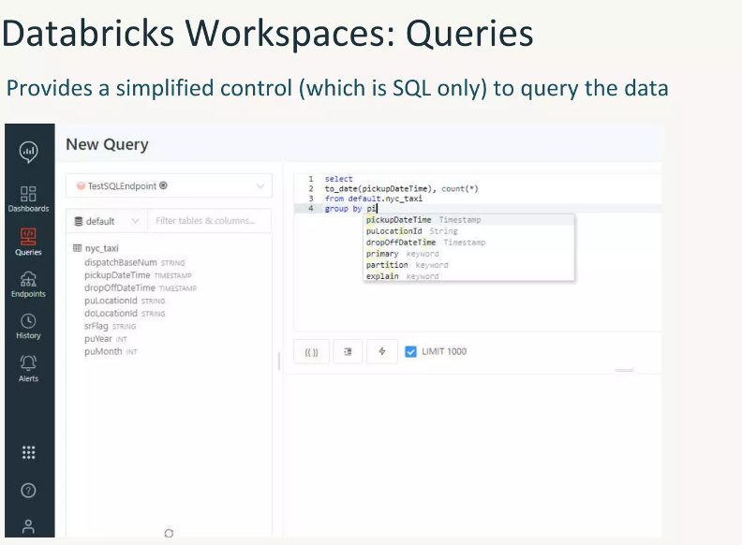

Slide 16
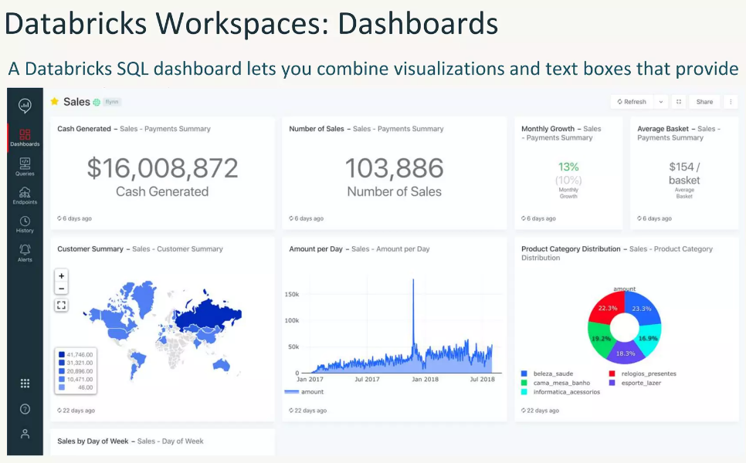

Slide 17
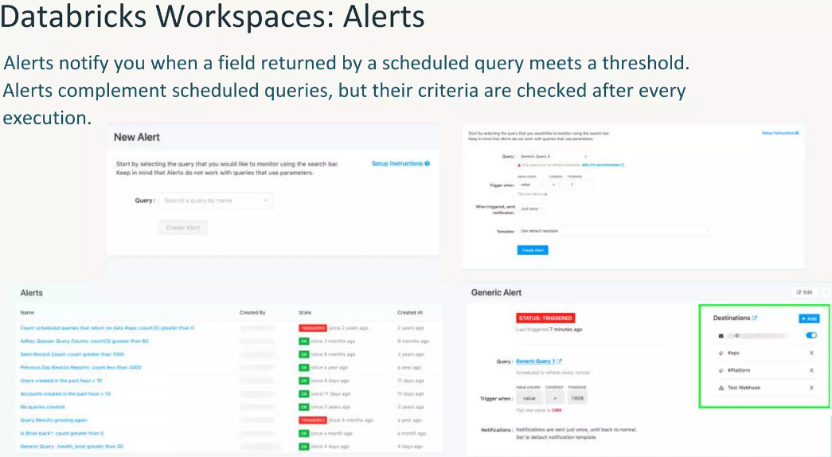

Slide 18
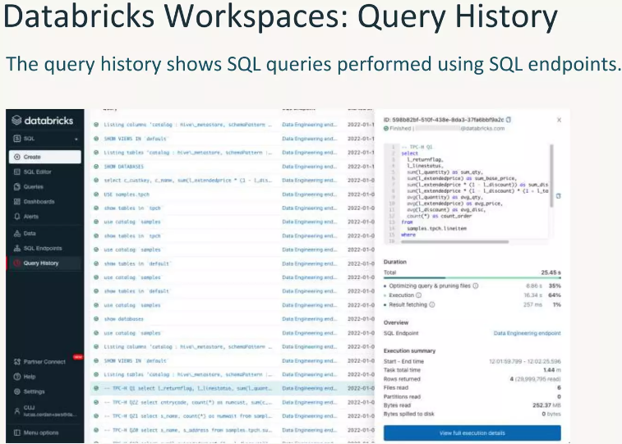

Slide 19
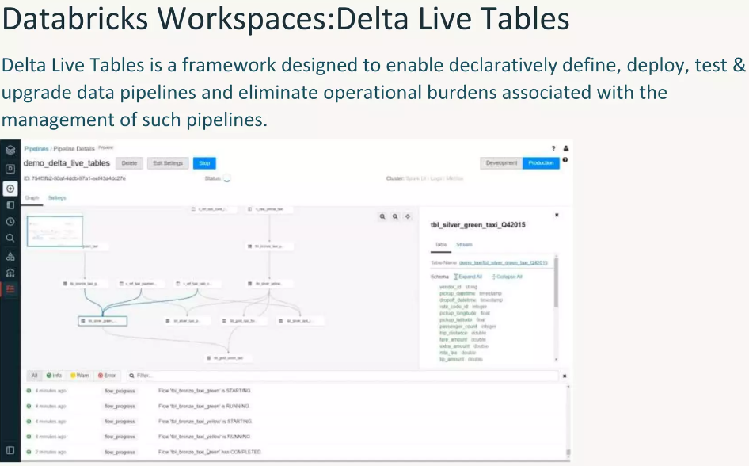

Slide 20
Thank You

