Slide 1
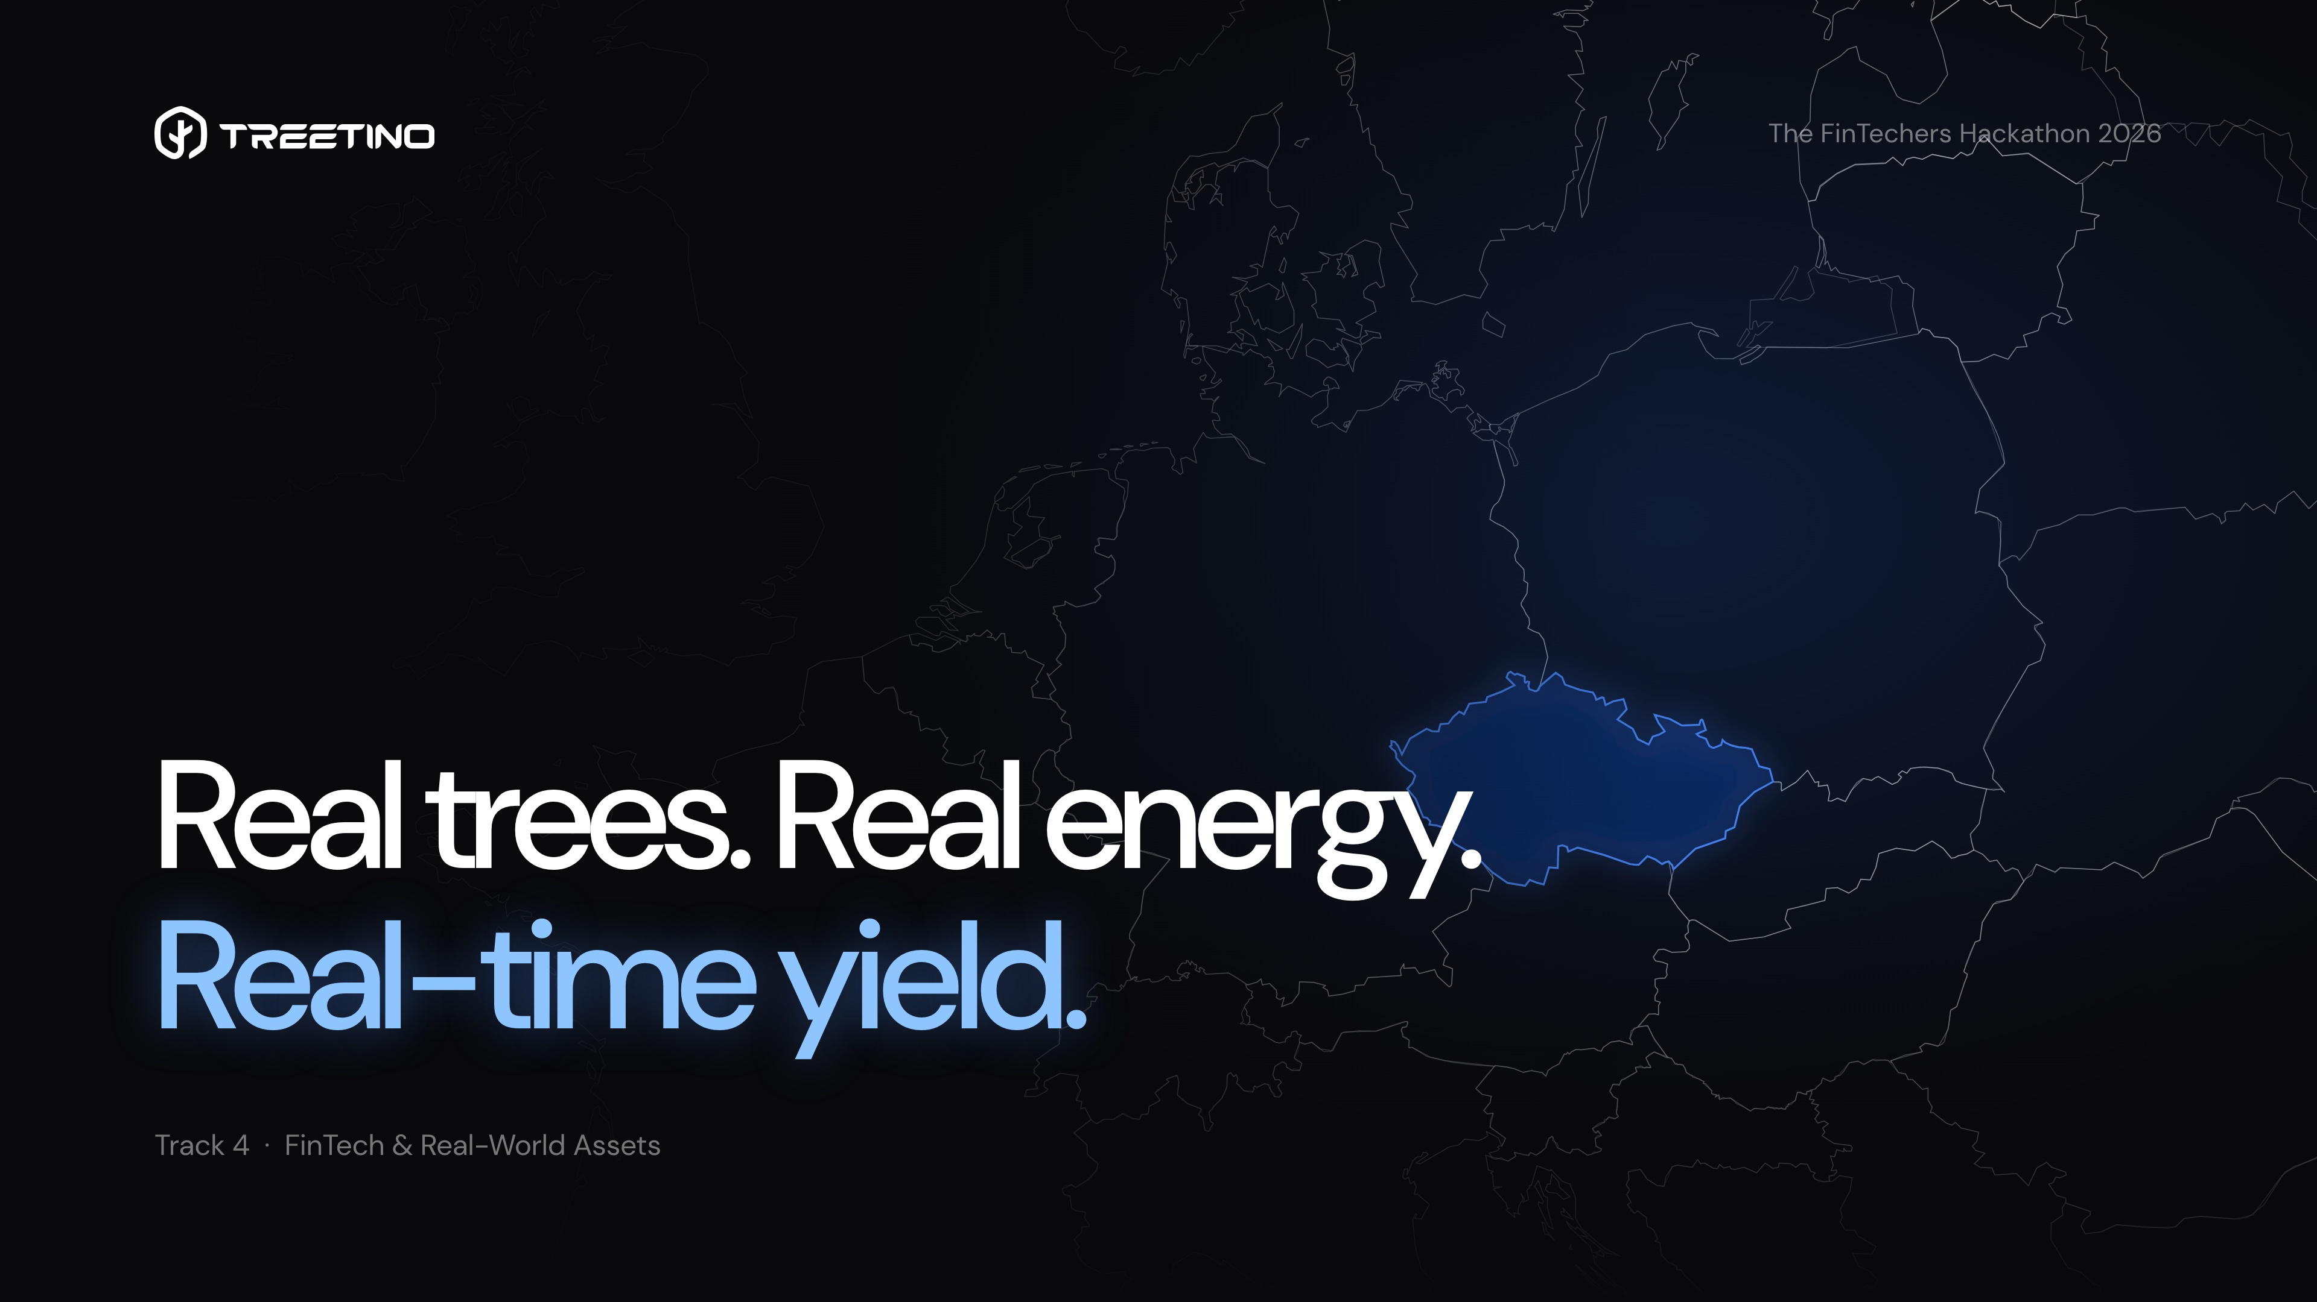
Notes:
0:00–0:15 | Hi everyone, I’m Jakub from Treetino. We build patented trees that produce clean energy, paired with battery storage and EV chargers. Today at The FinTechers we’re connecting that physical infrastructure to real-time fiat rails.

Slide 2
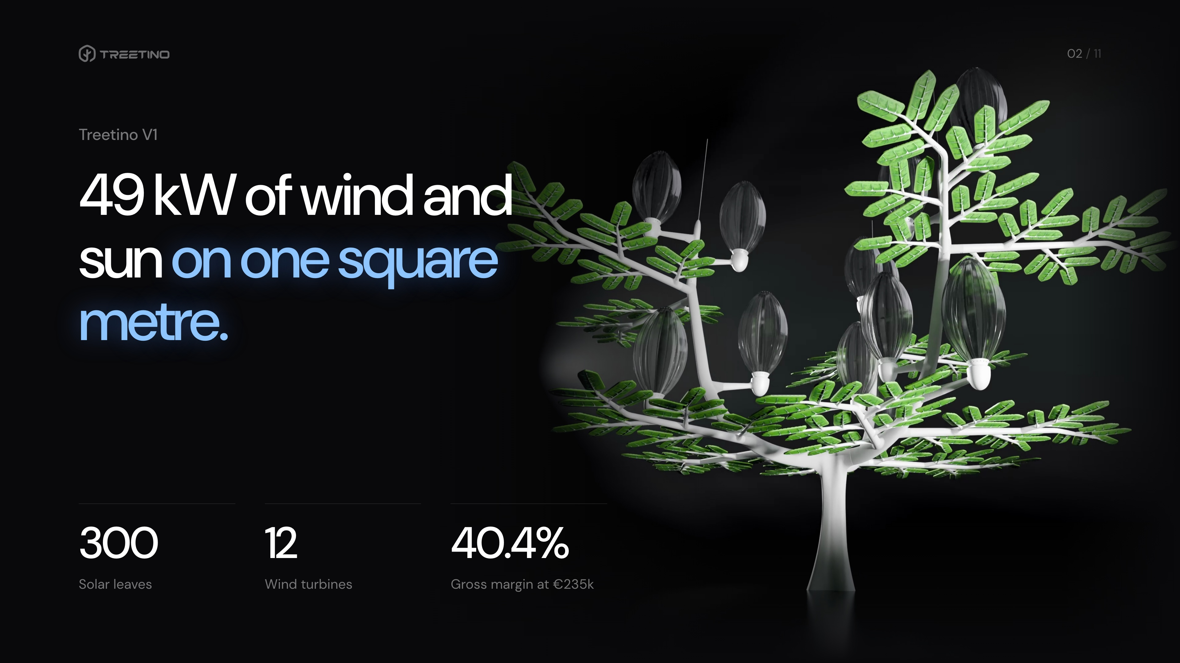
Notes:
0:15–0:35 | This is our flagship Treetino V1: 49 kilowatts of solar and wind power on a single square metre of ground — 300 solar leaves and 12 silent wind turbines.

Slide 3
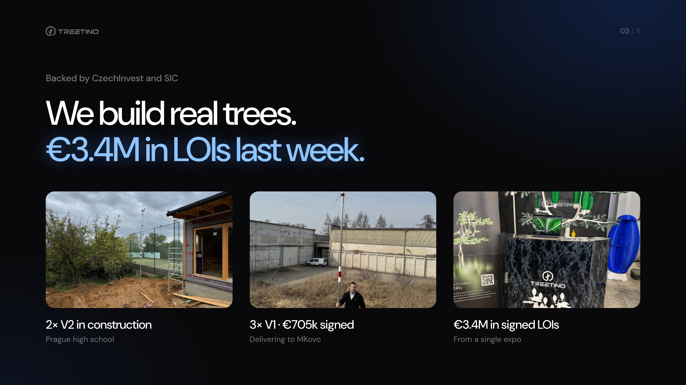
Notes:
0:35–1:00 | This is not a whitepaper. We’re backed by CzechInvest and SIC, R&D is done and we’re building: €705k in signed contracts — two V2 trees under construction at a Prague high school and three V1 trees for MKovo. And last week, at a single expo, we walked away with €3.4M in signed LOIs.

Slide 4
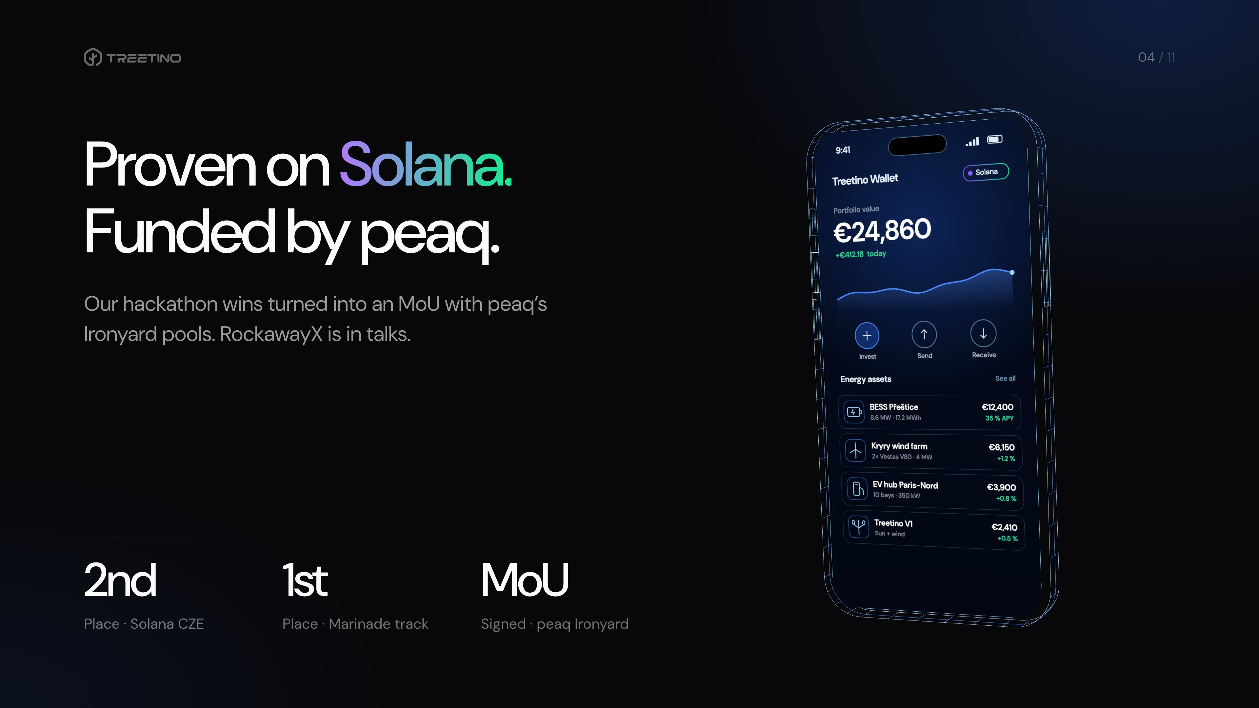
Notes:
1:00–1:25 | To scale across Europe we built an RWA protocol on Solana. At Solana CZE we won 2nd place overall and 1st in the Marinade track — great to see Marinade judging today. Since then we signed an MoU with peaq and their Ironyard liquidity pools. peaq tokenizes real-world assets for futuristic machine economies — they loved our product, and we’re in deep talks with RockawayX along the same vertical.

Slide 5
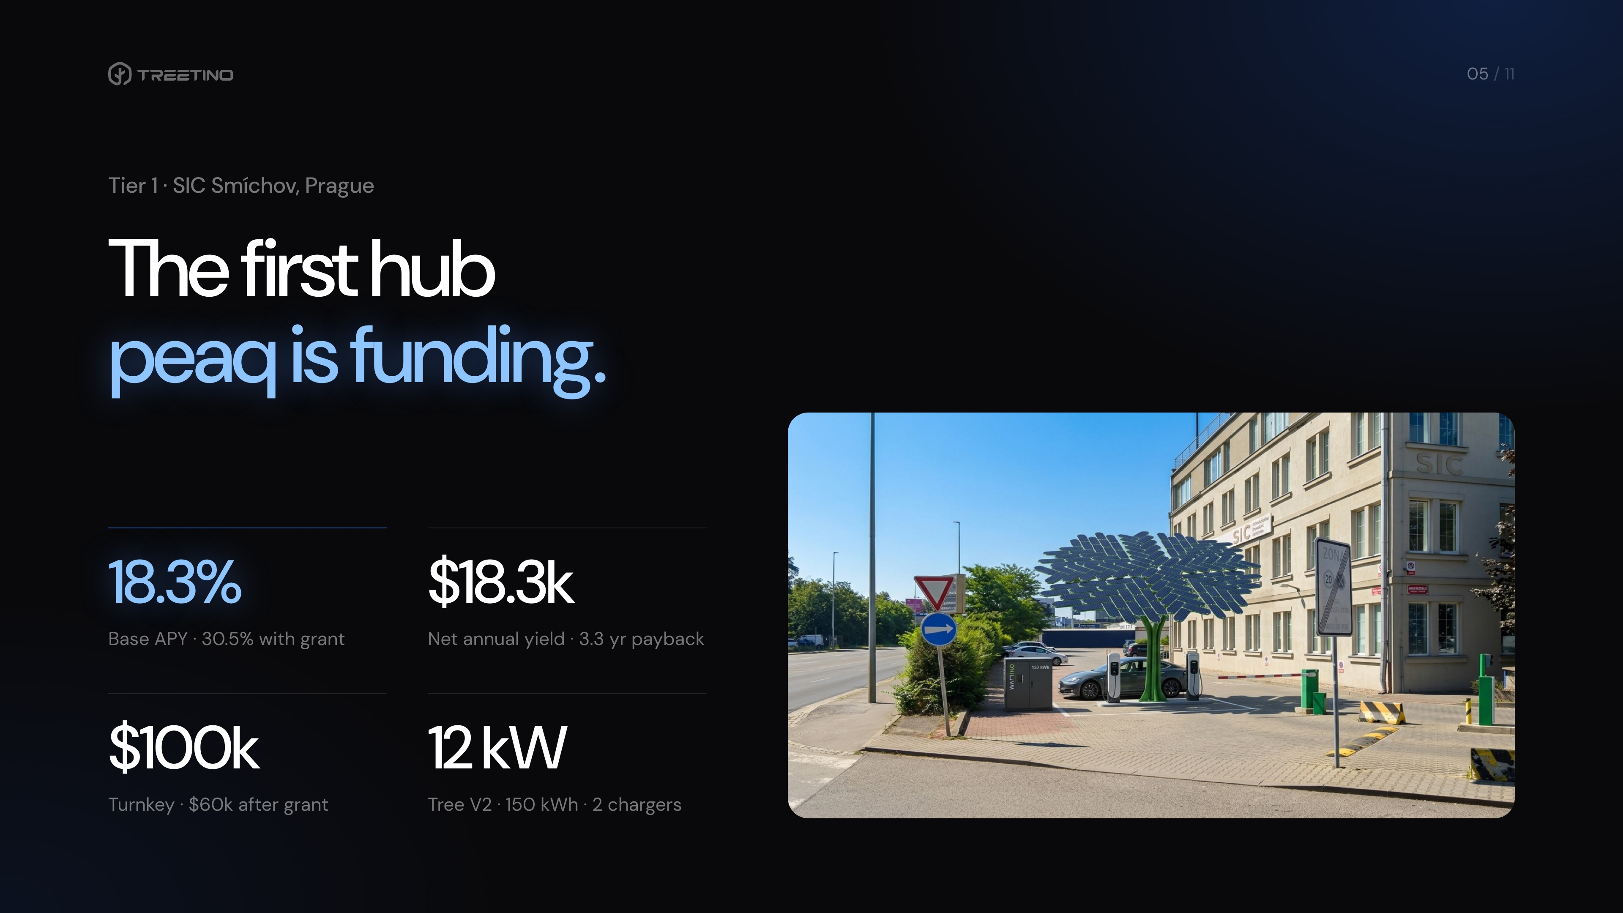
Notes:
1:25–1:55 | Specifically for peaq, we designed 4 tiers of funding — from $100k up to $1M — so we build trust step by step. We start with Tier 1 right here in Prague at SIC Smíchov: a $100k turnkey hub ($60k after grant) delivering $18.3k a year in net yield — that’s an 18.3% base APY, or 30.5% with the grant, paying back in 3.3 years. And this exact Tier 1 project is what we have completely simulated in this hackathon.

Slide 6
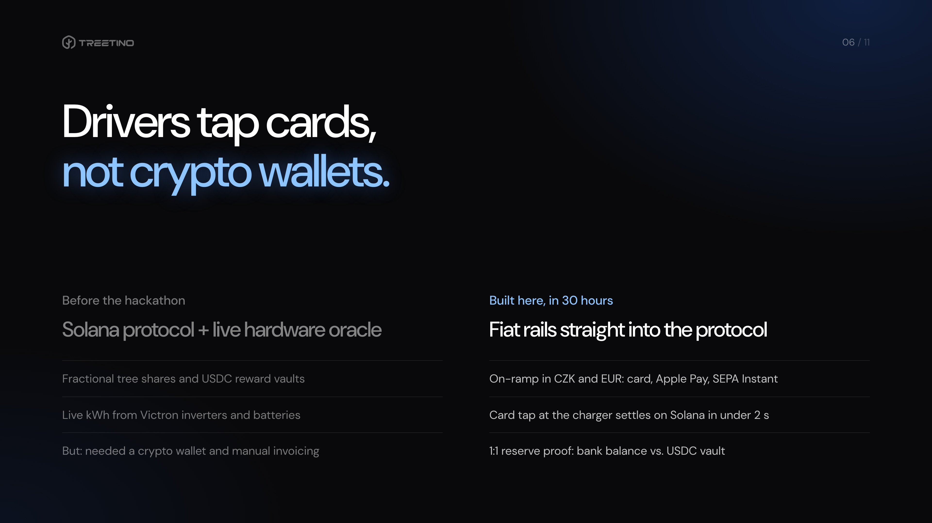
Notes:
1:55–2:20 | To be transparent about scope: before Monday we had the Solana contracts, the Victron telemetry oracle and the dashboard. What was missing was the fintech bridge. EV drivers don’t pay with Phantom — they tap Apple Pay in CZK or EUR. That on-ramp and the card-to-chain settlement is what we built here.

Slide 7
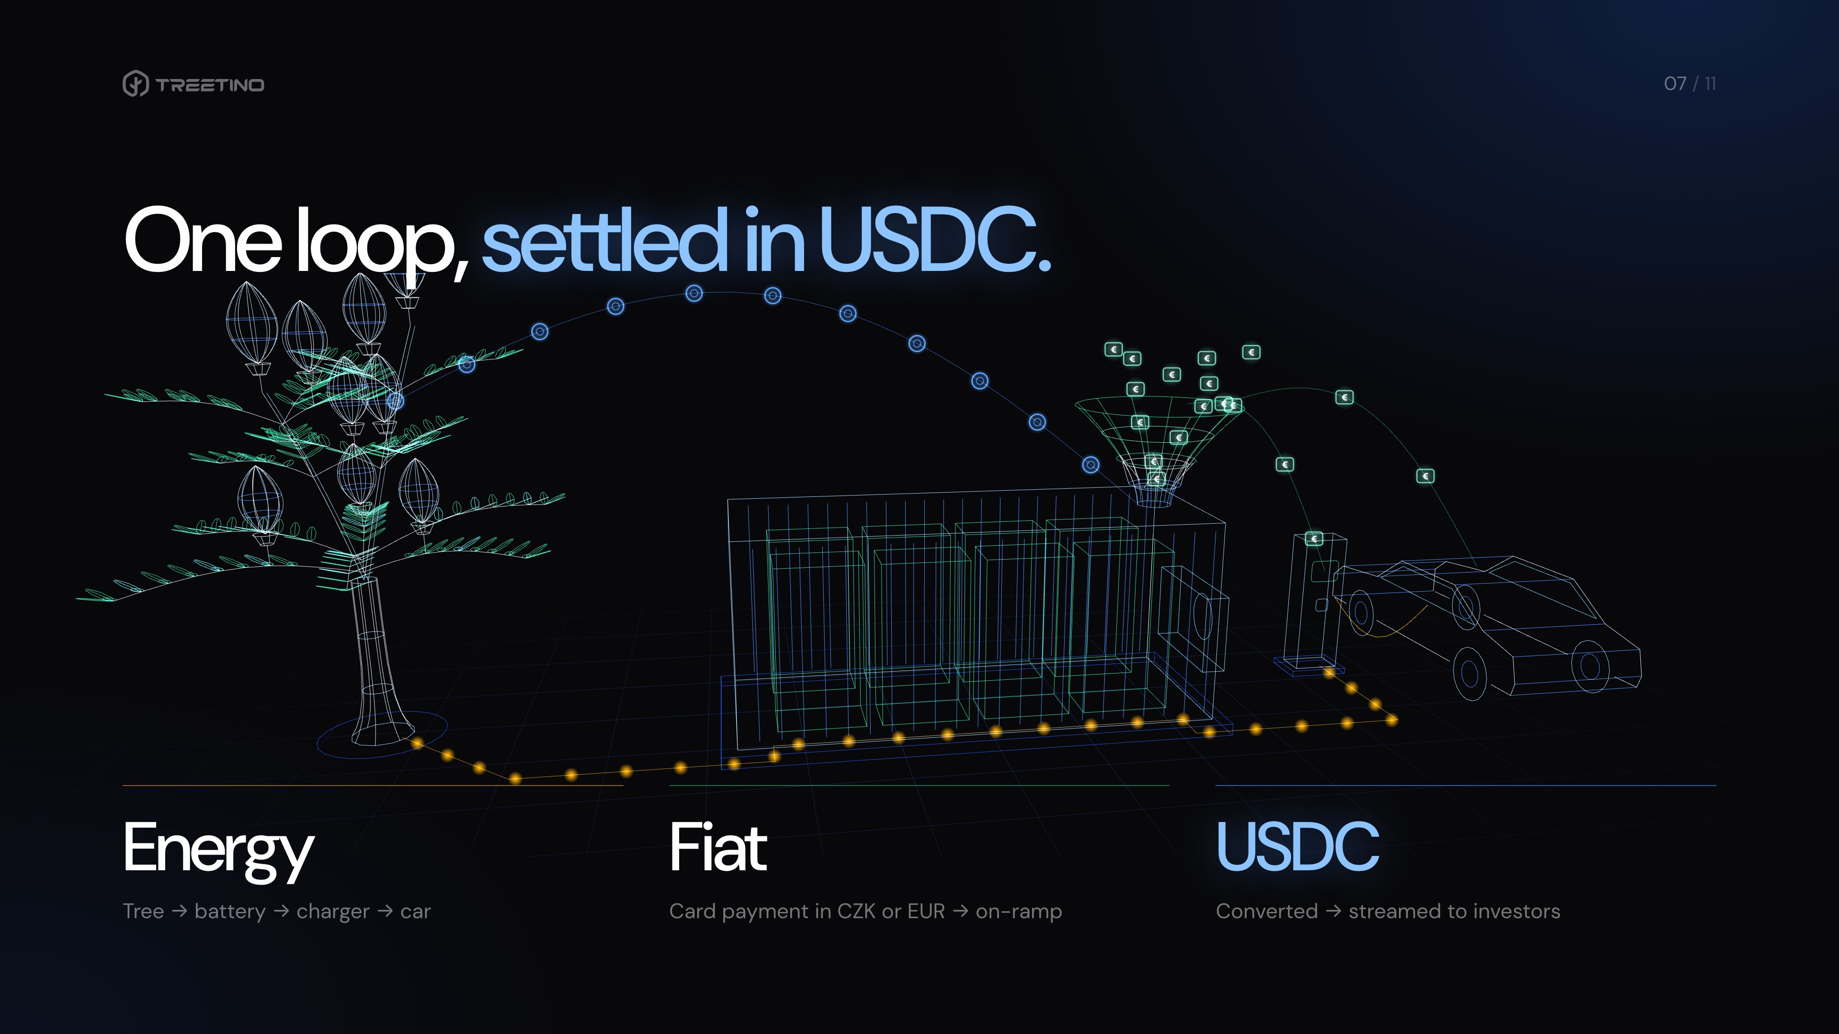
Notes:
2:20–2:45 | Here’s the whole loop. Energy flows in amber from the tree through the battery to the charger. When the driver pays by card, green fiat pours into our on-ramp gate, converts into blue USDC stablecoins, and streams straight into the tree’s vault.

Slide 8
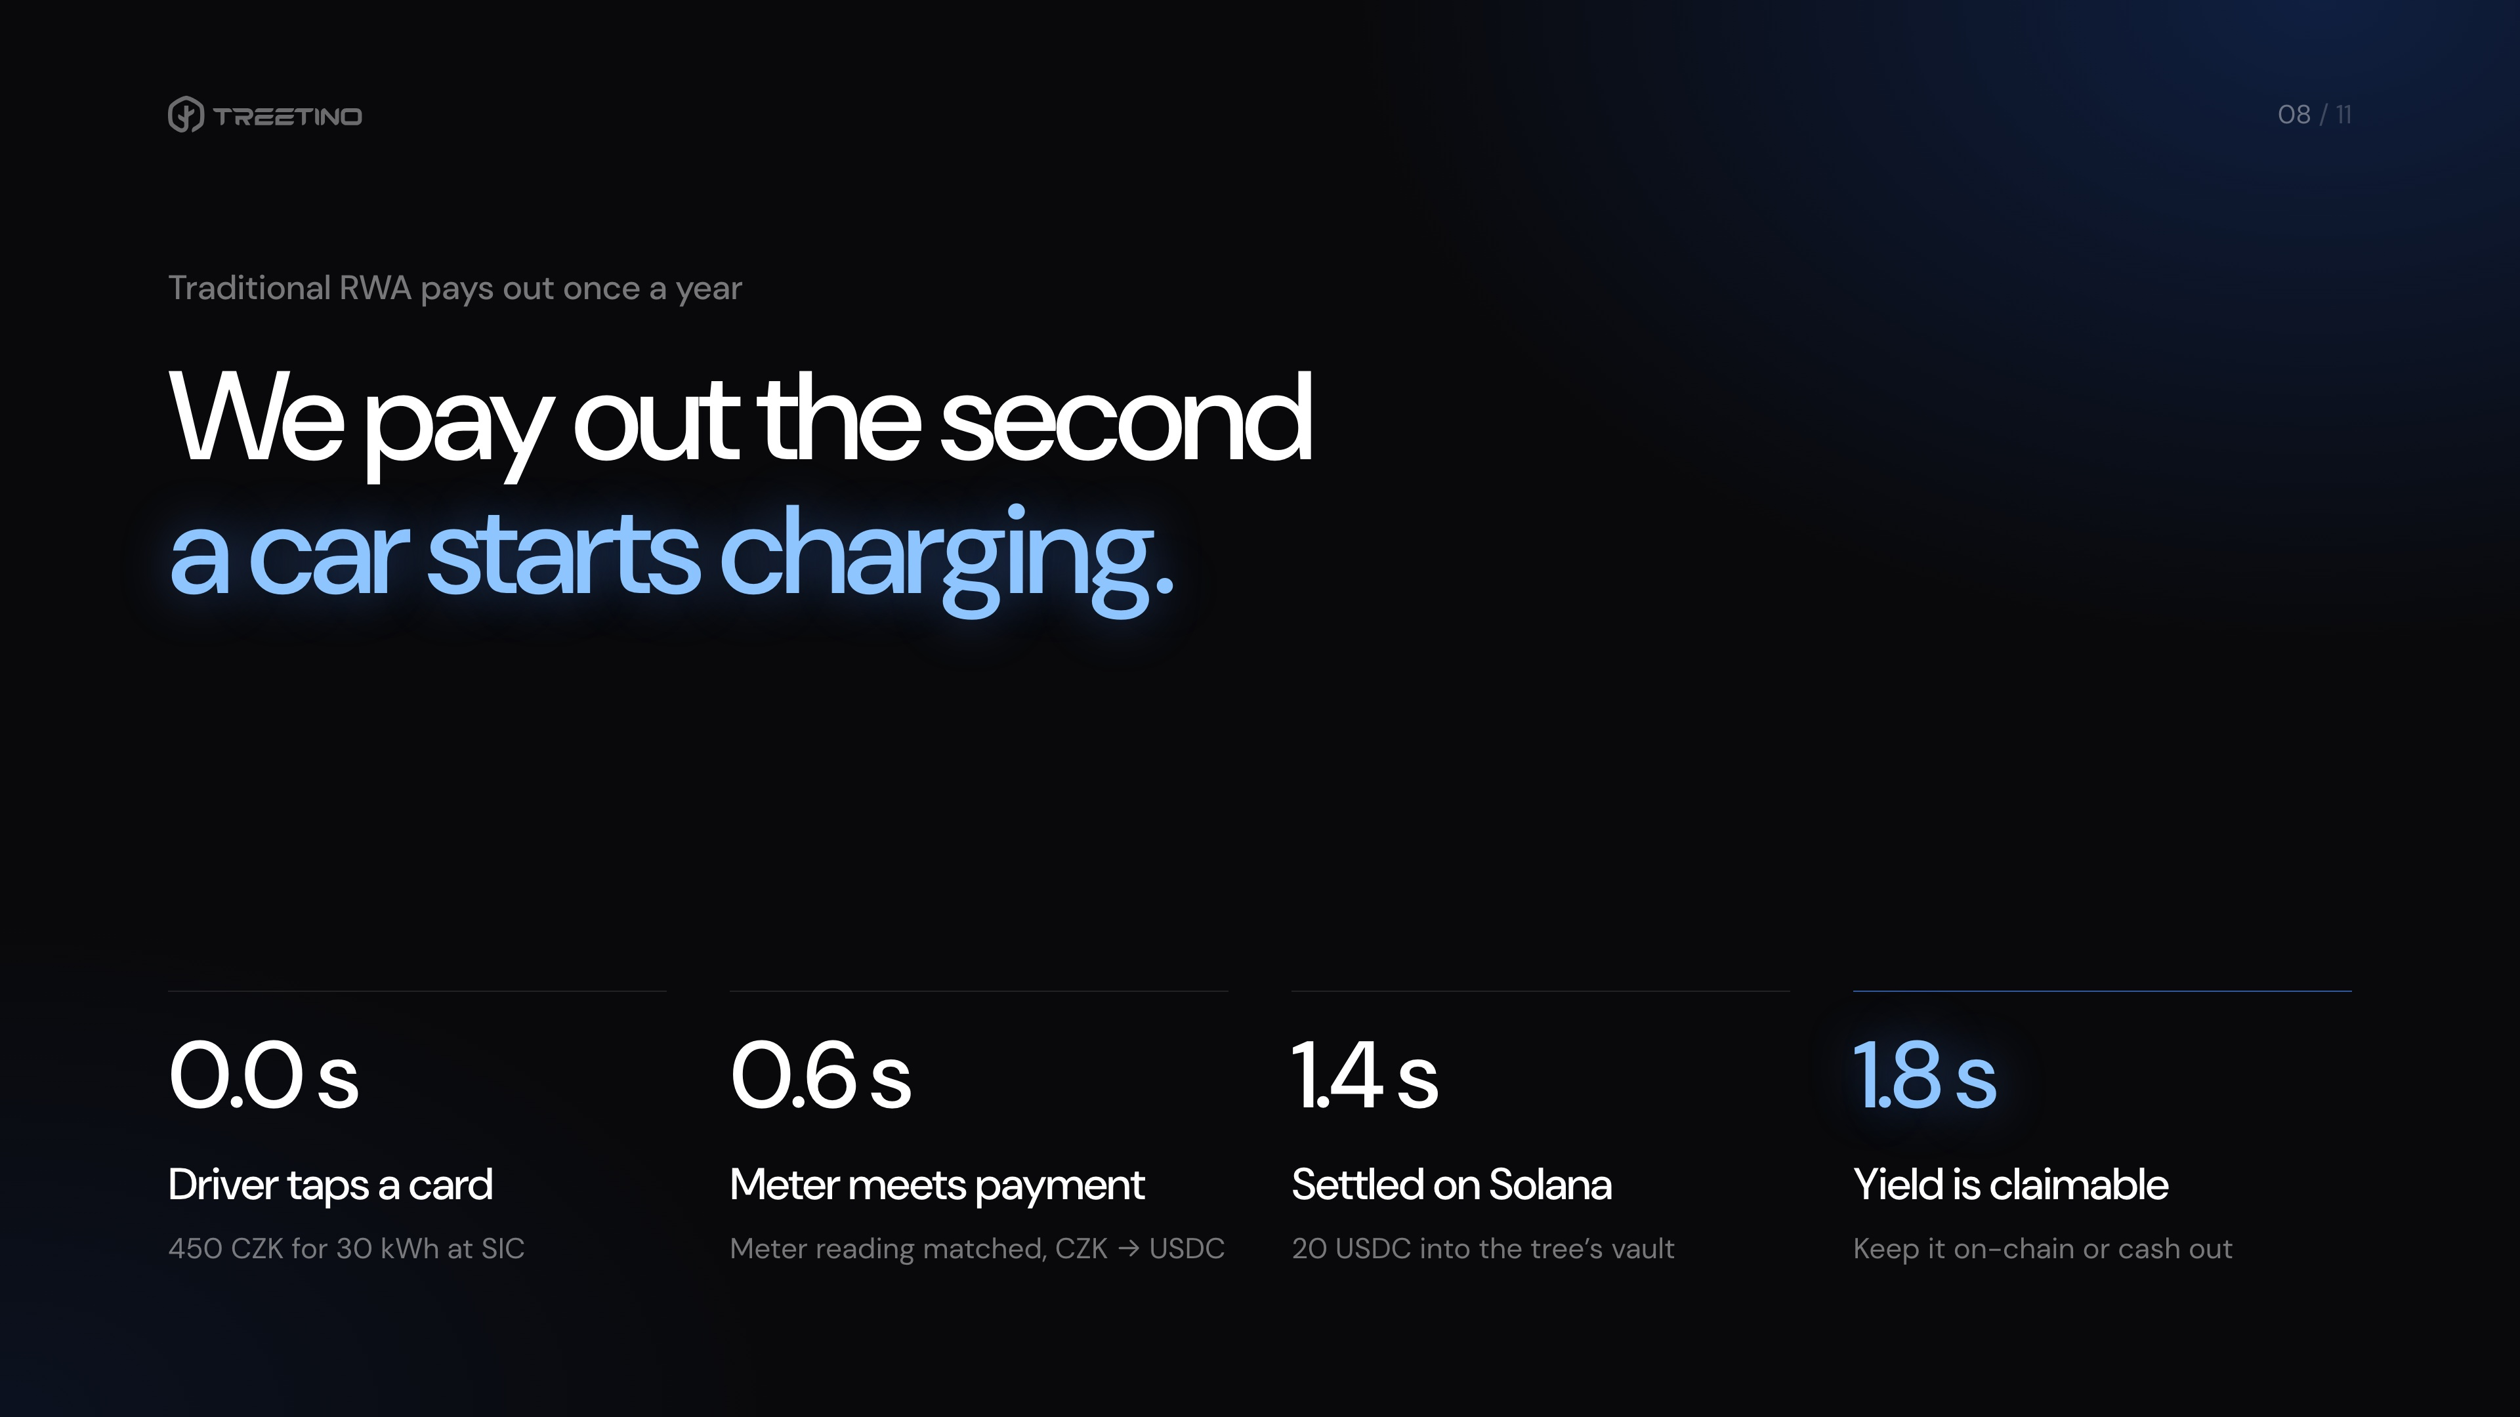
Notes:
2:45–3:10 | Why it matters: in traditional RWA — solar farms, real estate, bonds — investors wait a month or a year for off-chain accounting. Here, the second a driver taps their card, we convert the fiat into USDC and settle on Solana. Investors can claim yield while the car is still charging.

Slide 9
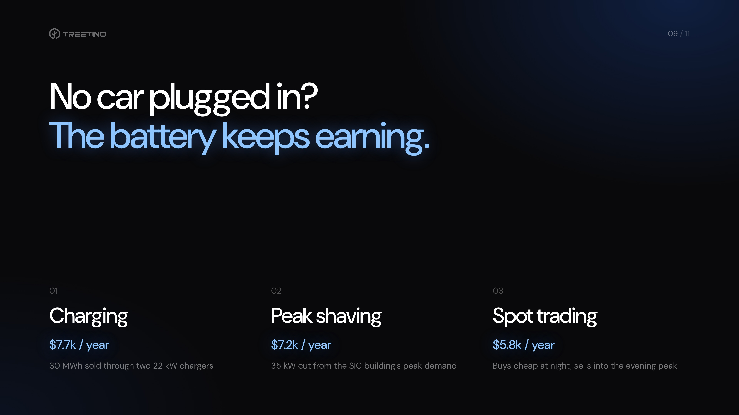
Notes:
3:10–3:35 | And at 3 AM with no car plugged in? The capital doesn’t sleep. The battery shaves 35 kW of peak demand for the SIC building and trades the 15-minute OTE spot market. Three fiat revenue streams, one vault.

Slide 10
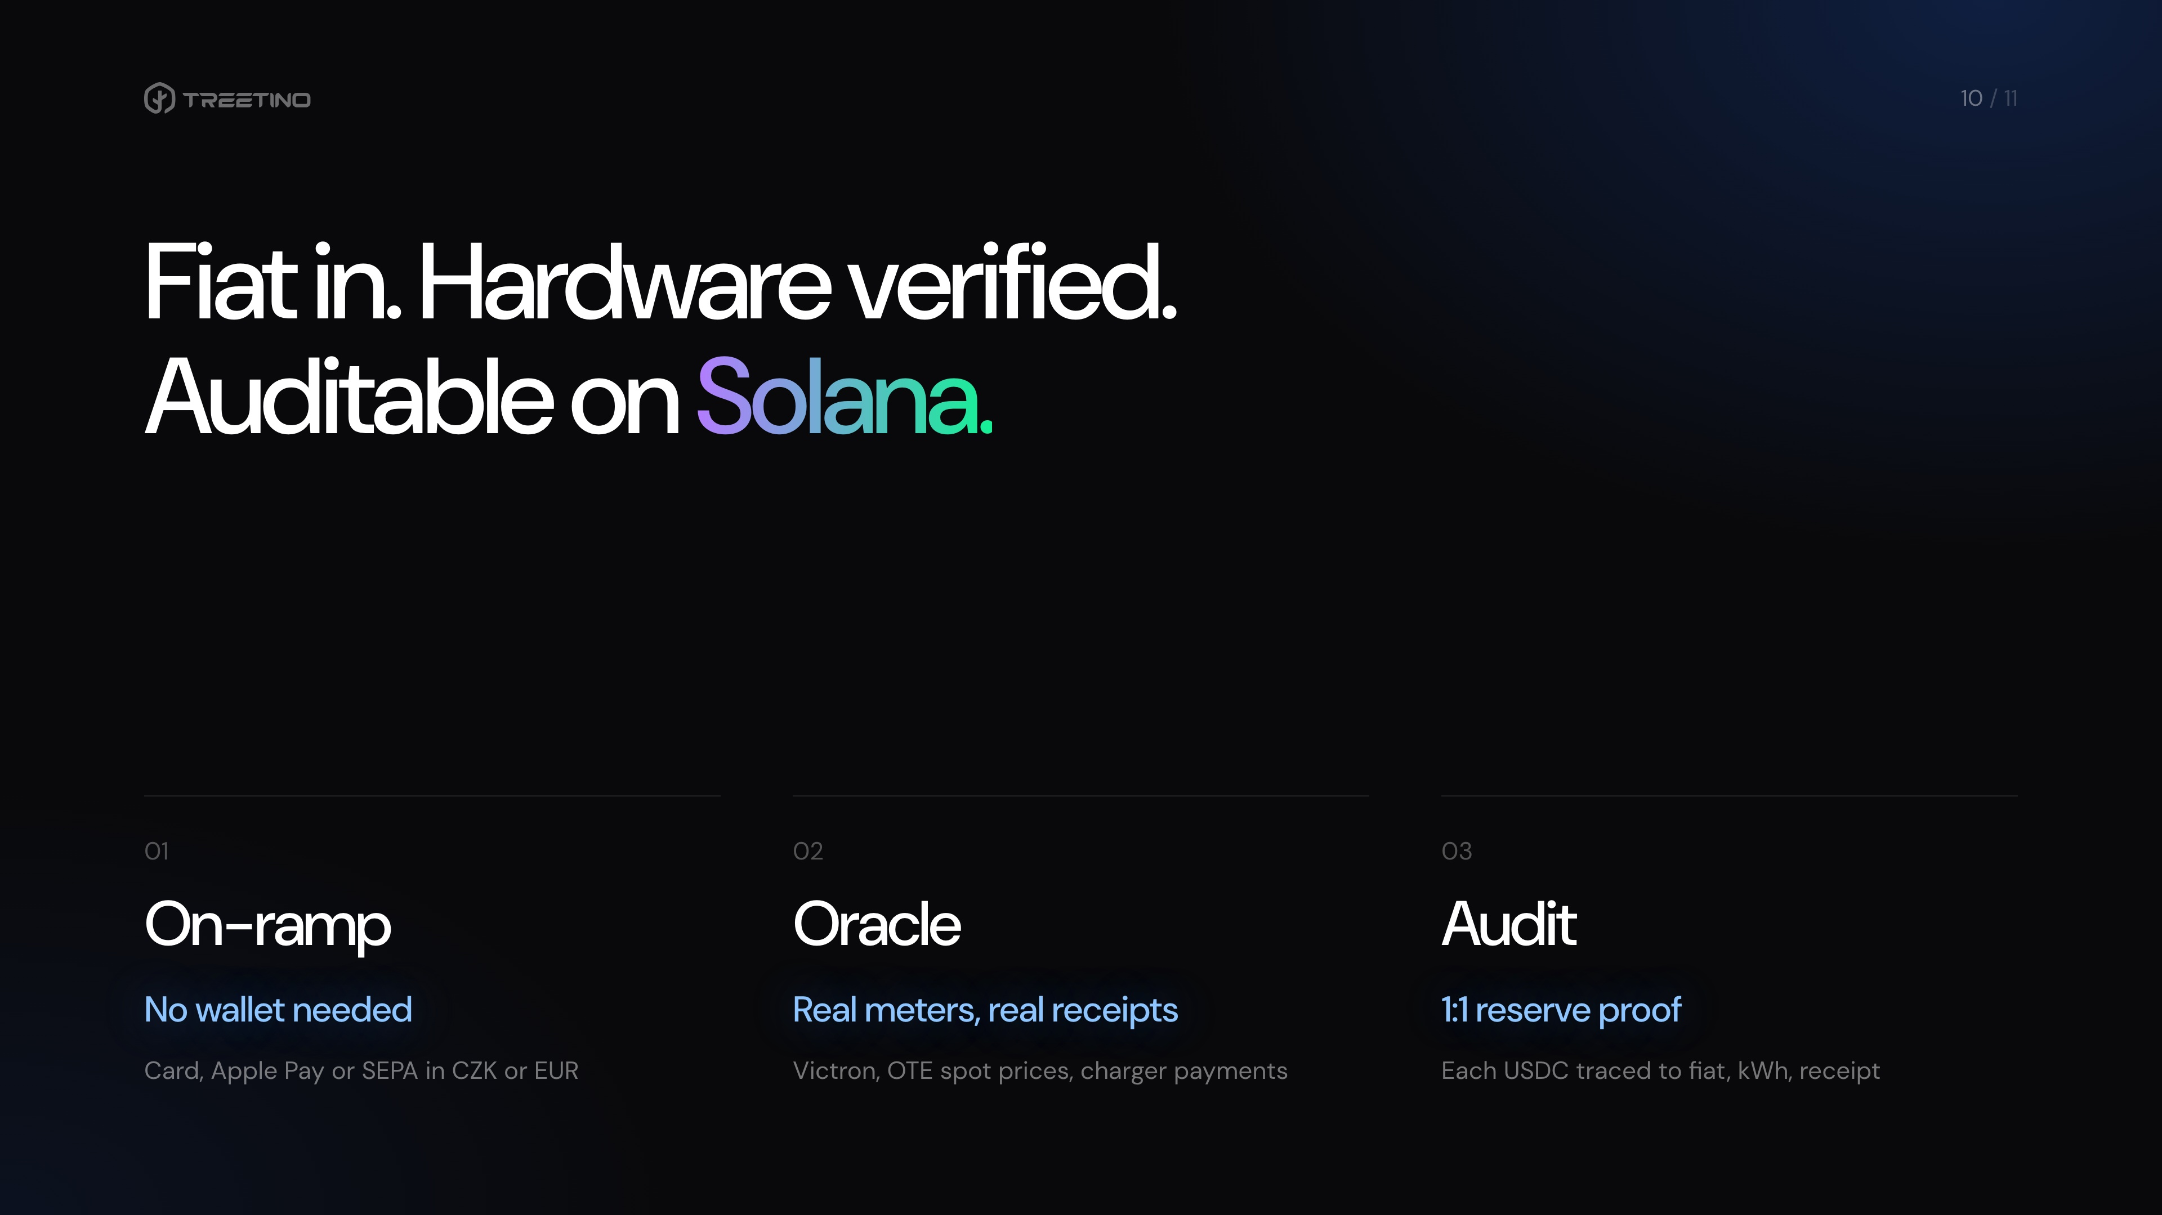
Notes:
3:35–3:50 | Under the hood: a fiat on-ramp for retail and institutions, live hardware and POS data feeding the settlement engine, and a 1:1 reserve proof for every USDC settled.

Slide 11
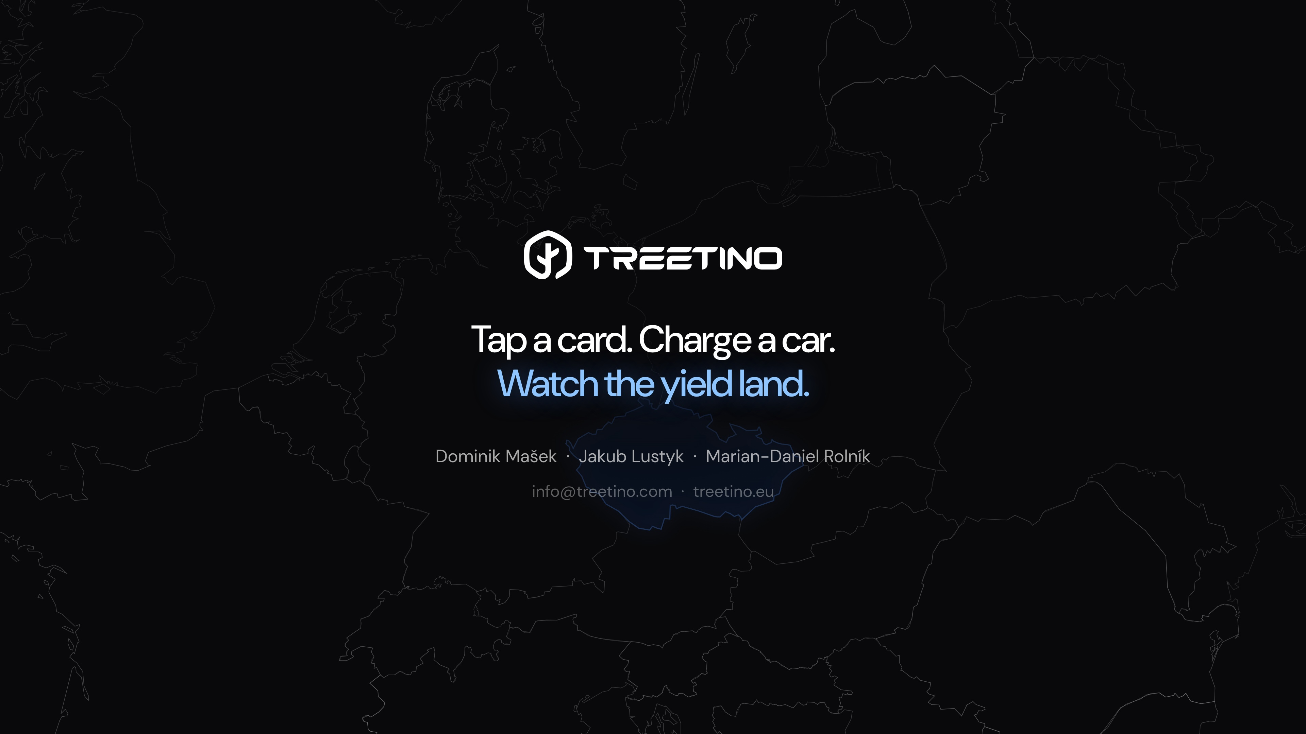
Notes:
3:50–4:00 | Let’s switch to the live app: we’ll on-ramp fiat, buy a share of the Prague tree, simulate a driver paying by card, and watch the yield land in the wallet.

