Slide 1
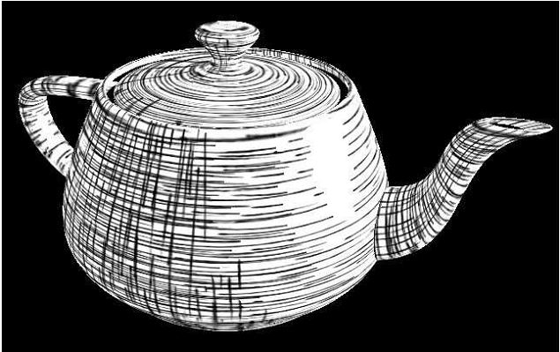
Hatching, Stroke Styles & Pointilism

Slide 2
What is hatching?
Hatching is an artistic technique used to create a tonal or shading effect.
The effect is created by drawing closely spaced parallel lines.
A common variation of hatching is to draw the lines at an angle to each other, this is simply called crosshatching.

Slide 3
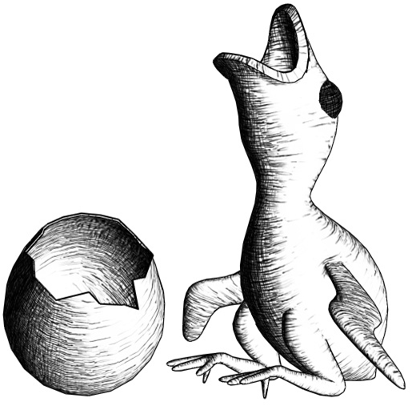
Objective
To create a real-time hatching effect with pixel shading and a single texture.

Slide 4
Creating Stroke Textures
Typically four different stroke textures are loaded to represent overlapping strokes. Two horizontal and two vertical.
One of the first suggestions this paper makes is to use only one texture and rotate the texture coordinates accordingly to obtain the original effect of four different strokes.

Slide 5
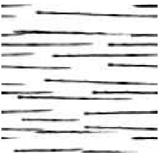
Creating Stroke Textures
So you would start with a texture
of strokes that looks similar to
this and this will give you all you
need.
The four different types of strokes, our stroke colors (stored in rgb channels) and our intensity threshold value (stored in alpha channel)

Slide 6
Threshold Scheme
Utilizing the threshold t of the alpha channel we can control stroke intensity by modulating between the stroke color and the background color.
To do this we give each stroke an intensity interval [start,end] and map t to this interval by start + t/(end-start)
After computing a desired intensity we can modulate the stroke color with the background

Slide 7
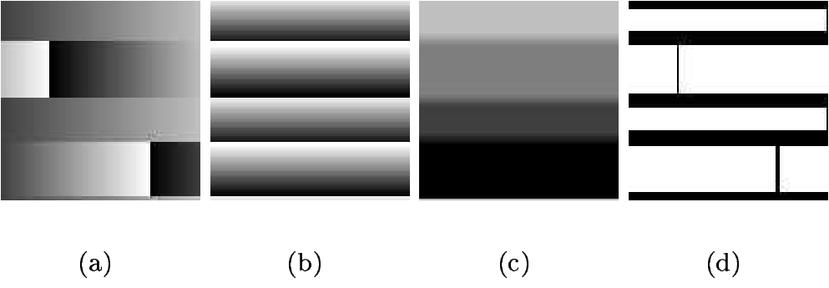
Varying the line style
For this method we do not encode stokes themselves into a texture, but instead encode lookups into a single-stroke textures called Stroke-Lookup Textures.
(a) is the r-channel with lookup in s
(b) is the g-channel with lookup in t
(c) is the b-channel which contains the threshold
(d) is the a-channel which is used as a stencil

Slide 8
Varying the line style
For achieving a uniform screen width of the strokes we use mip-map levels with strokes of the same texel size.
Generation of mip-map levels would halve the texel width of a stroke each level. I.E. further away strokes are smaller
For correct interpolation between mip-map levels the stroke-lookup coordinates are expanded from [0,1] to [-0.5,1.5]

Slide 9
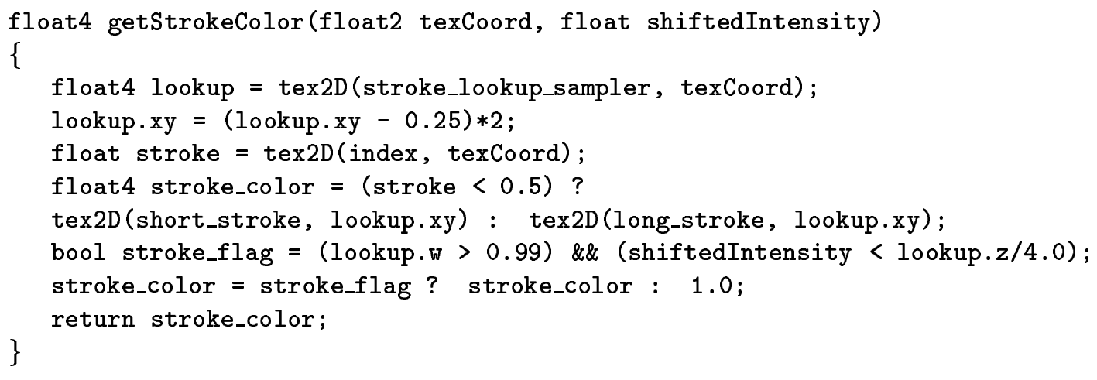
Varying the line style

Slide 10
Specular Highlights
Specular Highlighting: Lighter strokes can be drawn on the assumption that there is not a white background.
Once a certain threshold is reached we can draw a lighter stroke, instead of just white, using the same dark stroke textures and taking 1-previous_threshold to maintain stroke priority.

Slide 11
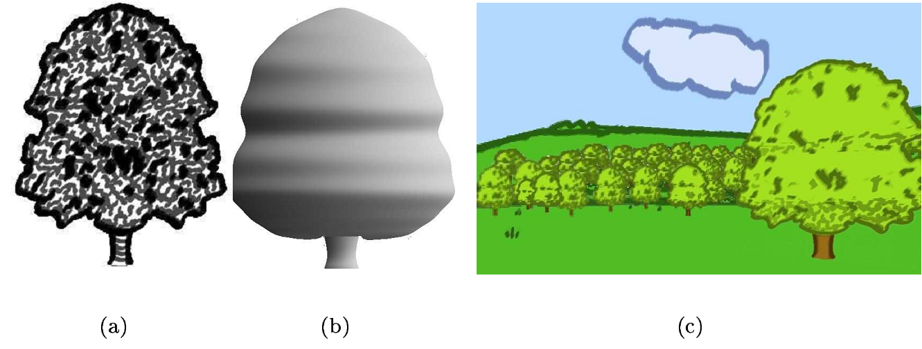
Lighting Hand Drawn Illustrations
Hatching can be used for lighting a hand drawn illustration and putting it into a 3D scene using a bill boarding effect.

Slide 12
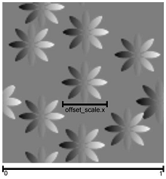
Stroke Colors & Pointillism
For a varying background or base color for a stroke, we would like to draw uni-colored strokes.
This is done by encoding offsets into the strokes which are used for reading the base color, so that all points of a stroke read the same color.

Slide 13
Conclusion
Utilizing pixel shaders we are provided with many stroke based rendering techniques.
The main one being the hatching scheme and the many extensions it has.

