Slide 1
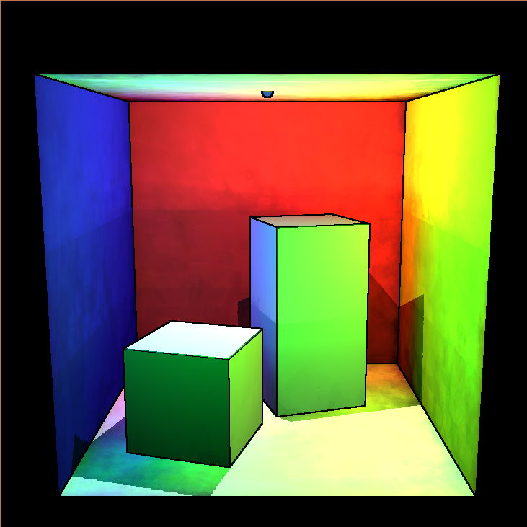
Introduction to 3D Non-Photo Realistic Rendering: Silhouettes and Outlines

Slide 2
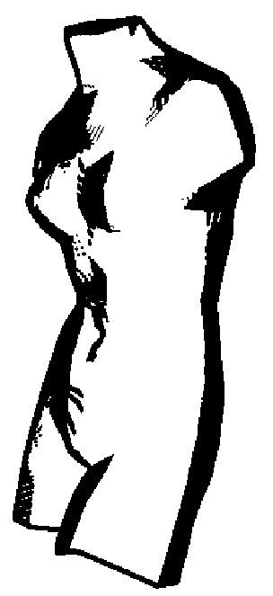
Objective
To obtain outlines and silhouettes from each individual object in real time using various techniques.

Slide 3
Outlines in Image Space
A simple way to generate outlines would be to render the scene from a desired point of view, detect the edges in the image and then display them.
However, the edges of a photograph do not typically correspond to the silhouettes that we want to illustrate. For instance highly textured surfaces will generate edges irrelevant to the objects shape and further more no edge would be detected between two overlapping objects with the same color

Slide 4
Depth Map
A better way to generate silhouettes is to render the image, extract the depth map and apply an edge detection to that map.
The idea is that the variation in depth between adjacent pixels is usually small while the variation between objects is large.
The problem is that the depth map does not detect boundaries between objects that are at the same depth, nor does it detect creases

Slide 5
Normal Map
We can augment the silhouette edges computed with the depth map by using surface normals as well.
The surface normals will detect changes in surface orientation i.e. give us what depth can't
So we apply an edge detection algorithm to our normal map and combine it with our depth map to produce our silhouette edge.

Slide 6
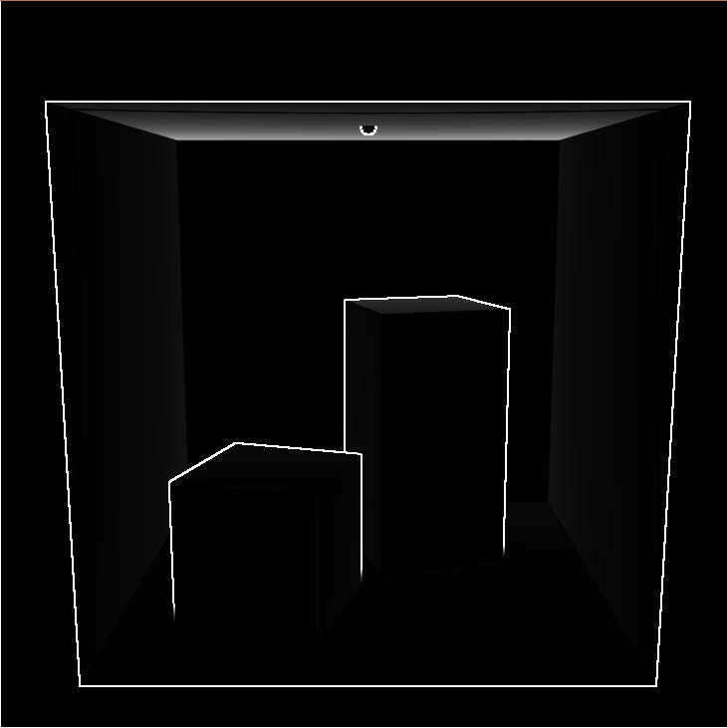
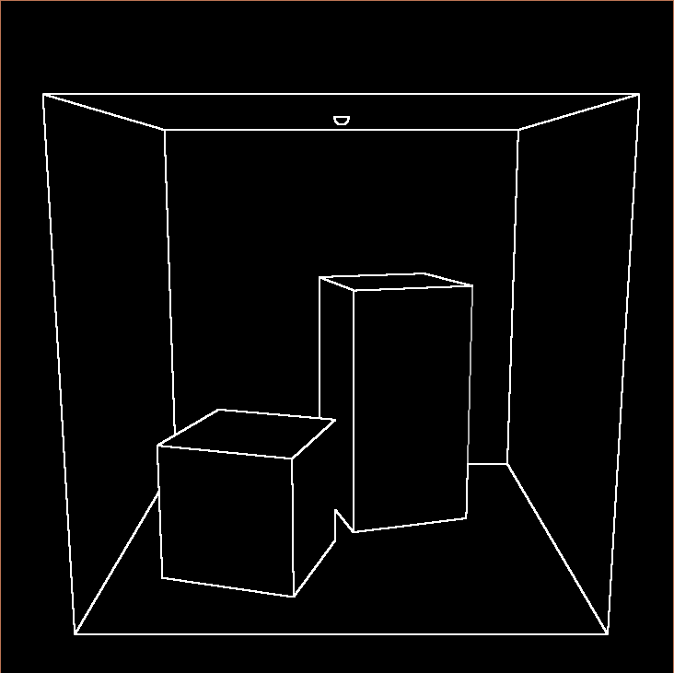
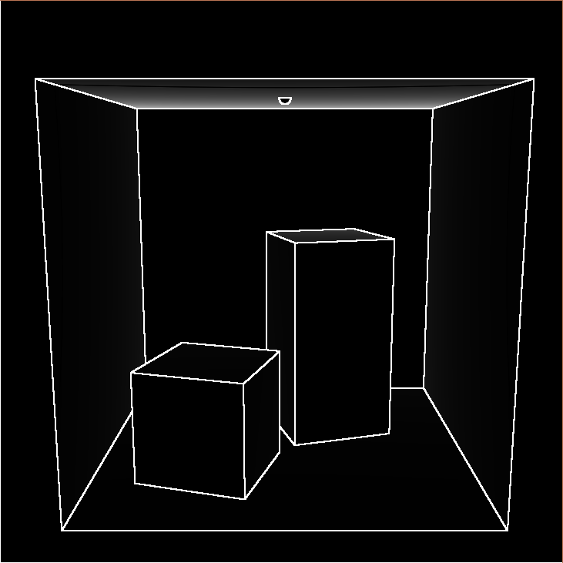
Depth and Normal Map
Depth+
Depth Normal Normal

Slide 7



What is a Silhouette
Concerning polygonal meshes, the silhouette consists of all edges that connect back-facing polygons to front-facing polygons.
For smooth surfaces it can be defined as the surface points with a surface normal perpendicular to the view vector.

Slide 8

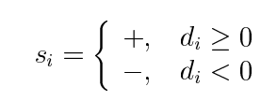
Smooth Surfaces
The first step in finding the silhouette of a smooth surface, in our case one that is defined by a triangular mesh, it to compute the normalized dot product of the normal of the mesh at every vertex with the view vector.
We are also interested in the sign of the dot product.

Slide 9


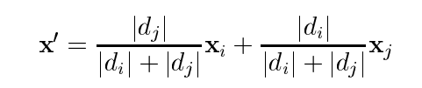
Smooth Surfaces
Recalling our goal is to find and noting that since both the view vector and surface normal are continuous over the surface their dot product must be as well. We can determine the point where a silhouette lies by observing a change in signs over a vertex. I.E. between points and if
We can approximate the silhouette point by linearly interpolating between the two vertecies:

Slide 10
Smooth Surfaces
Finally we can connect the silhouette points into a silhouette curve.
We do this by observing sign changes between a triangles vertecies. If one of the three vertecies has a different sign then the others we can compute the silhouette point on the two sides with opposites signs and connect those points with a line segment.
We do this for every triangle with a sign change and connect the line segments that share an endpoint and this produces a piecewise linear approximation of the silhouettes of a smooth surface.

Slide 11
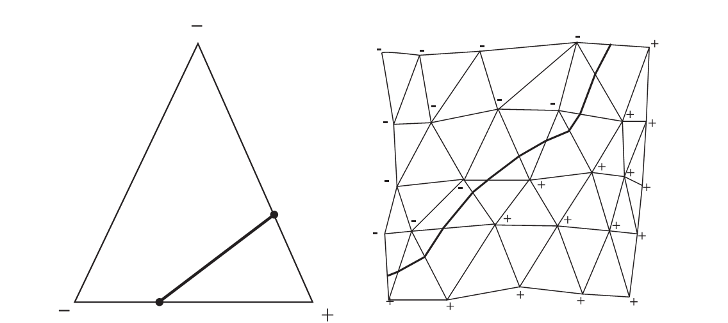
Smooth Surfaces

Slide 12
Visibility
Now we just need to determine which portions of our curve is visible.
There are three situations where the visibility of a surface curve can change.
1) It passes under a silhouette, boundary or crease in the image plane. 2) It intersects a silhouette, crease, or self intersection curve on the surface. 3) It is a silhouette or boundary and has a cusp.

Slide 13
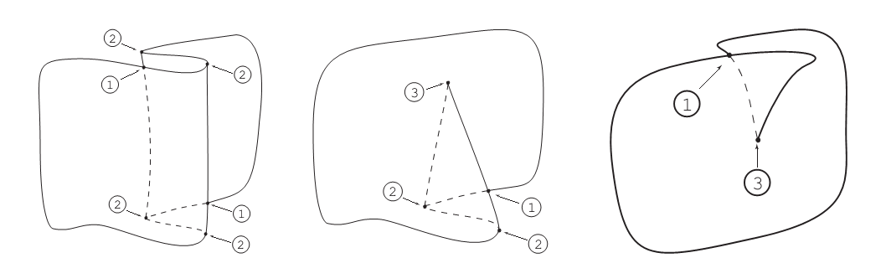
Visibility
The basic algorithm is to break all curves at potential changes in visibility, producing a new set of curves.
We then determine which of these new sets of curves are visible are not by casting a ray from the view vector. If the ray intersects any surfaces before the curve, then the curve is invisible.

Slide 14
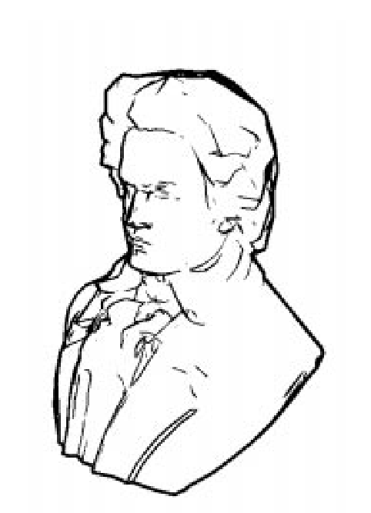
The End

