Slide 1
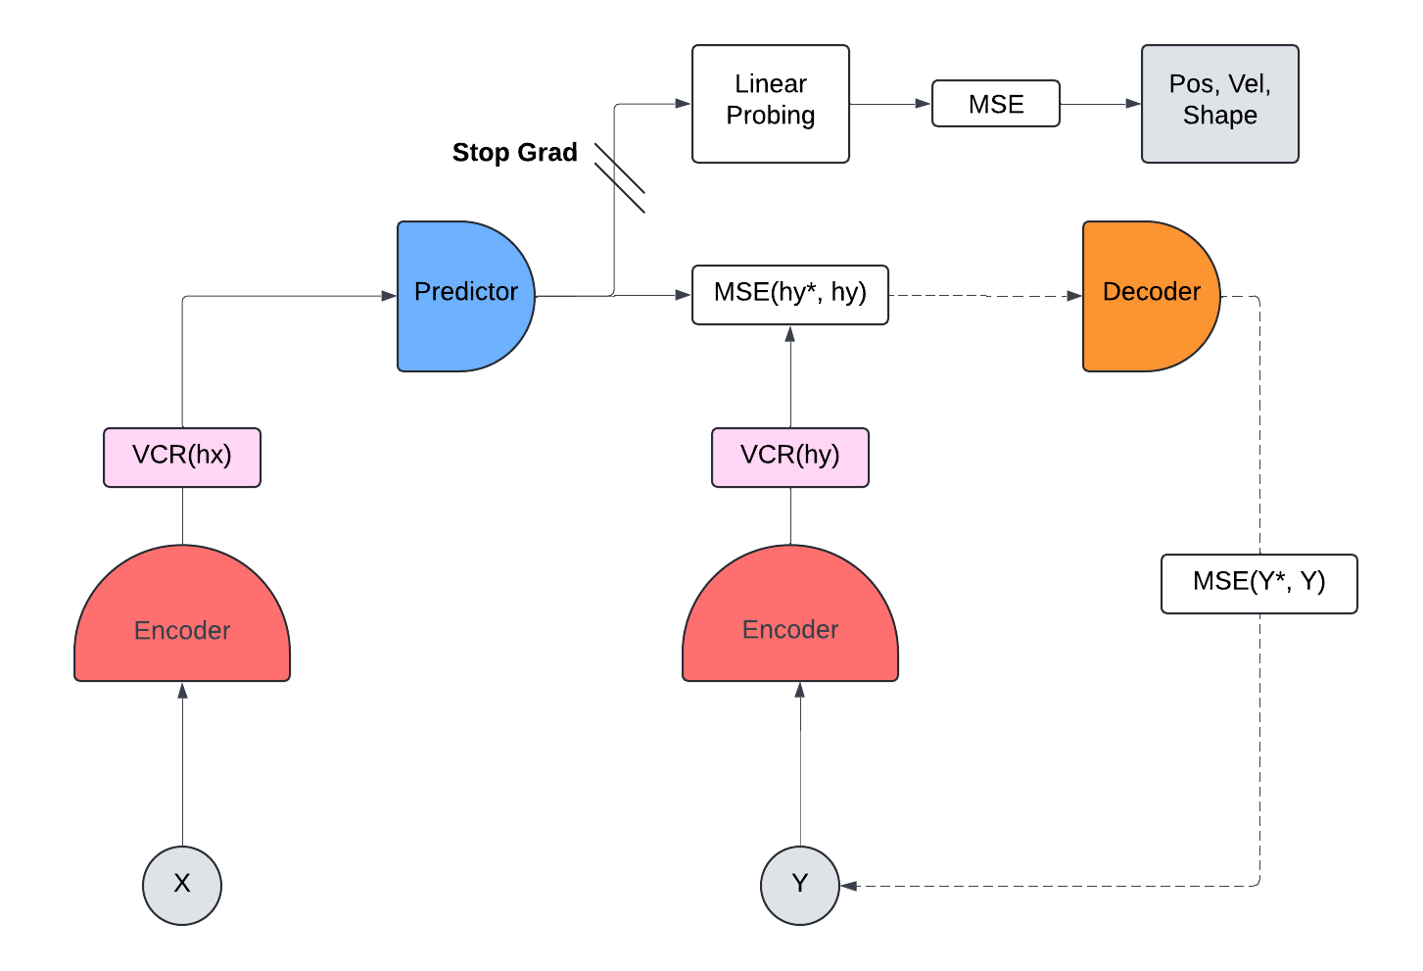
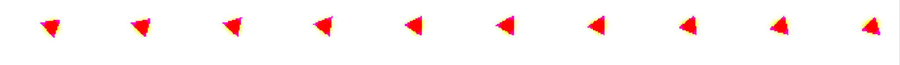
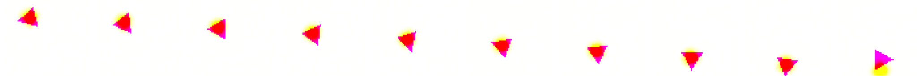
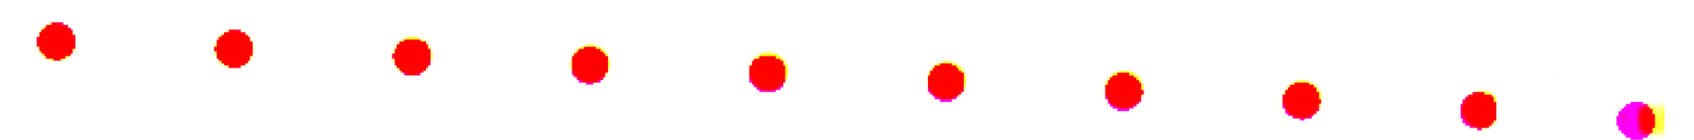
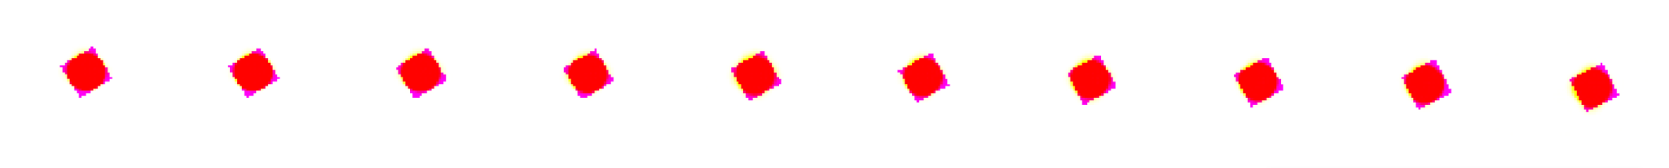
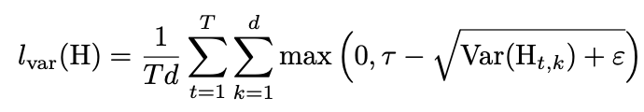
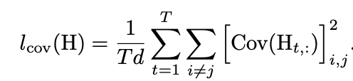

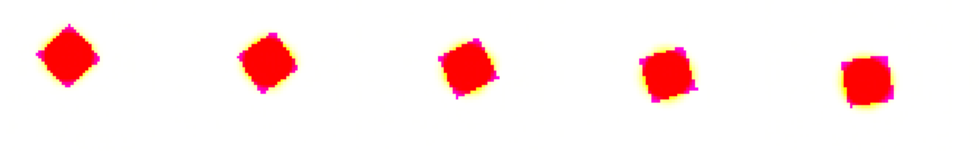
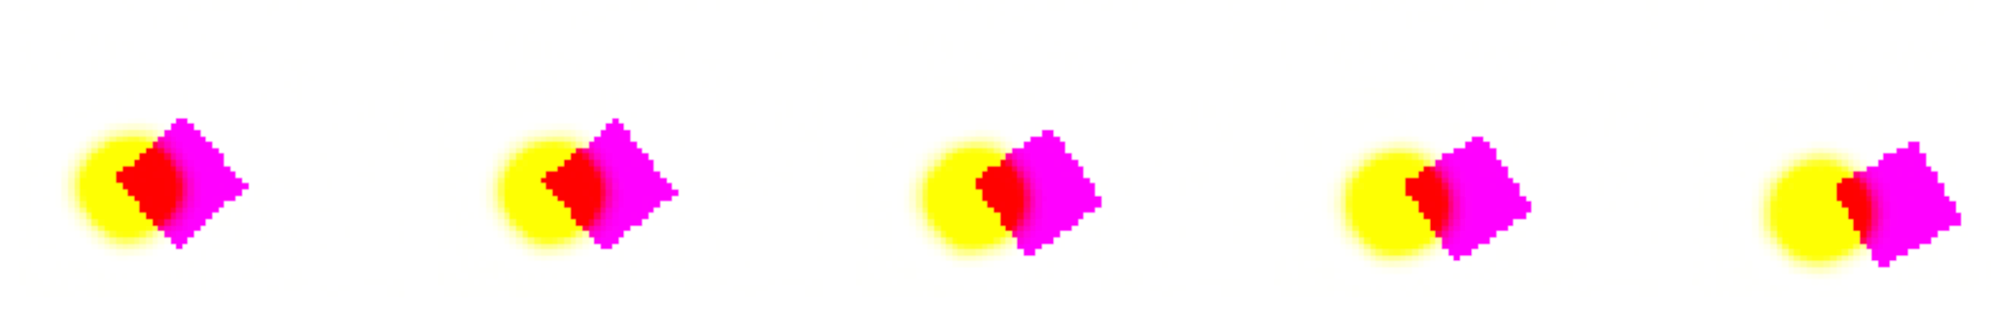
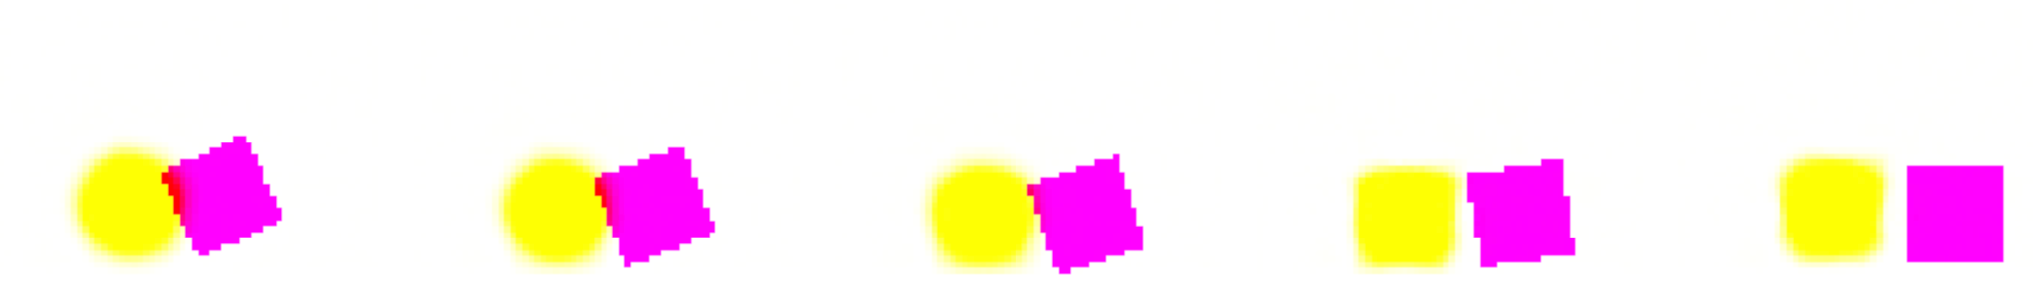
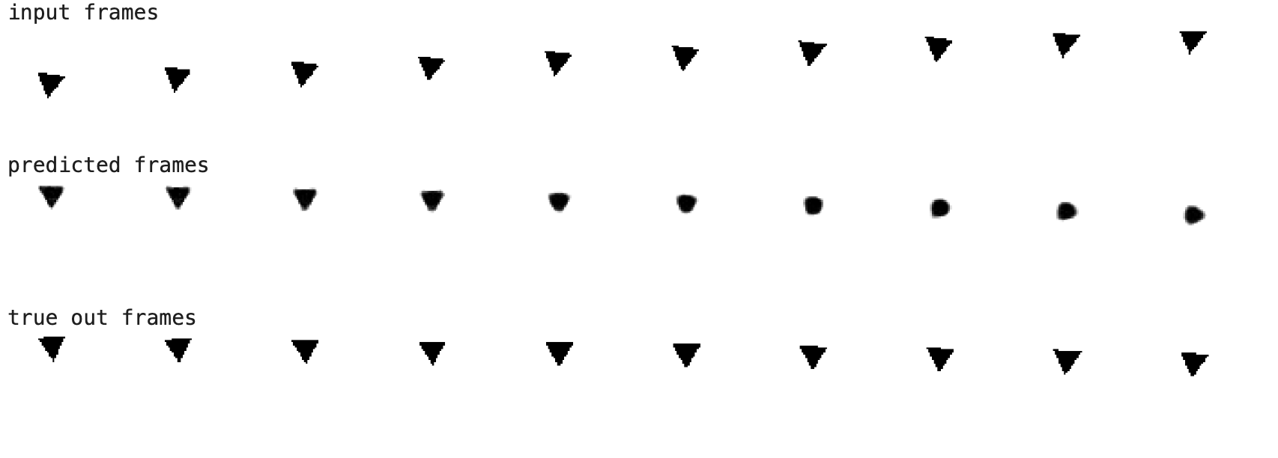
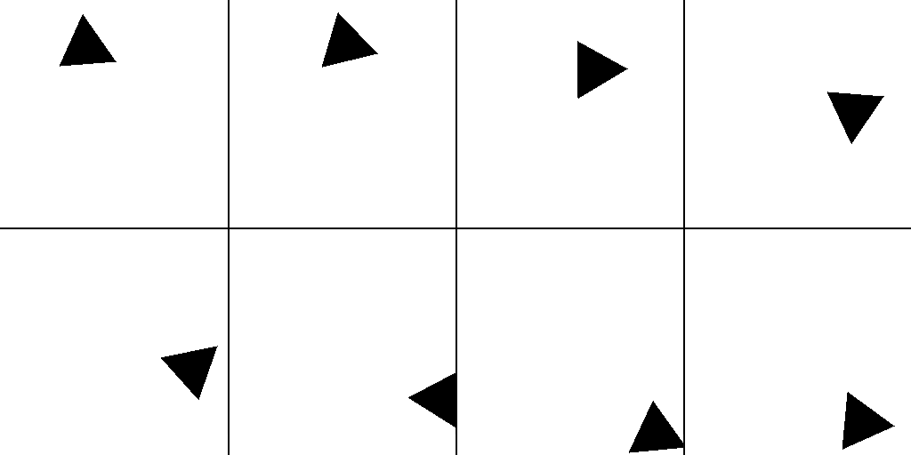
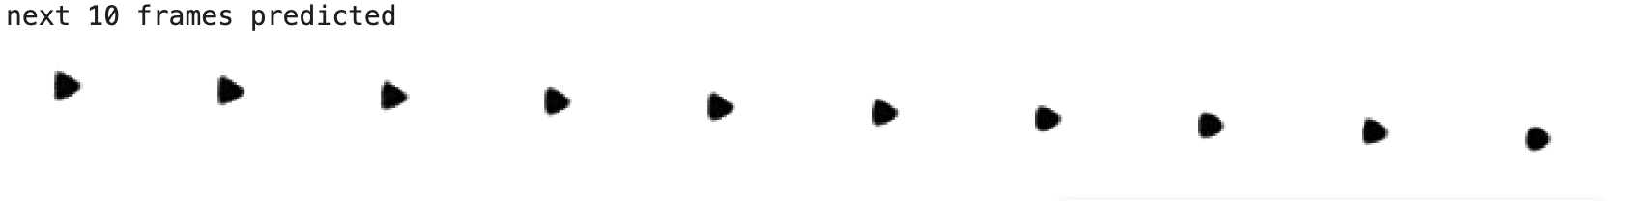
Implicitly Learning Physics from Videos using a Joint-Embedding Predictive Architecture
Raif Olson, Andrei Gerashchenko
Introduction
Predicting future frames
Existing self-supervised vision models are not good at learning physics implicitly, which some researchers believe is due to them learning to directly reproduce pixels rather than learn to reproduce semantic information. The Joint Embedding Predictive Architecture was introduced by Assran et al. (2023) to train image encoders to encode semantic information that could be used to reproduce the semantic information that was masked out of an image. The V-JEPA architecture by Bardes, A. et al. (2024) expanded this to video to teach vision models to learn information useful for modeling physics. More recently Drozdov, K. et al. (2024) modified the JEPA architecture to generate frames in simple datasets like Moving MNIST, and then train a linear probe to extract physical metrics like velocity to evaluate the models ability to understand physics just from self-supervised training. We reproduce Drozdov, K. et al model and train it on a new dataset with more advanced physics.
VCR Loss
Yellow objects are model predictions, purple objects are the training data, and red shows where they overlap.
Joint-Embedding Predictive Architecture (JEPA)
Module Architectures
1
Encoder and Decoder Architecture
Loss from Drozdov, K. et al. (2024)
2
The encoder and decoder follow the architecture from SimVP by Gao et al., (2022) which consists of 8 convolutional layers with 3x3 kernels and 64 channels for all layers.
Force variance to be above threshold theta to prevent representation collapse (simple solution of all 0)
Minimize covariance to make sure that features are distinct from one another
3
Predictor Architecture
Dataset
Set of frame predictions from a 100 frame long test. The first 10 frames were given to the model, at which point it began generating frames. Row 1 shows the first 5 generated frames. Row 2 shows generated frames 45-50. Row 3 shows the final 5 generated frames.
The predictor architecture is a Swin Transformer from Liu et al. (2021) with 4 Swin block layers, an input and output dimension of 64x10 frames, and a hidden dimension of 64. The goal of a small hidden dimension in the predictor is to force the model to only learn key physical quantities.
A Moving MNIST-inspired dataset was created consisting of circles, triangles, and squares bouncing around in a square environment, with gravity and various losses modelled. This dataset consists of 10,000 randomized 20 frame sequences. Each sequence is cut in half for training, with the model using the first 10 frames as an input in order to predict the following 10 frames. The dataset also contains annotations for object class, position, and velocity.
Future Work
A set of 7 linear probing layers will be added for extracting numerical values for position and velocity of shapes. This will be used to evaluate the accuracy of the model’s understanding of physics.
References
image
Katrina Drozdov et al. (2024). “Video Representation Learning with Joint-Embedding Predictive Architectures.” in: arXiv.
Assran, M., Duval, Q., Misra, I., Bojanowski, P., Vincent, P., Rabbat, M., ... & Ballas, N. (2023). “Self-supervised learning from images with a joint-embedding predictive architecture.” In Proceedings of the IEEE/CVF Conference on Computer Vision and Pattern Recognition (pp. 15619-15629).
Zhangyang Gao et al.. (2022) “Simvp: Simpler yet better video prediction.” In Proceedings of the IEEE/CVF Conference on Computer Vision and Pattern Recognition, pp. 3170–3180,
Ze Liu, Yutong Lin, Yue Cao, Han Hu, Yixuan Wei, Zheng Zhang, Stephen Lin, and Baining Guo (2021). “Swin transformer: Hierarchical vision transformer using shifted windows.” In Proceedings of the IEEE/CVF international conference on computer vision, pp. 10012–10022.
Set of training images from iteration 522. Shows a triangle moving to the right and bouncing off the right wall. Top images are from the training portion, bottom images are from the test portion.
Predicting the next 10 frames from the input frames. Row 1 is the input sequence (frames 0->9), row 2 is the output of the model (predicted frames 10-19), row 3 is the true frames (10-19), and row 4 is the what the model predicts will happen for frames (20-29) using it’s own predicted frames as input.

