Slide 1
Invoice Region Detection & Business-Parameter Extraction
From Scanned Invoice to Obligation-Readiness Verdict
Rolando · Diana · Jordan · Damir · Hessam
Deep Learning II — Group Project
Notes:
Welcome everyone. Today we're presenting an end-to-end pipeline that takes a scanned invoice image and decides whether it's ready to become a structured digital obligation record - with a transparent, user-configurable verdict, not a black box. Five of us, five stages, one shared interface contract.

Slide 2
The Business Problem
• A business receives thousands of invoices as images/scans
• Before an invoice can feed an automated finance workflow, someone must check:
– Is it signed or stamped?
– Does it cite a PO / contract / work order?
– Does it state clear payment terms and a valid date?
• Manual triage doesn't scale — slow, inconsistent, delays payment
• Goal: read an invoice image → structured JSON + a transparent Ready / Not-ready verdict
Notes:
This is the Pistac.io framing: a digital obligation record is a machine-readable summary of what an invoice obligates the business to do, and by when, that downstream systems can act on without a human reading the source image first. At real volume, manual review is the bottleneck we're targeting.

Slide 3
Why This Is a Vision + OCR Problem
• Not just "read the text" — first you must know where to look
• Detect visual marks (stamp/signature) and business regions before running OCR
• OCR only the relevant crops → faster, more accurate than OCR-everything
• Then apply rule-based extraction to the OCR'd text for structured fields
• Finally, judge the extracted signals against a user-defined policy
Notes:
We split the problem into detection (where), reading (what), and judgment (is it enough). That separation is what let five people work in parallel on independent, testable stages.

Slide 4
Pipeline Overview
01 Rolando
Data ingestion invoice_manifest.csv
02 Diana
Stamp/Signature YOLOv8n
03 Jordan
Region Detection YOLOv8n
04 Damir
OCR + Params/Terms EasyOCR + rules
05 Hessam
Integration + Verdict Engine + Streamlit App
Final JSON per invoice + Ready/Not-ready verdict
Notes:
Each notebook publishes its outputs to Google Drive; Hessam's integration stage consumes all four upstream outputs and produces one JSON per invoice plus the verdict. document_id is the join key across every CSV.

Slide 5
Datasets — and an Honest Domain Gap
Dataset | Contents | Used by
Invoice batches | ~5,201 unique real scans; 750 sampled; batch_1 has real annotations | Rolando, all
OCR Dataset of Multi-type Documents | 973 receipts, 100% annotated, 52,331 real boxes | Jordan, Damir
SignverOD | 2,765 document images, signature boxes | Diana
StaVer | 400 scans, stamp ground-truth masks | Diana
• None of these are invoices. Detectors train on the best real labelled data, then get applied to invoices
• On invoices: we report detection counts, not accuracy — there's no invoice-level ground truth
Notes:
Say this part out loud - it's a strength, not a weakness, to be upfront about it. Our metrics are real numbers on each dataset's own held-out split. Applying to invoices is an honest, disclosed domain-transfer step.

Slide 6
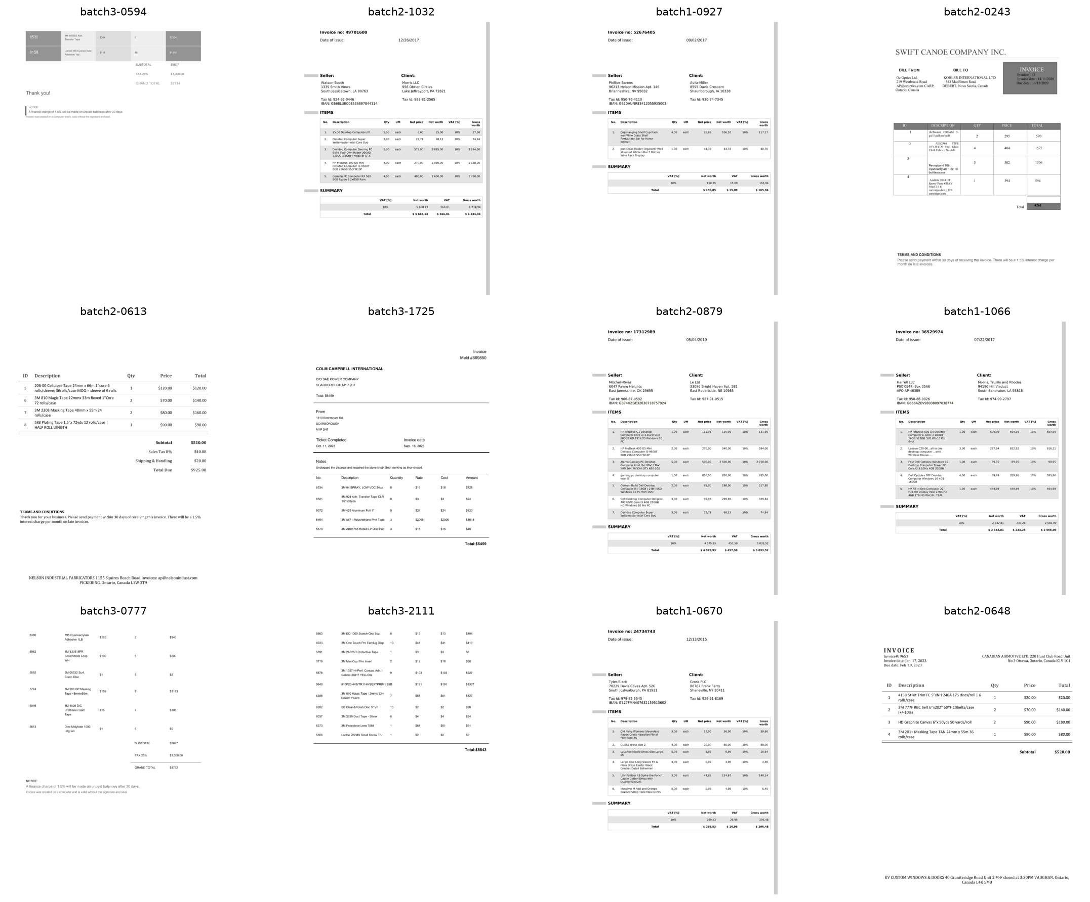
Rolando — Data Ingestion & the Manifest
• No model — this is data engineering, and the whole pipeline's honesty starts here
• Builds invoice_manifest.csv: document_id, image_path, width, height, split, has_ground_truth
• Annotation-aware resampling: naive sampling → 26.3% GT coverage → resampled to 100% (750 rows, split 525/120/105)
• Caught real data leakage: batch_3 secretly duplicates batches 1-2 → true unique count = 5,201, not 8,181 → duplicates excluded
Notes:
Garbage in, garbage out. If the manifest is wrong, every downstream metric is wrong. The annotation-aware resampling was a real trade-off: full labels vs. cross-batch visual variety. Catching the batch_3 duplication before it leaked into train/test splits was one of the more important engineering wins in this project.

Slide 7
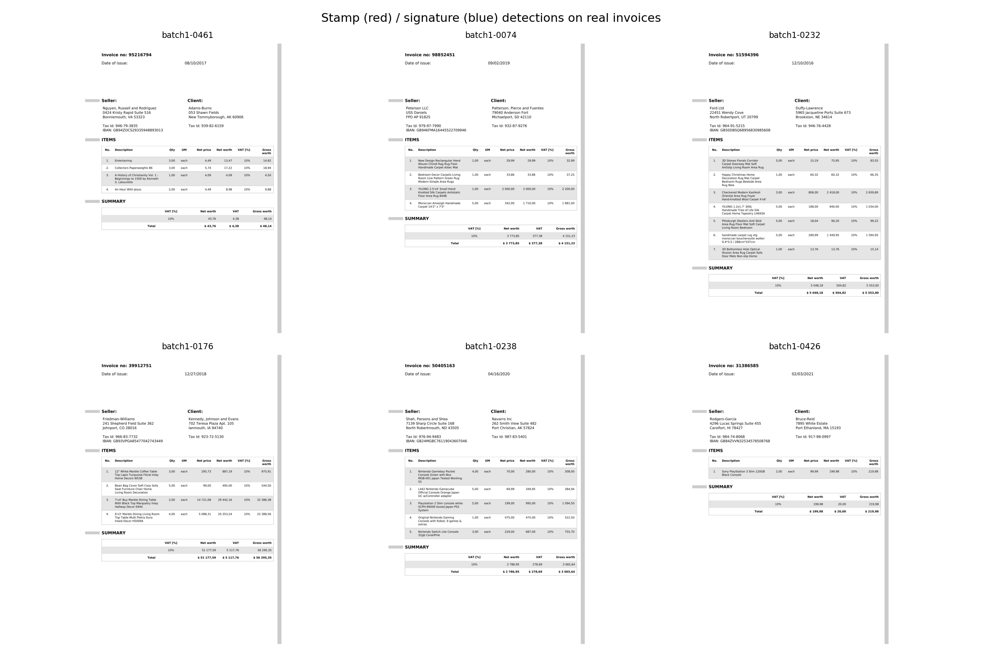
Diana — Stamp & Signature Detection
• Model: YOLOv8n, single 2-class detector (stamp, signature — never merged)
• SignverOD: normalized boxes → pixels; only category 1 (signature) kept
• StaVer: ships no boxes, only masks → boxes derived via connectedComponentsWithStats
• Budget-optimized run: ≤50 epochs, imgsz 640 (reduced after GPU exhaustion at epoch 86)
• Invoice inference: 0 of 750 invoices have any detection — corpus is clean, unsigned digital templates (honest domain-gap result, not a model failure)
Class | Precision | Recall | Mean IoU
stamp | 0.903 | 0.875 | 0.822
signature | 0.894 | 0.638 | 0.815
Notes:
Report per-class, never a blended score - a 'must be signed' business rule cares about the signature number specifically. Signature recall (0.638) is lower than precision (0.894) - the model is conservative, it misses some real signatures (382 false negatives) rather than over-calling them. The mask-to-box derivation for StaVer was the trickiest engineering piece of this notebook - know it cold for questions.

Slide 8
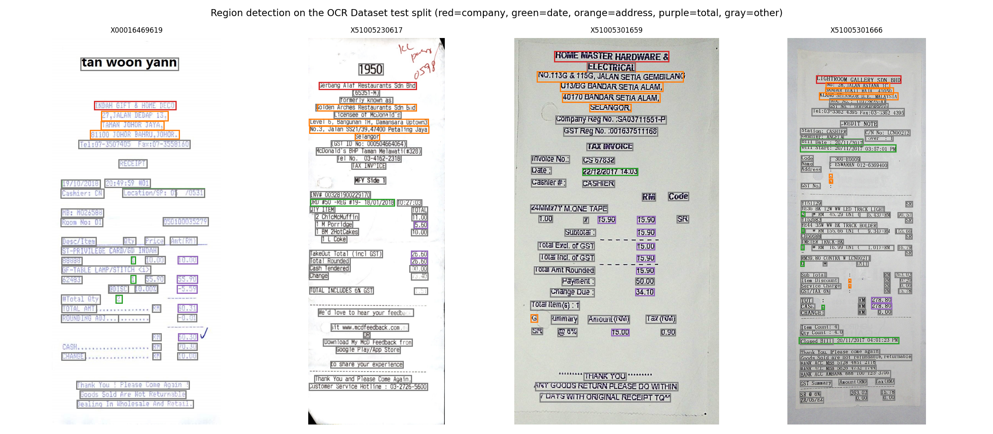
Jordan — Region Detection & IoU
• Model: YOLOv8n, 5-class detector: company, date, address, total, other_text
• OCR Dataset gives text boxes with no class + entity values with no coordinates
• Join by fuzzy-matching entity text to box text (rapidfuzz, threshold 88)
• Challenge: other_text massively outnumbers the four field classes → report per-class, never a single mAP
• Invoice inference: 750 of 750 invoices carry a region detection (domain shift, counts only)
Class | Precision | Recall | Mean IoU
company | 0.897 | 0.819 | 0.894
date | 0.756 | 0.855 | 0.812
address | 0.880 | 0.883 | 0.896
total | 0.763 | 0.783 | 0.887
other_text | 0.911 | 0.967 | 0.877
Macro mean IoU | — | — | 0.873
Notes:
Jordan's date/total/company boxes get a second life in the app: crop + OCR just that region to localize and read key fields - this feeds the verdict engine's date rule. date has the lowest precision (0.756) of the four named classes - dates are short, numeric, and easy to confuse with other short numeric text on a receipt.

Slide 9
Damir — OCR, Parameters & Terms
• OCR: EasyOCR (deep-learning, GPU) — vs Tesseract/PaddleOCR: stronger accuracy, simple setup
• Rule-based extraction (parameter_checker.py, terms_extraction.py) — transparent, user-extensible via config
• Two eval sets, always reported together, never one headline number:
– Primary (98 receipts, real GT): CER 0.2152 / WER 0.5423
– Secondary (120 clean invoices): CER 0.0002 / WER 0.0015
• Payment terms nearly absent from corpus: 99.6% have a date, only 0.4% have day-based terms
Metric | Receipts (primary) | Invoices (secondary)
CER (mean) | 0.2152 | 0.0002
WER (mean) | 0.5423 | 0.0015
Docs scored | 98 | 120 / 750 with GT
Notes:
Always name the denominator when reporting the secondary number - it's honest and it's a strength to volunteer this, not something a professor has to extract with a follow-up question. Required-field presence: PO Reference 54.7%, Order Number 19.9% - the two that actually gate readiness.

Slide 10
Hessam — Integration & the Final JSON
• Merges Diana + Jordan + Damir outputs into one JSON per invoice (document_id is the join key)
• Schema fixed by model_interface_contract.md — visual elements, detected regions, required parameters, payment context, terms & conditions, readiness, model metrics
• Integration nuance: Damir's parameter/terms CSVs are keyed to the receipt dataset, not the 750 invoices → invoice-level signals are derived at integration
• 750 fused per-invoice JSON records produced
Metric | Value
Invoices in manifest | 750
Final-JSON records produced | 750
Region boxes on invoices (other_text) | 54,009
Notes:
This is a subtle but important point: we didn't fork Damir's logic, we re-ran his exact shared functions against a different text source at integration time - so results stay comparable and auditable back to one implementation.

Slide 11
The Verdict Engine — User-Configurable, Fail-Closed
• The user builds a policy from four toggleable rule types before judging any invoice:
– Visual mark — stamp OR/AND signature (or either alone)
– Reference number — any-of PO / Order / Contract / Work Order
– Invoice date range
– Payment terms — e.g. > 30 days
• Verdict = AND of every enabled rule
• Fail-closed: missing evidence (unknown) counts as fail — never a silent pass
• Pure logic, no I/O — independently unit-tested (src/verdict_engine.py, 9/9 passing)
Notes:
This is the headline feature. A compliance officer, an AP clerk, and an auditor may reasonably want different thresholds - so the policy is exposed as configuration, not buried in code. And a readiness gate must never pass what it cannot confirm - that's why we chose fail-closed as the default, and we show it transparently in the breakdown rather than hiding the 'unknown' case.

Slide 12
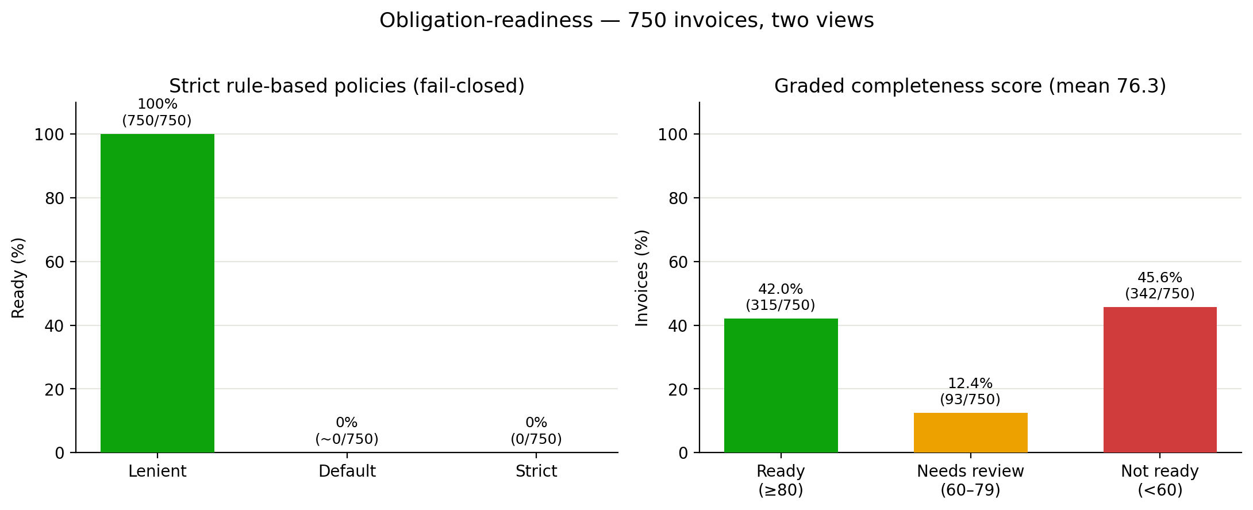
The Readiness Spread — Same 750 Invoices, Two Views
• Strict policies (fail-closed): Lenient 750/750 (100%), Default ~0/750 (~0%), Strict 0/750 (0%)
• Default ~0% = corpus carries no PO/contract references (earlier 63.3% was a matching artifact, corrected)
• Graded completeness: Ready 315/750 (42.0%), Needs review 93 (12.4%), Not ready 342 (45.6%), mean 76.3
Notes:
The verdict engine is a real, configurable system - same 750 invoices, different honest outcomes. The strict Default is ~0% because the corpus carries no PO/contract references (an earlier 63.3% there was a loose-matching artifact, since corrected); Strict is 0% because there are no stamps/signatures - fail-closed working as intended. Because the strict gate can't differentiate this corpus, we add a standardized graded completeness score (Ready 42%, Needs review 12%, Not ready 46%) that yields a meaningful, auditable spread.

Slide 13
Live Demo — the Streamlit App
• Live Demo — upload or pick one invoice → annotated boxes → verdict card with per-rule breakdown → JSON / report download
• Batch Gallery — apply the policy across all 750 invoices → "N of 750 pass" → filter, drill down, export the passing set
• Model Report — each member's real metrics + local-CPU-vs-Colab-GPU comparison charts
• Hybrid execution: gallery reads pre-computed results; a new upload runs the live pipeline
Notes:
[SHOW: switch policy presets live - Default / Strict / Lenient - and watch the verdict and the batch roll-up count change in real time.] This is the moment that makes 'configurable' concrete instead of just a claim.

Slide 14
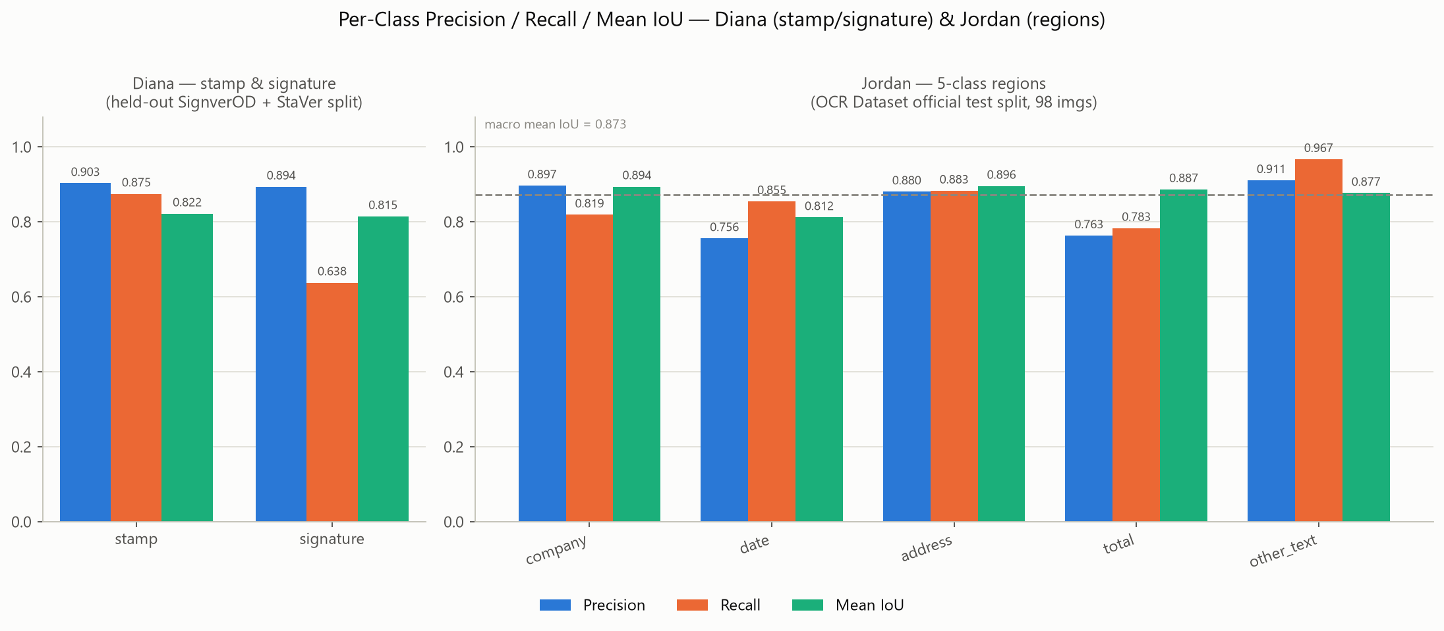
Results
Stage | Headline metric | Value
Diana (stamp/signature) | Precision / Recall / Mean IoU per class | stamp 0.903/0.875/0.822 — signature 0.894/0.638/0.815
Jordan (regions) | Per-class Mean IoU, macro mean IoU | 0.812–0.896 per class — macro 0.873
Damir (OCR) | CER / WER primary / CER secondary | 0.2152 / 0.5423 (receipts) — 0.0002 (invoices)
Hessam (integration) | Readiness: strict / graded | Default ~0%, Lenient 100%, Strict 0% / Ready 42.0% (315/750)
Notes:
These are the final numbers - traceable to each metrics JSON or the final_pipeline_report.md. State the strict readiness spread (Lenient 100% / Default ~0% / Strict 0%) and the graded completeness score (Ready 42%) if asked; the earlier Default 63.3% was a loose-matching artifact, since corrected, and Strict=0% is the fail-closed design on an unsigned corpus.

Slide 15
Limitations & Honest Caveats
• Domain gap: detectors train on documents/receipts, get applied to invoices — counts, not accuracy, on invoices
• GT coverage: annotation CSVs exist only for batch_1 — resampling lifted coverage 26.3% → 100%, trading cross-batch variety for full labels
• Data leakage caught: batch_3 duplicated batches 1-2 — true unique invoices = 5,201, not 8,181
• Integration re-derivation: Damir's receipt-keyed CSVs → invoice signals derived at integration; batch-path coverage is bounded by available OCR/annotation text
• Fail-closed by design: "Not-ready" includes both real failures and unconfirmed checks — always shown separately in the breakdown
• Compute budget: Diana's model trained at a reduced budget (≤50 epochs, imgsz 640) after a GPU-budget exhaustion at epoch 86
Notes:
Every one of these is stated plainly because owning a limitation is a stronger position than hiding it - and because it's true. Rehearse being able to explain why each trade-off was made, not just that it exists.

Slide 16
Conclusion & Future Work
• A business-facing readiness question decomposes into independently trainable/evaluable stages, integrated through a fixed schema, judged by a transparent, configurable, fail-closed engine
• Every stage evaluated on real, labelled data with real metrics; domain gap disclosed, not hidden
• Future work:
– Collect invoice-native ground truth for stamp/signature/region boxes
– Extend annotation-aware sampling beyond batch_1
– A learned OCR-quality gate to distinguish "absent" from "OCR failed"
– Expose confidence/fuzzy-match thresholds as live sidebar controls
Notes:
Close on the honesty theme: the biggest lever for improving this system isn't a bigger model, it's more invoice-native ground truth. That's a data problem, not a modeling problem, and we want to be clear about that distinction.

Slide 17
Thank You — Questions?
• Rolando — Data Ingestion & Manifest
• Diana — Stamp & Signature Detection
• Jordan — Region Detection & IoU
• Damir — OCR, Parameters & Terms
• Hessam — Integration, Verdict Engine & Streamlit App
Notes:
Open the floor. Each of us can speak in depth to our own stage - route detection/model questions to Diana or Jordan, OCR/extraction questions to Damir, data-quality questions to Rolando, and integration/app/verdict-engine questions to Hessam.

