Slide 1

Insurance Cross Sell Prediction
Roma Coffin
Brown University
Data 1030 Project
10/16/20
https://github.com/romacoffin/Health-Insurance-Cross-Sell-Prediction

Slide 2

Introduction
Leverage machine learning techniques to predict if someone will be interested in purchasing vehicle insurance
Dataset is from a health insurance provider leveraging their own customer’s data
The target variable is the customer’s response, if they are interested in purchasing insurance
Notes:
Cross selling is important especially in the insurance world because it provides insurance companies a great opportunity to sell a different or related product or service by leveraging their existing customer base
The dataset I used is from Kaggle for an ongoing competition where the goal is for a health insurance provider to leverage their own customer’s data from past years to see if they would also be inclined to buy car insurance from them.
There were 12 features in the dataset, the target variable was the response to see if a customer is or isn’t interested in purchasing insurance. Other features included gender, age, how long they had been with the current health insurance provider as well as some more vehicle related categories such as the age of their car or if their vehicle had been damaged before.

Slide 3
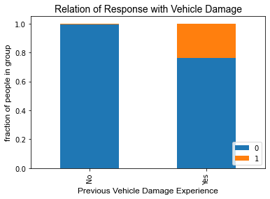
Exploratory data analysis
Those with prior vehicle damage experiences are more likely to be interested in purchasing vehicle insurance when compared to customers with no past vehicle damage
Notes:
This stacked bar plot looks at prior vehicle damage and the target variable.
So not surprisingly, it shows that people with past vehicle damage are more likely to be interested in purchasing vehicle insurance than people with no past vehicle damage.

Slide 4
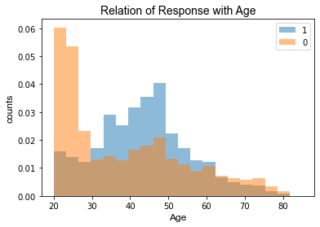
Exploratory data analysis
Customers between the ages of 35-50 are more likely to be interested in purchasing vehicle insurance when compared to customers between the ages of 20 to 30
Notes:
This category specific histogram looks at age and the target variable.
We see that the people between the ages of 35 to 50 are more likely to be interested in purchasing vehicle insurance while people between the ages of 20 to 30 are less likely. Which is also not surprising because as people get a bit older, they tend to be more risk averse

Slide 5
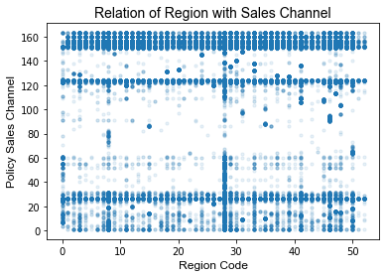
Exploratory data analysis
Region Code and Policy Sales Channel show us a relationship that can better understand sales distribution options
Notes:
The scatterplot looks at Region Code and Policy Sales Channel.
It is a little less straightforward than the other 2, but we see for example Region 28 and Policy Sales Channel 28, 125, and 150-160 have high volumes. Both features show us if certain locations have better sales with certain distribution channels which is quite interesting and I think as I continue my analysis looking more into this is key

Slide 6
Splitting and preprocessing the data
IID Data
381,209 rows x 12 columns (2 columns were removed)
No missing data
Basic split approach with default allocation 60 train/20 val/20 test
Labels did not need to be preprocessed
Continuous features all used standard scalar except age which used min max encoder
Categorical features all used one hot encoder except vehicle age which used ordinal encoder
Notes:
it is IID, has no missing values, has ~380k rows &12 columns
2 columns (ID and Vintage) were removed because they had no impact to the target
A basic split approach was used because the data was diverse and not easily grouped
602020 used bc there are under 1 mil datapoints in the dataset and to ensure all 3 splits have the same trend of the original data
All Continuous features used the standard scalar except age which used the min max encoder because it was reasonably bounded
Categorical features all used one hot encoder except vehicle age which used the ordinal encoder because it could be ordered

Slide 7
Questions?
Notes:
Thank you very much and now if anyone has any questions I would be happy to take them

Slide 8
Appendix

Slide 9
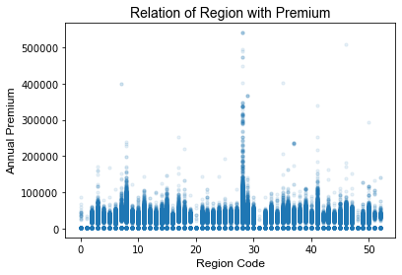
Exploratory data analysis

Slide 10
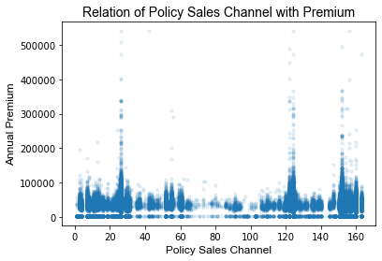
Exploratory data analysis

