Slide 1
Management application

Slide 2
Specifications
Manage
Users :
General informations
Membership
Usage permission on machines (training required)
Usage and Payments
Machine
Fees
Usage permission
Booking and usage
Sort
Export to csv file informations (members, payments…)

Slide 3
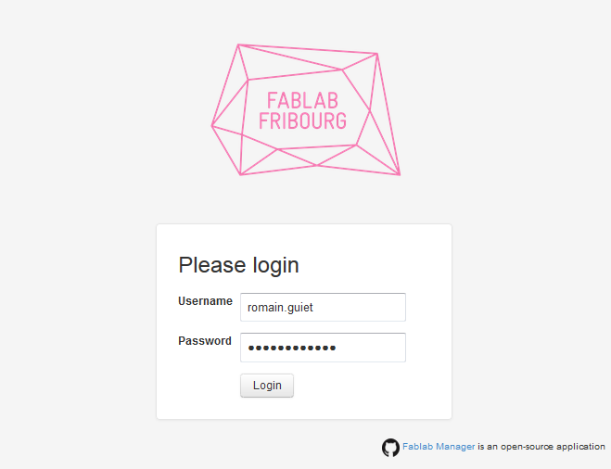
Home page
Ask your login and password

Slide 4
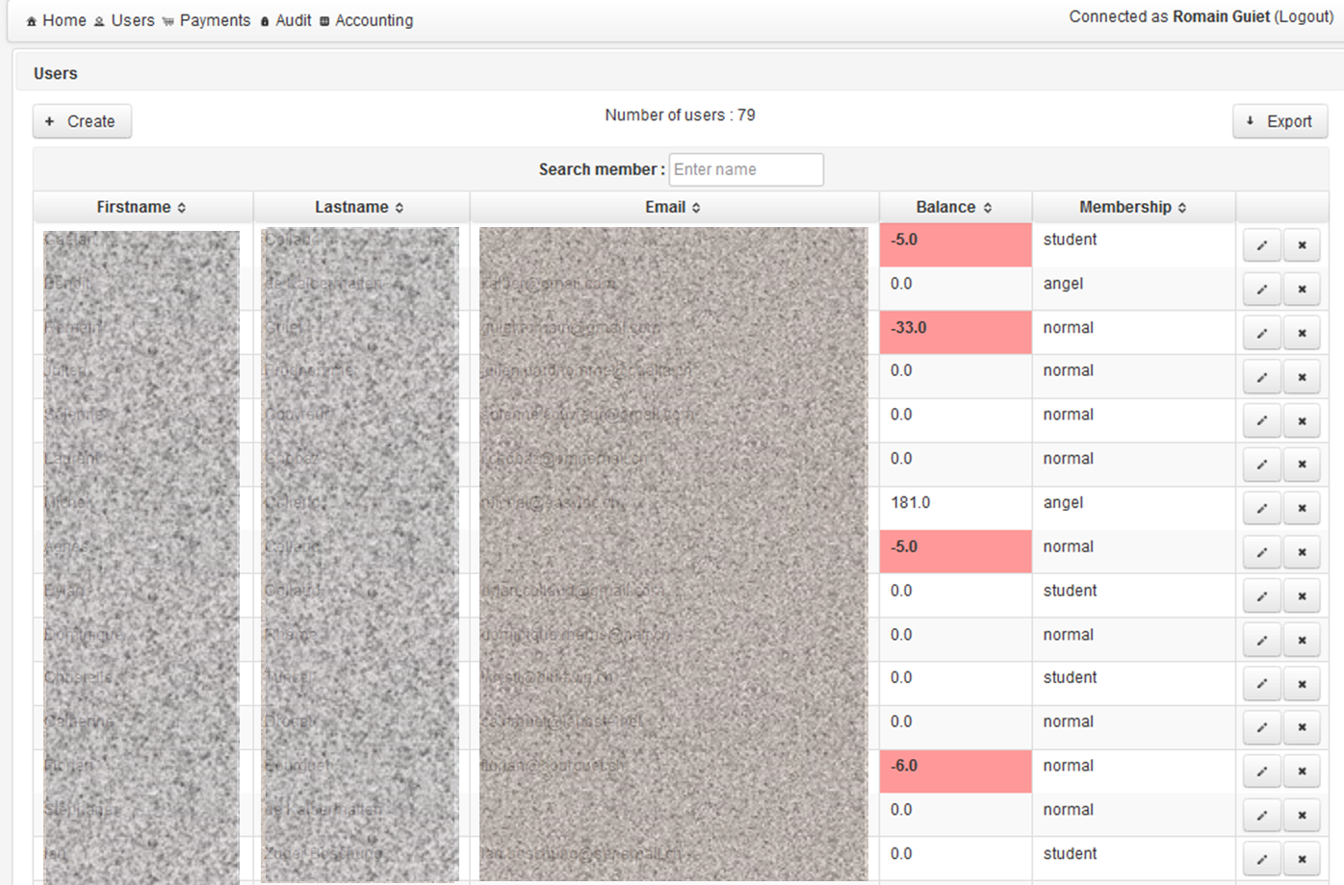
Users
The list of the members, with Name, e-mail, balance, membership (editable by admin)

Slide 5
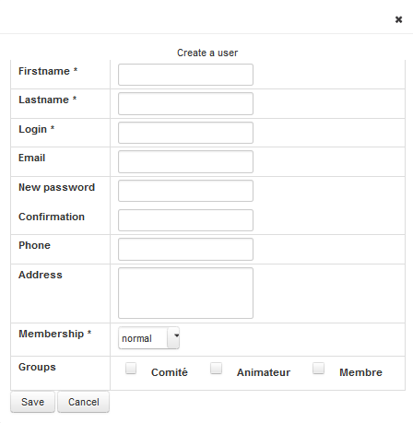
Users Create a user profile
Fill informations about the member . (Up to now manually)

Slide 6
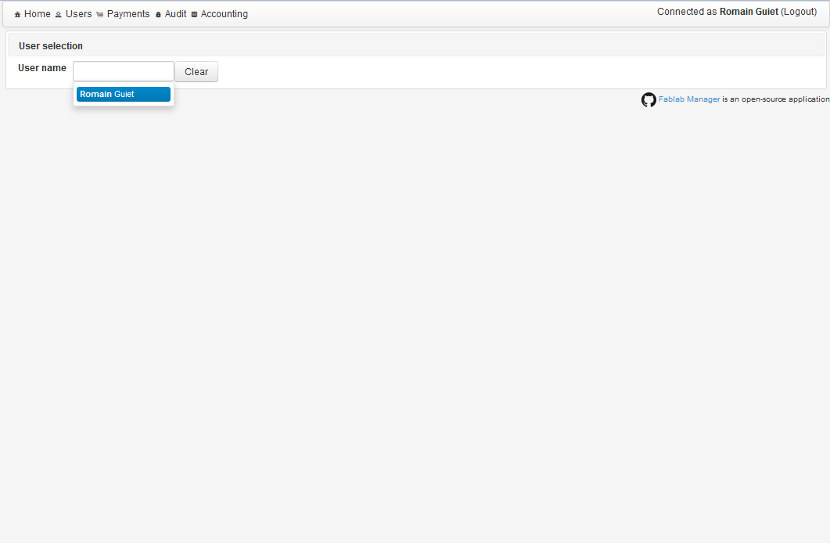
Payments
Type the name of a member. The auto-completion proposes you some names of the list.

Slide 7
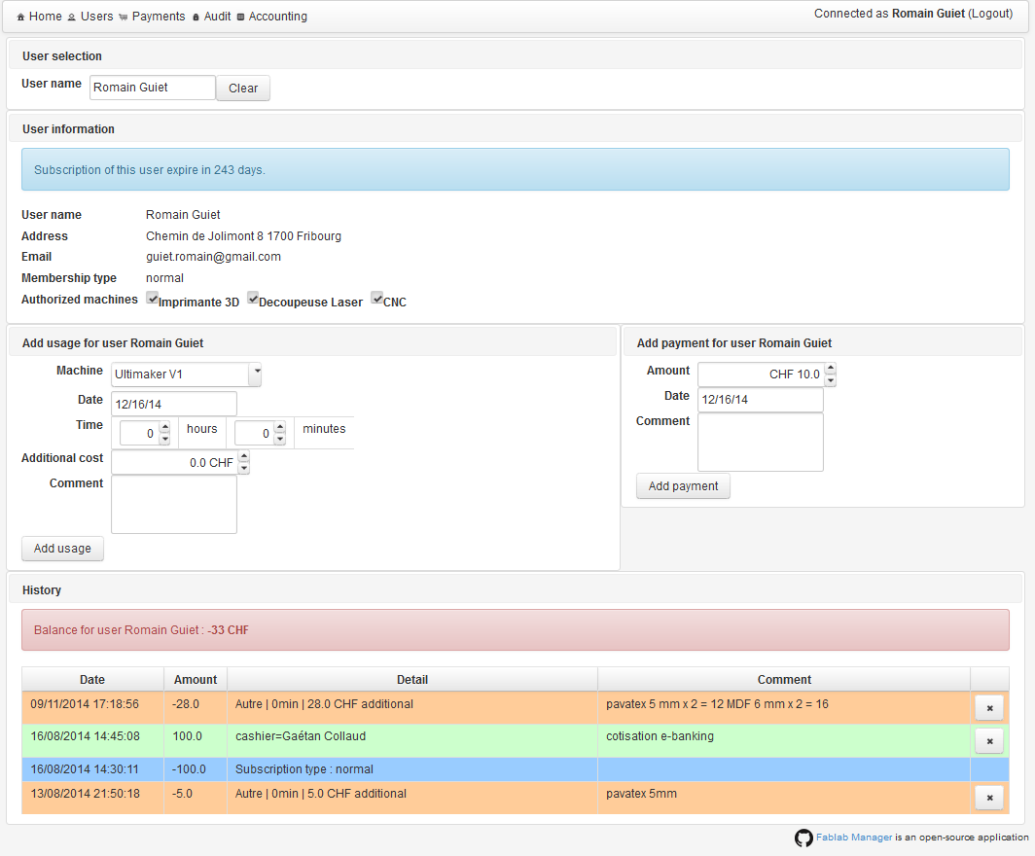
Payments
Upper panel : User information, rights to use for the machine
Middle panel : add Usage (left panel), and Payment (right panel)
Bottom panel : the History, Usage appears in orange and Payment in green.

Slide 8
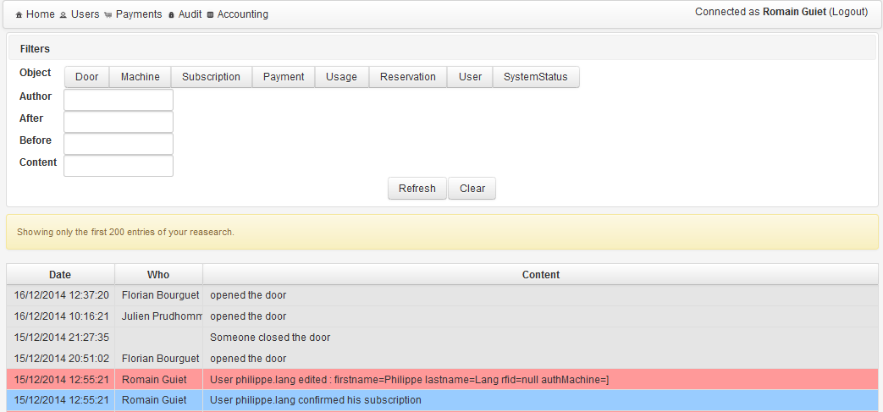
Audit
To get and sort what , when and by who every kind of actions were done.

Slide 9
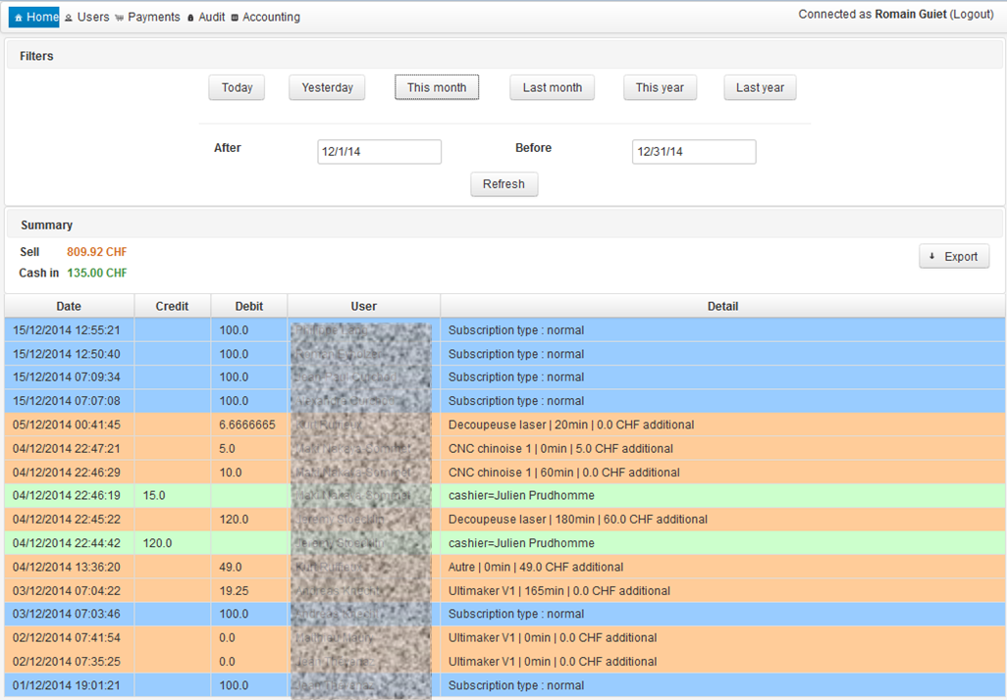
Accounting
Get a summary of monetary operations (the same color code used for the payments window)

Slide 10

GitHub
https://github.com/gaetancollaud/fablab-manager

Slide 11
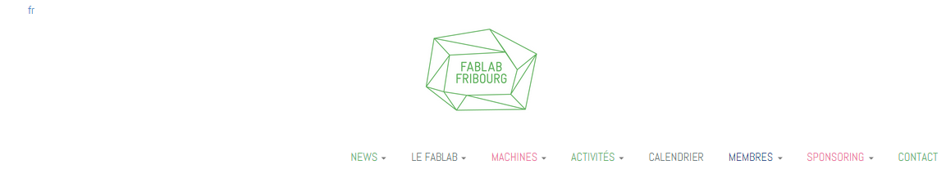











fablab-fribourg.ch

