Slide 1


The platform, screen by screen
21
9
0.0.3
SCREENS
SECTIONS
VERSION
ADAFSA Agricultural Monitoring Platform · design mockup
1

Slide 2
AN INTERACTIVE MOCKUP IS AVAILABLE
This mockup exists as an interactive website
romainbigare.github.io/adafsa-mockup
Every screen in this deck is a screenshot of the live, interactive mockup available at the url above.
ADAFSA Agricultural Monitoring Platform · design mockup
2

Slide 3
Contents
OVERVIEW
TREE MONITORING
IRRIGATION EFFICIENCY
OV
Overview
5
T1
Tree count
12
I1
Scores
20
CROP MONITORING
T2
Canopy health
13
I2
Trend by quarter
21
C1
Crops and area summary
7
T3
Annual change
14
CROP WATER CALCULATOR
C2
Cereals and fodder
8
LAND USE & STRUCTURES
W1
Monthly demand
23
C3
Open field crops
9
L1
Land use
16
W2
Season budget
24
C4
Fallow land
10
L2
Structures
17
YIELD OPTIMISATION
L3
Change tracking
18
Y1
Yield forecast
26
Y2
Crop calendar
27
INDIVIDUAL FARMS
F1
Farm register
29
F2
Farm profile
30
F3
Corrective actions
31
SUPPORT
S1
Support
33
ADAFSA Agricultural Monitoring Platform · design mockup
3

Slide 4
SECTION 1 OF 9
Overview
1 screen · OV
ADAFSA Agricultural Monitoring Platform · design mockup
4

Slide 5
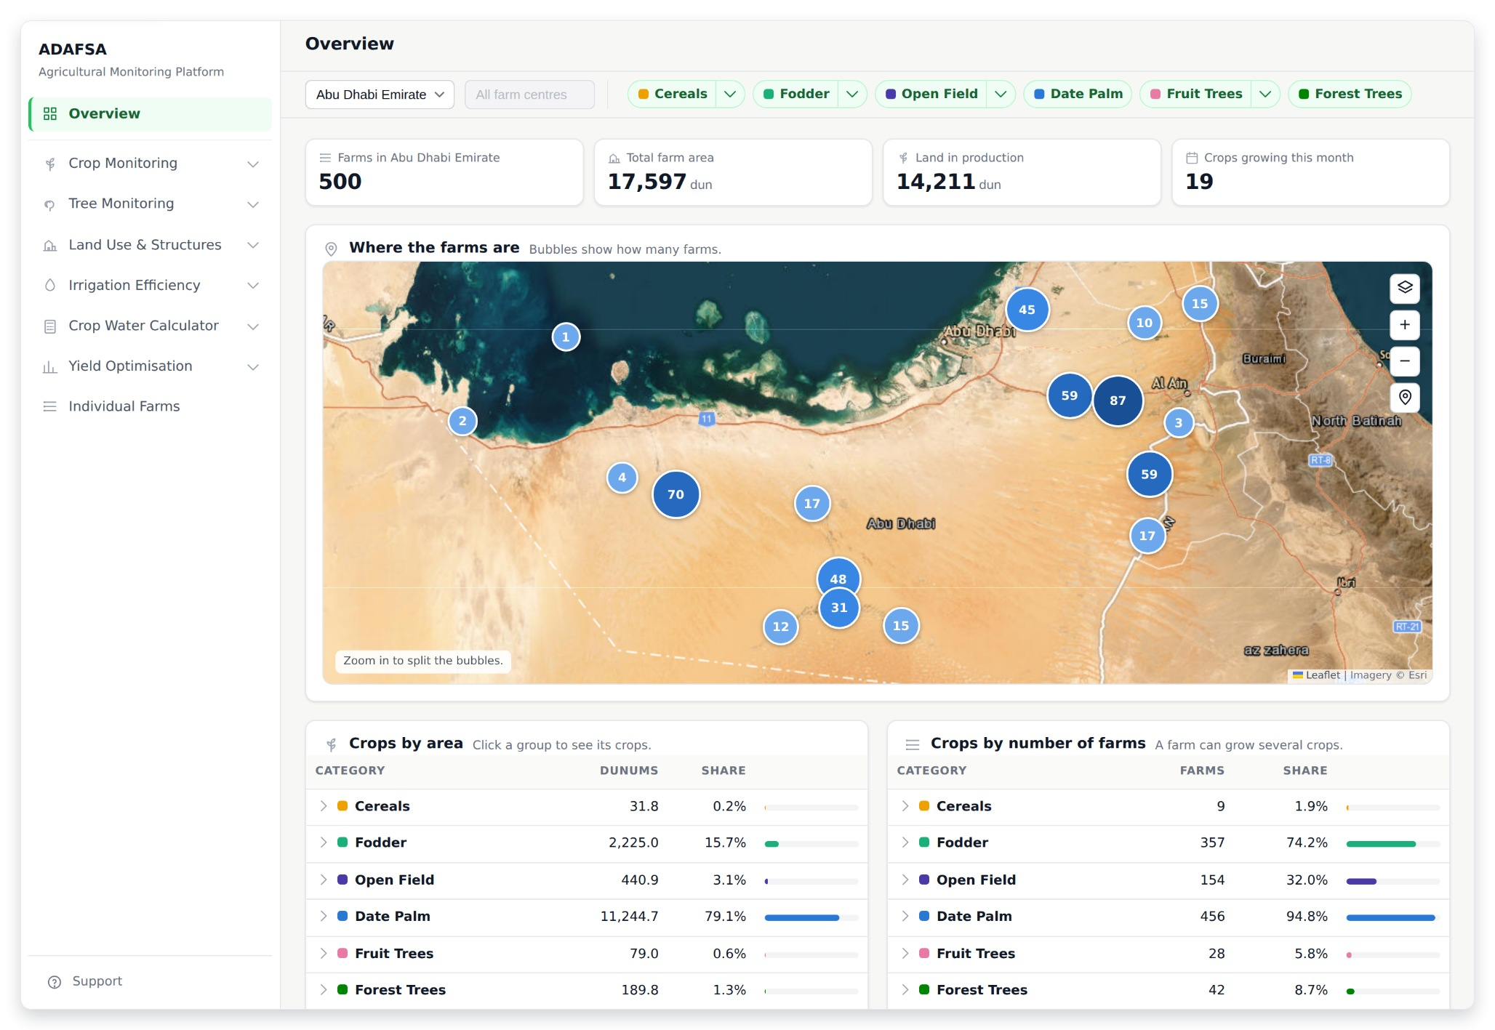
OVERVIEW
OV · Overview
The first page. Four numbers at the top: how many farms, their total area, how much land is in production, and how many crops are growing this month. The map shows where the farms are, and the two tables below split every crop group by the land it covers and by how many farms grow it.
ADAFSA Agricultural Monitoring Platform · design mockup
5
Notes:
OV — Overview The first page. Four numbers at the top: how many farms, their total area, how much land is in production, and how many crops are growing this month. The map shows where the farms are, and the two tables below split every crop group by the land it covers and by how many farms grow it.

Slide 6
SECTION 2 OF 9
Crop Monitoring
4 screens · C1 · C2 · C3 · C4
ADAFSA Agricultural Monitoring Platform · design mockup
6

Slide 7
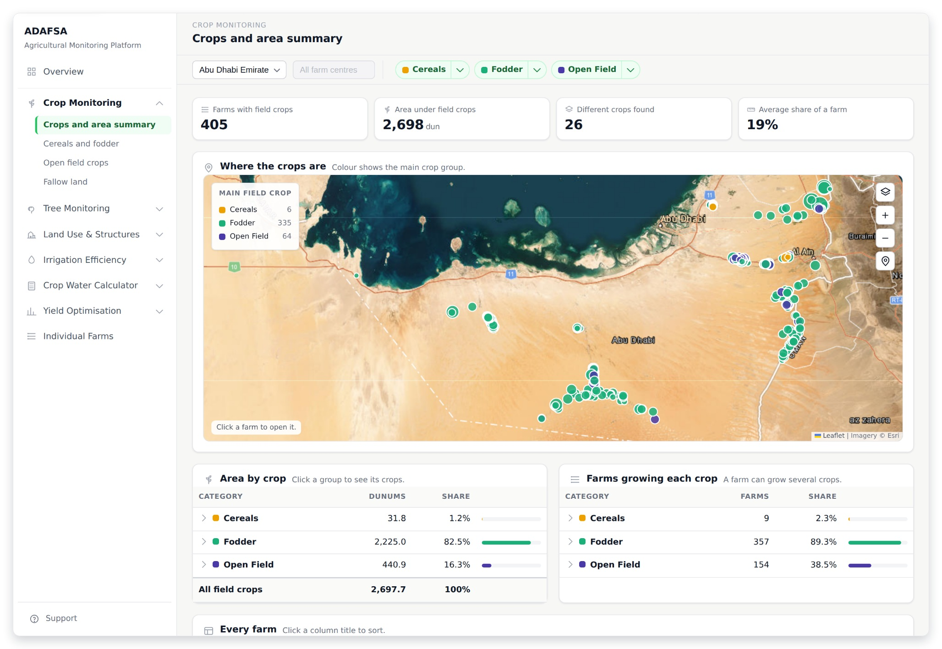
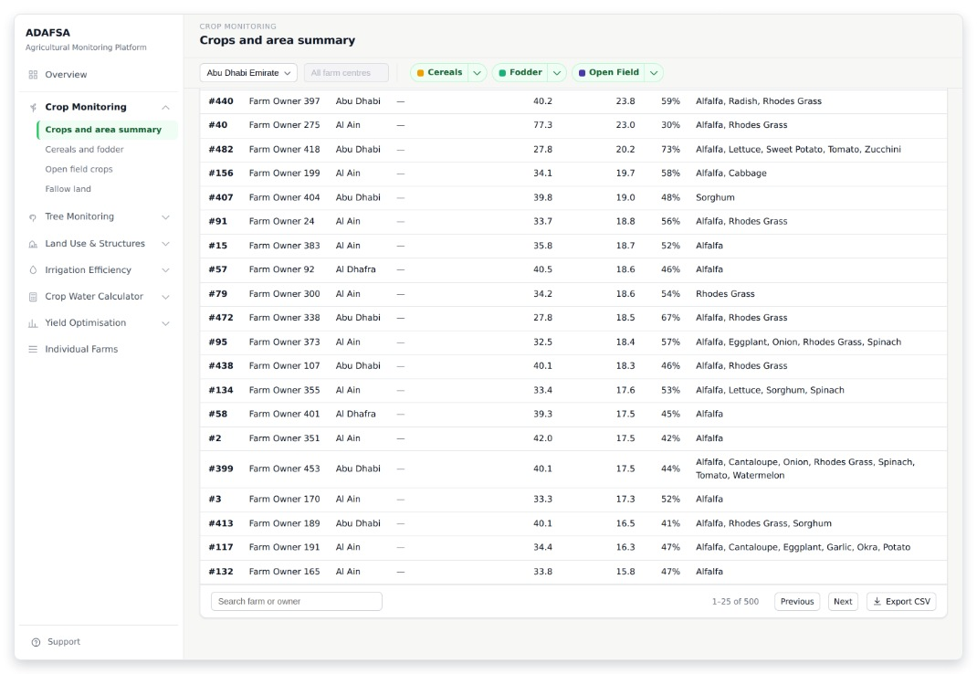
CROP MONITORING
C1 · Crops and area summary
Shows what is planted and where. The numbers: farms with field crops, the area under them, how many different crops, and the average share of a farm. The table of farms has no total, because a farm growing three crops is counted three times. (Module 1: crop location, crop type, cultivated area.)
THE REST OF THIS SCREEN
Scrolls · about 45% of this screen is shown above
ADAFSA Agricultural Monitoring Platform · design mockup
7
Notes:
C1 — Crops and area summary Shows what is planted and where. The numbers: farms with field crops, the area under them, how many different crops, and the average share of a farm. The table of farms has no total, because a farm growing three crops is counted three times. (Module 1: crop location, crop type, cultivated area.) The screenshot shows 47% of this screen; the rest is in the smaller shot beside it.

Slide 8
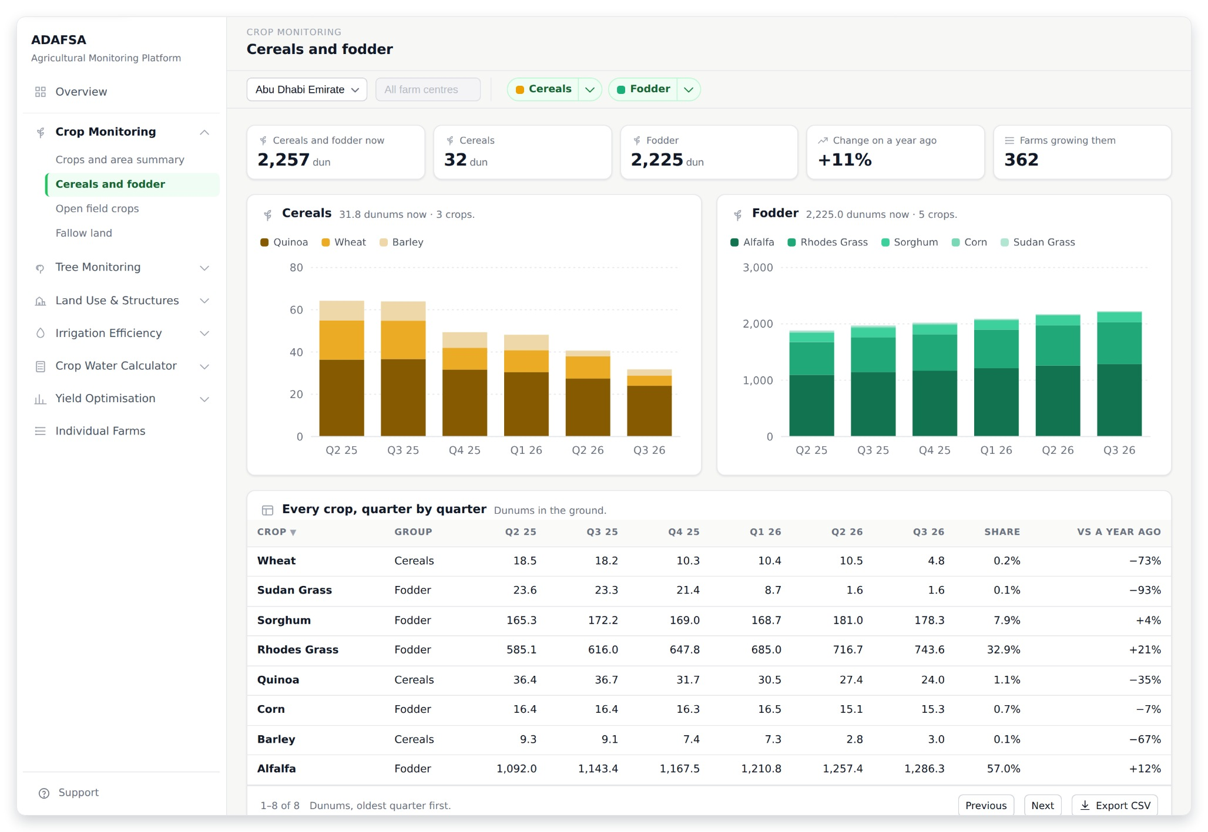
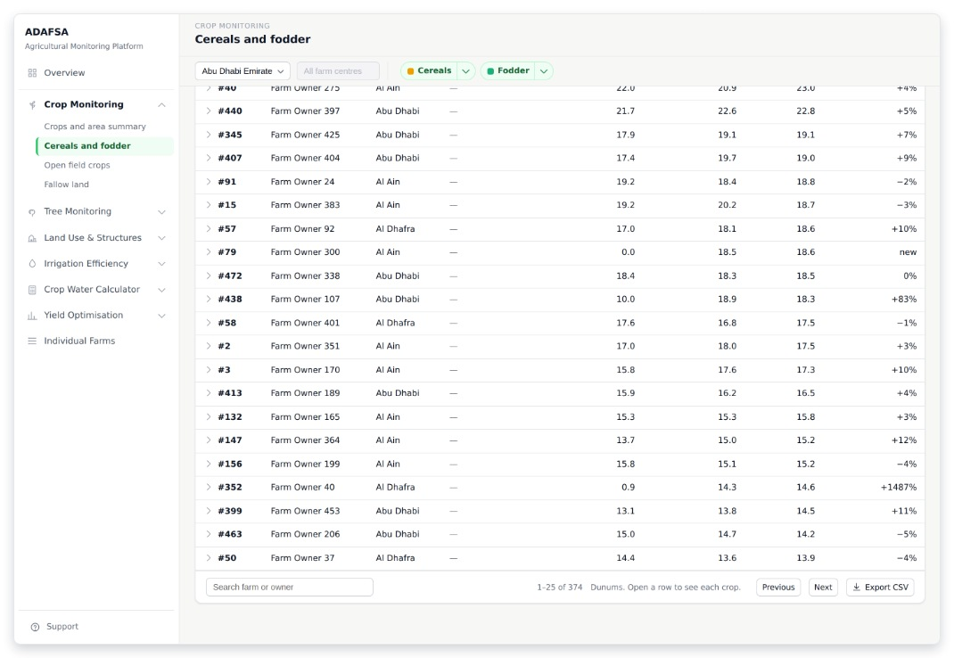
CROP MONITORING
C2 · Cereals and fodder
The crops that grow all year. Two stacked charts — cereals on the left, fodder on the right — over the last six quarters, in dunums. Six quarters shows both the quarter before and the same quarter last year. Below: every crop by quarter, then every farm, oldest figure first. (Module 1: cultivated area and seasonal change report.)
THE REST OF THIS SCREEN
Scrolls · about 45% of this screen is shown above
ADAFSA Agricultural Monitoring Platform · design mockup
8
Notes:
C2 — Cereals and fodder The crops that grow all year. Two stacked charts — cereals on the left, fodder on the right — over the last six quarters, in dunums. Six quarters shows both the quarter before and the same quarter last year. Below: every crop by quarter, then every farm, oldest figure first. (Module 1: cultivated area and seasonal change report.) The screenshot shows 47% of this screen; the rest is in the smaller shot beside it.

Slide 9
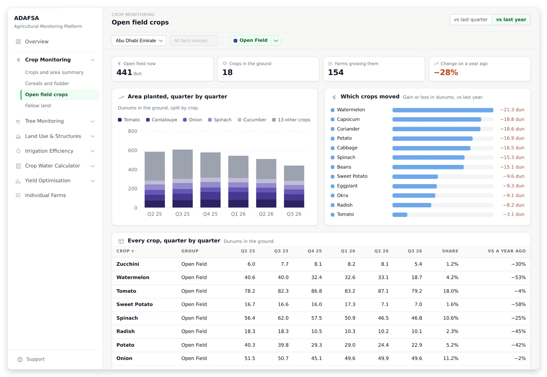
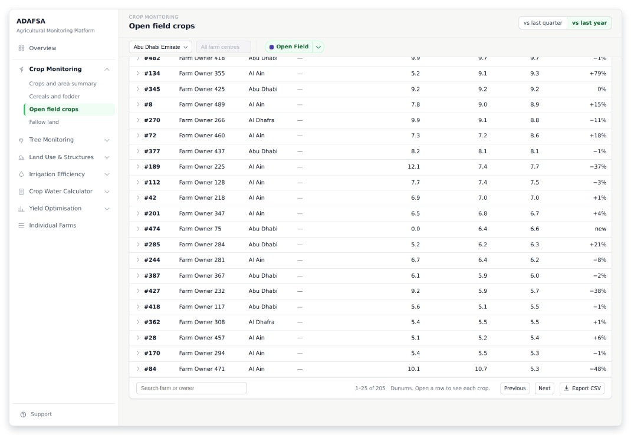
CROP MONITORING
C3 · Open field crops
The vegetables, which are seasonal: planted from September and out of the ground by March. Area planted quarter by quarter on the left. On the right, which crops moved against the same quarter last year — or, when one crop is picked, who its biggest growers are. (Module 1: cultivated area and seasonal change report.)
THE REST OF THIS SCREEN
Scrolls · about 40% of this screen is shown above
ADAFSA Agricultural Monitoring Platform · design mockup
9
Notes:
C3 — Open field crops The vegetables, which are seasonal: planted from September and out of the ground by March. Area planted quarter by quarter on the left. On the right, which crops moved against the same quarter last year — or, when one crop is picked, who its biggest growers are. (Module 1: cultivated area and seasonal change report.) The screenshot shows 39% of this screen; the rest is in the smaller shot beside it.

Slide 10
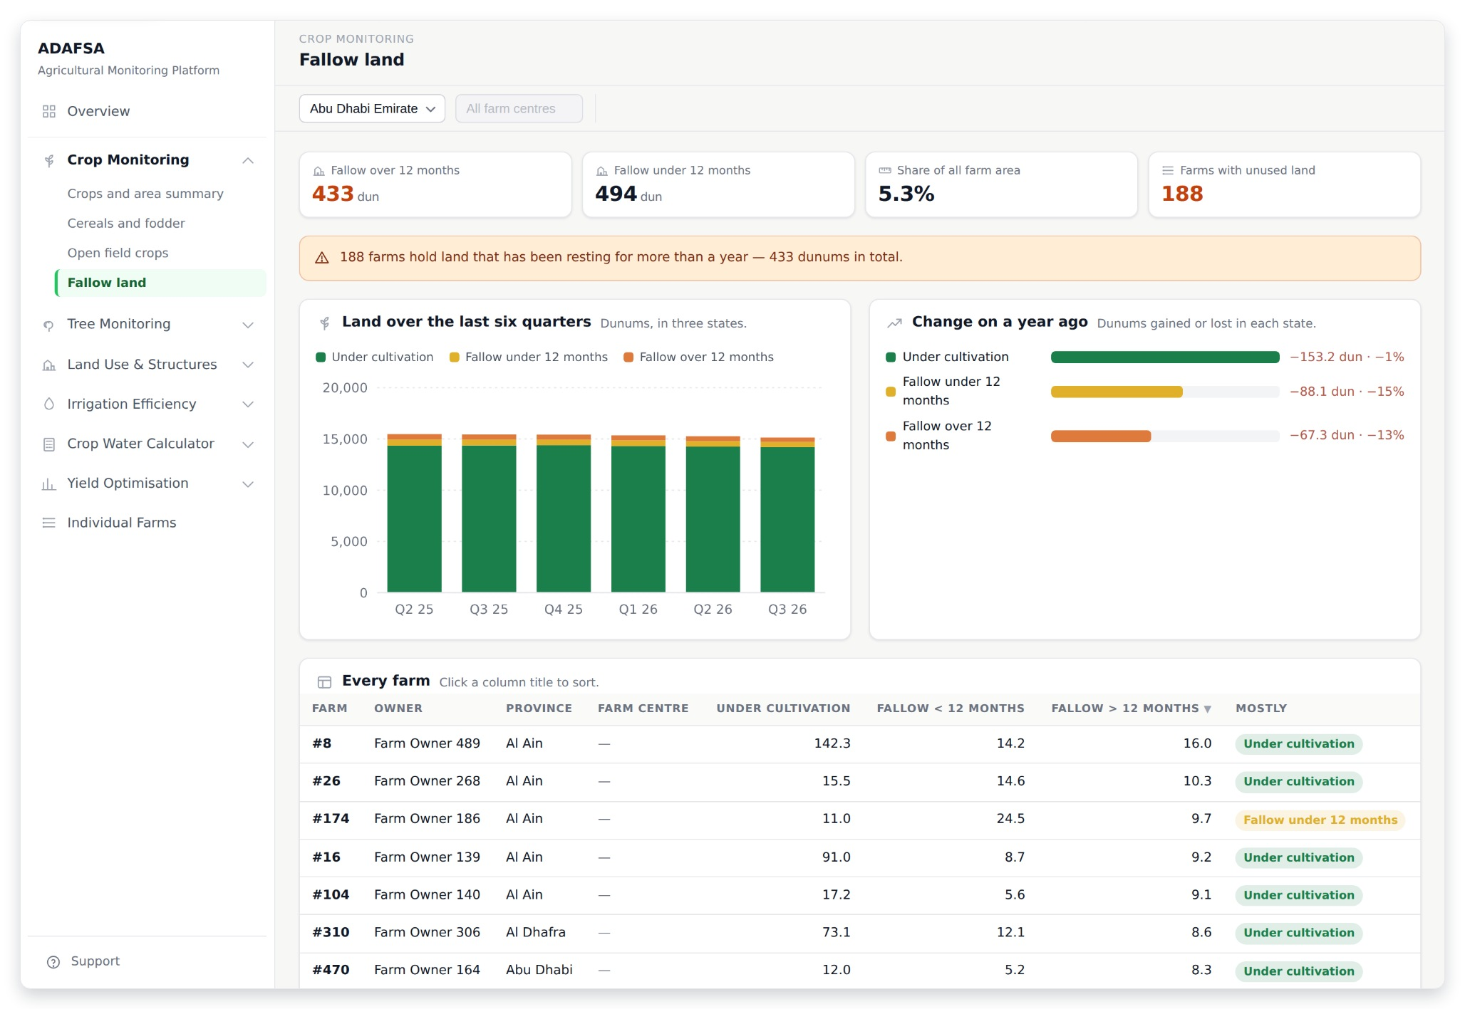
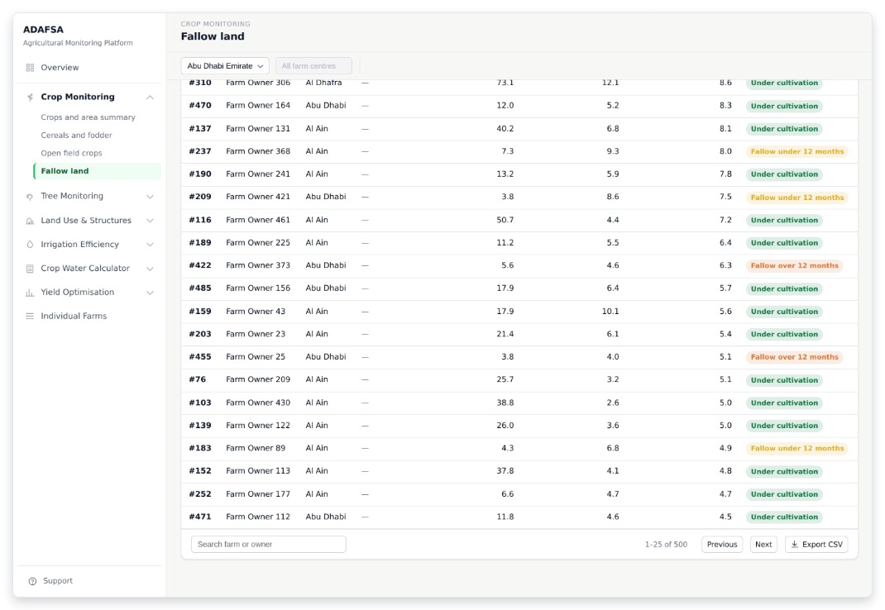
CROP MONITORING
C4 · Fallow land
Land that can be farmed, in three states: under cultivation, resting less than a year and waiting for a crop, and resting more than a year and not being used. Six quarters, stacked, with the year-on-year movement beside it. (Module 1: fallow land detection.)
THE REST OF THIS SCREEN
Scrolls · about 55% of this screen is shown above
ADAFSA Agricultural Monitoring Platform · design mockup
10
Notes:
C4 — Fallow land Land that can be farmed, in three states: under cultivation, resting less than a year and waiting for a crop, and resting more than a year and not being used. Six quarters, stacked, with the year-on-year movement beside it. (Module 1: fallow land detection.) The screenshot shows 55% of this screen; the rest is in the smaller shot beside it.

Slide 11
SECTION 3 OF 9
Tree Monitoring
3 screens · T1 · T2 · T3
ADAFSA Agricultural Monitoring Platform · design mockup
11

Slide 12
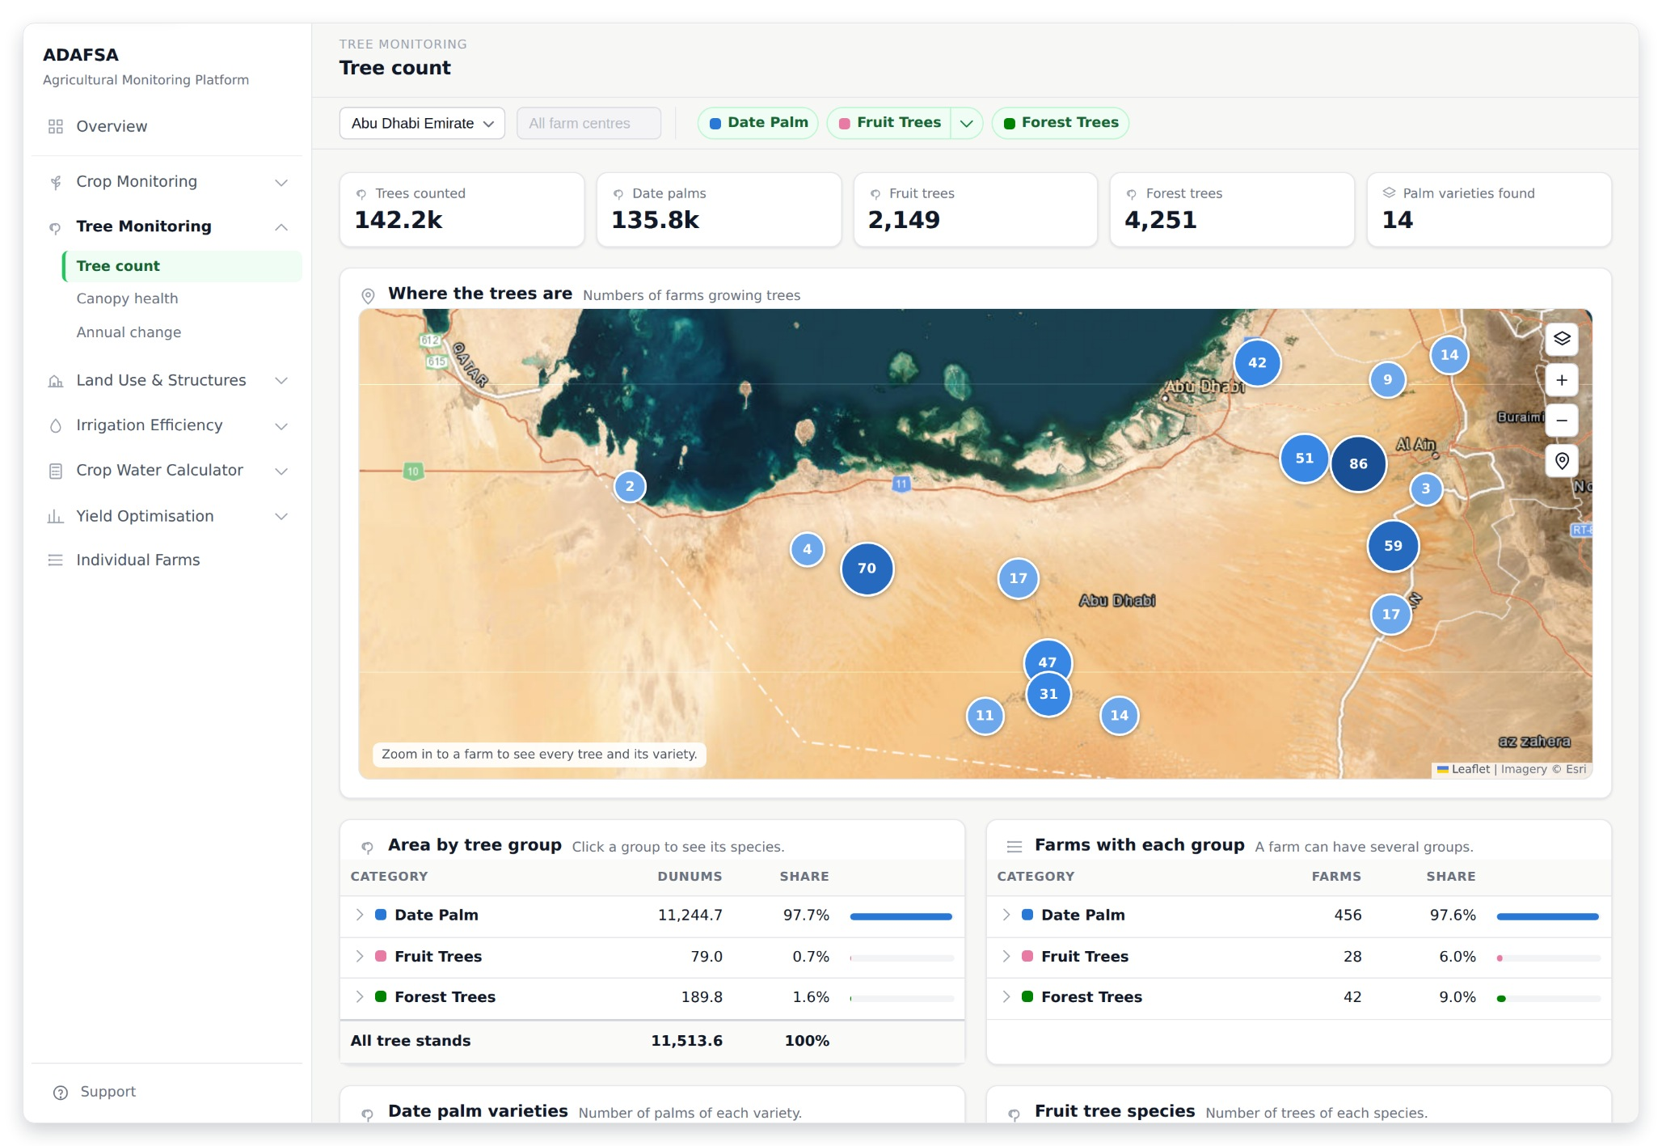
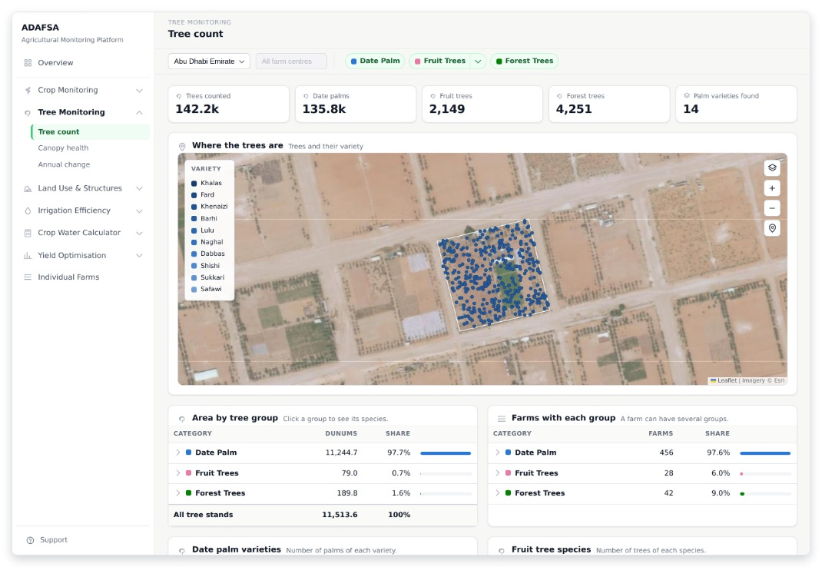
TREE MONITORING
T1 · Tree count
Counts the trees: the total, date palms, fruit trees, forest trees, and how many palm varieties were found. The map counts farms until you zoom into one, and then draws every tree in the colour of its variety. (Module 2: tree location, count, species and variety.)
ZOOMED IN
ADAFSA Agricultural Monitoring Platform · design mockup
12
Notes:
T1 — Tree count Counts the trees: the total, date palms, fruit trees, forest trees, and how many palm varieties were found. The map counts farms until you zoom into one, and then draws every tree in the colour of its variety. (Module 2: tree location, count, species and variety.) The smaller shot beside it is the same screen zoomed in.

Slide 13
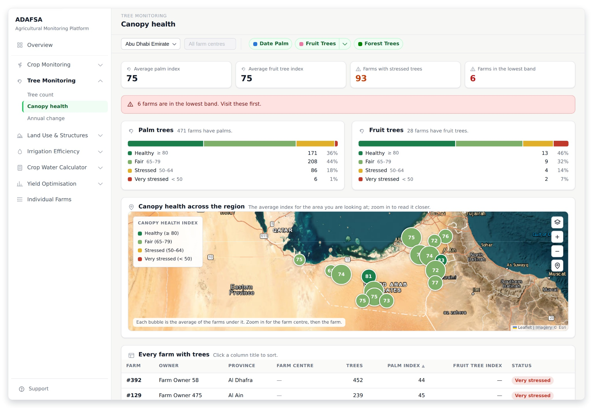
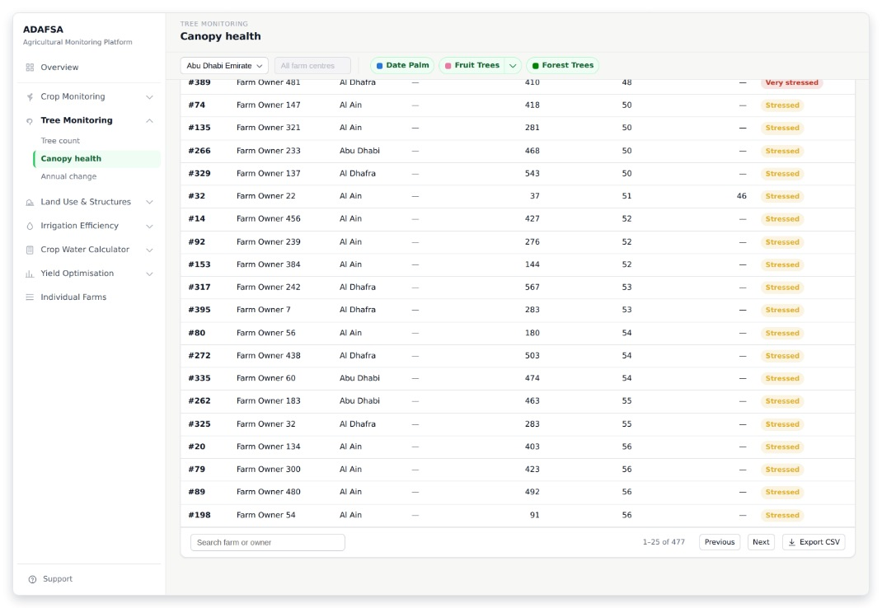
TREE MONITORING
T2 · Canopy health
The canopy health index, read from the satellite and scored for each farm: the average for palms, the average for fruit trees, farms with stressed trees, and farms in the lowest band. Zoom in and the map reads the index closer in. (Module 2: canopy health index.)
THE REST OF THIS SCREEN
Scrolls · about 50% of this screen is shown above
ADAFSA Agricultural Monitoring Platform · design mockup
13
Notes:
T2 — Canopy health The canopy health index, read from the satellite and scored for each farm: the average for palms, the average for fruit trees, farms with stressed trees, and farms in the lowest band. Zoom in and the map reads the index closer in. (Module 2: canopy health index.) The screenshot shows 49% of this screen; the rest is in the smaller shot beside it.

Slide 14
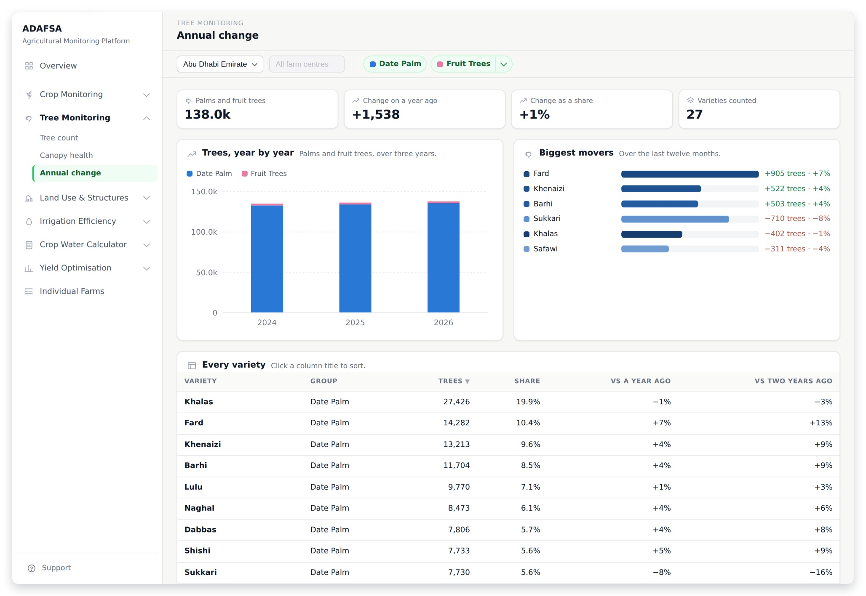
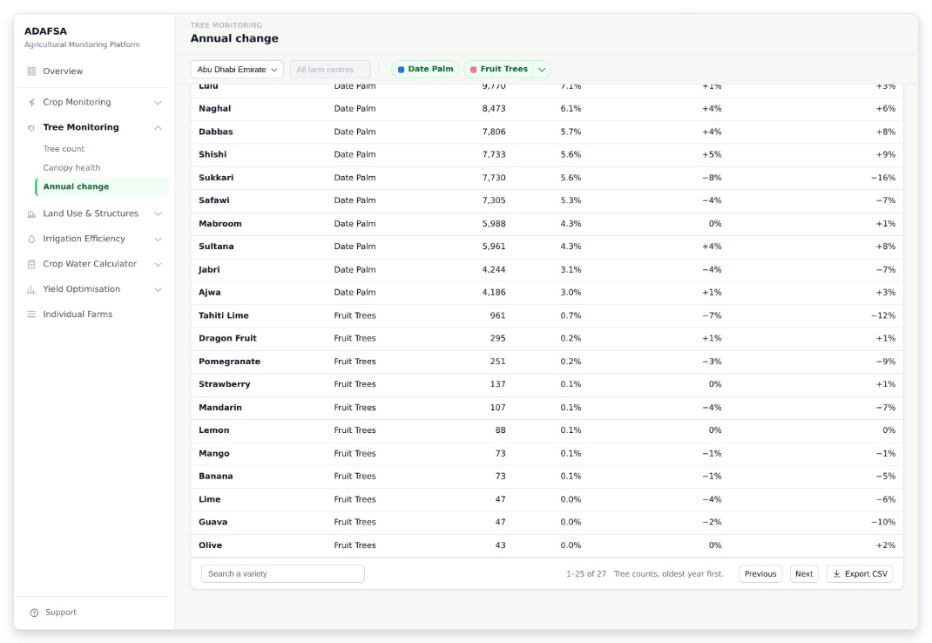
TREE MONITORING
T3 · Annual change
Trees year by year over three years, following whichever group is selected. Beside it, the three varieties that grew most and the three that shrank most in the last twelve months. The table lists varieties, not farms. (Module 2: annual change detection.)
THE REST OF THIS SCREEN
Scrolls · about 60% of this screen is shown above
ADAFSA Agricultural Monitoring Platform · design mockup
14
Notes:
T3 — Annual change Trees year by year over three years, following whichever group is selected. Beside it, the three varieties that grew most and the three that shrank most in the last twelve months. The table lists varieties, not farms. (Module 2: annual change detection.) The screenshot shows 58% of this screen; the rest is in the smaller shot beside it.

Slide 15
SECTION 4 OF 9
Land Use & Structures
3 screens · L1 · L2 · L3
ADAFSA Agricultural Monitoring Platform · design mockup
15

Slide 16
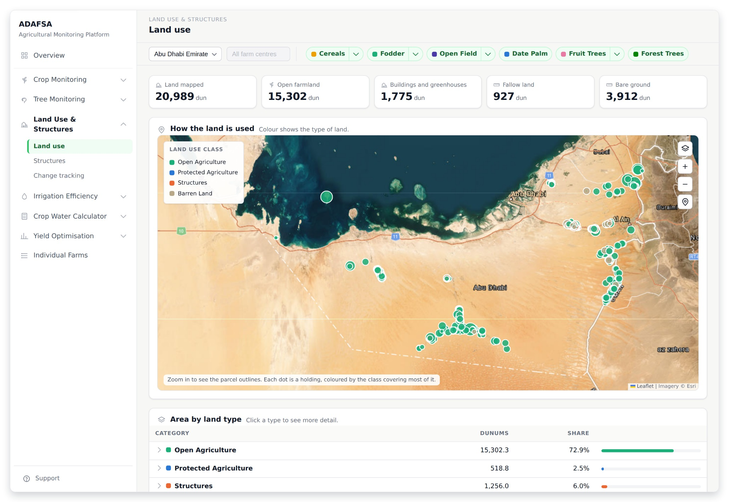
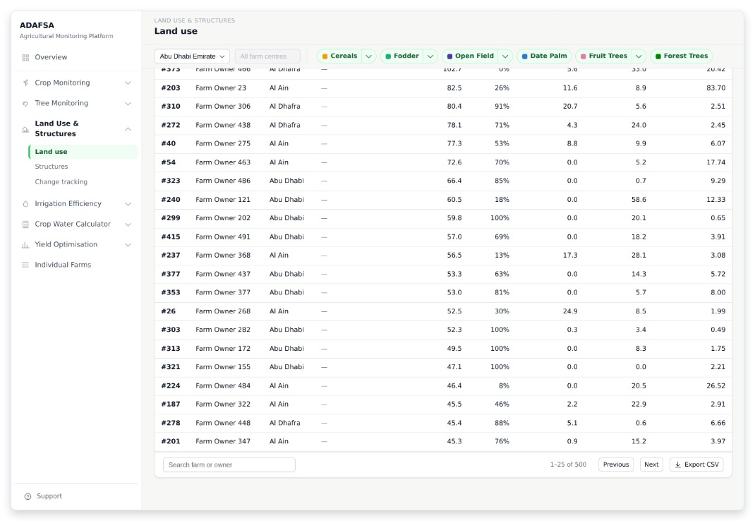
LAND USE & STRUCTURES
L1 · Land use
How the land is used: land mapped, open farmland, buildings and greenhouses, fallow land and bare ground. Zoom in and the map draws the real shape of each piece of land.
THE REST OF THIS SCREEN
Scrolls · about 45% of this screen is shown above
ADAFSA Agricultural Monitoring Platform · design mockup
16
Notes:
L1 — Land use How the land is used: land mapped, open farmland, buildings and greenhouses, fallow land and bare ground. Zoom in and the map draws the real shape of each piece of land. The screenshot shows 45% of this screen; the rest is in the smaller shot beside it.

Slide 17
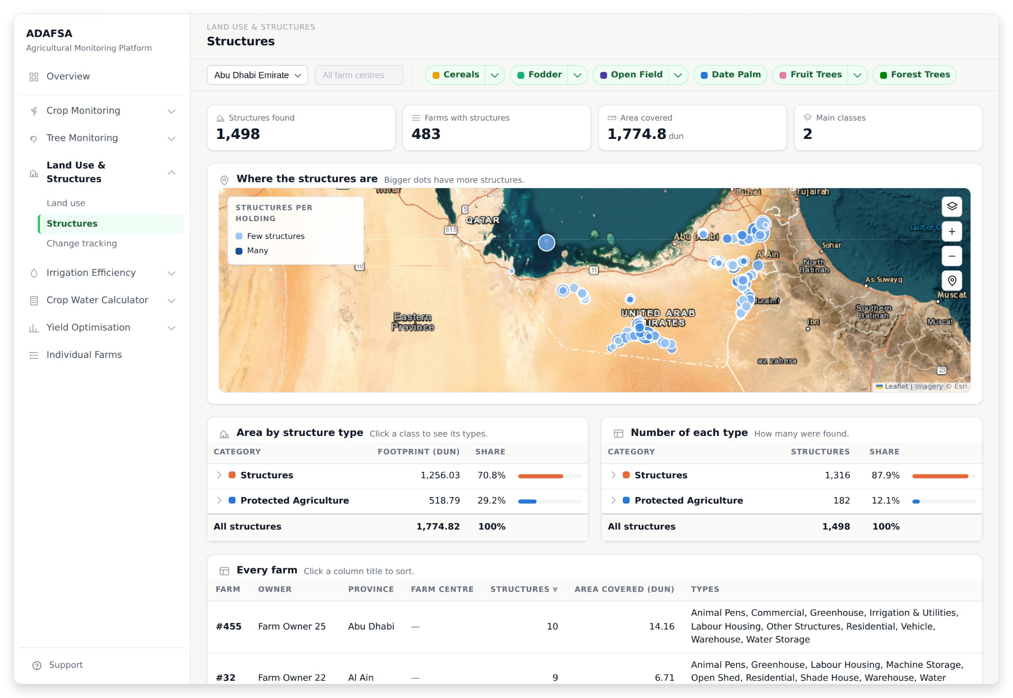
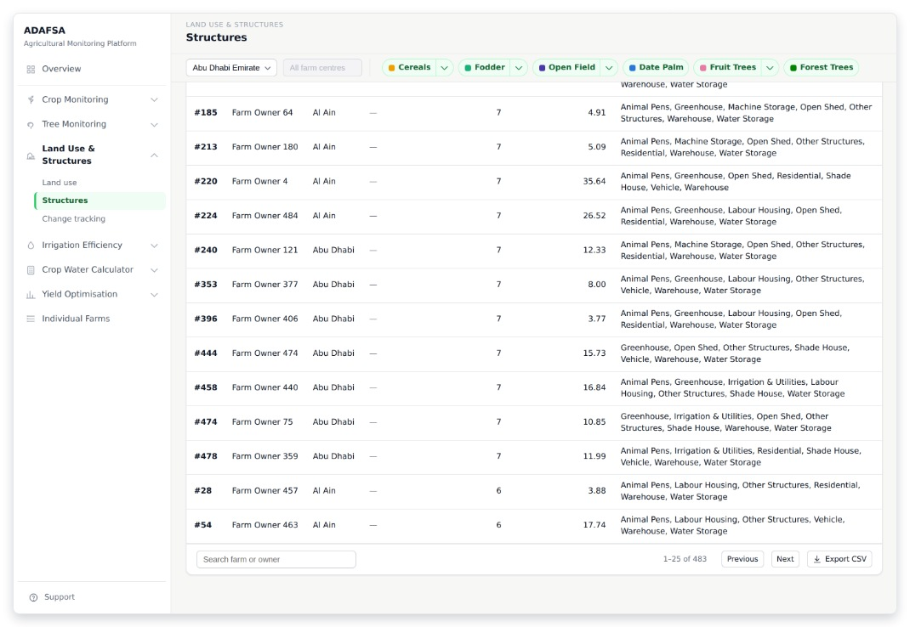
LAND USE & STRUCTURES
L2 · Structures
What is built on the farms: structures found, farms with structures, area covered, and the main classes. Houses, sheds, water tanks, pens, roads, pump rooms. (Module 3: structure detection.)
THE REST OF THIS SCREEN
Scrolls · about 40% of this screen is shown above
ADAFSA Agricultural Monitoring Platform · design mockup
17
Notes:
L2 — Structures What is built on the farms: structures found, farms with structures, area covered, and the main classes. Houses, sheds, water tanks, pens, roads, pump rooms. (Module 3: structure detection.) The screenshot shows 40% of this screen; the rest is in the smaller shot beside it.

Slide 18
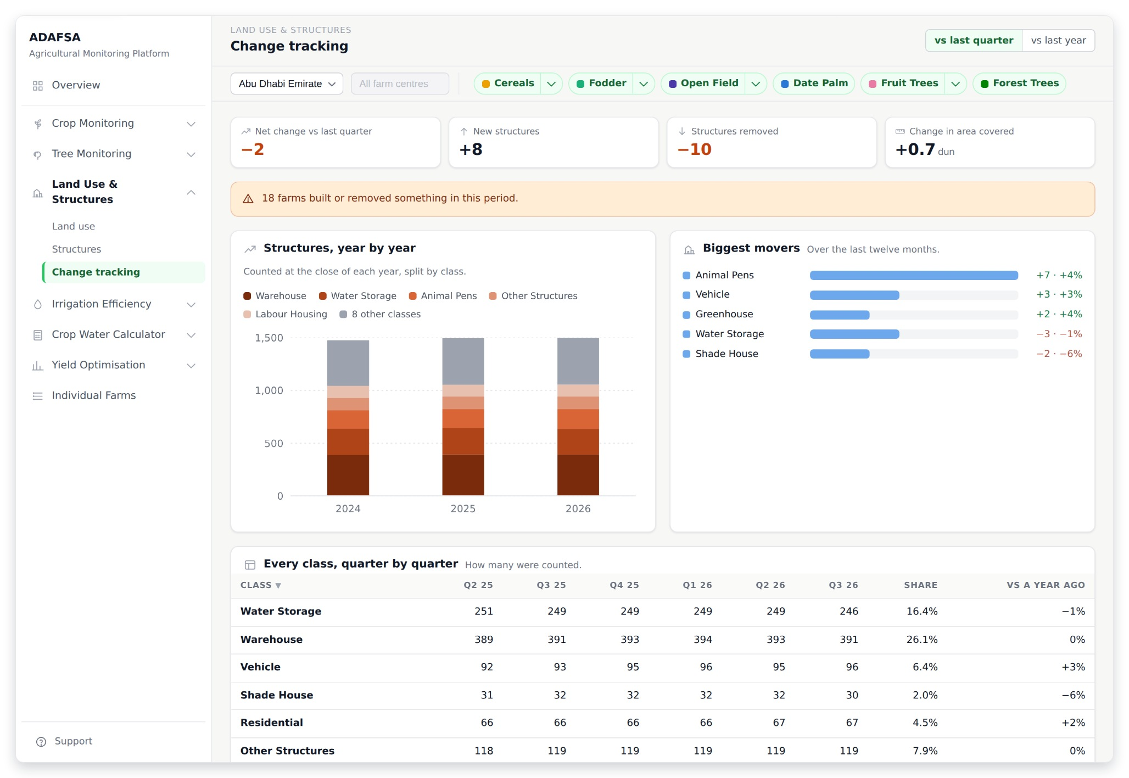
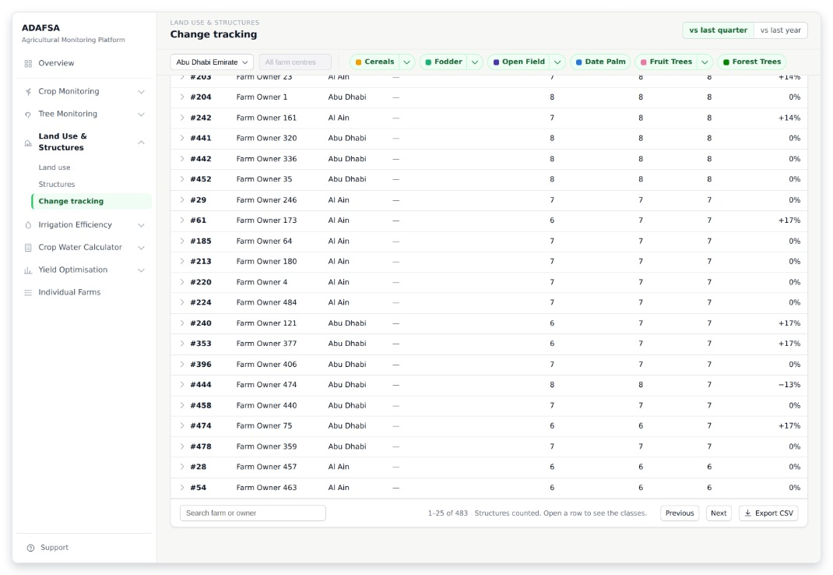
LAND USE & STRUCTURES
L3 · Change tracking
Buildings that are new and buildings that are gone: net change, new structures, structures removed, and the change in area covered. The chart runs year by year, because a building stands until somebody takes it down. (Module 3: change tracking.)
THE REST OF THIS SCREEN
Scrolls · about 40% of this screen is shown above
ADAFSA Agricultural Monitoring Platform · design mockup
18
Notes:
L3 — Change tracking Buildings that are new and buildings that are gone: net change, new structures, structures removed, and the change in area covered. The chart runs year by year, because a building stands until somebody takes it down. (Module 3: change tracking.) The screenshot shows 41% of this screen; the rest is in the smaller shot beside it.

Slide 19
SECTION 5 OF 9
Irrigation Efficiency
2 screens · I1 · I2
ADAFSA Agricultural Monitoring Platform · design mockup
19

Slide 20
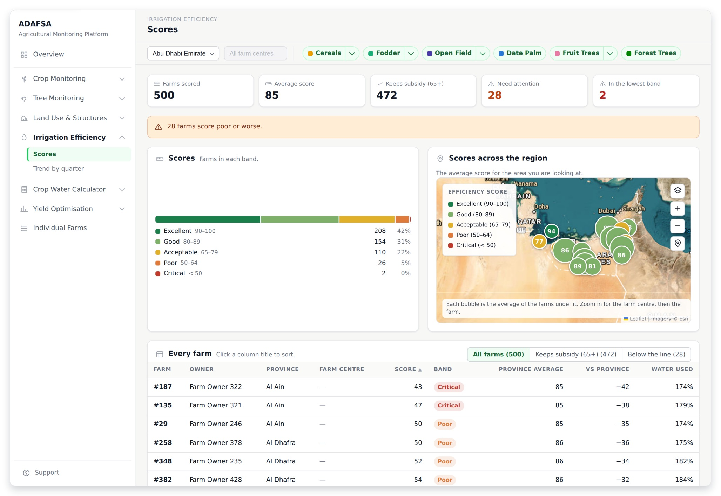
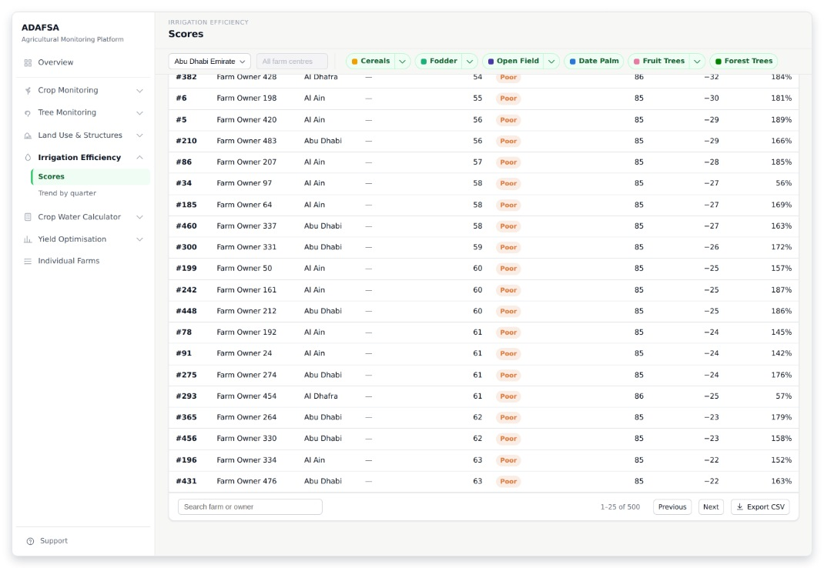
IRRIGATION EFFICIENCY
I1 · Scores
A water score from 0 to 100 for every farm: farms scored, the average, how many keep their subsidy at 65 or more, how many need attention, and how many are in the lowest band. (Module 4: IER score, band and subsidy list.)
THE REST OF THIS SCREEN
Scrolls · about 55% of this screen is shown above
ADAFSA Agricultural Monitoring Platform · design mockup
20
Notes:
I1 — Scores A water score from 0 to 100 for every farm: farms scored, the average, how many keep their subsidy at 65 or more, how many need attention, and how many are in the lowest band. (Module 4: IER score, band and subsidy list.) The screenshot shows 54% of this screen; the rest is in the smaller shot beside it.

Slide 21
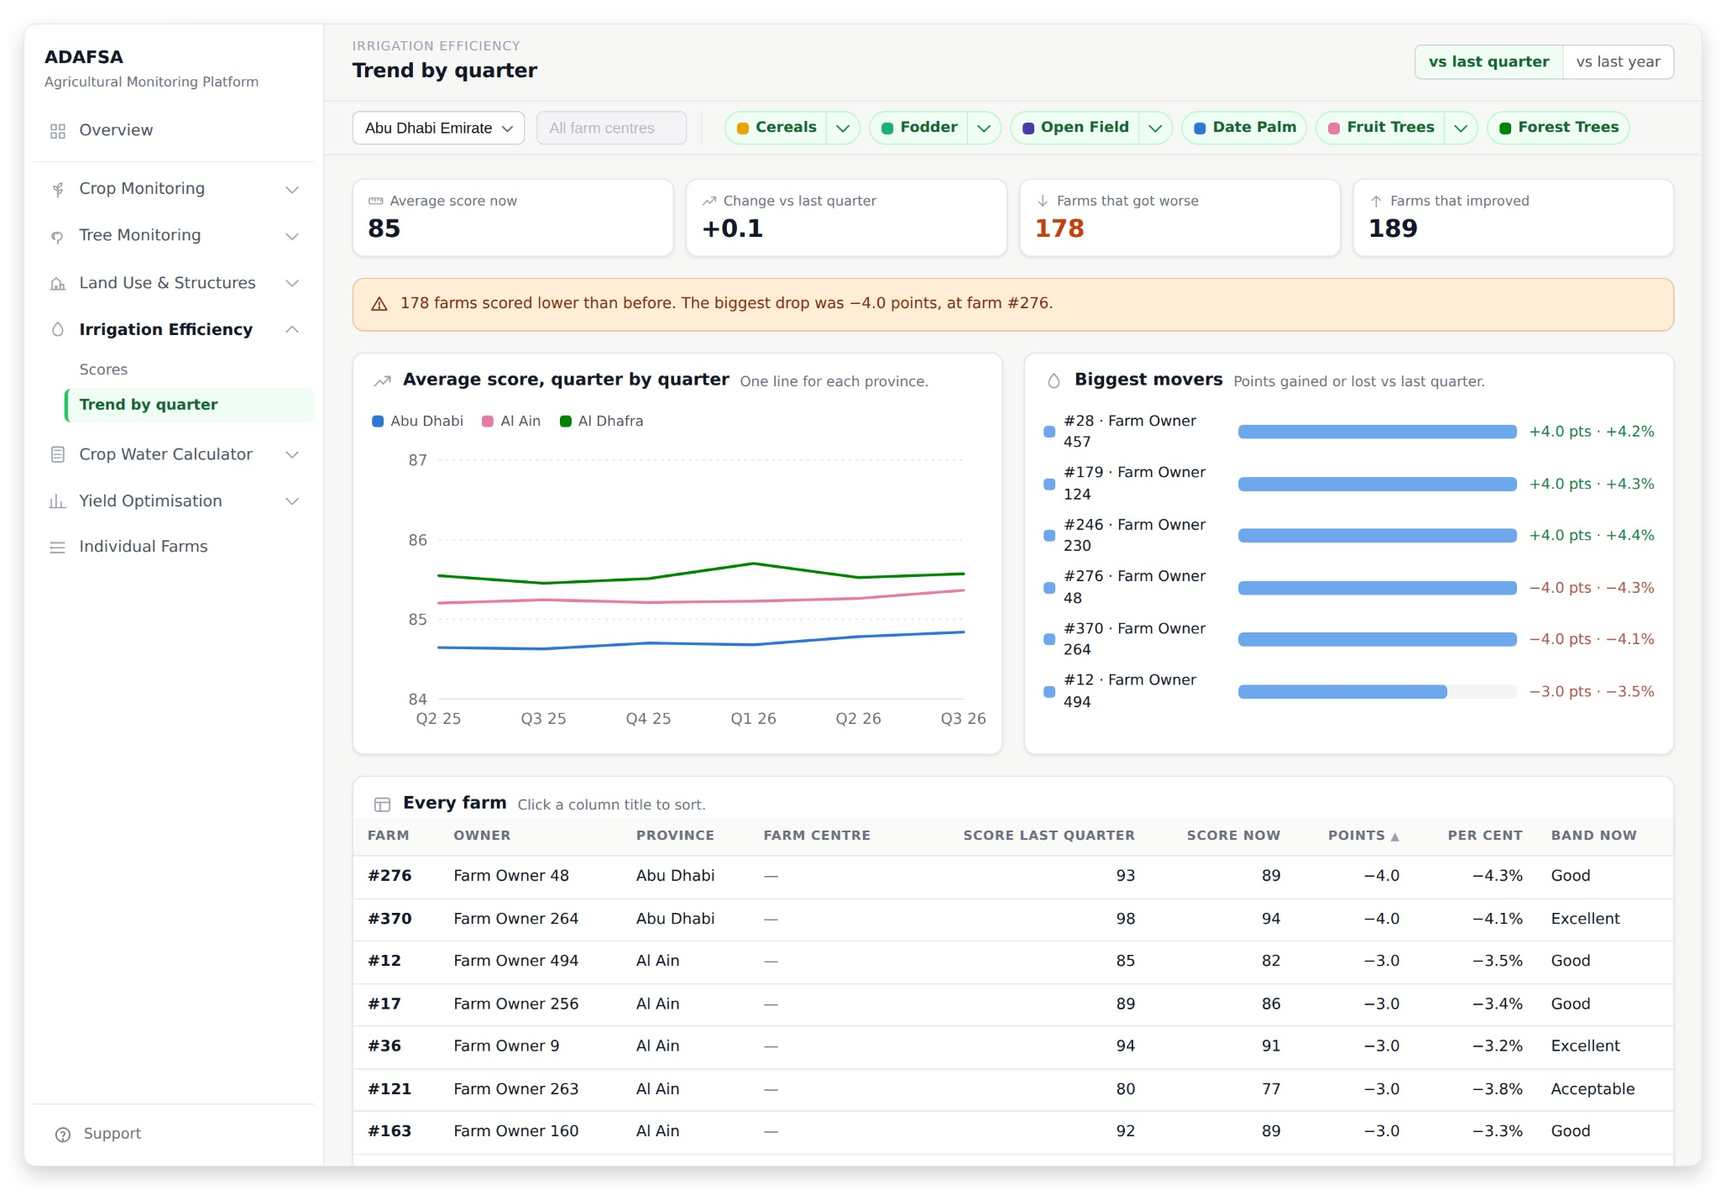
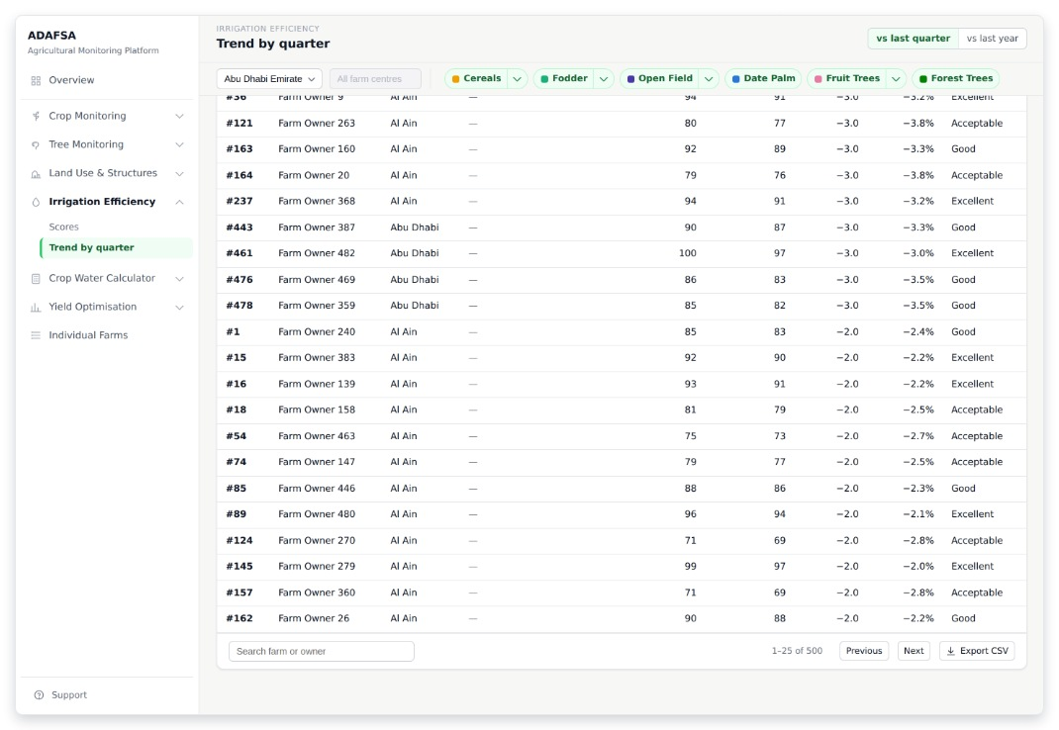
IRRIGATION EFFICIENCY
I2 · Trend by quarter
Are the scores moving? The average score now, the change since last quarter or last year, how many farms got worse and how many improved. A line, and no map. (Module 4: quarter-on-quarter trend.)
THE REST OF THIS SCREEN
Scrolls · about 55% of this screen is shown above
ADAFSA Agricultural Monitoring Platform · design mockup
21
Notes:
I2 — Trend by quarter Are the scores moving? The average score now, the change since last quarter or last year, how many farms got worse and how many improved. A line, and no map. (Module 4: quarter-on-quarter trend.) The screenshot shows 56% of this screen; the rest is in the smaller shot beside it.

Slide 22
SECTION 6 OF 9
Crop Water Calculator
2 screens · W1 · W2
ADAFSA Agricultural Monitoring Platform · design mockup
22

Slide 23
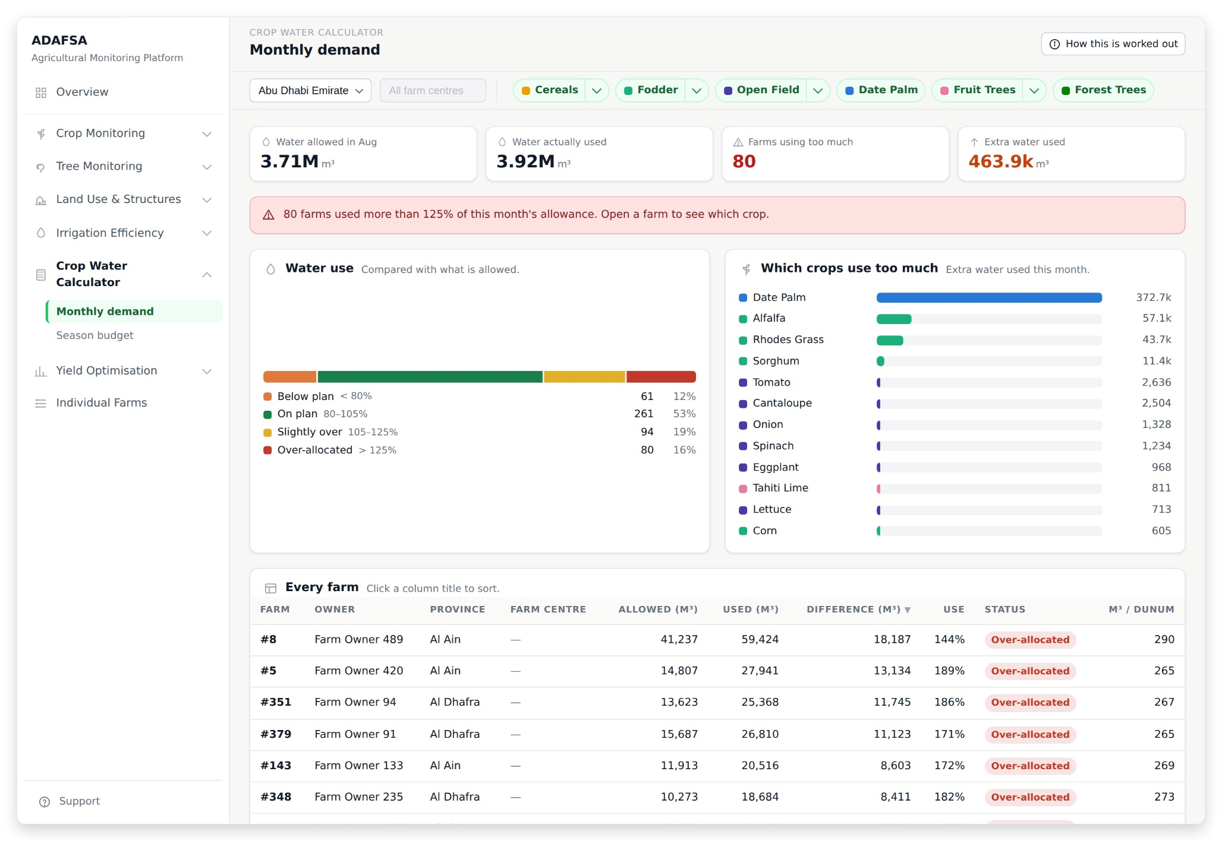
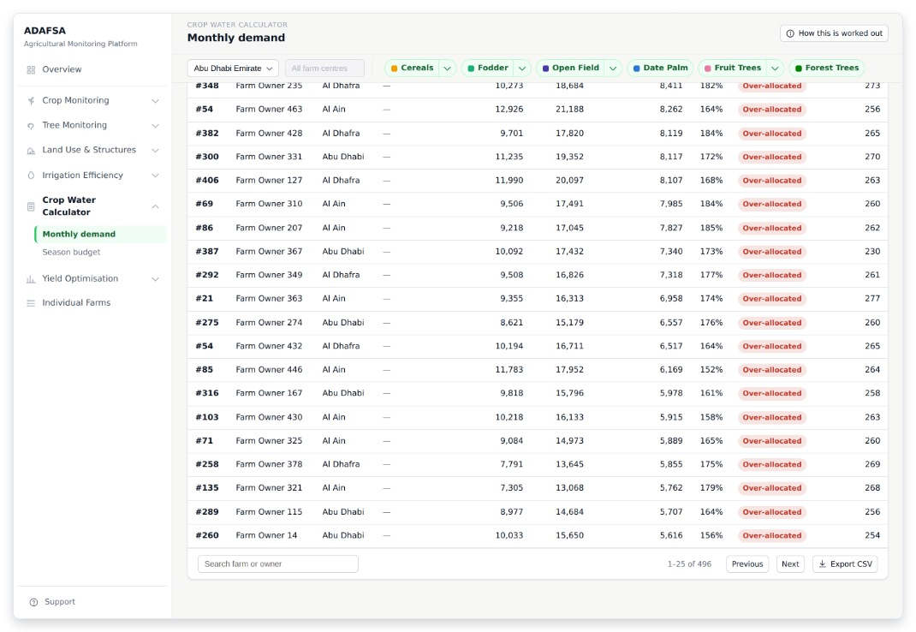
CROP WATER CALCULATOR
W1 · Monthly demand
Water this month: how much each farm is allowed, how much it used, how many farms use too much, and how much extra they used. (Module 6: monthly water demand and over-allocation flag.)
THE REST OF THIS SCREEN
Scrolls · about 55% of this screen is shown above
ADAFSA Agricultural Monitoring Platform · design mockup
23
Notes:
W1 — Monthly demand Water this month: how much each farm is allowed, how much it used, how many farms use too much, and how much extra they used. (Module 6: monthly water demand and over-allocation flag.) The screenshot shows 54% of this screen; the rest is in the smaller shot beside it.

Slide 24
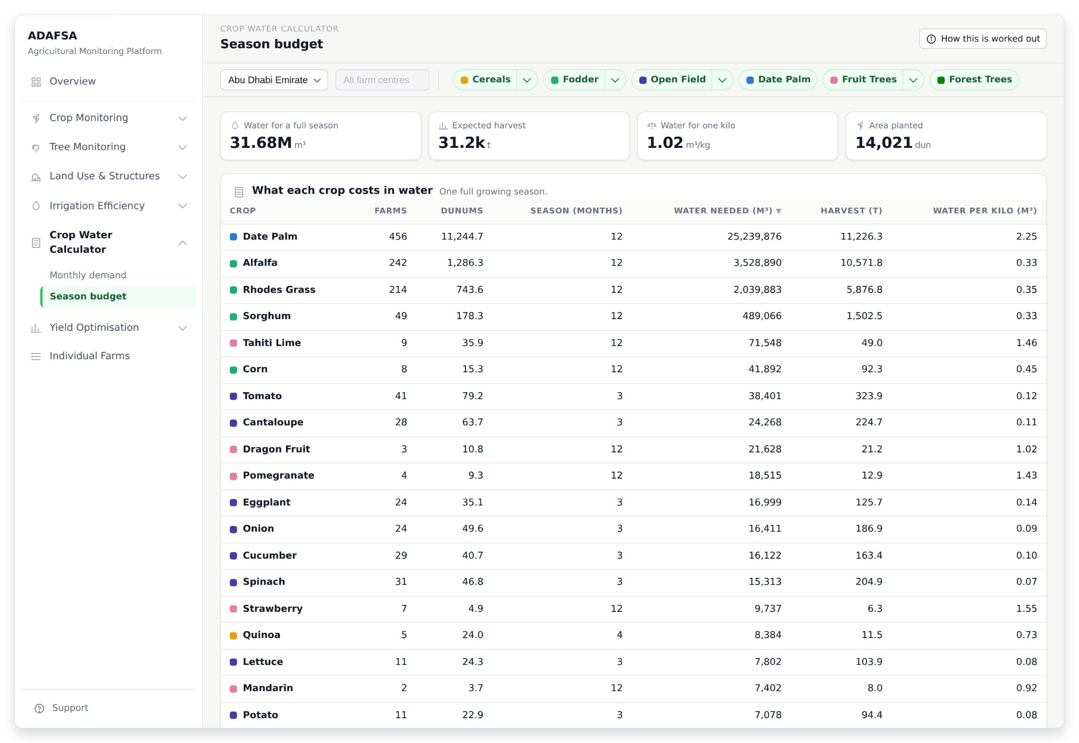
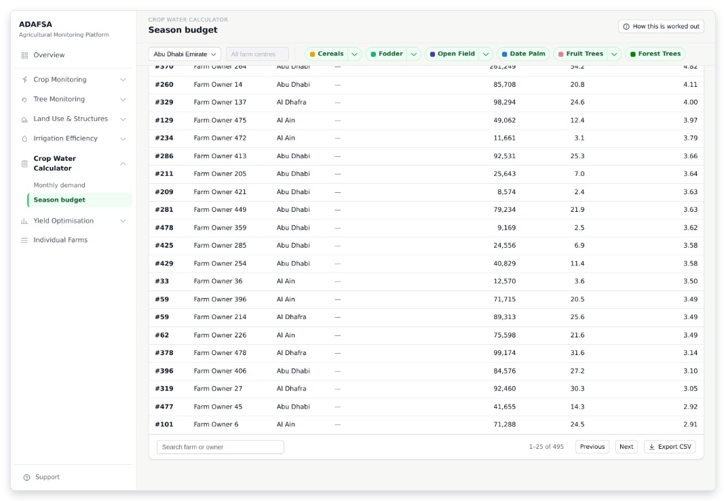
CROP WATER CALCULATOR
W2 · Season budget
Water over a whole season: the total water needed, the harvest expected from it, the water for one kilo of food, and the area planted. (Module 6: seasonal water budget.)
THE REST OF THIS SCREEN
Scrolls · about 35% of this screen is shown above
ADAFSA Agricultural Monitoring Platform · design mockup
24
Notes:
W2 — Season budget Water over a whole season: the total water needed, the harvest expected from it, the water for one kilo of food, and the area planted. (Module 6: seasonal water budget.) The screenshot shows 36% of this screen; the rest is in the smaller shot beside it.

Slide 25
SECTION 7 OF 9
Yield Optimisation
2 screens · Y1 · Y2
ADAFSA Agricultural Monitoring Platform · design mockup
25

Slide 26
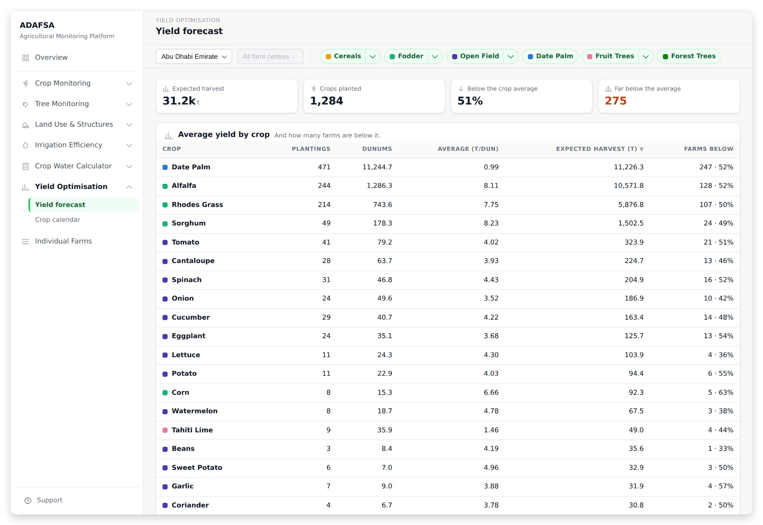
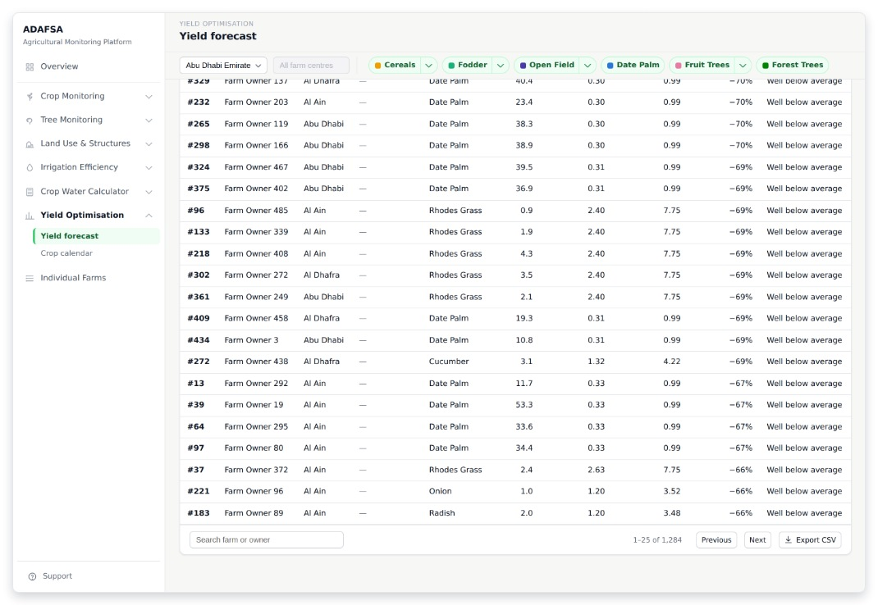
YIELD OPTIMISATION
Y1 · Yield forecast
What the harvest should be: expected tonnes, crops planted, how many farms are below the average for their crop, and how many are far below it. (Module 5: seasonal yield estimate.)
THE REST OF THIS SCREEN
Scrolls · about 25% of this screen is shown above
ADAFSA Agricultural Monitoring Platform · design mockup
26
Notes:
Y1 — Yield forecast What the harvest should be: expected tonnes, crops planted, how many farms are below the average for their crop, and how many are far below it. (Module 5: seasonal yield estimate.) The screenshot shows 27% of this screen; the rest is in the smaller shot beside it.

Slide 27
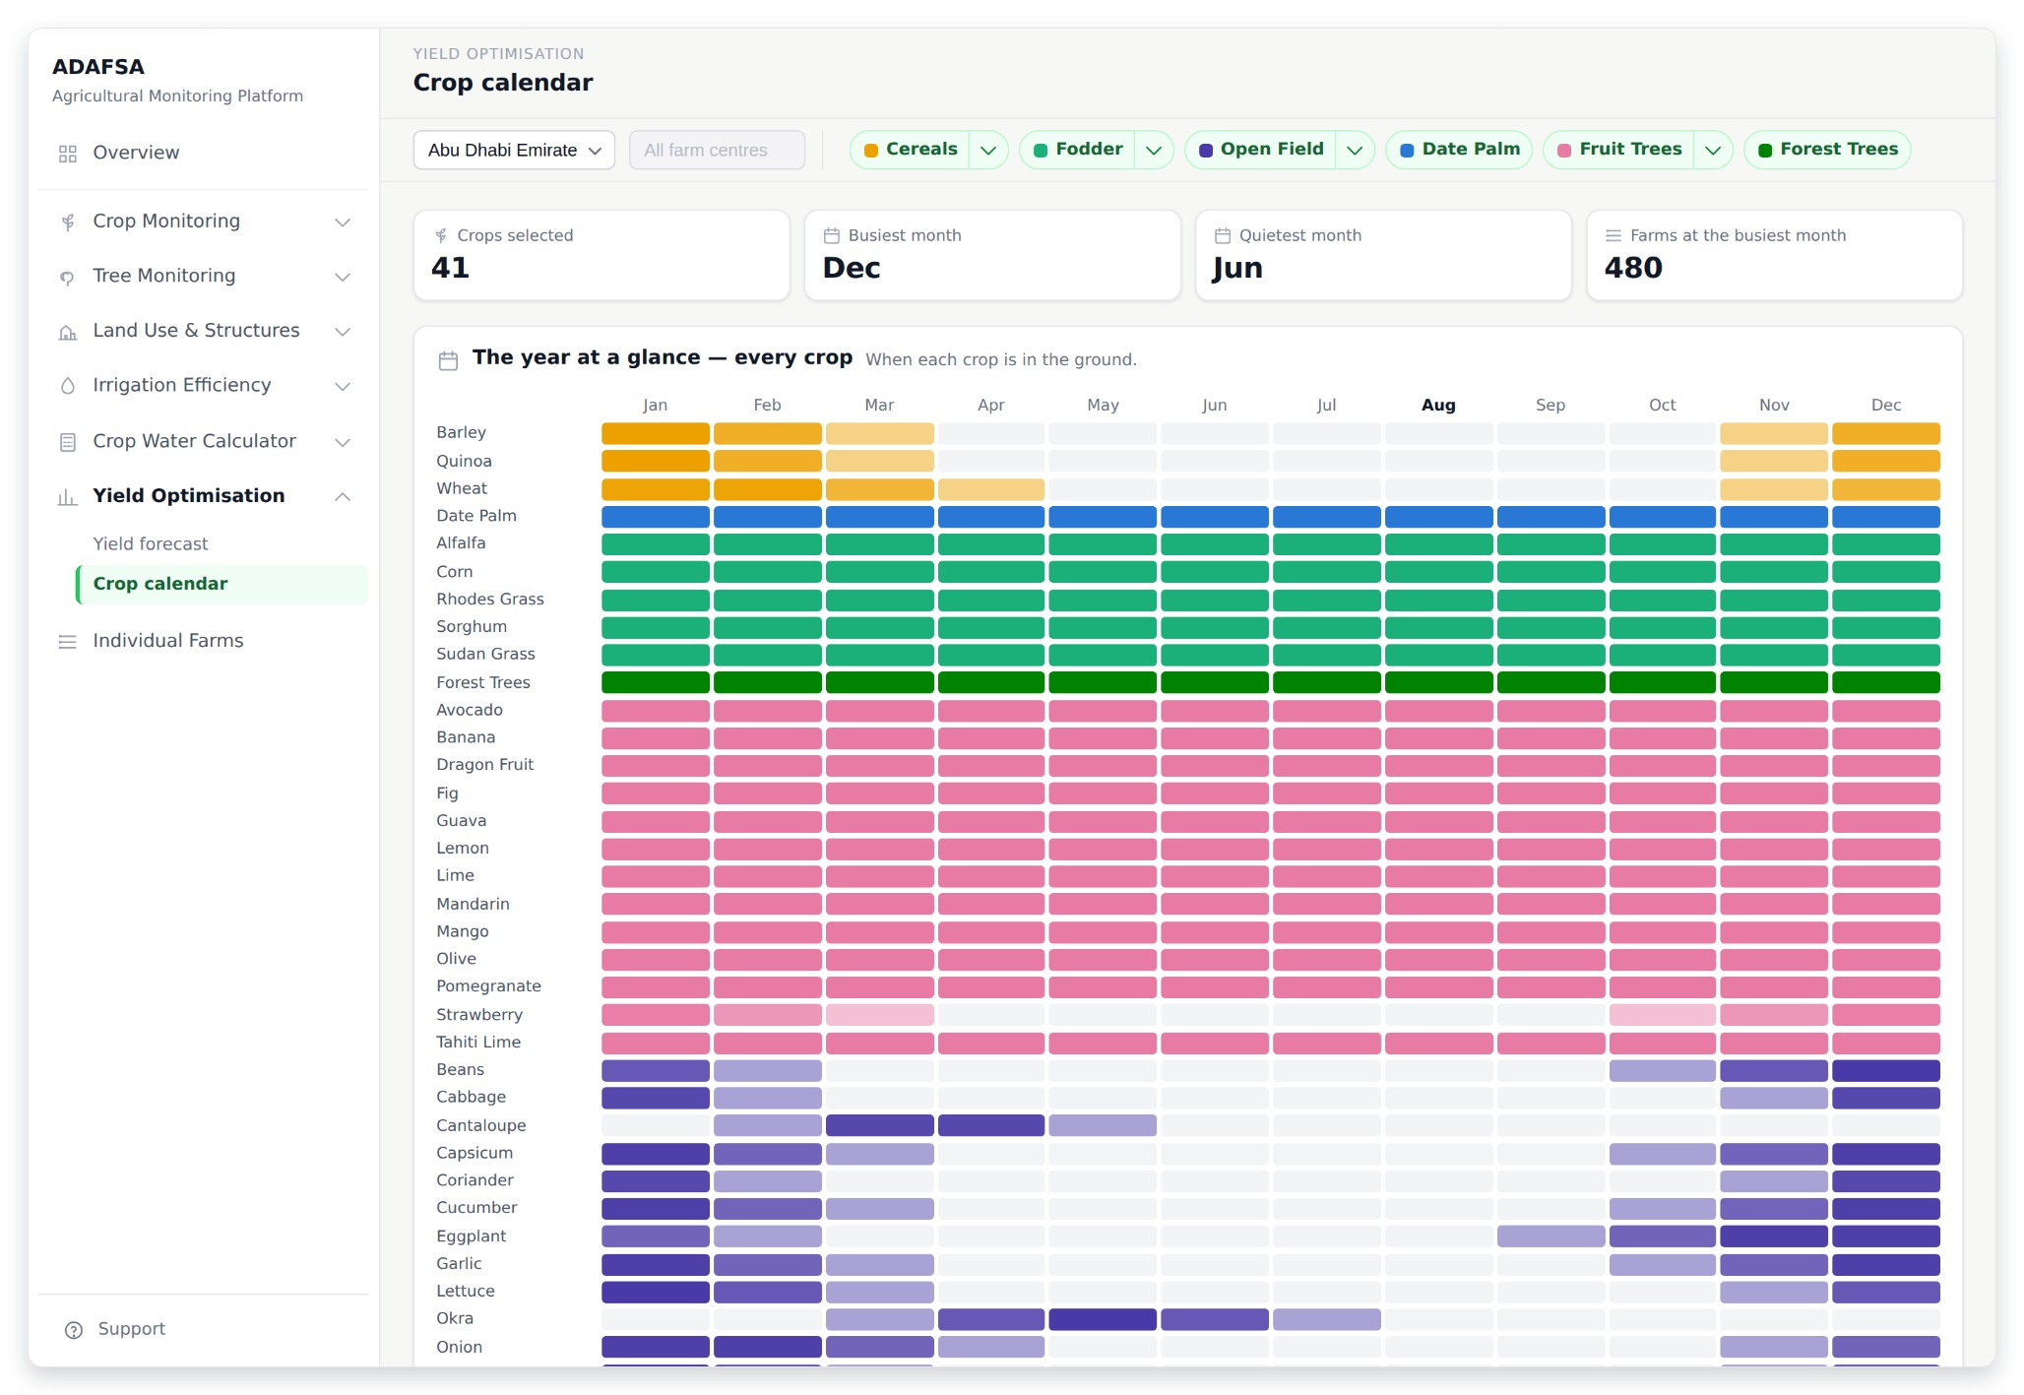
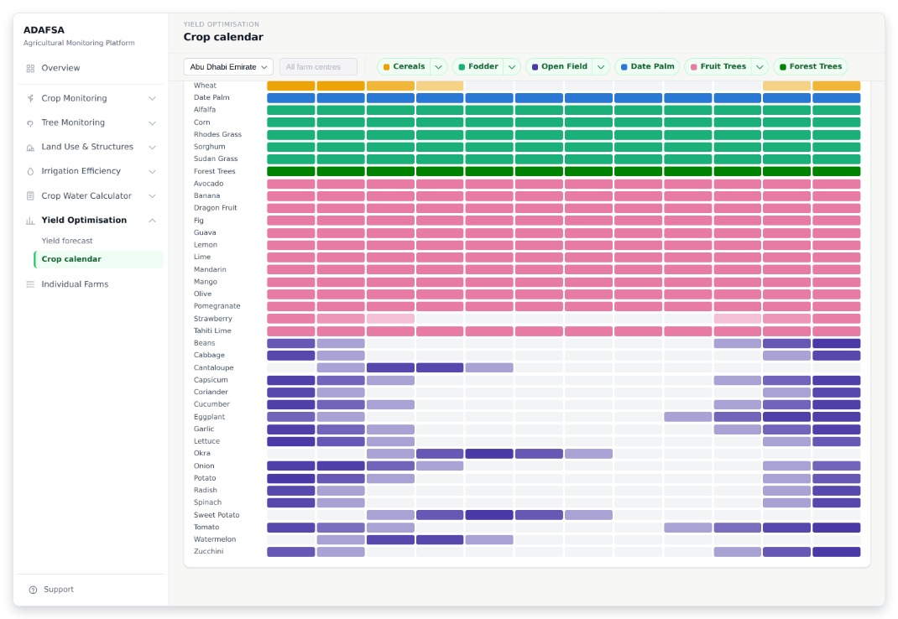
YIELD OPTIMISATION
Y2 · Crop calendar
When each crop is in the ground: crops selected, the busiest month, the quietest month, and how many farms are planting at the busiest time.
THE REST OF THIS SCREEN
Scrolls · about 80% of this screen is shown above
ADAFSA Agricultural Monitoring Platform · design mockup
27
Notes:
Y2 — Crop calendar When each crop is in the ground: crops selected, the busiest month, the quietest month, and how many farms are planting at the busiest time. The screenshot shows 82% of this screen; the rest is in the smaller shot beside it.

Slide 28
SECTION 8 OF 9
Individual Farms
3 screens · F1 · F2 · F3
ADAFSA Agricultural Monitoring Platform · design mockup
28

Slide 29
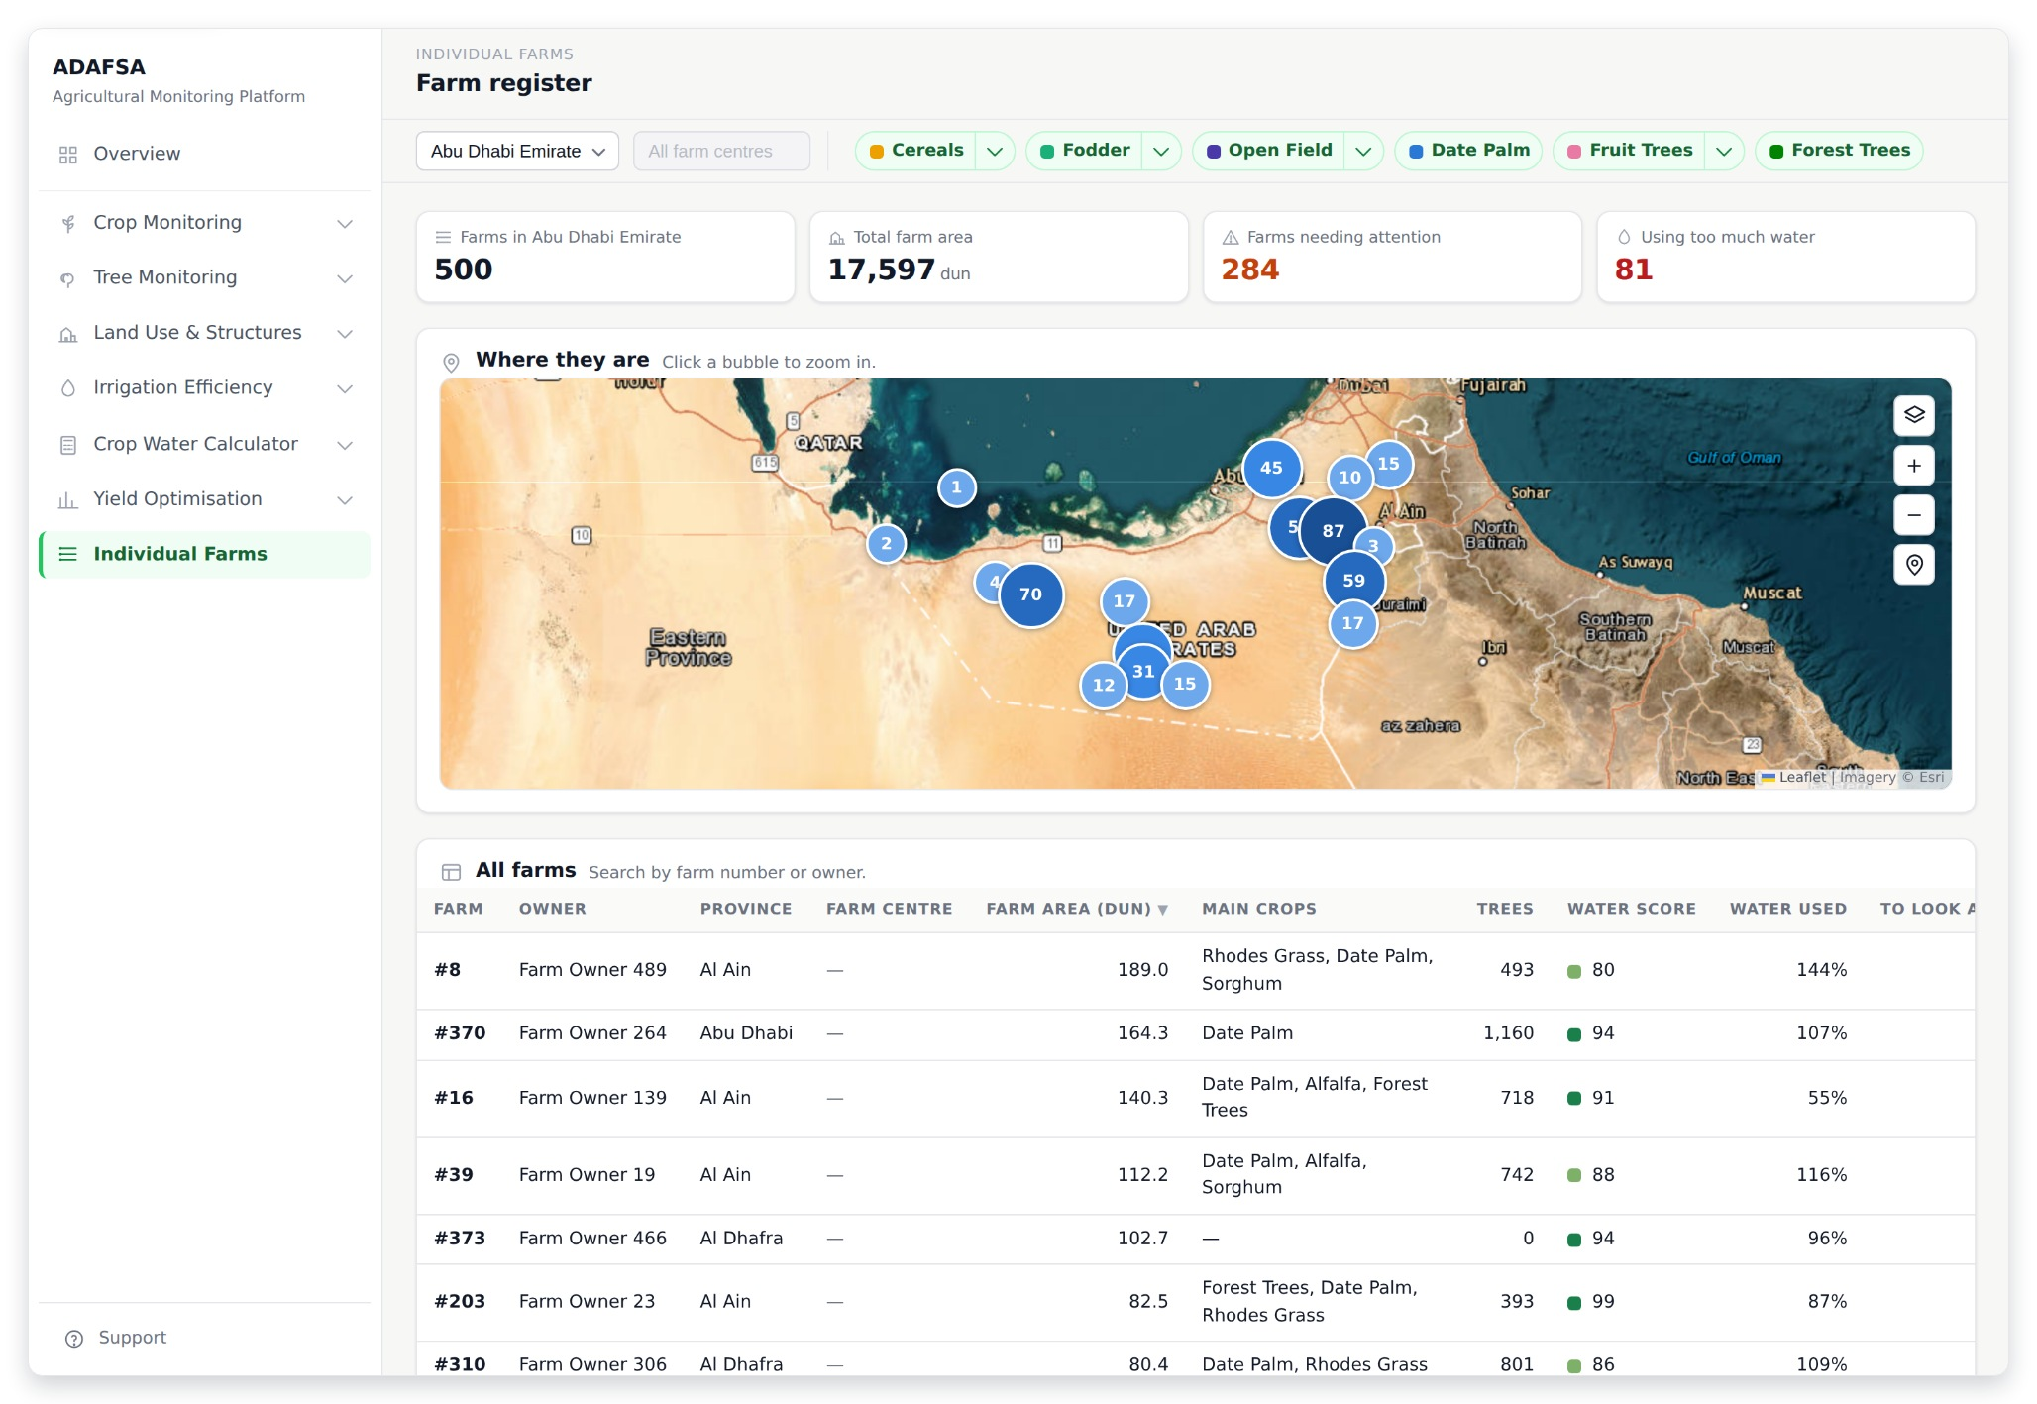
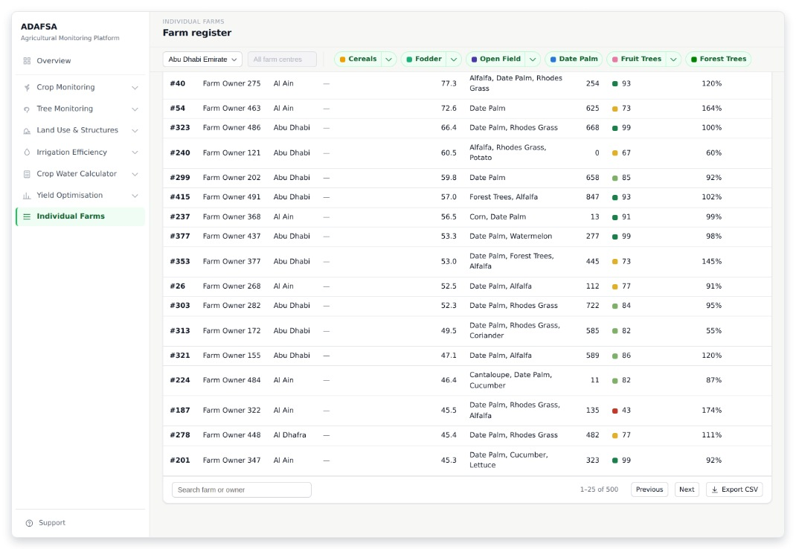
INDIVIDUAL FARMS
F1 · Farm register
The list of every farm: how many, their total area, how many need attention, and how many use too much water. Search by number or owner, sort any column, open one farm.
THE REST OF THIS SCREEN
Scrolls · about 50% of this screen is shown above
ADAFSA Agricultural Monitoring Platform · design mockup
29
Notes:
F1 — Farm register The list of every farm: how many, their total area, how many need attention, and how many use too much water. Search by number or owner, sort any column, open one farm. The screenshot shows 51% of this screen; the rest is in the smaller shot beside it.

Slide 30
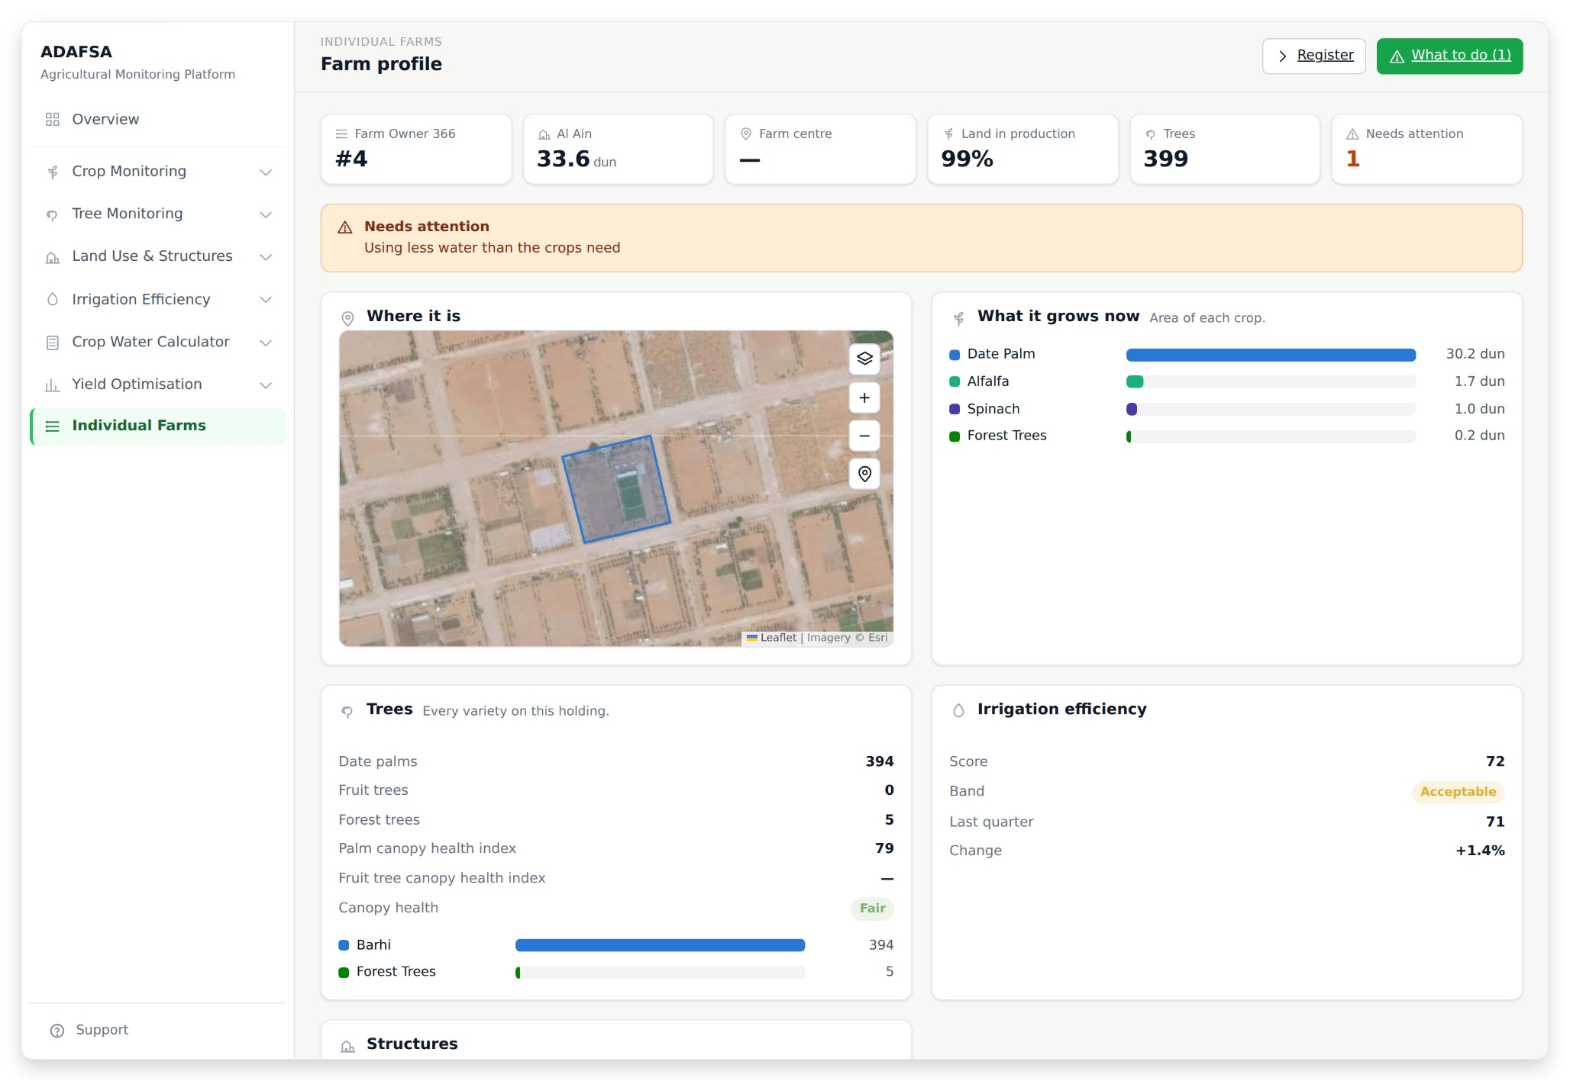
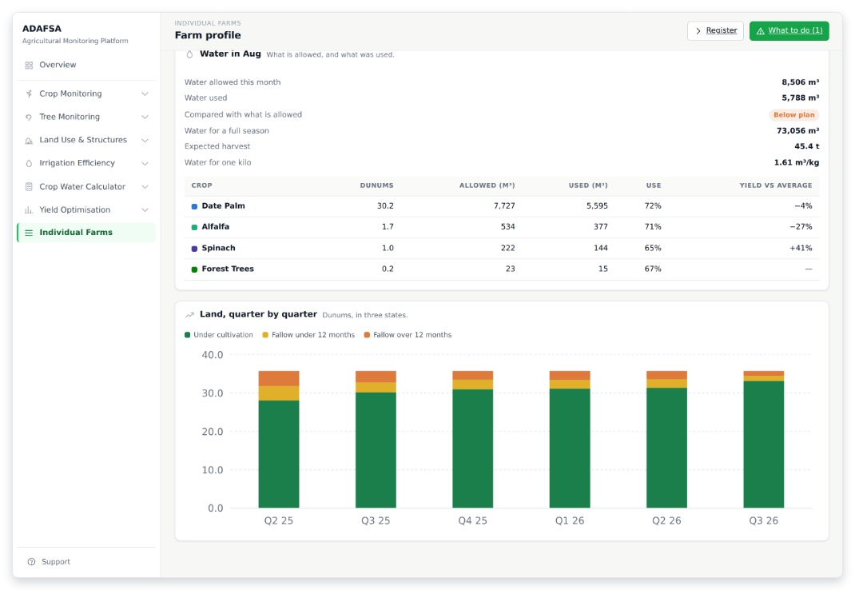
INDIVIDUAL FARMS
F2 · Farm profile
One farm on one page: the owner, the province, land in production, the tree count, and how many things need attention. Below that: crops, trees, water score and buildings. All six modules meet here.
THE REST OF THIS SCREEN
Scrolls · about 45% of this screen is shown above
ADAFSA Agricultural Monitoring Platform · design mockup
30
Notes:
F2 — Farm profile One farm on one page: the owner, the province, land in production, the tree count, and how many things need attention. Below that: crops, trees, water score and buildings. All six modules meet here. The screenshot shows 46% of this screen; the rest is in the smaller shot beside it.

Slide 31
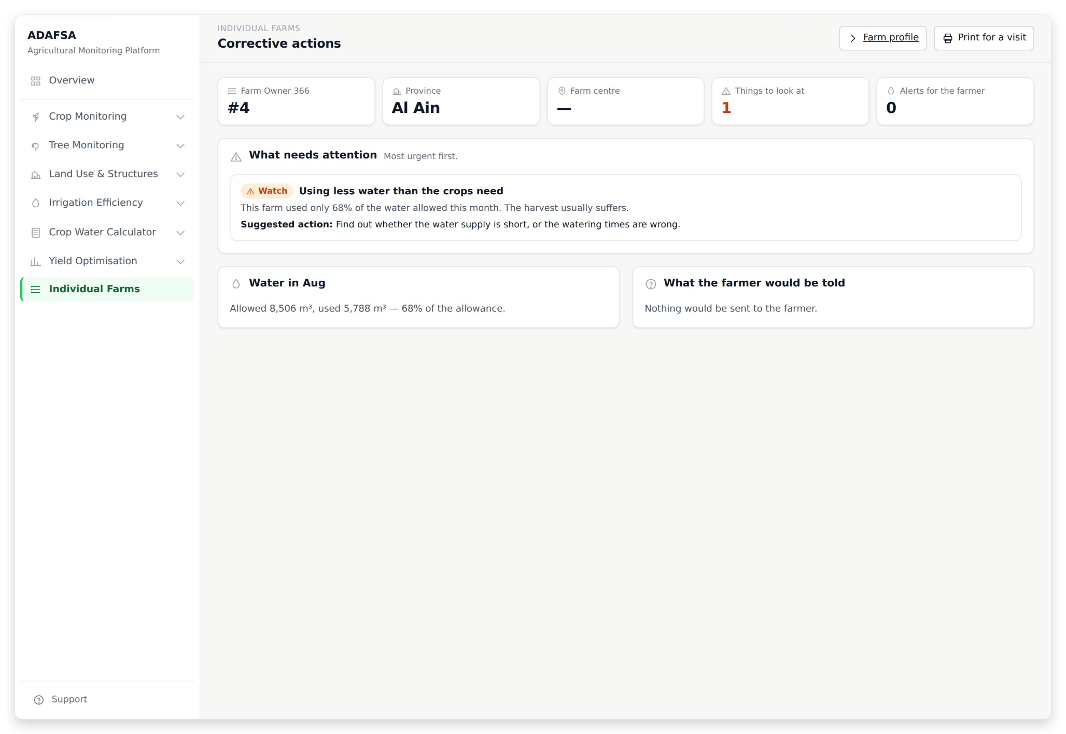
INDIVIDUAL FARMS
F3 · Corrective actions
What is wrong on this farm and what to do: things to look at, and alerts that would go to the farmer. Each one is written as an action, not as a number to work out. Print it and take it to the visit.
ADAFSA Agricultural Monitoring Platform · design mockup
31
Notes:
F3 — Corrective actions What is wrong on this farm and what to do: things to look at, and alerts that would go to the farmer. Each one is written as an action, not as a number to work out. Print it and take it to the visit.

Slide 32
SECTION 9 OF 9
Support
1 screen · S1
ADAFSA Agricultural Monitoring Platform · design mockup
32

Slide 33
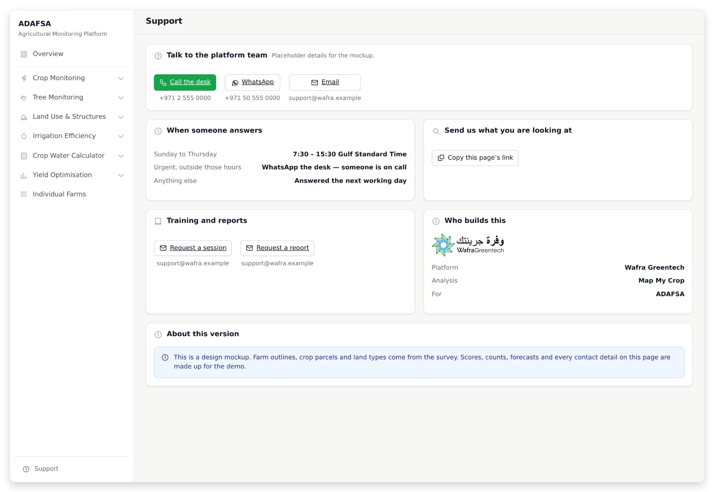
SUPPORT
S1 · Support
How to reach a person: telephone, WhatsApp and email, when someone answers, and how to send the exact screen you are looking at. Also who builds the platform, and a note on what is real data and what is made up. One page — in the old platform, more than half the menu was support and settings.
ADAFSA Agricultural Monitoring Platform · design mockup
33
Notes:
S1 — Support How to reach a person: telephone, WhatsApp and email, when someone answers, and how to send the exact screen you are looking at. Also who builds the platform, and a note on what is real data and what is made up. One page — in the old platform, more than half the menu was support and settings.

