Slide 1
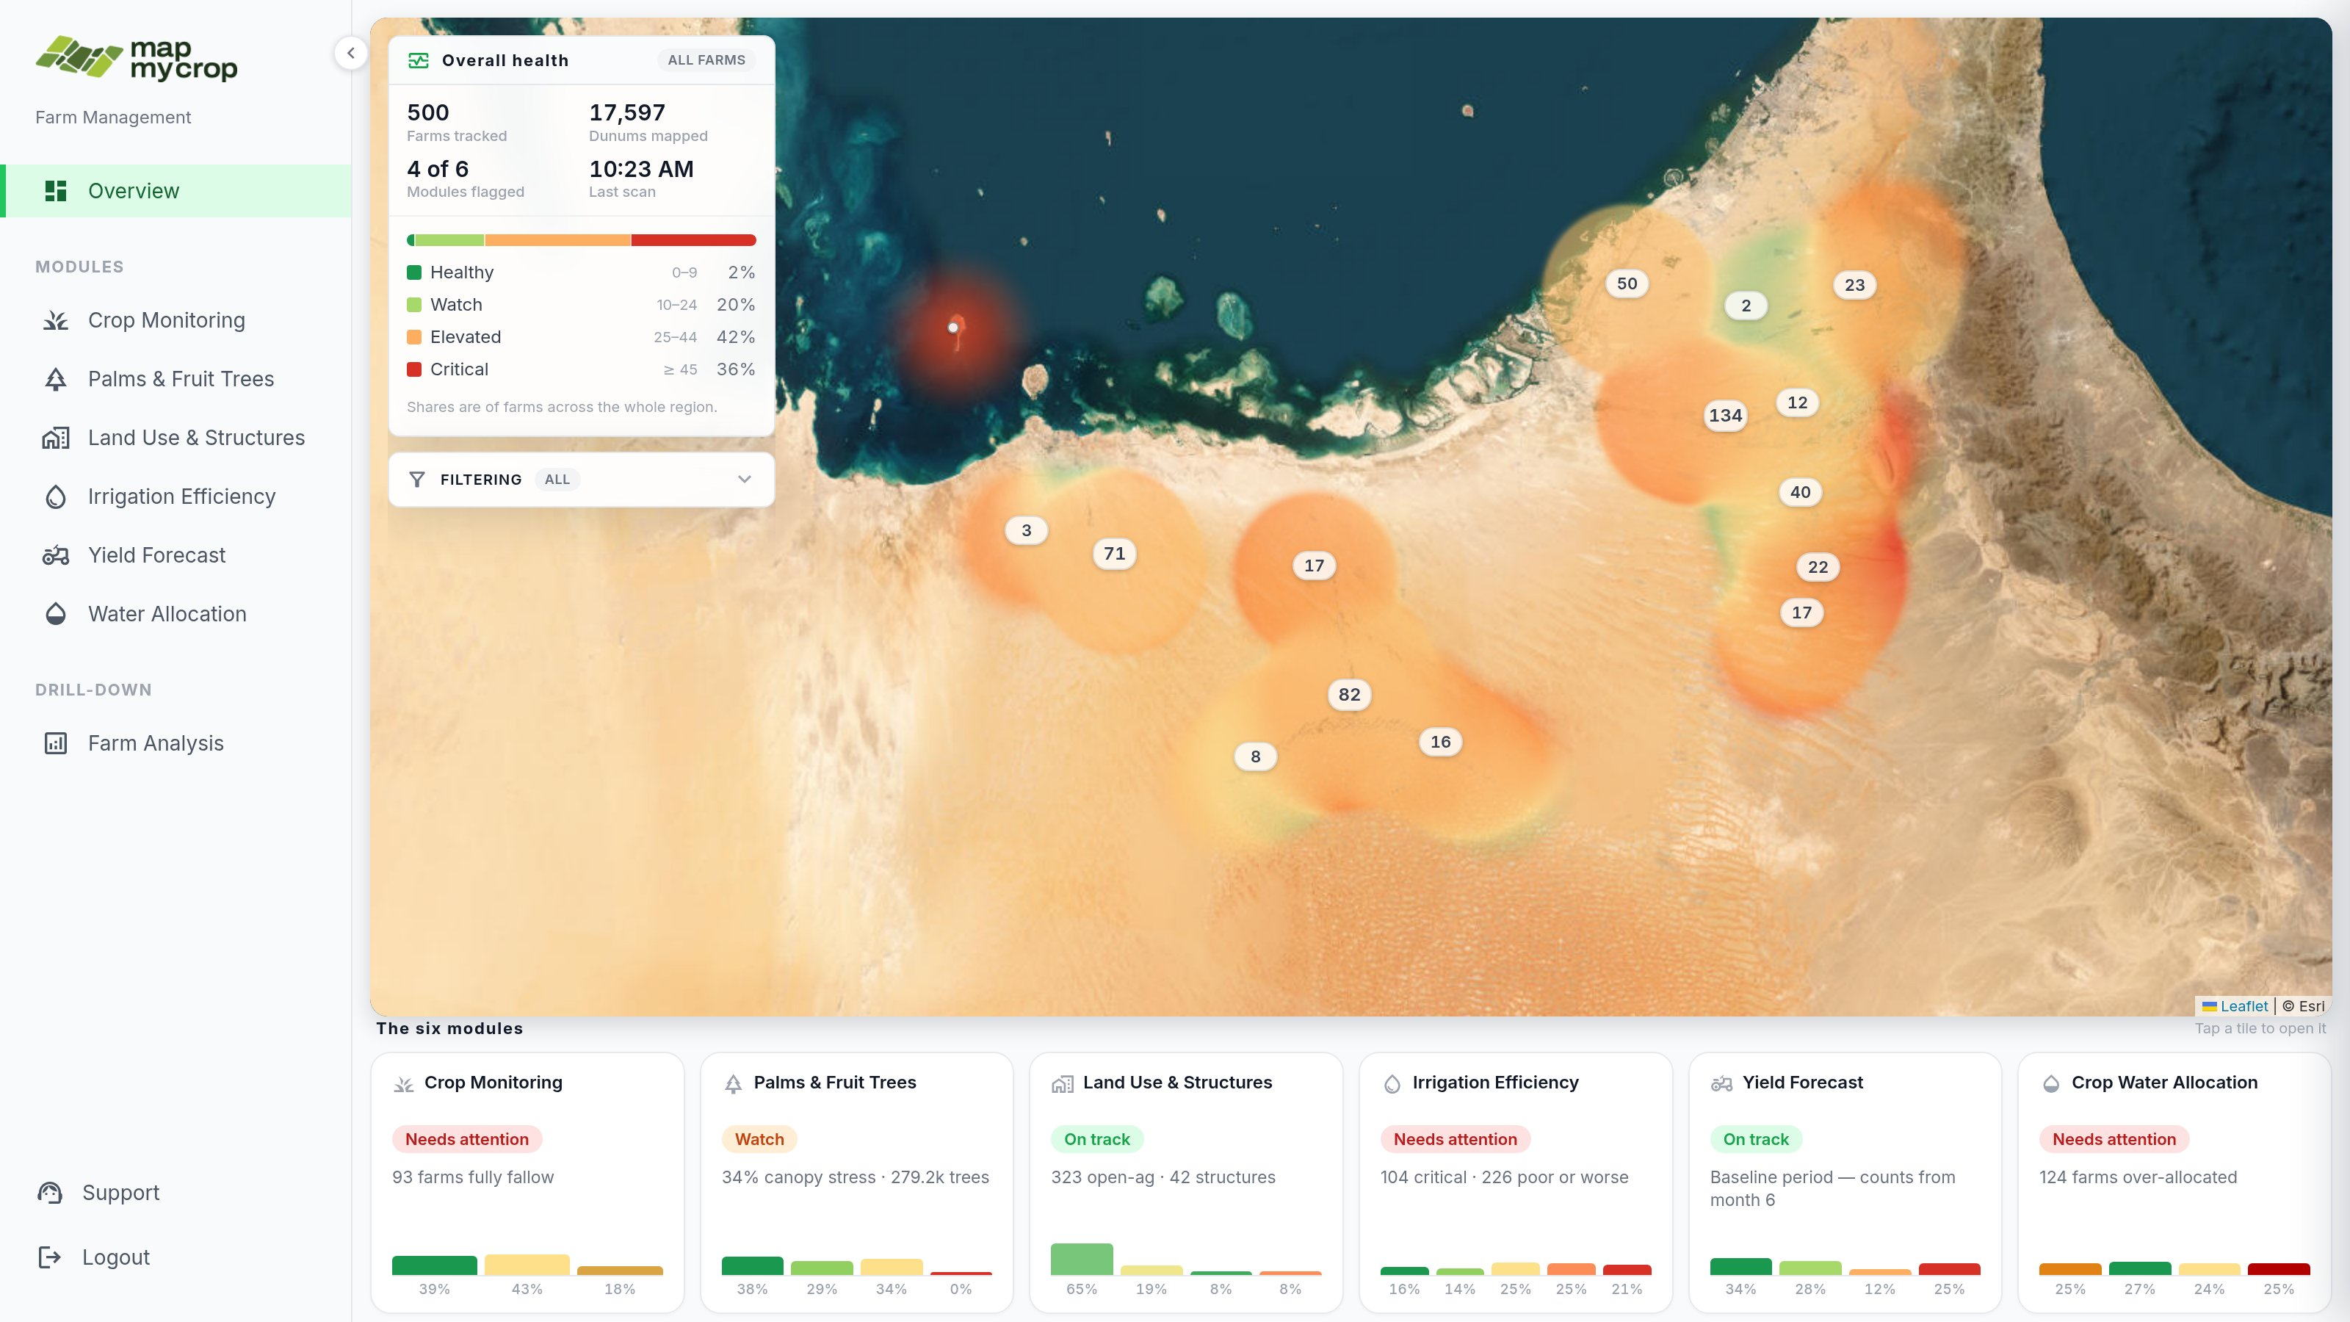

ADAFSA Platform - UX / UI Review
Preparing the platform for six analysis modules.
July 2026

Slide 2
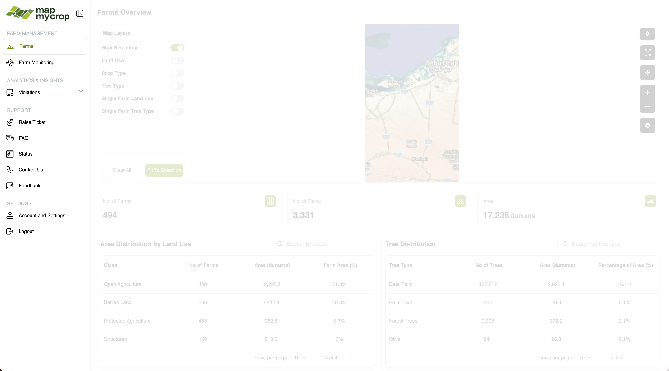
Analysis of Current Solution
Confusing navigation
Farms, Farm Monitoring, Enterprise Information. The navigation and categories are not clear yet. They could also do more to follow a natural user behaviour.
Seven of the ten entries are support and settings. Half the menu is about the tool, not the farms. This needs to be reduced.
The six analyses the client is buying appear nowhere here. This will need to be integrated in a mindful way.
2

Slide 3
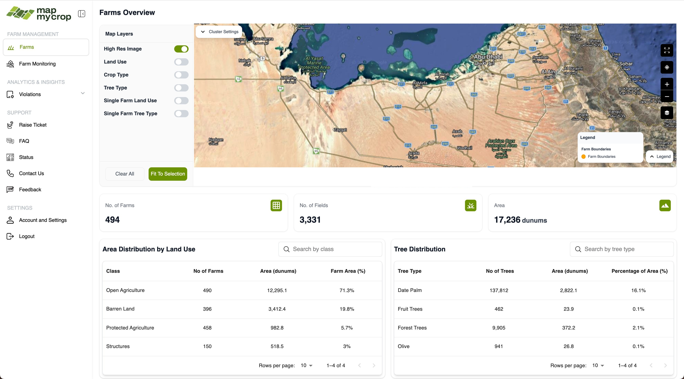
Analysis of Current Solution
The map only shows farm boundaries, which requires a high level of zoom, appearing empty at landing. We can encode more interesting information on a map.
Page morphology - very low density of information
Six switches. No information is shown on the map by default. Why High Res Image is in that list ? What's the difference between Tree Type and Single Farm Tree Type ?
Three counters count the inventory. They never say whether things are fine. Little information is shown for a large area taken.
Totals by category. No ranking, no sense of what is being monitored or how well we are doing.
3

Slide 4
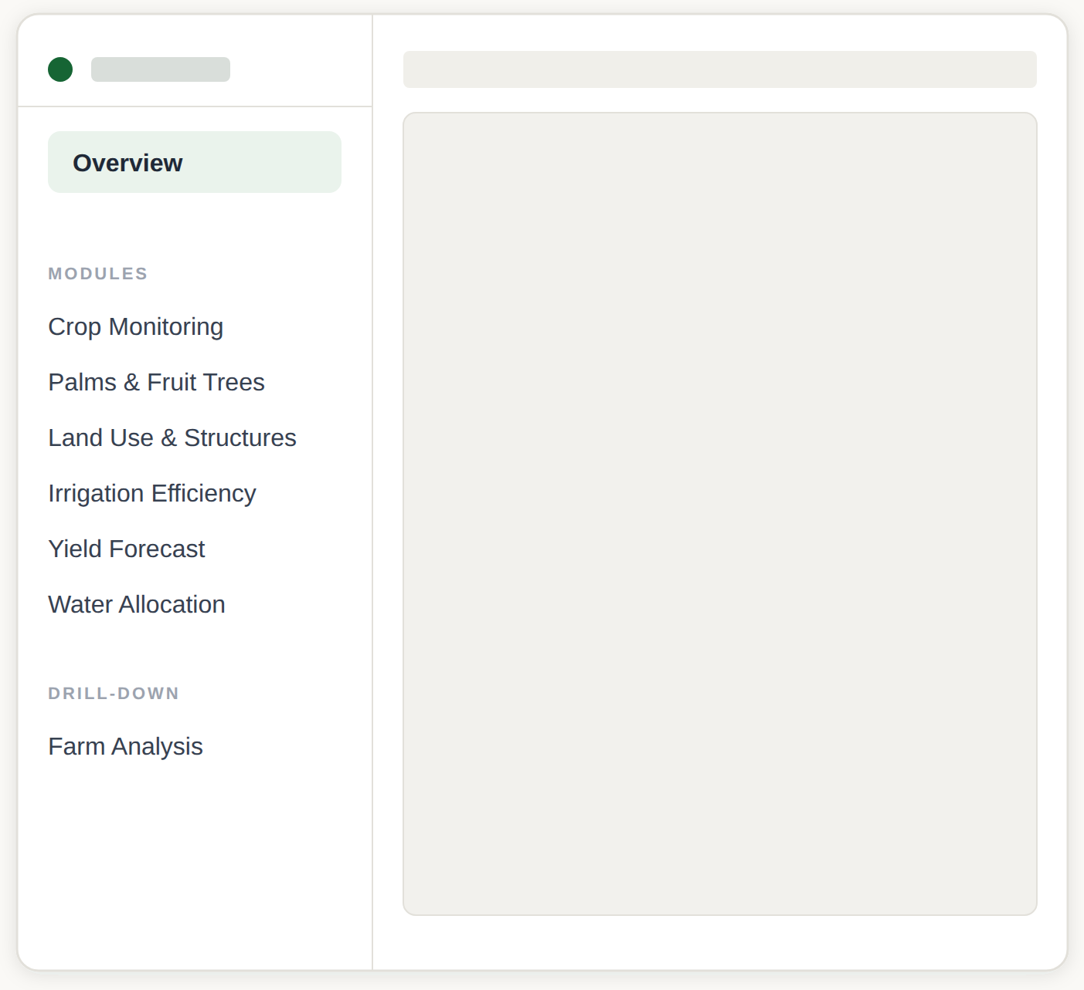
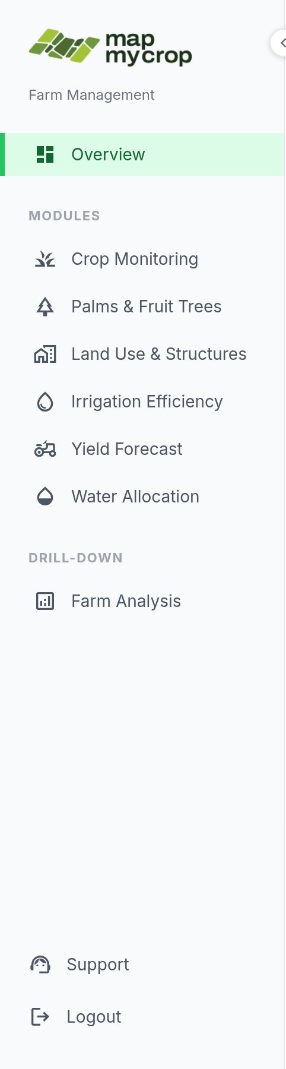



Step 1 : A better use of the navigation pane
Split the navigation pane into 3 technical levels
💡
What it could look like
Level 1 : The general situation
Outlining the current situation in the region
Level 2 : The modules
Responding to specific questions
Level 3 : The farm
Showing what happens on each farm
Each entry in the menu answers at one level.
4

Slide 5
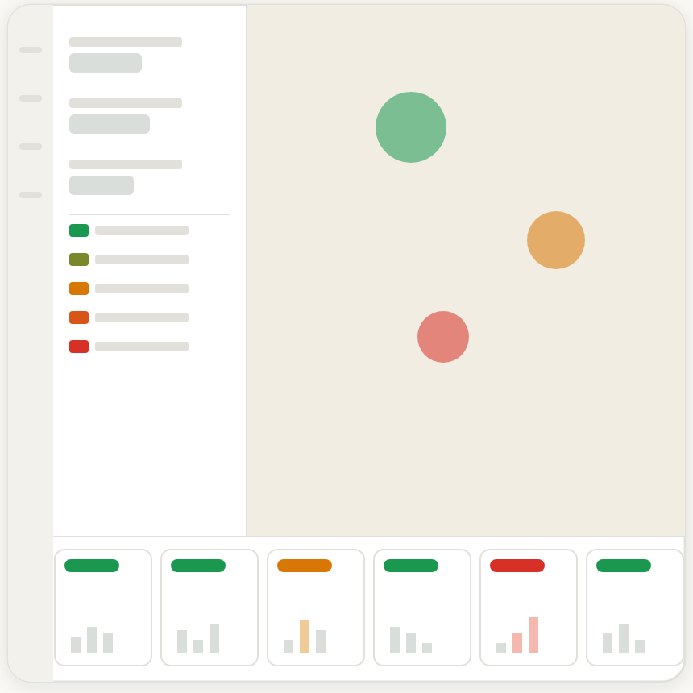
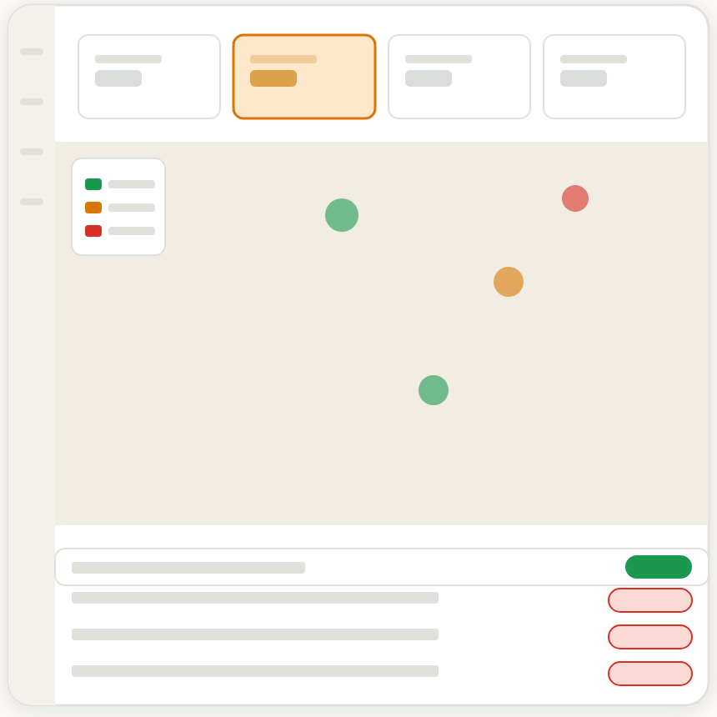
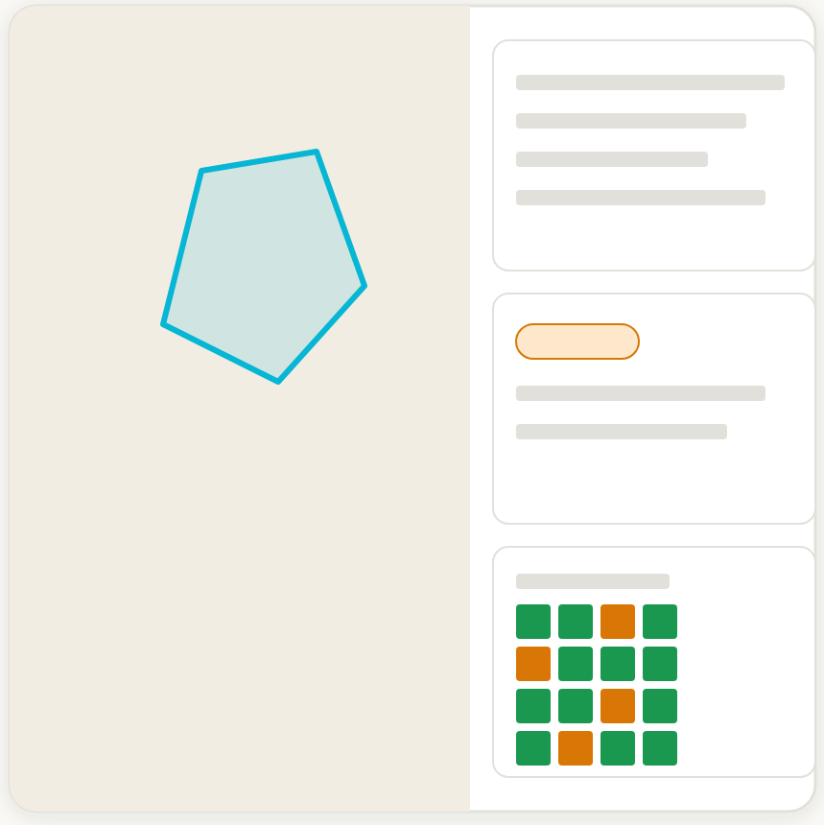
Step 2 : A thoughtful layout for each level
Maximising information per pixel and attention span
- Composite health metric
- Composite health heat map
- Summary card for all 6 modules
Overview
- Per module summary scores
- Per module health map
- Per module ranked table of farms
A module
- Per farm scores
- Per farm analytics
- Per farm suggestions
Farm Analysis
5

Slide 6
Level 1 layout : Overview page
A composite health metric on the map, 6 verdict cards for the 6 modules
The region's numbers and a composite health metric
Map shows critical health areas through heat map
The taxonomy becomes alive : filtering through the different taxonomy surfaces updated metrics.
Six cards, one status word each. Each opens its module.
6

Slide 7
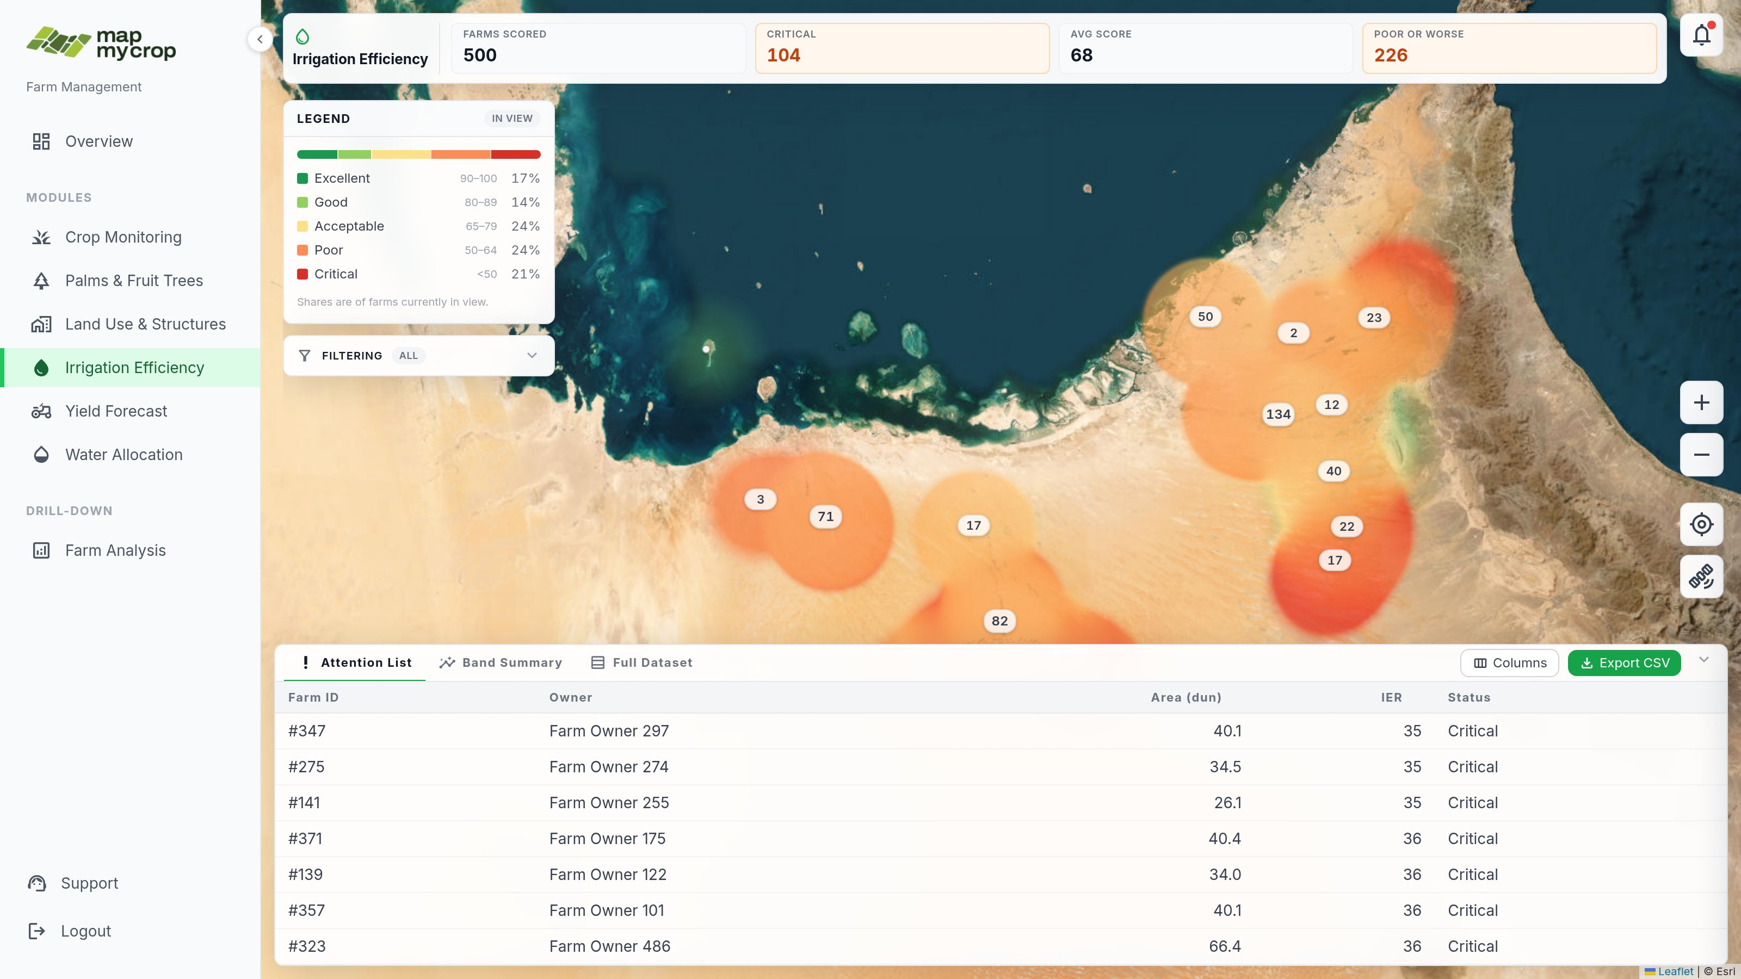
Level 2 layout : The module view
Full sorted data table, high-level metrics and taxonomy as filter
The numbers for this module.
One legend and one chart at a glance, to quickly understand numbers
Tick a crop or a tree type. The map and every number update together.
Map of farm boundaries + heatmap
Export, customise columns, sort, reorder, etc
Table with farms ranked worst first.
7

Slide 8
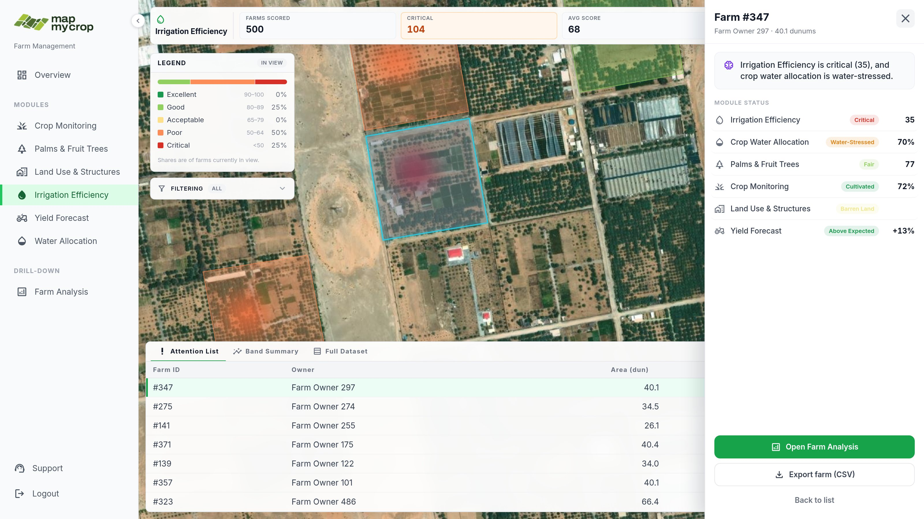
Level 2 layout : Zooming in
Single farm metrics included
To the point summary
All module metrics for this farm
The farm is highlighted in the view
Navigate to Level 3
8

Slide 9
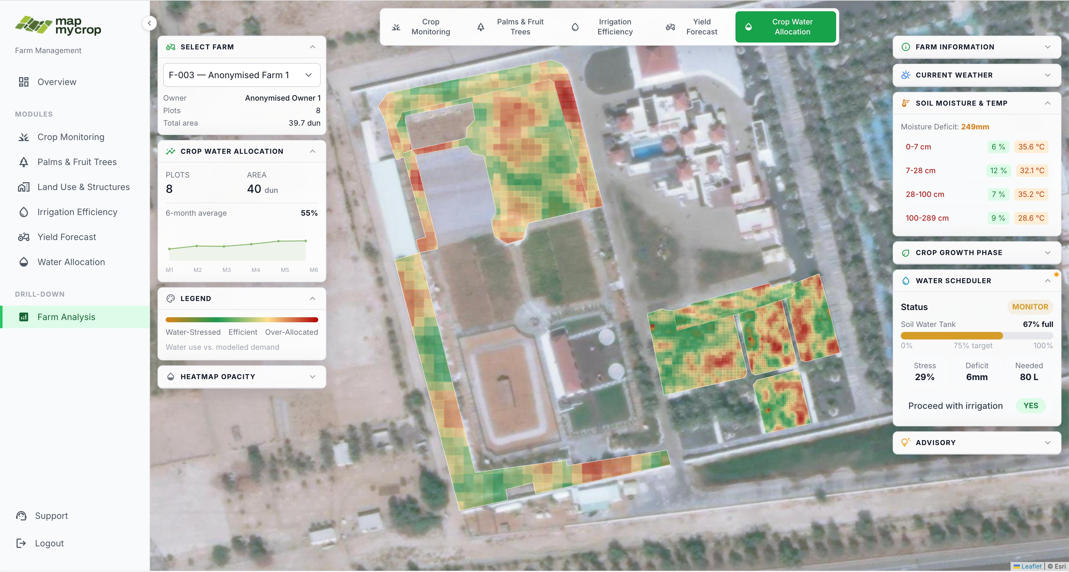
Level 3 layout : The full farm analytics
All metrics and scans accessible per farm
9

Slide 10
We follow the user's journey
Split the app into three distinct technical levels
Level 1 : The general overview
“Is anything wrong today?”
A quick look, first thing in the morning. Or engagement from high-level officials.
one level deeper
Level 2 : The modules
“Which farms need attention in terms of irrigation?”
A ranked list to work through during the week.
one level deeper
Level 3 : The farm
“What is happening on this farm?”
The full picture, all the metrics and scans.
10

Slide 11
🌍
See live demo
11

Slide 12
💼
Extra
Diagrams for the New Proposal
12

Slide 13
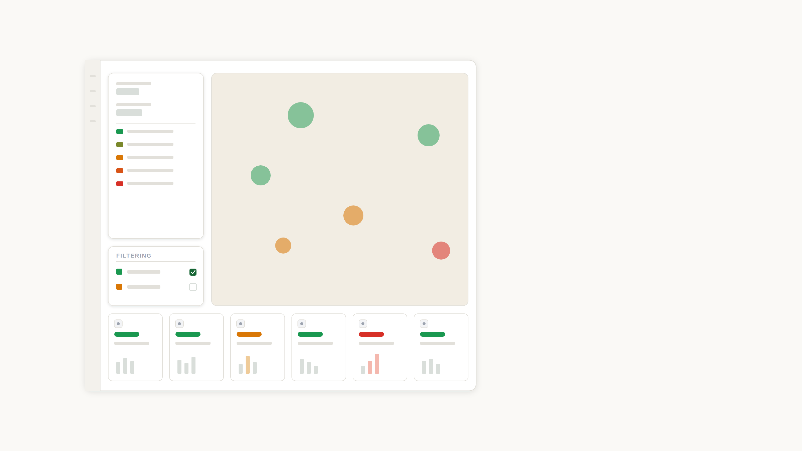
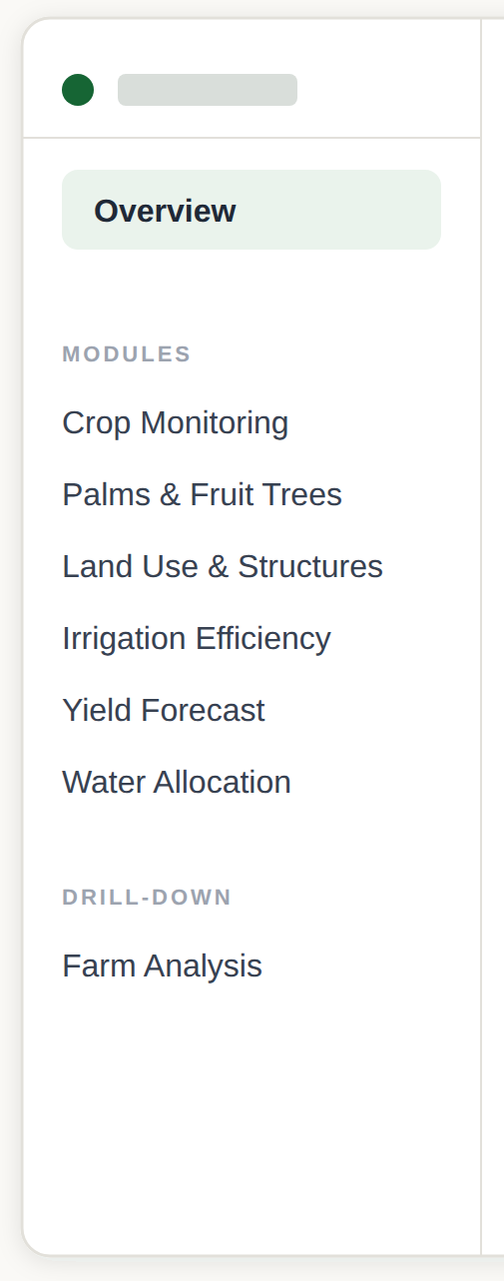
Proposal Diagrams
Level 1 - Overview
The region's numbers and a composite health metric
Map shows critical health areas through heat map
The taxonomy becomes alive : filtering through the different taxonomy surfaces updated metrics.
Six cards, one status word each. Each opens its module.
13

Slide 14
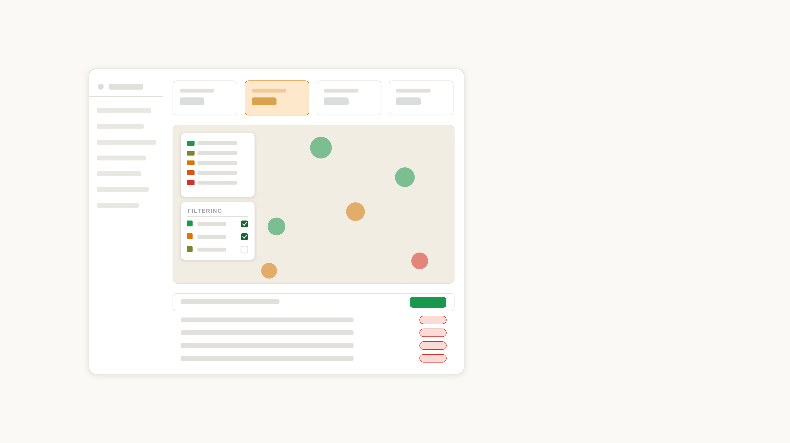
Proposal Diagrams
Level 2 - Module View
The numbers for this module.
One legend and one chart at a glance, to quickly understand numbers
Tick a crop or a tree type. The map and every number update together.
Map of farm boundaries + heatmap
Export, customise columns, sort, reorder, etc
Table with farms ranked worst first.
14

Slide 15
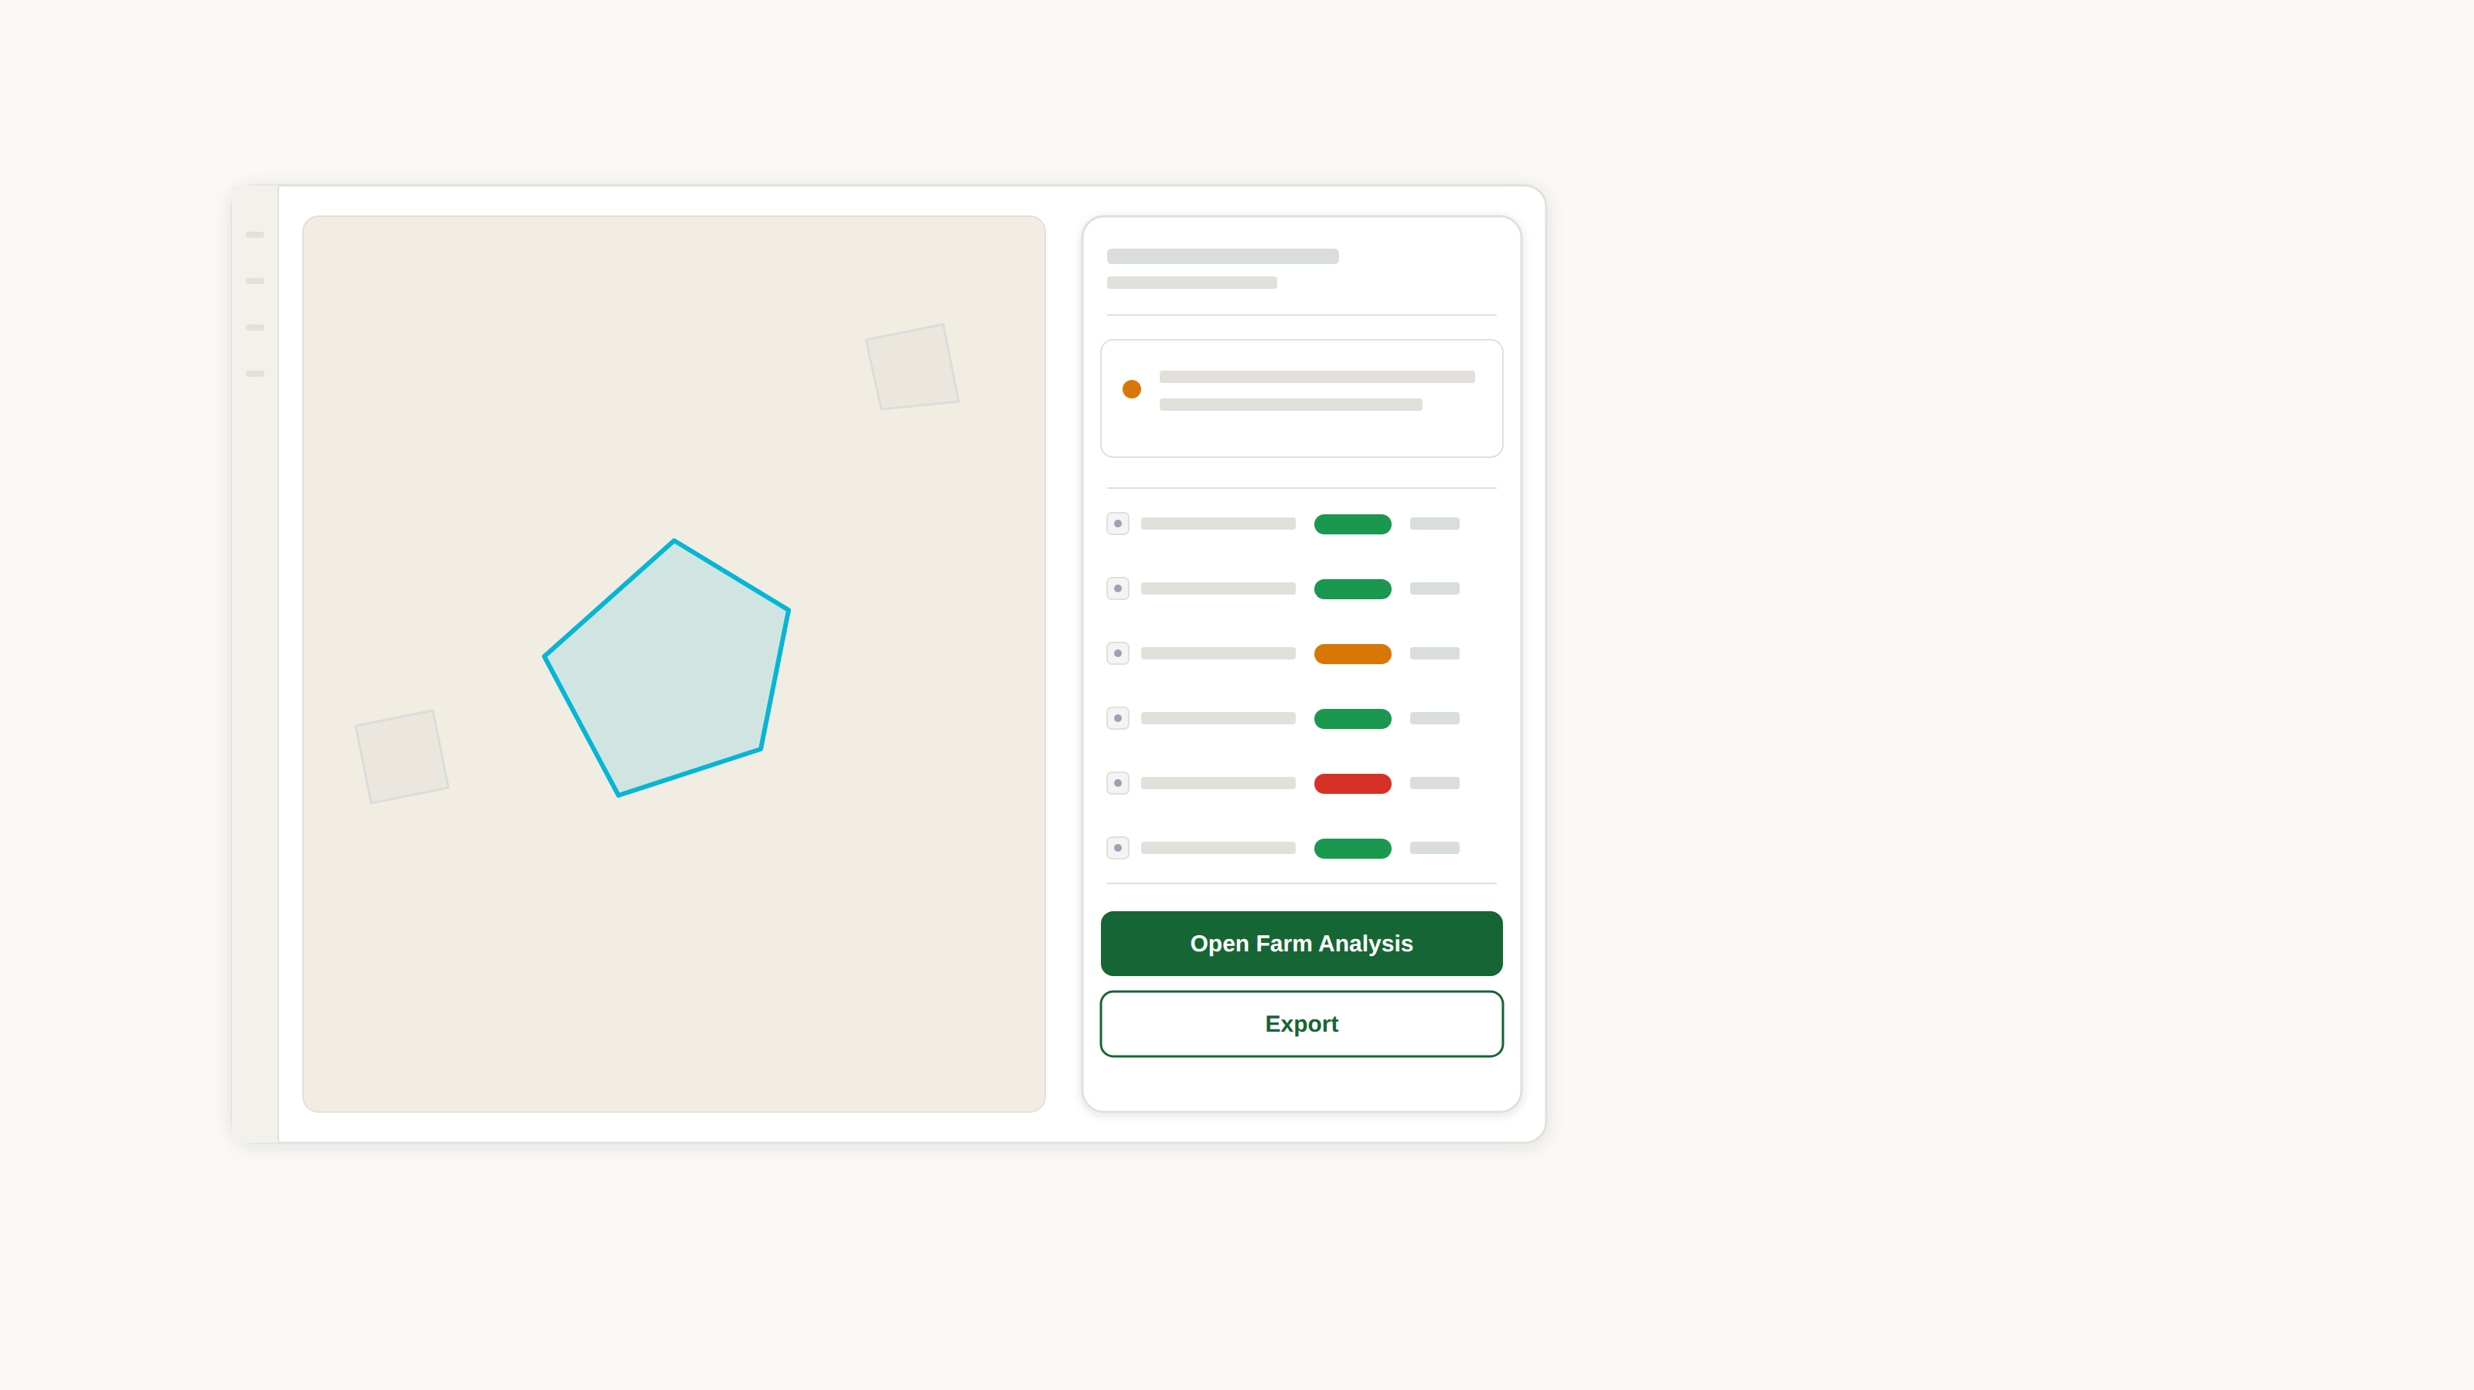
Proposal Diagrams
Level 2b - Farm Analysis
The farm, highlighted on the map.
The system's conclusion, in one sentence.
Every module's reading for this one farm.
It ends in an action: export, or open the full analysis.
15

