Slide 1

Wafra Farm App
60
1.7.3
SCREENS
VERSION
60 screens across 6 sections of the app, at version 1.7.3. Each page carries one screen on the left; the right-hand side is left clear for comments and notes.
Notes:
Wafra Farm App UI mockup, version 1.7.3. 60 screens.

Slide 2
Every screen
60 screens · the number is the page in this deck
FIRST RUN
LOG IN
ADVICE
A1
Welcome
4
A20
Log in
25
D1
Advice inbox
45
A2
Choose your language
5
A21
Join a farm as a guest
26
D2
Irrigation advice
46
A3
Guided tour — 1 of 5
6
MY FARM
D3
Fertilisation advice
47
A4
Guided tour — 2 of 5
7
B1
Farm home
28
D4
Crop protection advice
48
A5
Guided tour — 3 of 5
8
B2
Plot detail
29
D5
Plant diagnosis
49
A6
Guided tour — 4 of 5
9
B12
Irrigation schedule
30
D6
Plant diagnosis — result
50
A7
Guided tour — 5 of 5
10
B3
Crop cycles
31
MORE
A8
Sign up
11
B4
Add / edit crop cycle
32
F1
More
52
A9
Verify code
12
B5
Tree group
33
F2
My profile
53
A10
Tell us about your farm
13
B6
Tree detail
34
F3
Reports
54
A22
Too small for a survey
14
B7
Crop planner
35
F4
Weather
55
A11
Available service plans
15
B8
Farm progress
36
F5
Subscription info for existing users
56
A12
Not interested
16
B9
Draw my own plots
37
F6
Compare plans
57
A13
Locate your farm
17
B10
Manage workforce
38
F7
Settings
58
A14
Draw your farm boundary
18
MAP
F8
Units and formats
59
A15
Survey in progress
19
C1
Map
40
F9
Advice distribution
60
A16
Survey results
20
C2
Layers
41
F10
Data and storage
61
A17
Service plans
21
C4
Compare dates
42
F11
Activity log
62
A18
Confirm subscription
22
C5
Boundary editor
43
F12
Help and user guide
63
A19
You’re ready
23
F13
Crop guide
64
F14
One crop
65
F15
Pests and diseases
66
F16
One pest or disease
67
F17
Contact Wafra
68
Wafra Farm App · UI mockup v1.7.3
2
Notes:
Contents. 60 screens across 6 sections.

Slide 3
SECTION 1 OF 6
First run
20 screens · A1 · A2 · A3 · A4 · A5 · A6 · A7 · A8 · A9 · A10 · A22 · A11 · A12 · A13 · A14 · A15 · A16 · A17 · A18 · A19
Wafra Farm App · UI mockup v1.7.3
3
Notes:
First run — 20 screens.

Slide 4
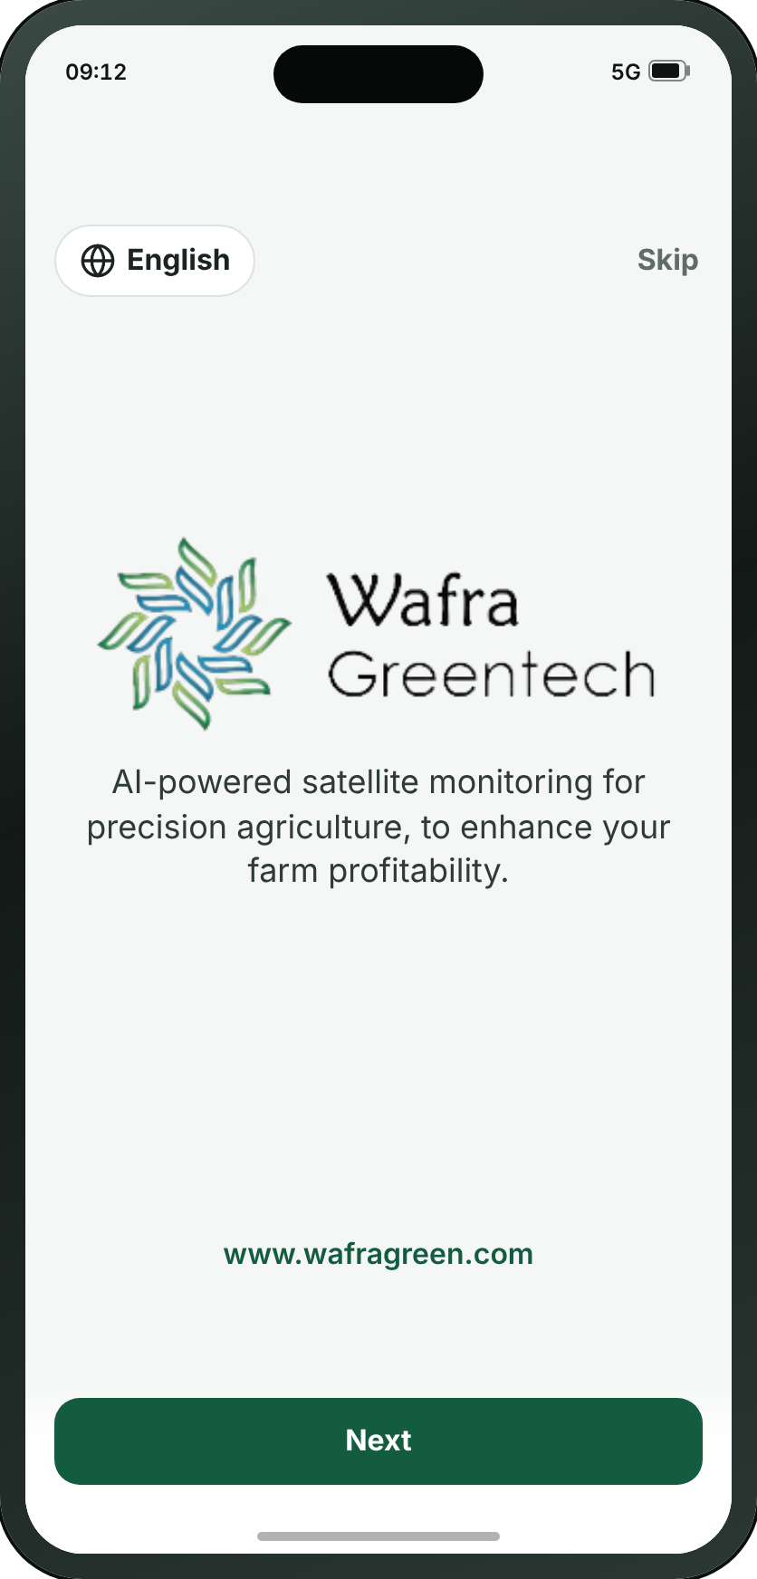
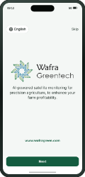
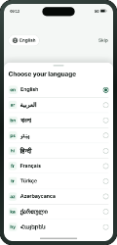
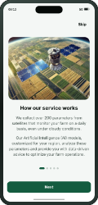
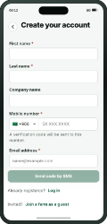
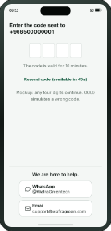
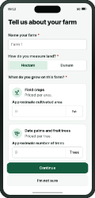
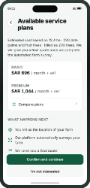
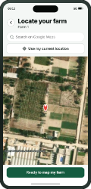
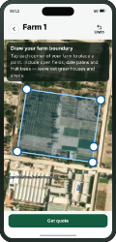
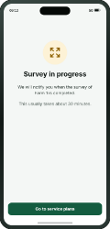
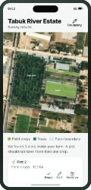
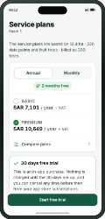
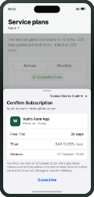
FIRST RUN
A1 · Welcome
→
→
→
→
→
→
→
→
→
→
→
→
A1
A2
A3
A8
A9
A10
A11
A13
A14
A15
A16
A17
A18
Welcome
Choose your language
Guided tour — 1 of 5
Sign up
Verify code
Tell us about your farm
Available service plans
Locate your farm
Draw your farm boundary
Survey in progress
Survey results
Service plans
Confirm subscription
WHAT THE SMALL BUTTONS DO
1
Next → A3 Guided tour — 1 of 5 (page 6)
1
Wafra Farm App · UI mockup v1.7.3
4
Notes:
A1 — Welcome
The first thing anyone sees, once, on the first launch: the mark and one sentence saying what the app does, centred, with the address at the foot. Next takes the tour and Skip goes straight to the sign-up form. Registered users see neither — they open on A20.
1. Next → A3
On the "Signing up" path.

Slide 5
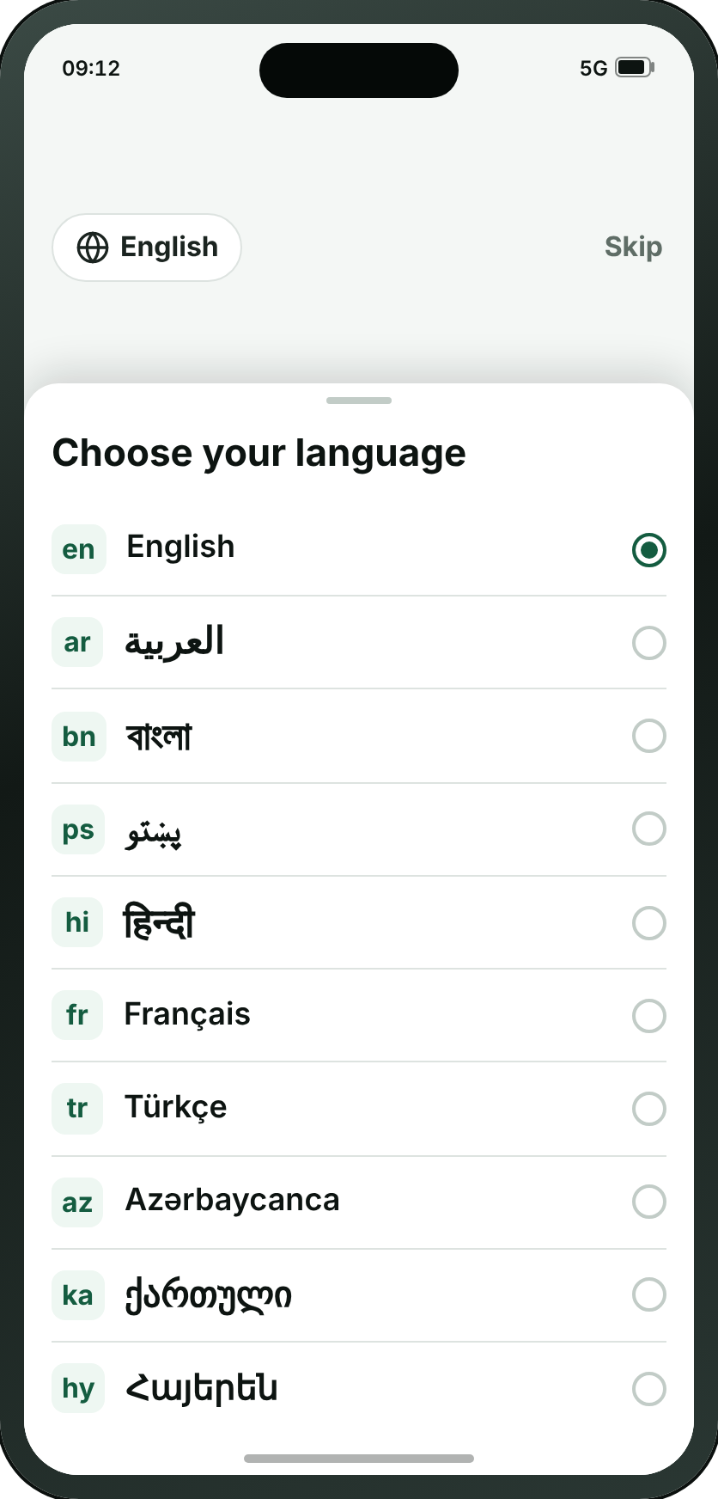
FIRST RUN
A2 · Choose your language
→
→
→
→
→
→
→
→
→
→
→
→
A1
A2
A3
A8
A9
A10
A11
A13
A14
A15
A16
A17
A18
Welcome
Choose your language
Guided tour — 1 of 5
Sign up
Verify code
Tell us about your farm
Available service plans
Locate your farm
Draw your farm boundary
Survey in progress
Survey results
Service plans
Confirm subscription
Wafra Farm App · UI mockup v1.7.3
5
Notes:
A2 — Choose your language
Not a screen — a pop-up sheet over A1, raised by the globe in its corner and closed by choosing a row. It has a page here because a printed deck cannot show a state of another screen any other way. Ten languages, each in its own script with its code beside it; pressing one turns the whole app round if it reads right to left, and closes the sheet. It is where Arabic and Pashto are chosen, and it is one tap from the corner of A1.
On the "Signing up" path.

Slide 6

FIRST RUN
A3 · Guided tour — 1 of 5
→
→
→
→
→
→
→
→
→
→
→
→
A1
A2
A3
A8
A9
A10
A11
A13
A14
A15
A16
A17
A18
Welcome
Choose your language
Guided tour — 1 of 5
Sign up
Verify code
Tell us about your farm
Available service plans
Locate your farm
Draw your farm boundary
Survey in progress
Survey results
Service plans
Confirm subscription
Wafra Farm App · UI mockup v1.7.3
6
Notes:
A3 — Guided tour — 1 of 5
How the service works, and the first of five pictures of the app doing its job, in the language just chosen. Next on A1 opens it and Help brings it back. Illustrated by a satellite over the same synthesised farmland the map screens draw.
On the "Signing up" path.

Slide 7
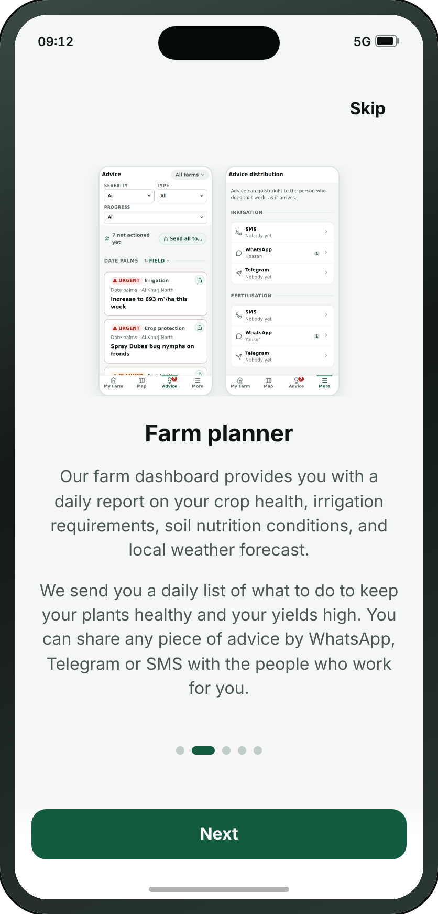
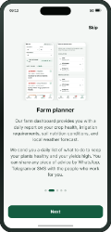
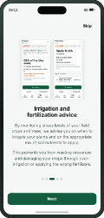
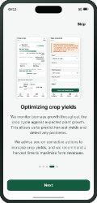
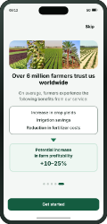
FIRST RUN
A4 · Guided tour — 2 of 5
→
→
→
→
→
→
A1
A3
A4
A5
A6
A7
A8
Welcome
Guided tour — 1 of 5
Guided tour — 2 of 5
Guided tour — 3 of 5
Guided tour — 4 of 5
Guided tour — 5 of 5
Sign up
Wafra Farm App · UI mockup v1.7.3
7
Notes:
A4 — Guided tour — 2 of 5
The farm planner, illustrated by D1 and F9 themselves. In the app these five are one carousel; on paper each needs a page of its own, or four of the five are never seen.
On the "The guided tour, offered from A1 and from Help" path.

Slide 8

FIRST RUN
A5 · Guided tour — 3 of 5
→
→
→
→
→
→
A1
A3
A4
A5
A6
A7
A8
Welcome
Guided tour — 1 of 5
Guided tour — 2 of 5
Guided tour — 3 of 5
Guided tour — 4 of 5
Guided tour — 5 of 5
Sign up
Wafra Farm App · UI mockup v1.7.3
8
Notes:
A5 — Guided tour — 3 of 5
Irrigation and fertilisation advice, illustrated by D2 and D3.
On the "The guided tour, offered from A1 and from Help" path.

Slide 9
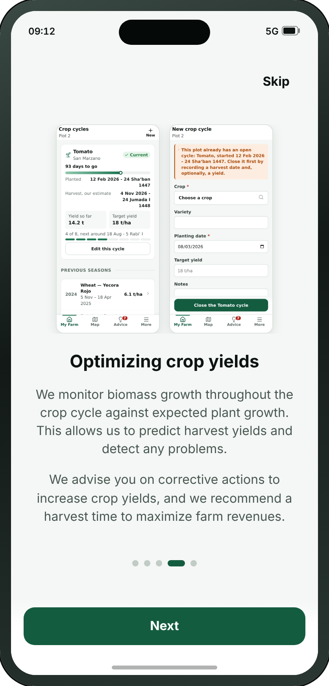
FIRST RUN
A6 · Guided tour — 4 of 5
→
→
→
→
→
→
A1
A3
A4
A5
A6
A7
A8
Welcome
Guided tour — 1 of 5
Guided tour — 2 of 5
Guided tour — 3 of 5
Guided tour — 4 of 5
Guided tour — 5 of 5
Sign up
Wafra Farm App · UI mockup v1.7.3
9
Notes:
A6 — Guided tour — 4 of 5
Optimising crop yields, illustrated by B3 and B4.
On the "The guided tour, offered from A1 and from Help" path.

Slide 10

FIRST RUN
A7 · Guided tour — 5 of 5
→
→
→
→
→
→
A1
A3
A4
A5
A6
A7
A8
Welcome
Guided tour — 1 of 5
Guided tour — 2 of 5
Guided tour — 3 of 5
Guided tour — 4 of 5
Guided tour — 5 of 5
Sign up
Wafra Farm App · UI mockup v1.7.3
10
Notes:
A7 — Guided tour — 5 of 5
What the farmers already using it get out of it, and the panel that hands on to the front door. The only one that argues with figures, and the only one drawn as a funnel: three savings narrowing into one.
On the "The guided tour, offered from A1 and from Help" path.

Slide 11
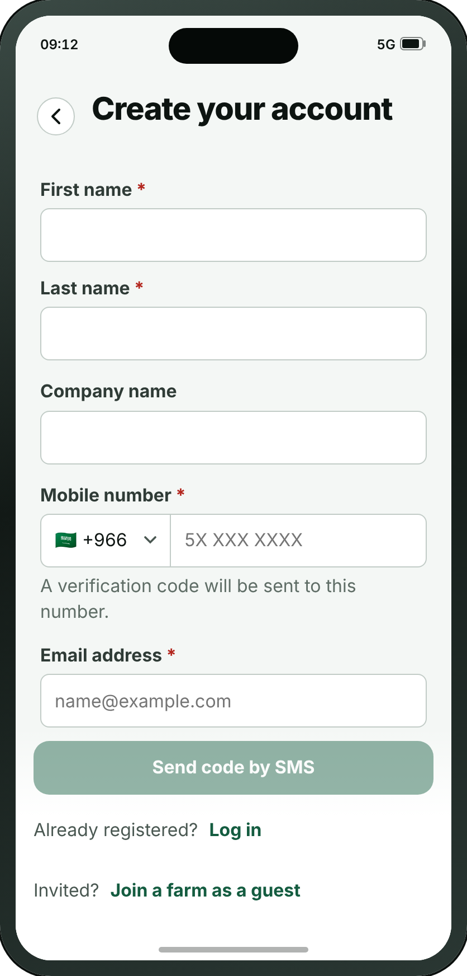
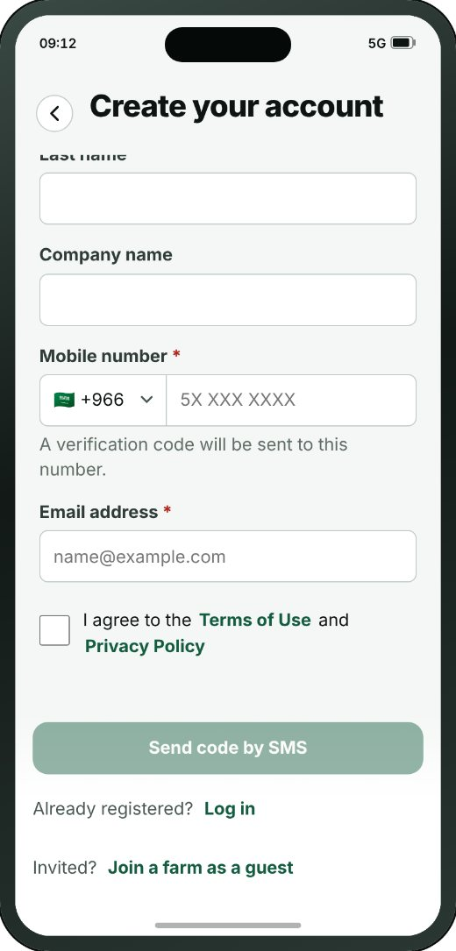
FIRST RUN
A8 · Sign up
→
→
→
→
→
→
→
→
→
→
→
→
A1
A2
A3
A8
A9
A10
A11
A13
A14
A15
A16
A17
A18
Welcome
Choose your language
Guided tour — 1 of 5
Sign up
Verify code
Tell us about your farm
Available service plans
Locate your farm
Draw your farm boundary
Survey in progress
Survey results
Service plans
Confirm subscription
THE REST OF THIS SCREEN
• This screen is shown to new users only. Anyone already registered goes straight to A20.
Scrolls · about 80% of this screen is shown above
Wafra Farm App · UI mockup v1.7.3
11
Notes:
A8 — Sign up
The whole account on one form, and since review 06/09 the email address is the account: a first and last name, an optional company, the address, a number from any country in the world, and a password. The two doors that used to be on A20 are at the foot of it.
On the "Signing up" path.
The screenshot shows 81% of this screen; the rest is below the fold.

Slide 12
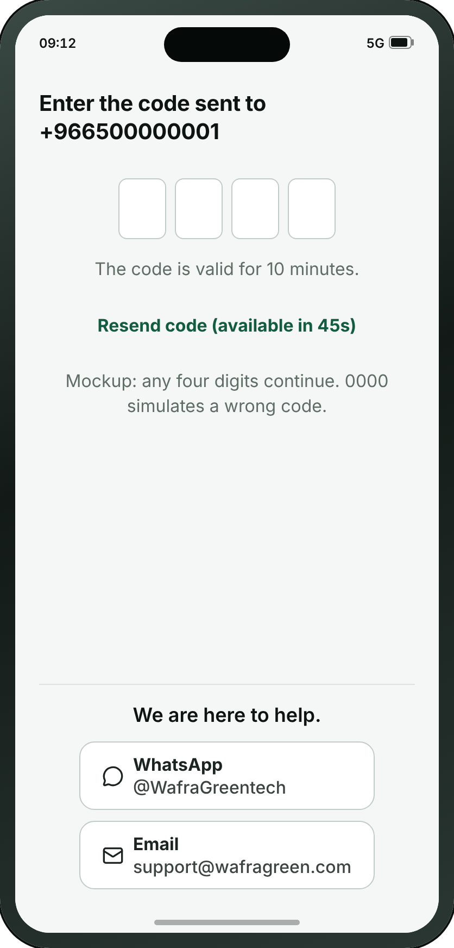
FIRST RUN
A9 · Verify code
→
→
→
→
→
→
→
→
→
→
→
→
A1
A2
A3
A8
A9
A10
A11
A13
A14
A15
A16
A17
A18
Welcome
Choose your language
Guided tour — 1 of 5
Sign up
Verify code
Tell us about your farm
Available service plans
Locate your farm
Draw your farm boundary
Survey in progress
Survey results
Service plans
Confirm subscription
Wafra Farm App · UI mockup v1.7.3
12
Notes:
A9 — Verify code
Four digits to the registered email address, and one sentence saying where they went. The boxes are real inputs, so the phone raises its own keyboard and can fill the code in itself; it sends on the last digit, and five wrong tries rest the account for a quarter of an hour. A brand new account is asked about Face ID here and nowhere else.
On the "Signing up" path.

Slide 13

FIRST RUN
A10 · Tell us about your farm
→
→
→
→
→
→
→
→
→
→
→
→
A1
A2
A3
A8
A9
A10
A11
A13
A14
A15
A16
A17
A18
Welcome
Choose your language
Guided tour — 1 of 5
Sign up
Verify code
Tell us about your farm
Available service plans
Locate your farm
Draw your farm boundary
Survey in progress
Survey results
Service plans
Confirm subscription
WHAT THE SMALL BUTTONS DO
1
I’m not sure → A13 Locate your farm (page 17)
1
Wafra Farm App · UI mockup v1.7.3
13
Notes:
A10 — Tell us about your farm
The moment an account becomes a farm: its name, the unit its land is measured in, and roughly how much of each it holds — a number under Field crops, a count under Date palms and fruit trees. Filling in one, the other, or both IS the answer to what is growing here; nothing is picked. “I’m not sure” skips the estimate and goes straight to locating the farm. Since v1.7.3 the two numbers are checked: a holding below the survey’s minimum goes to A22 instead of the price.
1. I’m not sure → A13
On the "Signing up" path.

Slide 14
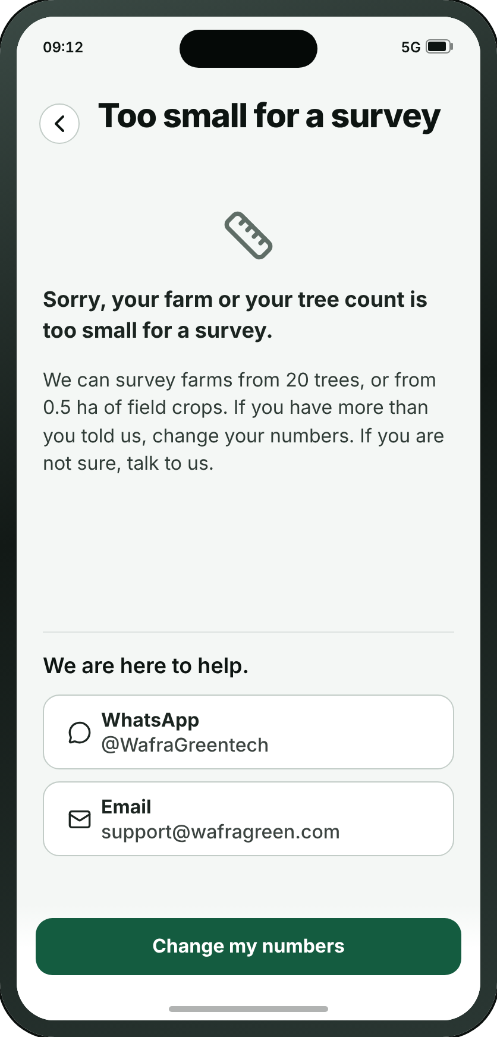
FIRST RUN
A22 · Too small for a survey
Wafra Farm App · UI mockup v1.7.3
14
Notes:
A22 — Too small for a survey
New at v1.7.3: “Sorry, your farm or your tree count is too small for a survey.” A10’s two numbers are checked before the price, and a holding below both limits lands here, with a way back to change them and a way to talk to us. The limits are a placeholder — fewer than 20 trees and under half a hectare of field crops — because nobody has said yet what too small is; a 20-tree farm can be surveyed, and is billed as 100 trees.

Slide 15
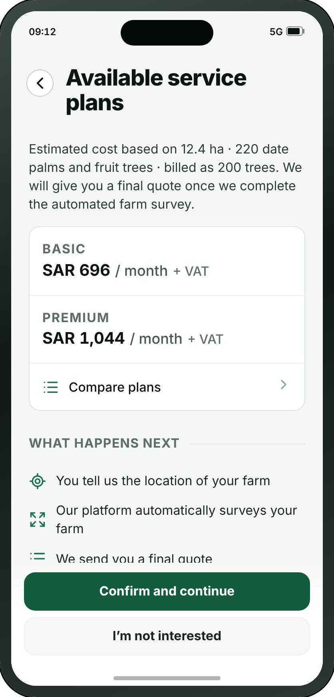
FIRST RUN
A11 · Available service plans
→
→
→
→
→
→
→
→
→
→
→
→
A1
A2
A3
A8
A9
A10
A11
A13
A14
A15
A16
A17
A18
Welcome
Choose your language
Guided tour — 1 of 5
Sign up
Verify code
Tell us about your farm
Available service plans
Locate your farm
Draw your farm boundary
Survey in progress
Survey results
Service plans
Confirm subscription
WHAT THE SMALL BUTTONS DO
1
I’m not interested → A12 Not interested (page 16)
1
Wafra Farm App · UI mockup v1.7.3
15
Notes:
A11 — Available service plans
The two real plans at their two real prices, presented as an estimate, with nothing to choose — the plan is picked later on A17 once the survey has priced the real farm. Trees are billed in bands, rounded down (125 trees is billed as 100), and never under 100 trees; the line at the top says so when the band is not the count. Under the plans, the four steps, which say plan selection comes last.
1. I’m not interested → A12
On the "Signing up" path.

Slide 16
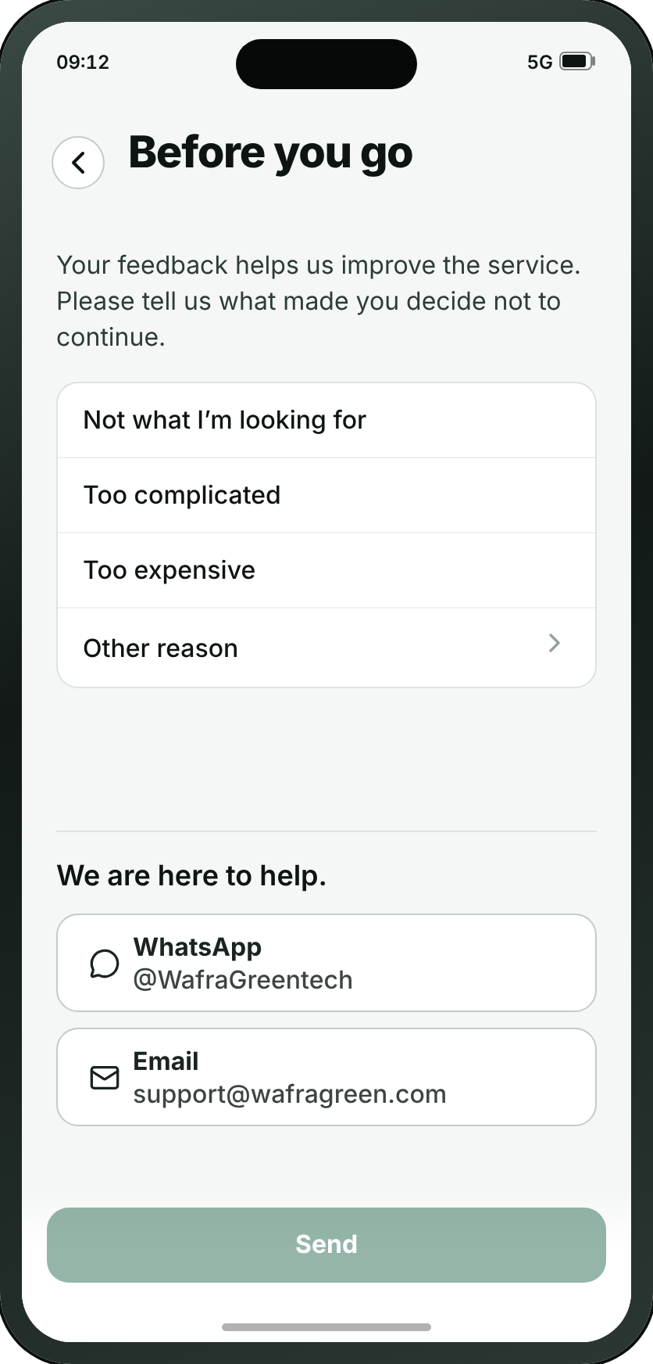
FIRST RUN
A12 · Not interested
WHAT THE SMALL BUTTONS DO
1
Other reason — Opens a drawer to type the reason
1
Wafra Farm App · UI mockup v1.7.3
16
Notes:
A12 — Not interested
New at review 21/09, and the only screen in the app that exists to learn something from somebody leaving. Behind “I’m not interested” on A11: four reasons in Mark’s order — not what I’m looking for, too complicated, too expensive, and a free-text other — with the WhatsApp and email buttons at the foot, because a farmer who is out because the app is too complicated is the one a person could still help, and he has no account and so no other way to reach one.
1. Other reason — Opens a drawer to type the reason

Slide 17
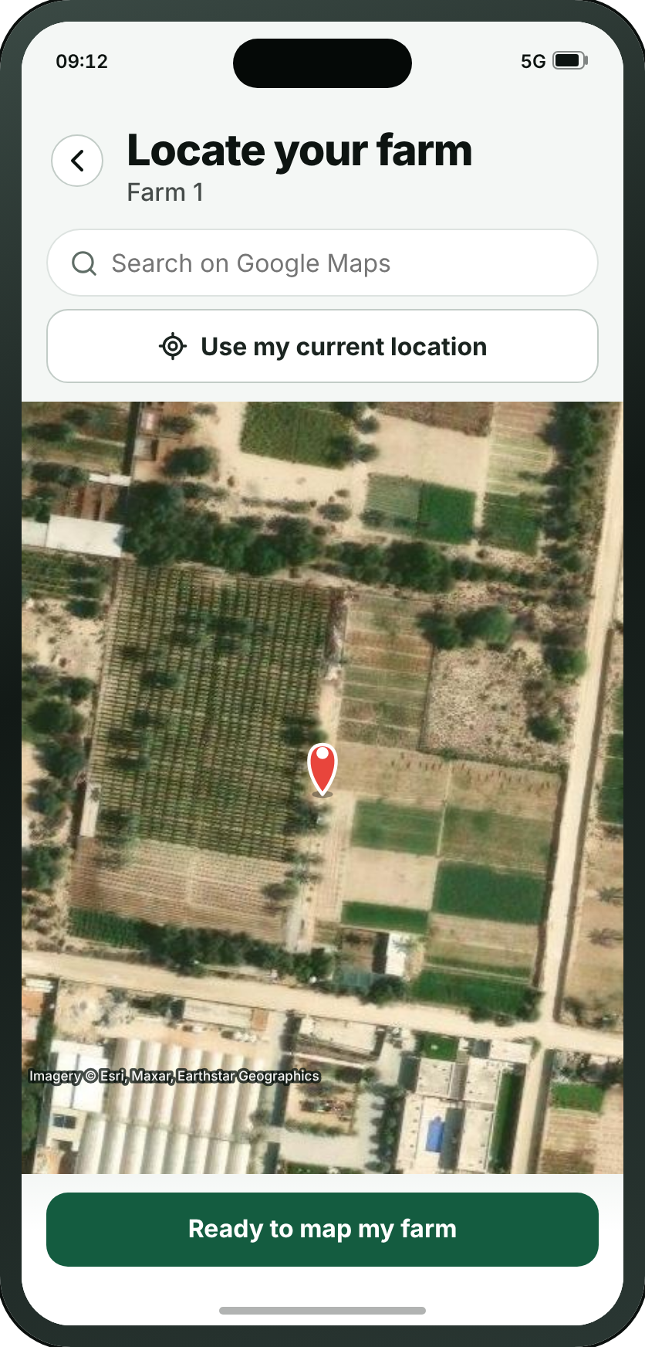
FIRST RUN
A13 · Locate your farm
→
→
→
→
→
→
→
→
→
→
→
→
A1
A2
A3
A8
A9
A10
A11
A13
A14
A15
A16
A17
A18
Welcome
Choose your language
Guided tour — 1 of 5
Sign up
Verify code
Tell us about your farm
Available service plans
Locate your farm
Draw your farm boundary
Survey in progress
Survey results
Service plans
Confirm subscription
WHAT THE SMALL BUTTONS DO
1
Ready to map my farm → A14 Draw your farm boundary (page 18)
1
Wafra Farm App · UI mockup v1.7.3
17
Notes:
A13 — Locate your farm
The first half of what used to be one screen. Review 21/09 split it: finding the farm and drawing round it were the same tap on the same map, so the screen was always in both modes and said it was in neither. This half only finds — two numbered, stacked options above the map, search or current location, and one button that confirms the farm is on screen. Nothing a farmer does here draws anything.
1. Ready to map my farm → A14
On the "Signing up" path.

Slide 18

FIRST RUN
A14 · Draw your farm boundary
→
→
→
→
→
→
→
→
→
→
→
→
A1
A2
A3
A8
A9
A10
A11
A13
A14
A15
A16
A17
A18
Welcome
Choose your language
Guided tour — 1 of 5
Sign up
Verify code
Tell us about your farm
Available service plans
Locate your farm
Draw your farm boundary
Survey in progress
Survey results
Service plans
Confirm subscription
Wafra Farm App · UI mockup v1.7.3
18
Notes:
A14 — Draw your farm boundary
The second half, and the one that draws. By the time anyone arrives the map is already over their land, which is what makes every tap on it unambiguous. The instruction is ON the map at lead size rather than six words in the bar with the rest behind an ⓘ — "text is very small and easy to miss. Farmer may not know how to proceed." One button, "Get quote", and since review 21/09 that is exactly what it does: it makes the farm, sends the boundary for survey, and the quote comes back on the far side. The screening that used to be done by charging first is done by A11 now, which shows both plans at their estimated cost before anyone gets here. Opened with a farm id it edits that farm’s outline instead, which is the one route that skips A13 entirely.
On the "Signing up" path.

Slide 19
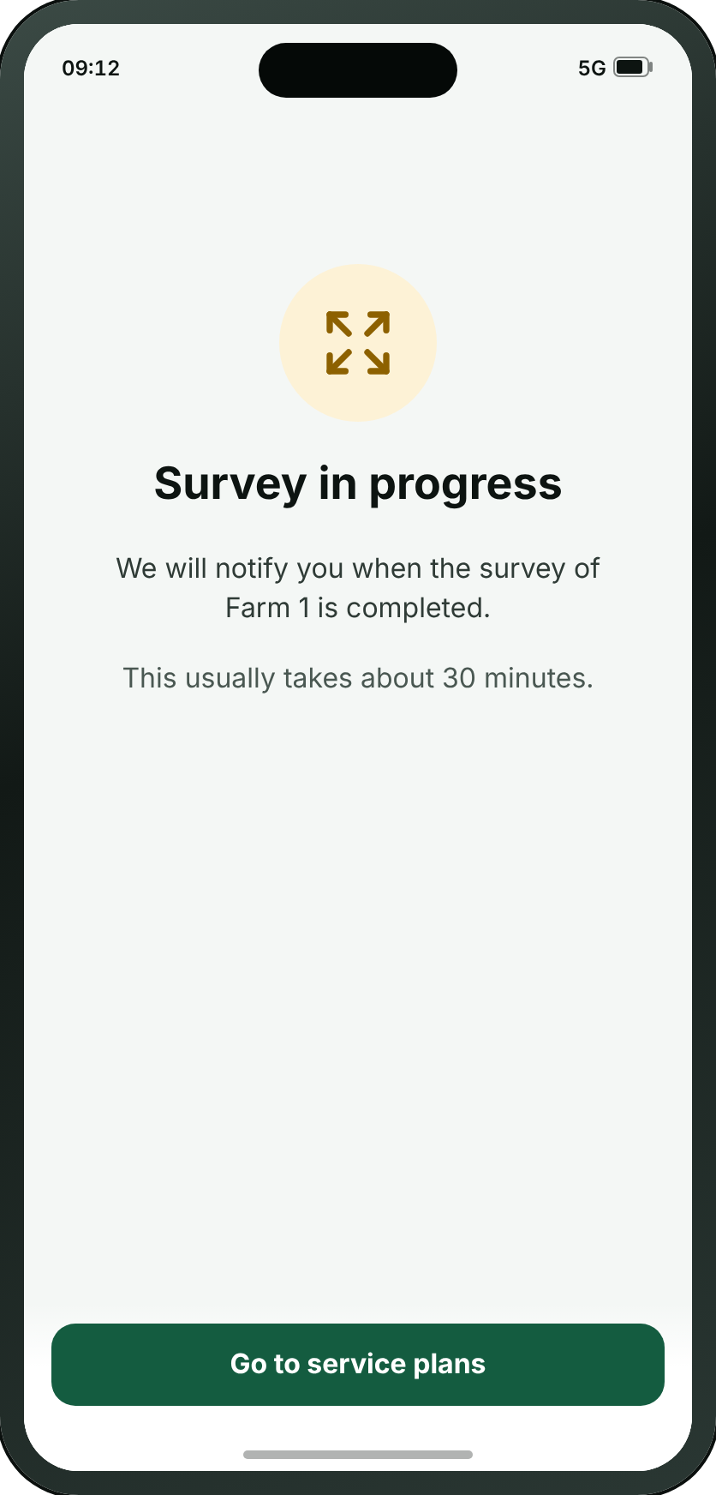
FIRST RUN
A15 · Survey in progress
→
→
→
→
→
→
→
→
→
→
→
→
A1
A2
A3
A8
A9
A10
A11
A13
A14
A15
A16
A17
A18
Welcome
Choose your language
Guided tour — 1 of 5
Sign up
Verify code
Tell us about your farm
Available service plans
Locate your farm
Draw your farm boundary
Survey in progress
Survey results
Service plans
Confirm subscription
WHAT THE SMALL BUTTONS DO
1
Go to service plans → A17 Service plans (page 21)
1
Wafra Farm App · UI mockup v1.7.3
19
Notes:
A15 — Survey in progress
The screen that says the satellite has been asked for something. Review 21/09 renamed it — the farmer is told a survey is starting before it and that his survey is ready after it, so calling the middle of it an analysis made three names for two things — and took out the line telling him to keep the app open: the survey runs on MMC’s servers, so the app has nothing to do while it waits and a push notification is what brings him back. It carries an estimated time, which is MMC’s number and varies by country. Its button goes on to the service plans.
1. Go to service plans → A17
On the "Signing up" path.

Slide 20
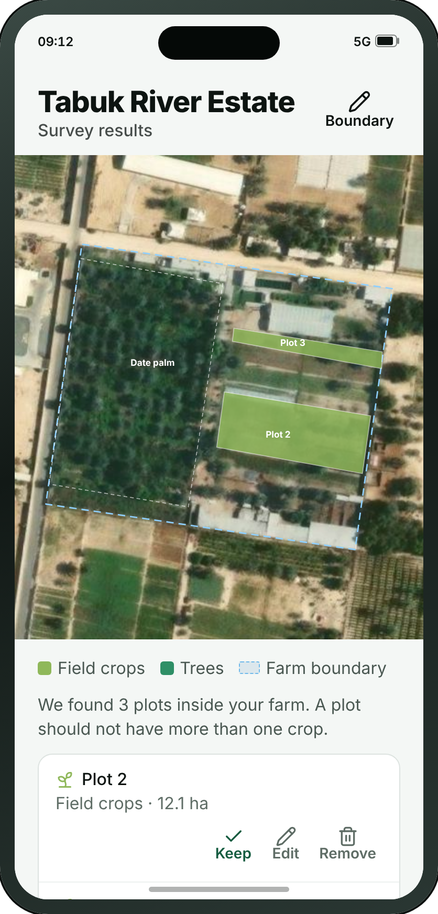
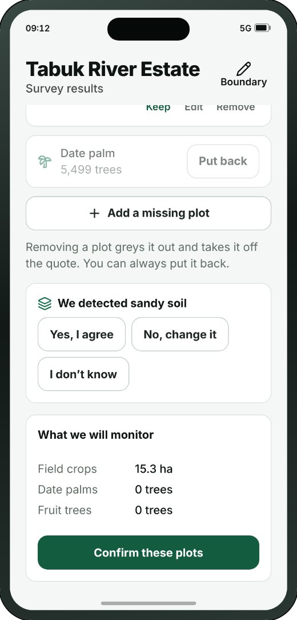
FIRST RUN
A16 · Survey results
→
→
→
→
→
→
→
→
→
→
→
→
A1
A2
A3
A8
A9
A10
A11
A13
A14
A15
A16
A17
A18
Welcome
Choose your language
Guided tour — 1 of 5
Sign up
Verify code
Tell us about your farm
Available service plans
Locate your farm
Draw your farm boundary
Survey in progress
Survey results
Service plans
Confirm subscription
THE REST OF THIS SCREEN
Scrolls · about 45% of this screen is shown above
Wafra Farm App · UI mockup v1.7.3
20
Notes:
A16 — Survey results
The plots the survey found, or the plots the farmer drew, as one list to approve, over the farm’s own outline: Keep, Edit and Remove on every plot, a button for a missing plot, and the way back to the boundary in the bar. Since v1.7.3 tree groups are named by their species and only a species with 40 trees or more is a tree group; fewer are counted, and said to be too few. And the soil: “We detected sandy loam” with three answers — Yes, I agree; No, change it; I don’t know. The farmer types nothing.
On the "Signing up" path.
The screenshot shows 47% of this screen; the rest is below the fold.

Slide 21

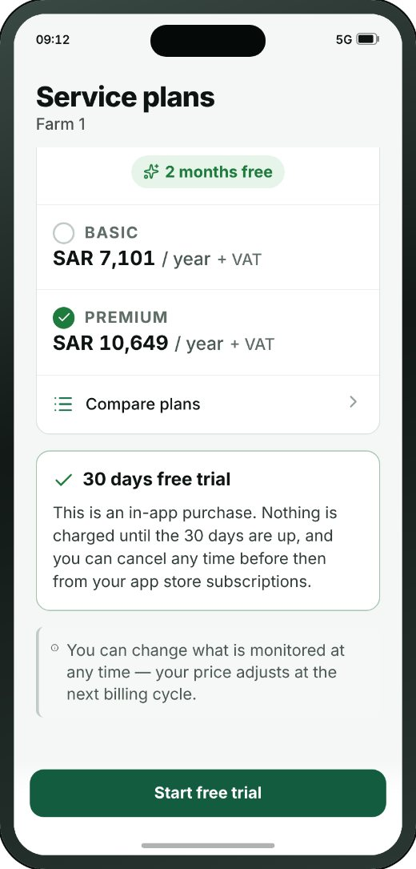
FIRST RUN
A17 · Service plans
→
→
→
→
→
→
→
→
→
→
→
→
A1
A2
A3
A8
A9
A10
A11
A13
A14
A15
A16
A17
A18
Welcome
Choose your language
Guided tour — 1 of 5
Sign up
Verify code
Tell us about your farm
Available service plans
Locate your farm
Draw your farm boundary
Survey in progress
Survey results
Service plans
Confirm subscription
THE REST OF THIS SCREEN
WHAT THE SMALL BUTTONS DO
1
Start free trial → A18 Confirm subscription (page 22)
1
Scrolls · about 80% of this screen is shown above
Wafra Farm App · UI mockup v1.7.3
21
Notes:
A17 — Service plans
The payment screen: two levels to pick between, a monthly/annual toggle above them, and one main confirmation button. Since v1.7.3 trees are billed in bands, rounded DOWN — 125 trees is billed as 100, not 150 — and nobody is billed for fewer than 100 trees: 0 to 99 is billed as 100, whatever the mix. The bands here stand in for the real ones, which are coming with examples. F5 is the same question for an account that already has one.
1. Start free trial → A18
On the "Signing up" path.
The screenshot shows 78% of this screen; the rest is below the fold.

Slide 22
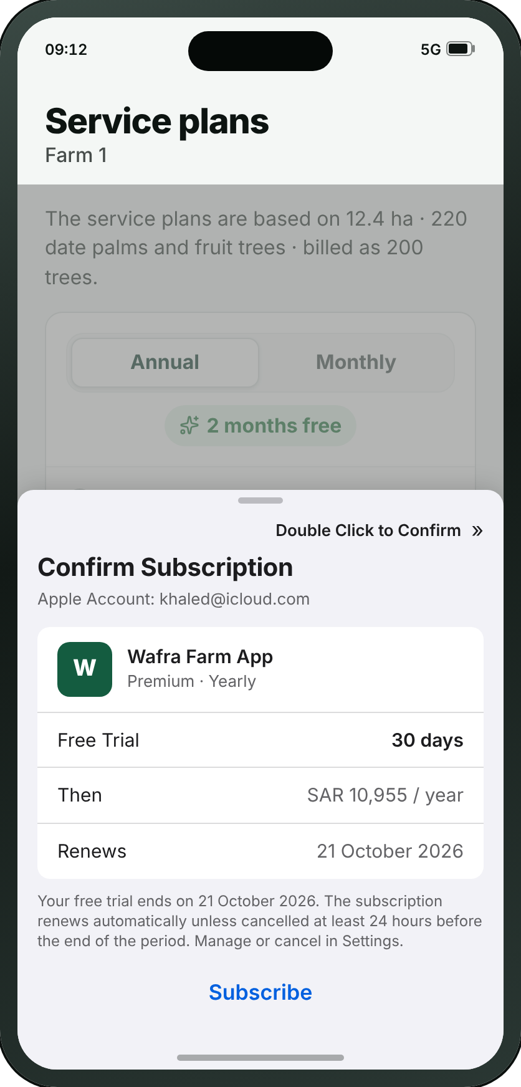
FIRST RUN
A18 · Confirm subscription
→
→
→
→
→
→
→
→
→
→
→
→
A1
A2
A3
A8
A9
A10
A11
A13
A14
A15
A16
A17
A18
Welcome
Choose your language
Guided tour — 1 of 5
Sign up
Verify code
Tell us about your farm
Available service plans
Locate your farm
Draw your farm boundary
Survey in progress
Survey results
Service plans
Confirm subscription
Wafra Farm App · UI mockup v1.7.3
22
Notes:
A18 — Confirm subscription
New at review 21/09 (second pass): the App Store purchase sheet, drawn as the drawer a farmer actually meets when he presses Start free trial. The 21/09 call settled that Wafra never sees a card — “we don’t charge a credit card, as the subscription is through Apple/Google” — and A17 says that in words; this is the same fact in the form it arrives. Deliberately not our design system: it is Apple’s sheet, drawn to iOS’s own metrics, because the point is that it is not ours to change. The Android equivalent is Google Play’s and is named on A17.
On the "Signing up" path.

Slide 23
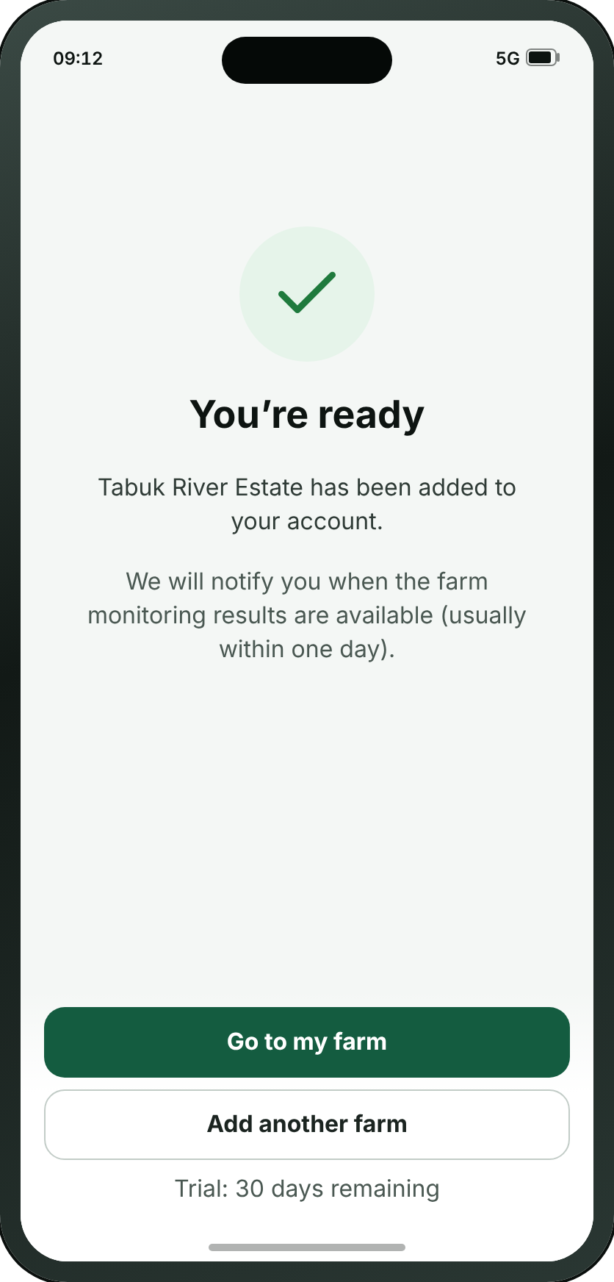
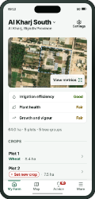
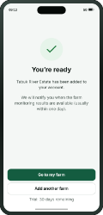
FIRST RUN
A19 · You’re ready
→
→
→
B1
A16
A17
A19
Farm home
Survey results
Service plans
You’re ready
Wafra Farm App · UI mockup v1.7.3
23
Notes:
A19 — You’re ready
The pause between setting up and starting. It says when the first satellite pass arrives, so the empty farm makes sense.
On the "Once the survey is ready" path.

Slide 24
SECTION 2 OF 6
Log in
2 screens · A20 · A21
Wafra Farm App · UI mockup v1.7.3
24
Notes:
Log in — 2 screens.

Slide 25
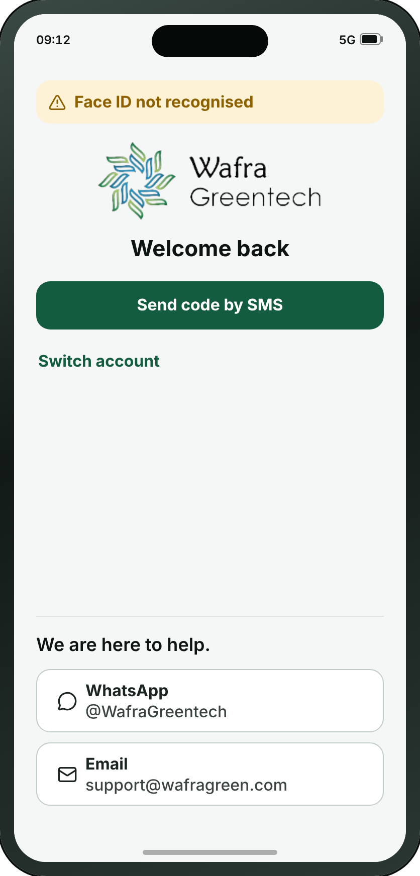
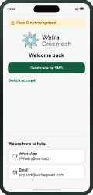
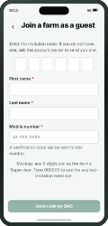
LOG IN
A20 · Log in
→
A20
A21
Log in
Join a farm as a guest
• Most users sign in with Face ID. This screen is drawn only when Face ID fails, which is what the notice at the top of it says.
• Creating an account and joining a farm as a guest are on A8, which is where somebody the app has never met lands.
• A code can be sent to the registered email address instead of a password.
• “Switch account” is for a farmer holding several accounts for different farms.
Wafra Farm App · UI mockup v1.7.3
25
Notes:
A20 — Log in
The way back in for somebody the app has already met, and only for them. It opens with the reason it is open at all — Face ID did not recognise him — then greets him by name and offers a password or a code to the registered email address. No app bar: the screen says "Welcome back" and does not also need a title saying "Log in". Creating an account and joining a farm as a guest are on A8, which is where a stranger lands.
On the "Joining a farm I was invited to" path.

Slide 26
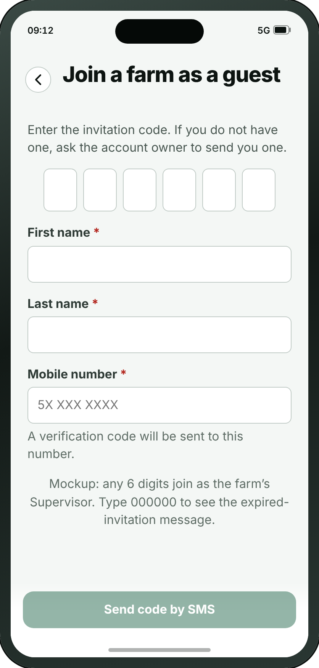
LOG IN
A21 · Join a farm as a guest
→
A20
A21
Log in
Join a farm as a guest
Wafra Farm App · UI mockup v1.7.3
26
Notes:
A21 — Join a farm as a guest
For someone invited to a farm they do not own — which is what “as a guest” says before they tap. Six digits typed in, or the QR code read off the phone of the person who set the account up, which is where review 06/09 put it: one phone shows, one phone scans.
On the "Joining a farm I was invited to" path.

Slide 27
SECTION 3 OF 6
My Farm
11 screens · B1 · B2 · B12 · B3 · B4 · B5 · B6 · B7 · B8 · B9 · B10
Wafra Farm App · UI mockup v1.7.3
27
Notes:
My Farm — 11 screens.

Slide 28
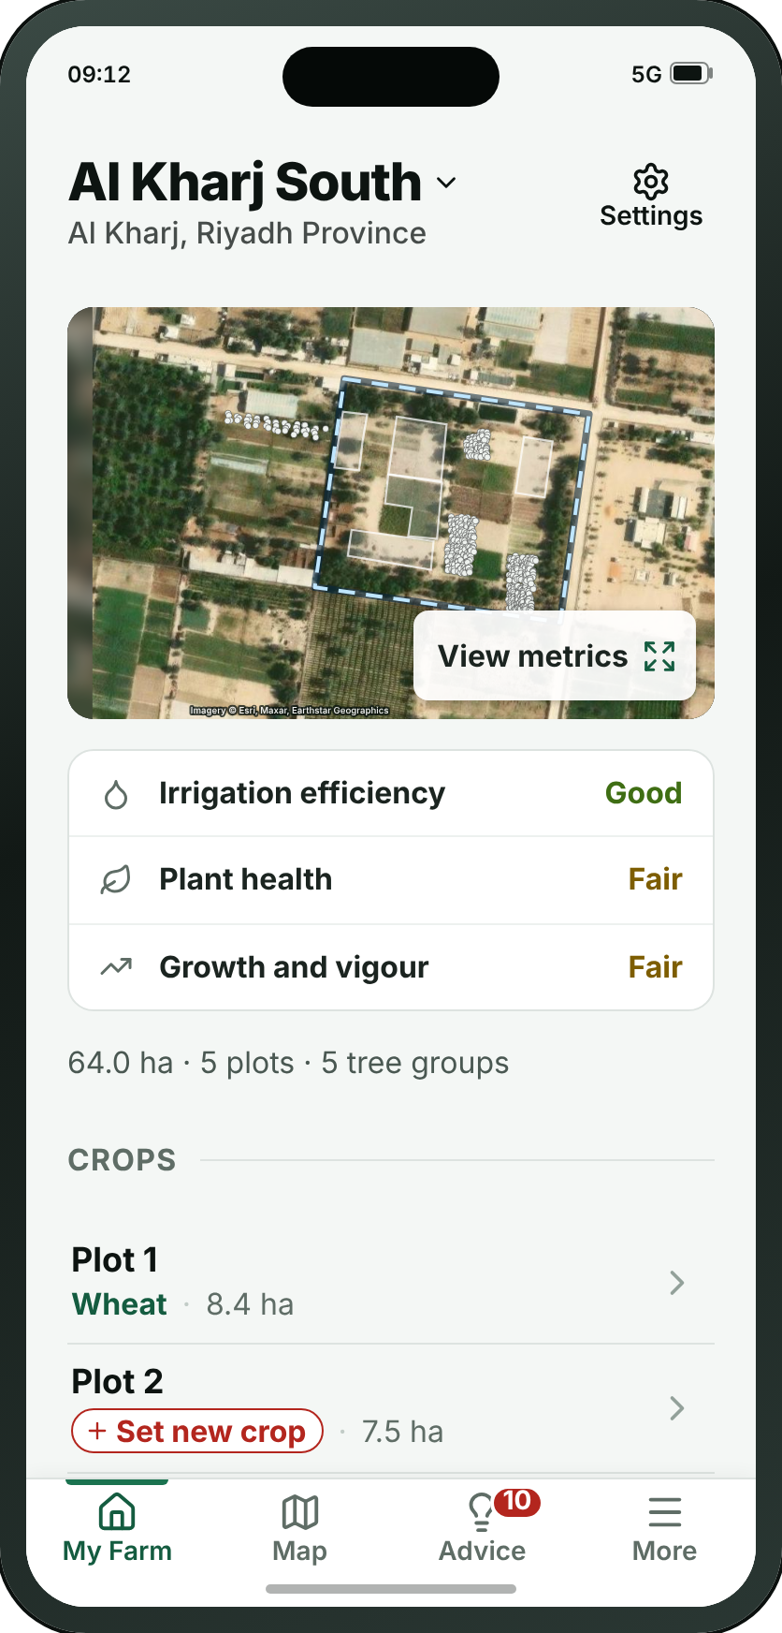
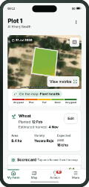
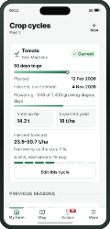
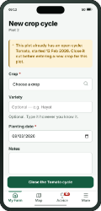
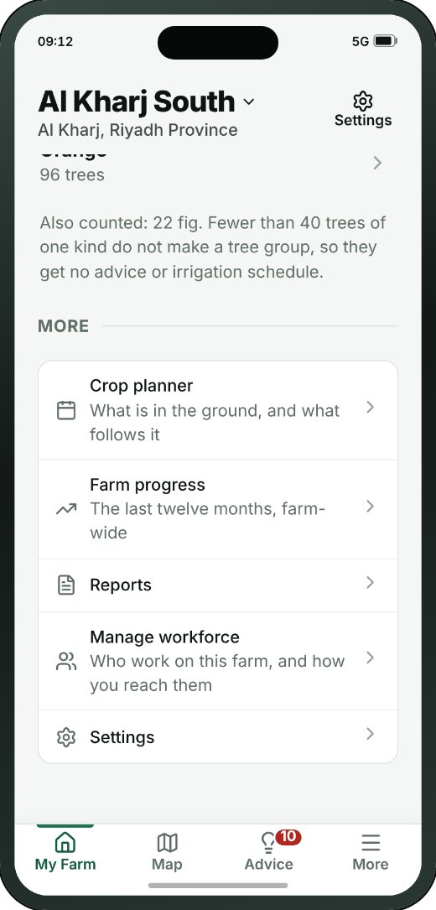
MY FARM
B1 · Farm home
→
→
→
1
B1
B2
B3
B4
Farm home
Plot detail
Crop cycles
Add / edit crop cycle
THE REST OF THIS SCREEN
WHAT THE SMALL BUTTONS DO
1
Switch farm — Switches between farms, and adds a new one
2
2
View metrics → C1 Map (page 40)
3
Open Plot 1 → B2 Plot detail (page 29)
4
Wheat → B3 Crop cycles (page 31)
5
Set new crop → B4 Add / edit crop cycle (page 32)
3
4
5
Scrolls · about 35% of this screen is shown above
Wafra Farm App · UI mockup v1.7.3
28
Notes:
B1 — Farm home
The farm and every plot on it. The map at the top has no metric picker: its one button says “View metrics” and opens the full map. Under it, three lines for the whole farm — irrigation efficiency, plant health, growth and vigour, each the average of all plots — as a word in its band’s colour, with a warning sign only when the word is a bad one; no percentages and no heading. The soil is chosen in Farm settings. The plot list has no health score: a plot or tree group with urgent advice says Urgent, with its warning sign, and pressing it opens the advice; otherwise it says nothing. Fields are Plot 1, 2, 3 in number order; tree groups are named by species, and a species under 40 trees is one line, counted, with no group.
1. Switch farm — Switches between farms, and adds a new one
2. View metrics → C1
3. Open Plot 1 → B2
4. Wheat → B3
5. Set new crop → B4
On the "From the farm to one plot, and what is growing on it" path.
The screenshot shows 35% of this screen; the rest is below the fold.

Slide 29
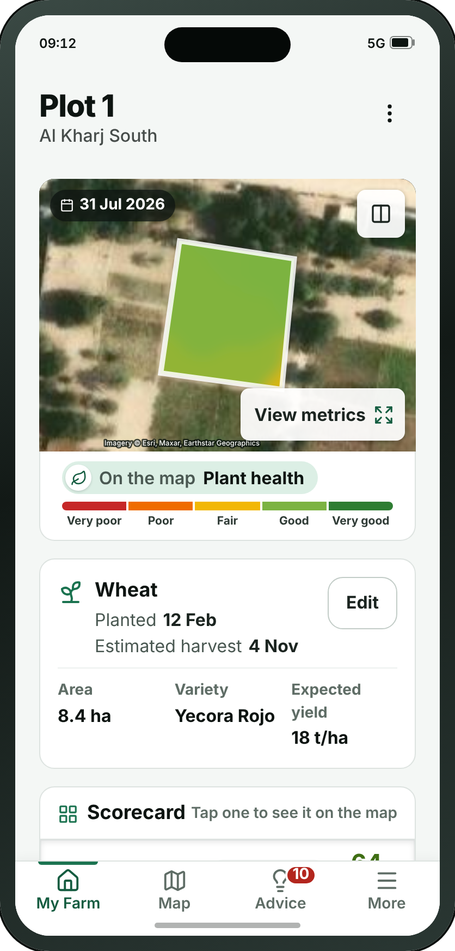
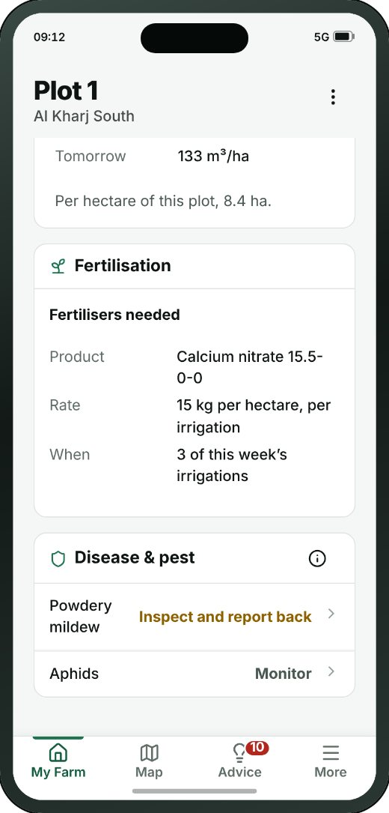
MY FARM
B2 · Plot detail
→
→
→
1
B1
B2
B3
B4
2
Farm home
Plot detail
Crop cycles
Add / edit crop cycle
THE REST OF THIS SCREEN
WHAT THE SMALL BUTTONS DO
1
More — Rename, edit the boundary, remove the plot
2
Which date? — Picks the imagery date, and compares two
3
3
View metrics → C1 Map (page 40)
4
Edit → B3 Crop cycles (page 31)
5
Plant health On the map64%Good — Shows this metric on the map
4
5
Scrolls · about 25% of this screen is shown above
Wafra Farm App · UI mockup v1.7.3
29
Notes:
B2 — Plot detail
One field, one long page (v1.7.3): the map, with “View metrics” on its expand button and, under it, a slim strip naming the metric it is painted with and its legend; the crop box — “Wheat”, then Planted and Estimated harvest; the scorecard, the only place a metric is printed as a number, where pressing a row paints the map; the agronomic trend of any of the five metrics, over the whole crop cycle, with numbers on both axes and the target drawn for the whole cycle while the plot’s line stops at today; the irrigation trend; the growth stage as a line chart, expected against today; then three boxes — Irrigation (today and tomorrow, per hectare; pressing it opens the week, B12), Fertilisation (what and when, per hectare) and Disease & pest (an action word, never a percentage). Every block’s title has its glyph. Urgent advice is inside its box; an empty box says “No action”. The two dock buttons are gone.
1. More — Rename, edit the boundary, remove the plot
2. Which date? — Picks the imagery date, and compares two
3. View metrics → C1
4. Edit → B3
5. Plant health On the map64%Good — Shows this metric on the map
On the "From the farm to one plot, and what is growing on it" path.
The screenshot shows 23% of this screen; the rest is below the fold.

Slide 30
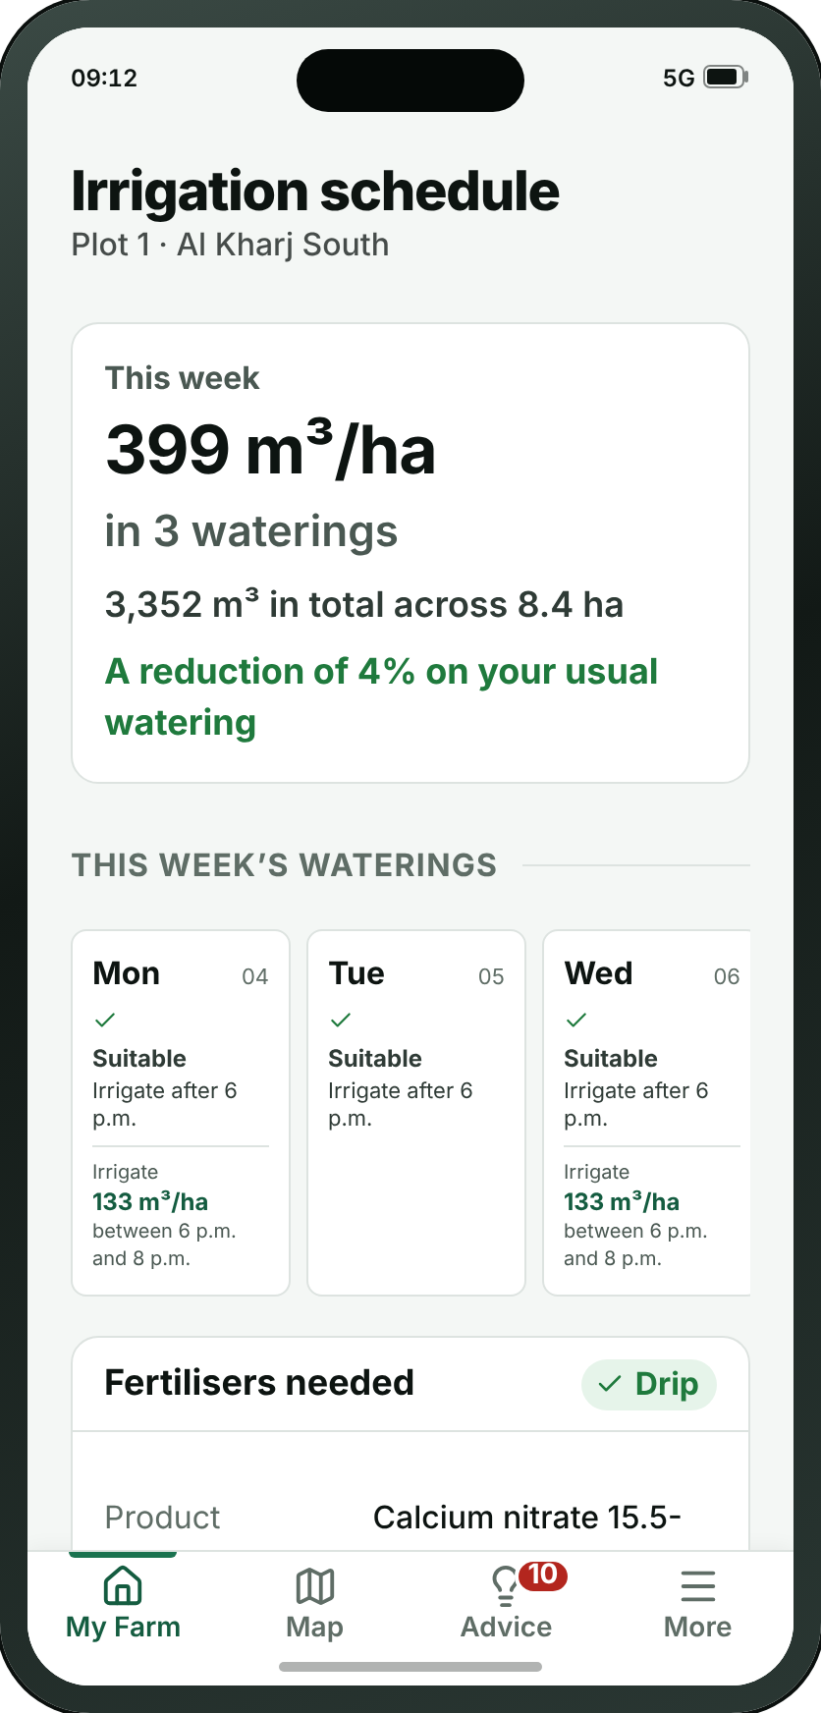
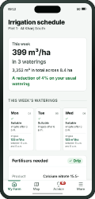
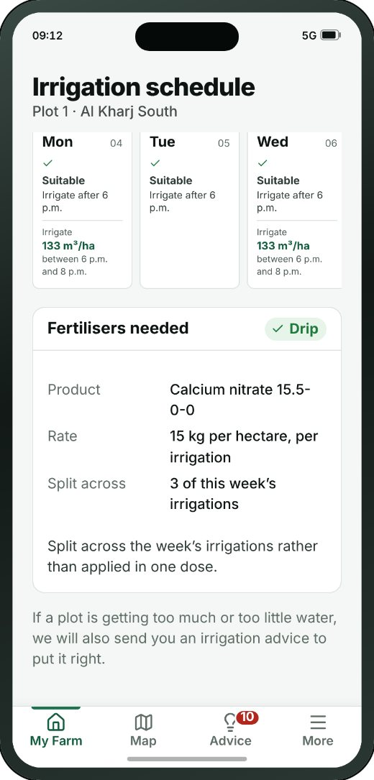
MY FARM
B12 · Irrigation schedule
→
→
B1
B2
B12
Farm home
Plot detail
Irrigation schedule
THE REST OF THIS SCREEN
Scrolls · about 65% of this screen is shown above
Wafra Farm App · UI mockup v1.7.3
30
Notes:
B12 — Irrigation schedule
Opened by pressing the irrigation box on a plot or tree group: the week’s water — the rate per hectare and the total, and whether it is more or less than usual — then each watering on its day with its two-hour window and the weather that decided it, and the fertilisers needed with the water, per hectare. Since v1.7.3 “Why this much water?” is gone, and so is the block with the soil, the irrigation system, its flow rate and its efficiency: the efficiency and the soil are the farm’s, and the system is not asked for in this version, so nothing is in minutes. A tree group is watered per hectare of the area it covers.
On the "A plot’s irrigation schedule" path.
The screenshot shows 66% of this screen; the rest is below the fold.

Slide 31


MY FARM
B3 · Crop cycles
→
→
→
1
B1
B2
B3
B4
Farm home
Plot detail
Crop cycles
Add / edit crop cycle
THE REST OF THIS SCREEN
WHAT THE SMALL BUTTONS DO
1
New → B4 Add / edit crop cycle (page 32)
2
Edit this cycle → B4 Add / edit crop cycle (page 32)
2
Scrolls · about 65% of this screen is shown above
Wafra Farm App · UI mockup v1.7.3
31
Notes:
B3 — Crop cycles
What has been planted here, season by season. Open field only — a tree group has no cycle. Closing a season keeps it, which is what makes one year comparable with the last.
1. New → B4
2. Edit this cycle → B4
On the "From the farm to one plot, and what is growing on it" path.
The screenshot shows 63% of this screen; the rest is below the fold.

Slide 32


MY FARM
B4 · Add / edit crop cycle
→
→
→
B1
B2
B3
B4
Farm home
Plot detail
Crop cycles
Add / edit crop cycle
THE REST OF THIS SCREEN
Scrolls · about 80% of this screen is shown above
Wafra Farm App · UI mockup v1.7.3
32
Notes:
B4 — Add / edit crop cycle
Starting a new planting, or closing the one that is running. A season closes with a harvest date, and a yield if anyone weighed it.
On the "From the farm to one plot, and what is growing on it" path.
The screenshot shows 82% of this screen; the rest is below the fold.

Slide 33




MY FARM
B5 · Tree group
→
→
1
B1
B5
B6
2
Farm home
Tree group
Tree detail
THE REST OF THIS SCREEN
WHAT THE SMALL BUTTONS DO
1
Search — Finds a tree by its number
2
Which date? — Picks the imagery date, and compares two
3
3
View metrics → C1 Map (page 40)
Scrolls · about 20% of this screen is shown above
Wafra Farm App · UI mockup v1.7.3
33
Notes:
B5 — Tree group
The same page as a field (B2), without the crop box. Named by species only — Olive, Lemon — and only a species with 40 trees or more is a tree group. The map is the trees, one dot each in the species’ colour. Scorecard (with Canopy health), Died or removed in the last 3 months, the agronomic trend, the irrigation trend and the fruit development trend, then the Irrigation, Fertilisation and Disease & pest boxes. Irrigation is per hectare of the area the group covers, never per tree.
1. Search — Finds a tree by its number
2. Which date? — Picks the imagery date, and compares two
3. View metrics → C1
On the "From the farm to a tree group, and down to one tree" path.
The screenshot shows 20% of this screen; the rest is below the fold.

Slide 34


MY FARM
B6 · Tree detail
→
→
1
B1
B5
B6
Farm home
Tree group
Tree detail
THE REST OF THIS SCREEN
WHAT THE SMALL BUTTONS DO
1
More — Replace, mark as removed, record a note
Scrolls · about 40% of this screen is shown above
Wafra Farm App · UI mockup v1.7.3
34
Notes:
B6 — Tree detail
One tree. It begins with a map of which tree it is — one dot per tree, no crown outline — because picking tree 2841 out of eight thousand is the hard part. Canopy health and the other readings are words in their band’s colour; the species is the species only, with no variety.
1. More — Replace, mark as removed, record a note
On the "From the farm to a tree group, and down to one tree" path.
The screenshot shows 38% of this screen; the rest is below the fold.

Slide 35



MY FARM
B7 · Crop planner
→
→
→
1
B1
B7
B3
B4
2
Farm home
Crop planner
Crop cycles
Add / edit crop cycle
THE REST OF THIS SCREEN
WHAT THE SMALL BUTTONS DO
1
About: Crop planner — Opens the guidance for this screen
2
Plot 1 · WheatStarted 12 Feb · harvest aro — Switches to another plot on this farm
Scrolls · about 35% of this screen is shown above
Wafra Farm App · UI mockup v1.7.3
35
Notes:
B7 — Crop planner
New at the 13/09 catalogue review. The app recorded cycles one plot at a time and planned across none of them, so nothing could say that four plots come free in March or that a field is going into its third season of the same family. Plots down the side, twelve months across, current cycles drawn where their real dates put them, and a suggested next crop read from each plot’s own closed history.
1. About: Crop planner — Opens the guidance for this screen
2. Plot 1 · WheatStarted 12 Feb · harvest aro — Switches to another plot on this farm
On the "Planning what follows this season" path.
The screenshot shows 33% of this screen; the rest is below the fold.

Slide 36



MY FARM
B8 · Farm progress
→
→
1
B1
B8
B2
Farm home
Farm progress
Plot detail
THE REST OF THIS SCREEN
WHAT THE SMALL BUTTONS DO
1
About: Farm progress — Opens the guidance for this screen
Scrolls · about 45% of this screen is shown above
Wafra Farm App · UI mockup v1.7.3
36
Notes:
B8 — Farm progress
Twelve months of one measure for the whole farm — the comparison the app could not make: B2 charts a single plot and C4 puts the farm at two dates side by side, and nothing showed the year. It is a trend for a chosen measure and deliberately not a farm health score: averaging crops that cannot be averaged is why B1 carries no such figure.
1. About: Farm progress — Opens the guidance for this screen
On the "Reading the year, and the plots behind it" path.
The screenshot shows 45% of this screen; the rest is below the fold.

Slide 37


MY FARM
B9 · Draw my own plots
→
→
1
B1
B9
A16
Farm home
Draw my own plots
Survey results
WHAT THE SMALL BUTTONS DO
1
About: Draw one plot — Opens the guidance for this screen
Wafra Farm App · UI mockup v1.7.3
37
Notes:
B9 — Draw my own plots
Drawing each plot on satellite imagery, corner by corner, and naming it. One plot is one crop, which is why the boundary is the only thing this route asks for before the summary. Reached from Farm settings now (Add a plot), not from first-run sign-up — the fork that used to send new sign-ups here is A9B, which this registry no longer carries; see the note near the top of this file.
1. About: Draw one plot — Opens the guidance for this screen
On the "Adding a plot by hand, after the farm already exists" path.

Slide 38



MY FARM
B10 · Manage workforce
→
B1
B10
Farm home
Manage workforce
THE REST OF THIS SCREEN
WHAT THE SMALL BUTTONS DO
1
Invite in personShow a QR code — Shows the code on this phone for the other person to scan
2
Invite by SMSSend a six-digit code — Sends the code to somebody who is not here
1
2
Scrolls · about 55% of this screen is shown above
Wafra Farm App · UI mockup v1.7.3
38
Notes:
B10 — Manage workforce
The people work is sent to on this farm: a name, a number and the app each of them actually reads. Nobody here holds an account — an advice reaches them as a message with a link — except the one person invited as supervisor. It is an address book, not the permission matrix the v1.5.4 review deleted.
1. Invite in personShow a QR code — Shows the code on this phone for the other person to scan
2. Invite by SMSSend a six-digit code — Sends the code to somebody who is not here
On the "The people work is sent to" path.
The screenshot shows 55% of this screen; the rest is below the fold.

Slide 39
SECTION 4 OF 6
Map
4 screens · C1 · C2 · C4 · C5
Wafra Farm App · UI mockup v1.7.3
39
Notes:
Map — 4 screens.

Slide 40



MAP
C1 · Map
→
→
1
2
C1
C2
B2
3
Map
Layers
Plot detail
4
WHAT THE SMALL BUTTONS DO
1
Search a place, farm, plot or tree — Finds a place, a farm, a plot or a tree
2
All farms — Switches which farm the map is showing
3
Layers → C2 Layers (page 41)
4
Compare → C4 Compare dates (page 42)
5
Pick a metric. Showing Plant health — Opens the list of metrics, each explained
5
Wafra Farm App · UI mockup v1.7.3
40
Notes:
C1 — Map
The farm from above, filling the screen, and the one place “Pick a metric” is. Every plot is labelled, always, at every zoom: zoomed out, a label that would cover its plot is drawn smaller rather than hidden. Tree groups are their trees: one dot per tree in one neutral colour, named by species — no areas, no crown outlines, no blue land-use shapes, no forest or hedges, and no key for the dots. A tap on a plot opens the plot (B2 or B5), with a way back; there is no plot sheet any more. The panel at the foot holds the picker, the five-colour legend and the image date.
1. Search a place, farm, plot or tree — Finds a place, a farm, a plot or a tree
2. All farms — Switches which farm the map is showing
3. Layers → C2
4. Compare → C4
5. Pick a metric. Showing Plant health — Opens the list of metrics, each explained
On the "Finding a plot on the map and opening it" path.

Slide 41

MAP
C2 · Layers
→
→
C1
C2
B2
Map
Layers
Plot detail
Wafra Farm App · UI mockup v1.7.3
41
Notes:
C2 — Layers
Which picture to draw the map on — satellite or Google Maps, each described — and two farm layers: the boundaries, and the trees, one dot each. No forest layer and no land-use shapes.
On the "Finding a plot on the map and opening it" path.

Slide 42


MAP
C4 · Compare dates
→
C1
C4
Map
Compare dates
WHAT THE SMALL BUTTONS DO
1
Pick a metric. Showing Plant health — Opens the list of metrics, each explained
1
Wafra Farm App · UI mockup v1.7.3
42
Notes:
C4 — Compare dates
The whole farm at two dates at once, split by a line you drag across it. It opens a week apart — an interval, resolved to the last satellite pass before the mark, rather than a count of passes that could mean anything.
1. Pick a metric. Showing Plant health — Opens the list of metrics, each explained
On the "Comparing two dates" path.

Slide 43

MAP
C5 · Boundary editor
• The boundary editor corrects the shape of one outline after the fact — a plot the survey drew slightly wrong, or a farm outline that has changed. Drag a corner to move it, add or remove corners, and split, join or remove the shape.
• The old outline is kept, with who changed it and when, so past analytics stay attached to the shape that was live at the time.
Wafra Farm App · UI mockup v1.7.3
43
Notes:
C5 — Boundary editor
Correcting the shape of a plot after the fact, and splitting, joining, removing or adding one. The old outline is kept, with who changed it and when.

Slide 44
SECTION 5 OF 6
Advice
6 screens · D1 · D2 · D3 · D4 · D5 · D6
Wafra Farm App · UI mockup v1.7.3
44
Notes:
Advice — 6 screens.

Slide 45




ADVICE
D1 · Advice inbox
→
→
D1
D2
B12
Advice inbox
Irrigation advice
Irrigation schedule
THE REST OF THIS SCREEN
Scrolls · about 35% of this screen is shown above
Wafra Farm App · UI mockup v1.7.3
45
Notes:
D1 — Advice inbox
The centre of the product, in two tabs: Plots and Trees. Sorted by field, every plot is listed in number order — 1, 2 … 10 — and a plot with nothing to do says “No action”. The Trees tab lists tree groups of 40 trees or more. Each advice is three lines, with the detail one tap away on D2, D3 or D4, and the same advice is also inside its plot’s boxes. The camera button is “Plant diagnosis” now, and stays on this screen.
On the "Reading a piece of advice and sending it on" path.
The screenshot shows 35% of this screen; the rest is below the fold.

Slide 46


ADVICE
D2 · Irrigation advice
→
→
D1
D2
B12
Advice inbox
Irrigation advice
Irrigation schedule
THE REST OF THIS SCREEN
WHAT THE SMALL BUTTONS DO
1
See this plot’s irrigation scheduleThe wee → B12 Irrigation schedule (page 30)
1
Scrolls · about 70% of this screen is shown above
Wafra Farm App · UI mockup v1.7.3
46
Notes:
D2 — Irrigation advice
One shot only (v1.7.2): raised when a plot is getting too much or too little water, it says which, the one amount that puts it right and when, and the soil moisture reading that raised it. The week’s schedule is not here any more — it is the plot’s own page, B12, linked at the foot.
1. See this plot’s irrigation scheduleThe wee → B12
On the "Reading a piece of advice and sending it on" path.
The screenshot shows 70% of this screen; the rest is below the fold.

Slide 47




ADVICE
D3 · Fertilisation advice
→
→
D1
D3
D4
Advice inbox
Fertilisation advice
Crop protection advice
THE REST OF THIS SCREEN
Scrolls · about 45% of this screen is shown above
Wafra Farm App · UI mockup v1.7.3
47
Notes:
D3 — Fertilisation advice
How much nitrogen, phosphate or potash the crop is short of, per hectare, and “Fertilisers needed”: the common products that supply it, each at its dose per hectare. The same content is in the fertilisation box on the plot page.
On the "The other two kinds of advice" path.
The screenshot shows 44% of this screen; the rest is below the fold.

Slide 48


ADVICE
D4 · Crop protection advice
→
→
D1
D3
D4
Advice inbox
Fertilisation advice
Crop protection advice
THE REST OF THIS SCREEN
Scrolls · about 35% of this screen is shown above
Wafra Farm App · UI mockup v1.7.3
48
Notes:
D4 — Crop protection advice
What to do, in one of three words — Action required, Inspect and report back, or Monitor — never a probability. Then the active ingredient, the spray conditions for the week, and the date after which the crop is safe to pick. The reminder to read the label stays on the screen.
On the "The other two kinds of advice" path.
The screenshot shows 37% of this screen; the rest is below the fold.

Slide 49





ADVICE
D5 · Plant diagnosis
→
→
→
D1
D5
D6
F16
Advice inbox
Plant diagnosis
Plant diagnosis — result
One pest or disease
THE REST OF THIS SCREEN
Scrolls · about 60% of this screen is shown above
Wafra Farm App · UI mockup v1.7.3
49
Notes:
D5 — Plant diagnosis
Called “Check a photo” until v1.7.3. A farmer standing over a plant he is worried about photographs it and gets a shortlist: pests, disease, and too much or too little water. The capture state is the frame and the three things that decide whether the answer is any good — distance, light, and a healthy part of the leaf in shot.
On the "Checking damage from a photograph" path.
The screenshot shows 60% of this screen; the rest is below the fold.

Slide 50


ADVICE
D6 · Plant diagnosis — result
→
→
→
D1
D5
D6
F16
Advice inbox
Plant diagnosis
Plant diagnosis — result
One pest or disease
THE REST OF THIS SCREEN
Scrolls · about 60% of this screen is shown above
Wafra Farm App · UI mockup v1.7.3
50
Notes:
D6 — Plant diagnosis — result
What came back: the likeliest cause, marked as a likely or possible match rather than a percentage, how to confirm it on the plant, what to do, the pre-harvest interval, and the second candidate it could also be.
On the "Checking damage from a photograph" path.
The screenshot shows 62% of this screen; the rest is below the fold.

Slide 51
SECTION 6 OF 6
More
17 screens · F1 · F2 · F3 · F4 · F5 · F6 · F7 · F8 · F9 · F10 · F11 · F12 · F13 · F14 · F15 · F16 · F17
Wafra Farm App · UI mockup v1.7.3
51
Notes:
More — 17 screens.

Slide 52





MORE
F1 · More
→
→
F1
F5
F6
More
Subscription info for existing users
Compare plans
THE REST OF THIS SCREEN
Scrolls · about 65% of this screen is shown above
Wafra Farm App · UI mockup v1.7.3
52
Notes:
F1 — More
Everything outside the day’s work. What appears depends on who is looking.
On the "What the plan covers, and what it costs" path.
The screenshot shows 65% of this screen; the rest is below the fold.

Slide 53

MORE
F2 · My profile
WHAT THE SMALL BUTTONS DO
1
Send code to new phone number → A9 Verify code (page 12)
1
Wafra Farm App · UI mockup v1.7.3
53
Notes:
F2 — My profile
Contact details, and nothing else since review 06/09: a first and last name, the number and the address, all of them editable. Committing the screen sends a code to the number and hands to A9, because the number is the one detail here that has to be proved.
1. Send code to new phone number → A9

Slide 54


MORE
F3 · Reports
THE REST OF THIS SCREEN
Scrolls · about 45% of this screen is shown above
Wafra Farm App · UI mockup v1.7.3
54
Notes:
F3 — Reports
The farm written up for a week, a season, or a bank, in whichever language was asked for. A placeholder until MMC sends examples; the nutrient report is called “Nutrient reports and analysis”.
The screenshot shows 45% of this screen; the rest is below the fold.

Slide 55


MORE
F4 · Weather
THE REST OF THIS SCREEN
Scrolls · about 30% of this screen is shown above
Wafra Farm App · UI mockup v1.7.3
55
Notes:
F4 — Weather
The forecast, and any warning attached to it, with the frost indicator. The week’s evapotranspiration is called that, in millimetres — it used to say “Water demand this week”.
The screenshot shows 28% of this screen; the rest is below the fold.

Slide 56


MORE
F5 · Subscription info for existing users
→
→
F1
F5
F6
More
Subscription info for existing users
Compare plans
THE REST OF THIS SCREEN
Scrolls · about 55% of this screen is shown above
Wafra Farm App · UI mockup v1.7.3
56
Notes:
F5 — Subscription info for existing users
What is being paid for and when it renews, with the sum shown. Where it was bought decides what this screen may offer, and since review 06/09 three jobs that were a phone number are rows: an invoice, switching the cycle or the level, and team members. A17 is the same question for an account that does not have one yet.
On the "What the plan covers, and what it costs" path.
The screenshot shows 56% of this screen; the rest is below the fold.

Slide 57


MORE
F6 · Compare plans
→
→
F1
F5
F6
More
Subscription info for existing users
Compare plans
THE REST OF THIS SCREEN
WHAT THE SMALL BUTTONS DO
1
Back to my plan → F5 Subscription info for existing users (page 56)
1
Scrolls · about 15% of this screen is shown above
Wafra Farm App · UI mockup v1.7.3
57
Notes:
F6 — Compare plans
MMC’s Feature_Comparison document, transcribed, across its two catalogues — Farm App Services for a crop or mixed holding, Tree Advisory for a tree one. Since v1.7.3 in the app’s own words: the scorecard in place of raw index names, Nutrition status in place of soil health, growth stage distribution, early stress warning with nothing in brackets, and Nutrient reports and analysis; farm anomaly detection, canopy water content and disease forecasting are gone. A Premium-only feature is a dash under Basic and a tick under Premium, with no other label. No prices — A17 and F5 have them.
1. Back to my plan → F5
On the "What the plan covers, and what it costs" path.
The screenshot shows 15% of this screen; the rest is below the fold.

Slide 58





MORE
F7 · Settings
→
→
→
→
F1
F7
F8
F9
F10
More
Settings
Units and formats
Advice distribution
Data and storage
1
WHAT THE SMALL BUTTONS DO
2
1
Units and formats → F8 Units and formats (page 59)
2
Advice distribution → F9 Advice distribution (page 60)
Wafra Farm App · UI mockup v1.7.3
58
Notes:
F7 — Settings
The language menu itself, the way through to units, notifications and storage, shared phones, Face ID, the legal documents, and closing the account for good.
1. Units and formats → F8
2. Advice distribution → F9
On the "Settings" path.

Slide 59

MORE
F8 · Units and formats
→
→
→
→
F1
F7
F8
F9
F10
More
Settings
Units and formats
Advice distribution
Data and storage
Wafra Farm App · UI mockup v1.7.3
59
Notes:
F8 — Units and formats
Land area, water, temperature, calendar, time and numerals, each in a section of its own. The calendar offers Gregorian, both, or Hijri — single, double, single.
On the "Settings" path.

Slide 60


MORE
F9 · Advice distribution
→
→
→
→
F1
F7
F8
F9
F10
More
Settings
Units and formats
Advice distribution
Data and storage
THE REST OF THIS SCREEN
Scrolls · about 45% of this screen is shown above
Wafra Farm App · UI mockup v1.7.3
60
Notes:
F9 — Advice distribution
A standing rule for where each kind of advice goes: irrigation, fertilisation and crop protection, each by SMS, WhatsApp or Telegram, each naming the people on the team who receive it.
On the "Settings" path.
The screenshot shows 47% of this screen; the rest is below the fold.

Slide 61


MORE
F10 · Data and storage
→
→
→
→
F1
F7
F8
F9
F10
More
Settings
Units and formats
Advice distribution
Data and storage
THE REST OF THIS SCREEN
Scrolls · about 35% of this screen is shown above
Wafra Farm App · UI mockup v1.7.3
61
Notes:
F10 — Data and storage
How much of the phone the app has taken up, whether to wait for Wi-Fi, and what is still waiting to be sent.
On the "Settings" path.
The screenshot shows 36% of this screen; the rest is below the fold.

Slide 62


MORE
F11 · Activity log
THE REST OF THIS SCREEN
Scrolls · about 20% of this screen is shown above
Wafra Farm App · UI mockup v1.7.3
62
Notes:
F11 — Activity log
Who did what, when, and on which farm. Entries are added and never edited afterwards, which is the point of it.
The screenshot shows 22% of this screen; the rest is below the fold.

Slide 63






MORE
F12 · Help and user guide
→
→
→
→
→
F1
F12
F13
F14
F15
F16
More
Help and user guide
Crop guide
One crop
Pests and diseases
One pest or disease
THE REST OF THIS SCREEN
Scrolls · about 15% of this screen is shown above
Wafra Farm App · UI mockup v1.7.3
63
Notes:
F12 — Help and user guide
Answers to the questions that come up most, a glossary for the agronomy words the app uses, and the tour again for anyone who skipped it.
On the "Looking a crop or a disease up" path.
The screenshot shows 14% of this screen; the rest is below the fold.

Slide 64


MORE
F13 · Crop guide
→
→
→
→
→
F1
F12
F13
F14
F15
F16
More
Help and user guide
Crop guide
One crop
Pests and diseases
One pest or disease
THE REST OF THIS SCREEN
Scrolls · about 15% of this screen is shown above
Wafra Farm App · UI mockup v1.7.3
64
Notes:
F13 — Crop guide
New at the 13/09 catalogue review: the 37 crops the app already knew about, readable at last. They were picker data — a name and three varieties, offered when a farmer declares what he planted — and nothing anywhere said how long the season runs, what it drinks, or what goes wrong with it. Grouped by family, searchable by variety, and marked where the farmer grows it himself.
On the "Looking a crop or a disease up" path.
The screenshot shows 17% of this screen; the rest is below the fold.

Slide 65


MORE
F14 · One crop
→
→
→
→
→
F1
F12
F13
F14
F15
F16
More
Help and user guide
Crop guide
One crop
Pests and diseases
One pest or disease
THE REST OF THIS SCREEN
Scrolls · about 50% of this screen is shown above
Wafra Farm App · UI mockup v1.7.3
65
Notes:
F14 — One crop
The page behind a crop: the season it commits the ground for, the water it takes, spacing, sowing and harvest windows, its varieties, and the pests and diseases that name it — each of which opens its own entry. The cross-link is the point of shipping the two directories together.
On the "Looking a crop or a disease up" path.
The screenshot shows 52% of this screen; the rest is below the fold.

Slide 66


MORE
F15 · Pests and diseases
→
→
→
→
→
F1
F12
F13
F14
F15
F16
More
Help and user guide
Crop guide
One crop
Pests and diseases
One pest or disease
THE REST OF THIS SCREEN
Scrolls · about 40% of this screen is shown above
Wafra Farm App · UI mockup v1.7.3
66
Notes:
F15 — Pests and diseases
The directory the app had been referring farmers to for months without having one: the glossary told them to look up a pre-harvest interval “in the disease directory”, and there was none. Eighteen entries written for this region — red palm weevil, dubas bug, bayoud — searchable by name, symptom or crop.
On the "Looking a crop or a disease up" path.
The screenshot shows 39% of this screen; the rest is below the fold.

Slide 67


MORE
F16 · One pest or disease
→
→
→
→
→
F1
F12
F13
F14
F15
F16
More
Help and user guide
Crop guide
One crop
Pests and diseases
One pest or disease
THE REST OF THIS SCREEN
Scrolls · about 40% of this screen is shown above
Wafra Farm App · UI mockup v1.7.3
67
Notes:
F16 — One pest or disease
What to look for, what brings it on, what to do about it, and how long before the crop can be picked. Reached from the risk strip on a plot, from a photo diagnosis, or from the crop it affects — which is what stops a reference library being one nobody opens.
On the "Looking a crop or a disease up" path.
The screenshot shows 41% of this screen; the rest is below the fold.

Slide 68

MORE
F17 · Contact Wafra
Wafra Farm App · UI mockup v1.7.3
68
Notes:
F17 — Contact Wafra
Two large buttons, call or message, and a slower route for anything that needs a written record.

