Slide 1

Wafra Farm App
57
1.8.0
SCREENS
VERSION
57 screens across 6 sections of the app, at version 1.8.0. Each page carries one screen on the left; the right-hand side is left clear for comments and notes.
Notes:
Wafra Farm App UI mockup, version 1.8.0. 57 screens.

Slide 2
Every screen
57 screens · the number is the page in this deck
FIRST RUN
LOG IN
ADVICE
A1
Welcome
4
A20
Log in
23
D1
Advice inbox
42
A2
Choose your language
5
A21
Join a farm as a guest
24
D2
Irrigation advice
43
A3
Guided tour — 1 of 5
6
MY FARM
D3
Fertilisation advice
44
A4
Guided tour — 2 of 5
7
B1
Farm home
26
D4
Crop protection advice
45
A5
Guided tour — 3 of 5
8
B2
Field detail
27
D5
Plant diagnosis
46
A6
Guided tour — 4 of 5
9
B3
Crop cycles
28
D6
Plant diagnosis — result
47
A7
Guided tour — 5 of 5
10
B4
Add / edit crop cycle
29
MORE
A8
Sign up
11
B5
Tree field
30
F1
More
49
A9
Verify code
12
B6
Tree detail
31
F2
My profile
50
A10
Tell us about your farm
13
B7
Crop planner
32
F3
Reports
51
A22
Too small for a survey
14
B8
Farm progress
33
F4
Weather
52
A11
Available service plans
15
B9
Add fields
34
F5
Subscription info for existing users
53
A12
Not interested
16
B10
Manage workforce
35
F6
Compare plans
54
A13
Draw your fields
17
MAP
F7
Settings
55
A16
Your fields
18
C1
Map
37
F8
Units and formats
56
A17
Service plans
19
C2
Layers
38
F9
Advice distribution
57
A18
Confirm subscription
20
C4
Compare dates
39
F10
Data and storage
58
A19
You’re ready
21
C5
Boundary editor
40
F11
Activity log
59
F12
Help and user guide
60
F13
Crop guide
61
F14
One crop
62
F15
Pests and diseases
63
F16
One pest or disease
64
F17
Contact Wafra
65
Wafra Farm App · UI mockup v1.8.0
2
Notes:
Contents. 57 screens across 6 sections.

Slide 3
SECTION 1 OF 6
First run
18 screens · A1 · A2 · A3 · A4 · A5 · A6 · A7 · A8 · A9 · A10 · A22 · A11 · A12 · A13 · A16 · A17 · A18 · A19
Wafra Farm App · UI mockup v1.8.0
3
Notes:
First run — 18 screens.

Slide 4
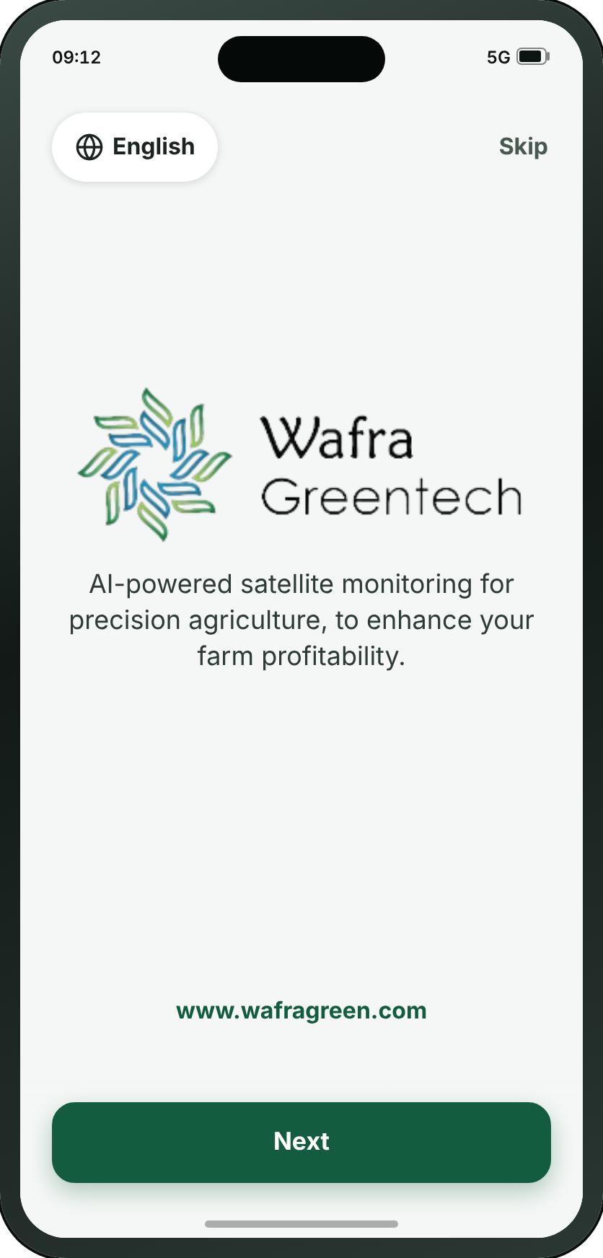
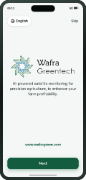
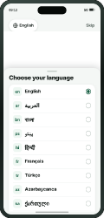
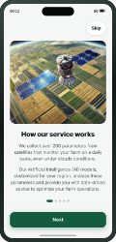
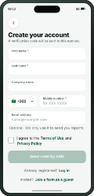
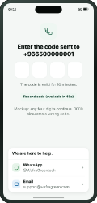
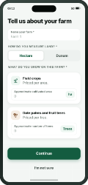
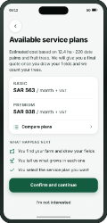
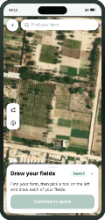
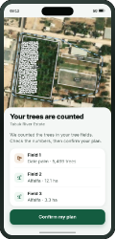
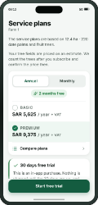
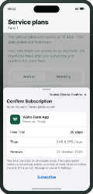
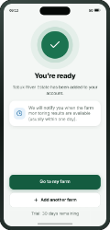
FIRST RUN
A1 · Welcome
→
→
→
→
→
→
→
→
→
→
→
A1
A2
A3
A8
A9
A10
A11
A13
A16
A17
A18
A19
Welcome
Choose your language
Guided tour — 1 of 5
Sign up
Verify code
Tell us about your farm
Available service plans
Draw your fields
Your fields
Service plans
Confirm subscription
You’re ready
WHAT THE SMALL BUTTONS DO
1
Next → A3 Guided tour — 1 of 5 (page 6)
1
Wafra Farm App · UI mockup v1.8.0
4
Notes:
A1 — Welcome
The first thing anyone sees, once, on the first launch: the mark and one sentence saying what the app does, centred, with the address at the foot. Next takes the tour and Skip goes straight to the sign-up form. Registered users see neither — they open on A20.
1. Next → A3
On the "Signing up" path.

Slide 5
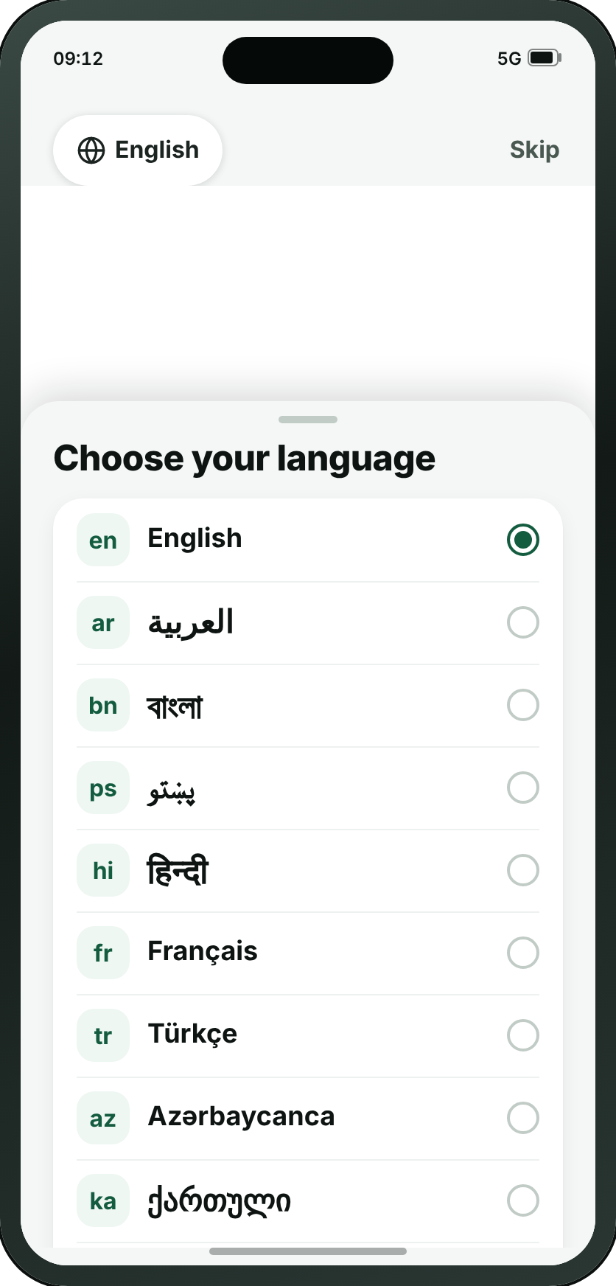
FIRST RUN
A2 · Choose your language
→
→
→
→
→
→
→
→
→
→
→
A1
A2
A3
A8
A9
A10
A11
A13
A16
A17
A18
A19
Welcome
Choose your language
Guided tour — 1 of 5
Sign up
Verify code
Tell us about your farm
Available service plans
Draw your fields
Your fields
Service plans
Confirm subscription
You’re ready
Wafra Farm App · UI mockup v1.8.0
5
Notes:
A2 — Choose your language
Not a screen — a pop-up sheet over A1, raised by the globe in its corner and closed by choosing a row. It has a page here because a printed deck cannot show a state of another screen any other way. Ten languages, each in its own script with its code beside it; pressing one turns the whole app round if it reads right to left, and closes the sheet. It is where Arabic and Pashto are chosen, and it is one tap from the corner of A1.
On the "Signing up" path.

Slide 6
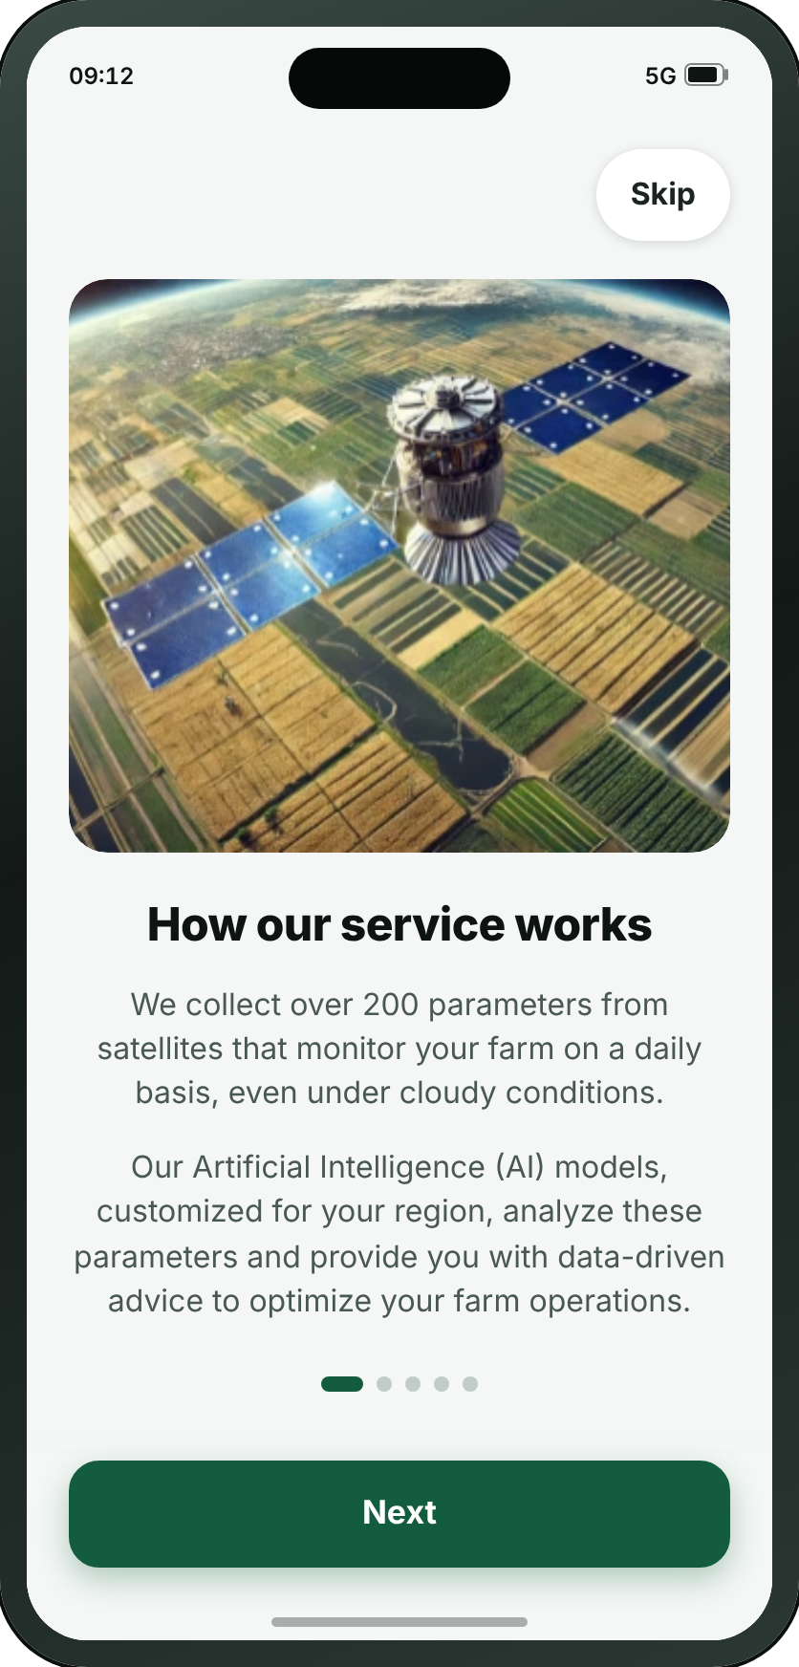
FIRST RUN
A3 · Guided tour — 1 of 5
→
→
→
→
→
→
→
→
→
→
→
A1
A2
A3
A8
A9
A10
A11
A13
A16
A17
A18
A19
Welcome
Choose your language
Guided tour — 1 of 5
Sign up
Verify code
Tell us about your farm
Available service plans
Draw your fields
Your fields
Service plans
Confirm subscription
You’re ready
Wafra Farm App · UI mockup v1.8.0
6
Notes:
A3 — Guided tour — 1 of 5
How the service works, and the first of five pictures of the app doing its job, in the language just chosen. Next on A1 opens it and Help brings it back. Illustrated by a satellite over the same synthesised farmland the map screens draw.
On the "Signing up" path.

Slide 7
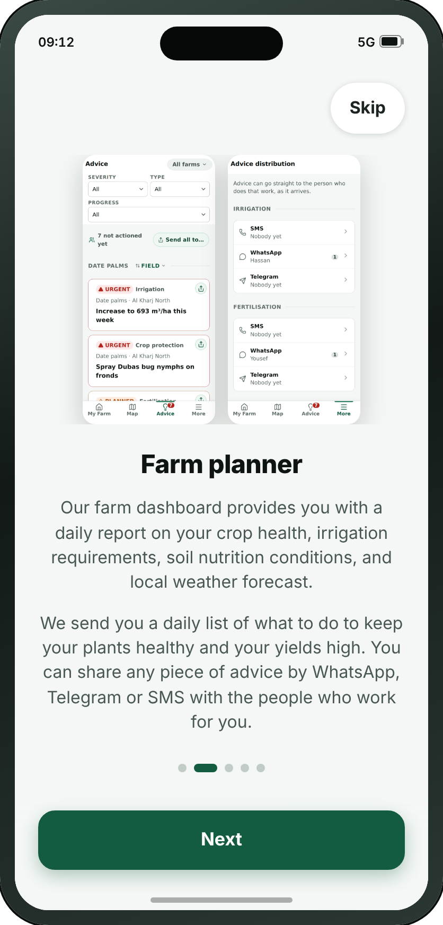

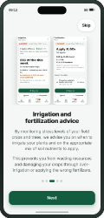
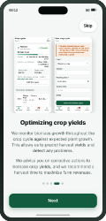
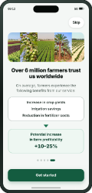
FIRST RUN
A4 · Guided tour — 2 of 5
→
→
→
→
→
→
A1
A3
A4
A5
A6
A7
A8
Welcome
Guided tour — 1 of 5
Guided tour — 2 of 5
Guided tour — 3 of 5
Guided tour — 4 of 5
Guided tour — 5 of 5
Sign up
Wafra Farm App · UI mockup v1.8.0
7
Notes:
A4 — Guided tour — 2 of 5
The farm planner, illustrated by D1 and F9 themselves. In the app these five are one carousel; on paper each needs a page of its own, or four of the five are never seen.
On the "The guided tour, offered from A1 and from Help" path.

Slide 8
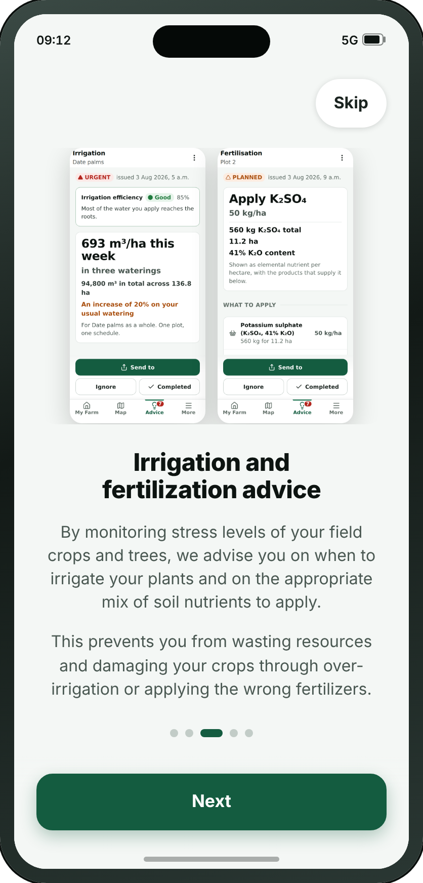
FIRST RUN
A5 · Guided tour — 3 of 5
→
→
→
→
→
→
A1
A3
A4
A5
A6
A7
A8
Welcome
Guided tour — 1 of 5
Guided tour — 2 of 5
Guided tour — 3 of 5
Guided tour — 4 of 5
Guided tour — 5 of 5
Sign up
Wafra Farm App · UI mockup v1.8.0
8
Notes:
A5 — Guided tour — 3 of 5
Irrigation and fertilisation advice, illustrated by D2 and D3.
On the "The guided tour, offered from A1 and from Help" path.

Slide 9
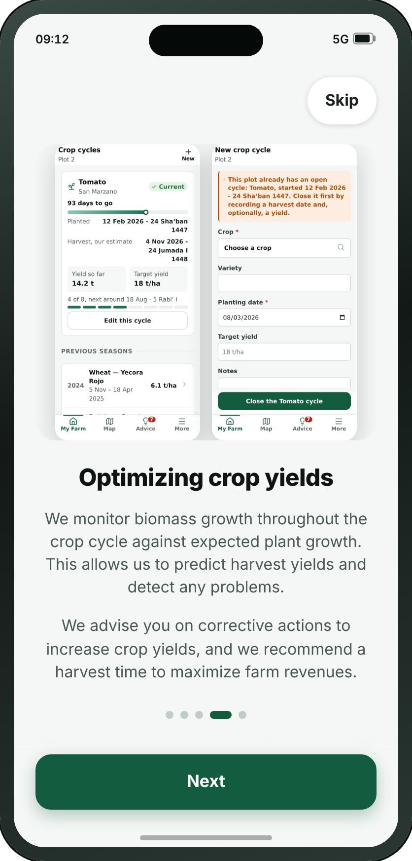
FIRST RUN
A6 · Guided tour — 4 of 5
→
→
→
→
→
→
A1
A3
A4
A5
A6
A7
A8
Welcome
Guided tour — 1 of 5
Guided tour — 2 of 5
Guided tour — 3 of 5
Guided tour — 4 of 5
Guided tour — 5 of 5
Sign up
Wafra Farm App · UI mockup v1.8.0
9
Notes:
A6 — Guided tour — 4 of 5
Optimising crop yields, illustrated by B3 and B4.
On the "The guided tour, offered from A1 and from Help" path.

Slide 10
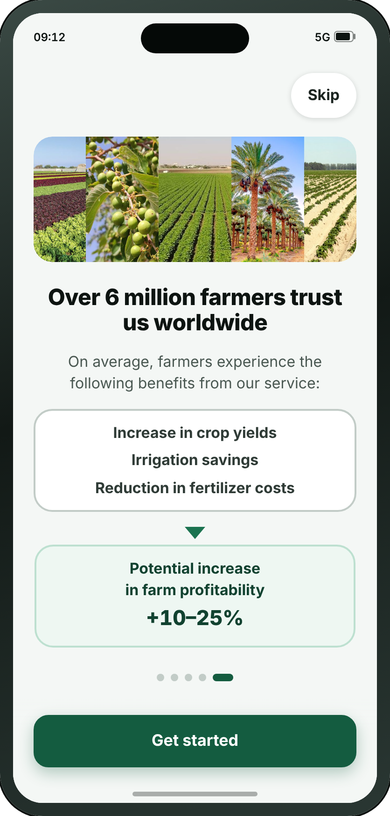
FIRST RUN
A7 · Guided tour — 5 of 5
→
→
→
→
→
→
A1
A3
A4
A5
A6
A7
A8
Welcome
Guided tour — 1 of 5
Guided tour — 2 of 5
Guided tour — 3 of 5
Guided tour — 4 of 5
Guided tour — 5 of 5
Sign up
Wafra Farm App · UI mockup v1.8.0
10
Notes:
A7 — Guided tour — 5 of 5
What the farmers already using it get out of it, and the panel that hands on to the front door. The only one that argues with figures, and the only one drawn as a funnel: three savings narrowing into one.
On the "The guided tour, offered from A1 and from Help" path.

Slide 11
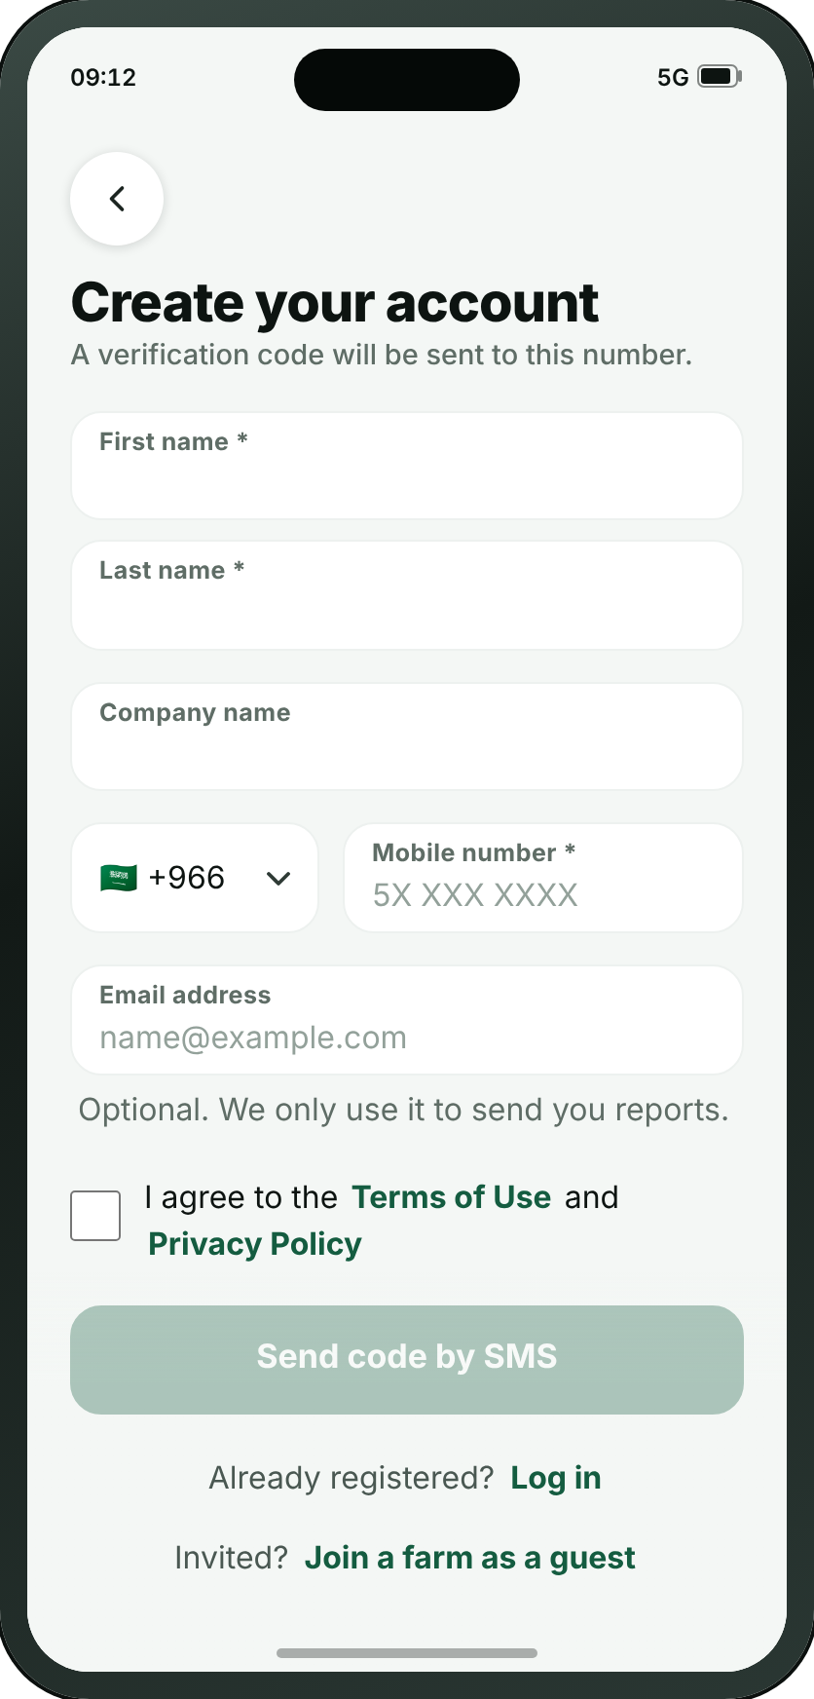
FIRST RUN
A8 · Sign up
→
→
→
→
→
→
→
→
→
→
→
A1
A2
A3
A8
A9
A10
A11
A13
A16
A17
A18
A19
Welcome
Choose your language
Guided tour — 1 of 5
Sign up
Verify code
Tell us about your farm
Available service plans
Draw your fields
Your fields
Service plans
Confirm subscription
You’re ready
• This screen is shown to new users only. Anyone already registered goes straight to A20.
Wafra Farm App · UI mockup v1.8.0
11
Notes:
A8 — Sign up
The whole account on one form, and since Oct 2026 the mobile number is the account: a first and last name, an optional company, a number from any country in the world, proved by a code sent by SMS, and an email address that is optional and for reports only. No password. The two doors that used to be on A20 are at the foot of it.
On the "Signing up" path.

Slide 12
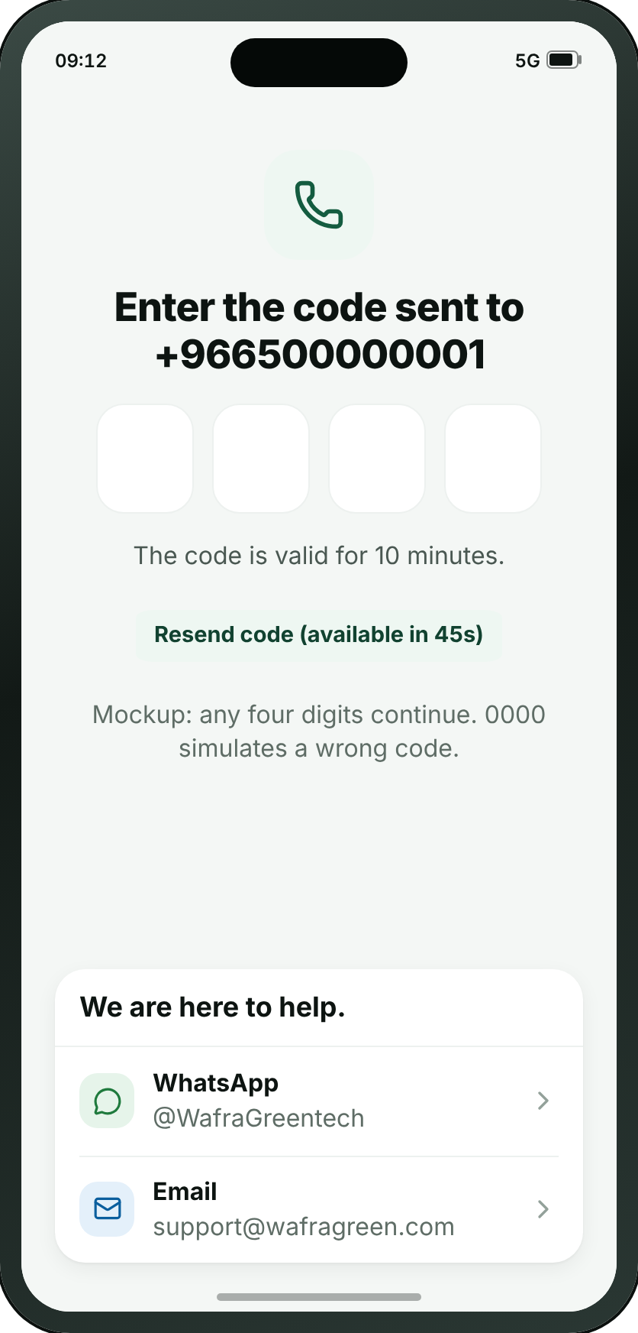
FIRST RUN
A9 · Verify code
→
→
→
→
→
→
→
→
→
→
→
A1
A2
A3
A8
A9
A10
A11
A13
A16
A17
A18
A19
Welcome
Choose your language
Guided tour — 1 of 5
Sign up
Verify code
Tell us about your farm
Available service plans
Draw your fields
Your fields
Service plans
Confirm subscription
You’re ready
Wafra Farm App · UI mockup v1.8.0
12
Notes:
A9 — Verify code
Four digits sent by SMS to the mobile number, which is the account, and one sentence saying where they went. The boxes are real inputs, so the phone raises its own keyboard and can fill the code in itself; it sends on the last digit, and five wrong tries rest the account for a quarter of an hour. A brand new account is asked about Face ID here and nowhere else.
On the "Signing up" path.

Slide 13
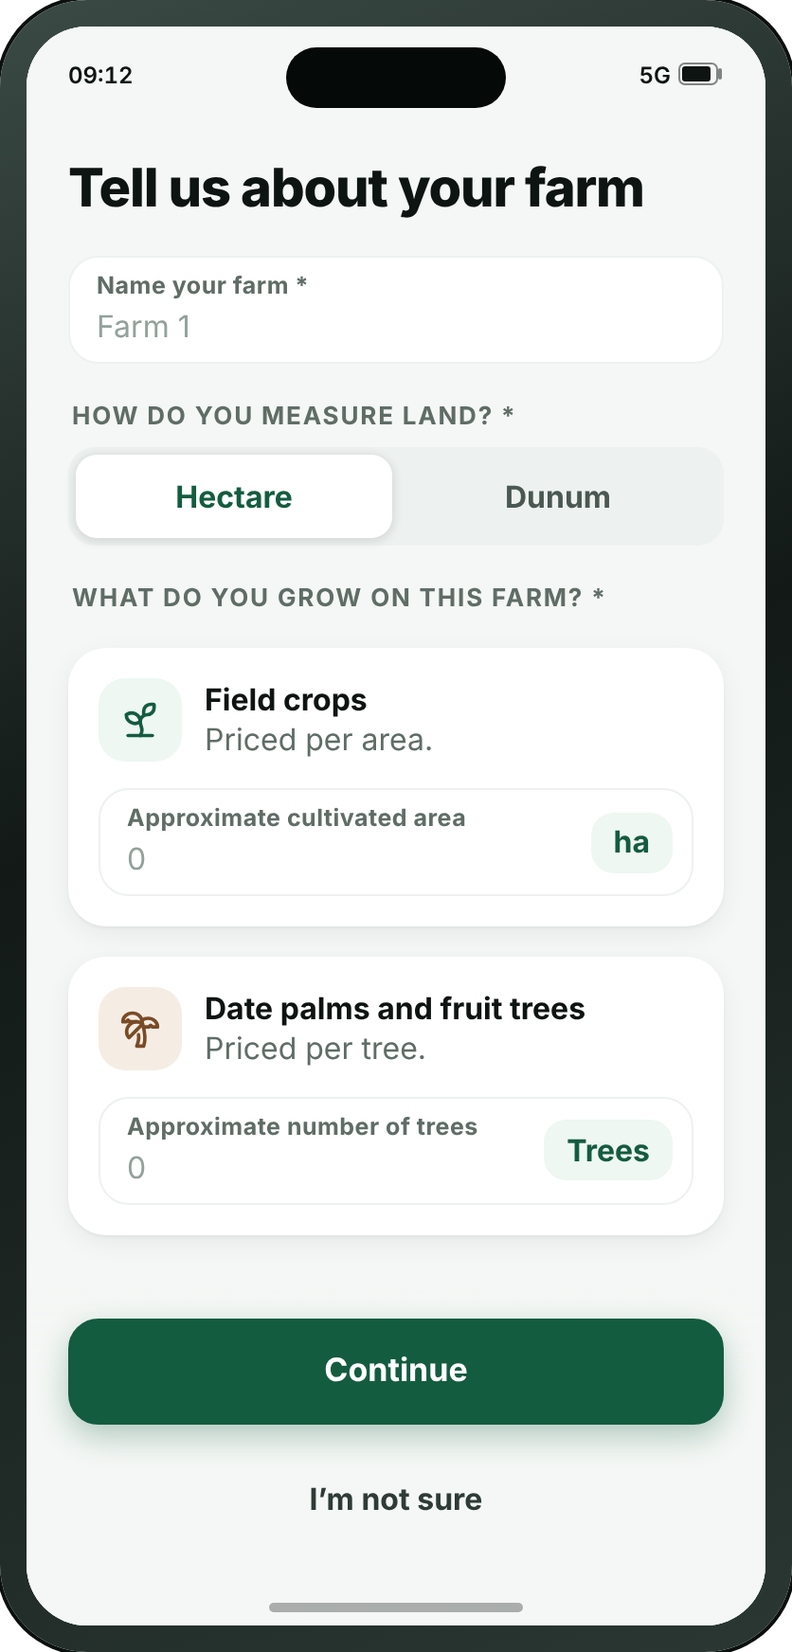
FIRST RUN
A10 · Tell us about your farm
→
→
→
→
→
→
→
→
→
→
→
A1
A2
A3
A8
A9
A10
A11
A13
A16
A17
A18
A19
Welcome
Choose your language
Guided tour — 1 of 5
Sign up
Verify code
Tell us about your farm
Available service plans
Draw your fields
Your fields
Service plans
Confirm subscription
You’re ready
WHAT THE SMALL BUTTONS DO
1
I’m not sure → A13 Draw your fields (page 17)
1
Wafra Farm App · UI mockup v1.8.0
13
Notes:
A10 — Tell us about your farm
The moment an account becomes a farm: its name, the unit its land is measured in, and roughly how much of each it holds — a number under Field crops, a count under Date palms and fruit trees. Filling in one, the other, or both IS the answer to what is growing here; nothing is picked. “I’m not sure” skips the estimate and goes straight to locating the farm. Since v1.7.3 the two numbers are checked: a holding below the survey’s minimum goes to A22 instead of the price.
1. I’m not sure → A13
On the "Signing up" path.

Slide 14
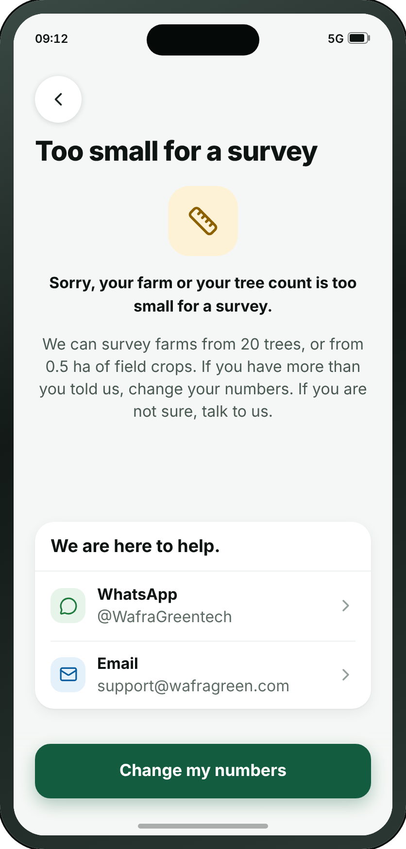
FIRST RUN
A22 · Too small for a survey
Wafra Farm App · UI mockup v1.8.0
14
Notes:
A22 — Too small for a survey
New at v1.7.3: “Sorry, your farm or your tree count is too small for a survey.” A10’s two numbers are checked before the price, and a holding below both limits lands here, with a way back to change them and a way to talk to us. The limits are a placeholder — fewer than 20 trees and under half a hectare of field crops — because nobody has said yet what too small is; a 20-tree farm can be surveyed, and is billed as 100 trees.

Slide 15
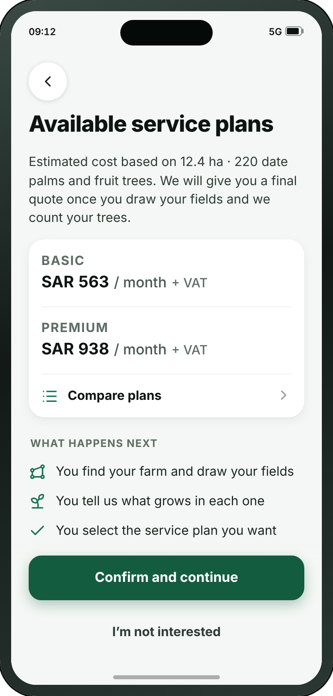
FIRST RUN
A11 · Available service plans
→
→
→
→
→
→
→
→
→
→
→
A1
A2
A3
A8
A9
A10
A11
A13
A16
A17
A18
A19
Welcome
Choose your language
Guided tour — 1 of 5
Sign up
Verify code
Tell us about your farm
Available service plans
Draw your fields
Your fields
Service plans
Confirm subscription
You’re ready
WHAT THE SMALL BUTTONS DO
1
I’m not interested → A12 Not interested (page 16)
1
Wafra Farm App · UI mockup v1.8.0
15
Notes:
A11 — Available service plans
The two real plans at their two real prices, presented as an estimate, with nothing to choose — the plan is picked later on A17 once the survey has priced the real farm. The price is rounded up to a price band, and never under 100 trees; the line at the top says so when the band is not the count. Under the plans, the four steps, which say plan selection comes last.
1. I’m not interested → A12
On the "Signing up" path.

Slide 16
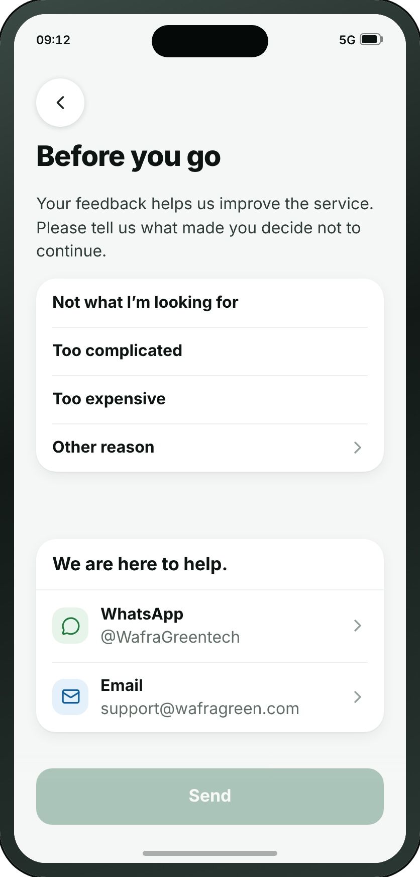
FIRST RUN
A12 · Not interested
WHAT THE SMALL BUTTONS DO
1
Other reason — Opens a drawer to type the reason
1
Wafra Farm App · UI mockup v1.8.0
16
Notes:
A12 — Not interested
New at review 21/09, and the only screen in the app that exists to learn something from somebody leaving. Behind “I’m not interested” on A11: four reasons in Mark’s order — not what I’m looking for, too complicated, too expensive, and a free-text other — with the WhatsApp and email buttons at the foot, because a farmer who is out because the app is too complicated is the one a person could still help, and he has no account and so no other way to reach one.
1. Other reason — Opens a drawer to type the reason

Slide 17
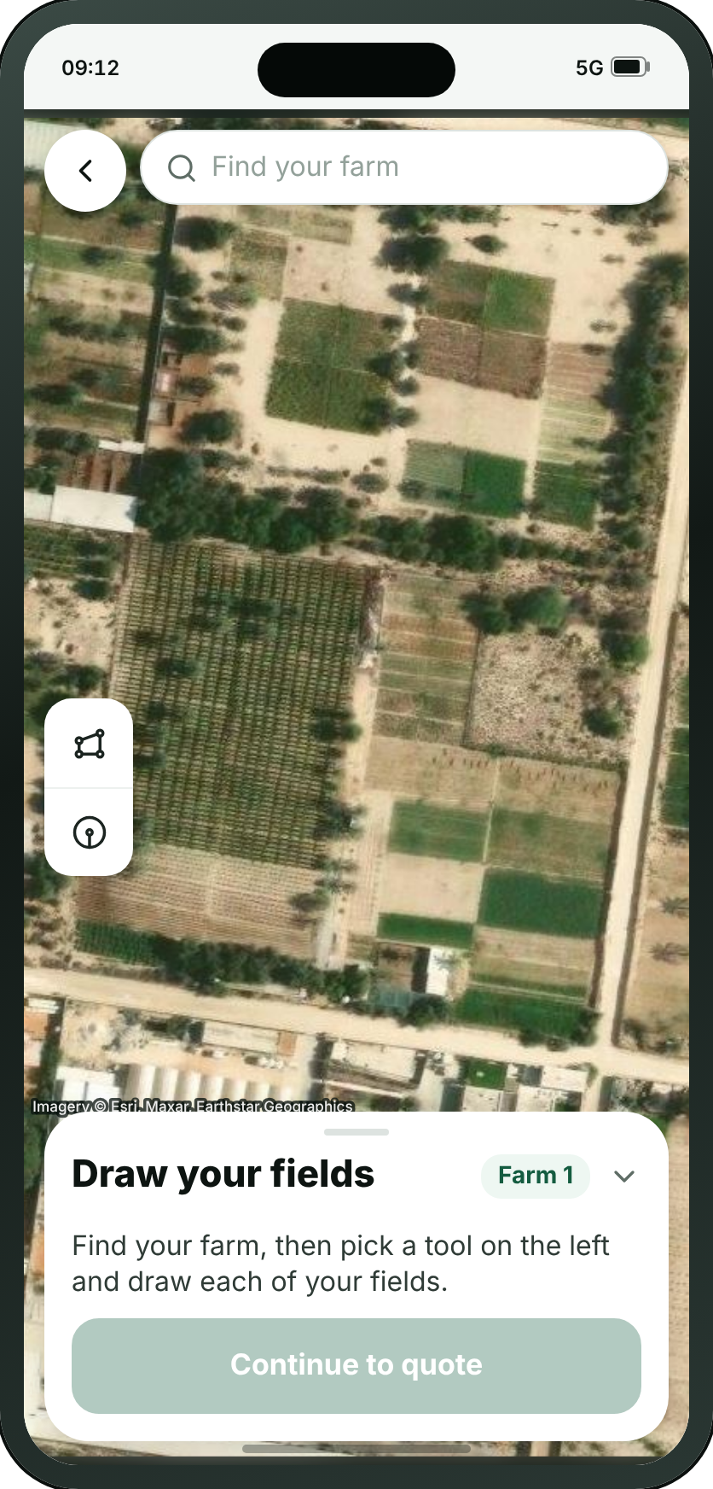
FIRST RUN
A13 · Draw your fields
→
→
→
→
→
→
→
→
→
→
→
A1
A2
A3
A8
A9
A10
A11
A13
A16
A17
A18
A19
Welcome
Choose your language
Guided tour — 1 of 5
Sign up
Verify code
Tell us about your farm
Available service plans
Draw your fields
Your fields
Service plans
Confirm subscription
You’re ready
WHAT THE SMALL BUTTONS DO
1
Draw a field — Adds a field to draw corner by corner
2
Round field — Adds a round field: tap its centre, drag its edge
1
3
Your fields — Folds the list of fields away, and opens it again
4
Continue to quote → A16 Your fields (page 18)
2
3
4
Wafra Farm App · UI mockup v1.8.0
17
Notes:
A13 — Draw your fields
One screen to find the farm and draw on it (v1.7.4), and the map is the whole screen: search for the farm, or browse the map to it. Two small tools on the side of the map, bare glyphs: a polygon for a field of any shape, shaped corner by corner, and a circle for a centre pivot — press the middle of the field and drag the handle on its edge to set its size. The moment a field is drawn, a sheet asks what grows in it: a crop from the list, or date palms and fruit trees, which we then count. The fields drawn are in a drawer at the bottom, with the button that moves on; its handle folds the list away. Replaces the old locate-the-farm and draw-the-boundary screens and the whole-farm survey.
1. Draw a field — Adds a field to draw corner by corner
2. Round field — Adds a round field: tap its centre, drag its edge
3. Your fields — Folds the list of fields away, and opens it again
4. Continue to quote → A16
On the "Signing up" path.

Slide 18
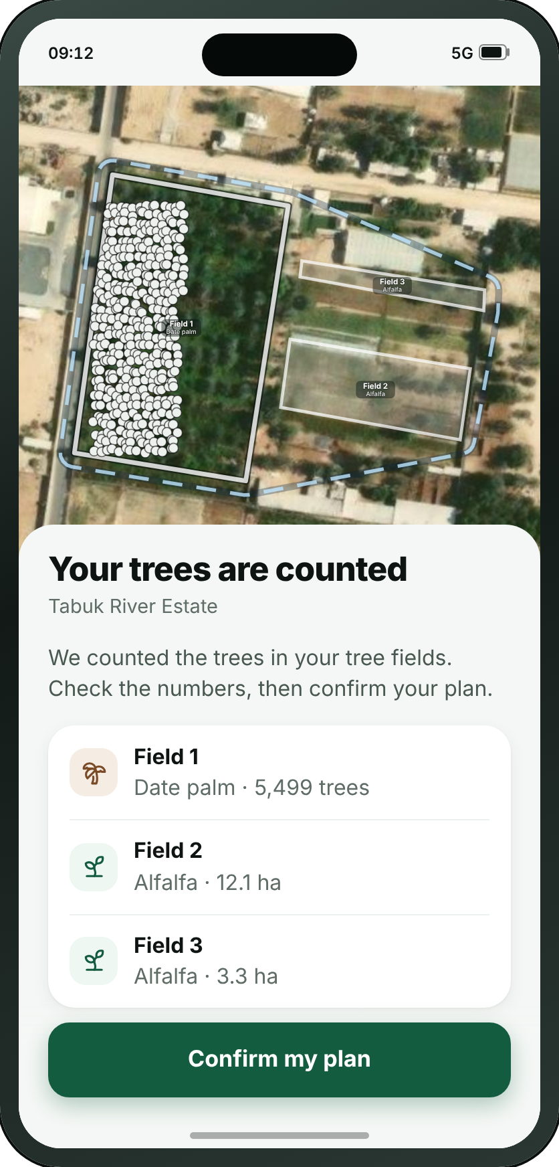
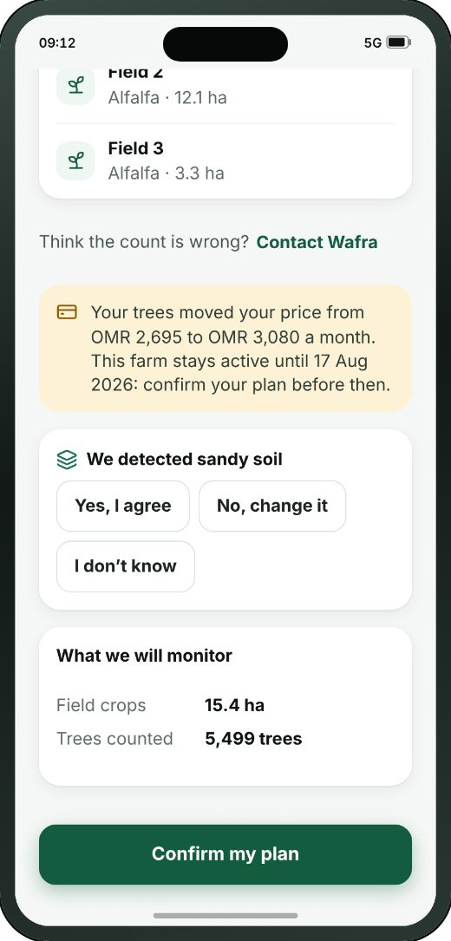
FIRST RUN
A16 · Your fields
→
→
→
→
→
→
→
→
→
→
→
A1
A2
A3
A8
A9
A10
A11
A13
A16
A17
A18
A19
Welcome
Choose your language
Guided tour — 1 of 5
Sign up
Verify code
Tell us about your farm
Available service plans
Draw your fields
Your fields
Service plans
Confirm subscription
You’re ready
THE REST OF THIS SCREEN
Scrolls · about 55% of this screen is shown above
Wafra Farm App · UI mockup v1.8.0
18
Notes:
A16 — Your fields
The fields to approve, in two sittings. Straight after drawing: every field with what grows in it and its size, over the map they were drawn on — keep, change or take off the quote — and a total to price, with the tree fields estimated because their trees are not counted yet. Then, when the count is in (opened from My Farm): the same fields with the number of trees found in each, the soil we read with three answers — Yes, I agree; No, change it; I don’t know — and the plan to confirm again on A17. A tree field under 40 trees is counted but too few for advice.
On the "Signing up" path.
The screenshot shows 55% of this screen; the rest is below the fold.

Slide 19

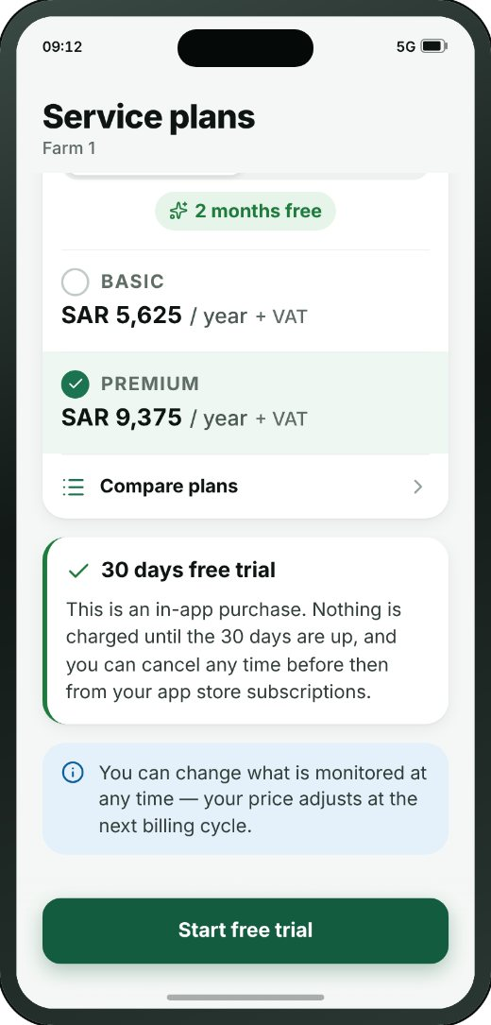
FIRST RUN
A17 · Service plans
→
→
→
→
→
→
→
→
→
→
→
A1
A2
A3
A8
A9
A10
A11
A13
A16
A17
A18
A19
Welcome
Choose your language
Guided tour — 1 of 5
Sign up
Verify code
Tell us about your farm
Available service plans
Draw your fields
Your fields
Service plans
Confirm subscription
You’re ready
THE REST OF THIS SCREEN
WHAT THE SMALL BUTTONS DO
1
Start free trial → A18 Confirm subscription (page 20)
1
Scrolls · about 75% of this screen is shown above
Wafra Farm App · UI mockup v1.8.0
19
Notes:
A17 — Service plans
The payment screen: two levels, a monthly/annual toggle above them, and one main confirmation button. Before there is a farm it prices the fields just drawn — crops by area, tree fields on an estimate, and the screen says so; when the trees are counted it prices the farm’s own fields and counted trees, and pressing the button confirms the plan. The price is rounded up to a price band, never under 100 trees. F5 is the same question for an account that already has one.
1. Start free trial → A18
On the "Signing up" path.
The screenshot shows 74% of this screen; the rest is below the fold.

Slide 20
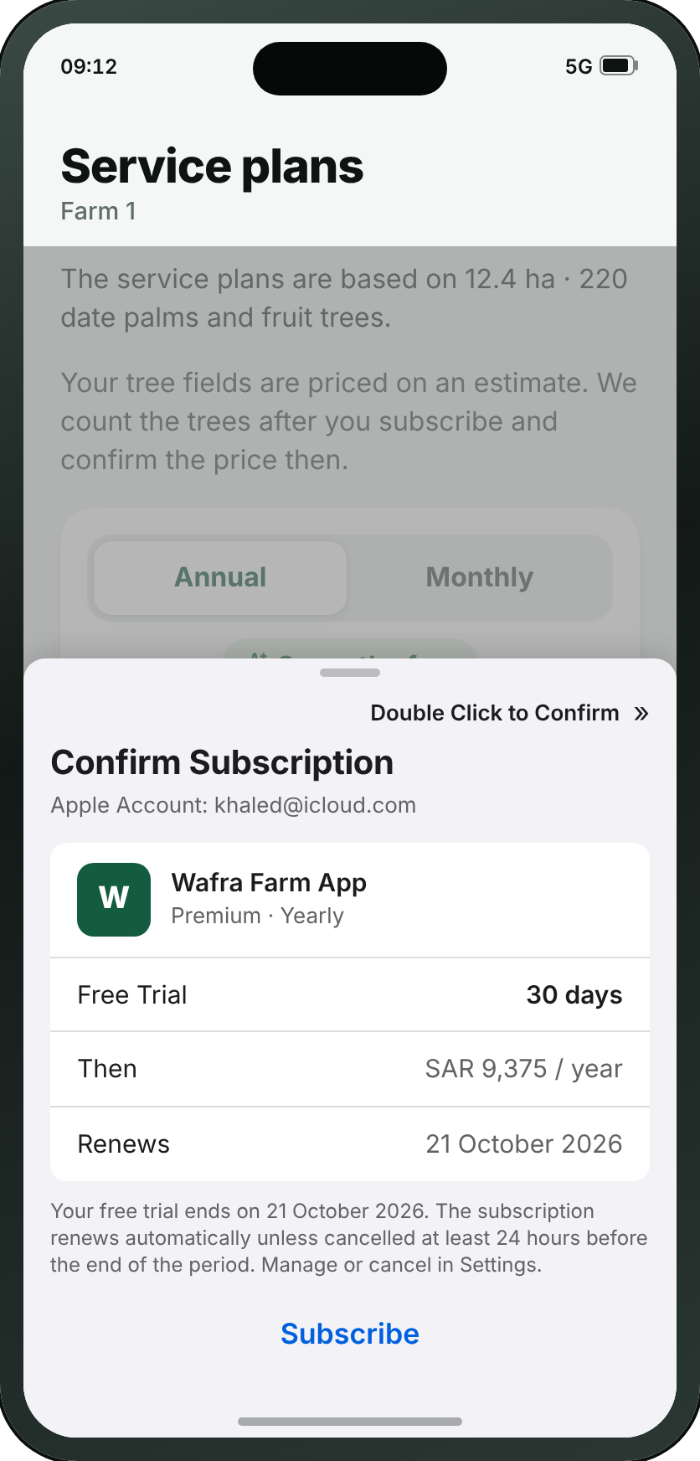
FIRST RUN
A18 · Confirm subscription
→
→
→
→
→
→
→
→
→
→
→
A1
A2
A3
A8
A9
A10
A11
A13
A16
A17
A18
A19
Welcome
Choose your language
Guided tour — 1 of 5
Sign up
Verify code
Tell us about your farm
Available service plans
Draw your fields
Your fields
Service plans
Confirm subscription
You’re ready
Wafra Farm App · UI mockup v1.8.0
20
Notes:
A18 — Confirm subscription
New at review 21/09 (second pass): the App Store purchase sheet, drawn as the drawer a farmer actually meets when he presses Start free trial. The 21/09 call settled that Wafra never sees a card — “we don’t charge a credit card, as the subscription is through Apple/Google” — and A17 says that in words; this is the same fact in the form it arrives. Deliberately not our design system: it is Apple’s sheet, drawn to iOS’s own metrics, because the point is that it is not ours to change. The Android equivalent is Google Play’s and is named on A17.
On the "Signing up" path.

Slide 21
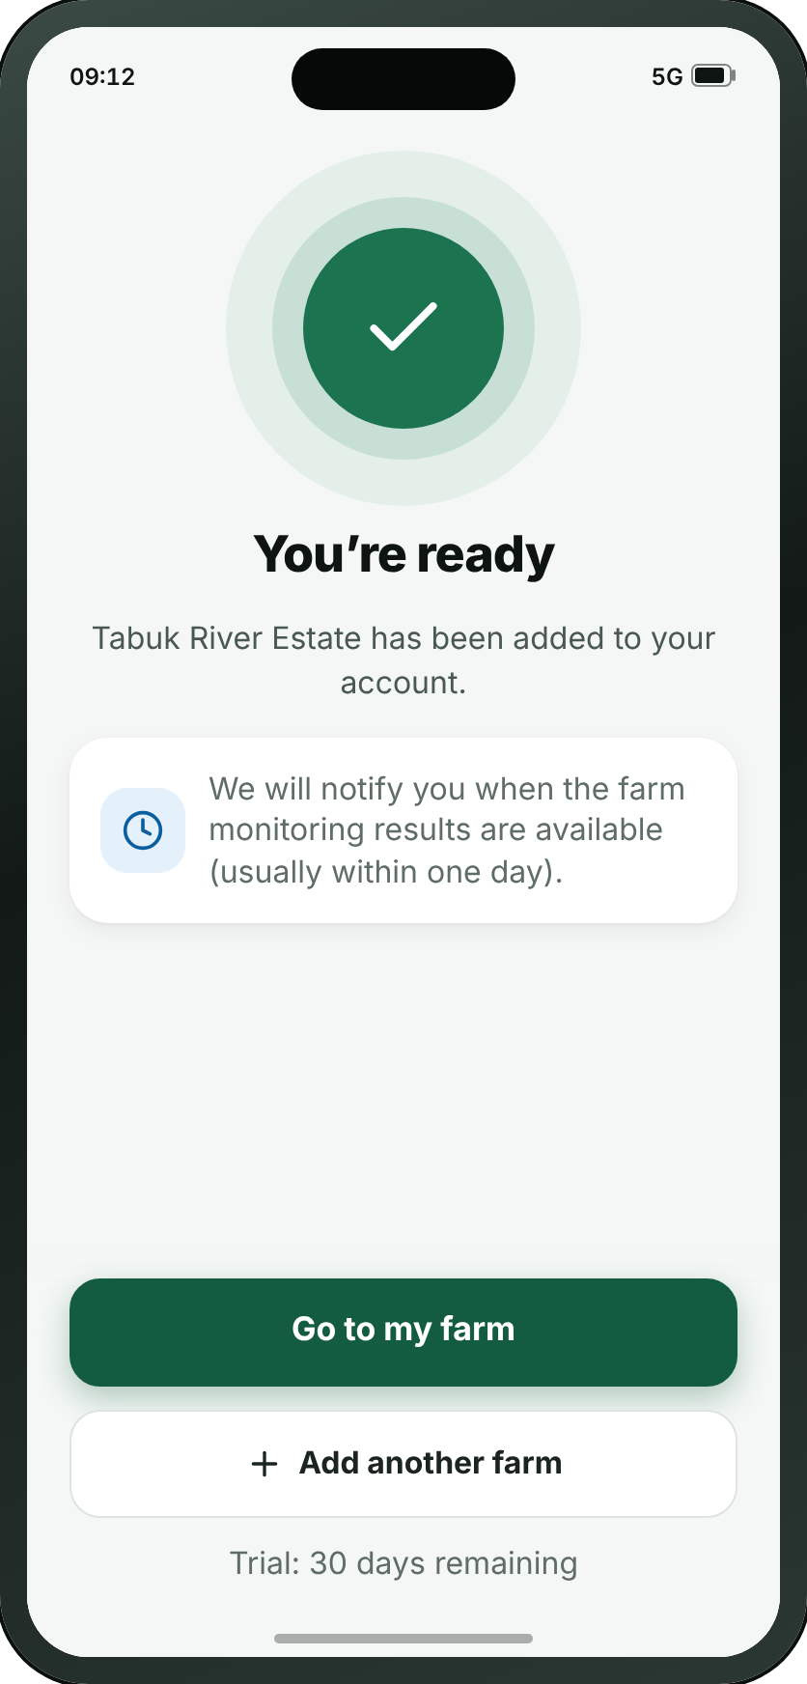
FIRST RUN
A19 · You’re ready
→
→
→
→
→
→
→
→
→
→
→
A1
A2
A3
A8
A9
A10
A11
A13
A16
A17
A18
A19
Welcome
Choose your language
Guided tour — 1 of 5
Sign up
Verify code
Tell us about your farm
Available service plans
Draw your fields
Your fields
Service plans
Confirm subscription
You’re ready
Wafra Farm App · UI mockup v1.8.0
21
Notes:
A19 — You’re ready
The pause between setting up and starting. It says when the first satellite pass arrives, so the empty farm makes sense.
On the "Signing up" path.

Slide 22
SECTION 2 OF 6
Log in
2 screens · A20 · A21
Wafra Farm App · UI mockup v1.8.0
22
Notes:
Log in — 2 screens.

Slide 23
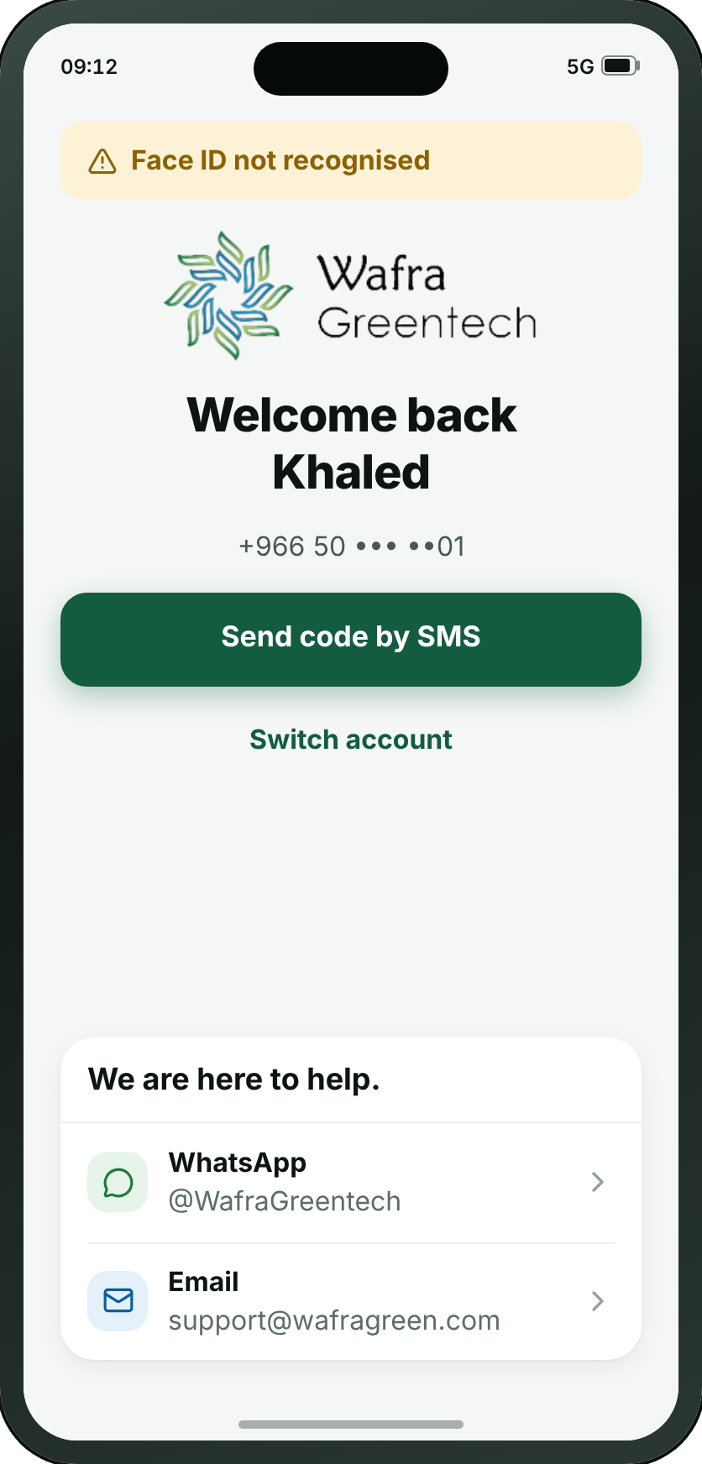

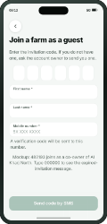
LOG IN
A20 · Log in
→
A20
A21
Log in
Join a farm as a guest
• Most users sign in with Face ID. This screen is drawn only when Face ID fails, which is what the notice at the top of it says.
• Creating an account and joining a farm as a guest are on A8, which is where somebody the app has never met lands.
• A code can be sent to the registered email address instead of a password.
• “Switch account” is for a farmer holding several accounts for different farms.
Wafra Farm App · UI mockup v1.8.0
23
Notes:
A20 — Log in
The way back in for somebody the app has already met, and only for them. It opens with the reason it is open at all — Face ID did not recognise him — then greets him by name, shows his number with its middle hidden, and sends a code to it by SMS: the number is the account. Switch account asks for another number, with its country code. No app bar: the screen says "Welcome back" and does not also need a title saying "Log in". Creating an account and joining a farm as a guest are on A8, which is where a stranger lands.
On the "Joining a farm I was invited to" path.

Slide 24
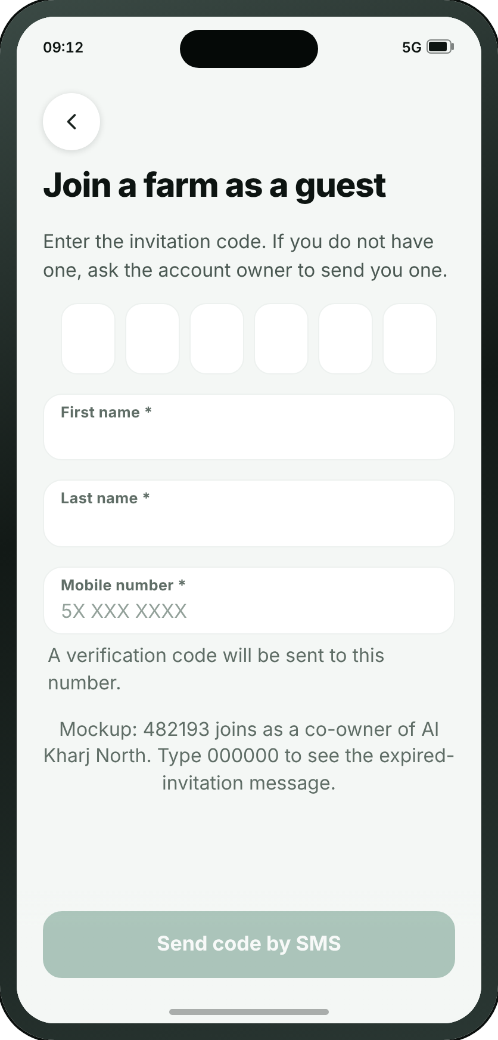
LOG IN
A21 · Join a farm as a guest
→
A20
A21
Log in
Join a farm as a guest
Wafra Farm App · UI mockup v1.8.0
24
Notes:
A21 — Join a farm as a guest
For someone invited to a farm they do not own — which is what “as a guest” says before they tap. Six digits typed in, or the QR code read off the phone of the person who set the account up, which is where review 06/09 put it: one phone shows, one phone scans.
On the "Joining a farm I was invited to" path.

Slide 25
SECTION 3 OF 6
My Farm
10 screens · B1 · B2 · B3 · B4 · B5 · B6 · B7 · B8 · B9 · B10
Wafra Farm App · UI mockup v1.8.0
25
Notes:
My Farm — 10 screens.

Slide 26
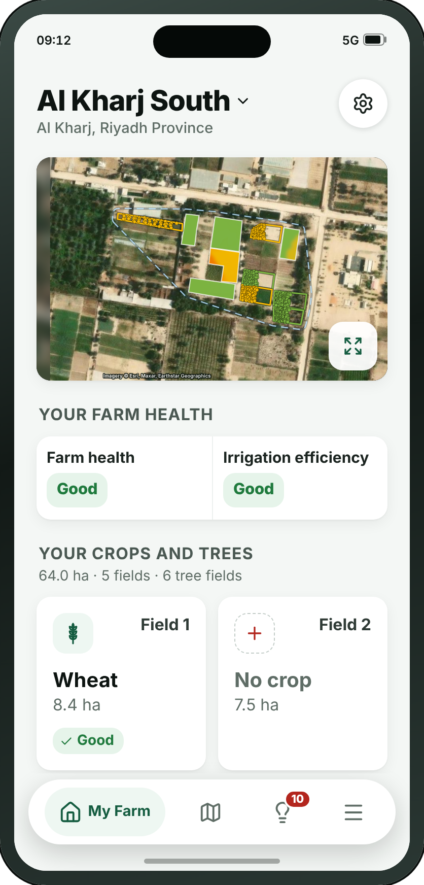

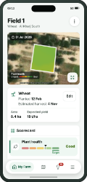
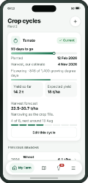
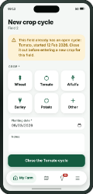
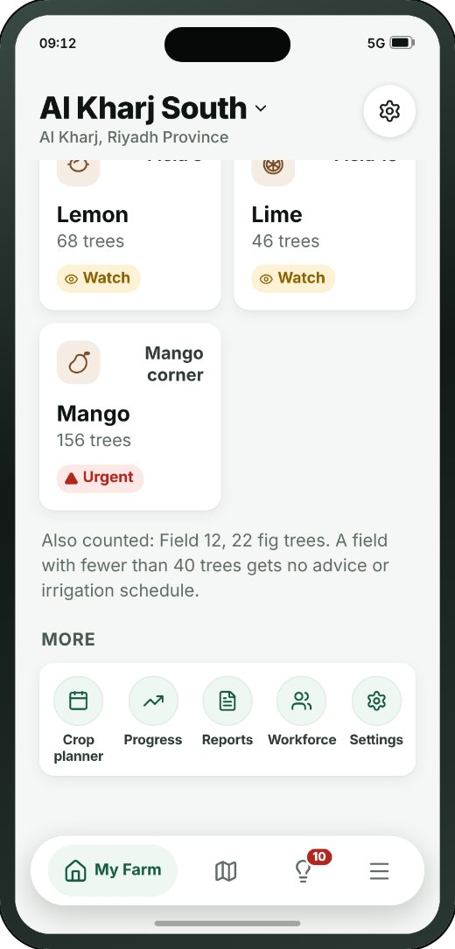
MY FARM
B1 · Farm home
→
→
→
1
B1
B2
B3
B4
Farm home
Field detail
Crop cycles
Add / edit crop cycle
THE REST OF THIS SCREEN
WHAT THE SMALL BUTTONS DO
2
1
Switch farm — Switches between farms, and adds a new one
2
View metrics → C1 Map (page 37)
3
Open Field 1 → B2 Field detail (page 27)
3
Scrolls · about 35% of this screen is shown above
Wafra Farm App · UI mockup v1.8.0
26
Notes:
B1 — Farm home
The farm and every field on it. The map at the top is coloured by the metric chosen on the map screen, with no picker and no legend: its one button, the expand glyph, opens the full map, where the metrics are chosen; the farm outline the app worked out from the fields is drawn faintly. Under it, the survey while it runs ("This is taking longer than usual" after three hours) or when it failed (Contact Wafra, Redraw), the tree count when it is in, and a read-only farm says so and for how long it is kept. A farm with no measured size has no map and no scores. Then one slim strip of two scores for the whole farm — farm health and irrigation efficiency — and “Your crops and trees”: a grid of cards, two columns, in field number order, trees among the fields. Each card shows the crop’s own icon with the field’s name across from it — Field 1, or the name the farmer gave it — then the crop or the species as its headline, the size or the tree count under it, and how the field is doing: Good, Watch or Urgent. A card is one button: pressed anywhere, it opens the field. A tree field still being counted pulses. Under “More”, five round shortcuts.
1. Switch farm — Switches between farms, and adds a new one
2. View metrics → C1
3. Open Field 1 → B2
On the "From the farm to one plot, and what is growing on it" path.
The screenshot shows 34% of this screen; the rest is below the fold.

Slide 27

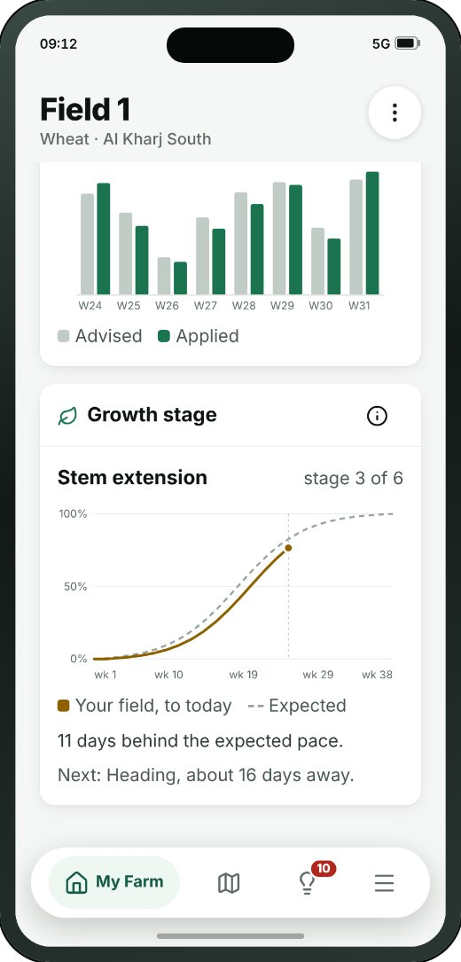
MY FARM
B2 · Field detail
1
→
→
→
B1
B2
B3
B4
Farm home
Field detail
Crop cycles
Add / edit crop cycle
THE REST OF THIS SCREEN
WHAT THE SMALL BUTTONS DO
1
More — Rename, edit the boundary, remove the plot
2
2
View metrics → C1 Map (page 37)
3
Edit → B3 Crop cycles (page 28)
3
4
Plant health: Good — Shows this metric on the map
5
Growth and vigour: Good — Shows this metric on the map
4
5
Scrolls · about 20% of this screen is shown above
Wafra Farm App · UI mockup v1.8.0
27
Notes:
B2 — Field detail
One field, one long page (v1.7.4): the map, with its expand button opening the full map and, small over the foot of the picture, a legend naming the metric it is painted with, and its colours between the two end words; the app bar names the field, and the crop and farm under it; the crop box — “Wheat”, then Planted and Estimated harvest; the scorecard, where pressing a row paints the map; the agronomic trend of any of the five metrics, over the whole crop cycle; the irrigation trend; the growth stage as a line chart, expected against today; then, under a rule and a header of its own, the irrigation schedule — the week’s water as one big figure, the week as a strip of days (the days that carry fertiliser say so), and the fertiliser that goes in with the water drawn as nutrient bars, a dose and the days. Disease & pest is not on this page. The ⋯ menu renames the field, edits its boundary, adds a crop cycle, shares or deletes it.
1. More — Rename, edit the boundary, remove the plot
2. View metrics → C1
3. Edit → B3
4. Plant health: Good — Shows this metric on the map
5. Growth and vigour: Good — Shows this metric on the map
On the "From the farm to one plot, and what is growing on it" path.
The screenshot shows 20% of this screen; the rest is below the fold.

Slide 28
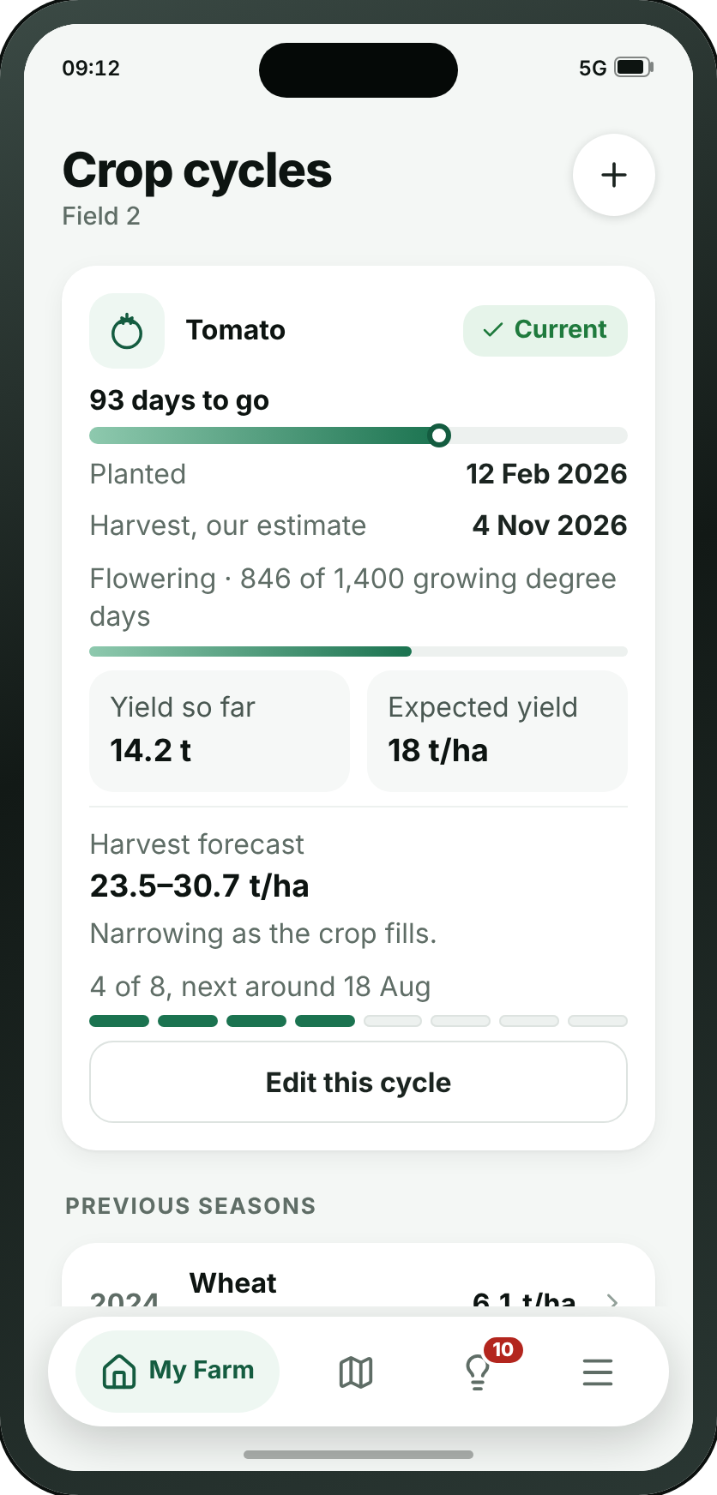
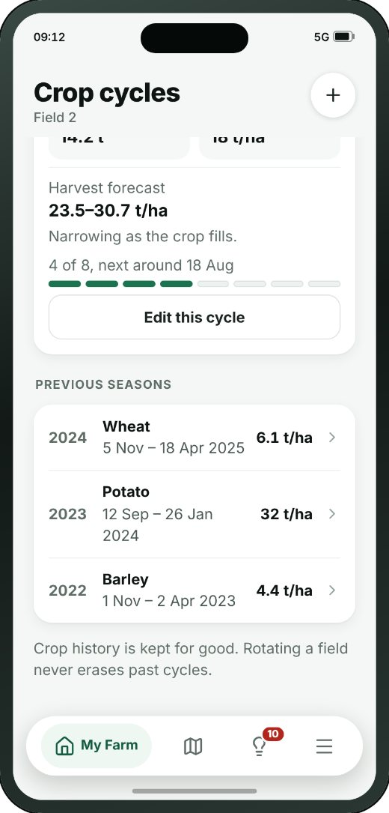
MY FARM
B3 · Crop cycles
1
→
→
→
B1
B2
B3
B4
Farm home
Field detail
Crop cycles
Add / edit crop cycle
THE REST OF THIS SCREEN
WHAT THE SMALL BUTTONS DO
1
New → B4 Add / edit crop cycle (page 29)
2
Edit this cycle → B4 Add / edit crop cycle (page 29)
2
Scrolls · about 70% of this screen is shown above
Wafra Farm App · UI mockup v1.8.0
28
Notes:
B3 — Crop cycles
What has been planted here, season by season. Open field only — a tree group has no cycle. Closing a season keeps it, which is what makes one year comparable with the last.
1. New → B4
2. Edit this cycle → B4
On the "From the farm to one plot, and what is growing on it" path.
The screenshot shows 68% of this screen; the rest is below the fold.

Slide 29
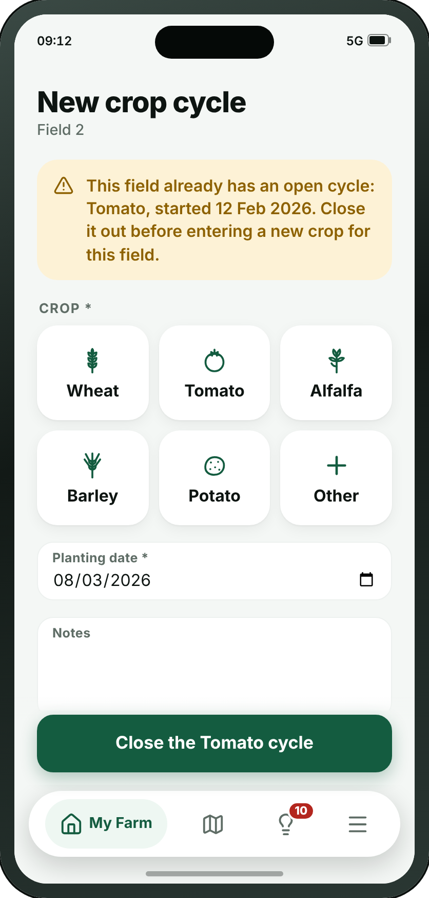
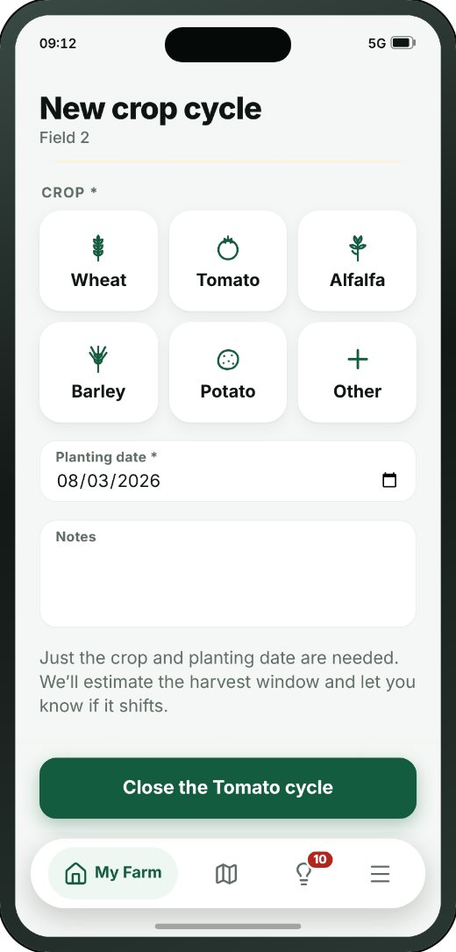
MY FARM
B4 · Add / edit crop cycle
→
→
→
B1
B2
B3
B4
Farm home
Field detail
Crop cycles
Add / edit crop cycle
THE REST OF THIS SCREEN
Scrolls · about 80% of this screen is shown above
Wafra Farm App · UI mockup v1.8.0
29
Notes:
B4 — Add / edit crop cycle
Starting a new planting, or closing the one that is running. A season closes with a harvest date, and a yield if anyone weighed it.
On the "From the farm to one plot, and what is growing on it" path.
The screenshot shows 82% of this screen; the rest is below the fold.

Slide 30
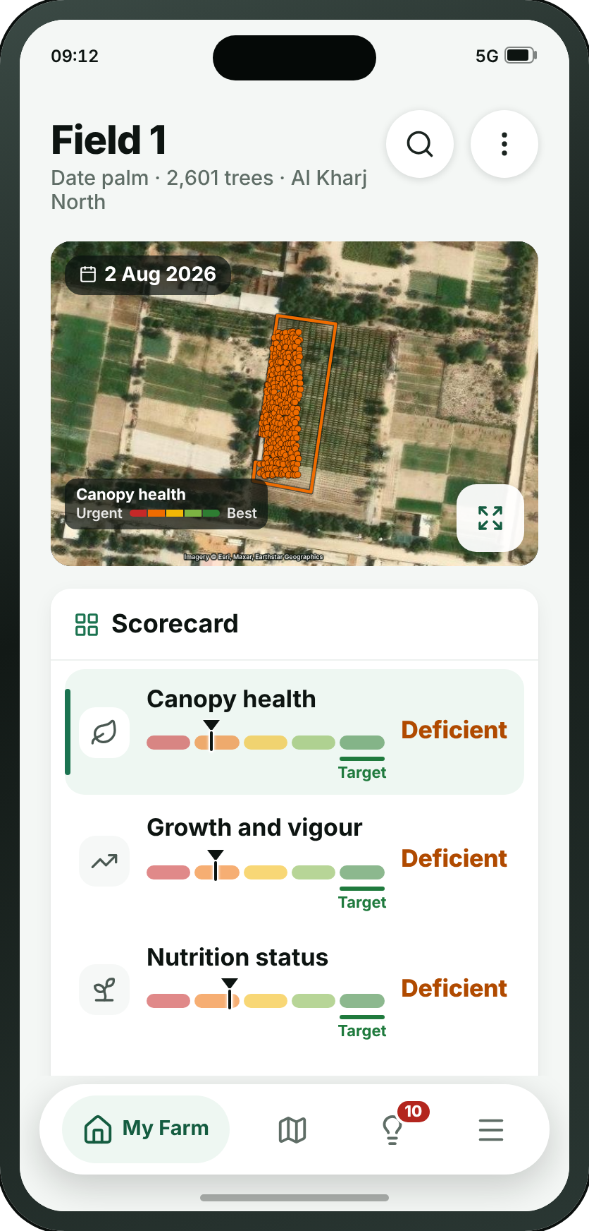
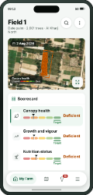
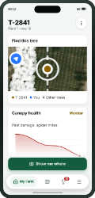

MY FARM
B5 · Tree field
1
→
→
2
B1
B5
B6
Farm home
Tree field
Tree detail
THE REST OF THIS SCREEN
WHAT THE SMALL BUTTONS DO
1
Search — Finds a tree by its number
3
2
More — Rename the field, share or delete it
3
View metrics → C1 Map (page 37)
4
Canopy health: Deficient — Shows this metric on the map
4
5
Growth and vigour: Deficient — Shows this metric on the map
5
Scrolls · about 20% of this screen is shown above
Wafra Farm App · UI mockup v1.8.0
30
Notes:
B5 — Tree field
The same page as a field (B2), without the crop box. A field of trees the farmer drew, numbered — or named — like any other field, with its species under the name: every species in it, “Olive, Orange”, never a variety. Only a field with 40 trees or more gets this page. The map is the trees, one dot each, and the field’s outline, both coloured by the metric. Scorecard (with Canopy health), Died or removed in the last 3 months — “See which trees” lists exactly those trees, each opening B6 — the trends, then the same irrigation schedule. The ⋯ menu renames the field. Irrigation is per hectare of the area the field covers, never per tree.
1. Search — Finds a tree by its number
2. More — Rename the field, share or delete it
3. View metrics → C1
4. Canopy health: Deficient — Shows this metric on the map
5. Growth and vigour: Deficient — Shows this metric on the map
On the "From the farm to a tree group, and down to one tree" path.
The screenshot shows 20% of this screen; the rest is below the fold.

Slide 31


MY FARM
B6 · Tree detail
1
→
→
B1
B5
B6
Farm home
Tree field
Tree detail
THE REST OF THIS SCREEN
WHAT THE SMALL BUTTONS DO
1
More — Show on map, plant diagnosis, edit details, report a problem
Scrolls · about 35% of this screen is shown above
Wafra Farm App · UI mockup v1.8.0
31
Notes:
B6 — Tree detail
One tree. It begins with a map of which tree it is — one dot per tree, no crown outline — because picking tree 2841 out of eight thousand is the hard part. Canopy health and the other readings are words in their band’s colour. The ⋯ menu: Show on map, Plant diagnosis for this tree, Edit details (its species and cultivar — the one place a cultivar is asked for), and Report a problem — not a tree, dead, or in the wrong place — sent to MMC as a correction.
1. More — Show on map, plant diagnosis, edit details, report a problem
On the "From the farm to a tree group, and down to one tree" path.
The screenshot shows 37% of this screen; the rest is below the fold.

Slide 32



MY FARM
B7 · Crop planner
1
→
→
→
B1
B7
B3
B4
2
Farm home
Crop planner
Crop cycles
Add / edit crop cycle
THE REST OF THIS SCREEN
WHAT THE SMALL BUTTONS DO
1
About: Crop planner — Opens the guidance for this screen
2
Field 1 · WheatStarted 12 Feb · harvest ar — Switches to another plot on this farm
Scrolls · about 30% of this screen is shown above
Wafra Farm App · UI mockup v1.8.0
32
Notes:
B7 — Crop planner
New at the 13/09 catalogue review. The app recorded cycles one plot at a time and planned across none of them, so nothing could say that four plots come free in March or that a field is going into its third season of the same family. Plots down the side, twelve months across, current cycles drawn where their real dates put them, and a suggested next crop read from each plot’s own closed history.
1. About: Crop planner — Opens the guidance for this screen
2. Field 1 · WheatStarted 12 Feb · harvest ar — Switches to another plot on this farm
On the "Planning what follows this season" path.
The screenshot shows 32% of this screen; the rest is below the fold.

Slide 33



MY FARM
B8 · Farm progress
1
→
→
B1
B8
B2
Farm home
Farm progress
Field detail
THE REST OF THIS SCREEN
WHAT THE SMALL BUTTONS DO
1
About: Farm progress — Opens the guidance for this screen
Scrolls · about 40% of this screen is shown above
Wafra Farm App · UI mockup v1.8.0
33
Notes:
B8 — Farm progress
Twelve months of one measure for the whole farm — the comparison the app could not make: B2 charts a single plot and C4 puts the farm at two dates side by side, and nothing showed the year. It is a trend for a chosen measure and deliberately not a farm health score: averaging crops that cannot be averaged is why B1 carries no such figure.
1. About: Farm progress — Opens the guidance for this screen
On the "Reading the year, and the plots behind it" path.
The screenshot shows 41% of this screen; the rest is below the fold.

Slide 34
MY FARM
B9 · Add fields
→
B1
B9
Farm home
Add fields
WHAT THE SMALL BUTTONS DO
1
Draw a field — Adds a field to draw corner by corner
2
Round field — Adds a round field: tap its centre, drag its edge
1
3
Your fields — Folds the list of fields away, and opens it again
4
Continue to quote → A16 Your fields (page 18)
2
3
4
Wafra Farm App · UI mockup v1.8.0
34
Notes:
B9 — Add fields
The same drawing screen as A13, opened from Farm settings’ “Add fields”: polygon or round field, what grows in each, and the fields are added to the farm. A tree field is counted, and its price confirmed, like a new farm’s.
1. Draw a field — Adds a field to draw corner by corner
2. Round field — Adds a round field: tap its centre, drag its edge
3. Your fields — Folds the list of fields away, and opens it again
4. Continue to quote → A16
On the "Adding fields, after the farm already exists" path.

Slide 35



MY FARM
B10 · Manage workforce
→
B1
B10
Farm home
Manage workforce
THE REST OF THIS SCREEN
WHAT THE SMALL BUTTONS DO
1
Invite in personShow a QR code — Shows the code on this phone for the other person to scan
2
Invite by SMSSend a six-digit code — Sends the code to somebody who is not here
1
2
Scrolls · about 45% of this screen is shown above
Wafra Farm App · UI mockup v1.8.0
35
Notes:
B10 — Manage workforce
The people work is sent to on this farm: a name, a number and the app each of them actually reads. Nobody here holds an account — an advice reaches them as a message with a link — except the one person invited as supervisor. It is an address book, not the permission matrix the v1.5.4 review deleted.
1. Invite in personShow a QR code — Shows the code on this phone for the other person to scan
2. Invite by SMSSend a six-digit code — Sends the code to somebody who is not here
On the "The people work is sent to" path.
The screenshot shows 47% of this screen; the rest is below the fold.

Slide 36
SECTION 4 OF 6
Map
4 screens · C1 · C2 · C4 · C5
Wafra Farm App · UI mockup v1.8.0
36
Notes:
Map — 4 screens.

Slide 37



MAP
C1 · Map
1
→
→
2
3
C1
C2
B2
Map
Layers
Field detail
4
WHAT THE SMALL BUTTONS DO
1
All farms — Switches which farm the map is showing
2
Search a place, farm, field or tree — Finds a place, a farm, a plot or a tree
3
Layers → C2 Layers (page 38)
4
Compare → C4 Compare dates (page 39)
5
Plant health — Paints the map with this metric
5
Wafra Farm App · UI mockup v1.8.0
37
Notes:
C1 — Map
The farm from above, filling the screen, and the one place “Pick a metric” is. Every plot is labelled, always, at every zoom: zoomed out, a label that would cover its plot is drawn smaller rather than hidden. Tree groups are their trees: one dot per tree and an outline, both coloured by the metric like the fields, named by species — no filled areas, no crown outlines, no blue land-use shapes, no forest or hedges. A tap on a plot opens the plot (B2 or B5), with a way back; there is no plot sheet any more. The panel at the foot holds the picker, the five-colour legend and the image date.
1. All farms — Switches which farm the map is showing
2. Search a place, farm, field or tree — Finds a place, a farm, a plot or a tree
3. Layers → C2
4. Compare → C4
5. Plant health — Paints the map with this metric
On the "Finding a plot on the map and opening it" path.

Slide 38

MAP
C2 · Layers
→
→
C1
C2
B2
Map
Layers
Field detail
Wafra Farm App · UI mockup v1.8.0
38
Notes:
C2 — Layers
Which picture to draw the map on — satellite or Google Maps, each described — and two farm layers: the boundaries, and the trees, one dot each. No forest layer and no land-use shapes.
On the "Finding a plot on the map and opening it" path.

Slide 39


MAP
C4 · Compare dates
→
C1
C4
Map
Compare dates
WHAT THE SMALL BUTTONS DO
1
Plant health — Paints the map with this metric
1
Wafra Farm App · UI mockup v1.8.0
39
Notes:
C4 — Compare dates
The whole farm at two dates at once, split by a line you drag across it. It opens a week apart — an interval, resolved to the last satellite pass before the mark, rather than a count of passes that could mean anything.
1. Plant health — Paints the map with this metric
On the "Comparing two dates" path.

Slide 40

MAP
C5 · Boundary editor
• The boundary editor corrects the shape of one outline after the fact — a plot the survey drew slightly wrong, or a farm outline that has changed. Drag a corner to move it, add or remove corners, and split, join or remove the shape.
• The old outline is kept, with who changed it and when, so past analytics stay attached to the shape that was live at the time.
Wafra Farm App · UI mockup v1.8.0
40
Notes:
C5 — Boundary editor
Correcting the shape of a field after the fact, and splitting, joining, removing or adding one. The old outline is kept, with who changed it and when; the farm outline is worked out again and saved with the fields as the boundary’s next version. A field dragged more than 1 km from the rest is not saved: the farmer is told to make two farms.

Slide 41
SECTION 5 OF 6
Advice
6 screens · D1 · D2 · D3 · D4 · D5 · D6
Wafra Farm App · UI mockup v1.8.0
41
Notes:
Advice — 6 screens.

Slide 42




ADVICE
D1 · Advice inbox
→
→
1
D1
D2
B2
Advice inbox
Irrigation advice
Field detail
THE REST OF THIS SCREEN
WHAT THE SMALL BUTTONS DO
1
Filter and sort — Opens every filter and the sort, in one sheet
2
Photograph a plant to find out what is wro → D5 Plant diagnosis (page 46)
2
Scrolls · about 35% of this screen is shown above
Wafra Farm App · UI mockup v1.8.0
42
Notes:
D1 — Advice inbox
The centre of the product, in two tabs, Fields and Trees, which sit in the app bar. One filter bar says what the list is narrowed to and how it is sorted; it opens one sheet with every filter — farm, severity, type, status — and the sort, and its foot is the “not actioned yet · Send all to…” line. Sorted by field, the fields of one crop are listed under the crop’s name — Alfalfa: Field 1, Field 2, Field 5 — each with its own advice, and a field with nothing to do says “No action”. Each advice is three lines, with the detail one tap away on D2, D3 or D4. “Plant diagnosis” is a floating button over the list.
1. Filter and sort — Opens every filter and the sort, in one sheet
2. Photograph a plant to find out what is wro → D5
On the "Reading a piece of advice and sending it on" path.
The screenshot shows 36% of this screen; the rest is below the fold.

Slide 43


ADVICE
D2 · Irrigation advice
→
→
D1
D2
B2
Advice inbox
Irrigation advice
Field detail
THE REST OF THIS SCREEN
WHAT THE SMALL BUTTONS DO
1
See this field’s irrigation scheduleThe we → B2 Field detail (page 27)
1
Scrolls · about 65% of this screen is shown above
Wafra Farm App · UI mockup v1.8.0
43
Notes:
D2 — Irrigation advice
One shot only (v1.7.2): raised when a plot is getting too much or too little water, it says which, the one amount that puts it right and when, and the soil moisture reading that raised it. The week’s schedule is not here any more — it is the end of the plot’s own page, B2, linked at the foot.
1. See this field’s irrigation scheduleThe we → B2
On the "Reading a piece of advice and sending it on" path.
The screenshot shows 66% of this screen; the rest is below the fold.

Slide 44




ADVICE
D3 · Fertilisation advice
→
→
D1
D3
D4
Advice inbox
Fertilisation advice
Crop protection advice
THE REST OF THIS SCREEN
Scrolls · about 45% of this screen is shown above
Wafra Farm App · UI mockup v1.8.0
44
Notes:
D3 — Fertilisation advice
How much nitrogen, phosphate or potash the crop is short of, per hectare, and “Fertilisers needed”: the common products that supply it, each at its dose per hectare. The same content is in the fertilisation box on the plot page.
On the "The other two kinds of advice" path.
The screenshot shows 43% of this screen; the rest is below the fold.

Slide 45


ADVICE
D4 · Crop protection advice
→
→
D1
D3
D4
Advice inbox
Fertilisation advice
Crop protection advice
THE REST OF THIS SCREEN
Scrolls · about 35% of this screen is shown above
Wafra Farm App · UI mockup v1.8.0
45
Notes:
D4 — Crop protection advice
What to do, in one of three words — Action required, Inspect and report back, or Monitor — never a probability. Then the active ingredient, the spray conditions for the week, and the date after which the crop is safe to pick. The reminder to read the label stays on the screen.
On the "The other two kinds of advice" path.
The screenshot shows 36% of this screen; the rest is below the fold.

Slide 46




ADVICE
D5 · Plant diagnosis
→
→
→
D1
D5
D6
F16
Advice inbox
Plant diagnosis
Plant diagnosis — result
One pest or disease
Wafra Farm App · UI mockup v1.8.0
46
Notes:
D5 — Plant diagnosis
Called “Check a photo” until v1.7.3. A farmer standing over a plant he is worried about photographs it and gets a shortlist: pests, disease, and too much or too little water. The capture state is the frame and the three things that decide whether the answer is any good — distance, light, and a healthy part of the leaf in shot.
On the "Checking damage from a photograph" path.

Slide 47


ADVICE
D6 · Plant diagnosis — result
→
→
→
D1
D5
D6
F16
Advice inbox
Plant diagnosis
Plant diagnosis — result
One pest or disease
THE REST OF THIS SCREEN
Scrolls · about 60% of this screen is shown above
Wafra Farm App · UI mockup v1.8.0
47
Notes:
D6 — Plant diagnosis — result
What came back: the likeliest cause, marked as a likely or possible match rather than a percentage, how to confirm it on the plant, what to do, the pre-harvest interval, and the second candidate it could also be.
On the "Checking damage from a photograph" path.
The screenshot shows 60% of this screen; the rest is below the fold.

Slide 48
SECTION 6 OF 6
More
17 screens · F1 · F2 · F3 · F4 · F5 · F6 · F7 · F8 · F9 · F10 · F11 · F12 · F13 · F14 · F15 · F16 · F17
Wafra Farm App · UI mockup v1.8.0
48
Notes:
More — 17 screens.

Slide 49





MORE
F1 · More
→
→
F1
F5
F6
More
Subscription info for existing users
Compare plans
THE REST OF THIS SCREEN
Scrolls · about 60% of this screen is shown above
Wafra Farm App · UI mockup v1.8.0
49
Notes:
F1 — More
Everything outside the day’s work. What appears depends on who is looking.
On the "What the plan covers, and what it costs" path.
The screenshot shows 59% of this screen; the rest is below the fold.

Slide 50

MORE
F2 · My profile
WHAT THE SMALL BUTTONS DO
1
Send code to new phone number → A9 Verify code (page 12)
1
Wafra Farm App · UI mockup v1.8.0
50
Notes:
F2 — My profile
Contact details, and nothing else since review 06/09: a first and last name, the number and the address, all of them editable. Committing the screen sends a code to the number and hands to A9, because the number is the one detail here that has to be proved.
1. Send code to new phone number → A9

Slide 51


MORE
F3 · Reports
THE REST OF THIS SCREEN
Scrolls · about 45% of this screen is shown above
Wafra Farm App · UI mockup v1.8.0
51
Notes:
F3 — Reports
The farm written up for a week, a season, or a bank, in whichever language was asked for. A placeholder until MMC sends examples; the nutrient report is called “Nutrient reports and analysis”.
The screenshot shows 44% of this screen; the rest is below the fold.

Slide 52


MORE
F4 · Weather
THE REST OF THIS SCREEN
Scrolls · about 25% of this screen is shown above
Wafra Farm App · UI mockup v1.8.0
52
Notes:
F4 — Weather
The forecast, and any warning attached to it, with the frost indicator. The week’s evapotranspiration is called that, in millimetres — it used to say “Water demand this week”.
The screenshot shows 27% of this screen; the rest is below the fold.

Slide 53


MORE
F5 · Subscription info for existing users
→
→
F1
F5
F6
More
Subscription info for existing users
Compare plans
THE REST OF THIS SCREEN
Scrolls · about 60% of this screen is shown above
Wafra Farm App · UI mockup v1.8.0
53
Notes:
F5 — Subscription info for existing users
What is being paid for and when it renews, with the sum shown. Where it was bought decides what this screen may offer, and since review 06/09 three jobs that were a phone number are rows: an invoice, switching the cycle or the level, and team members. A17 is the same question for an account that does not have one yet.
On the "What the plan covers, and what it costs" path.
The screenshot shows 62% of this screen; the rest is below the fold.

Slide 54


MORE
F6 · Compare plans
→
→
F1
F5
F6
More
Subscription info for existing users
Compare plans
THE REST OF THIS SCREEN
WHAT THE SMALL BUTTONS DO
1
Back to my plan → F5 Subscription info for existing users (page 53)
1
Scrolls · about 15% of this screen is shown above
Wafra Farm App · UI mockup v1.8.0
54
Notes:
F6 — Compare plans
MMC’s Feature_Comparison document, transcribed, across its two catalogues — Farm App Services for the crop features, Tree Advisory for the tree features of the same two plans. Since v1.7.3 in the app’s own words: the scorecard in place of raw index names, Nutrition status in place of soil health, growth stage distribution, early stress warning with nothing in brackets, and Nutrient reports and analysis; farm anomaly detection, canopy water content and disease forecasting are gone. A Premium-only feature is a dash under Basic and a tick under Premium, with no other label. No prices — A17 and F5 have them.
1. Back to my plan → F5
On the "What the plan covers, and what it costs" path.
The screenshot shows 17% of this screen; the rest is below the fold.

Slide 55





MORE
F7 · Settings
→
→
→
→
F1
F7
F8
F9
F10
More
Settings
Units and formats
Advice distribution
Data and storage
1
WHAT THE SMALL BUTTONS DO
2
1
Units and formats → F8 Units and formats (page 56)
2
Advice distribution → F9 Advice distribution (page 57)
Wafra Farm App · UI mockup v1.8.0
55
Notes:
F7 — Settings
The language menu itself, the way through to units, notifications and storage, shared phones, Face ID, the legal documents, and closing the account for good.
1. Units and formats → F8
2. Advice distribution → F9
On the "Settings" path.

Slide 56

MORE
F8 · Units and formats
→
→
→
→
F1
F7
F8
F9
F10
More
Settings
Units and formats
Advice distribution
Data and storage
Wafra Farm App · UI mockup v1.8.0
56
Notes:
F8 — Units and formats
Land area, water, temperature, calendar, time and numerals, each in a section of its own. The calendar offers Gregorian, both, or Hijri — single, double, single.
On the "Settings" path.

Slide 57


MORE
F9 · Advice distribution
→
→
→
→
F1
F7
F8
F9
F10
More
Settings
Units and formats
Advice distribution
Data and storage
THE REST OF THIS SCREEN
Scrolls · about 50% of this screen is shown above
Wafra Farm App · UI mockup v1.8.0
57
Notes:
F9 — Advice distribution
A standing rule for where each kind of advice goes: irrigation, fertilisation and crop protection, each by SMS, WhatsApp or Telegram, each naming the people on the team who receive it.
On the "Settings" path.
The screenshot shows 50% of this screen; the rest is below the fold.

Slide 58


MORE
F10 · Data and storage
→
→
→
→
F1
F7
F8
F9
F10
More
Settings
Units and formats
Advice distribution
Data and storage
THE REST OF THIS SCREEN
Scrolls · about 35% of this screen is shown above
Wafra Farm App · UI mockup v1.8.0
58
Notes:
F10 — Data and storage
How much of the phone the app has taken up, whether to wait for Wi-Fi, and what is still waiting to be sent.
On the "Settings" path.
The screenshot shows 36% of this screen; the rest is below the fold.

Slide 59


MORE
F11 · Activity log
THE REST OF THIS SCREEN
Scrolls · about 20% of this screen is shown above
Wafra Farm App · UI mockup v1.8.0
59
Notes:
F11 — Activity log
Who did what, when, and on which farm. Entries are added and never edited afterwards, which is the point of it.
The screenshot shows 22% of this screen; the rest is below the fold.

Slide 60






MORE
F12 · Help and user guide
→
→
→
→
→
F1
F12
F13
F14
F15
F16
More
Help and user guide
Crop guide
One crop
Pests and diseases
One pest or disease
THE REST OF THIS SCREEN
Scrolls · about 15% of this screen is shown above
Wafra Farm App · UI mockup v1.8.0
60
Notes:
F12 — Help and user guide
Answers to the questions that come up most, a glossary for the agronomy words the app uses, and the tour again for anyone who skipped it.
On the "Looking a crop or a disease up" path.
The screenshot shows 14% of this screen; the rest is below the fold.

Slide 61


MORE
F13 · Crop guide
→
→
→
→
→
F1
F12
F13
F14
F15
F16
More
Help and user guide
Crop guide
One crop
Pests and diseases
One pest or disease
THE REST OF THIS SCREEN
Scrolls · about 25% of this screen is shown above
Wafra Farm App · UI mockup v1.8.0
61
Notes:
F13 — Crop guide
New at the 13/09 catalogue review: the 37 crops the app already knew about, readable at last. They were picker data — a name, offered when a farmer declares what he planted — and nothing anywhere said how long the season runs, what it drinks, or what goes wrong with it. Grouped by family, searchable by name, and marked where the farmer grows it himself.
On the "Looking a crop or a disease up" path.
The screenshot shows 23% of this screen; the rest is below the fold.

Slide 62


MORE
F14 · One crop
→
→
→
→
→
F1
F12
F13
F14
F15
F16
More
Help and user guide
Crop guide
One crop
Pests and diseases
One pest or disease
THE REST OF THIS SCREEN
Scrolls · about 55% of this screen is shown above
Wafra Farm App · UI mockup v1.8.0
62
Notes:
F14 — One crop
The page behind a crop: the season it commits the ground for, the water it takes, spacing, sowing and harvest windows, and the pests and diseases that name it — each of which opens its own entry. The cross-link is the point of shipping the two directories together.
On the "Looking a crop or a disease up" path.
The screenshot shows 56% of this screen; the rest is below the fold.

Slide 63


MORE
F15 · Pests and diseases
→
→
→
→
→
F1
F12
F13
F14
F15
F16
More
Help and user guide
Crop guide
One crop
Pests and diseases
One pest or disease
THE REST OF THIS SCREEN
Scrolls · about 40% of this screen is shown above
Wafra Farm App · UI mockup v1.8.0
63
Notes:
F15 — Pests and diseases
The directory the app had been referring farmers to for months without having one: the glossary told them to look up a pre-harvest interval “in the disease directory”, and there was none. Eighteen entries written for this region — red palm weevil, dubas bug, bayoud — searchable by name, symptom or crop.
On the "Looking a crop or a disease up" path.
The screenshot shows 38% of this screen; the rest is below the fold.

Slide 64


MORE
F16 · One pest or disease
→
→
→
→
→
F1
F12
F13
F14
F15
F16
More
Help and user guide
Crop guide
One crop
Pests and diseases
One pest or disease
THE REST OF THIS SCREEN
Scrolls · about 40% of this screen is shown above
Wafra Farm App · UI mockup v1.8.0
64
Notes:
F16 — One pest or disease
What to look for, what brings it on, what to do about it, and how long before the crop can be picked. Reached from the risk strip on a plot, from a photo diagnosis, or from the crop it affects — which is what stops a reference library being one nobody opens.
On the "Looking a crop or a disease up" path.
The screenshot shows 42% of this screen; the rest is below the fold.

Slide 65

MORE
F17 · Contact Wafra
Wafra Farm App · UI mockup v1.8.0
65
Notes:
F17 — Contact Wafra
Two large buttons, call or message, and a slower route for anything that needs a written record.

