Slide 1

Wafra Farm App
60
1.7.2
SCREENS
VERSION
60 screens across 6 sections of the app, at version 1.7.2. Each page carries one screen on the left; the right-hand side is left clear for comments and notes.
Notes:
Wafra Farm App UI mockup, version 1.7.2. 60 screens.

Slide 2
Every screen
60 screens · the number is the page in this deck
FIRST RUN
LOG IN
ADVICE
A1
Welcome
4
A20
Log in
24
D1
Advice inbox
45
A2
Choose your language
5
A21
Join a farm as a guest
25
D2
Irrigation advice
46
A3
Guided tour — 1 of 5
6
MY FARM
D3
Fertilisation advice
47
A4
Guided tour — 2 of 5
7
B1
Farm home
27
D4
Crop protection advice
48
A5
Guided tour — 3 of 5
8
B2
Plot detail
28
D5
Check a photo
49
A6
Guided tour — 4 of 5
9
B12
Irrigation schedule
29
D6
Photo result
50
A7
Guided tour — 5 of 5
10
B3
Crop cycles
30
MORE
A8
Sign up
11
B4
Add / edit crop cycle
31
F1
More
52
A9
Verify code
12
B5
Tree group
32
F2
My profile
53
A10
Tell us about your farm
13
B6
Tree detail
33
F3
Reports
54
A11
Available service plans
14
B7
Crop planner
34
F4
Weather
55
A12
Not interested
15
B8
Farm progress
35
F5
Subscription info for existing users
56
A13
Locate your farm
16
B9
Draw my own plots
36
F6
Compare plans
57
A14
Draw your farm boundary
17
B10
Manage workforce
37
F7
Settings
58
A15
Survey in progress
18
MAP
F8
Units and formats
59
A16
Survey results
19
C1
Map
39
F9
Advice distribution
60
A17
Service plans
20
C2
Layers
40
F10
Data and storage
61
A18
Confirm subscription
21
C3
Plot sheet
41
F11
Activity log
62
A19
You’re ready
22
C4
Compare dates
42
F12
Help and user guide
63
C5
Boundary editor
43
F13
Crop guide
64
F14
One crop
65
F15
Pests and diseases
66
F16
One pest or disease
67
F17
Contact Wafra
68
Wafra Farm App · UI mockup v1.7.2
2
Notes:
Contents. 60 screens across 6 sections.

Slide 3
SECTION 1 OF 6
First run
19 screens · A1 · A2 · A3 · A4 · A5 · A6 · A7 · A8 · A9 · A10 · A11 · A12 · A13 · A14 · A15 · A16 · A17 · A18 · A19
Wafra Farm App · UI mockup v1.7.2
3
Notes:
First run — 19 screens.

Slide 4
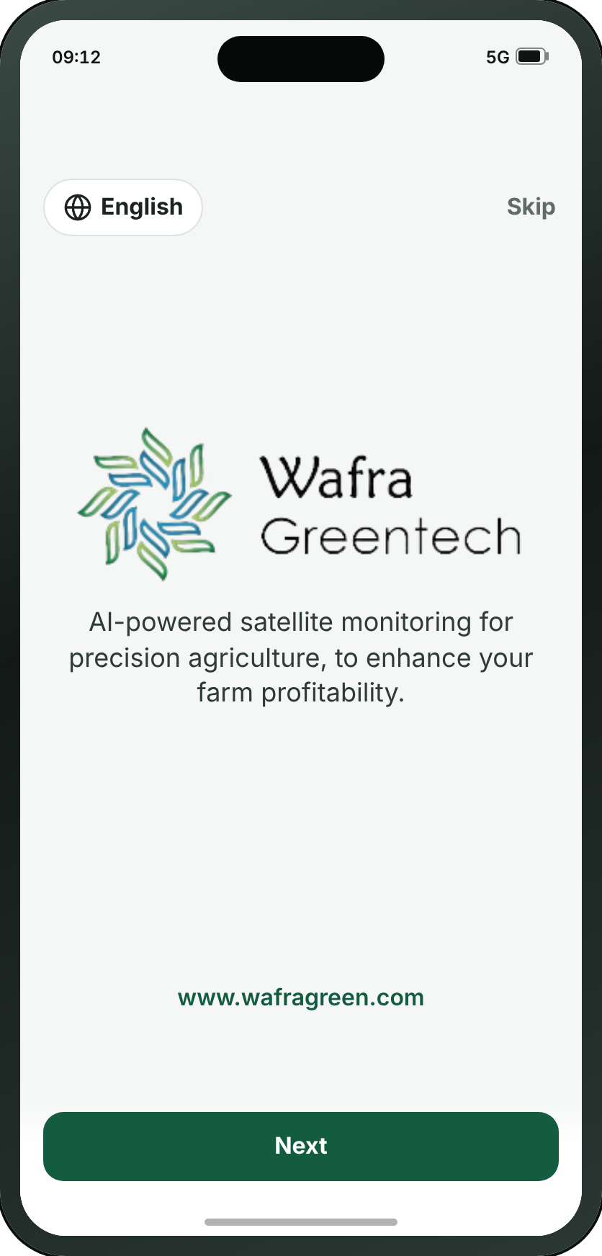
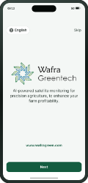
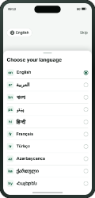
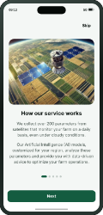
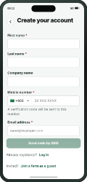
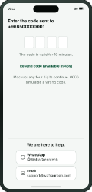
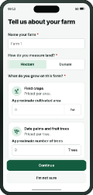
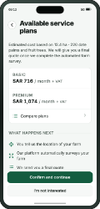
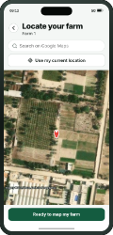
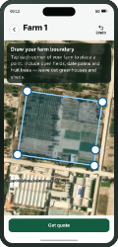
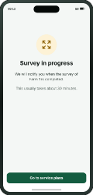
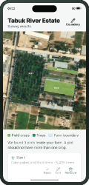
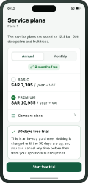
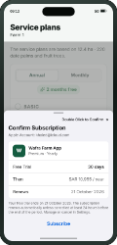
FIRST RUN
A1 · Welcome
→
→
→
→
→
→
→
→
→
→
→
→
A1
A2
A3
A8
A9
A10
A11
A13
A14
A15
A16
A17
A18
Welcome
Choose your language
Guided tour — 1 of 5
Sign up
Verify code
Tell us about your farm
Available service plans
Locate your farm
Draw your farm boundary
Survey in progress
Survey results
Service plans
Confirm subscription
WHAT THE SMALL BUTTONS DO
1
Next → A3 Guided tour — 1 of 5 (page 6)
1
Wafra Farm App · UI mockup v1.7.2
4
Notes:
A1 — Welcome
The first thing anyone sees, once, on the first launch: the mark and one sentence saying what the app does, centred, with the address at the foot. Next takes the tour and Skip goes straight to the sign-up form. Registered users see neither — they open on A20.
1. Next → A3
On the "Signing up" path.

Slide 5
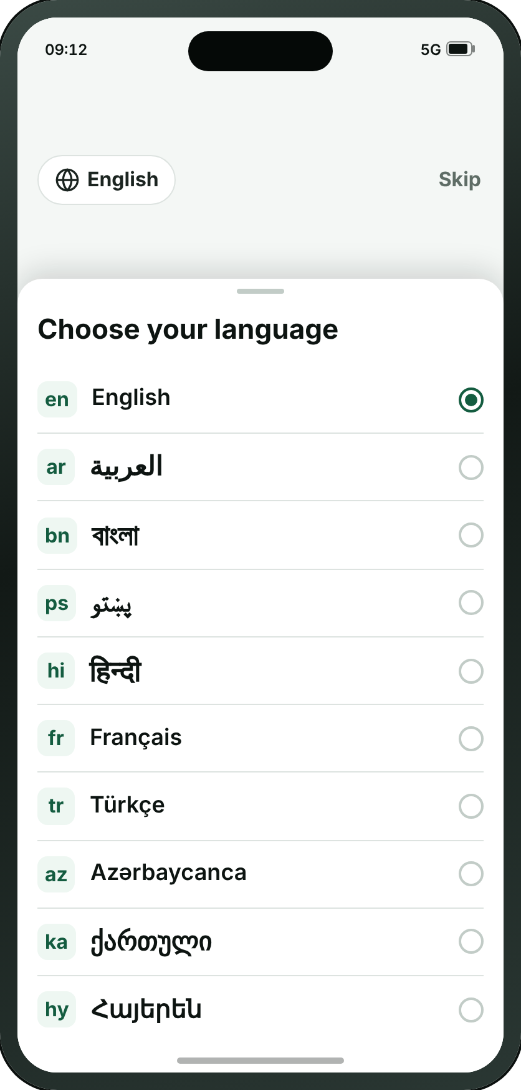
FIRST RUN
A2 · Choose your language
→
→
→
→
→
→
→
→
→
→
→
→
A1
A2
A3
A8
A9
A10
A11
A13
A14
A15
A16
A17
A18
Welcome
Choose your language
Guided tour — 1 of 5
Sign up
Verify code
Tell us about your farm
Available service plans
Locate your farm
Draw your farm boundary
Survey in progress
Survey results
Service plans
Confirm subscription
Wafra Farm App · UI mockup v1.7.2
5
Notes:
A2 — Choose your language
Not a screen — a pop-up sheet over A1, raised by the globe in its corner and closed by choosing a row. It has a page here because a printed deck cannot show a state of another screen any other way. Ten languages, each in its own script with its code beside it; pressing one turns the whole app round if it reads right to left, and closes the sheet. It is where Arabic and Pashto are chosen, and it is one tap from the corner of A1.
On the "Signing up" path.

Slide 6

FIRST RUN
A3 · Guided tour — 1 of 5
→
→
→
→
→
→
→
→
→
→
→
→
A1
A2
A3
A8
A9
A10
A11
A13
A14
A15
A16
A17
A18
Welcome
Choose your language
Guided tour — 1 of 5
Sign up
Verify code
Tell us about your farm
Available service plans
Locate your farm
Draw your farm boundary
Survey in progress
Survey results
Service plans
Confirm subscription
Wafra Farm App · UI mockup v1.7.2
6
Notes:
A3 — Guided tour — 1 of 5
How the service works, and the first of five pictures of the app doing its job, in the language just chosen. Next on A1 opens it and Help brings it back. Illustrated by a satellite over the same synthesised farmland the map screens draw.
On the "Signing up" path.

Slide 7
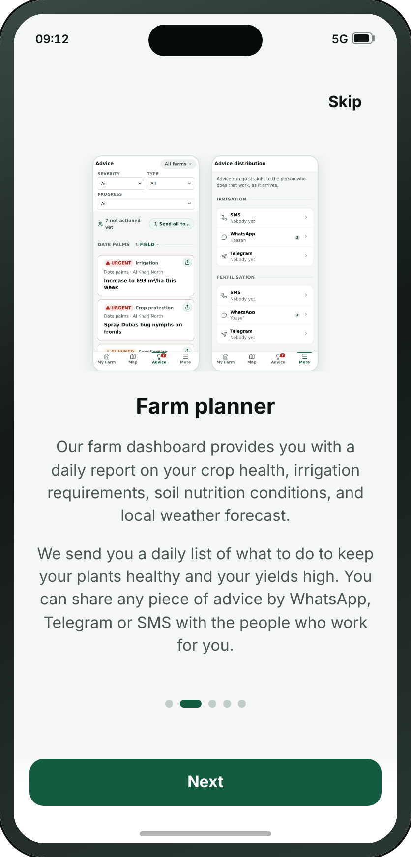
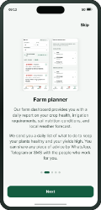
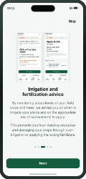
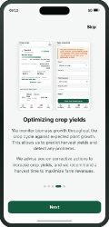
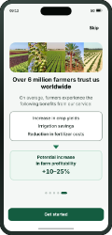
FIRST RUN
A4 · Guided tour — 2 of 5
→
→
→
→
→
→
A1
A3
A4
A5
A6
A7
A8
Welcome
Guided tour — 1 of 5
Guided tour — 2 of 5
Guided tour — 3 of 5
Guided tour — 4 of 5
Guided tour — 5 of 5
Sign up
Wafra Farm App · UI mockup v1.7.2
7
Notes:
A4 — Guided tour — 2 of 5
The farm planner, illustrated by D1 and F9 themselves. In the app these five are one carousel; on paper each needs a page of its own, or four of the five are never seen.
On the "The guided tour, offered from A1 and from Help" path.

Slide 8

FIRST RUN
A5 · Guided tour — 3 of 5
→
→
→
→
→
→
A1
A3
A4
A5
A6
A7
A8
Welcome
Guided tour — 1 of 5
Guided tour — 2 of 5
Guided tour — 3 of 5
Guided tour — 4 of 5
Guided tour — 5 of 5
Sign up
Wafra Farm App · UI mockup v1.7.2
8
Notes:
A5 — Guided tour — 3 of 5
Irrigation and fertilisation advice, illustrated by D2 and D3.
On the "The guided tour, offered from A1 and from Help" path.

Slide 9
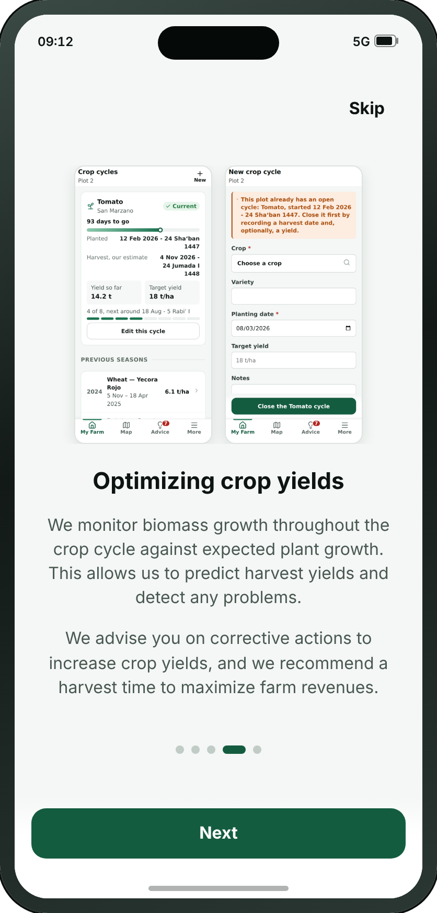
FIRST RUN
A6 · Guided tour — 4 of 5
→
→
→
→
→
→
A1
A3
A4
A5
A6
A7
A8
Welcome
Guided tour — 1 of 5
Guided tour — 2 of 5
Guided tour — 3 of 5
Guided tour — 4 of 5
Guided tour — 5 of 5
Sign up
Wafra Farm App · UI mockup v1.7.2
9
Notes:
A6 — Guided tour — 4 of 5
Optimising crop yields, illustrated by B3 and B4.
On the "The guided tour, offered from A1 and from Help" path.

Slide 10

FIRST RUN
A7 · Guided tour — 5 of 5
→
→
→
→
→
→
A1
A3
A4
A5
A6
A7
A8
Welcome
Guided tour — 1 of 5
Guided tour — 2 of 5
Guided tour — 3 of 5
Guided tour — 4 of 5
Guided tour — 5 of 5
Sign up
Wafra Farm App · UI mockup v1.7.2
10
Notes:
A7 — Guided tour — 5 of 5
What the farmers already using it get out of it, and the panel that hands on to the front door. The only one that argues with figures, and the only one drawn as a funnel: three savings narrowing into one.
On the "The guided tour, offered from A1 and from Help" path.

Slide 11
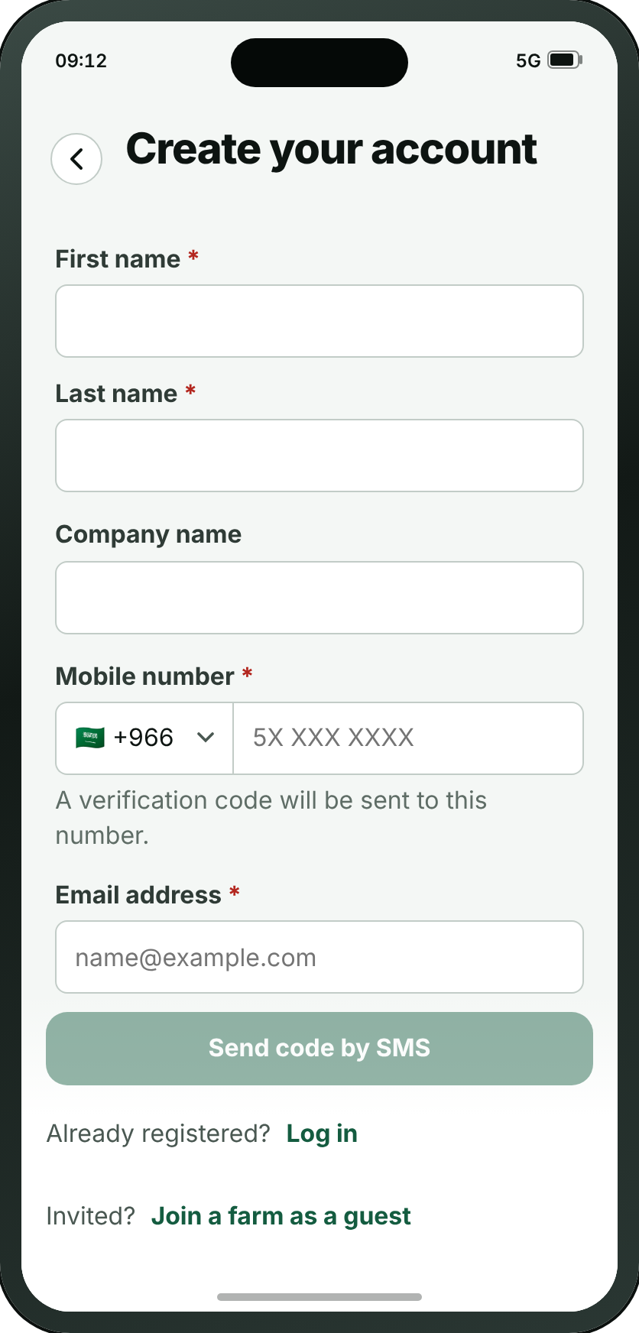
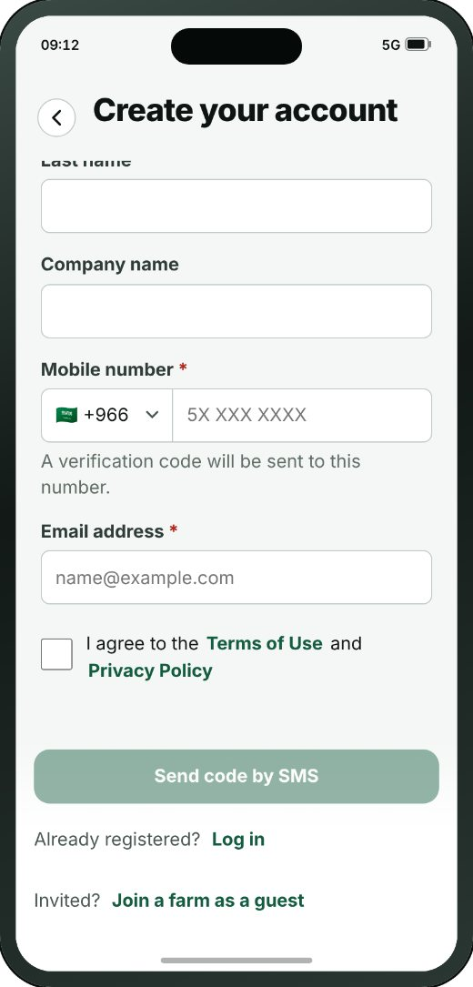
FIRST RUN
A8 · Sign up
→
→
→
→
→
→
→
→
→
→
→
→
A1
A2
A3
A8
A9
A10
A11
A13
A14
A15
A16
A17
A18
Welcome
Choose your language
Guided tour — 1 of 5
Sign up
Verify code
Tell us about your farm
Available service plans
Locate your farm
Draw your farm boundary
Survey in progress
Survey results
Service plans
Confirm subscription
THE REST OF THIS SCREEN
• This screen is shown to new users only. Anyone already registered goes straight to A20.
Scrolls · about 80% of this screen is shown above
Wafra Farm App · UI mockup v1.7.2
11
Notes:
A8 — Sign up
The whole account on one form, and since review 06/09 the email address is the account: a first and last name, an optional company, the address, a number from any country in the world, and a password. The two doors that used to be on A20 are at the foot of it.
On the "Signing up" path.
The screenshot shows 81% of this screen; the rest is below the fold.

Slide 12
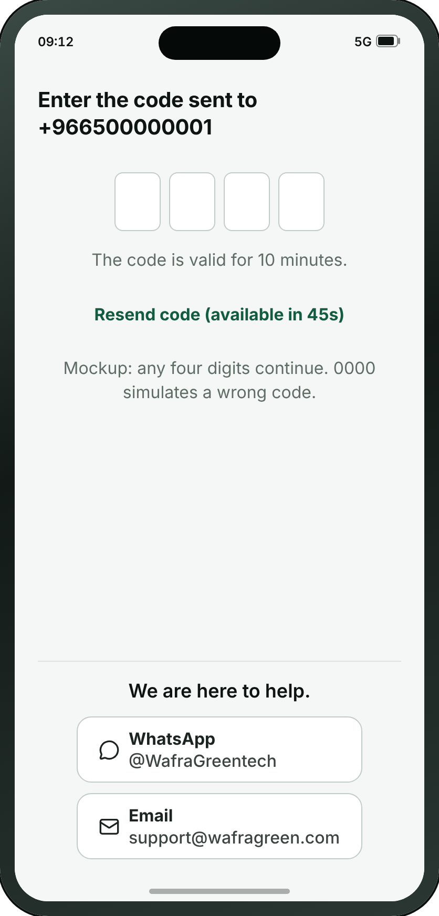
FIRST RUN
A9 · Verify code
→
→
→
→
→
→
→
→
→
→
→
→
A1
A2
A3
A8
A9
A10
A11
A13
A14
A15
A16
A17
A18
Welcome
Choose your language
Guided tour — 1 of 5
Sign up
Verify code
Tell us about your farm
Available service plans
Locate your farm
Draw your farm boundary
Survey in progress
Survey results
Service plans
Confirm subscription
Wafra Farm App · UI mockup v1.7.2
12
Notes:
A9 — Verify code
Four digits to the registered email address, and one sentence saying where they went. The boxes are real inputs, so the phone raises its own keyboard and can fill the code in itself; it sends on the last digit, and five wrong tries rest the account for a quarter of an hour. A brand new account is asked about Face ID here and nowhere else.
On the "Signing up" path.

Slide 13

FIRST RUN
A10 · Tell us about your farm
→
→
→
→
→
→
→
→
→
→
→
→
A1
A2
A3
A8
A9
A10
A11
A13
A14
A15
A16
A17
A18
Welcome
Choose your language
Guided tour — 1 of 5
Sign up
Verify code
Tell us about your farm
Available service plans
Locate your farm
Draw your farm boundary
Survey in progress
Survey results
Service plans
Confirm subscription
WHAT THE SMALL BUTTONS DO
1
I’m not sure → A13 Locate your farm (page 16)
1
Wafra Farm App · UI mockup v1.7.2
13
Notes:
A10 — Tell us about your farm
The moment an account becomes a farm: its name, the unit its land is measured in, and roughly how much of each it holds — a number under Field crops, a count under Date palms and fruit trees. Filling in one, the other, or both IS the answer to what is growing here; nothing is picked. Review 21/09 took the word “first” out of the title — there is a later option to add a second farm, so the idea of a first one is noise this early — and turned the hint under the two numbers into a quiet “I’m not sure”, which skips the estimate and goes straight to locating the farm.
1. I’m not sure → A13
On the "Signing up" path.

Slide 14
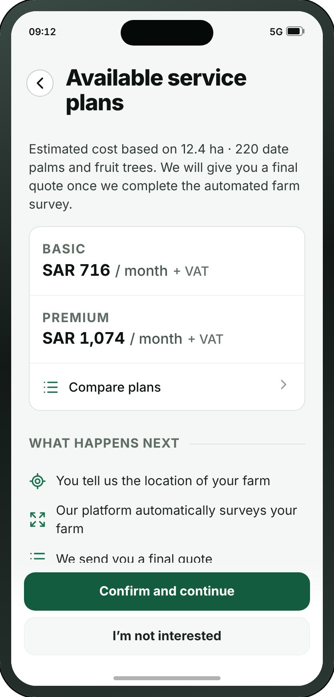
FIRST RUN
A11 · Available service plans
→
→
→
→
→
→
→
→
→
→
→
→
A1
A2
A3
A8
A9
A10
A11
A13
A14
A15
A16
A17
A18
Welcome
Choose your language
Guided tour — 1 of 5
Sign up
Verify code
Tell us about your farm
Available service plans
Locate your farm
Draw your farm boundary
Survey in progress
Survey results
Service plans
Confirm subscription
WHAT THE SMALL BUTTONS DO
1
I’m not interested → A12 Not interested (page 15)
1
Wafra Farm App · UI mockup v1.7.2
14
Notes:
A11 — Available service plans
Rebuilt at review 21/09 out of A17’s own layout: Mark struck the old price-estimate screen through and made its replacement by duplicating the plan page. The two real plans at their two real prices, presented as an estimate, with NOTHING to choose — the radio buttons came off, because the plan is picked later on A17 once the survey has priced the real farm. Under them, the four steps in the reviewer’s own order, which is where the app says plan selection comes last. The call calls this screen A13a; the two plan screens are told apart by their titles rather than by a letter.
1. I’m not interested → A12
On the "Signing up" path.

Slide 15
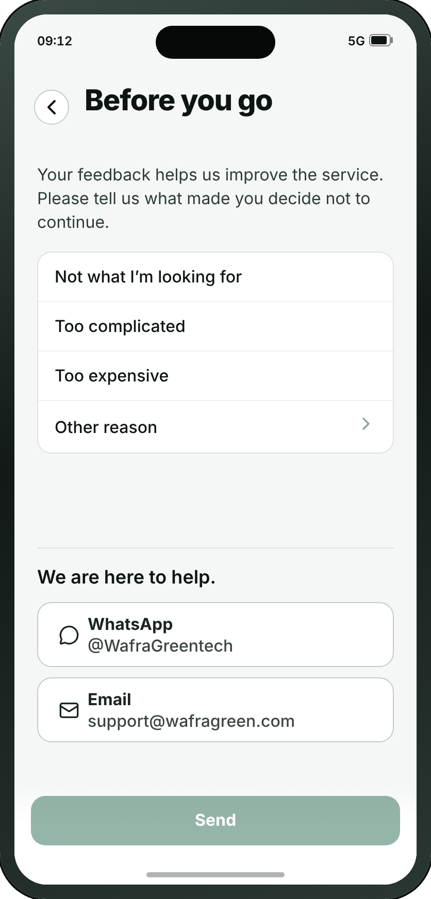
FIRST RUN
A12 · Not interested
WHAT THE SMALL BUTTONS DO
1
Other reason — Opens a drawer to type the reason
1
Wafra Farm App · UI mockup v1.7.2
15
Notes:
A12 — Not interested
New at review 21/09, and the only screen in the app that exists to learn something from somebody leaving. Behind “I’m not interested” on A11: four reasons in Mark’s order — not what I’m looking for, too complicated, too expensive, and a free-text other — with the WhatsApp and email buttons at the foot, because a farmer who is out because the app is too complicated is the one a person could still help, and he has no account and so no other way to reach one.
1. Other reason — Opens a drawer to type the reason

Slide 16
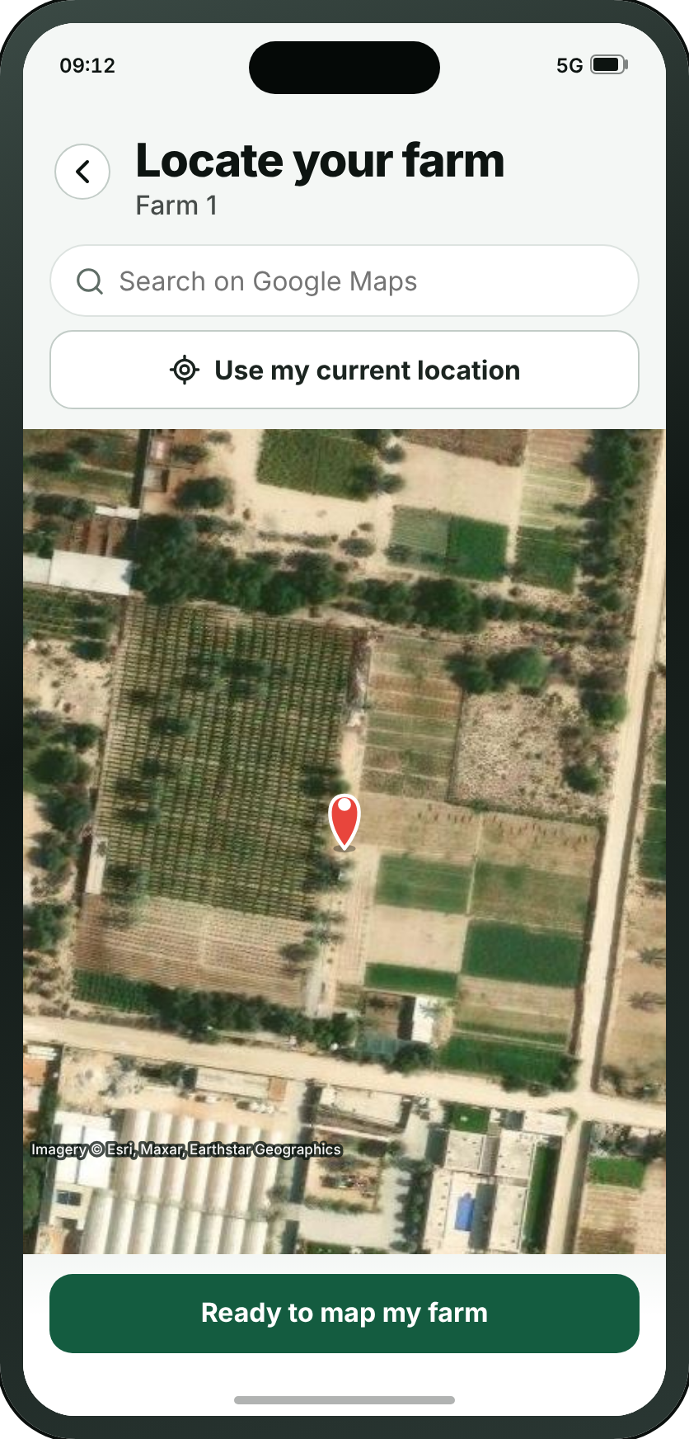
FIRST RUN
A13 · Locate your farm
→
→
→
→
→
→
→
→
→
→
→
→
A1
A2
A3
A8
A9
A10
A11
A13
A14
A15
A16
A17
A18
Welcome
Choose your language
Guided tour — 1 of 5
Sign up
Verify code
Tell us about your farm
Available service plans
Locate your farm
Draw your farm boundary
Survey in progress
Survey results
Service plans
Confirm subscription
WHAT THE SMALL BUTTONS DO
1
Ready to map my farm → A14 Draw your farm boundary (page 17)
1
Wafra Farm App · UI mockup v1.7.2
16
Notes:
A13 — Locate your farm
The first half of what used to be one screen. Review 21/09 split it: finding the farm and drawing round it were the same tap on the same map, so the screen was always in both modes and said it was in neither. This half only finds — two numbered, stacked options above the map, search or current location, and one button that confirms the farm is on screen. Nothing a farmer does here draws anything.
1. Ready to map my farm → A14
On the "Signing up" path.

Slide 17

FIRST RUN
A14 · Draw your farm boundary
→
→
→
→
→
→
→
→
→
→
→
→
A1
A2
A3
A8
A9
A10
A11
A13
A14
A15
A16
A17
A18
Welcome
Choose your language
Guided tour — 1 of 5
Sign up
Verify code
Tell us about your farm
Available service plans
Locate your farm
Draw your farm boundary
Survey in progress
Survey results
Service plans
Confirm subscription
Wafra Farm App · UI mockup v1.7.2
17
Notes:
A14 — Draw your farm boundary
The second half, and the one that draws. By the time anyone arrives the map is already over their land, which is what makes every tap on it unambiguous. The instruction is ON the map at lead size rather than six words in the bar with the rest behind an ⓘ — "text is very small and easy to miss. Farmer may not know how to proceed." One button, "Get quote", and since review 21/09 that is exactly what it does: it makes the farm, sends the boundary for survey, and the quote comes back on the far side. The screening that used to be done by charging first is done by A11 now, which shows both plans at their estimated cost before anyone gets here. Opened with a farm id it edits that farm’s outline instead, which is the one route that skips A13 entirely.
On the "Signing up" path.

Slide 18
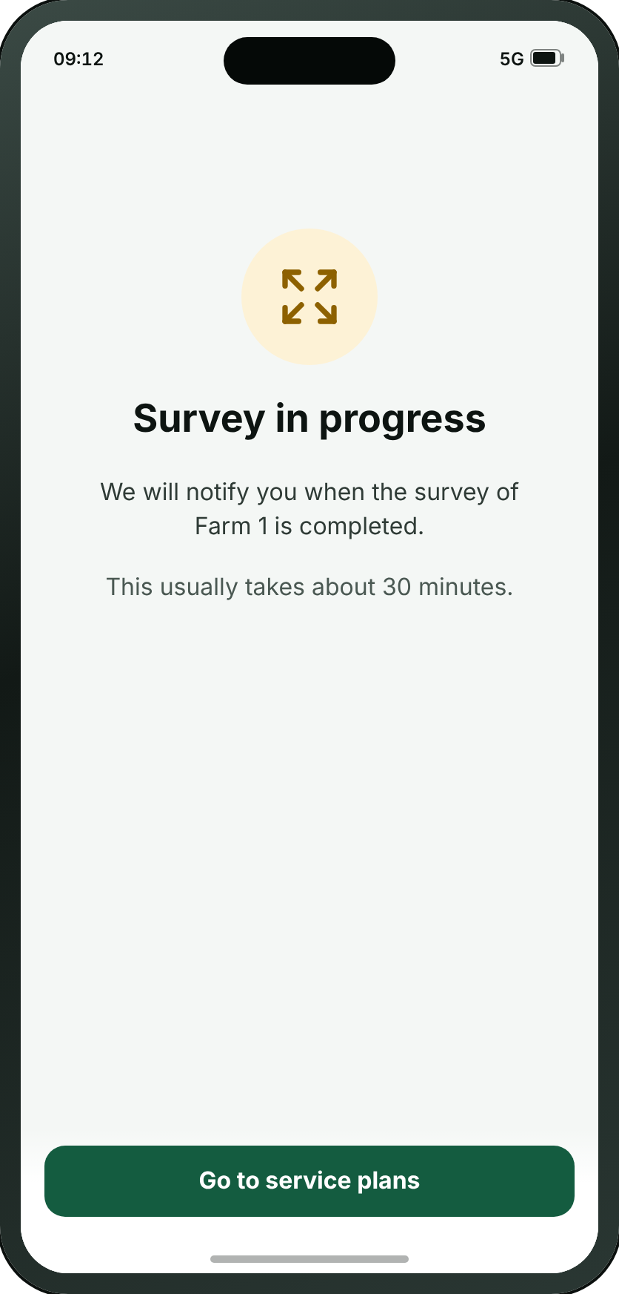
FIRST RUN
A15 · Survey in progress
→
→
→
→
→
→
→
→
→
→
→
→
A1
A2
A3
A8
A9
A10
A11
A13
A14
A15
A16
A17
A18
Welcome
Choose your language
Guided tour — 1 of 5
Sign up
Verify code
Tell us about your farm
Available service plans
Locate your farm
Draw your farm boundary
Survey in progress
Survey results
Service plans
Confirm subscription
WHAT THE SMALL BUTTONS DO
1
Go to service plans → A17 Service plans (page 20)
1
Wafra Farm App · UI mockup v1.7.2
18
Notes:
A15 — Survey in progress
The screen that says the satellite has been asked for something. Review 21/09 renamed it — the farmer is told a survey is starting before it and that his survey is ready after it, so calling the middle of it an analysis made three names for two things — and took out the line telling him to keep the app open: the survey runs on MMC’s servers, so the app has nothing to do while it waits and a push notification is what brings him back. It carries an estimated time, which is MMC’s number and varies by country. Its button goes on to the service plans.
1. Go to service plans → A17
On the "Signing up" path.

Slide 19
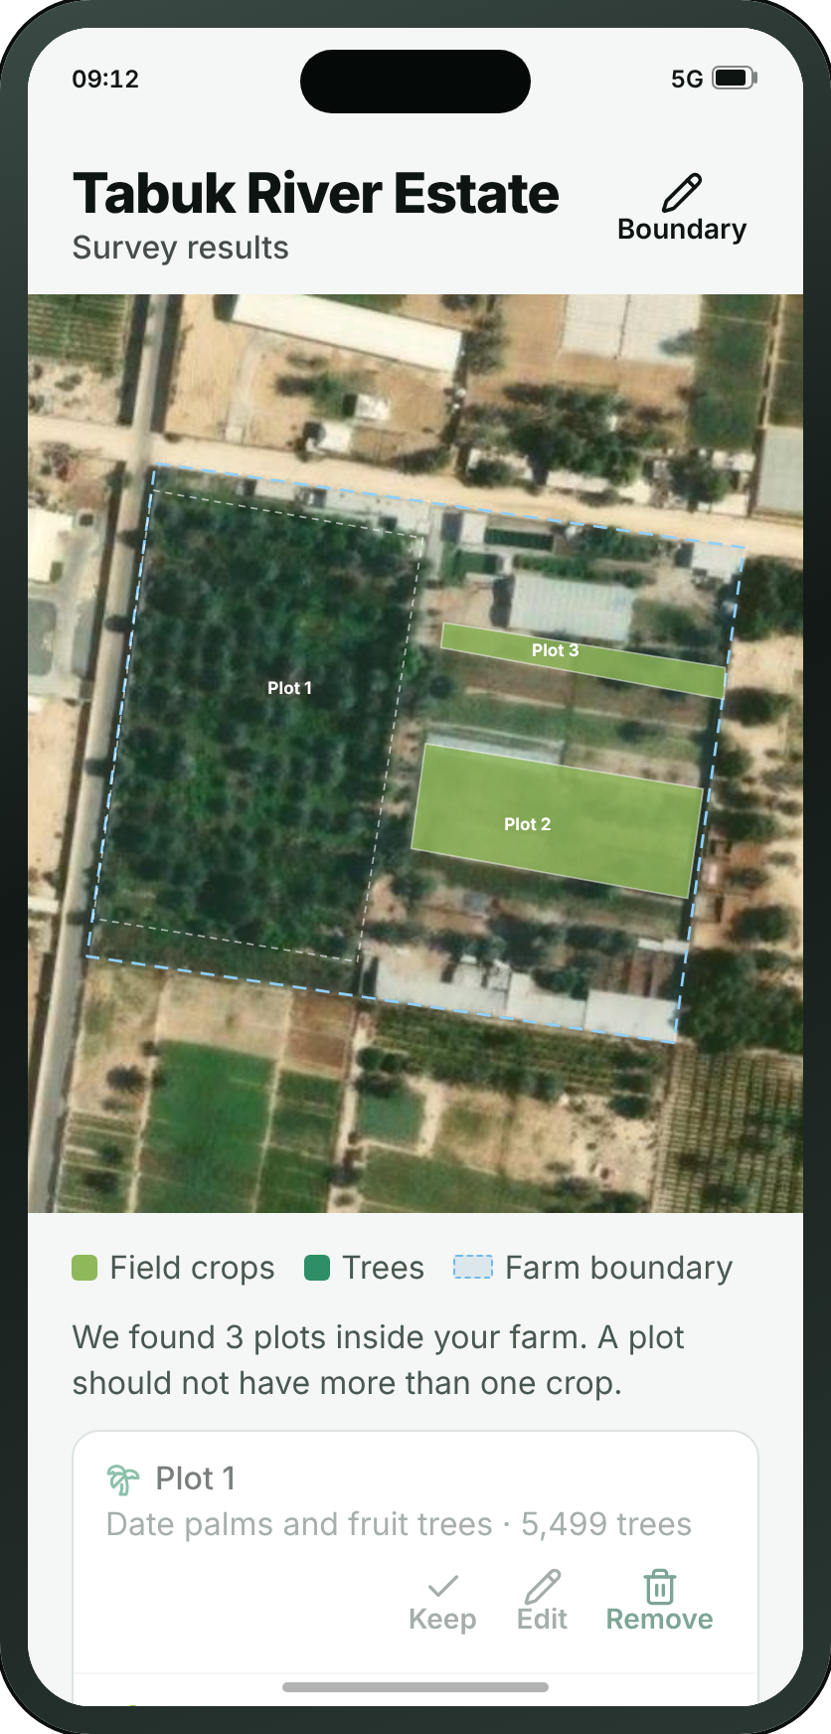
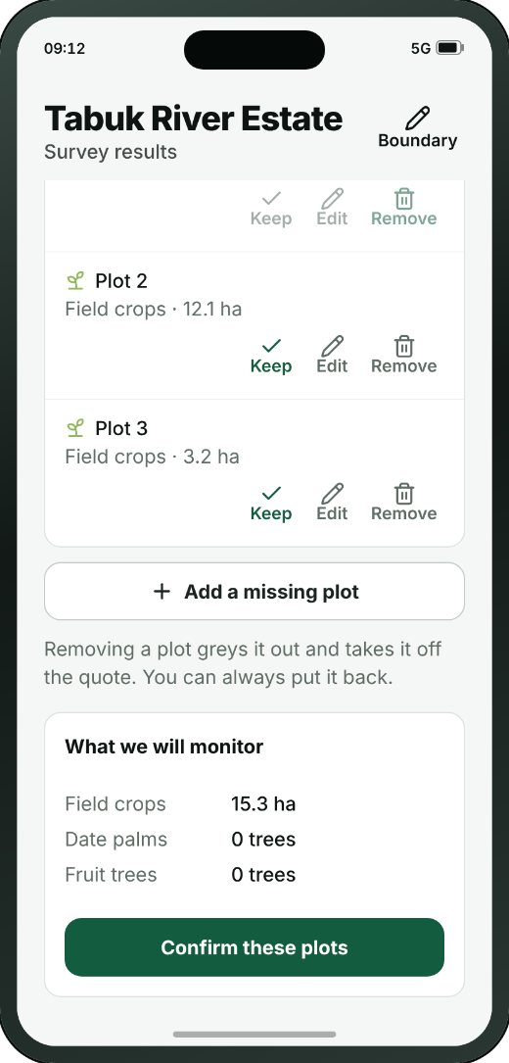
FIRST RUN
A16 · Survey results
→
→
→
→
→
→
→
→
→
→
→
→
A1
A2
A3
A8
A9
A10
A11
A13
A14
A15
A16
A17
A18
Welcome
Choose your language
Guided tour — 1 of 5
Sign up
Verify code
Tell us about your farm
Available service plans
Locate your farm
Draw your farm boundary
Survey in progress
Survey results
Service plans
Confirm subscription
THE REST OF THIS SCREEN
Scrolls · about 55% of this screen is shown above
Wafra Farm App · UI mockup v1.7.2
19
Notes:
A16 — Survey results
The plots the survey found, or the plots the farmer drew, as one list to approve, over the farm’s own outline. Every row offers all three of Keep, Edit and Remove, one button underneath adds a plot that is missing, and the app bar carries the way back to the boundary. It is the second sitting now: the plan was chosen and paid for before the survey ran, so what Home opens when the answer comes back is this — what was found — with A17 one step beyond it, re-priced on the real plots.
On the "Signing up" path.
The screenshot shows 53% of this screen; the rest is below the fold.

Slide 20
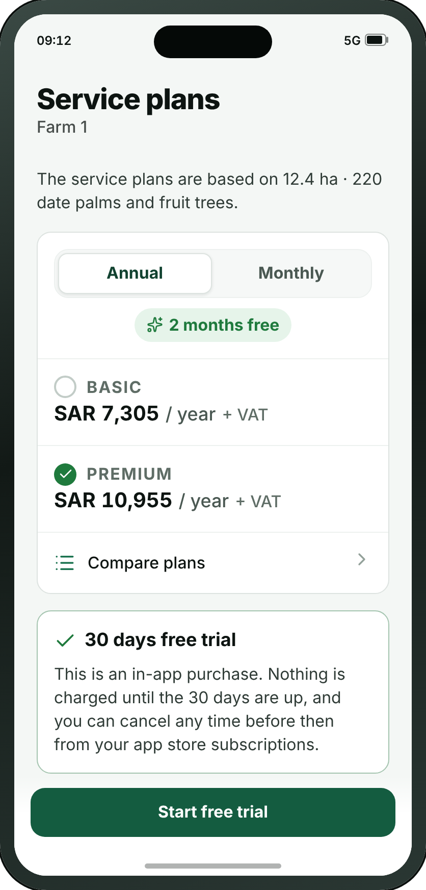
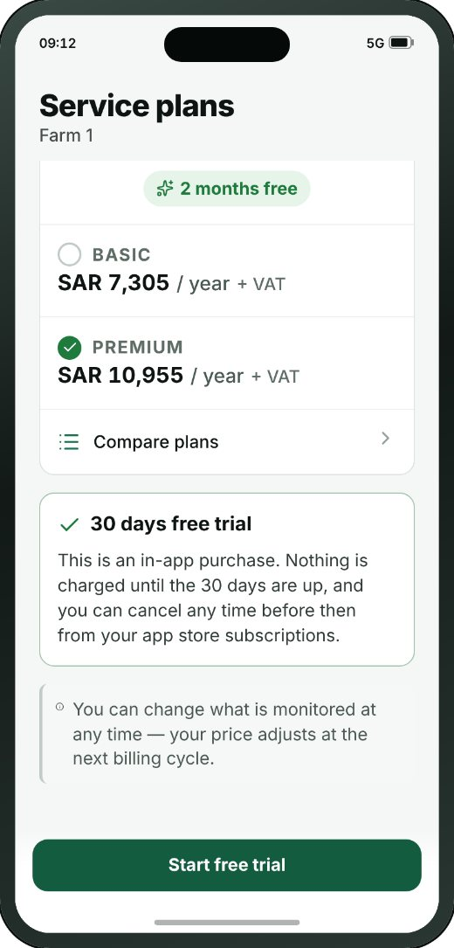
FIRST RUN
A17 · Service plans
→
→
→
→
→
→
→
→
→
→
→
→
A1
A2
A3
A8
A9
A10
A11
A13
A14
A15
A16
A17
A18
Welcome
Choose your language
Guided tour — 1 of 5
Sign up
Verify code
Tell us about your farm
Available service plans
Locate your farm
Draw your farm boundary
Survey in progress
Survey results
Service plans
Confirm subscription
THE REST OF THIS SCREEN
WHAT THE SMALL BUTTONS DO
1
Start free trial → A18 Confirm subscription (page 21)
1
Scrolls · about 80% of this screen is shown above
Wafra Farm App · UI mockup v1.7.2
20
Notes:
A17 — Service plans
The payment screen. Review 21/09 split it into a monthly and an annual page and the third pass of the same review put it back together — the period is a toggle on this screen, not a second screen code. Two levels to pick between and one main confirmation button at the bottom. It comes AFTER the survey again — “Sequence: A13, A15, A16, A17”, and the four steps on A11 say the same thing in longer form: a quote third, a plan chosen fourth. Reached before the answer is back it says the survey is still running rather than inventing a figure. The monthly/annual toggle sits ABOVE the two cards at review 21/09’s third pass — the period is what the two prices MEAN, so it is declared before them — and it defaults to annual, with the saving spelt out under it. It is a toggle on this one screen and no longer a second screen code: “don’t create a separate screen code to show the monthly plan page.” F5 is the same question for an account that already has one.
1. Start free trial → A18
On the "Signing up" path.
The screenshot shows 81% of this screen; the rest is below the fold.

Slide 21
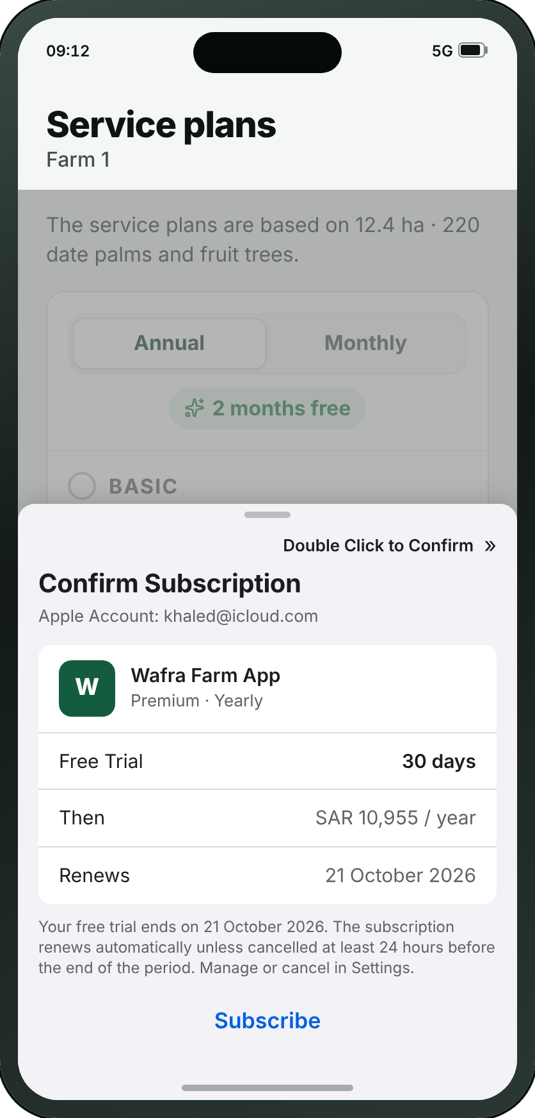
FIRST RUN
A18 · Confirm subscription
→
→
→
→
→
→
→
→
→
→
→
→
A1
A2
A3
A8
A9
A10
A11
A13
A14
A15
A16
A17
A18
Welcome
Choose your language
Guided tour — 1 of 5
Sign up
Verify code
Tell us about your farm
Available service plans
Locate your farm
Draw your farm boundary
Survey in progress
Survey results
Service plans
Confirm subscription
Wafra Farm App · UI mockup v1.7.2
21
Notes:
A18 — Confirm subscription
New at review 21/09 (second pass): the App Store purchase sheet, drawn as the drawer a farmer actually meets when he presses Start free trial. The 21/09 call settled that Wafra never sees a card — “we don’t charge a credit card, as the subscription is through Apple/Google” — and A17 says that in words; this is the same fact in the form it arrives. Deliberately not our design system: it is Apple’s sheet, drawn to iOS’s own metrics, because the point is that it is not ours to change. The Android equivalent is Google Play’s and is named on A17.
On the "Signing up" path.

Slide 22
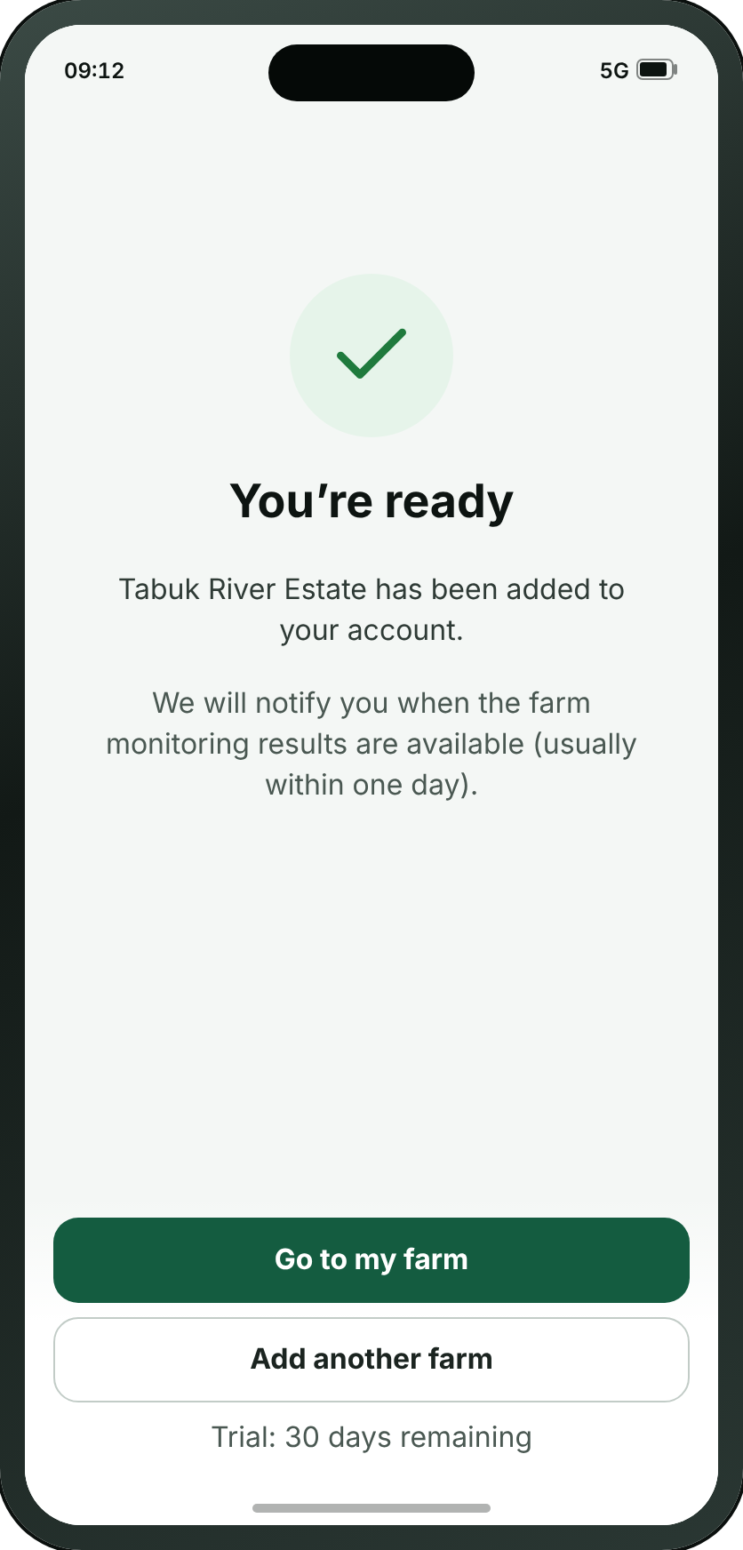
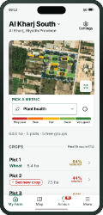
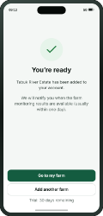
FIRST RUN
A19 · You’re ready
→
→
→
B1
A16
A17
A19
Farm home
Survey results
Service plans
You’re ready
Wafra Farm App · UI mockup v1.7.2
22
Notes:
A19 — You’re ready
The pause between setting up and starting. It says when the first satellite pass arrives, so the empty farm makes sense.
On the "Once the survey is ready" path.

Slide 23
SECTION 2 OF 6
Log in
2 screens · A20 · A21
Wafra Farm App · UI mockup v1.7.2
23
Notes:
Log in — 2 screens.

Slide 24
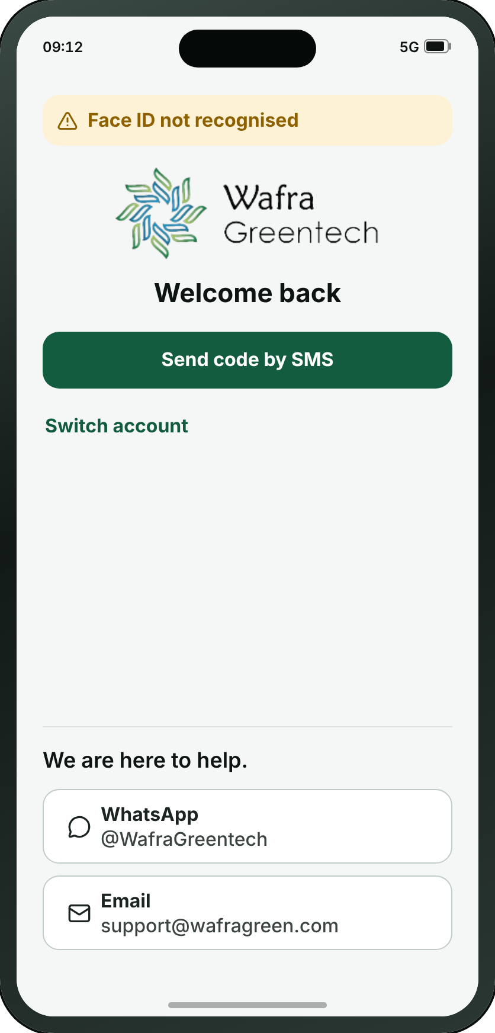
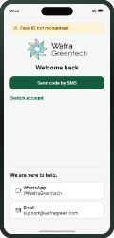
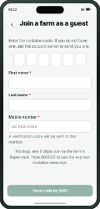
LOG IN
A20 · Log in
→
A20
A21
Log in
Join a farm as a guest
• Most users sign in with Face ID. This screen is drawn only when Face ID fails, which is what the notice at the top of it says.
• Creating an account and joining a farm as a guest are on A8, which is where somebody the app has never met lands.
• A code can be sent to the registered email address instead of a password.
• “Switch account” is for a farmer holding several accounts for different farms.
Wafra Farm App · UI mockup v1.7.2
24
Notes:
A20 — Log in
The way back in for somebody the app has already met, and only for them. It opens with the reason it is open at all — Face ID did not recognise him — then greets him by name and offers a password or a code to the registered email address. No app bar: the screen says "Welcome back" and does not also need a title saying "Log in". Creating an account and joining a farm as a guest are on A8, which is where a stranger lands.
On the "Joining a farm I was invited to" path.

Slide 25
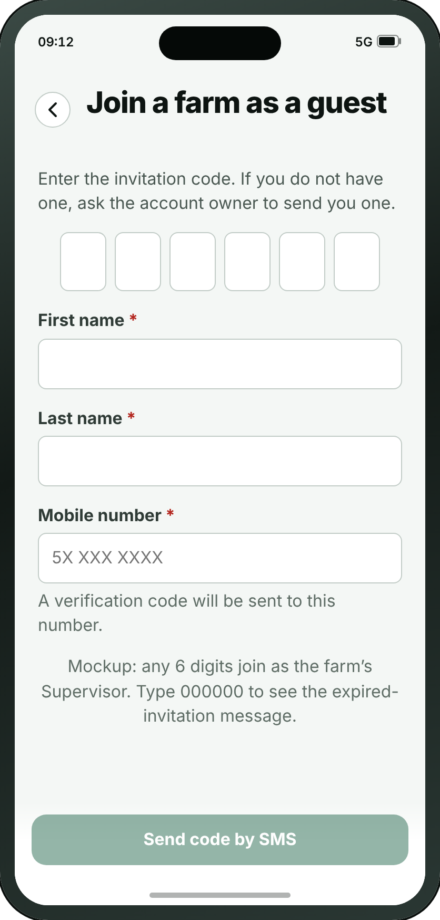
LOG IN
A21 · Join a farm as a guest
→
A20
A21
Log in
Join a farm as a guest
Wafra Farm App · UI mockup v1.7.2
25
Notes:
A21 — Join a farm as a guest
For someone invited to a farm they do not own — which is what “as a guest” says before they tap. Six digits typed in, or the QR code read off the phone of the person who set the account up, which is where review 06/09 put it: one phone shows, one phone scans.
On the "Joining a farm I was invited to" path.

Slide 26
SECTION 3 OF 6
My Farm
11 screens · B1 · B2 · B12 · B3 · B4 · B5 · B6 · B7 · B8 · B9 · B10
Wafra Farm App · UI mockup v1.7.2
26
Notes:
My Farm — 11 screens.

Slide 27

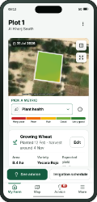
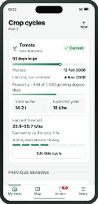
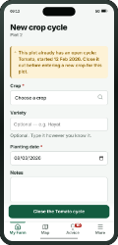
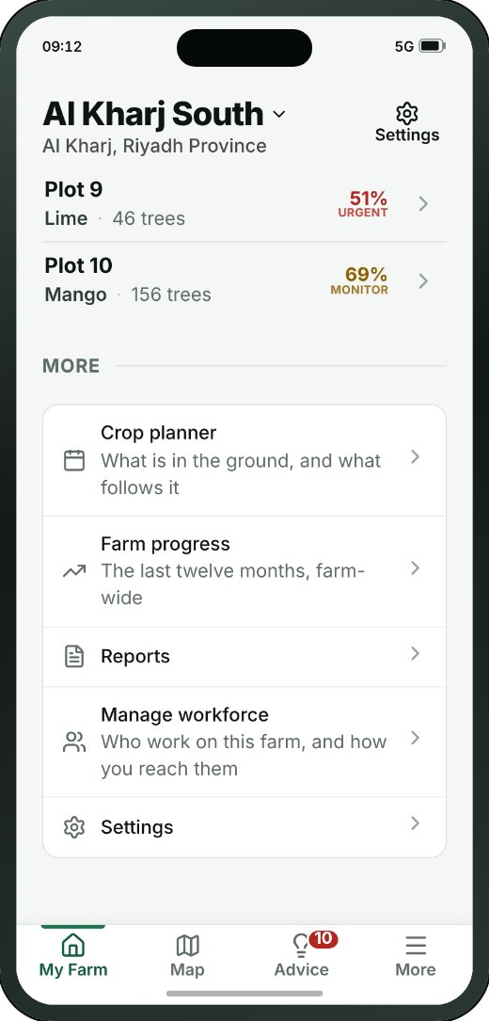
MY FARM
B1 · Farm home
→
→
→
1
B1
B2
B3
B4
Farm home
Plot detail
Crop cycles
Add / edit crop cycle
THE REST OF THIS SCREEN
WHAT THE SMALL BUTTONS DO
1
Switch farm — Switches between farms, and adds a new one
2
2
Open map → C1 Map (page 39)
3
Pick a metric. Showing Plant health — Opens the list of metrics, each explained
3
4
Open Plot 1 → B2 Plot detail (page 28)
5
Wheat → B3 Crop cycles (page 30)
6
Set new crop → B4 Add / edit crop cycle (page 31)
4
5
6
Scrolls · about 35% of this screen is shown above
Wafra Farm App · UI mockup v1.7.2
27
Notes:
B1 — Farm home
The farm and every plot on it, on one screen — the crops first, the tree groups after, each list in plot order (Plot 1, Plot 2 …) whether or not a crop is set. Every plot is numbered; none is named after its crop. The map at the top uses the same “Pick a metric” control and colour legend as every other map, and its expand button opens the full map with a way back.
1. Switch farm — Switches between farms, and adds a new one
2. Open map → C1
3. Pick a metric. Showing Plant health — Opens the list of metrics, each explained
4. Open Plot 1 → B2
5. Wheat → B3
6. Set new crop → B4
On the "From the farm to one plot, and what is growing on it" path.
The screenshot shows 37% of this screen; the rest is below the fold.

Slide 28
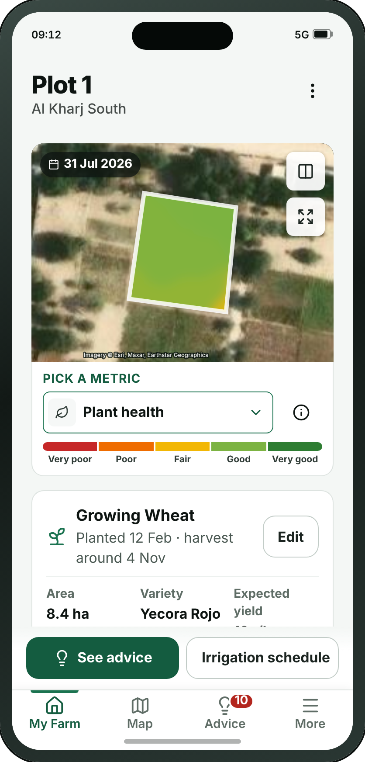
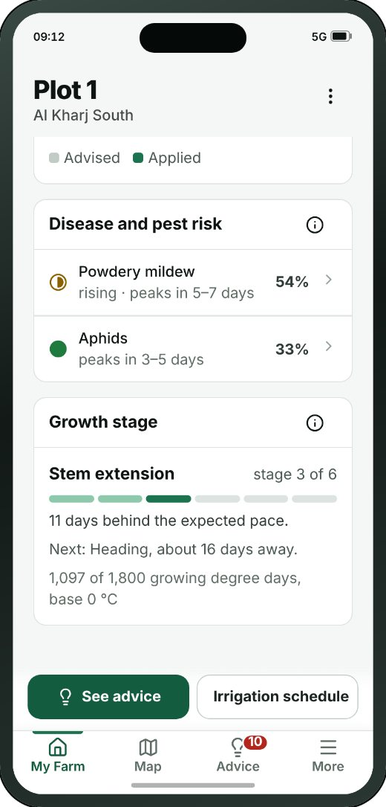
MY FARM
B2 · Plot detail
→
→
→
1
B1
B2
B3
B4
2
Farm home
Plot detail
Crop cycles
Add / edit crop cycle
3
THE REST OF THIS SCREEN
WHAT THE SMALL BUTTONS DO
1
More — Rename, edit the boundary, remove the plot
2
Which date? — Picks the imagery date, and compares two
3
Open in the map → C1 Map (page 39)
4
Pick a metric. Showing Plant health — Opens the list of metrics, each explained
4
5
Edit → B3 Crop cycles (page 30)
6
See advice → D1 Advice inbox (page 45)
7
Irrigation schedule → B12 Irrigation schedule (page 29)
5
8
Plant health On the map64%Good — Shows this metric on the map
6
7
8
Scrolls · about 25% of this screen is shown above
Wafra Farm App · UI mockup v1.7.2
28
Notes:
B2 — Plot detail
One field, in the order a farmer reads it (v1.7.2): the map with its metric picker and legend; the crop cycle, compact, edited on B3; the score card — all five metrics as numbers in their legend colours, and pressing one shows it on the map; advice for this plot, shown even when there is none; a trend of any of the five metrics, opening on the one the map shows; the irrigation trend; disease and pest risk; and the growth stage. The dock has two buttons: See advice, which opens the inbox for this plot only, and Irrigation schedule (B12).
1. More — Rename, edit the boundary, remove the plot
2. Which date? — Picks the imagery date, and compares two
3. Open in the map → C1
4. Pick a metric. Showing Plant health — Opens the list of metrics, each explained
5. Edit → B3
6. See advice → D1
7. Irrigation schedule → B12
8. Plant health On the map64%Good — Shows this metric on the map
On the "From the farm to one plot, and what is growing on it" path.
The screenshot shows 24% of this screen; the rest is below the fold.

Slide 29
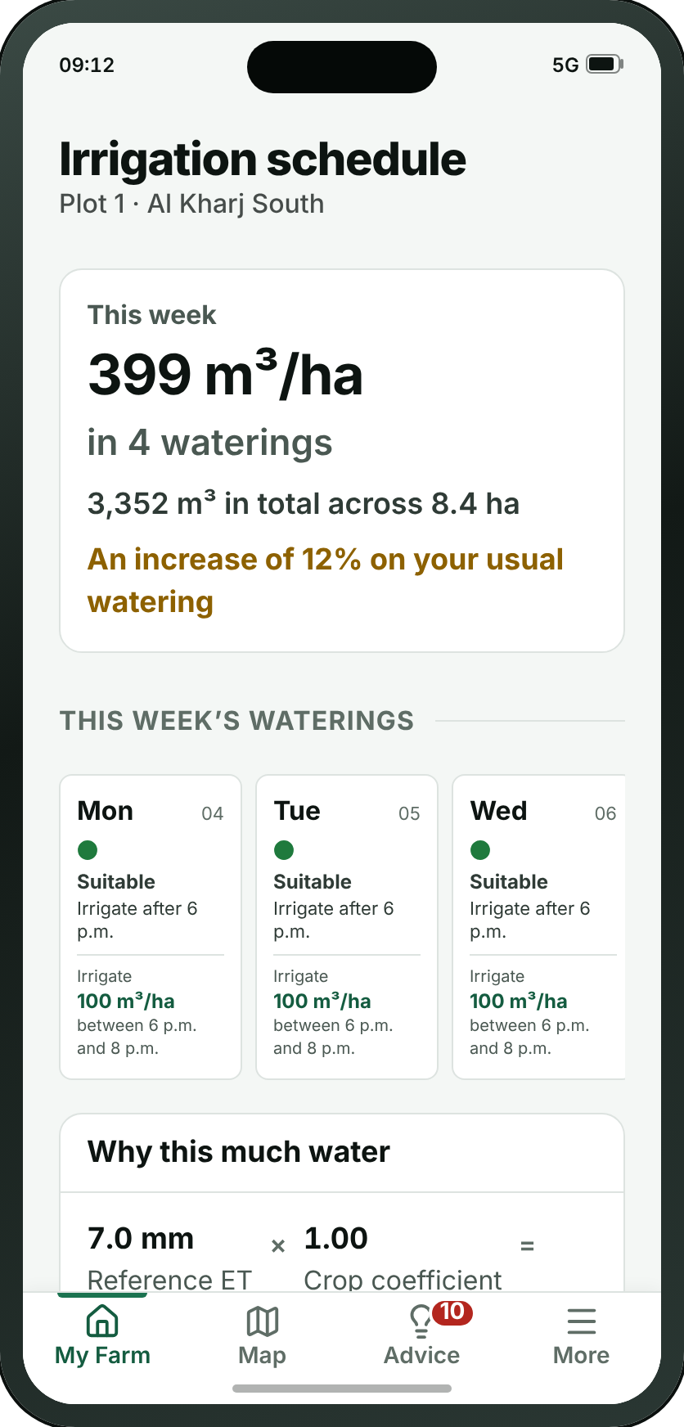
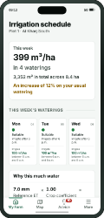
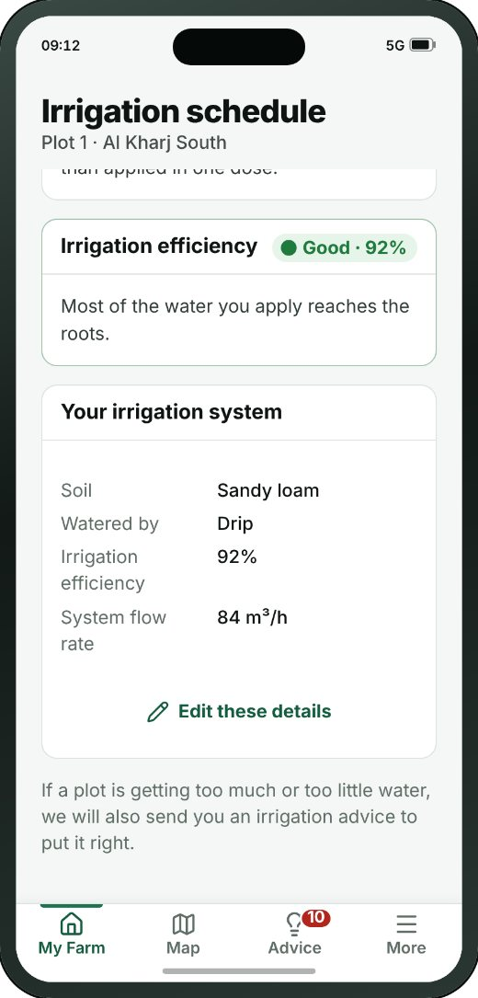
MY FARM
B12 · Irrigation schedule
→
→
B1
B2
B12
Farm home
Plot detail
Irrigation schedule
THE REST OF THIS SCREEN
Scrolls · about 35% of this screen is shown above
Wafra Farm App · UI mockup v1.7.2
29
Notes:
B12 — Irrigation schedule
New at v1.7.2, opened from the second button on a plot or tree group: the week’s water for this plot — the rate per hectare, the total, and whether it is more or less than usual; each watering on its day with its two-hour window and the weather that decided it; why this much (reference ET × crop coefficient); fertigation where the plot is on drip; the efficiency of the system; and the system itself — soil, method, flow rate — which used to sit in the crop cycle box on B2.
On the "A plot’s irrigation schedule" path.
The screenshot shows 35% of this screen; the rest is below the fold.

Slide 30
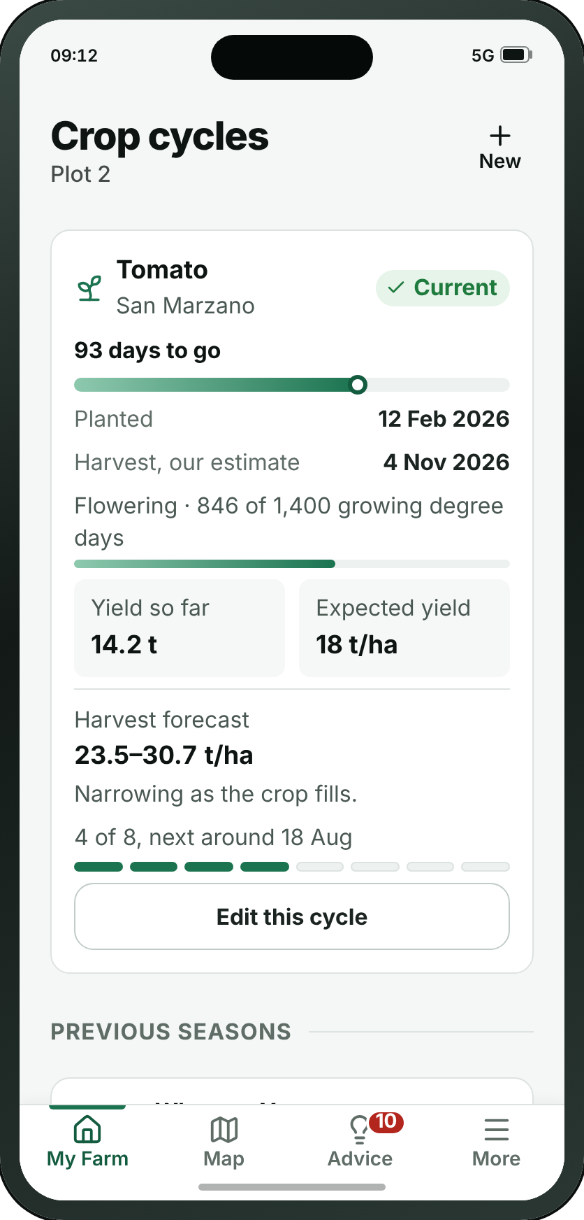

MY FARM
B3 · Crop cycles
→
→
→
1
B1
B2
B3
B4
Farm home
Plot detail
Crop cycles
Add / edit crop cycle
THE REST OF THIS SCREEN
WHAT THE SMALL BUTTONS DO
1
New → B4 Add / edit crop cycle (page 31)
2
Edit this cycle → B4 Add / edit crop cycle (page 31)
2
Scrolls · about 65% of this screen is shown above
Wafra Farm App · UI mockup v1.7.2
30
Notes:
B3 — Crop cycles
What has been planted here, season by season. Open field only — a tree group has no cycle. Closing a season keeps it, which is what makes one year comparable with the last.
1. New → B4
2. Edit this cycle → B4
On the "From the farm to one plot, and what is growing on it" path.
The screenshot shows 63% of this screen; the rest is below the fold.

Slide 31


MY FARM
B4 · Add / edit crop cycle
→
→
→
B1
B2
B3
B4
Farm home
Plot detail
Crop cycles
Add / edit crop cycle
THE REST OF THIS SCREEN
Scrolls · about 80% of this screen is shown above
Wafra Farm App · UI mockup v1.7.2
31
Notes:
B4 — Add / edit crop cycle
Starting a new planting, or closing the one that is running. A season closes with a harvest date, and a yield if anyone weighed it.
On the "From the farm to one plot, and what is growing on it" path.
The screenshot shows 82% of this screen; the rest is below the fold.

Slide 32




MY FARM
B5 · Tree group
→
→
1
B1
B5
B6
2
Farm home
Tree group
Tree detail
3
THE REST OF THIS SCREEN
WHAT THE SMALL BUTTONS DO
1
Search — Finds a tree by its number
2
Which date? — Picks the imagery date, and compares two
3
Open in the map → C1 Map (page 39)
4
4
Pick a metric. Showing Tree health — Opens the list of metrics, each explained
5
Tree health On the map27%Poor — Shows this metric on the map
6
See advice → D1 Advice inbox (page 45)
7
Irrigation schedule → B12 Irrigation schedule (page 29)
8
Soil moisture41%Very dry — Shows this metric on the map
5
6
7
8
Scrolls · about 20% of this screen is shown above
Wafra Farm App · UI mockup v1.7.2
32
Notes:
B5 — Tree group
The same screen as a field (B2), without the crop cycle: map, score card, the trees that recently stopped signalling, advice, the trend of any metric, irrigation, disease and pest risk and the growth stage, with See advice and Irrigation schedule in the dock. “Health overview” is called Score card now, and it carries all five metrics, not three.
1. Search — Finds a tree by its number
2. Which date? — Picks the imagery date, and compares two
3. Open in the map → C1
4. Pick a metric. Showing Tree health — Opens the list of metrics, each explained
5. Tree health On the map27%Poor — Shows this metric on the map
6. See advice → D1
7. Irrigation schedule → B12
8. Soil moisture41%Very dry — Shows this metric on the map
On the "From the farm to a tree group, and down to one tree" path.
The screenshot shows 20% of this screen; the rest is below the fold.

Slide 33


MY FARM
B6 · Tree detail
→
→
1
B1
B5
B6
Farm home
Tree group
Tree detail
THE REST OF THIS SCREEN
WHAT THE SMALL BUTTONS DO
1
More — Replace, mark as removed, record a note
Scrolls · about 40% of this screen is shown above
Wafra Farm App · UI mockup v1.7.2
33
Notes:
B6 — Tree detail
One tree. It begins with a map of which tree it is, because picking tree 2841 out of eight thousand is the hard part.
1. More — Replace, mark as removed, record a note
On the "From the farm to a tree group, and down to one tree" path.
The screenshot shows 39% of this screen; the rest is below the fold.

Slide 34



MY FARM
B7 · Crop planner
→
→
→
1
B1
B7
B3
B4
2
Farm home
Crop planner
Crop cycles
Add / edit crop cycle
THE REST OF THIS SCREEN
WHAT THE SMALL BUTTONS DO
1
About: Crop planner — Opens the guidance for this screen
2
Plot 1 · WheatStarted 12 Feb · harvest aro — Switches to another plot on this farm
Scrolls · about 35% of this screen is shown above
Wafra Farm App · UI mockup v1.7.2
34
Notes:
B7 — Crop planner
New at the 13/09 catalogue review. The app recorded cycles one plot at a time and planned across none of them, so nothing could say that four plots come free in March or that a field is going into its third season of the same family. Plots down the side, twelve months across, current cycles drawn where their real dates put them, and a suggested next crop read from each plot’s own closed history.
1. About: Crop planner — Opens the guidance for this screen
2. Plot 1 · WheatStarted 12 Feb · harvest aro — Switches to another plot on this farm
On the "Planning what follows this season" path.
The screenshot shows 33% of this screen; the rest is below the fold.

Slide 35



MY FARM
B8 · Farm progress
→
→
1
B1
B8
B2
Farm home
Farm progress
Plot detail
THE REST OF THIS SCREEN
WHAT THE SMALL BUTTONS DO
1
About: Farm progress — Opens the guidance for this screen
Scrolls · about 40% of this screen is shown above
Wafra Farm App · UI mockup v1.7.2
35
Notes:
B8 — Farm progress
Twelve months of one measure for the whole farm — the comparison the app could not make: B2 charts a single plot and C4 puts the farm at two dates side by side, and nothing showed the year. It is a trend for a chosen measure and deliberately not a farm health score: averaging crops that cannot be averaged is why B1 carries no such figure.
1. About: Farm progress — Opens the guidance for this screen
On the "Reading the year, and the plots behind it" path.
The screenshot shows 42% of this screen; the rest is below the fold.

Slide 36


MY FARM
B9 · Draw my own plots
→
→
1
B1
B9
A16
Farm home
Draw my own plots
Survey results
WHAT THE SMALL BUTTONS DO
1
About: Draw one plot — Opens the guidance for this screen
Wafra Farm App · UI mockup v1.7.2
36
Notes:
B9 — Draw my own plots
Drawing each plot on satellite imagery, corner by corner, and naming it. One plot is one crop, which is why the boundary is the only thing this route asks for before the summary. Reached from Farm settings now (Add a plot), not from first-run sign-up — the fork that used to send new sign-ups here is A9B, which this registry no longer carries; see the note near the top of this file.
1. About: Draw one plot — Opens the guidance for this screen
On the "Adding a plot by hand, after the farm already exists" path.

Slide 37



MY FARM
B10 · Manage workforce
→
B1
B10
Farm home
Manage workforce
THE REST OF THIS SCREEN
WHAT THE SMALL BUTTONS DO
1
Invite in personShow a QR code — Shows the code on this phone for the other person to scan
2
Invite by SMSSend a six-digit code — Sends the code to somebody who is not here
1
2
Scrolls · about 55% of this screen is shown above
Wafra Farm App · UI mockup v1.7.2
37
Notes:
B10 — Manage workforce
The people work is sent to on this farm: a name, a number and the app each of them actually reads. Nobody here holds an account — an advice reaches them as a message with a link — except the one person invited as supervisor. It is an address book, not the permission matrix the v1.5.4 review deleted.
1. Invite in personShow a QR code — Shows the code on this phone for the other person to scan
2. Invite by SMSSend a six-digit code — Sends the code to somebody who is not here
On the "The people work is sent to" path.
The screenshot shows 55% of this screen; the rest is below the fold.

Slide 38
SECTION 4 OF 6
Map
5 screens · C1 · C2 · C3 · C4 · C5
Wafra Farm App · UI mockup v1.7.2
38
Notes:
Map — 5 screens.

Slide 39





MAP
C1 · Map
→
→
→
1
2
C1
C2
C3
C5
3
Map
Layers
Plot sheet
Boundary editor
4
WHAT THE SMALL BUTTONS DO
1
Search a place, farm, plot or tree — Finds a place, a farm, a plot or a tree
2
All farms — Switches which farm the map is showing
3
Layers → C2 Layers (page 40)
4
Compare → C4 Compare dates (page 42)
5
Pick a metric. Showing Plant health — Opens the list of metrics, each explained
5
Wafra Farm App · UI mockup v1.7.2
39
Notes:
C1 — Map
The farm from above, filling the screen. Every plot is labelled with its number and its crop, always. The panel at the foot says “Pick a metric” over a button that names the one shown, with a five-colour legend under it in that metric’s own words: red is bad and green is good, and on soil moisture and water stress blue means too much water. Opened from a plot or farm screen, the map carries a back button and is fitted to that plot, with no plot sheet raised. Four tools: search, layers, compare and locate — zoom is a pinch, and finding a tree is on the tree group itself.
1. Search a place, farm, plot or tree — Finds a place, a farm, a plot or a tree
2. All farms — Switches which farm the map is showing
3. Layers → C2
4. Compare → C4
5. Pick a metric. Showing Plant health — Opens the list of metrics, each explained
On the "Finding a plot on the map and correcting its boundary" path.

Slide 40

MAP
C2 · Layers
→
→
→
C1
C2
C3
C5
Map
Layers
Plot sheet
Boundary editor
Wafra Farm App · UI mockup v1.7.2
40
Notes:
C2 — Layers
Which picture to draw the map on — satellite or Google Maps, each described — and two farm layers: the boundaries, and tree points. The metric is chosen on the map itself, so the list of monitoring layers is gone, and irrigation efficiency moved to each plot’s irrigation schedule.
On the "Finding a plot on the map and correcting its boundary" path.

Slide 41

MAP
C3 · Plot sheet
→
→
→
C1
C2
C3
C5
Map
Layers
Plot sheet
Boundary editor
• The plot sheet is a pop-up panel that appears when the user taps a plot on the map. It shows the general metrics for the plot selected, and opens the full plot screen if he wants more.
Wafra Farm App · UI mockup v1.7.2
41
Notes:
C3 — Plot sheet
A tap on a plot, answered without leaving the map: its name, crop and status, the metric the map is showing with its colour and word, and all five metrics in the score card’s order and colours — pressing one repaints the map. It drags up to full height and opens the plot. It is not raised when the map is opened from a plot screen.
On the "Finding a plot on the map and correcting its boundary" path.

Slide 42


MAP
C4 · Compare dates
→
C1
C4
Map
Compare dates
WHAT THE SMALL BUTTONS DO
1
Pick a metric. Showing Plant health — Opens the list of metrics, each explained
1
Wafra Farm App · UI mockup v1.7.2
42
Notes:
C4 — Compare dates
The whole farm at two dates at once, split by a line you drag across it. It opens a week apart — an interval, resolved to the last satellite pass before the mark, rather than a count of passes that could mean anything.
1. Pick a metric. Showing Plant health — Opens the list of metrics, each explained
On the "Comparing two dates" path.

Slide 43

MAP
C5 · Boundary editor
→
→
→
C1
C2
C3
C5
Map
Layers
Plot sheet
Boundary editor
• The boundary editor corrects the shape of one outline after the fact — a plot the survey drew slightly wrong, or a farm outline that has changed. Drag a corner to move it, add or remove corners, and split, join or remove the shape.
• The old outline is kept, with who changed it and when, so past analytics stay attached to the shape that was live at the time.
Wafra Farm App · UI mockup v1.7.2
43
Notes:
C5 — Boundary editor
Correcting the shape of a plot after the fact, and splitting, joining, removing or adding one. The old outline is kept, with who changed it and when.
On the "Finding a plot on the map and correcting its boundary" path.

Slide 44
SECTION 5 OF 6
Advice
6 screens · D1 · D2 · D3 · D4 · D5 · D6
Wafra Farm App · UI mockup v1.7.2
44
Notes:
Advice — 6 screens.

Slide 45




ADVICE
D1 · Advice inbox
→
→
D1
D2
B12
Advice inbox
Irrigation advice
Irrigation schedule
THE REST OF THIS SCREEN
Scrolls · about 30% of this screen is shown above
Wafra Farm App · UI mockup v1.7.2
45
Notes:
D1 — Advice inbox
The centre of the product. Each item is three lines — how urgent and what kind, which ground and which crop, and what to do — with the detail one tap away on D2, D3 or D4. Opened from a plot’s See advice, it is narrowed to that plot, and the line under the filters says so with a way to clear it. The crop on every card is read from the plot it is about, so it always matches the plot screen.
On the "Reading a piece of advice and sending it on" path.
The screenshot shows 31% of this screen; the rest is below the fold.

Slide 46


ADVICE
D2 · Irrigation advice
→
→
D1
D2
B12
Advice inbox
Irrigation advice
Irrigation schedule
THE REST OF THIS SCREEN
WHAT THE SMALL BUTTONS DO
1
See this plot’s irrigation scheduleThe wee → B12 Irrigation schedule (page 29)
1
Scrolls · about 70% of this screen is shown above
Wafra Farm App · UI mockup v1.7.2
46
Notes:
D2 — Irrigation advice
One shot only (v1.7.2): raised when a plot is getting too much or too little water, it says which, the one amount that puts it right and when, and the soil moisture reading that raised it. The week’s schedule is not here any more — it is the plot’s own page, B12, linked at the foot.
1. See this plot’s irrigation scheduleThe wee → B12
On the "Reading a piece of advice and sending it on" path.
The screenshot shows 72% of this screen; the rest is below the fold.

Slide 47




ADVICE
D3 · Fertilisation advice
→
→
D1
D3
D4
Advice inbox
Fertilisation advice
Crop protection advice
THE REST OF THIS SCREEN
Scrolls · about 40% of this screen is shown above
Wafra Farm App · UI mockup v1.7.2
47
Notes:
D3 — Fertilisation advice
How much nitrogen, phosphate or potash the crop is short of, per hectare, with the common products that supply it. The Monday review settled the word: nutrition was ambiguous, fertilisation is what a farmer buys.
On the "The other two kinds of advice" path.
The screenshot shows 42% of this screen; the rest is below the fold.

Slide 48


ADVICE
D4 · Crop protection advice
→
→
D1
D3
D4
Advice inbox
Fertilisation advice
Crop protection advice
THE REST OF THIS SCREEN
Scrolls · about 40% of this screen is shown above
Wafra Farm App · UI mockup v1.7.2
48
Notes:
D4 — Crop protection advice
The active ingredient, and the date after which the crop is safe to pick. The reminder to read the label stays on the screen.
On the "The other two kinds of advice" path.
The screenshot shows 38% of this screen; the rest is below the fold.

Slide 49





ADVICE
D5 · Check a photo
→
→
→
D1
D5
D6
F16
Advice inbox
Check a photo
Photo result
One pest or disease
THE REST OF THIS SCREEN
Scrolls · about 65% of this screen is shown above
Wafra Farm App · UI mockup v1.7.2
49
Notes:
D5 — Check a photo
New at the 13/09 catalogue review, and the one feature on that list that makes the phone the right device rather than the web platform: a farmer standing over damage he does not recognise photographs it and gets a shortlist. The capture state is the frame and the three things that decide whether the answer is any good — distance, light, and a healthy part of the leaf in shot.
On the "Checking damage from a photograph" path.
The screenshot shows 65% of this screen; the rest is below the fold.

Slide 50


ADVICE
D6 · Photo result
→
→
→
D1
D5
D6
F16
Advice inbox
Check a photo
Photo result
One pest or disease
THE REST OF THIS SCREEN
Scrolls · about 65% of this screen is shown above
Wafra Farm App · UI mockup v1.7.2
50
Notes:
D6 — Photo result
What came back: the likeliest cause with a match percentage beside it, how to confirm it on the plant, what to do, the pre-harvest interval, and the second candidate it could also be. A diagnosis from one photograph is a shortlist rather than a verdict, and the screen says so twice.
On the "Checking damage from a photograph" path.
The screenshot shows 65% of this screen; the rest is below the fold.

Slide 51
SECTION 6 OF 6
More
17 screens · F1 · F2 · F3 · F4 · F5 · F6 · F7 · F8 · F9 · F10 · F11 · F12 · F13 · F14 · F15 · F16 · F17
Wafra Farm App · UI mockup v1.7.2
51
Notes:
More — 17 screens.

Slide 52





MORE
F1 · More
→
→
F1
F5
F6
More
Subscription info for existing users
Compare plans
THE REST OF THIS SCREEN
Scrolls · about 65% of this screen is shown above
Wafra Farm App · UI mockup v1.7.2
52
Notes:
F1 — More
Everything outside the day’s work. What appears depends on who is looking.
On the "What the plan covers, and what it costs" path.
The screenshot shows 67% of this screen; the rest is below the fold.

Slide 53

MORE
F2 · My profile
WHAT THE SMALL BUTTONS DO
1
Send code to new phone number → A9 Verify code (page 12)
1
Wafra Farm App · UI mockup v1.7.2
53
Notes:
F2 — My profile
Contact details, and nothing else since review 06/09: a first and last name, the number and the address, all of them editable. Committing the screen sends a code to the number and hands to A9, because the number is the one detail here that has to be proved.
1. Send code to new phone number → A9

Slide 54


MORE
F3 · Reports
THE REST OF THIS SCREEN
Scrolls · about 45% of this screen is shown above
Wafra Farm App · UI mockup v1.7.2
54
Notes:
F3 — Reports
The farm written up for a week, a season, or a bank. It comes back as a document in whichever language was asked for.
The screenshot shows 45% of this screen; the rest is below the fold.

Slide 55


MORE
F4 · Weather
THE REST OF THIS SCREEN
Scrolls · about 30% of this screen is shown above
Wafra Farm App · UI mockup v1.7.2
55
Notes:
F4 — Weather
The forecast, and any warning attached to it. It came off the farm screen in the v1.5.4 review — it is a thing to look up rather than a thing to be shown every time the app opens.
The screenshot shows 28% of this screen; the rest is below the fold.

Slide 56


MORE
F5 · Subscription info for existing users
→
→
F1
F5
F6
More
Subscription info for existing users
Compare plans
THE REST OF THIS SCREEN
Scrolls · about 55% of this screen is shown above
Wafra Farm App · UI mockup v1.7.2
56
Notes:
F5 — Subscription info for existing users
What is being paid for and when it renews, with the sum shown. Where it was bought decides what this screen may offer, and since review 06/09 three jobs that were a phone number are rows: an invoice, switching the cycle or the level, and team members. A17 is the same question for an account that does not have one yet.
On the "What the plan covers, and what it costs" path.
The screenshot shows 57% of this screen; the rest is below the fold.

Slide 57


MORE
F6 · Compare plans
→
→
F1
F5
F6
More
Subscription info for existing users
Compare plans
THE REST OF THIS SCREEN
WHAT THE SMALL BUTTONS DO
1
Back to my plan → F5 Subscription info for existing users (page 56)
1
Scrolls · about 15% of this screen is shown above
Wafra Farm App · UI mockup v1.7.2
57
Notes:
F6 — Compare plans
MMC’s own Feature_Comparison document, transcribed: forty-five features in fourteen groups across the two catalogues it describes — Farm App Services for a crop or mixed holding, Tree Advisory for a tree one. They are two products and cannot be merged, because they disagree: canopy water content is in Basic on one and Premium-only on the other. No prices — A17 and F5 are the screens with a figure on them, and both link here.
1. Back to my plan → F5
On the "What the plan covers, and what it costs" path.
The screenshot shows 14% of this screen; the rest is below the fold.

Slide 58





MORE
F7 · Settings
→
→
→
→
F1
F7
F8
F9
F10
More
Settings
Units and formats
Advice distribution
Data and storage
1
WHAT THE SMALL BUTTONS DO
2
1
Units and formats → F8 Units and formats (page 59)
2
Advice distribution → F9 Advice distribution (page 60)
Wafra Farm App · UI mockup v1.7.2
58
Notes:
F7 — Settings
The language menu itself, the way through to units, notifications and storage, shared phones, Face ID, the legal documents, and closing the account for good.
1. Units and formats → F8
2. Advice distribution → F9
On the "Settings" path.

Slide 59

MORE
F8 · Units and formats
→
→
→
→
F1
F7
F8
F9
F10
More
Settings
Units and formats
Advice distribution
Data and storage
Wafra Farm App · UI mockup v1.7.2
59
Notes:
F8 — Units and formats
Land area, water, temperature, calendar, time and numerals, each in a section of its own. The calendar offers Gregorian, both, or Hijri — single, double, single.
On the "Settings" path.

Slide 60


MORE
F9 · Advice distribution
→
→
→
→
F1
F7
F8
F9
F10
More
Settings
Units and formats
Advice distribution
Data and storage
THE REST OF THIS SCREEN
Scrolls · about 45% of this screen is shown above
Wafra Farm App · UI mockup v1.7.2
60
Notes:
F9 — Advice distribution
A standing rule for where each kind of advice goes: irrigation, fertilisation and crop protection, each by SMS, WhatsApp or Telegram, each naming the people on the team who receive it.
On the "Settings" path.
The screenshot shows 47% of this screen; the rest is below the fold.

Slide 61


MORE
F10 · Data and storage
→
→
→
→
F1
F7
F8
F9
F10
More
Settings
Units and formats
Advice distribution
Data and storage
THE REST OF THIS SCREEN
Scrolls · about 35% of this screen is shown above
Wafra Farm App · UI mockup v1.7.2
61
Notes:
F10 — Data and storage
How much of the phone the app has taken up, whether to wait for Wi-Fi, and what is still waiting to be sent.
On the "Settings" path.
The screenshot shows 36% of this screen; the rest is below the fold.

Slide 62


MORE
F11 · Activity log
THE REST OF THIS SCREEN
Scrolls · about 20% of this screen is shown above
Wafra Farm App · UI mockup v1.7.2
62
Notes:
F11 — Activity log
Who did what, when, and on which farm. Entries are added and never edited afterwards, which is the point of it.
The screenshot shows 22% of this screen; the rest is below the fold.

Slide 63






MORE
F12 · Help and user guide
→
→
→
→
→
F1
F12
F13
F14
F15
F16
More
Help and user guide
Crop guide
One crop
Pests and diseases
One pest or disease
THE REST OF THIS SCREEN
Scrolls · about 15% of this screen is shown above
Wafra Farm App · UI mockup v1.7.2
63
Notes:
F12 — Help and user guide
Answers to the questions that come up most, a glossary for the agronomy words the app uses, and the tour again for anyone who skipped it.
On the "Looking a crop or a disease up" path.
The screenshot shows 14% of this screen; the rest is below the fold.

Slide 64


MORE
F13 · Crop guide
→
→
→
→
→
F1
F12
F13
F14
F15
F16
More
Help and user guide
Crop guide
One crop
Pests and diseases
One pest or disease
THE REST OF THIS SCREEN
Scrolls · about 15% of this screen is shown above
Wafra Farm App · UI mockup v1.7.2
64
Notes:
F13 — Crop guide
New at the 13/09 catalogue review: the 37 crops the app already knew about, readable at last. They were picker data — a name and three varieties, offered when a farmer declares what he planted — and nothing anywhere said how long the season runs, what it drinks, or what goes wrong with it. Grouped by family, searchable by variety, and marked where the farmer grows it himself.
On the "Looking a crop or a disease up" path.
The screenshot shows 17% of this screen; the rest is below the fold.

Slide 65


MORE
F14 · One crop
→
→
→
→
→
F1
F12
F13
F14
F15
F16
More
Help and user guide
Crop guide
One crop
Pests and diseases
One pest or disease
THE REST OF THIS SCREEN
Scrolls · about 50% of this screen is shown above
Wafra Farm App · UI mockup v1.7.2
65
Notes:
F14 — One crop
The page behind a crop: the season it commits the ground for, the water it takes, spacing, sowing and harvest windows, its varieties, and the pests and diseases that name it — each of which opens its own entry. The cross-link is the point of shipping the two directories together.
On the "Looking a crop or a disease up" path.
The screenshot shows 52% of this screen; the rest is below the fold.

Slide 66


MORE
F15 · Pests and diseases
→
→
→
→
→
F1
F12
F13
F14
F15
F16
More
Help and user guide
Crop guide
One crop
Pests and diseases
One pest or disease
THE REST OF THIS SCREEN
Scrolls · about 40% of this screen is shown above
Wafra Farm App · UI mockup v1.7.2
66
Notes:
F15 — Pests and diseases
The directory the app had been referring farmers to for months without having one: the glossary told them to look up a pre-harvest interval “in the disease directory”, and there was none. Eighteen entries written for this region — red palm weevil, dubas bug, bayoud — searchable by name, symptom or crop.
On the "Looking a crop or a disease up" path.
The screenshot shows 39% of this screen; the rest is below the fold.

Slide 67


MORE
F16 · One pest or disease
→
→
→
→
→
F1
F12
F13
F14
F15
F16
More
Help and user guide
Crop guide
One crop
Pests and diseases
One pest or disease
THE REST OF THIS SCREEN
Scrolls · about 40% of this screen is shown above
Wafra Farm App · UI mockup v1.7.2
67
Notes:
F16 — One pest or disease
What to look for, what brings it on, what to do about it, and how long before the crop can be picked. Reached from the risk strip on a plot, from a photo diagnosis, or from the crop it affects — which is what stops a reference library being one nobody opens.
On the "Looking a crop or a disease up" path.
The screenshot shows 41% of this screen; the rest is below the fold.

Slide 68

MORE
F17 · Contact Wafra
Wafra Farm App · UI mockup v1.7.2
68
Notes:
F17 — Contact Wafra
Two large buttons, call or message, and a slower route for anything that needs a written record.

