Slide 2
Rapport automatisé RSTUDIO
Réalisé par Lejaille Thibault

Slide 3
Synthèse

Slide 4
Synthèse TRAIN
variable | type | n | nmiss | propmiss | valdiff | valex
id | integer | 300000 | 0 | 0.00% | 300000 | 1/2/3/4/5/6
annee_naissance | integer | 300000 | 290 | 0.10% | 69 | 1986/1982/1987/1994/1985/1974
annee_permis | integer | 300000 | 290 | 0.10% | 70 | 2006/2001/2013/1994/2008/2009
marque | character | 300000 | 0 | 0.00% | 155 | RENAULT/DACIA/CITROEN/HONDA/CHRYSLER/DAEWOO
puis_fiscale | integer | 300000 | 0 | 0.00% | 51 | 4/8/7/5/11/9
anc_veh | integer | 300000 | 0 | 0.00% | 44 | 1/2/4/16/20/3
codepostal | character | 300000 | 0 | 0.00% | 23696 | 1034/1001/1002/1004/1005/1007
energie_veh | character | 300000 | 0 | 0.00% | 6 | gpl/hybride essence/electricite/gazole/essence/NR
kmage_annuel | integer | 300000 | 0 | 0.00% | 1244 | 2924/11580/7149/6526/2872/7191
crm | integer | 300000 | 0 | 0.00% | 149 | 68/50/95/100/51/72
profession | character | 300000 | 0 | 0.00% | 17 | enseignant, formateur, chercheur/cadre, ingenieur/artisan/homme ou femme au foyer/demandeur d'emploi/etudiant
var1 | integer | 300000 | 290 | 0.10% | 70 | 10/15/3/22/8/7
var2 | integer | 300000 | 0 | 0.00% | 6 | 1/2/4/5/3/0
var3 | integer | 300000 | 0 | 0.00% | 2 | 372/272
var4 | integer | 300000 | 0 | 0.00% | 10 | 0/2/1/4/3/7
var5 | integer | 300000 | 0 | 0.00% | 2 | 1/2
var6 | character | 300000 | 0 | 0.00% | 5 | A/B/C/D/N
var7 | character | 300000 | 0 | 0.00% | 19 | 1/7/10/3/11/20
var8 | character | 300000 | 0 | 0.00% | 24 | B1/H1/M1/B2/M2/T1
var9 | integer | 300000 | 0 | 0.00% | 335 | 60/115/90/75/150/121
var10 | integer | 300000 | 0 | 0.00% | 213 | 155/175/170/161/162/185
var11 | integer | 300000 | 0 | 0.00% | 44 | 1/2/4/16/20/3
var12 | integer | 300000 | 0 | 0.00% | 1244 | 855/1490/1278/1065/825/1293
var13 | integer | 300000 | 0 | 0.00% | 4 | 3/5/4/2
var14 | character | 300000 | 0 | 0.00% | 8 | N/E/D/A/F/C
var15 | integer | 300000 | 0 | 0.00% | 10 | 1/2/3/0/4/5
var16 | character | 300000 | 0 | 0.00% | 7 | 1/3/0/5/2/4
var17 | integer | 300000 | 0 | 0.00% | 6 | 1/4/2/0/3/5
var18 | integer | 300000 | 0 | 0.00% | 46 | 27/28/29/26/33/34
var19 | integer | 300000 | 0 | 0.00% | 29 | 0/2/3/1/6/5
var20 | integer | 300000 | 0 | 0.00% | 2 | 0/1
var21 | integer | 300000 | 0 | 0.00% | 2 | 0/1
var22 | integer | 300000 | 0 | 0.00% | 25 | 1/4/2/0/3/6
prime_tot_ttc | numeric | 300000 | 0 | 0.00% | 52717 | 254.75/259.89/431.65/577.99/222.67/595.23
prix_ref | numeric | 300000 | 0 | 0.00% | 174228 | 374.632352941176/519.78/454.368421052632/577.99/445.34/595.23
AD_val | character | 300000 | 0 | 0.00% | 23696 | 1034/1001/1002/1004/1005/1007
count_AD_val | numeric | 300000 | 0 | 0.00% | 47 | 0.47/0/0.01/0.02/0.07/0.03

Slide 5
Synthèse TRAIN
variable | type | n | nmiss | propmiss | valdiff | valex | nb_new | value_new
AD_val | integer | 30000 | 0 | 0.00% | 50 | 97109/97110/97111/97112/97113/97114 | 20226 | 97110/97111/97112/97113/97114/97115
anc_veh | integer | 30000 | 0 | 0.00% | 44 | 2/36/3/1/0/33 | 0 | O
annee_naissance | integer | 30000 | 17 | 0.06% | 51 | 1992/1991/1976/1984/1990/1980 | 1 | 1938
annee_permis | integer | 30000 | 17 | 0.06% | 52 | 2011/2010/1995/2004/2009/1999 | 1 | 1957
codepostal | character | 30000 | 0 | 0.00% | 50 | 97109/97110/97111/97112/97113/97114 | 20226 | 97110/97111/97112/97113/97114/97115
count_AD_val | numeric | 30000 | 0 | 0.00% | 44 | 0.16/0.07/0.36/0.29/3.58/0.72 | 28330 | 3.58/0.72/1.65/1.35/1.9/2.82
crm | integer | 30000 | 0 | 0.00% | 104 | 88/50/68/100/54/125 | 2 | 170
energie_veh | character | 30000 | 0 | 0.00% | 6 | essence/gazole/gpl/hybride essence/NR/electricite | 0 | O
id | integer | 30000 | 0 | 0.00% | 30000 | 300001/300002/300003/300004/300005/300006 | 30000 | 300001/300002/300003/300004/300005/300006
kmage_annuel | integer | 30000 | 0 | 0.00% | 900 | 2983/6496/6971/7293/6982/7000 | 26 | 12267/13757/12801/2959/3026/12945
marque | character | 30000 | 0 | 0.00% | 74 | RENAULT/BMW/PEUGEOT/MITSUBISHI/FORD/TOYOTA | 2 | GEELY/SOVAM
profession | character | 30000 | 0 | 0.00% | 17 | enseignant, formateur, chercheur/ouvrier/educateur, animateur, moniteur/agent, employe/artisan/profession liberale | 0 | O
puis_fiscale | integer | 30000 | 0 | 0.00% | 36 | 4/6/10/13/9/7 | 0 | O
var1 | integer | 30000 | 17 | 0.06% | 52 | 5/6/21/12/7/17 | 1 | 59
var10 | integer | 30000 | 0 | 0.00% | 160 | 151/184/178/233/205/180 | 0 | O
var11 | integer | 30000 | 0 | 0.00% | 44 | 2/36/3/1/0/33 | 0 | O
var12 | integer | 30000 | 0 | 0.00% | 899 | 890/1055/1215/1330/1219/1225 | 25 | 1672/2103/1821/876/916/1862
var13 | integer | 30000 | 0 | 0.00% | 4 | 3/5/4/2 | 0 | O
var14 | character | 30000 | 0 | 0.00% | 1 | N | 0 | O
var15 | integer | 30000 | 0 | 0.00% | 10 | 0/7/2/1/3/4 | 0 | O
var16 | character | 30000 | 0 | 0.00% | 7 | 1/4/3/0/2/5 | 0 | O
var17 | integer | 30000 | 0 | 0.00% | 6 | 0/1/4/2/3/5 | 0 | O
var18 | integer | 30000 | 0 | 0.00% | 23 | 20/21/22/16/17/18 | 0 | O
var19 | integer | 30000 | 0 | 0.00% | 16 | 2/1/0/3/6/7 | 0 | O
var2 | integer | 30000 | 0 | 0.00% | 6 | 3/5/2/4/1/0 | 0 | O
var20 | integer | 30000 | 0 | 0.00% | 2 | 0/1 | 0 | O
var21 | integer | 30000 | 0 | 0.00% | 2 | 1/0 | 0 | O
var22 | integer | 30000 | 0 | 0.00% | 13 | 0/1/2/4/3/6 | 0 | O
var3 | integer | 30000 | 0 | 0.00% | 2 | 372/272 | 0 | O
var4 | integer | 30000 | 0 | 0.00% | 10 | 0/1/2/5/9/3 | 0 | O
var5 | integer | 30000 | 0 | 0.00% | 2 | 1/2 | 0 | O
var6 | character | 30000 | 0 | 0.00% | 5 | A/C/B/D/N | 0 | O
var7 | character | 30000 | 0 | 0.00% | 17 | 1/7/5/6/2/10 | 0 | O
var8 | character | 30000 | 0 | 0.00% | 20 | B1/M1/H1/M2/B2/T2 | 0 | O
var9 | integer | 30000 | 0 | 0.00% | 221 | 60/90/120/192/138/95 | 0 | O

Slide 6
Synthèse TRAIN
Var1 | Freq
character | 10
integer | 24
numeric | 3

Slide 7
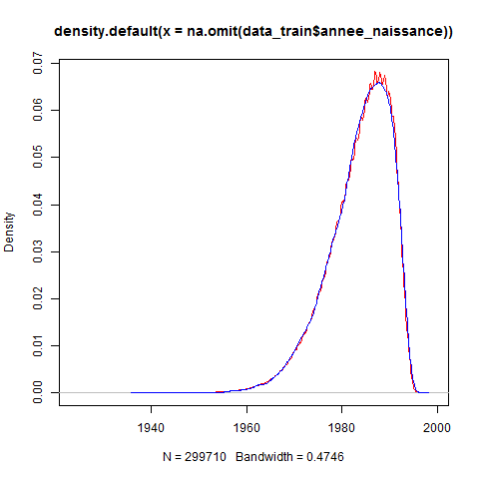
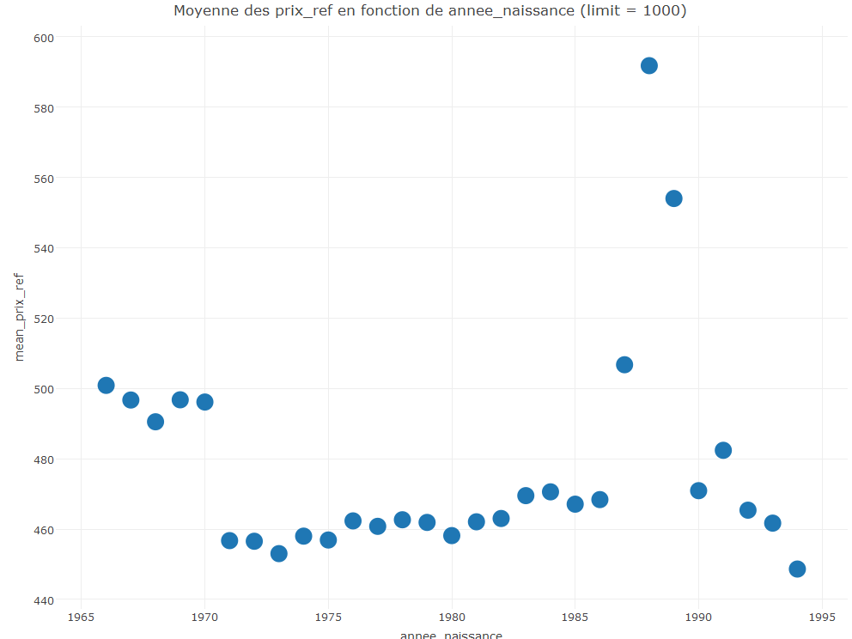
Variable : annee_naissance
Commentaires :

Slide 8
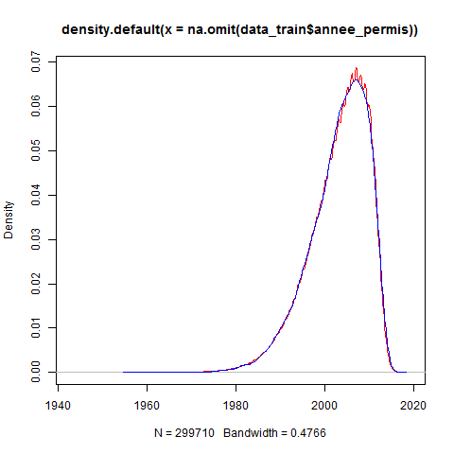
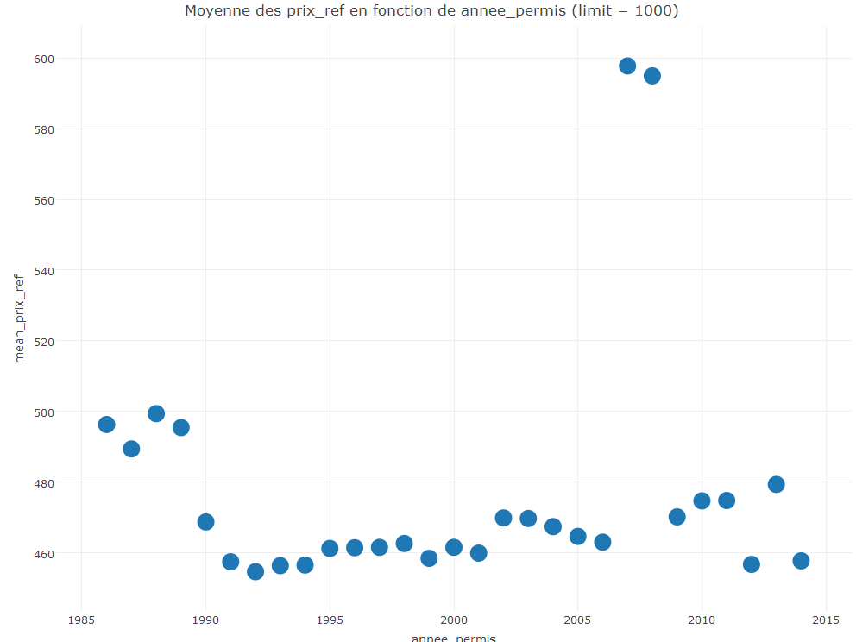
Variable : annee_permis
Commentaires :

Slide 9
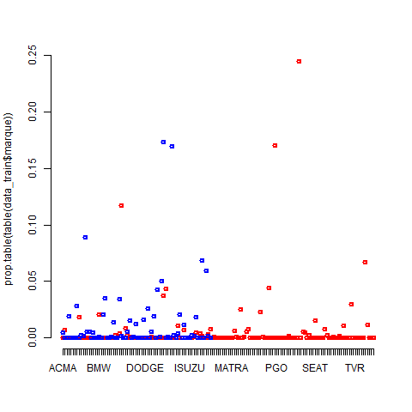
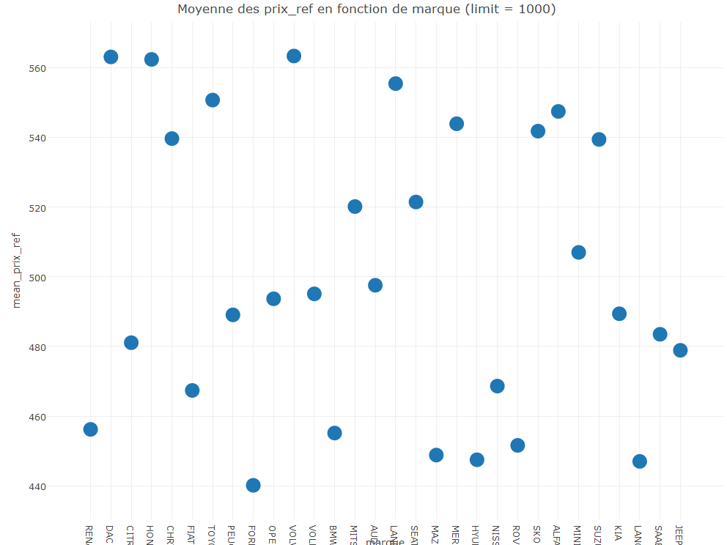
Variable : marque
Commentaires :

Slide 10
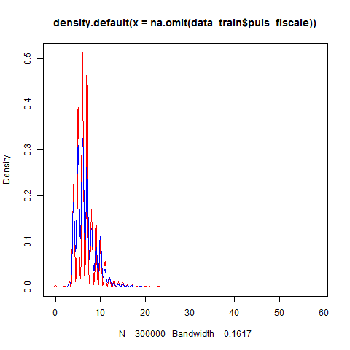
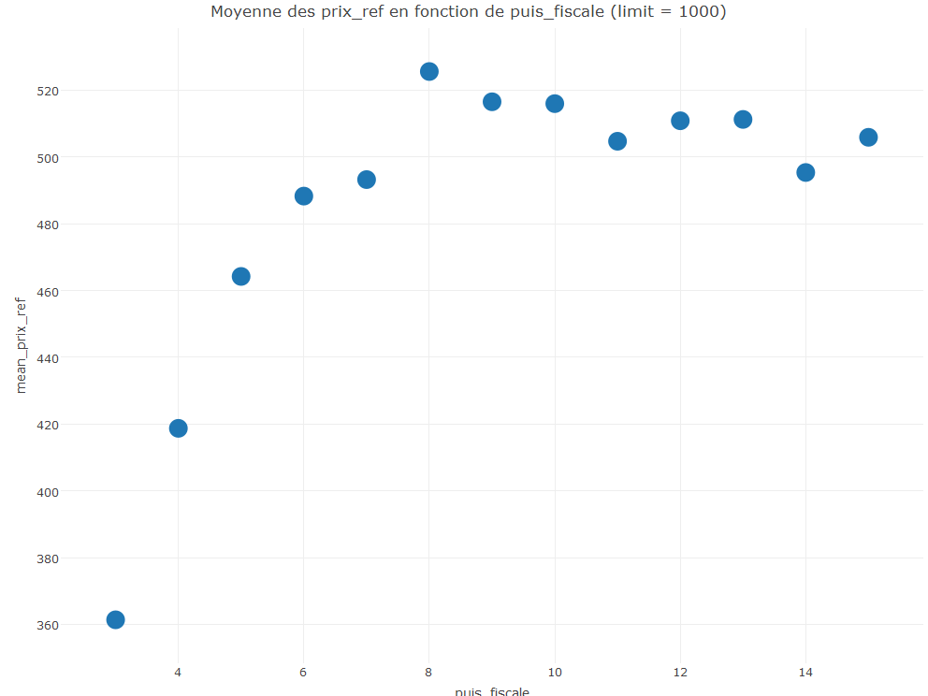
Variable : puis_fiscale
Commentaires :

Slide 11
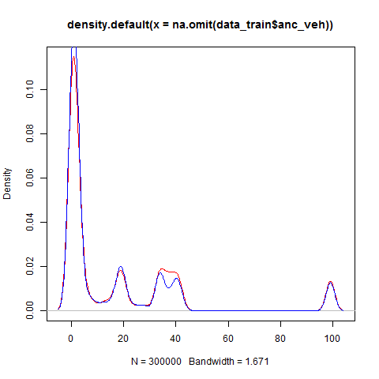
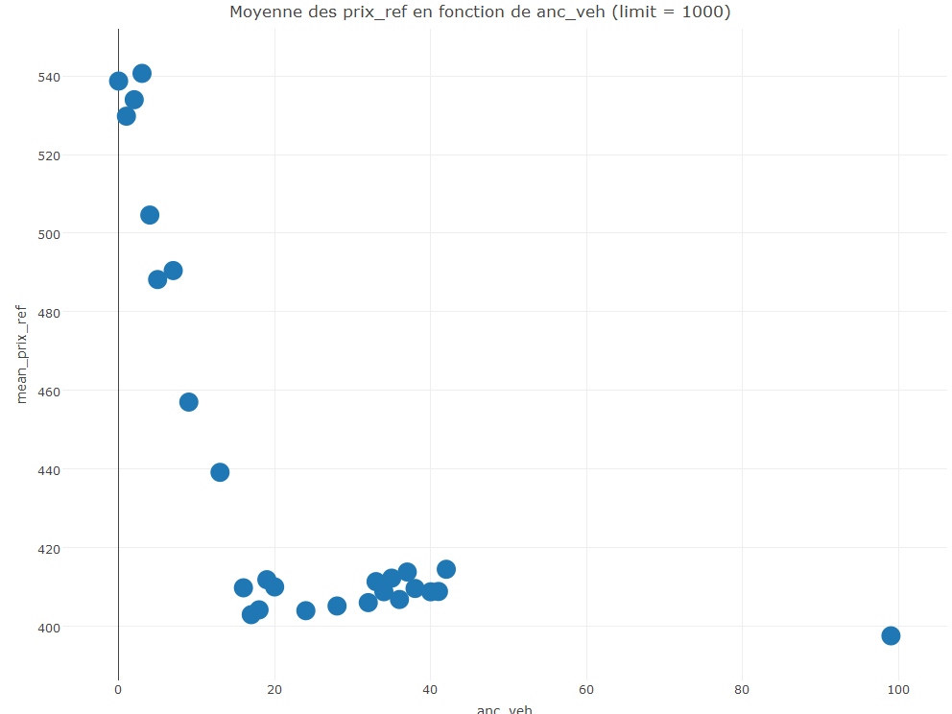
Variable : anc_veh
Commentaires :

Slide 12
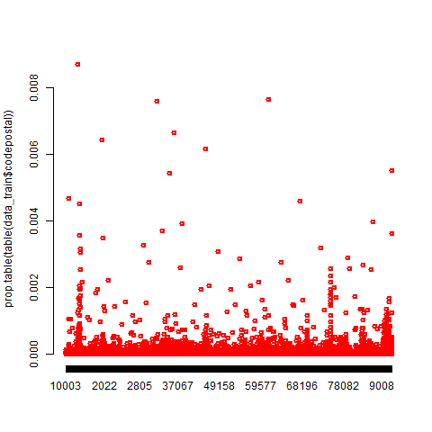
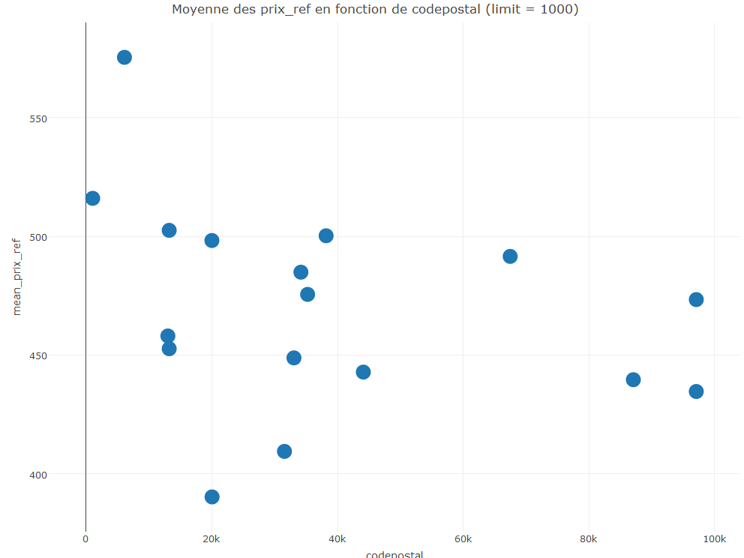
Variable : codepostal
Commentaires :

Slide 13
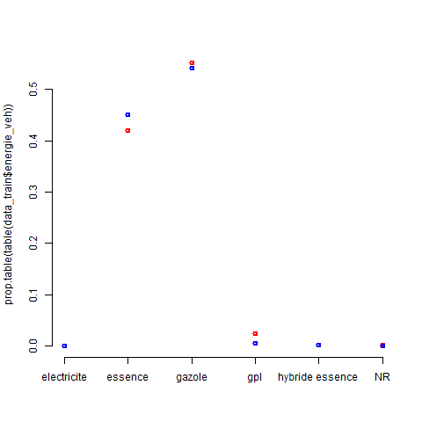
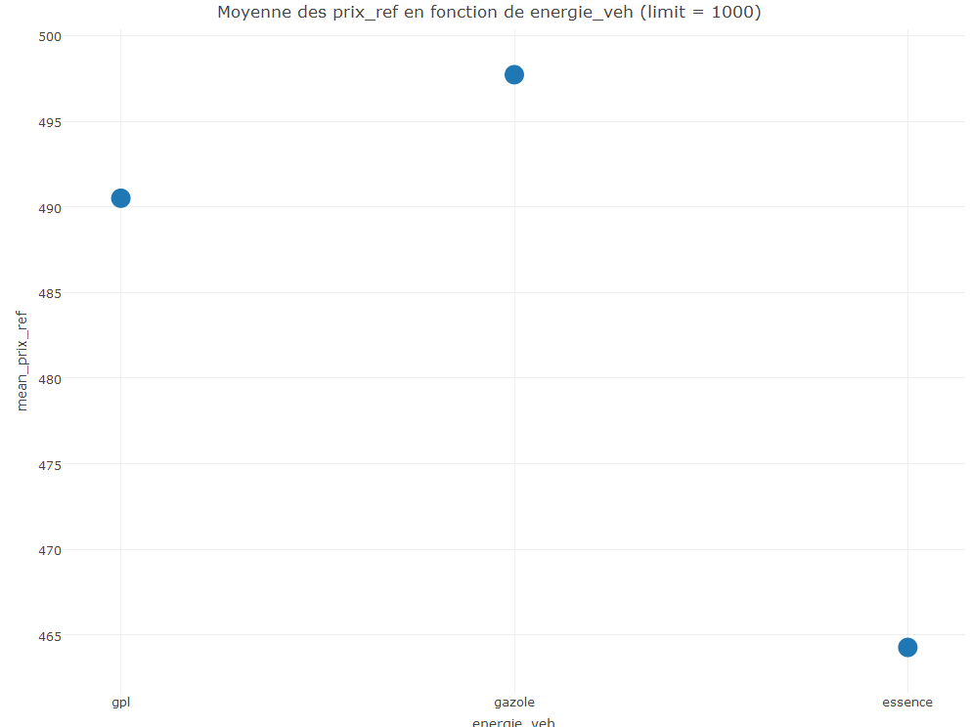
Variable : energie_veh
Commentaires :

Slide 14
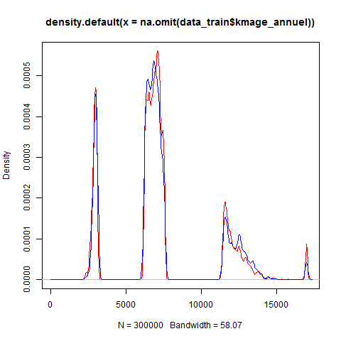
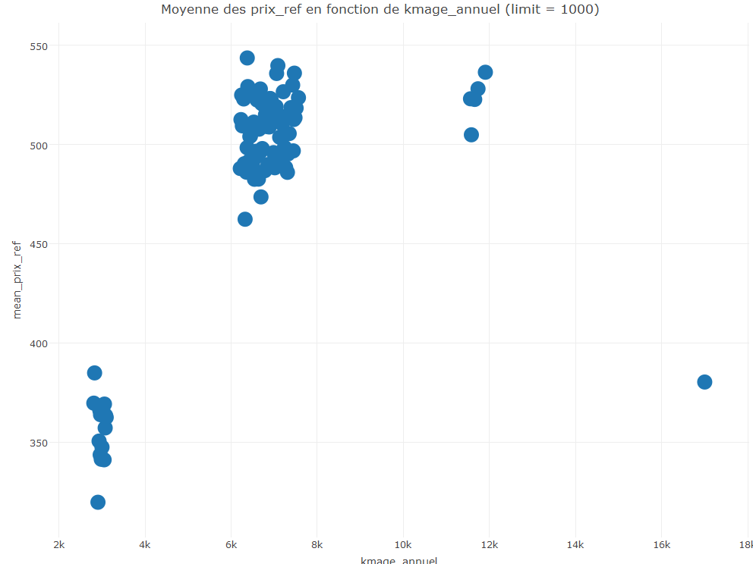
Variable : kmage_annuel
Commentaires :

Slide 15
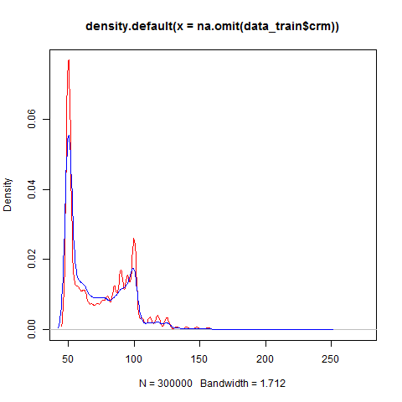
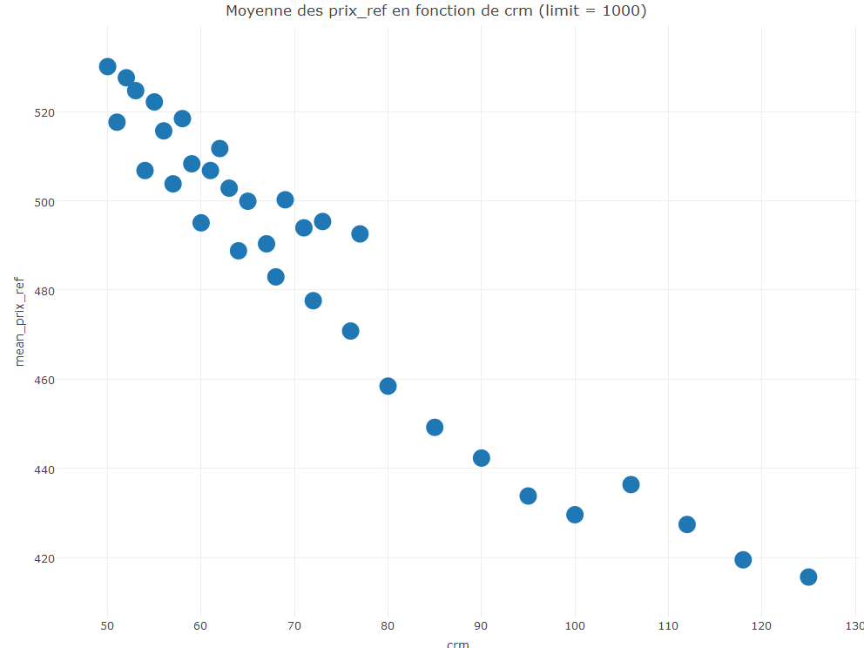
Variable : crm
Commentaires :

Slide 16
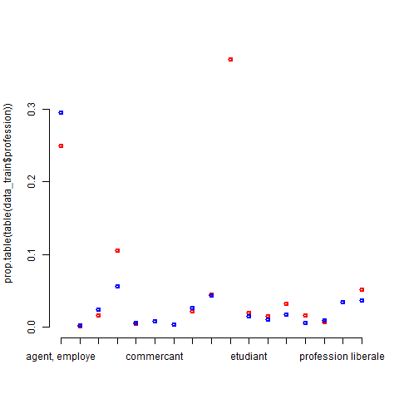
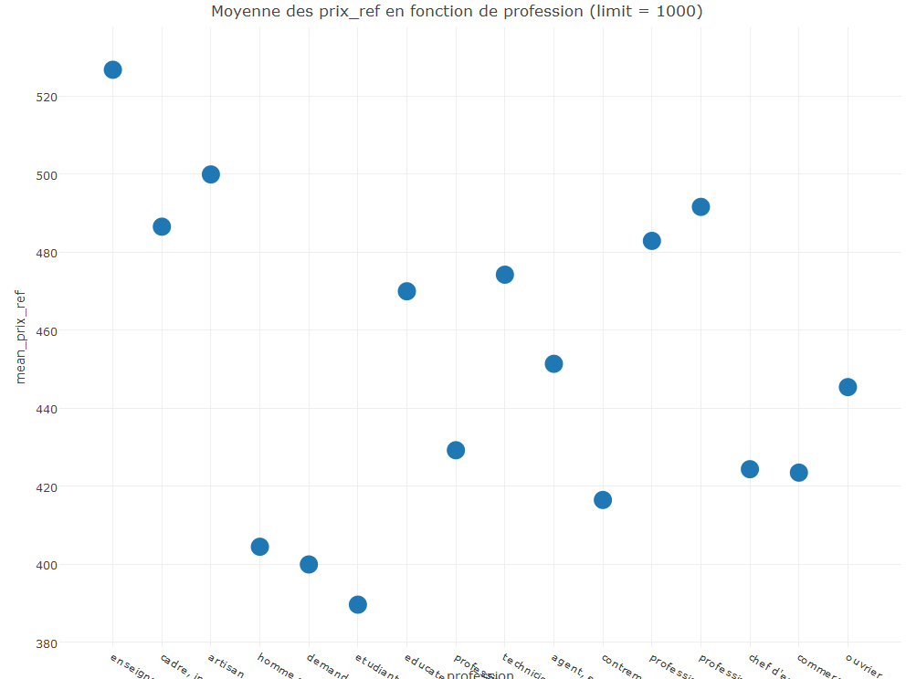
Variable : profession
Commentaires :

Slide 17
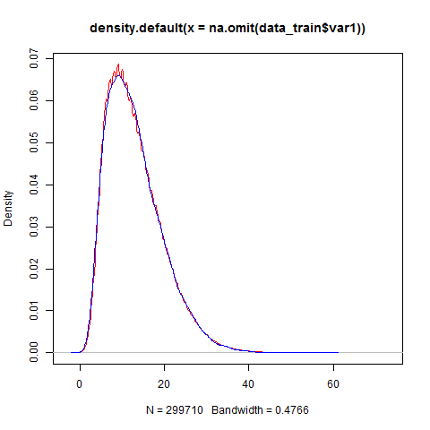
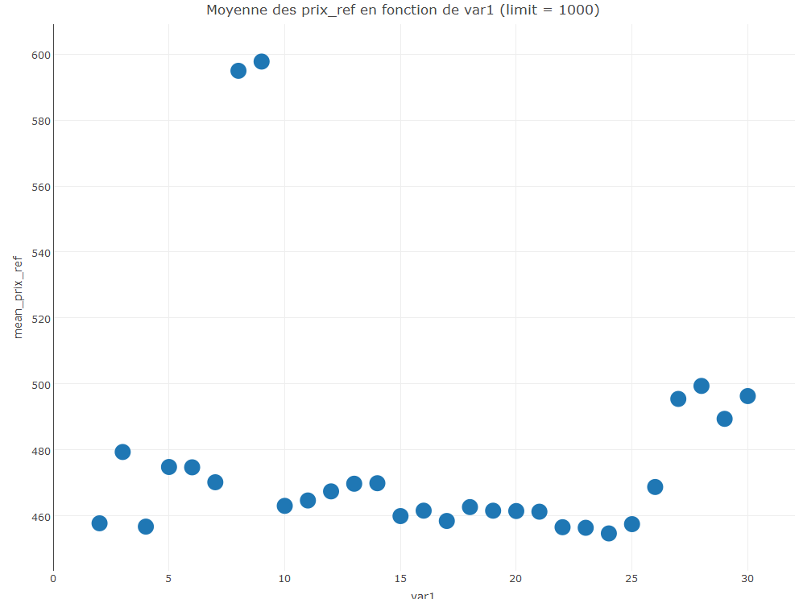
Variable : var1
Commentaires :

Slide 18
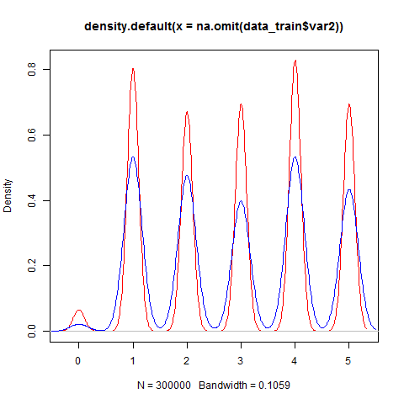
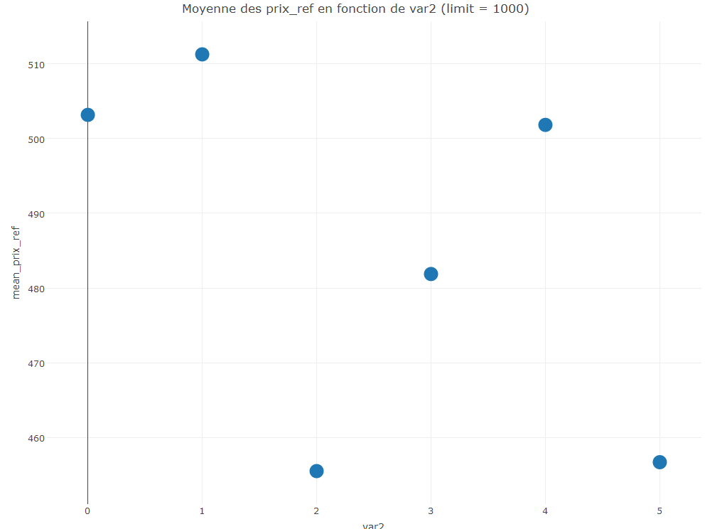
Variable : var2
Commentaires :

Slide 19
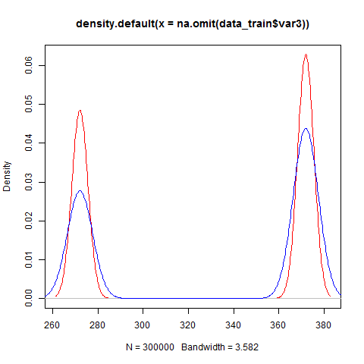
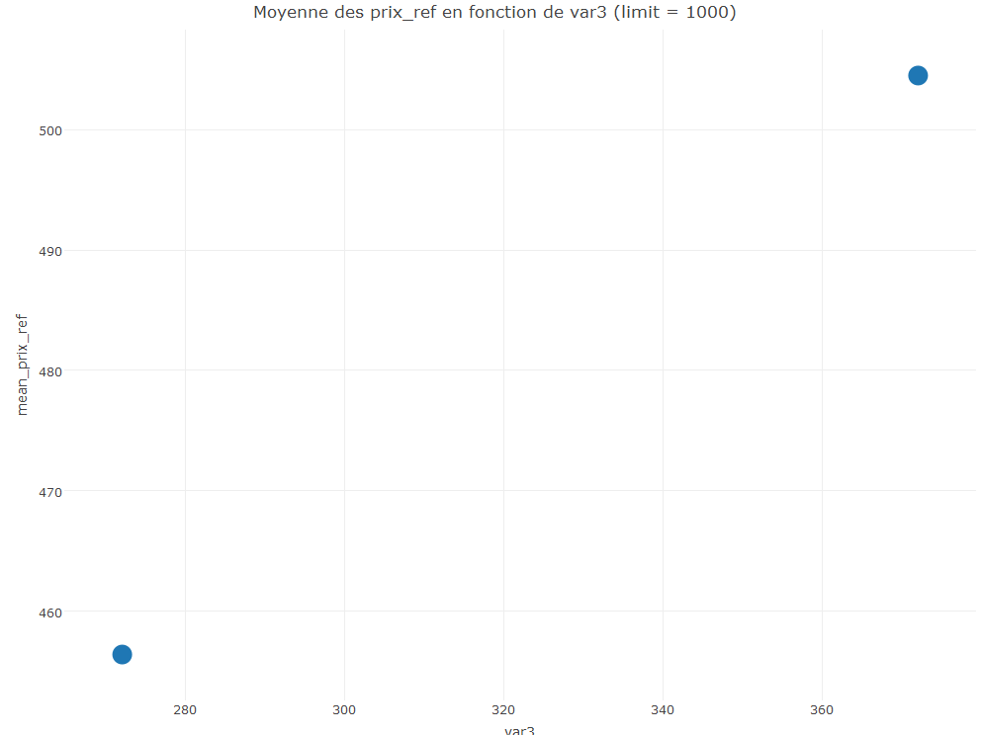
Variable : var3
Commentaires :

Slide 20
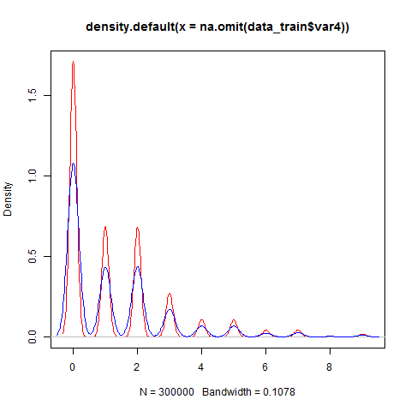
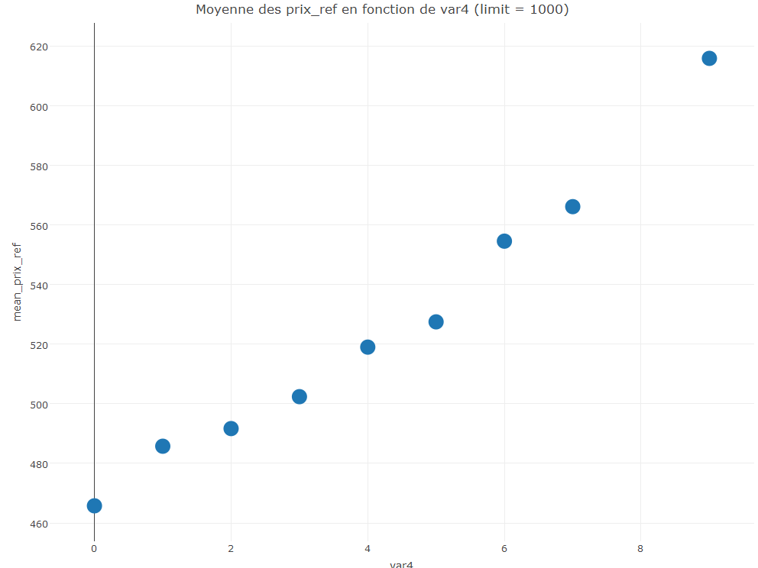
Variable : var4
Commentaires :

Slide 21
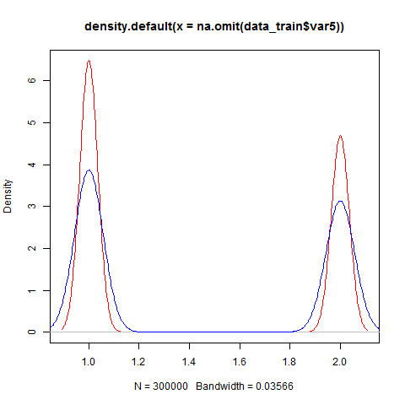
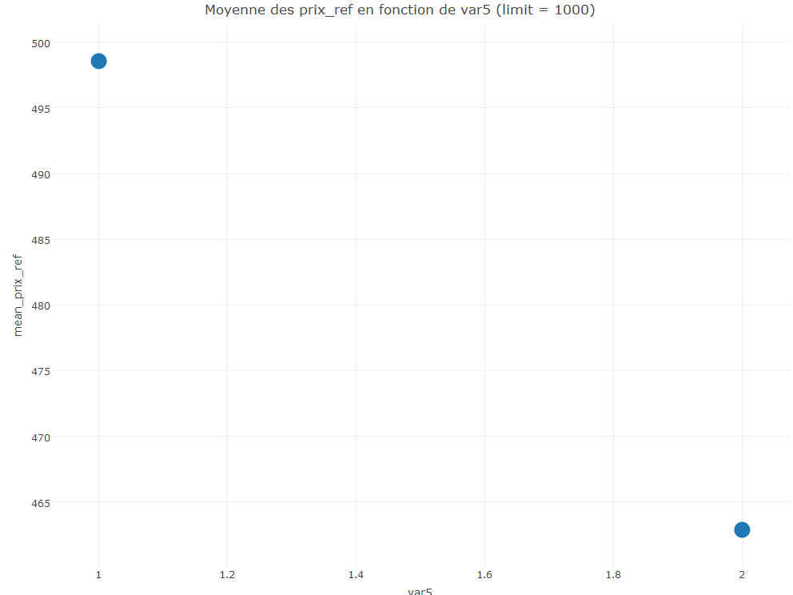
Variable : var5
Commentaires :

Slide 22
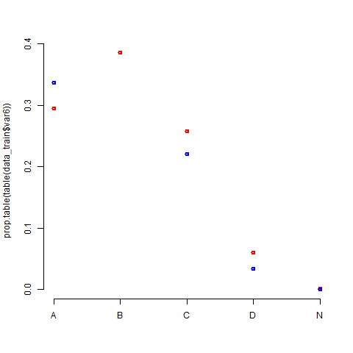
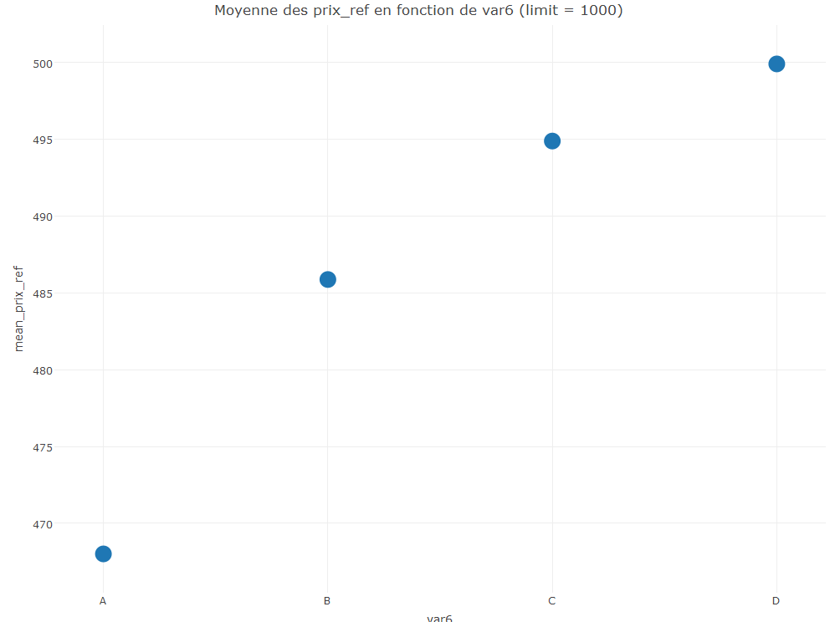
Variable : var6
Commentaires :

Slide 23
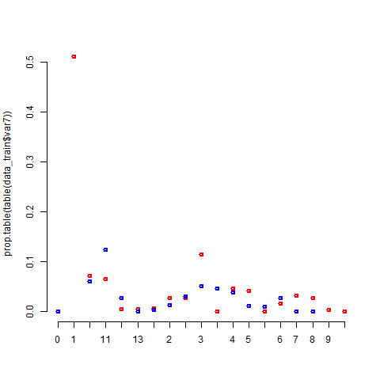
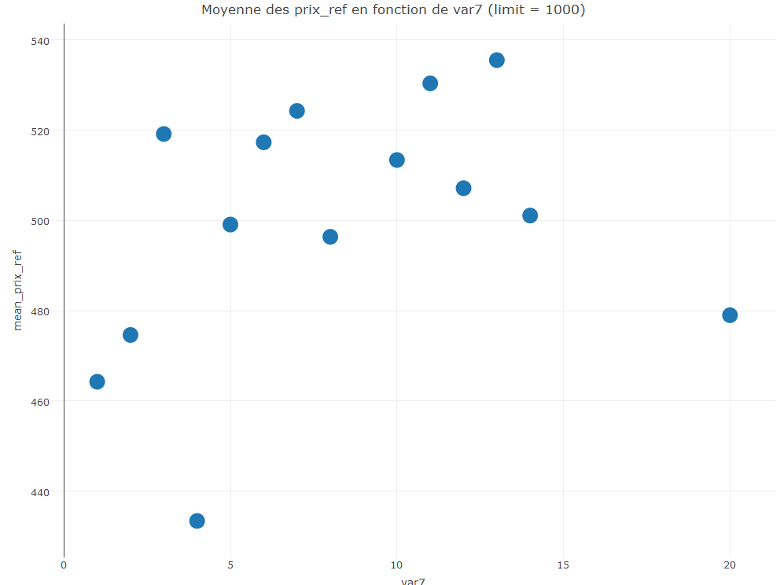
Variable : var7
Commentaires :

Slide 24
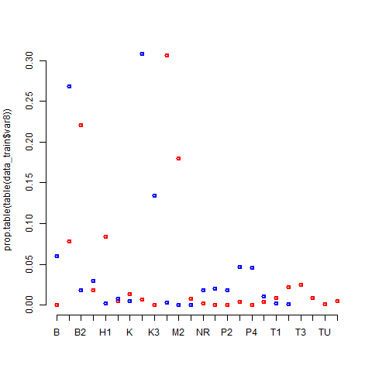
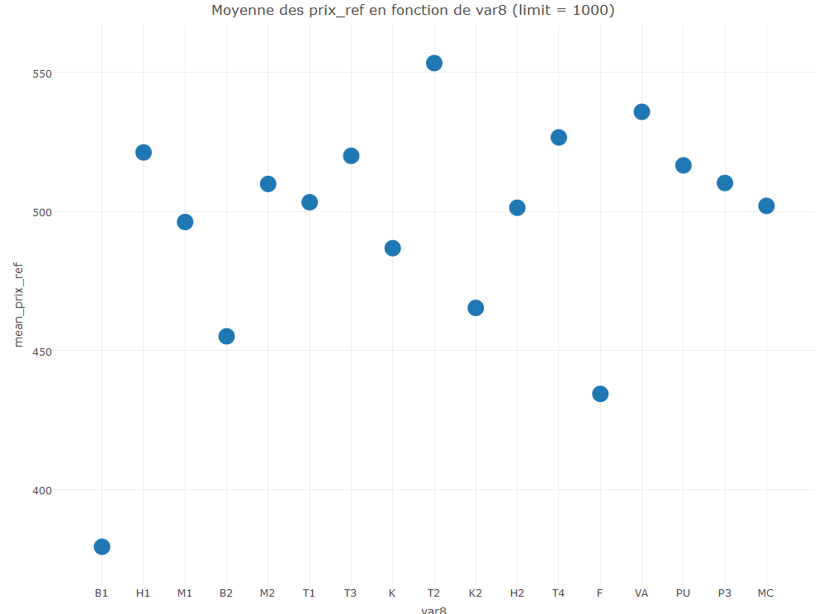
Variable : var8
Commentaires :

Slide 25
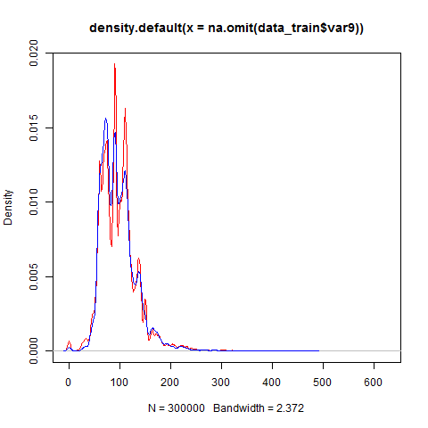
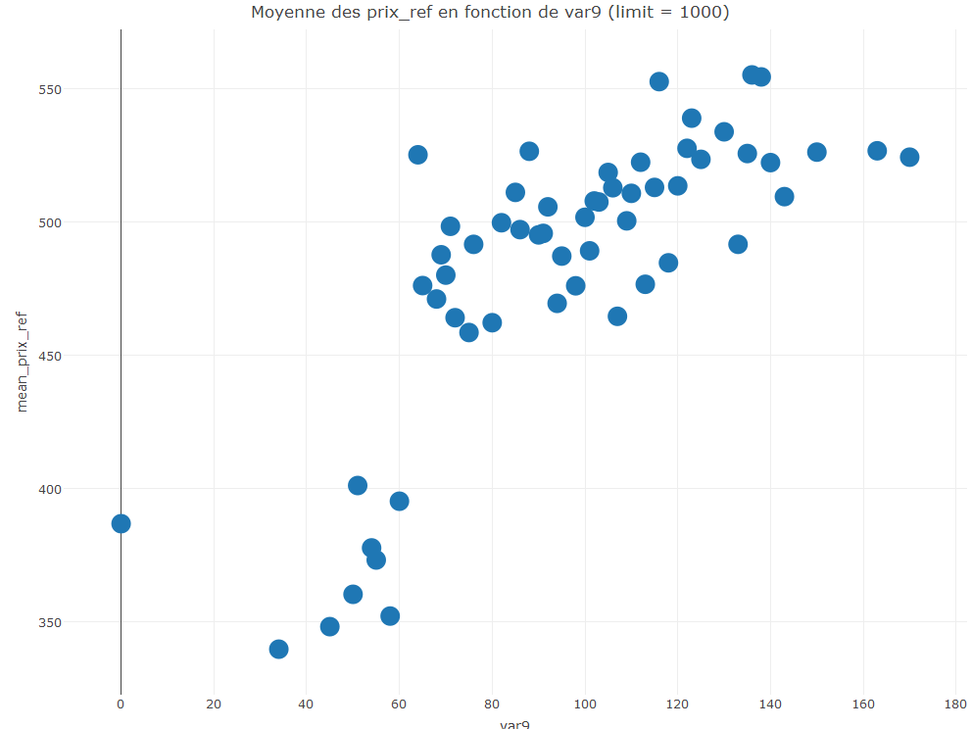
Variable : var9
Commentaires :

Slide 26
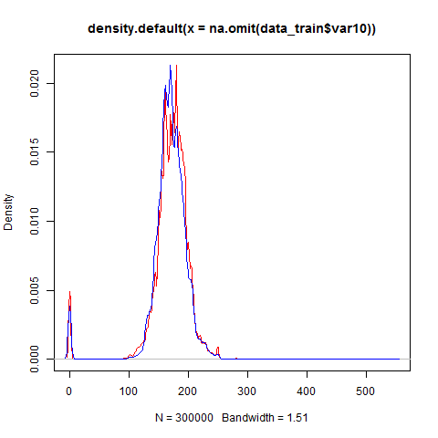
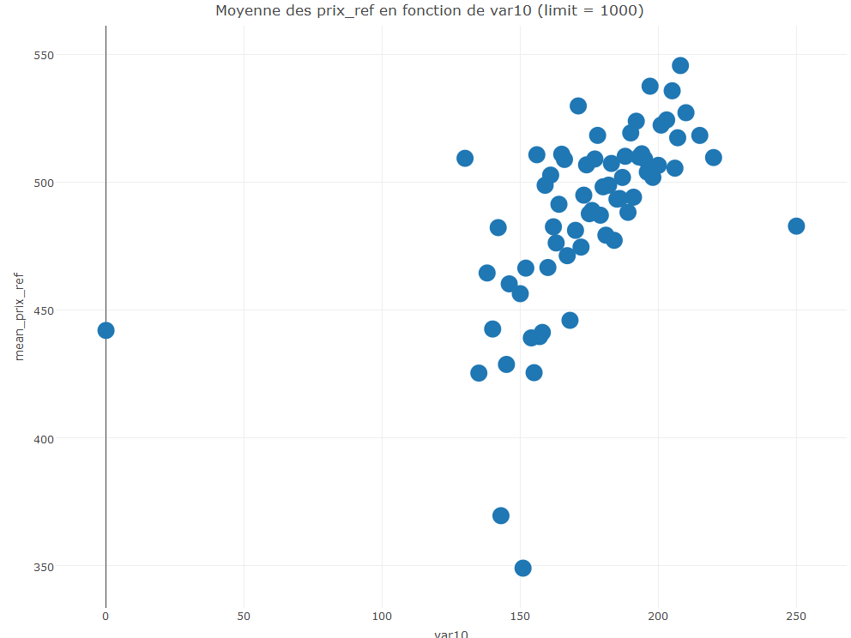
Variable : var10
Commentaires :

Slide 27
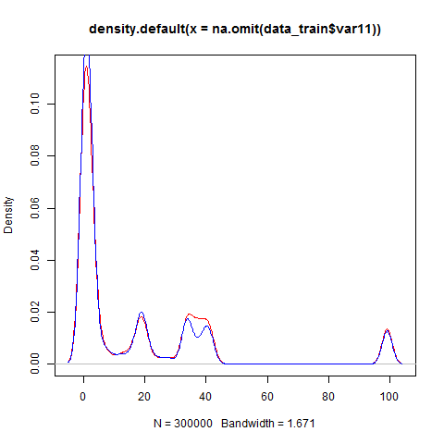
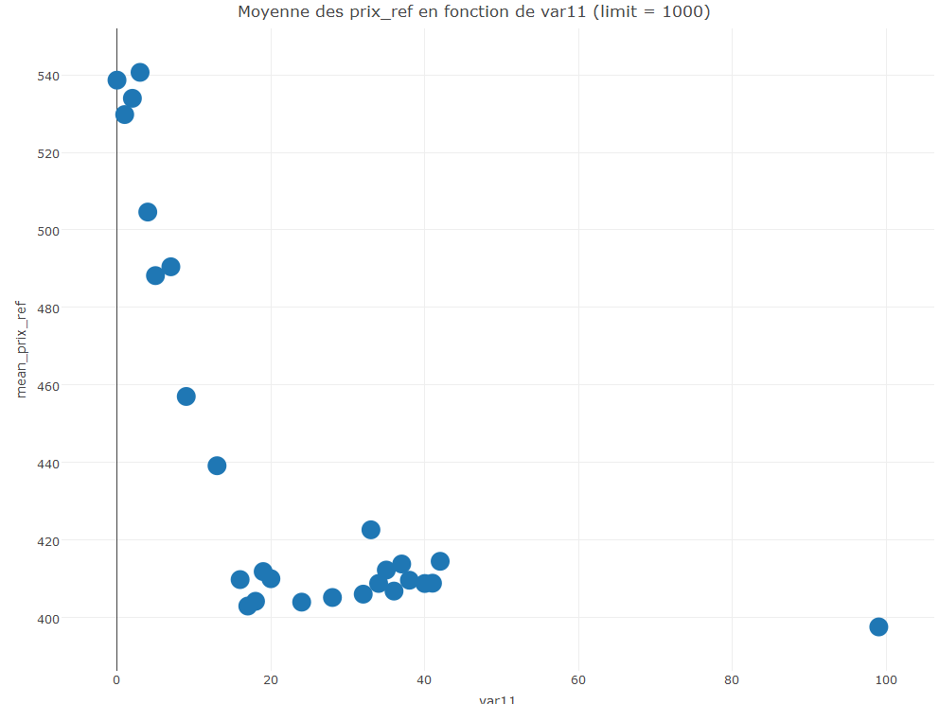
Variable : var11
Commentaires :

Slide 28
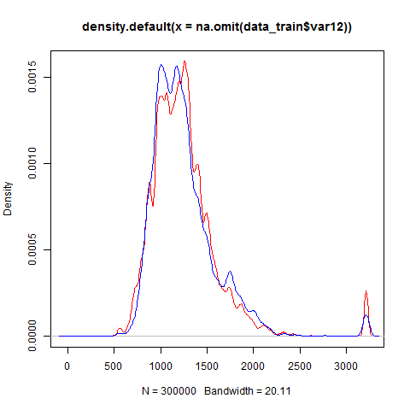
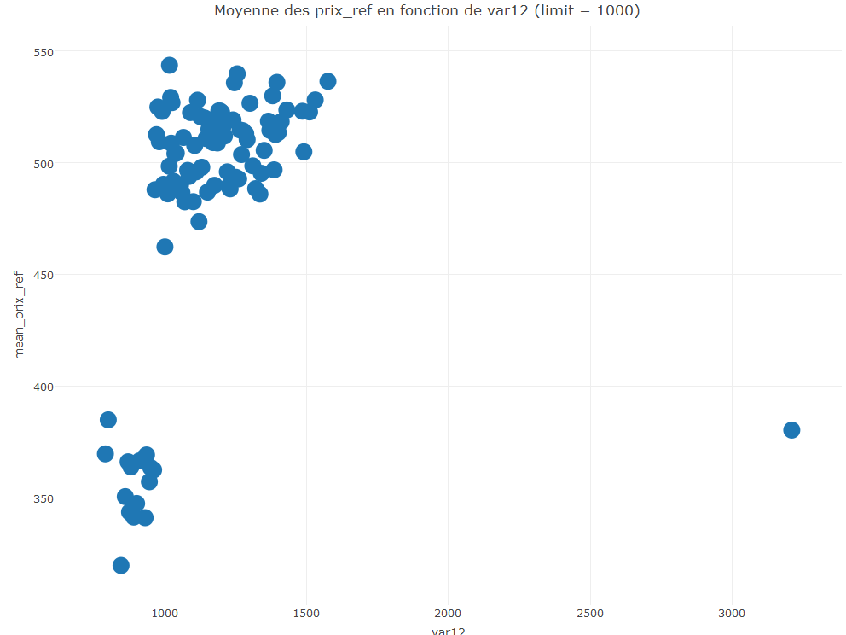
Variable : var12
Commentaires :

Slide 29
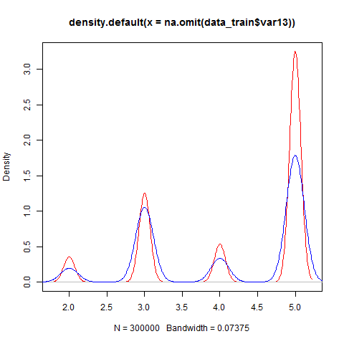
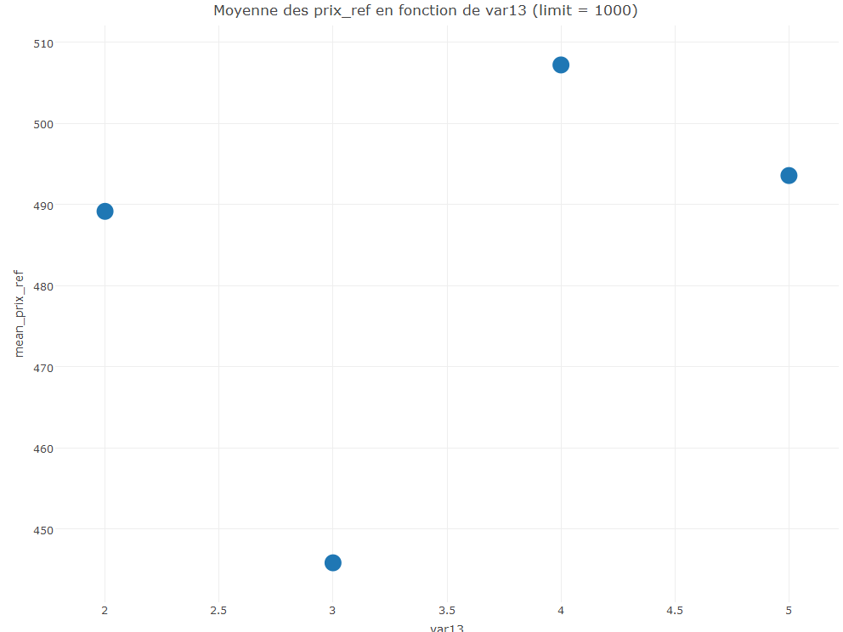
Variable : var13
Commentaires :

Slide 30
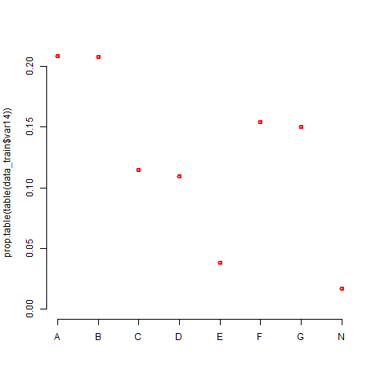
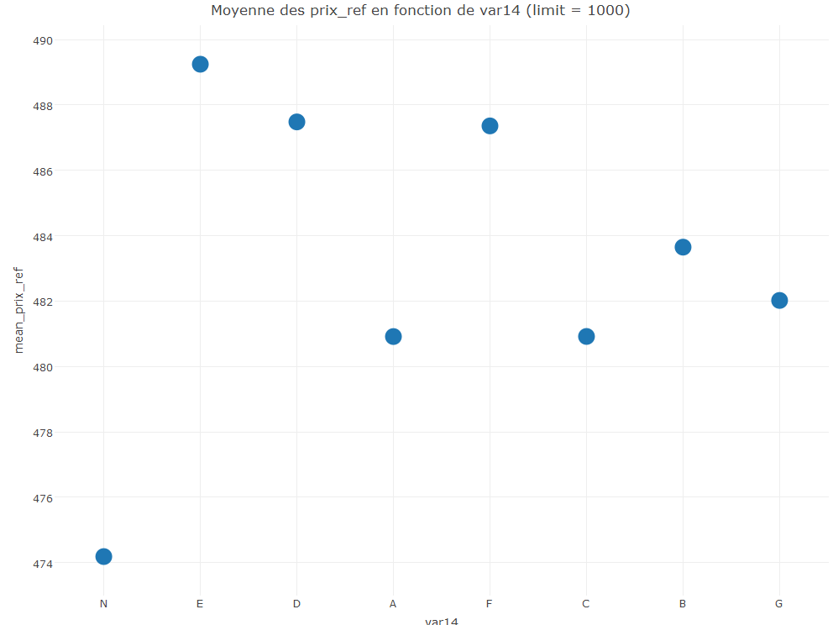
Variable : var14
Commentaires :

Slide 31
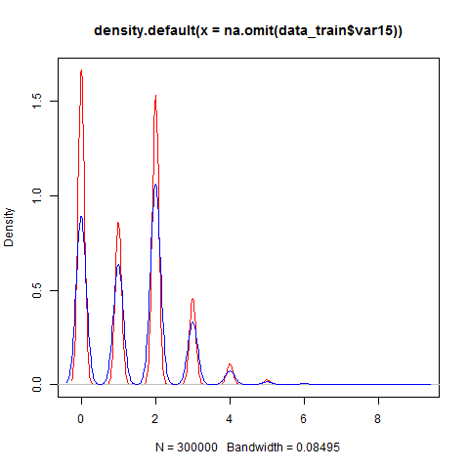
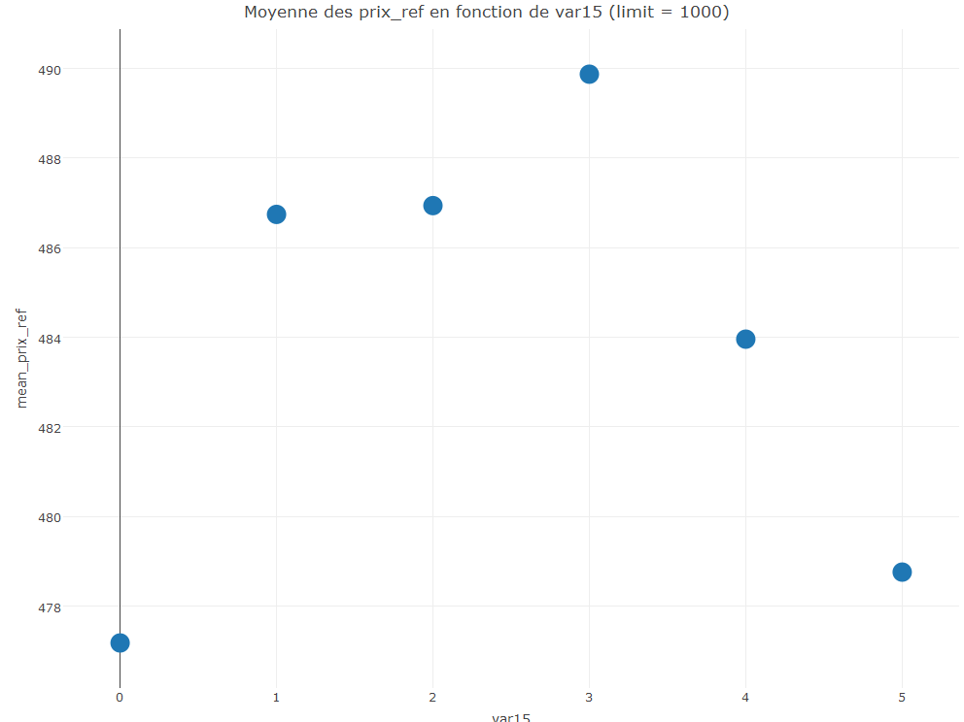
Variable : var15
Commentaires :

Slide 32


Variable : var16
Commentaires :

Slide 33


Variable : var17
Commentaires :

Slide 34


Variable : var18
Commentaires :

Slide 35


Variable : var19
Commentaires :

Slide 36


Variable : var20
Commentaires :

Slide 37


Variable : var21
Commentaires :

Slide 38


Variable : var22
Commentaires :

