Slide 1


Machine learning using Python

Slide 2
Index
0: Introduction
1 : Logistic regresion
2: CART
3 : Elastic net classification
4 : Random Forest classifier
5 : gbm classifier
6 : svm classifier
7 : combination of rf and en
8 : combination of rf and gbm

Slide 3


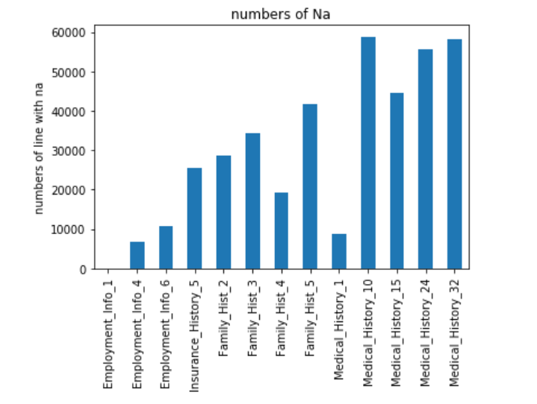
Introduction
the data_train and data_valid is loaded and combined for treatment

Slide 4

Introduction
For data_train:
70% = 35967 to train data
14.4%= 7399 to cross validation data
15.6% = 8015 to test data
For data_valid:
100% = 8000 to validation data
All data is standardised

Slide 5
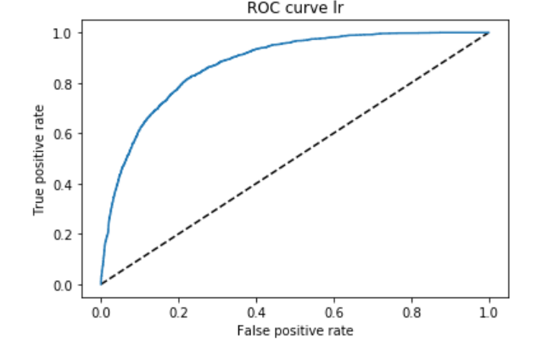
Logistic regression
In python the logistic regression is penalized.
Ridge(l2) or lasso(l1)
To reduce the effect of penalization the parameter C is chosen equal to 1e6
Auc = 0.88

Slide 6
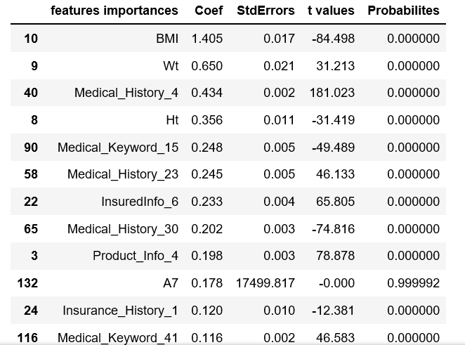
Logistic regression
Features importances can be calculated with coef and p-value

Slide 7
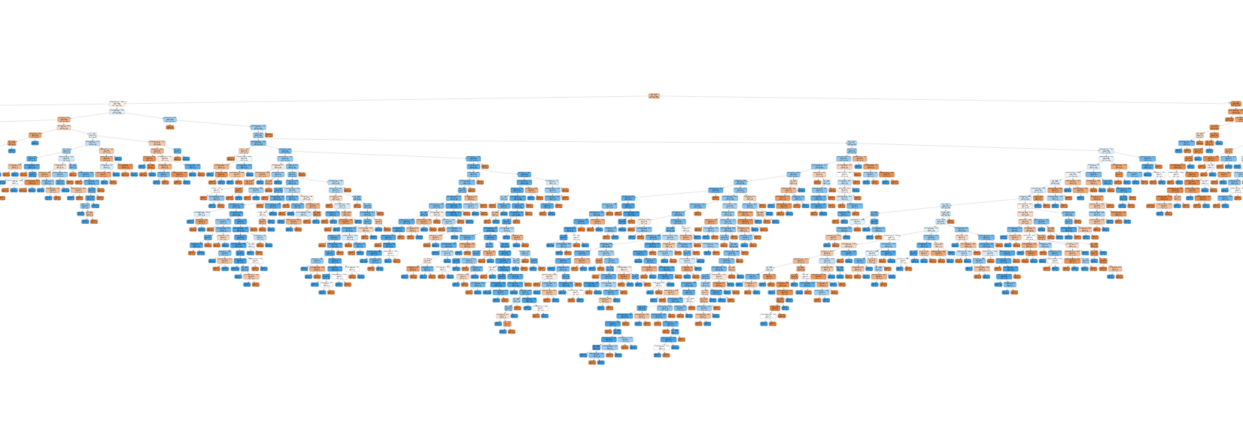
Decision tree classifier
The default tree is plotted with the function ‘DecisionTreeClassifier’
Too many element on the tree
Value of auc is equal to 0.73

Slide 8
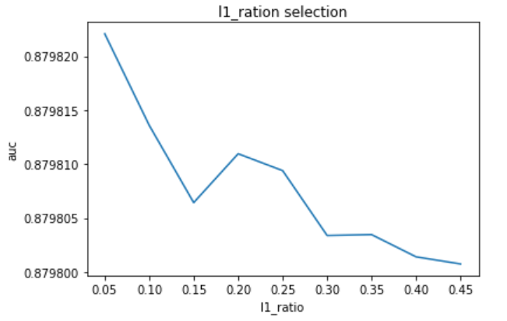
Elasticnet classifier
Elasticnet is a penalized logistic regression. The penalty is a mixed of lasso and ridge. To chose the best value cross validation is require.
penalized parameter is given by:
alpha (l1_ratio * ||w||_1 + 0.5* (1 - l1_ratio) * ||w||^2_2)
l1_ratio allow to select a ratio between lasso(||w||_1) and ridge(||w||_2).
The best value is 0.05
For each value of l1_ratio the best value of alpha is calculated by ElastiNetCV.
Value of auc = 0.88

Slide 9
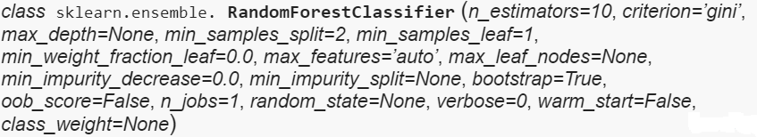
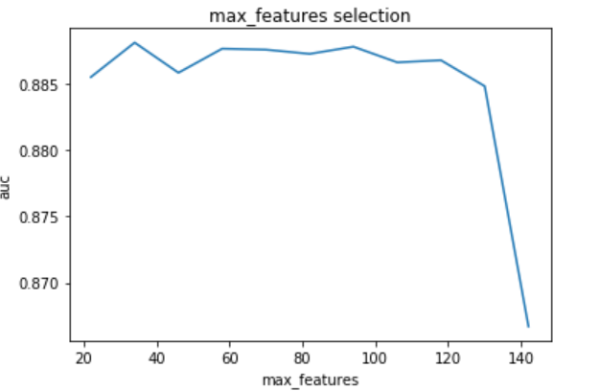
Random Forest
Random Forest is implemented in python by the function below:
Max_features can be optimisation with cross validation data.
Max_features =60

Slide 10
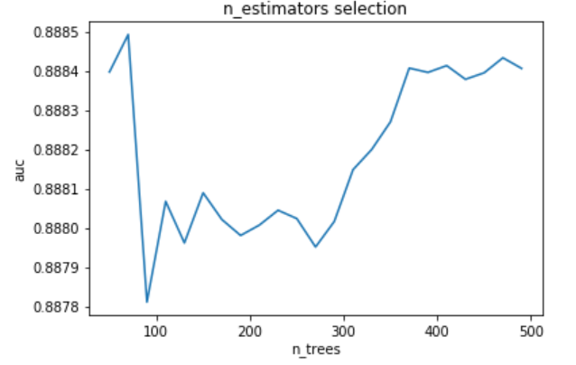
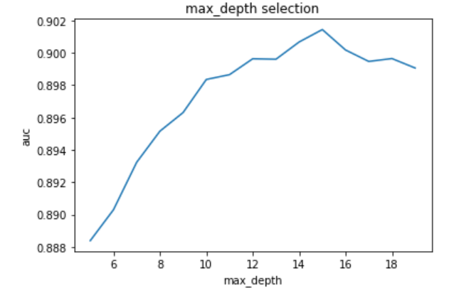
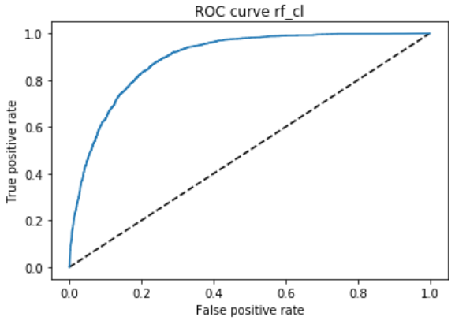
Random Forest
N_estimators = 50
Max_depth =15
Auc equal to 0.89

Slide 11
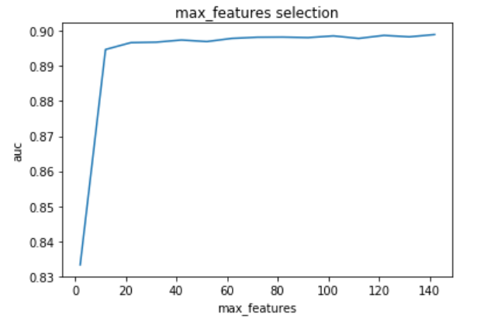
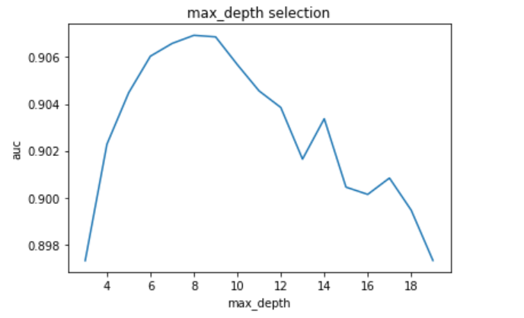
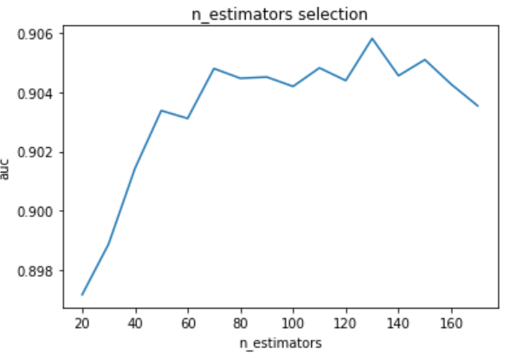
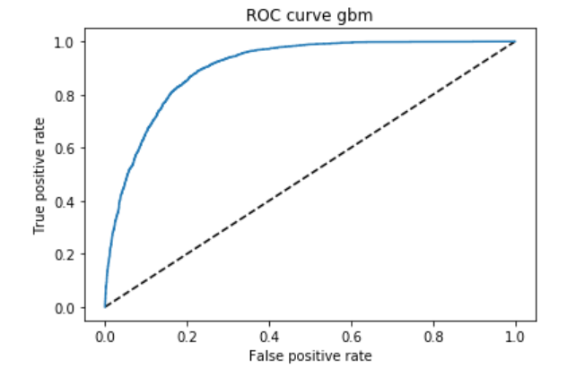
Gbm classifier
As Random Forest some parameters have been optimized with cross validation data.
Max_features = 42
Max_depth =8
N_estimators = 130
auc =0.90

Slide 12
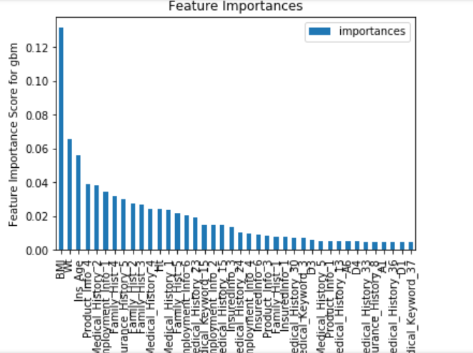
Gbm classifier
The first 40 most important features

Slide 13
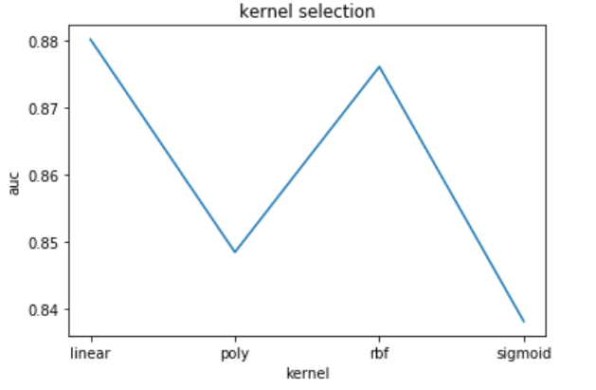
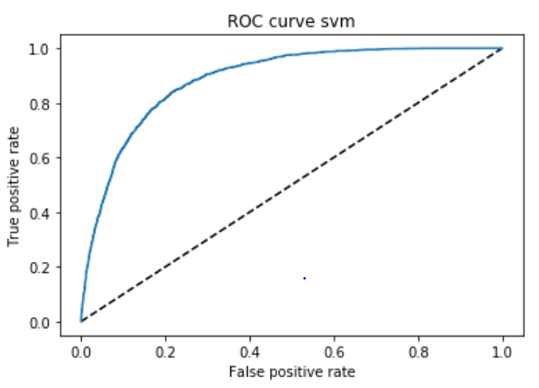
svm classifier
For svm model only the kernel have been tested:
Kernel ‘linear’ is better in our data than ‘rbf’
Auc = 0.89

Slide 14
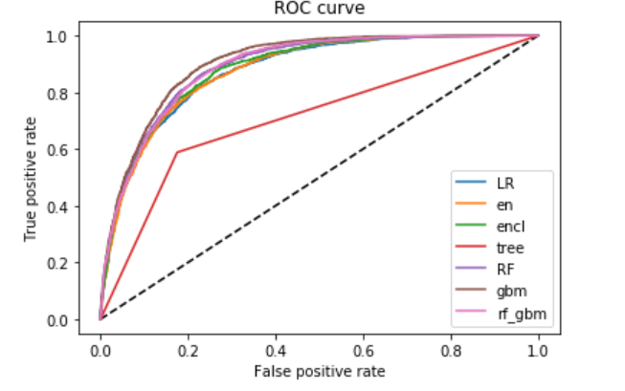
Conclusion
Here the best is the gbm

