Slide 1
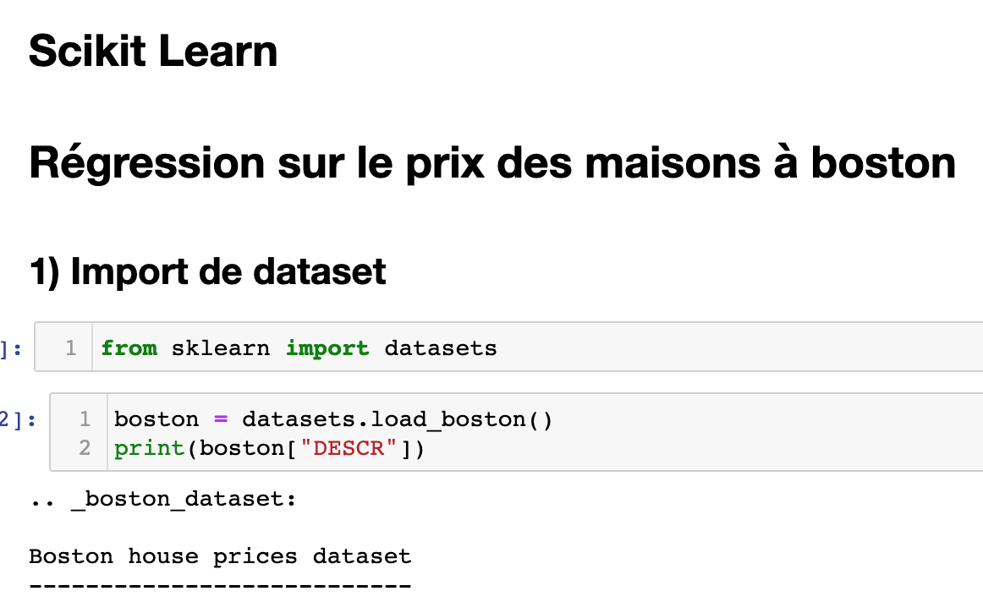
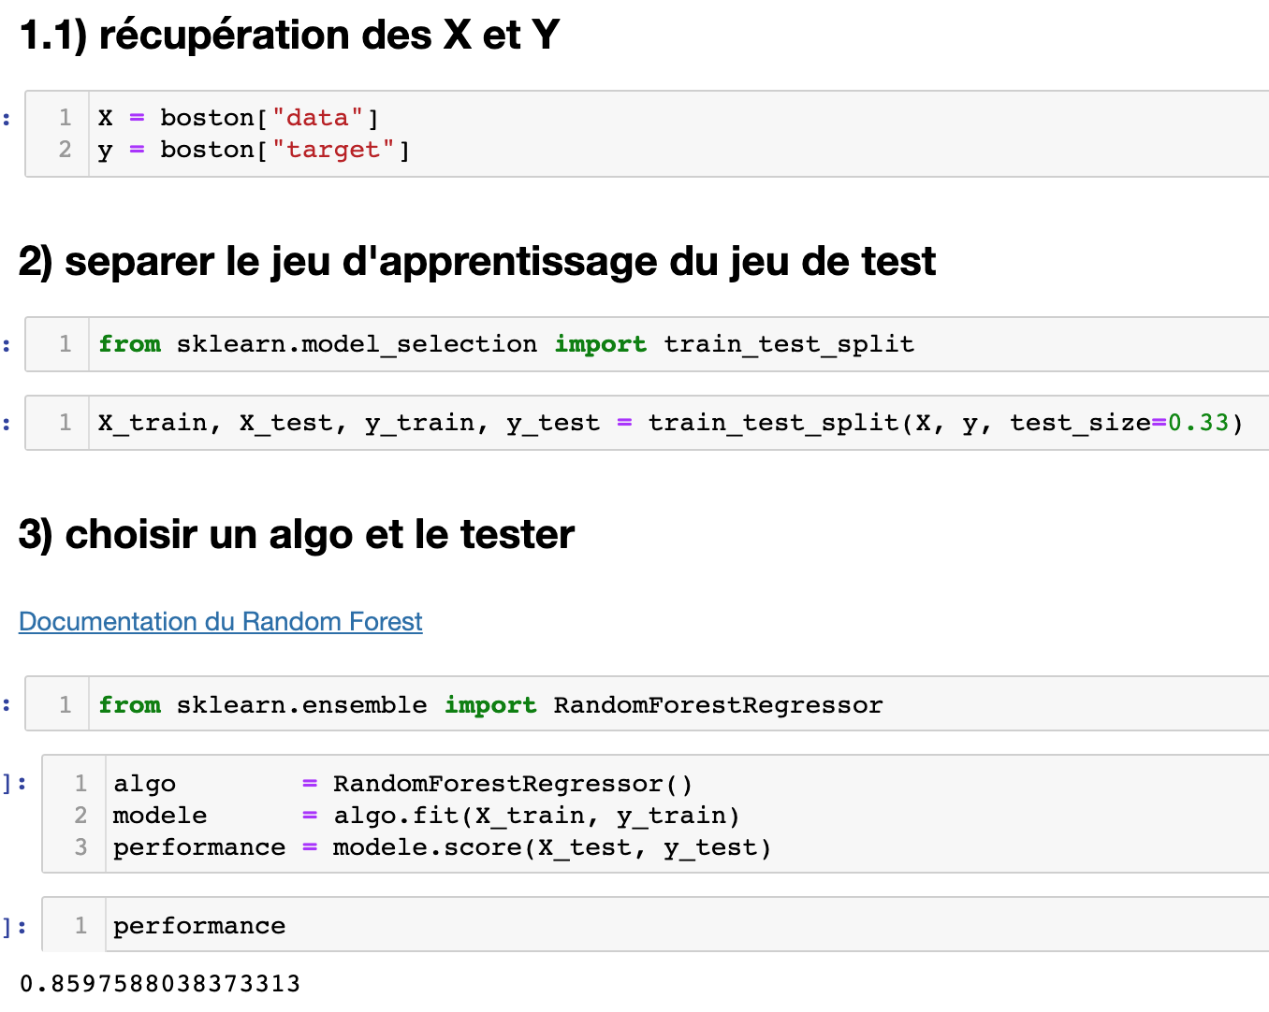

Slide 2
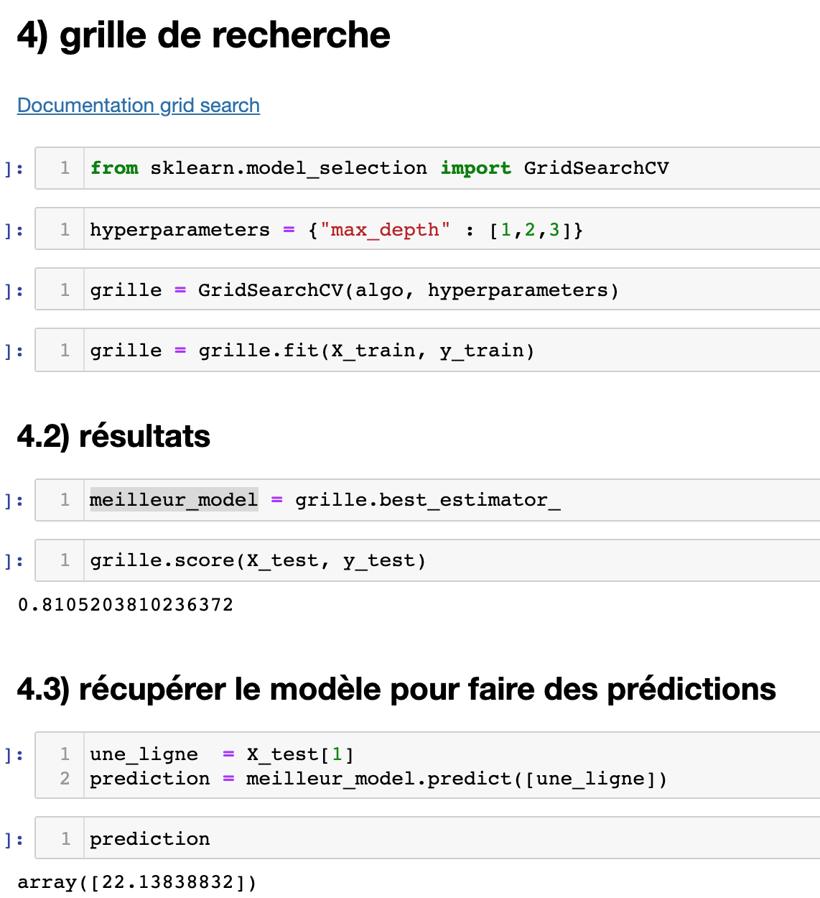
Documentation du Random Forest
Documentation grid search

Slide 3
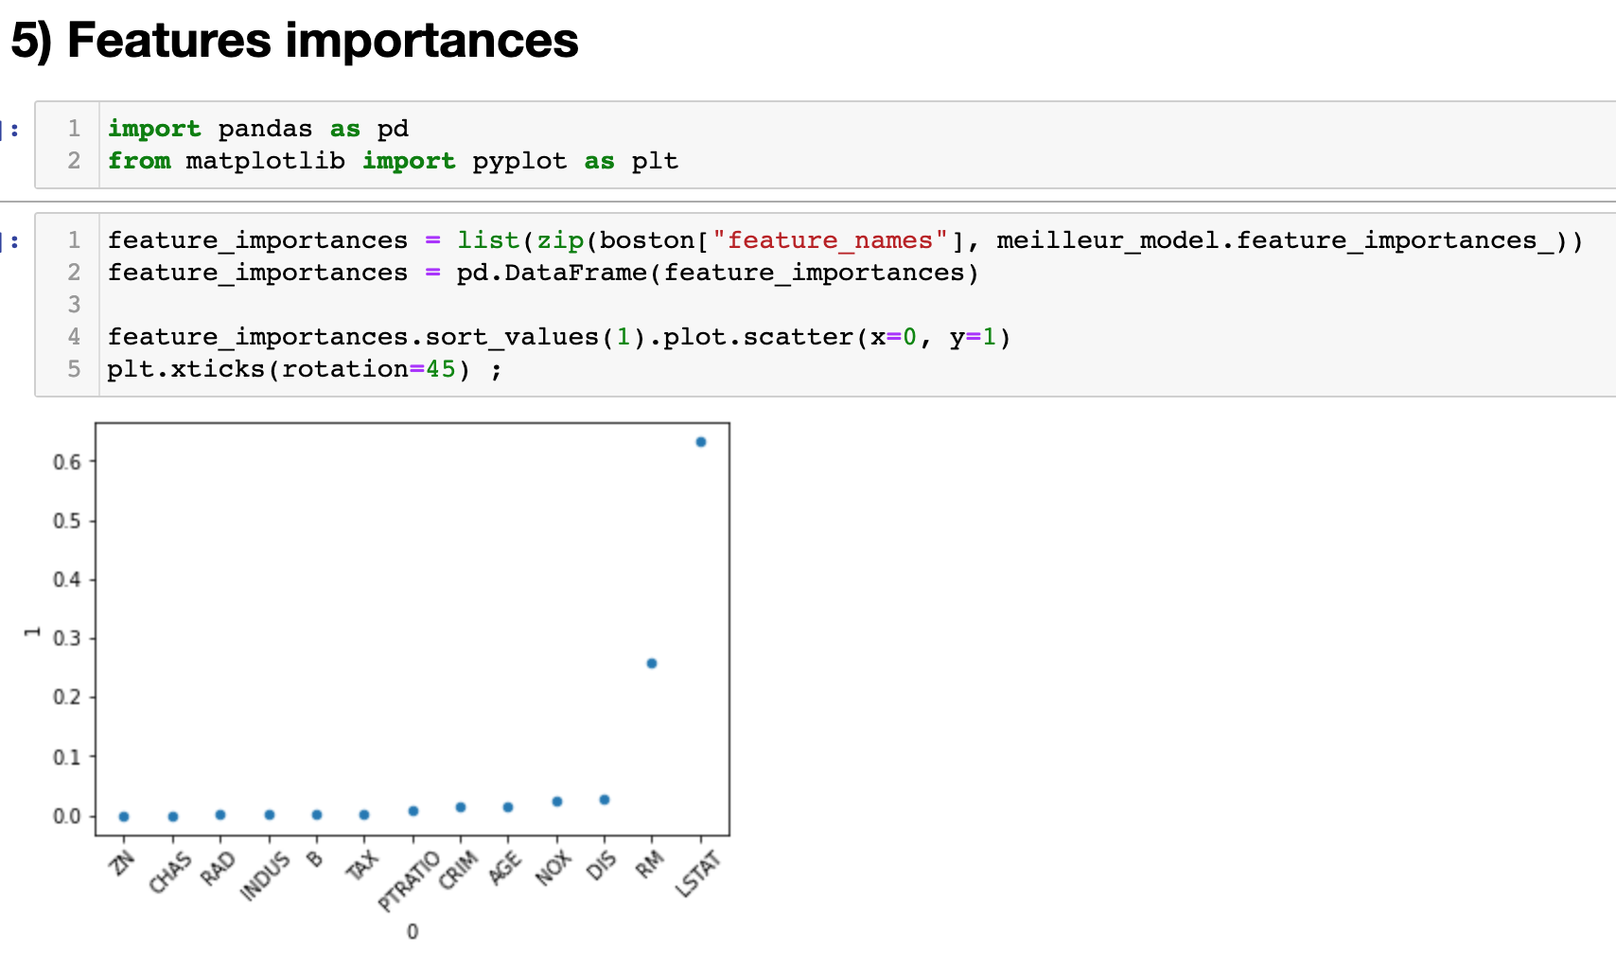

Slide 4
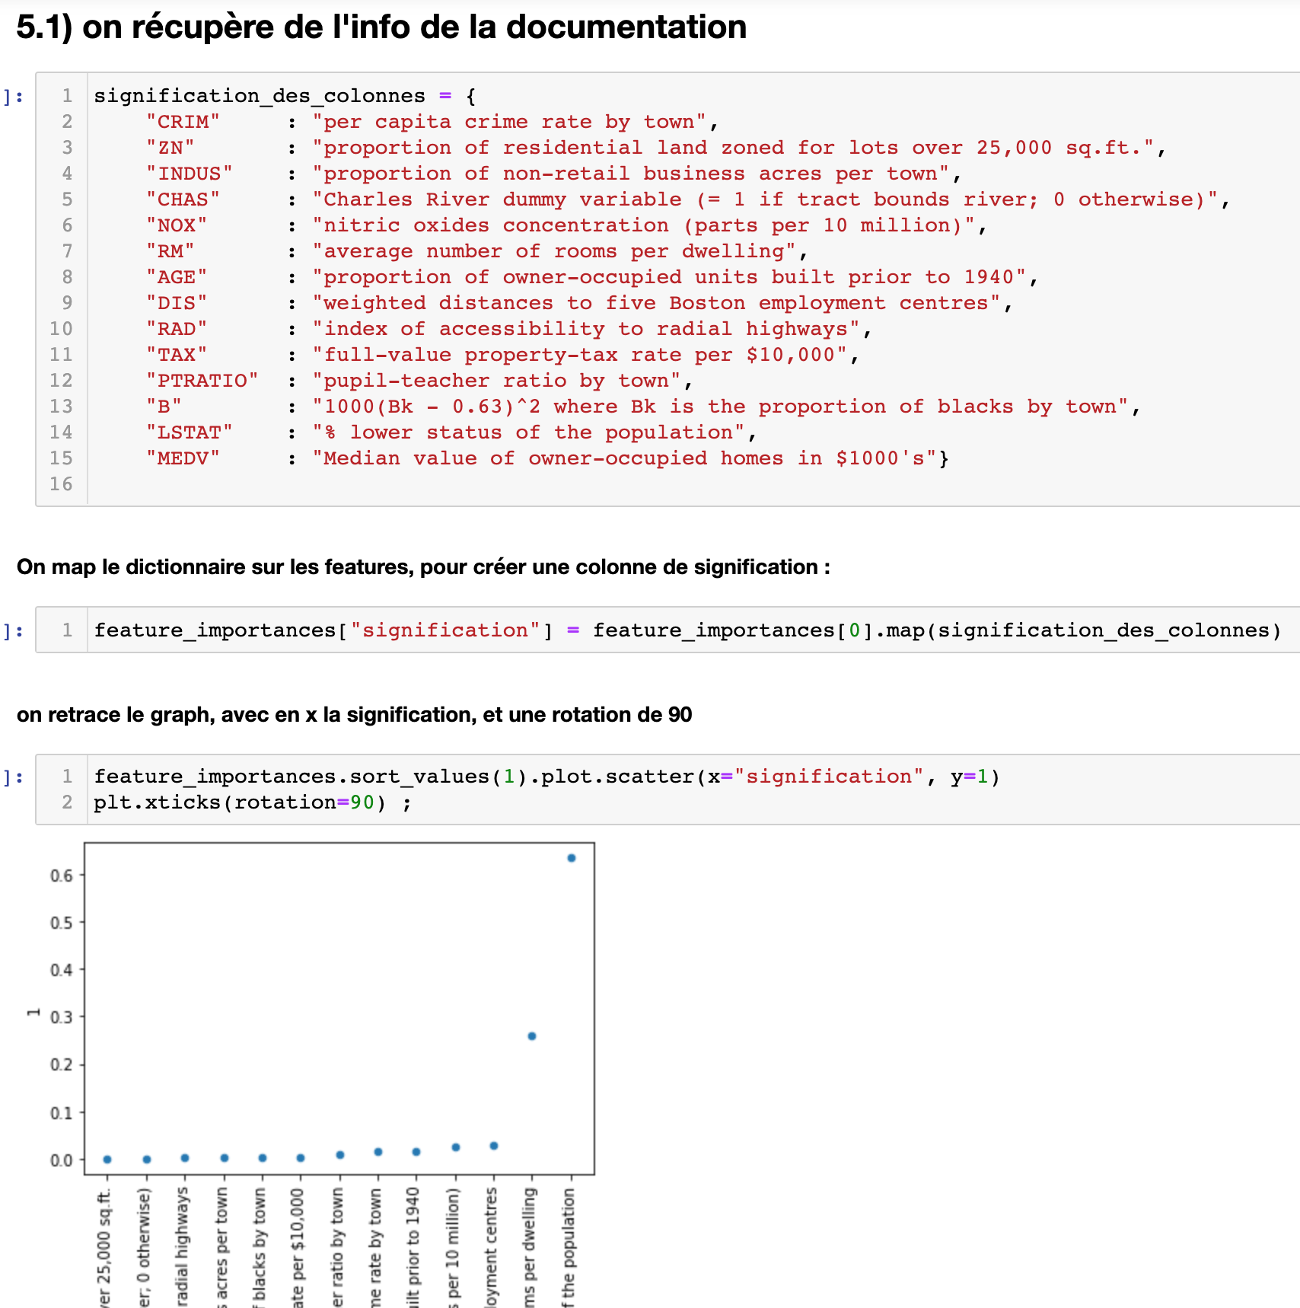
signification_des_colonnes = {
"CRIM" : "per capita crime rate by town",
"ZN" : "proportion of residential land zoned for lots over 25,000 sq.ft.",
"INDUS" : "proportion of non-retail business acres per town",
"CHAS" : "Charles River dummy variable (= 1 if tract bounds river; 0 otherwise)",
"NOX" : "nitric oxides concentration (parts per 10 million)",
"RM" : "average number of rooms per dwelling",
"AGE" : "proportion of owner-occupied units built prior to 1940",
"DIS" : "weighted distances to five Boston employment centres",
"RAD" : "index of accessibility to radial highways",
"TAX" : "full-value property-tax rate per $10,000",
"PTRATIO" : "pupil-teacher ratio by town",
"B" : "1000(Bk - 0.63)^2 where Bk is the proportion of blacks by town",
"LSTAT" : "% lower status of the population",
"MEDV" : "Median value of owner-occupied homes in $1000's"}
Texte copiable (j’espère..)

