Slide 1

MCM Central Bank Liquidity Framework
22 February 2022
Romain Lafarguette, Ph.D. (MCM/CO)
Kei Moriya, Ph.D. (ITD/CMDC)
https://romainlafarguette.github.io/

Slide 2
Overview
Forecasting infrastructure based on high-quality open-source codes
Forecast the three main autonomous factors separately and the total liquidity position
Using the most recent methods in the statistical literature
Easy to use for the authorities: complex modeling issues are taken care of automatically
Provides automatic reporting and data visualization for daily operations
Team of experts (MCM, ITD, STX) to help the authorities during missions

Slide 3
The Team
Project Leader: Romain Lafarguette, Ph.D. (MCM, Eng/Fra/Chn)
ITD experts
Kei Moriya, Ph.D. (ITD, Eng)
Adeleke Adeyemi, Ph.D. (ITD, Eng)
External Experts
Prof. Anastasios Panagiotelis, Ph.D. (Univ. Sydney, Eng)
Prof. Nikolaos Kourentzes, Ph.D (Univ. Skovde, Eng)
Alain Quartier-La-Tente, Ph.D. (INSEE France, Eng/Fra/Esp)
Etienne Vaccaro-Grange, Ph.D. (NYU Abu Dhabi, Eng/Fra)
… and more to come !
We also deliver general training in forecasting and programming during MCM TA

Slide 4
Refresher: Analytical Central Bank Balance Sheet
Assets
Liabilities
Net Foreign Assets
Domestic assets
Other assets net
Currrency in circulation
Securities issued by the central bank
Liabilities to deposit money banks (bank reserves)
Capital and revaluation account
(Claims – liabilities to non residents)
Claims on the government
Claims on deposit money banks
Other assets – other liabilities
Government deposits
In red: Autonomous Factors
In green: Policy Position
In blue: Other Items

Slide 5
Why Accurate Liquidity Forecasting is Important
Calibrate central bank operations accurately
Planify structural operations, anticipate fine-tuning operations, calibrate RR
Mitigate money markets volatility and strengthen financial stability
Improve monetary policy transmission
Support market development

Slide 6








Models Family
Seasonality
Smoothing
Use regression based methods
Capture regular and irregular seasonality
With new parsimonious approaches
Memory effect
Adjust quickly to structural changes
Models
Volatility
Combination
Deal with complex data
Model volatility as a separate process
Combine multiple approaches
State space, regression & smoothing
Can handle more complex patterns

Slide 7
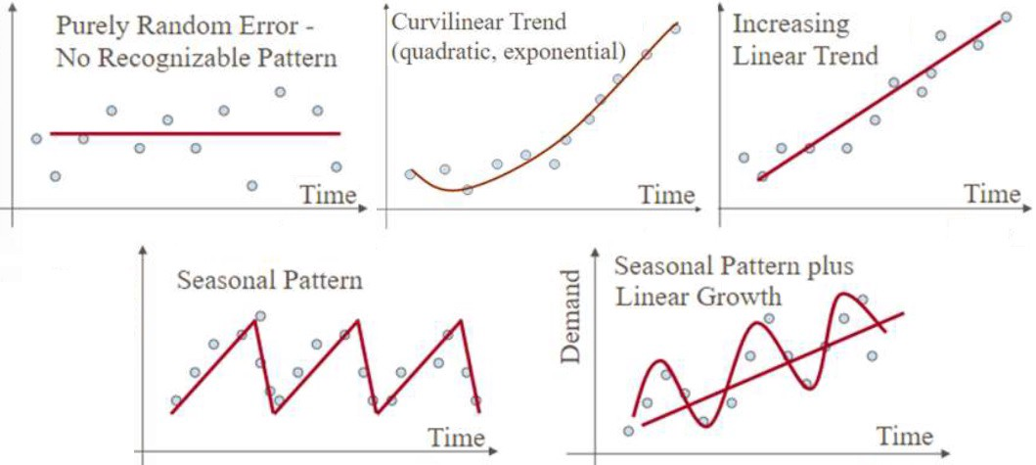
Time Series Patterns
Source: medium.com

Slide 8
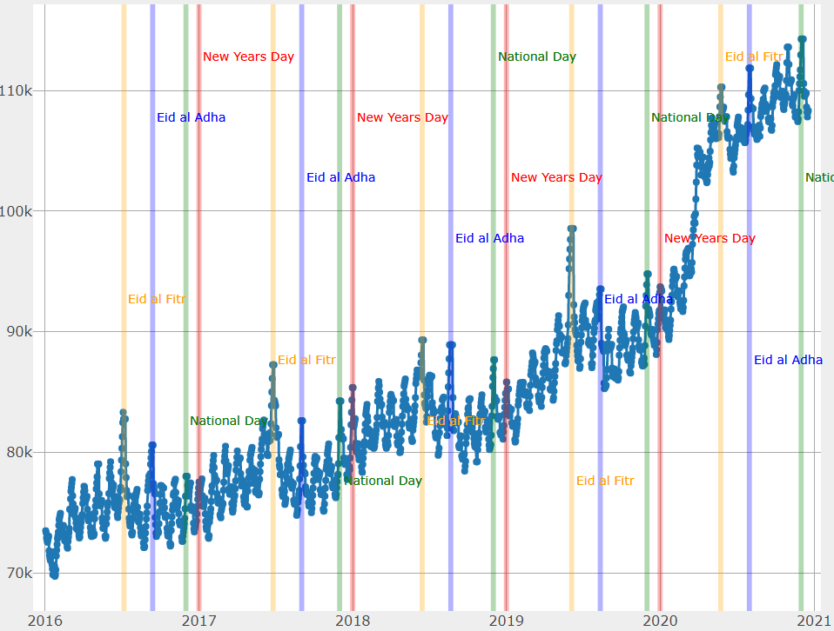
Seasonal Patterns in Practice

Slide 9




Statistical Trade-Offs
Features
Accurate models perform well in specific situations
Can underperform severely in other
Complexity
Capture a very particular, single, complex pattern
Accuracy
Performances
Robust models
perform reasonably well on average
Limited risk of underperformance
Forecastability
Capacity to handle different data patterns equally well
Rosbustness
Data-driven decision
Forecastability
Complexity

Slide 10
Empirical Strategy
Estimate all Models
Out-of-Sample Performance
How accurate each model is?
Forecast
Based on the best model, forecast
How each model exploits the information in the data?

Slide 11
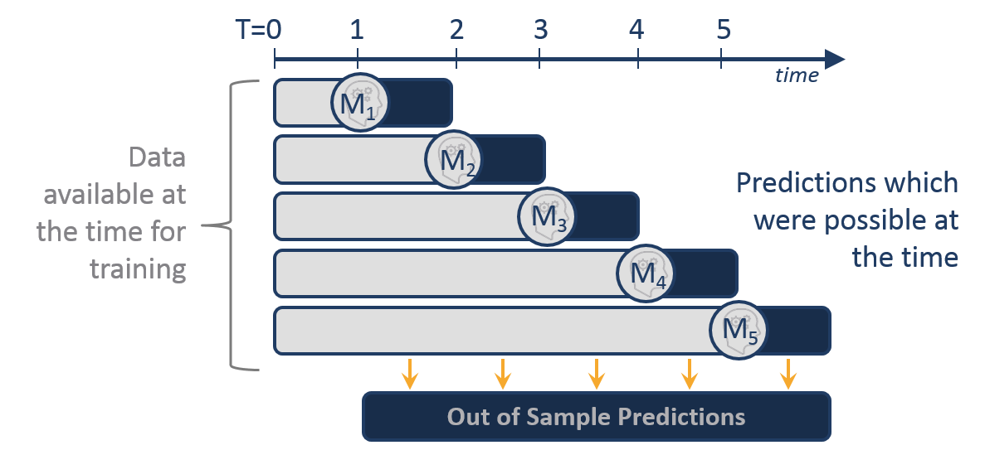
Out of Sample Performance: Concept
Source: alphascientist.com

Slide 12
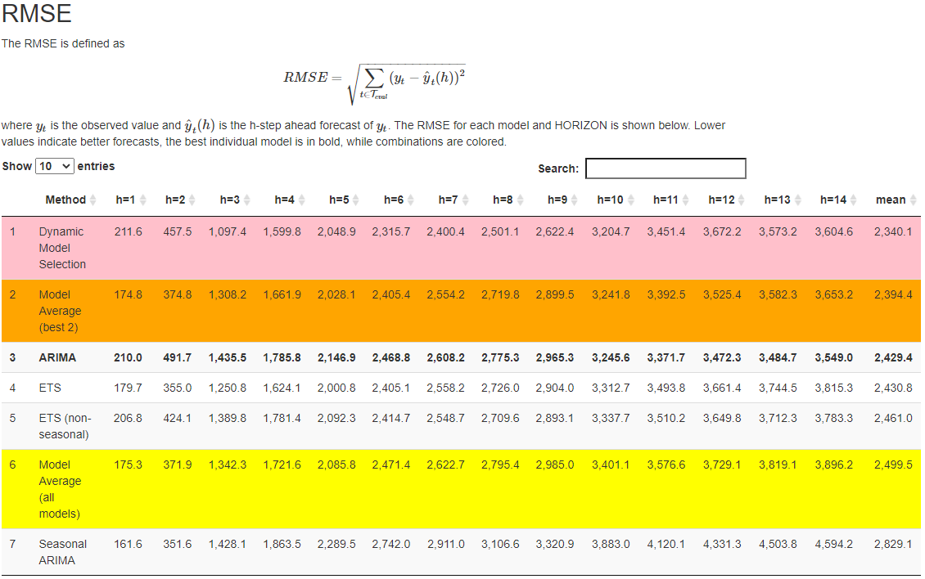
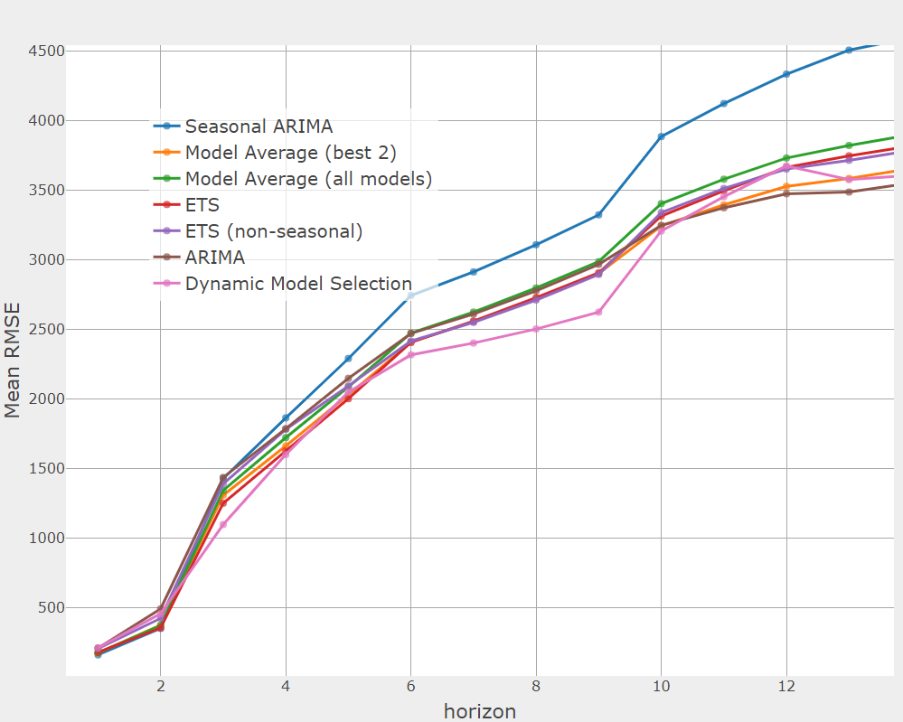
Out-of-Sample Output

Slide 13
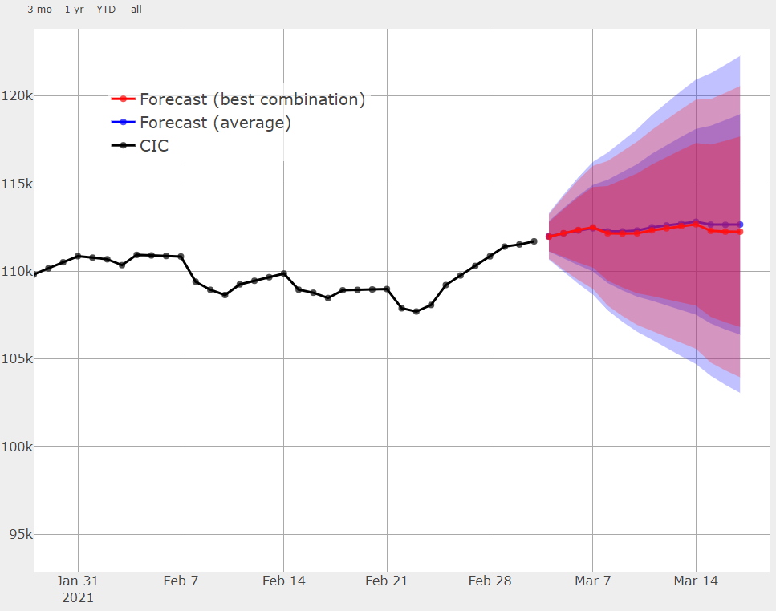
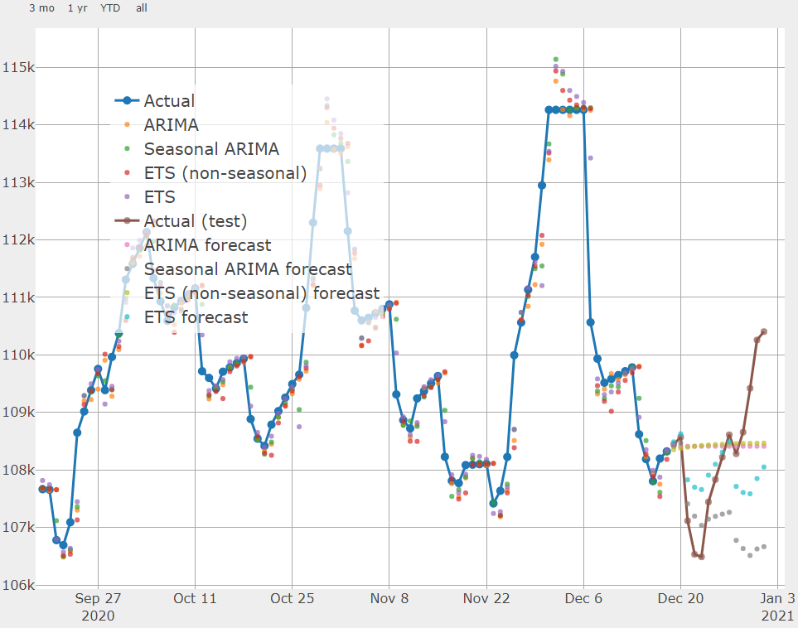
Forecasting Output

Slide 14



Models Selection
Leverage on Models Diversity to Reduce Modeling Risks
Single Models
Dynamic Selection
Model Averaging
Test each of them
Ranked by performance
Take the most recent best model
Adjust quickly to structural changes
Average the top 3 models
Reduce modeling risk

Slide 15
Forecasting Infrastructure
R Codes
Input/Output
Config File
Data inputs
Framework
Forecast Files
Forecast Reports
Validation Files
Validation Reports

Slide 16



Operational Procedure
Data Feed
01
Every day update the data
Use an Excel template
Validation
Once every quarter, or after structural break
Investigate models performance
Can take a few hours
Update config file
Forecast
03
02
Every day, forecast the autonomous factors & total liquidity projections
Execute in a few seconds
Warnings for outdated validation

Slide 17
Contributions
Forecast the three main autonomous factors with advanced models
Combine the autonomous factors forecasts into a single liquidity measure
Incorporate risk into liquidity forecasts
Use a robust modeling framework to deal with structural breaks and complex data samples
Automatic data reporting and data visualization
User-friendly interface based on an open-source and free statistical software (R)
Community of experts, working on public codes (Github)

Slide 18
Live Demo
Files at \\was.int.imf.org\ecn\ems_shared\CB_liquidity\reports

Slide 19
Further Directions #1: Further Forecasting
Forecasting
At the heart of analytics, artificial intelligence, articulating with central bank operations
Further development
Add new forecasting models to the battery of models currently tested:
Other time series libraries/algorithms, e.g. with exogeneous data incl. “frontier data” (internet-based data, weather for seasonality movement, risk sentiment, etc.)
Machine learning algorithms
The framework can easily be extended outside central bank liquidity forecasting
intranet stats, macro-framework data (e.g. inflation), trade and capital flows, etc.
Need to be accompanied by thorough training to avoid misuse of the framework
Don’t be overconfident in forecasting models (e.g. Zillow case)

Slide 20
Further Directions #2: Python and GitHub
Current code in R, Python would allow easier integration into infrastructure (cloud)
Code sharing infrastructure:
Organization account would allow single source for sharing code, feedback
Would make IMF work more visible and more accessible
Collaboration:
Provide member countries with a reliable framework
Public repository, can lead to further collaborations (1 + 1 > 2)
Free, open source
Status:
Pilot ongoing
Would really need to make our code available for collaboration with authorities & STX

Slide 21
Appendix Technical Slides

Slide 22
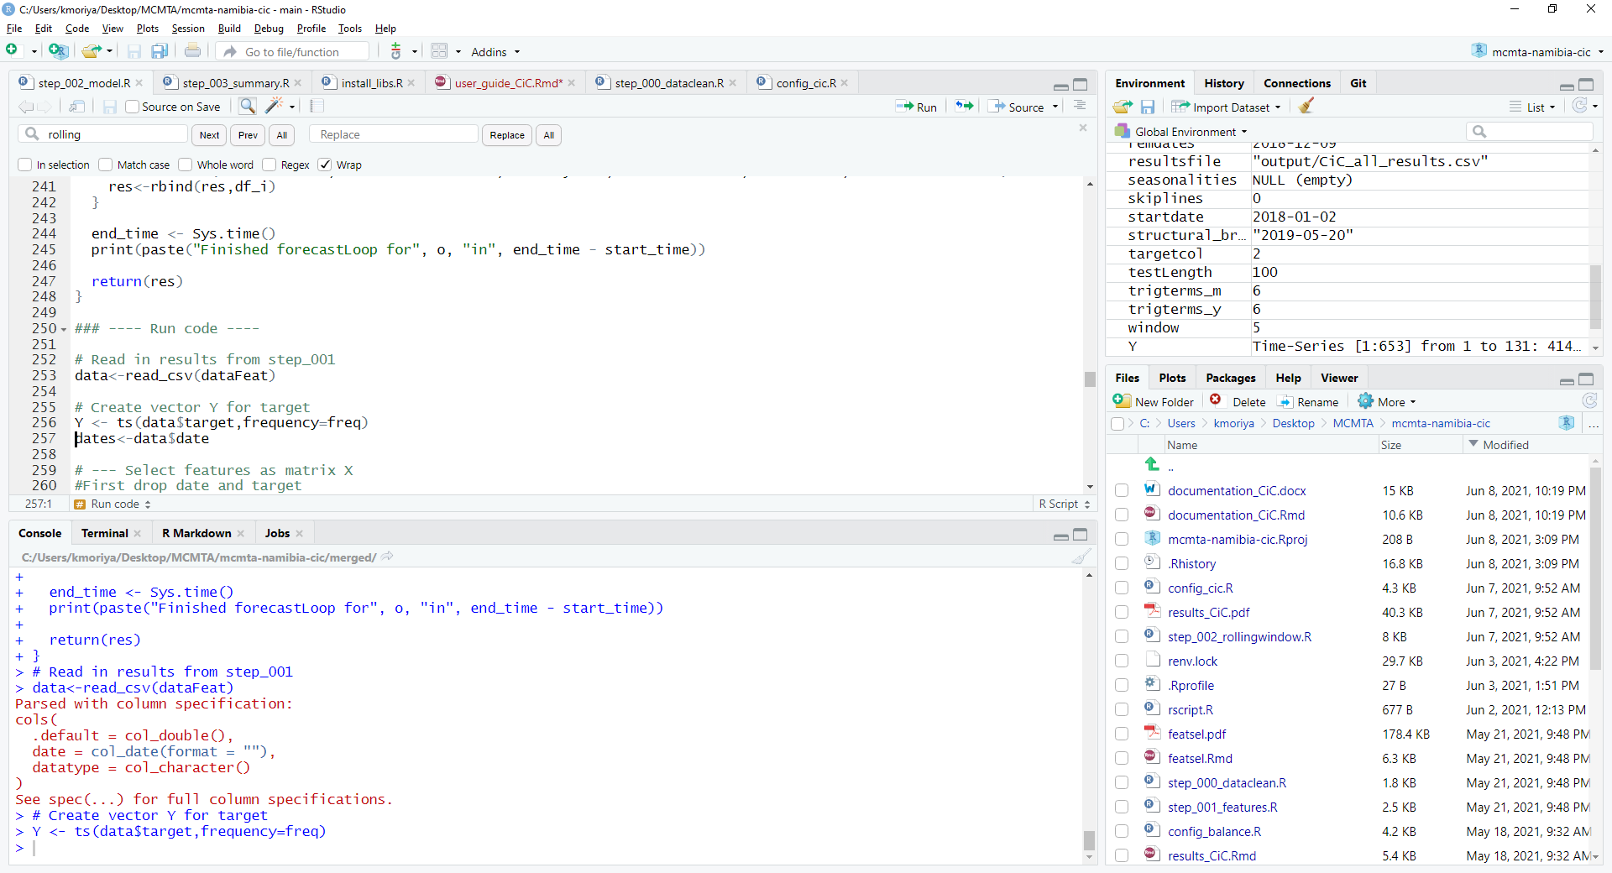
R Studio Interface (https://www.rstudio.com/ )

Slide 23
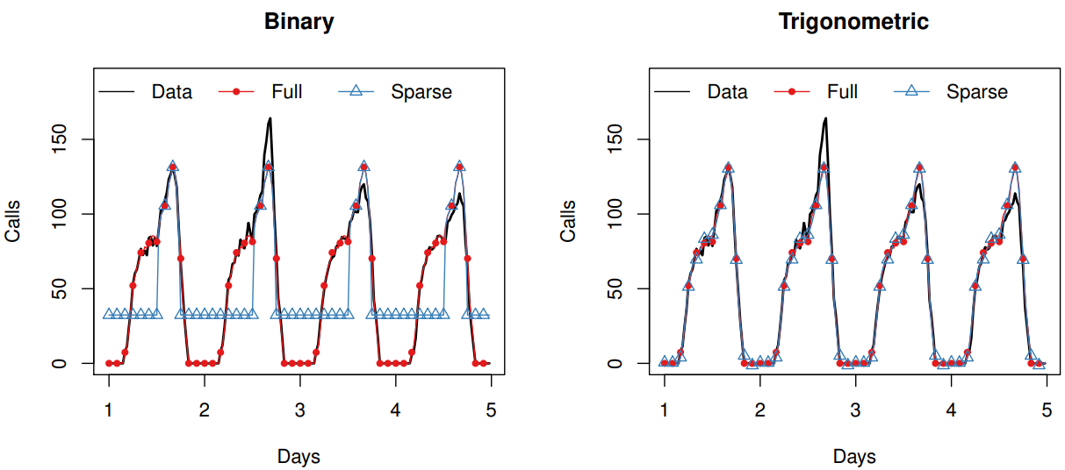
Modeling Seasonality
Binary tries to capture every single phenomenon
Trigonometric models a cycle : much more parsimonious

Slide 24
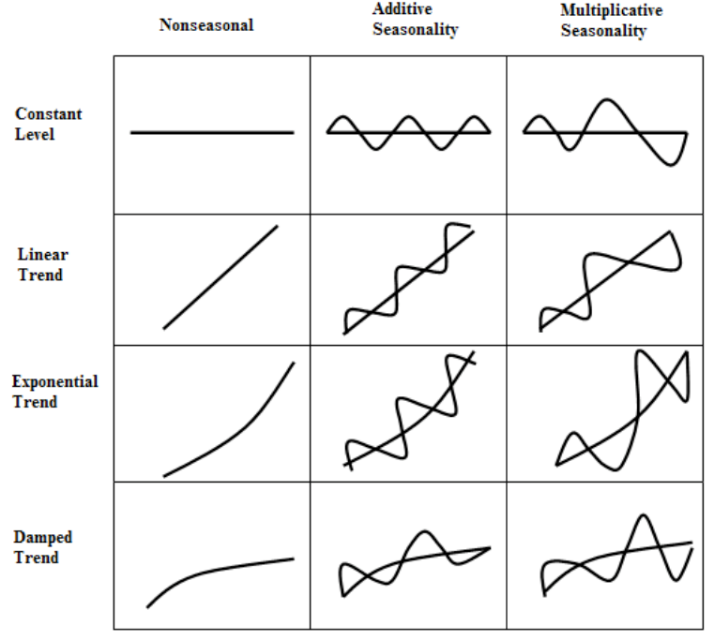
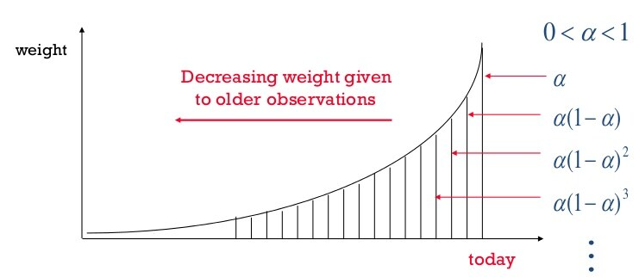
Exponential Smoothing

Slide 25
Main References
Cabrero, Alberto, Gonzalo Camba-Mendez, Astrid Hirsh, and Fernando Nieto. 2002. “Modeling the Daily Banknotes in Circulation in the Context of Liquidity Management of the European Central Bank,” European Central Bank Working Paper No. 142, May.
Gray, Simon T. 2008. “Liquidity Forecasting,”, Bank of England, Centre for Central Banking Studies Handbook—No. 27, June.
Andrea Shaechter, 2000 “Liquidity Forecasting”, International Monetary Fund
Veyrune, Romain, Shaoyu Guo. 2019. “Autonomous Factor Forecast Quality: The Case of the Eurosystem”, IMF Working paper No. 19/296, December.
Anderson, D., & Burnham, K. (2004). Model selection and multi-model inference. 2nd ed. NY: Springer-Verlag.
Athanasopoulos, G., Hyndman, R. J., Kourentzes, N., & Petropoulos, F. (2017). Forecasting with temporal hierarchies. European Journal of Operational Research, 262(1), 60-74.
De Livera, A. M., Hyndman, R. J., & Snyder, R. D. (2011). Forecasting time series with complex seasonal patterns using exponential smoothing. Journal of the American statistical association, 106(496), 1513-1527.
Wickramasuriya, S. L., Athanasopoulos, G., & Hyndman, R. J. (2019). Optimal forecast reconciliation for hierarchical and grouped time series through trace minimization. Journal of the American Statistical Association, 114(526), 804-819.

Slide 26
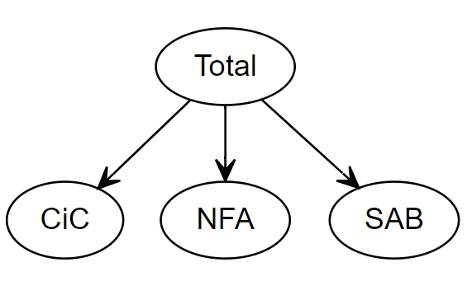
Hierarchical Forecasts of the Autonomous Factors
Forecast the autonomous factors using a hierarchical modeling approach, with different models for each AF
Forecasting the sum of the autonomous factors separately
Reconciling the forecasts using aggregation technics as described for instance in Hyndman, Rob J., et al. "Optimal combination forecasts for hierarchical time series." (2011)
Use either OLS computation of the weights or the “minT” approach: minimize the trace of the VarCov forecast matrix. Exploit the covariance among regressors to maximize the accuracy

Slide 27
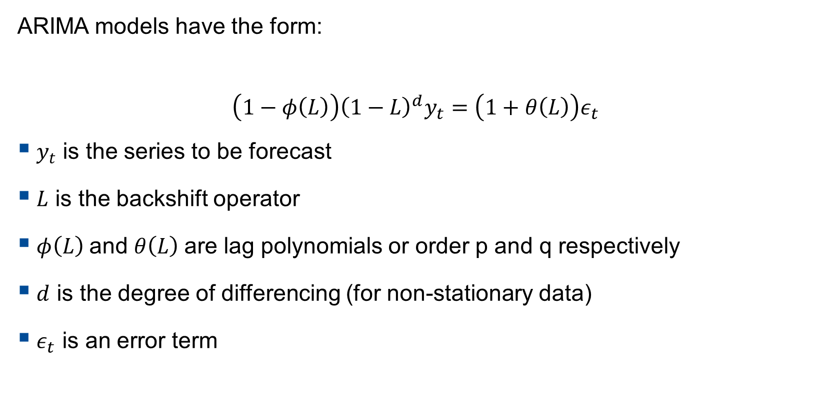
ARIMA Model
ARIMA models have the form:
$$\left(1−φ\left(L\right)\right){\left(1−L\right)}^{d}y_{t}=\left(1+θ\left(L\right)\right)ε_{t}$$
$y_{t}$ is the series to be forecast
$L$ is the backshift operator
$φ\left(L\right)$and $θ\left(L\right)$are lag polynomials or order p and q respectively
$d$ is the degree of differencing (for non-stationary data)
$ε_{t}$ is an error term

Slide 28
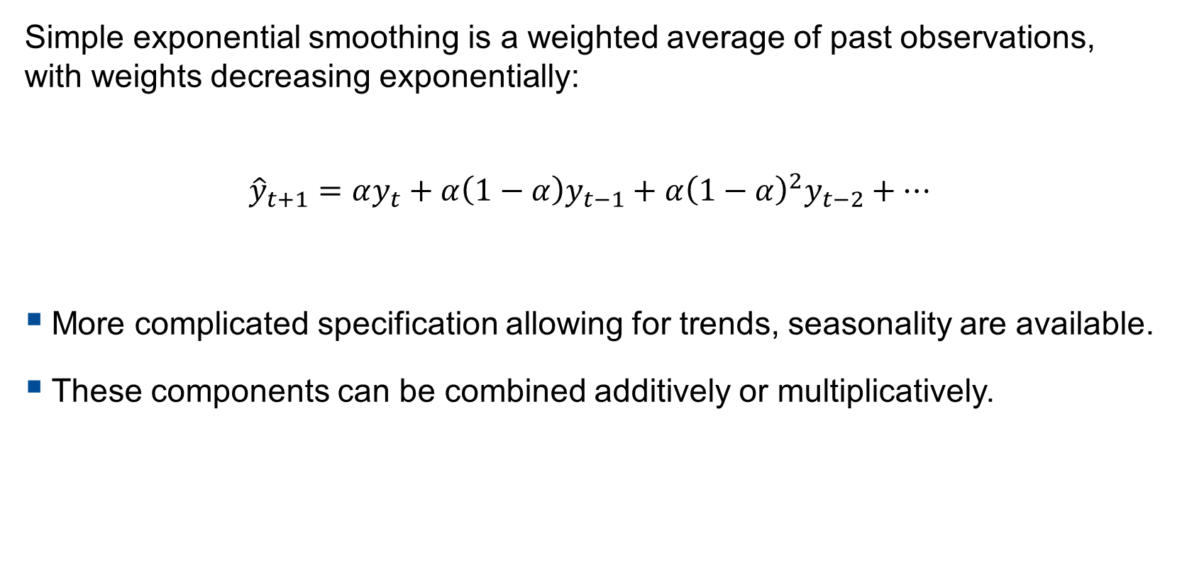
ETS (Exponential Smoothing) Model
Simple exponential smoothing is a weighted average of past observations, with weights decreasing exponentially:
$${\hat{y}}_{t+1}=αy_{t}+α\left(1−α\right)y_{t−1}+α{\left(1−α\right)}^{2}y_{t−2}+…$$
More complicated specification allowing for trends, seasonality are available.
These components can be combined additively or multiplicatively.

Slide 29

Advanced Models – ARIMA with Trigonometric Seasonality
ARIMA with trigonometric seasonality
ARIMA trig A: first estimate coefficients of $X_{t}$ and $D_{t}$ and then estimate ARIMA part (it is a regARIMA model)
ARIMA trig B: jointly estimate all coefficients

Slide 30
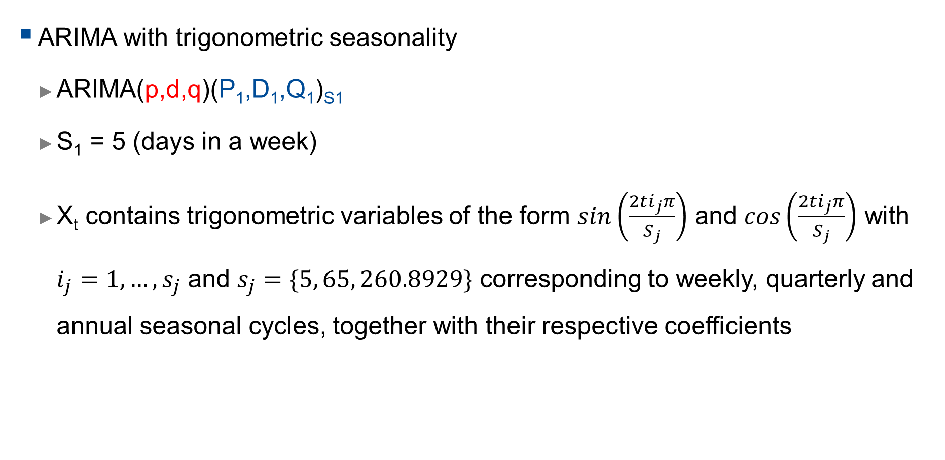
Advanced Models – ARIMA with Trigonometric Seasonality
ARIMA with trigonometric seasonality
ARIMA(p,d,q)(P₁,D₁,Q₁)_{S1}
S₁ = 5 (days in a week)
X_{t} contains trigonometric variables of the form $sin\left(\frac{2ti_{j}π}{S_{j}}\right)$ and $cos\left(\frac{2ti_{j}π}{S_{j}}\right)$ with $i_{j}=1, …, s_{j}$ and $s_{j}=\{5, 65, 260.8929\}$ corresponding to weekly, quarterly and annual seasonal cycles, together with their respective coefficients
$${\left(1−\sum_{i=1}^{p}{φ_{i}B^{i}}\right)\left(1−\sum_{k=1}^{P1}{{Φ1}_{k}B^{s1k}}\right)\left(1−B\right)}^{d}{\left(1−B^{s1}\right)}^{D1}Y_{t}=\left(1−\sum_{j=1}^{q}{θ_{j}B^{j}}\right)\left(1−\sum_{l=1}^{Q1}{{Θ1}_{l}B^{s1l}}\right)ε_{t}+Xt+D_{t}$$

Slide 31
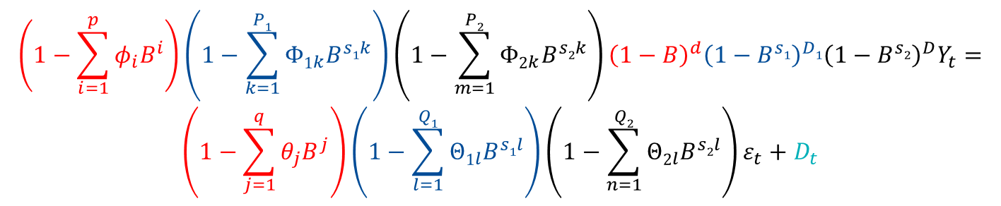
Advanced Models - ARIMA
ARIMA with multiple stochastic seasonality
ARIMA(p,d,q)(P₁,D₁,Q₁)_{S1}(P₂,D₂,Q₂)_{S2}
S₁ = 5 (days in a week)
S₂ = 5*13 (days in a quarter, 13 weeks)
$${\left(1−\sum_{i=1}^{p}{φ_{i}B^{i}}\right)\left(1−\sum_{k=1}^{P1}{{Φ1}_{k}B^{s1k}}\right)\left(1−\sum_{m=1}^{P2}{{Φ2}_{k}B^{s2k}}\right)\left(1−B\right)}^{d}{\left(1−B^{s1}\right)}^{D1}{\left(1−B^{s2}\right)}^{D}Y_{t}=$$
$$\left(1−\sum_{j=1}^{q}{θ_{j}B^{j}}\right)\left(1−\sum_{l=1}^{Q1}{{Θ1}_{l}B^{s1l}}\right)\left(1−\sum_{n=1}^{Q2}{{Θ2}_{l}B^{s2l}}\right)ε_{t}+D_{t}$$

Slide 32
Advanced Model: TBATS model
Combines in a single state-space model:
Exponential smoothing to model level and trend
Trigonometric terms to account for seasonality
Box-Cox transformation to account for non-normality
ARIMA errors to model the residuals dynamic
The TBATS model has appealing properties but, for some countries, tend to underperform simpler models (trigonometric ARIMA for instance). For some other countries, it performs very well

Slide 33
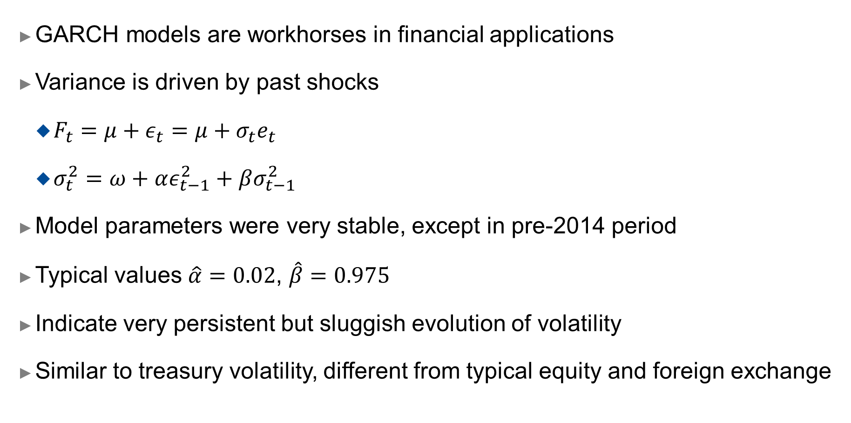
GARCH Models
GARCH models are workhorses in financial applications
Variance is driven by past shocks
$F_{t}=μ+ε_{t}=μ+σ_{t}e_{t}$
$σ_{t}^{2}=ω+αε_{t−1}^{2}+βσ_{t−1}^{2}$
Model parameters were very stable, except in pre-2014 period
Typical values $\hat{α}=0.02$, $\hat{β}=0.975$
Indicate very persistent but sluggish evolution of volatility
Similar to treasury volatility, different from typical equity and foreign exchange

Slide 34
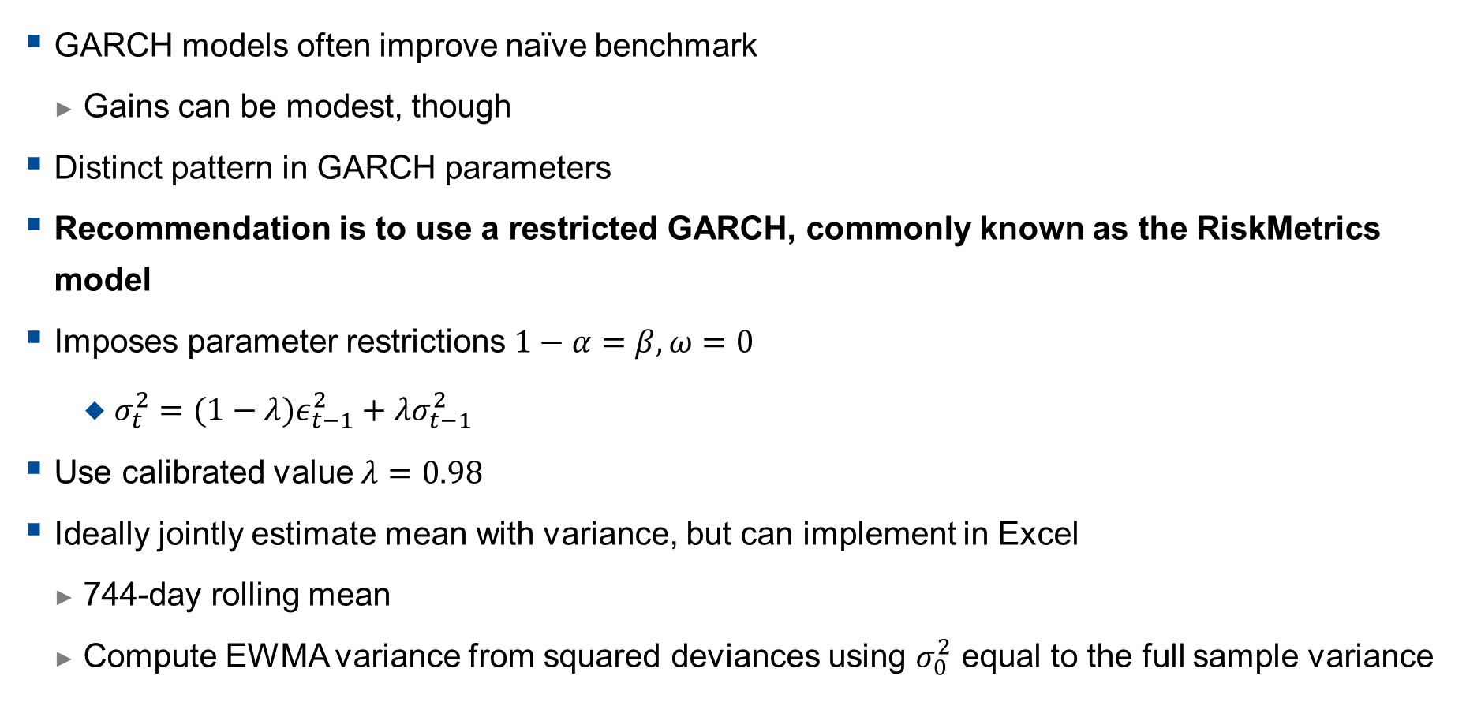
GARCH versus EWMA
GARCH models often improve naïve benchmark
Gains can be modest, though
Distinct pattern in GARCH parameters
Recommendation is to use a restricted GARCH, commonly known as the RiskMetrics model
Imposes parameter restrictions $1−α=β,ω=0$
$σ_{t}^{2}=(1−λ)ε_{t−1}^{2}+λσ_{t−1}^{2}$
Use calibrated value $λ=0.98$
Ideally jointly estimate mean with variance, but can implement in Excel
744-day rolling mean
Compute EWMA variance from squared deviances using $σ_{0}^{2}$ equal to the full sample variance

Slide 35
Terms Elimination and Trigonometric Seasonality
Elimination of seasonal terms:
Eliminating terms from the binary (indicator variable) representation, removes the effect of seasonal periods.
Eliminating terms in the trigonometric representation results in smoother approximations of the seasonal shape.
Elimination of terms can be done using information criteria
Besides, trigonometric representation is more parsimonious, as it involves less parameters to estimate: reduce parametric noise

Slide 36
Expanding Window Setup
Construct a rolling window of 780 observations (approx. 3 years).
First window, for instance 3/1/2012-10/2/2015,
For each model class, select and estimate model,
Produce forecasts from 1-day ahead to 20-days ahead (11/2/2015-10/3/2015).
Roll window forwards by one day:
Second window 3/1/2012-11/2/2015,
Reselect and restimate models,
Produce forecasts from 1-day ahead to 20-days ahead (12/2/2015-11/3/2015).
This is repeated until all data is used.

Slide 37
Performance Evaluation
A visual example of the rolling origin evaluation for a single model. At each origin, the model is re-specified fully, potentially changing form and parameters.

Slide 38
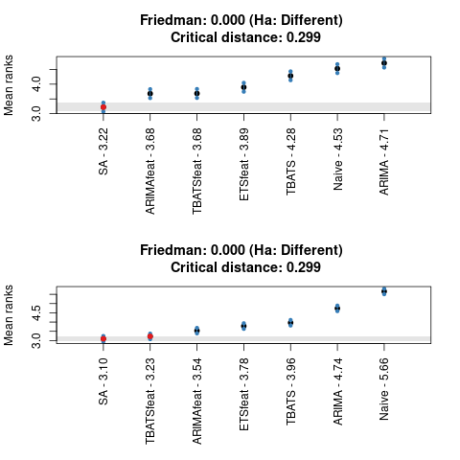
Example: State Account Forecasts Statistical Significance
When ranks are considered, Simple Average, significantly outperforms other models (mostly),
Top plot on right shows 5-day ahead forecasts,
Bottom plot on right shows 20-day ahead forecasts.

Slide 39
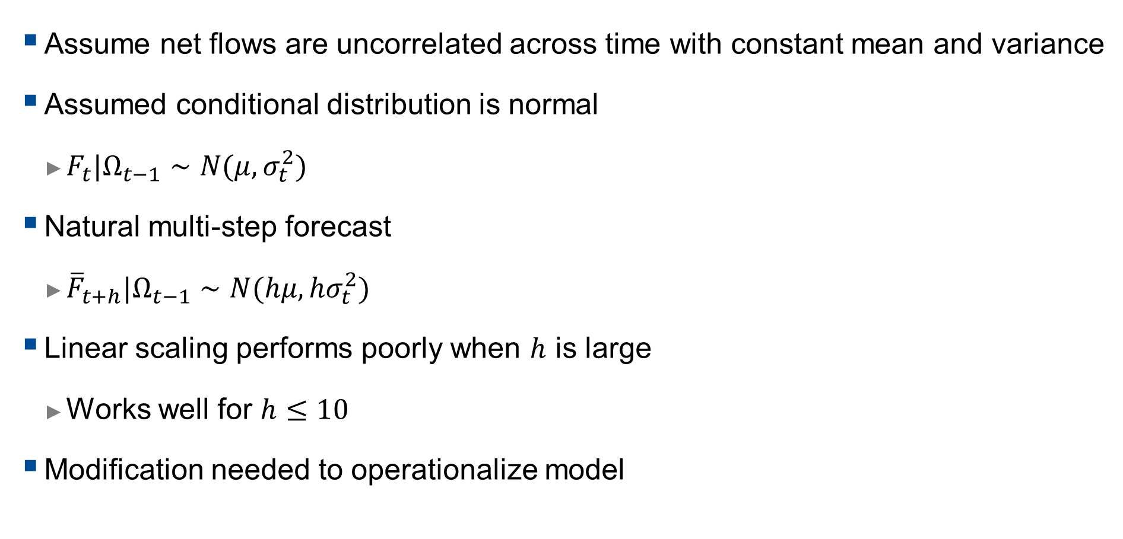
Baseline Model
Assume net flows are uncorrelated across time with constant mean and variance
Assumed conditional distribution is normal
$F_{t}|Ω_{t−1}∼N(μ,σ_{t}^{2})$
Natural multi-step forecast
${\overline{F}}_{t+h}|Ω_{t−1}∼N(hμ,hσ_{t}^{2})$
Linear scaling performs poorly when $h$ is large
Works well for $h≤10$
Modification needed to operationalize model

Slide 40
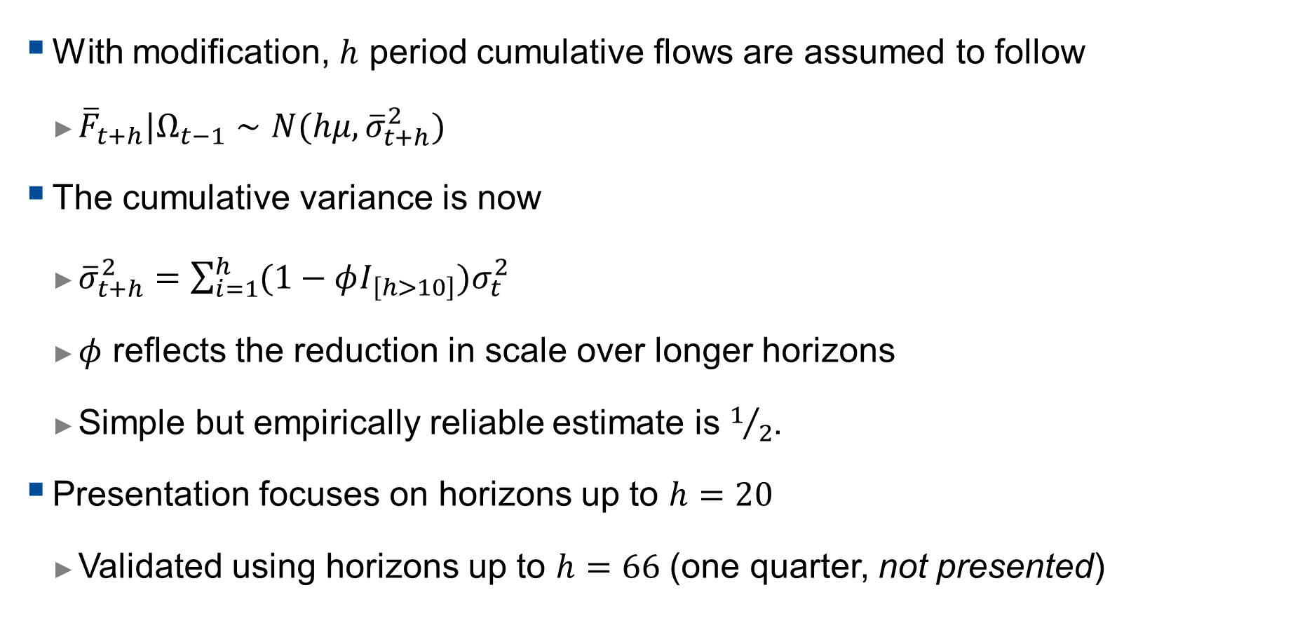
Modified multi-step density forecast
With modification, $h$ period cumulative flows are assumed to follow
${\overline{F}}_{t+h}|Ω_{t−1}∼N(hμ, {\overline{σ}}_{t+h}^{2})$
The cumulative variance is now
${\overline{σ}}_{t+h}^{2}=\sum_{i=1}^{h}{(1−φI_{\left[h>10\right]})σ_{t}^{2}}$
$φ$ reflects the reduction in scale over longer horizons
Simple but empirically reliable estimate is $1/2$.
Presentation focuses on horizons up to $h=20$
Validated using horizons up to $h=66$ (one quarter, not presented)

Slide 41
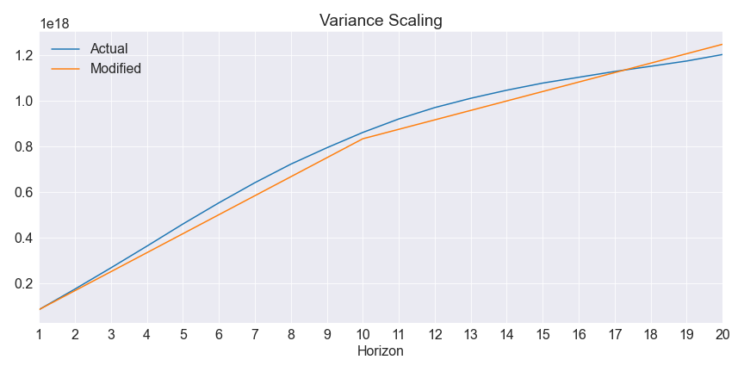
Modified Variance Scaling

Slide 42
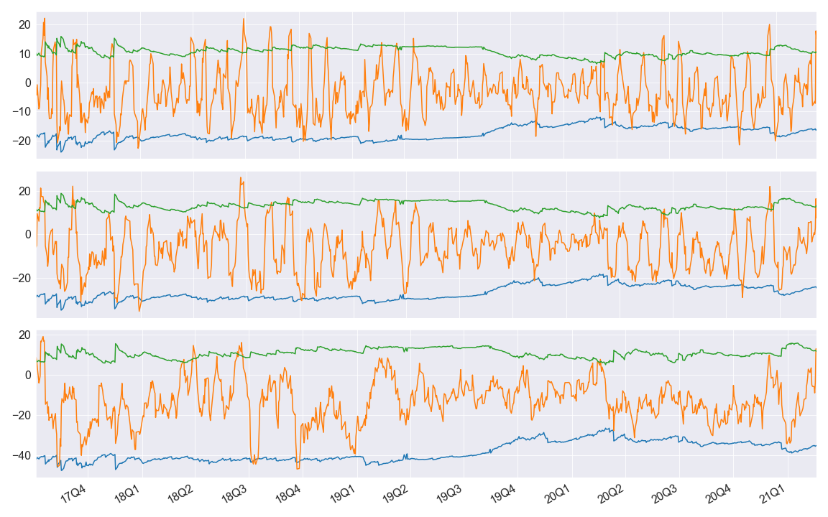
GARCH Model Performance (95%)

Slide 43
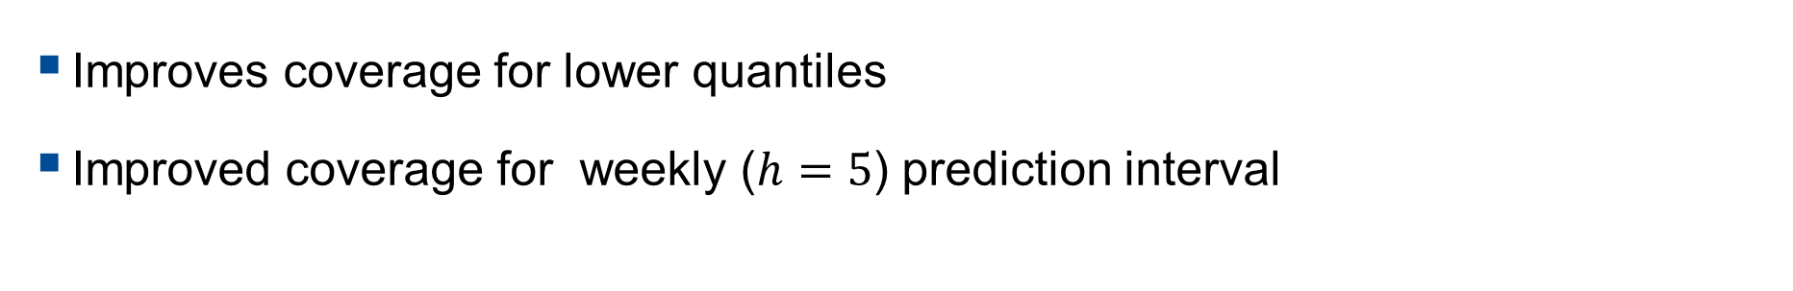
GARCH Model Performance
 | h=5 | h=10 | h=20
78 | 72.5 | 74.9 | 84.8
90 | 86.5 | 88.8 | 92.6
95 | 91.8 | 95.6 | 96.9
99 | 97.3 | 98.6 | 99.4
Improves coverage for lower quantiles
Improved coverage for weekly ($h=5$) prediction interval

Slide 44
Interactive Charts
Interactive Charts: Plotly (and others)
Can be generated via programs (R, Python, etc.) at scale
Interactivity allows better inspection of results
Examples at \\was.int.imf.org\ecn\ems_shared\CB_liquidity (may need to copy locally)
Possible to have Fund-wide libraries that allow easy creation
Aligns with creation of dashboards, being data-driven

