Slide 1
flodym: A library for dynamic material flow analysis
DdS Autumn School 2025
Jakob Dürrwächter
With: Bennet Weiß, Merlin Hosak, Falko Ueckerdt

Slide 2
Motivation
What is MFA?
Mass balance: Tracks material through system along life cycle stages
Why Dynamic MFA (In the context of LCA)
Stock-and flow time dynamics
  Future demands
  Secondary material availability
  Temporal inter-dependency
  Circular economy interventions
Concise and complete map of single materials’ social metabolism
Don’t take my word for it
  Review paper¹ found 200 studies on LCA-MFA combination
  DdS Autumn school
¹Barkhausen et al. 2023, J. Clean. Prod.
https://doi.org/10.1016/j.jclepro.2023.137017

Slide 3
Why Flodym?
ODYM by Stefan Pauliuk¹
Great concept: abstraction, data classes
> 100 citations
But: Doesn’t make full use of available data structures
Flodym
Objects & structure similar to ODYM
Integrated dimension management
Other functional extensions & API streamlining
Complete refactor/rewrite with current software development practices
→ Flexible, extensible, clean and simple application
¹https://github.com/IndEcol/ODYM

Slide 4
Outline of this course
Intro & MFA Principle
Short presentation
flodym API
Jupyter slides
Small JupyterLab exercises in between

Slide 5
Example Research Question
You’d like to compare the future emission intensity of automobile production
in the EU and the US.
For this, you need the future share of steel production from scrap
→ How much steel is produced from scrap in these regions in the future?

Slide 6
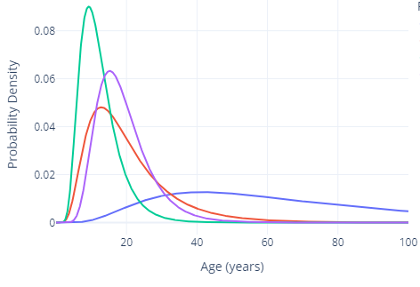







How does dynamic MFA work?
Vocabulary
System environment
Process
$$F_{S→M}(t,r,g)$$
$$F_{M→U}(t,r,p)$$
$$F_{U→S}(t,r)$$
Flow
Raw Steel
Production
Manu-facturing
Use
Recycling
Use
Stock
Dynamic Stock:
Lifetime distribution functions
Different stock types:
Inflow-driven, stock-driven, …
$$P$$
Parameter
$$F_{M→S}(t,r)$$
Dimensions
$t$ – time
$r$ – region
$g$ – grade
$p$ – product
$F_{S→M}(t,r,g)=P_{production}(t,r,g)$
Multiplication:
Multiply element-wise
Sum over excess
$F_{M→S}\left(t,r\right) =F_{S→M}(t,r,g)∗P_{loss_rate}(t)$
Subtraction:
Sum over excess dimensions
Subtract element-wise
$F_{M→U}\left(t,r,p\right)=(F_{S→M}\left(t,r,g\right)−F_{M→S}\left(t,r\right))∗P_{product_share}\left(r,p\right)$
$F_{U→S}(t,r)=S_{U}(F_{M→U}(t,r,p), P_{lifetime}(p))$

Slide 7
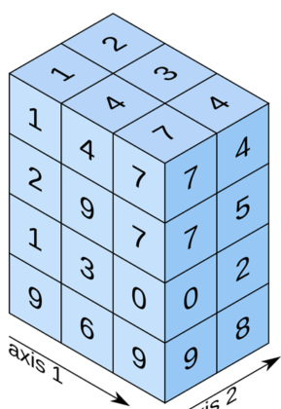
FlodymArrays
These operations need dimension information → FlodymArray class:
FlodymArrays are used
  As Flows
  As Parameters
  In Stock Models (inflow, outflow, stock)
FlodymArray
dims: DimensionSet
values: np.ndarray
“t”
“Time”
“r”
“Region”
“p”
“Product”
2020
2030
2040
2050
“EUR”
“USA”
“CHA”
“Vcl”
“Bld”

Slide 8
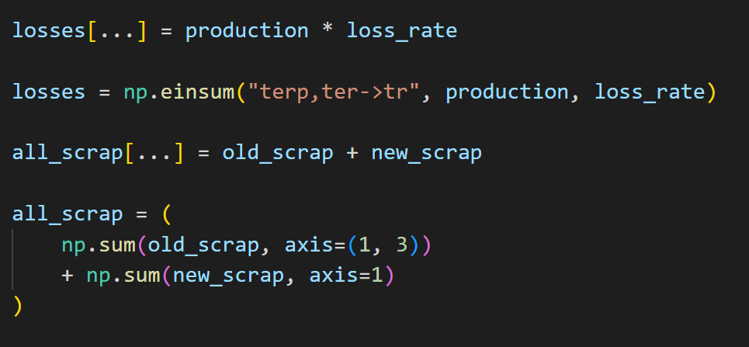
Math operations
Multiplication:
Addition:
flodym
numpy
flodym
numpy
Advantages:
Easy to write
Easy to read/understand
Adding/removing/reordering dimensions requires no changes
Reduces human error

Slide 9
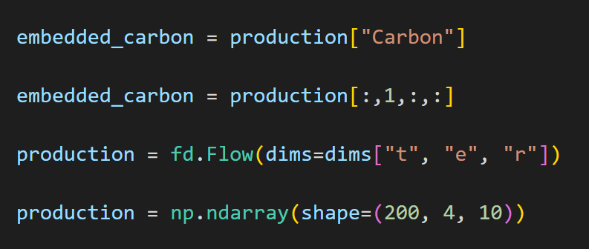
Indexing & Initialization
Indexing:
Initialization:
flodym
numpy
flodym
numpy
Advantages:
Easy to read & understand: The code expresses what is happening
Adding/removing/reordering dimension items
(another element, another region) requires no changes.

Slide 10
Flodym Functionality
Handles operations of/between multi-dimensional arrays
Embedded in MFASystem class, with mass balance checks
Integrates dynamic stock models
System definition & data read-in
Plotting and data export
Different degrees of integration / customization

Slide 11
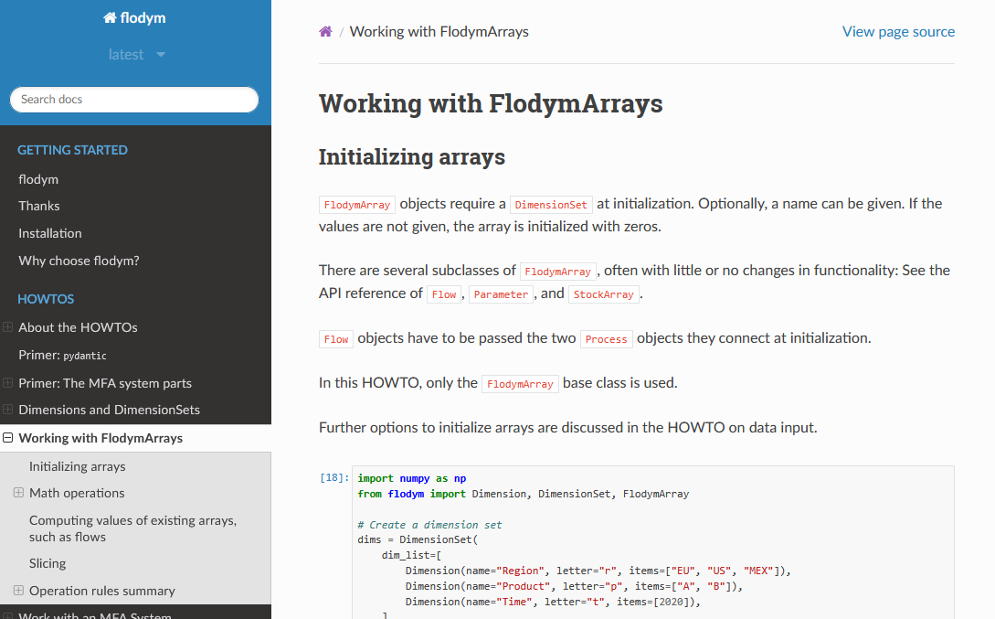
Resources
Installation: `pip install flodym`
Github: https://github.com/pik-piam/flodym
Documentation: https://flodym.readthedocs.io
  Howtos
  Examples
  API Reference
This course: https://github.com/jakobbd/flodym_course
Publication (submitted): https://joss.theoj.org/papers/92b6faa2d82b8694f4ad5d394053ef32

Slide 12
Extra Slides

Slide 13
Intensive vs extensive quantities
Flows: Extensive (unit: mass)
  Reducing dimensions: Sum
  Summing is okay (just reduces information, overall sum stays constant)
  Broadcasting is not
Shares: Intensive (unit: none)
  Reducing dimension: Weighted average
  Summing is not okay
  Broadcasting is (but makes meaning ambiguous)

Slide 14
Operation deep-dive
Add/subtract two flows
  Information about distribution along dimension needs to be present in all summands
  => Sum to common dimension, then sum
Multiply flow by a share
  All share dimensions should be present in flow
  => Expand share to flow dimensions, then multiply element-wise
Split flow by a share
  Sum along all splitting dimensions (at once) should be one;
  all other share dimensions should be present in flow
  => Expand share to flow dimensions, expand flow to share dimensions, multiply element-wise
Multiply two shares
  Works, because they are only broadcast, not summed (but subsequent summing may be wrong)
Add two shares
  Does not work, because they may be summed
Multiply two flows
  Should never occur (unit: mass squared?)

Slide 15
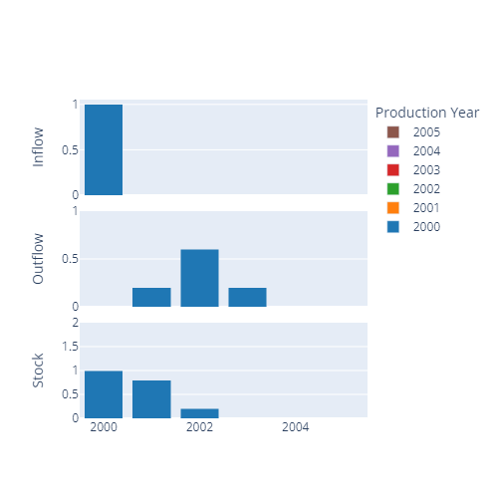
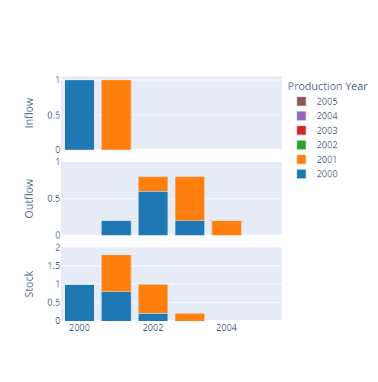
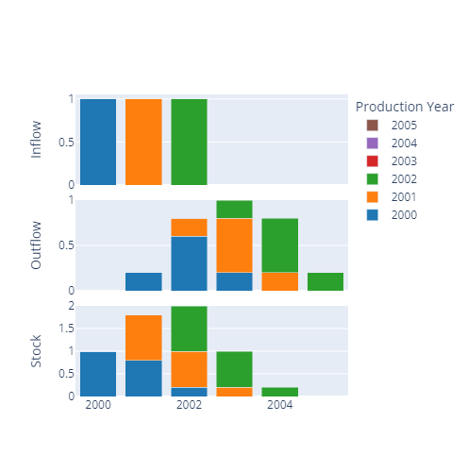
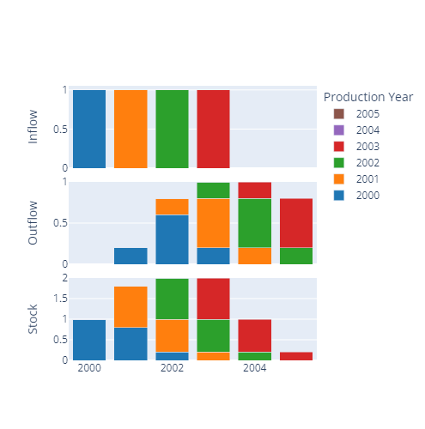
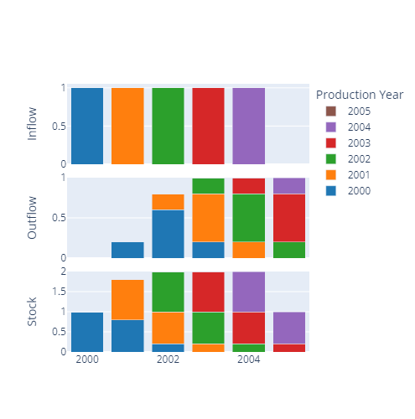
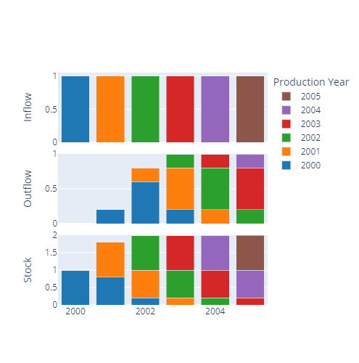
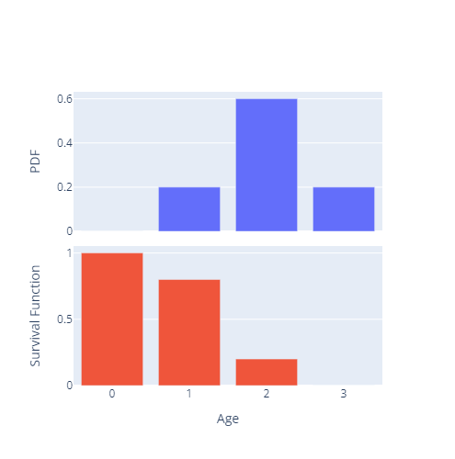
Dynamic Stock Models

Slide 16
Stocks
SimpleFlowDrivenStock:
  No lifetime model
  Input and output known (if not given, default to 0)
  Stock change is net inflow
InflowDrivenDSM
  Inflow and lifetime distribution known
  Calculate outflow and stock from lifetime model
StockDrivenDSM
  Stock and lifetime distribution known
  Calculate inflow from inverted lifetime model
  Calculate outflow from forward lifetime model

Slide 17
Application Example

Slide 18
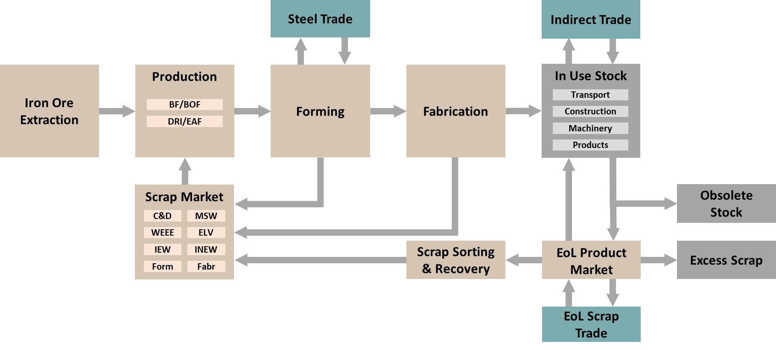
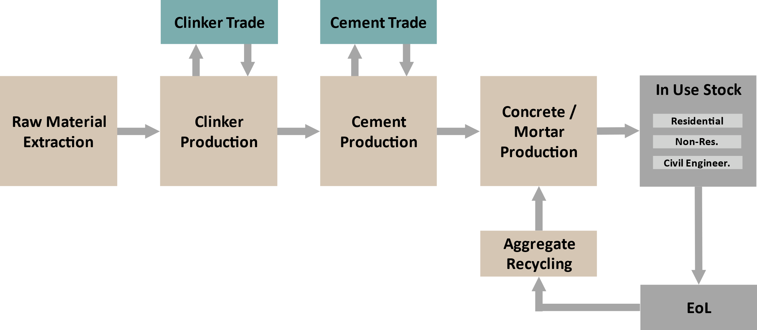
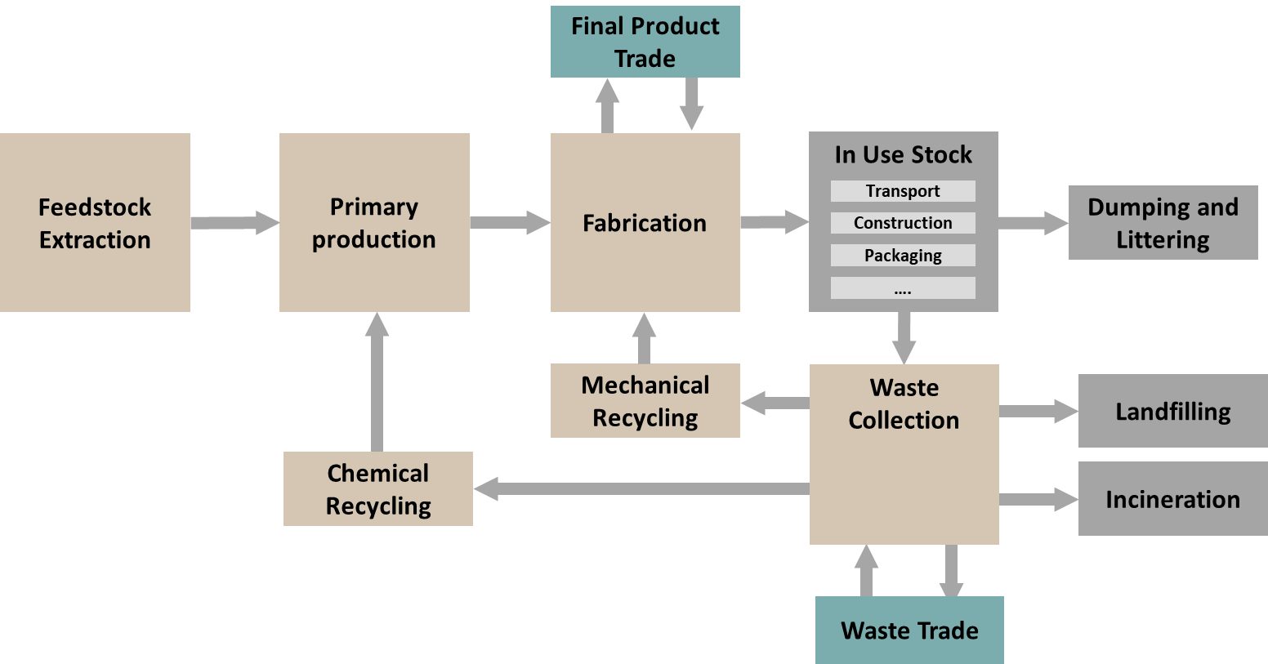
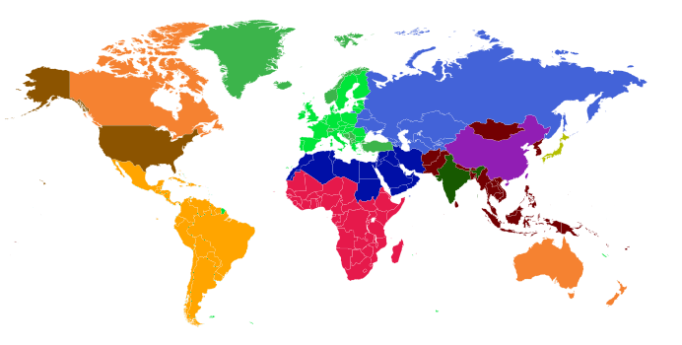
REMIND-MFA: Dynamic Material Flow Analysis Model
Steel
Cement
Plastics
Top-down, stock driven historic & prospective MFA
Developed for soft-link to the Integrated Assessment Model REMIND
12 global regions; input data generation allows for arbitrary regional resolution
Time: 1900-2100
Representation of circular economy methods

Slide 19
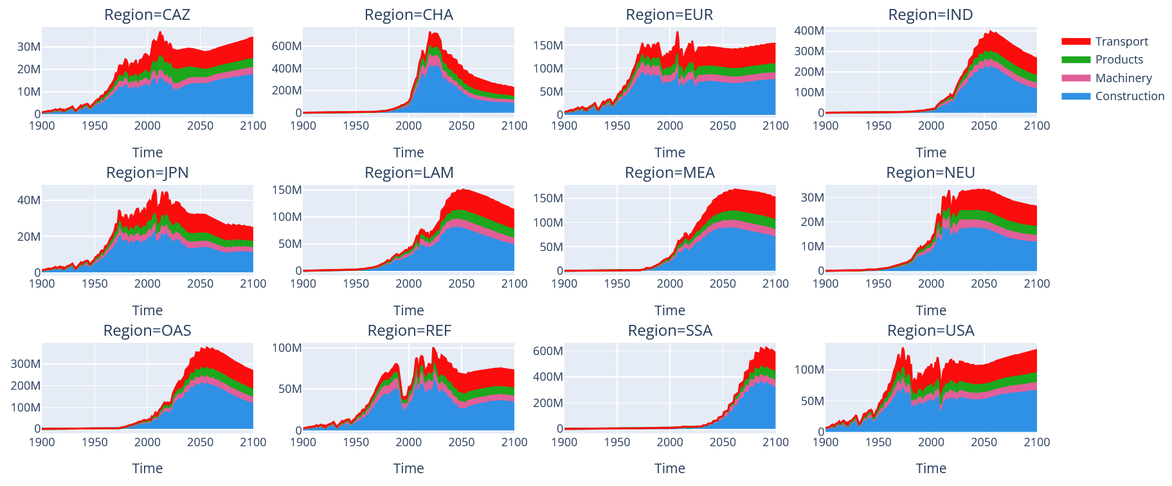
REMIND-MFA Example Results: Demand for Steel in Products

Slide 20
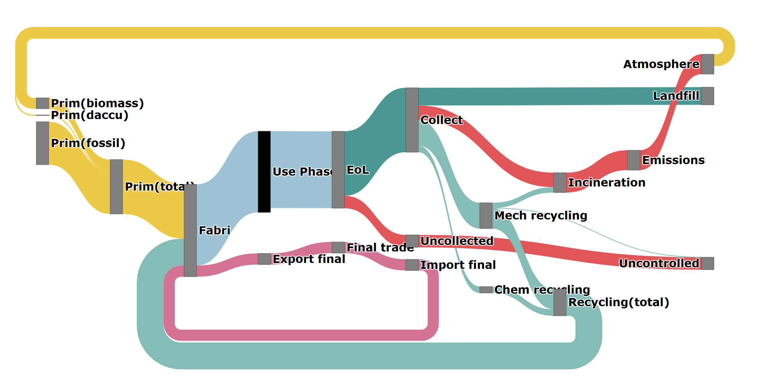
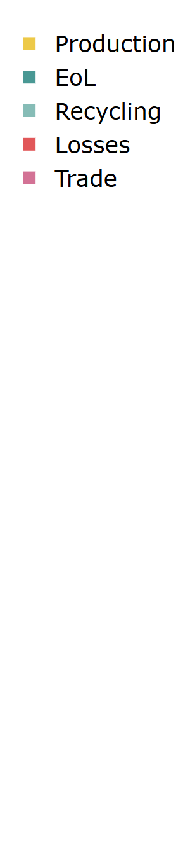
REMIND-MFA Example Results: Global Plastic Flows 2050

