Slide 1
Impact of E-books on Publishing Industry in US
Rahul Sood
Shumeng Li
Roma Kaul
Anagha Diwanji
Sarika Dhoot
Notes:
Overview on the E-book industry and big five publishers
With the advent of internet, popularity of ebooks grew in 2000s

Slide 2
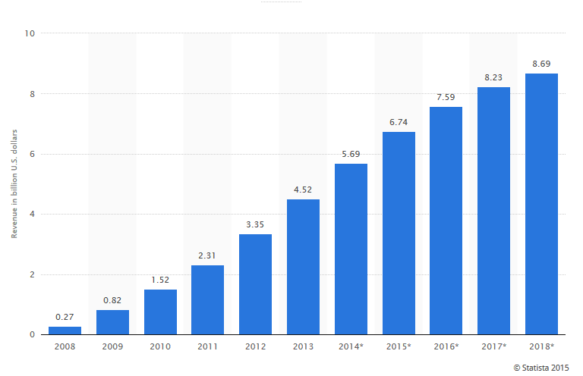
Revenue from e-book sales in the United States from 2008 to 2018 (in billion U.S. dollars)
Notes:
http://www.statista.com/statistics/190800/ebook-sales-revenue-forecast-for-the-us-market/
As the graph indicates, there has been a steady growth in revenue from e-book sales and a major contribution to the growth in popularity of ebooks is the launch of kindle in 2011.
Initially there were very few ebook readers, but due to the increasing popularity of internet and advent of ereaders, there has been a steady growth in revenue from ebook sales in US from 2008. And as the graph indicates, this growth is expected to continue in the coming years.

Slide 3
E-book Sales Surpass Hardcover
Some American publishers are now bringing in more revenue from e-books than paper books
Print book sales at the Penguin Group fell 7% in the first six months of 2011,
E-book sales helped to offset some of the Borders sales loss, with e-book sales doubling in the U.S. and increasing 128% worldwide
Notes:
There are many examples where american publishers are now bringing in more revenue from ebooks than hardcover books.
One such example is that of the penguin group.

Slide 4
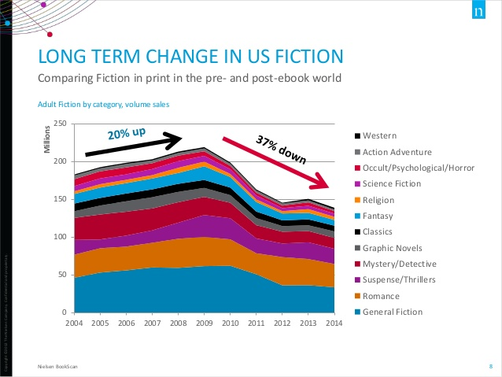
In the latest quarter, adult fiction accounts for 65% of ebook sales
Nonfiction print book sales: They were up 18% from 2004–2009, and have decreased 23% since then. Hardest hit categories: travel (-50%) and reference (-37%). Flourishing categories: religion/bibles (+43%), cooking/entertaining (+11%), the latter specifically driven by celebrities.
Notes:
Now lets see how a particular genre of books has been affected by ebooks. The graph shows comparison of fiction print book sales in pre and post ebook world. They were up 20% from 2004-2009 and have gone down 37% since then.
They were up 20% from 2004–2009, and have decreased 37% since then (as a result of ebooks picking up momentum).
Fiction e-book sales: Romance started off as the strongest genre in e-book format, and has remained dominant since. Today it constitutes 24% of all e-book sales.
Source: https://janefriedman.com/ebooks-print-market/

Slide 5
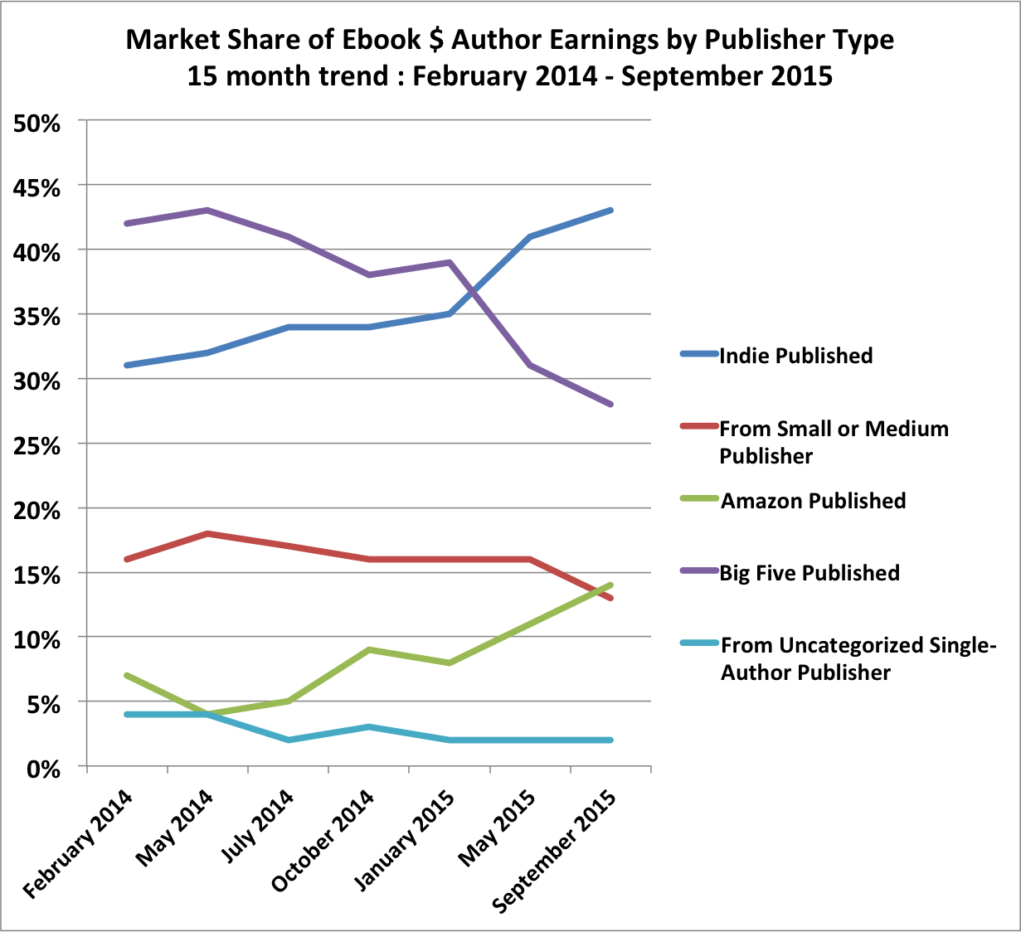
Impact on Indie and self-publishing
Authors leverage e-books to bypass traditional publishers
Can reach their fan base quicker
Lower up-front investment
Higher profit margins/royalties
E-books allow for growth of self-publishing
Notes:
A major impact of ebooks on publishing industry is the growth of indie and self publishing.
Self publishing- authors bypass traditional publishers and they publish it by themselves or go for independent publishers.
Ebooks have made self publishing easier because of the very low up-front investment. Thus authors end up getting higher profit margins or royalties.
As u can see in the graph. There has been a drastic change in the trend towards the end of 2014. Market share of ebooks published by indie or self publishers has shot up and market share of ebooks published by tradiional publishers has gone down.
This is one of the key transformations brought about by ebooks.
Graph.

Slide 6
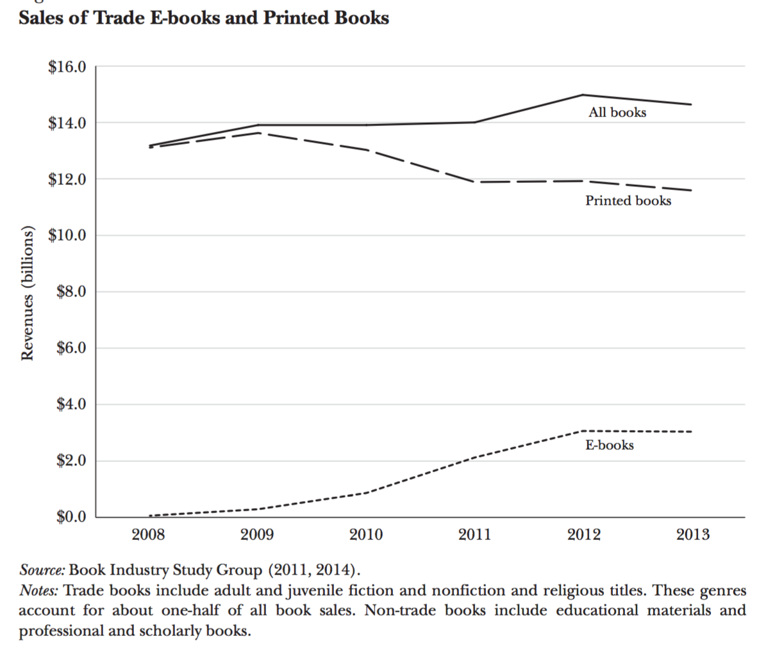
Transform the competition model
Publishers now have to publish both the e-version and the printed version because of the growing demand of e-books.
Notes:
Publishers now have to publish both the e-version and the printed version because of the growing demand of ebooks.

Slide 7
E-READER IS NOT A WTA PLATFORM but it still uses similar strategies
Vertical integration:
self-publishing: author uses low price to attract readers
Penetration pricing:
Amazon Unlimited
Subsidize the user
Average printed version price of a new book is 2 times of the e-book version
Publisher
Reader
Kindle
Notes:
http://goodereader.com/blog/electronic-readers/the-main-reasons-why-ebooks-are-better-than-print

Slide 8
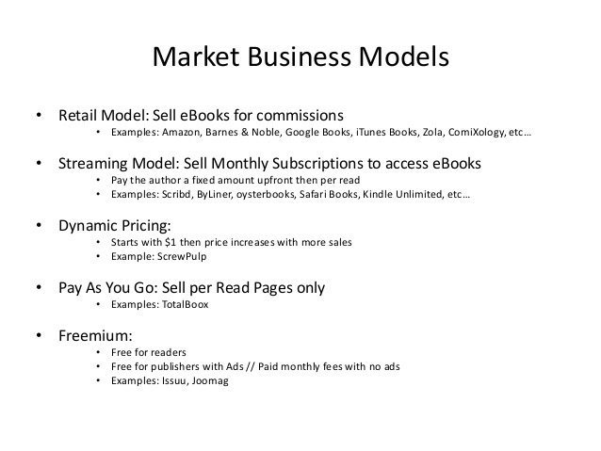
Business Model (Pricing Strategies)

Slide 9
Source
Gilbert R J. E-books: A Tale of Digital Disruption[J]. The Journal of Economic Perspectives, 2015, 29(3): 165-184.
Li H. The Impact of Ebooks on Print Book Sales: Cannibalization and Market Expansion[J]. 2013.
http://www.publishersweekly.com/pw/by-topic/industry-news/publisher-news/article/48181-penguin-satisfied-with-competitive-first-half.html
http://authorearnings.com/report/january-2015-author-earnings-report/
http://authorearnings.com/report/print-vs-digital-report/

Slide 10
Thank you!

