Slide 1
EXCam coords
Brian Kern
2021 Oct 18

Slide 2
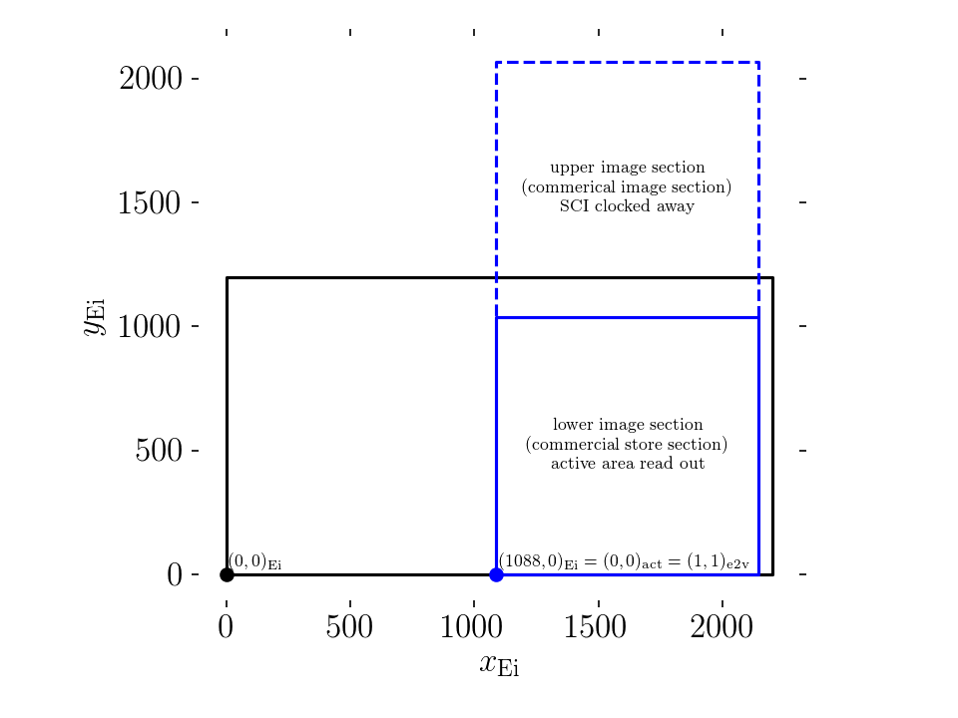
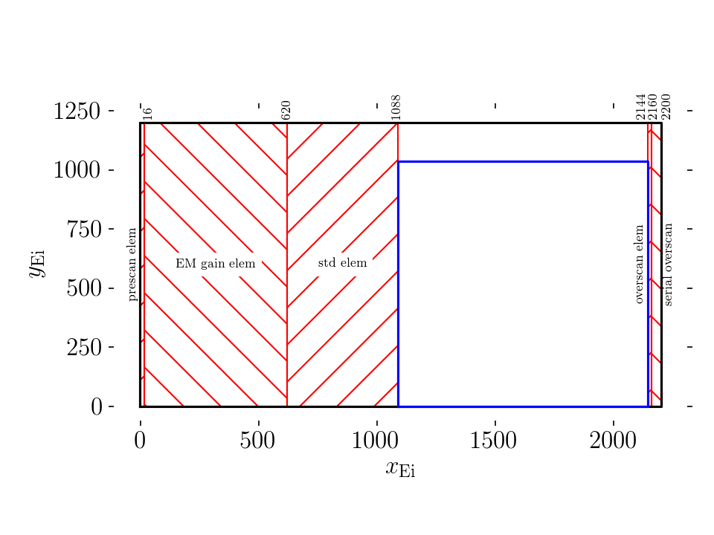
EXCam image from CIE
Dominant stability budget terms
Location of active area pixels during integration
Location of serial elements at time of parallel shift

Slide 3
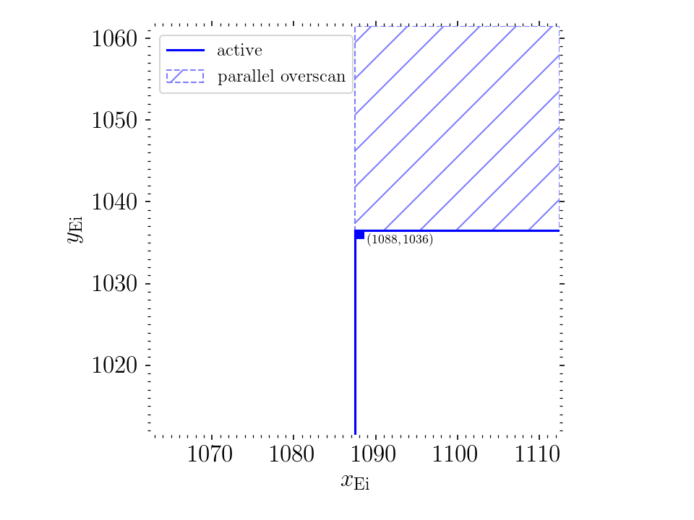
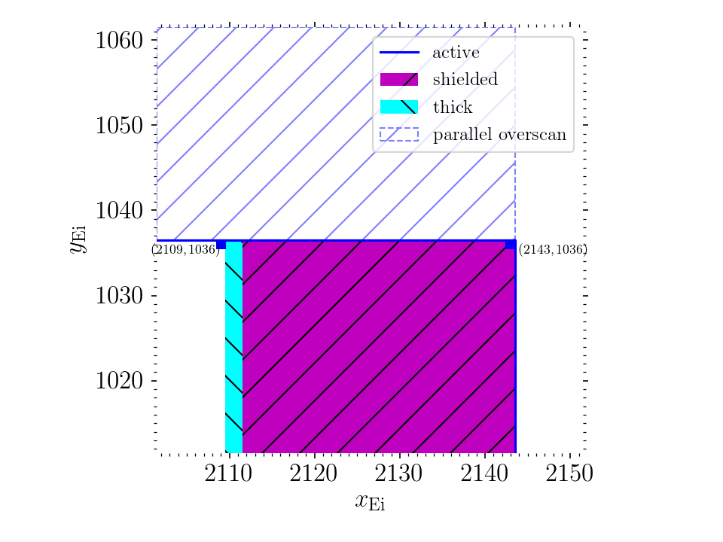
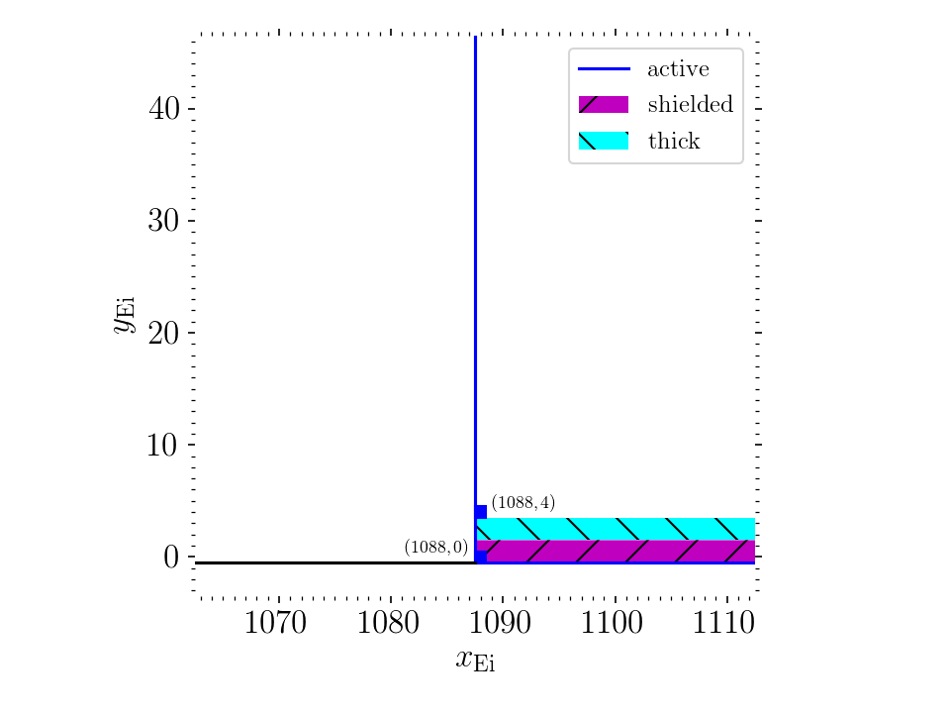
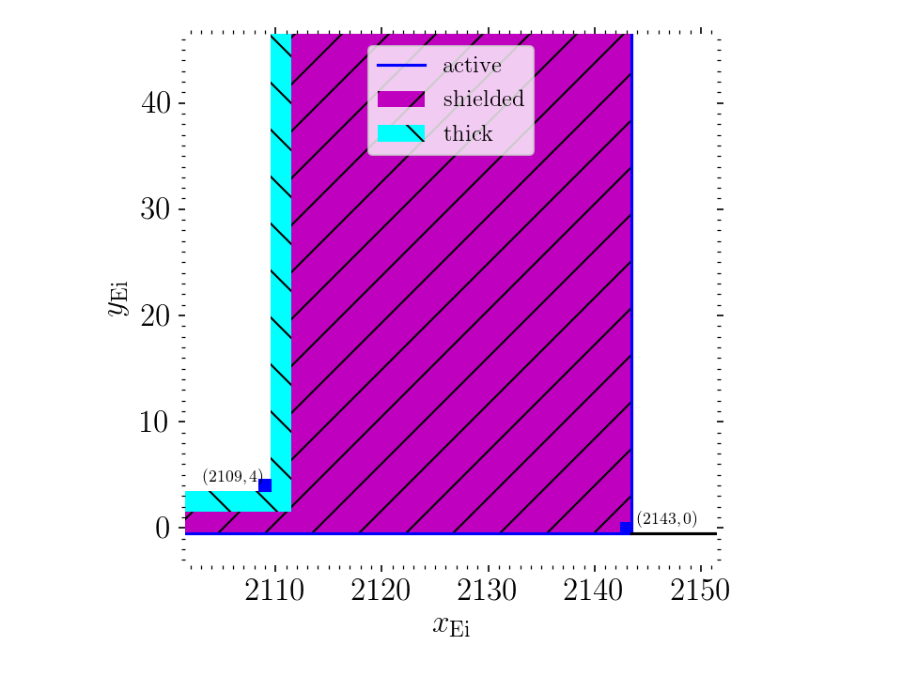
corners
“last” usable
Pixels are at x=1088-2109, y=4-1036
This makes center of usable area (1598.5, 520)
Assumes we don’t use thick Si
Assumes nominal locations (quoted +/- 10 um)

