Slide 1
Roman grism line-grid simulation package
Wave 1b — emission-line point sources with exact truth tables, for line-by-line validation of grism dispersion and extraction
DRAFT · 2026-07-24
roman_disperser · branch feature/optical-model-line-test · commit eee413e

Slide 2
Where the data is
Run store (Roman AWS cluster; readable from head and compute nodes):
/mnt/roman-science/grs/line-tests-20260724/
├── catalog_lines/ 408K input catalog: positions + line SEDs + line list
├── lines_stpsf/ 4.5G simulations, real (STPSF) PSFs — one dir per PA
├── lines_gauss/ 4.5G simulations, Gaussian-control PSFs — same layout
├── lines_stpsf_l2/ 7.3G romanisim L2 ASDF products for lines_stpsf
├── lines_gauss_l2/ 7.3G same for lines_gauss
├── scripts/ 36K verbatim campaign drivers + configs + pointings
├── slurm-meta/ 148K per-job audit: task script + environment record
└── logs/ 2.5M per-file romanisim wrap logs
Pointing directories are named pointing_{pa000,pa010}_001.001.001.001.001.001 (suffix = APT plan.pass.segment.observation.visit.exposure).
Code: roman_disperser repo, branch feature/optical-model-line-test (PR #17).

Slide 3
What was simulated — sources and spectra
15,112 point sources: every star with F158 ≤ 20 in the parent reference catalog.
All stars carry the same spectrum: five Gaussian emission lines on a flat continuum that is then removed — the images contain lines only.
Continuum anchor: mag 16.3072 in F158 (flux_scale = 3.0000e-7 maggies); line amplitudes are defined relative to that (removed) continuum.
line_id | λ [Å, vacuum] | FWHM [Å] | amp / continuum | line flux [erg s⁻¹ cm⁻²] | detected e⁻ (+1 order, 190.22 s)
0 | 11000 | 10 | 5.00 | 1.44e-14 | 22,600
1 | 12500 | 10 | 6.25 | 1.39e-14 | 32,000
2 | 15500 | 10 | 7.50 | 1.09e-14 | 27,500
3 | 17000 | 10 | 8.75 | 1.05e-14 | 24,800
4 | 19000 | 10 | 10.00 | 9.63e-15 | 19,300
Detected e⁻ = 33×33 px aperture sum on the noise-free image × exposure time.

Slide 4
What was simulated — run matrix and observation
Four runs = {STPSF PSFs, Gaussian PSFs} × {PA 0°, PA 10°}, all 18 SCAs each:
STPSF: real chromatic, field-dependent, asymmetric PSFs (4×4 spatial grid × 56 wavelengths per SCA, 4× oversampled)
Gaussian: centred symmetric Gaussians (FWHM 2.5 px) in the same cache format — a PSF-shape control with identical geometry
PA 10°: the same pointing rolled by 10° — a sky-orientation control
One pointing: RA 10.0°, Dec 0.0°, exposure 190.22 s, MA table 1036 (GRISM, 190.22287 s).
Spectral orders 0, +1, +2 are dispersed for every source.
All randomness is seeded (config seed 42); per-SCA RNG keys are recorded in the FITS headers and meta files.

Slide 5
What was simulated — pipeline
1. Simulate. JAX-based disperser renders all sources, orders and SCAs.
Output per SCA: FITS with a noise-free MODEL extension (counts/s) and a Poisson-sampled ISIM extension (counts at 190.22 s).
2. Wrap. romanisim converts each MODEL/ISIM to a Roman L2 ASDF (ramp simulation with MA table 1036, then ramp fit).
Output per SCA: *_l2.asdf with data / err / dq (DN/s), 11 resultants, effective exposure 190.22287 s.
3. Measure + truth. Every first-order (star, line) position is predicted by the optical model and measured on the noise-free MODEL image; independently, float64 truth positions are tabulated for all orders.
Output per pointing: residuals.parquet (closure measurement) and truth_lines.parquet (shipped truth table).

Slide 6
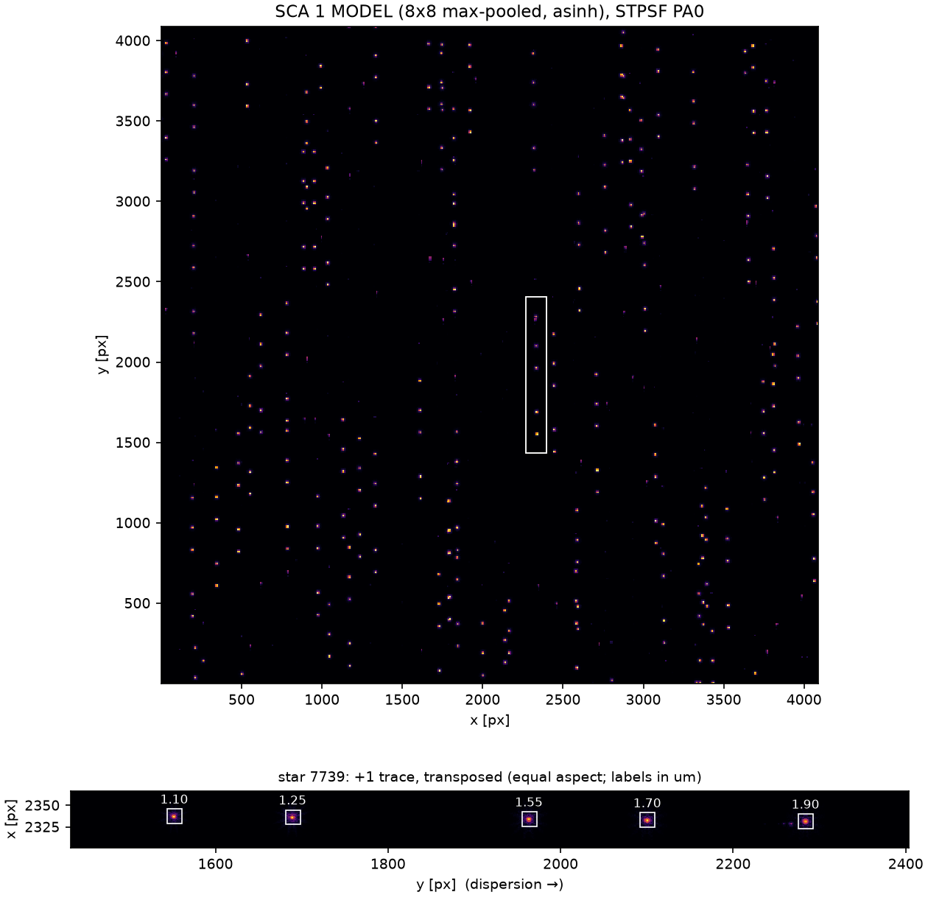
Simulated image (SCA 1, STPSF, PA 0)
Noise-free MODEL image. Top: full SCA (8×8 max-pooled for display). Bottom: one star's +1-order trace, transposed to equal aspect — five isolated emission-line spots with their 17×17 px measurement boxes.

Slide 7
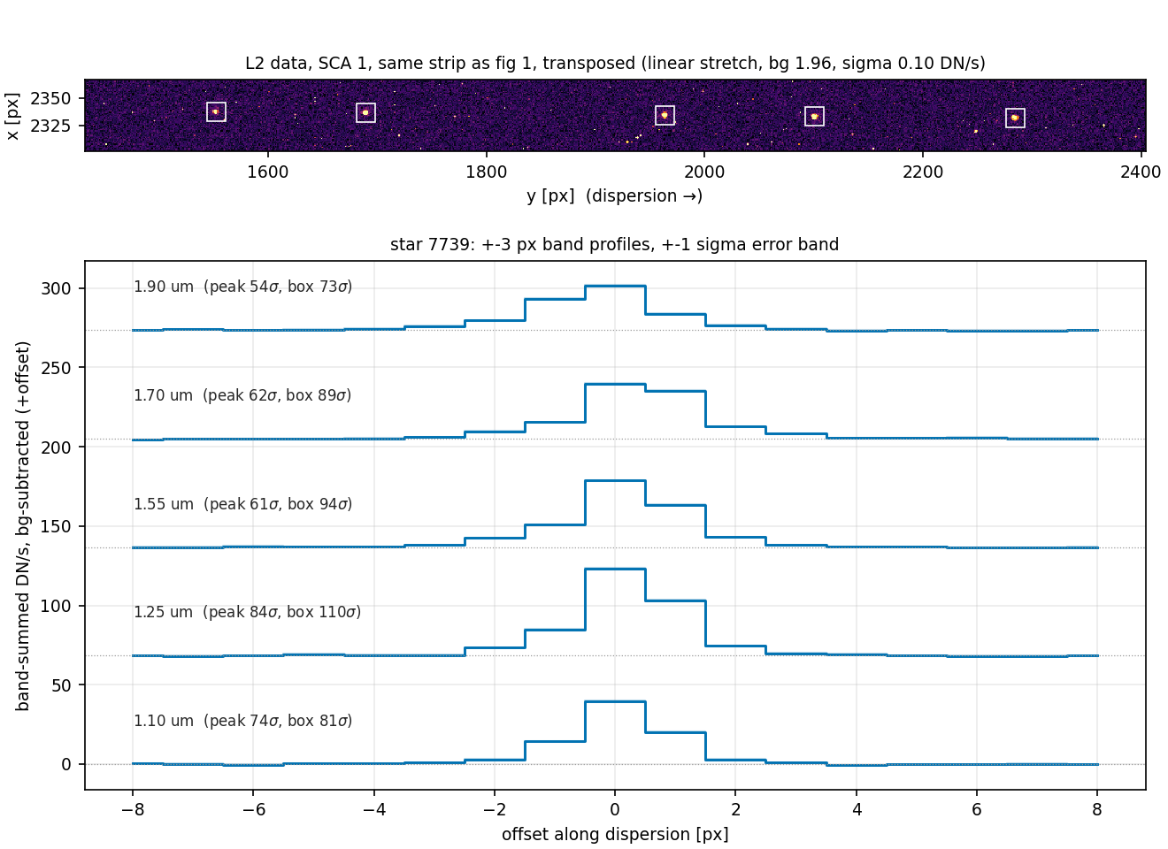
L2 product and noise (same strip)
L2 data for the same strip (background 1.96 DN/s, robust σ 0.105 DN/s). Per-line peak SNR 54–84, box SNR 73–110; median peak SNR over all 322 measured boxes on SCA 1 is 66.

Slide 8
Line-position measurement
For every first-order (star, line) pair, on the noise-free MODEL image:
Predict the line's detector position with the optical model (two independent implementations; they agree to ≤ 0.005 px).
Cut a 17×17 px box at the prediction; drop the pair if the box is not fully on-detector (this is the only cut).
Collapse a ±3 px band across dispersion; fit and subtract a linear baseline to the off-line pixels (|Δ| > 4 px).
Measure the flux-weighted centroid within ±4 px of the prediction.
Residuals d_disp / d_cross are measured − predicted, projected on the local dispersion / cross-dispersion directions, in native pixels.
Convention: a “measured position” is a flux-weighted centroid. For the STPSF PSFs this differs from the PSF peak by up to ~0.08 px, and depends on the window (±4 px is core-weighted; wing-weighted apertures move per-SCA offsets by up to ~30%).

Slide 9
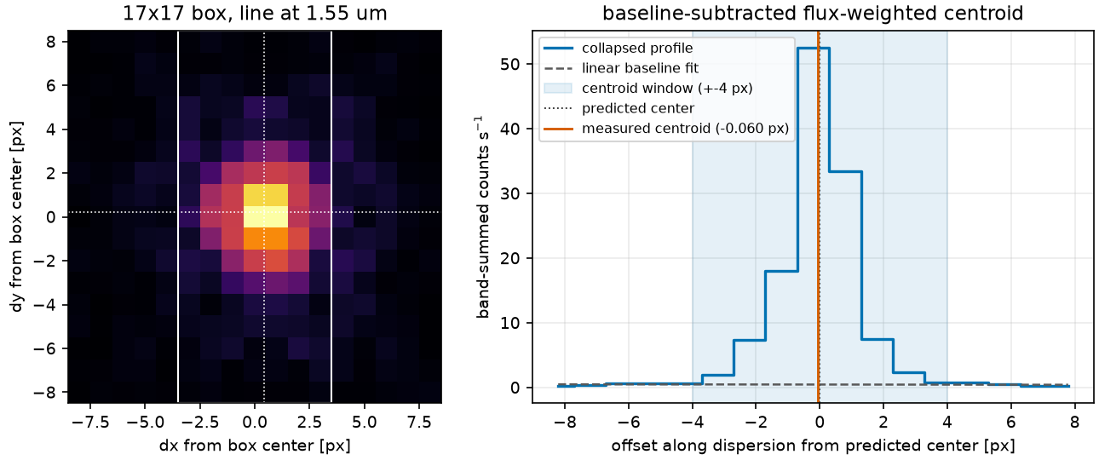
The estimator on one line
One 17×17 box (1.55 µm line, SCA 1): the ±3 px collapse band, the band-summed profile, linear baseline, ±4 px centroid window, and measured centroid vs prediction.

Slide 10
Results — summary
Statistics over all finite-centroid first-order boxes (MAD = unscaled median absolute deviation):
run | boxes (measured/total) | d_disp median [px] | d_disp MAD [px] | d_cross median [px] | optical-model implementations agree to [px]
stpsf pa000 | 5290 / 8575 | −0.015 | 0.041 | +0.024 | 0.0040
stpsf pa010 | 5266 / 8465 | −0.017 | 0.040 | +0.025 | 0.0053
gauss pa000 | 5290 / 8575 | +0.000 | 0.010 | −0.001 | 0.0040
gauss pa010 | 5266 / 8465 | −0.000 | 0.010 | −0.001 | 0.0053
Unmeasured boxes are all geometric edge drops (17×17 box not fully on-detector); none are dropped for lack of flux.
Every per-SCA median agrees with the 1× wave-1 run to < 1e-5 px, and with the 2026-07-03 validation run to ≤ 0.0036 px.

Slide 11
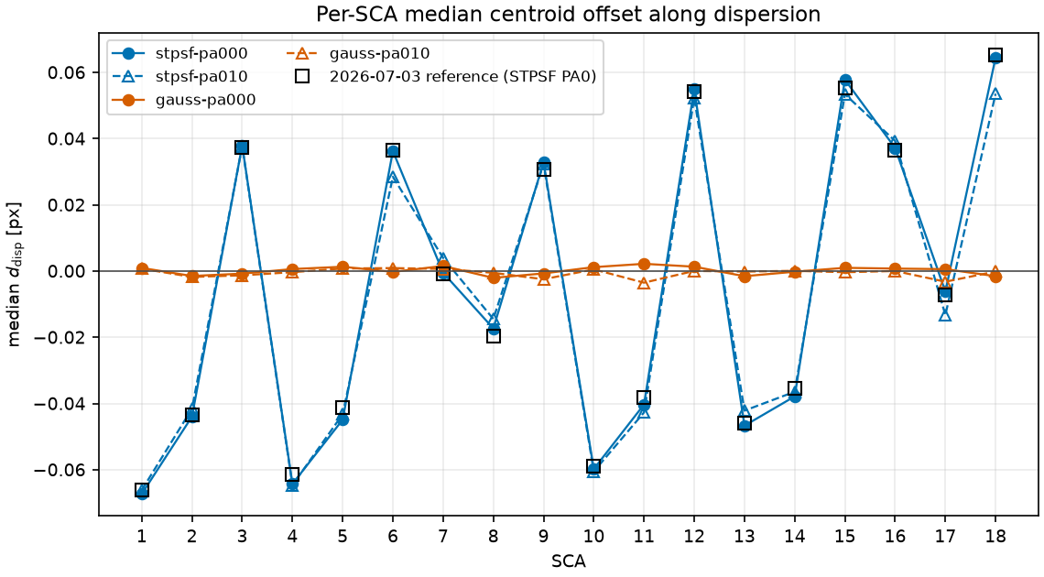
Results — per-SCA median offset
Median d_disp per SCA for the four runs, with the 2026-07-03 reference overlaid. STPSF runs show a fixed per-SCA pattern up to ±0.065 px, the same at both PAs; Gaussian-control runs are consistent with zero on every SCA.

Slide 12
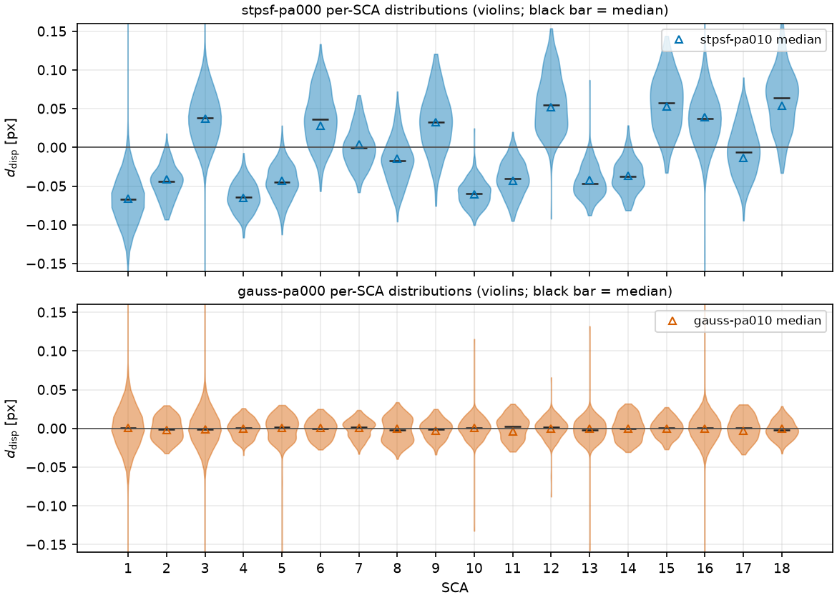
Results — per-SCA distributions
d_disp distributions per SCA (PA 0 runs; PA 10 medians as open triangles). Per-SCA MADs: 0.011–0.028 px (STPSF), 0.008–0.014 px (Gaussian).

Slide 13
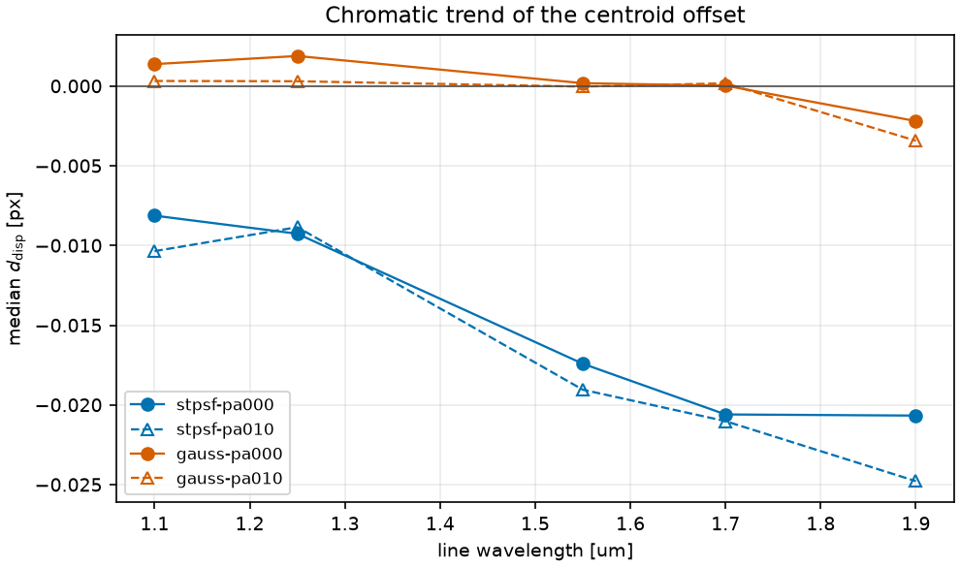
Results — offset vs wavelength
Median d_disp per line, pooled over SCAs (opposite-sign SCAs partially cancel). STPSF runs trend from −0.008 px at 1.10 µm to −0.021 px at 1.90 µm; Gaussian runs are flat within ±0.003 px.

Slide 14
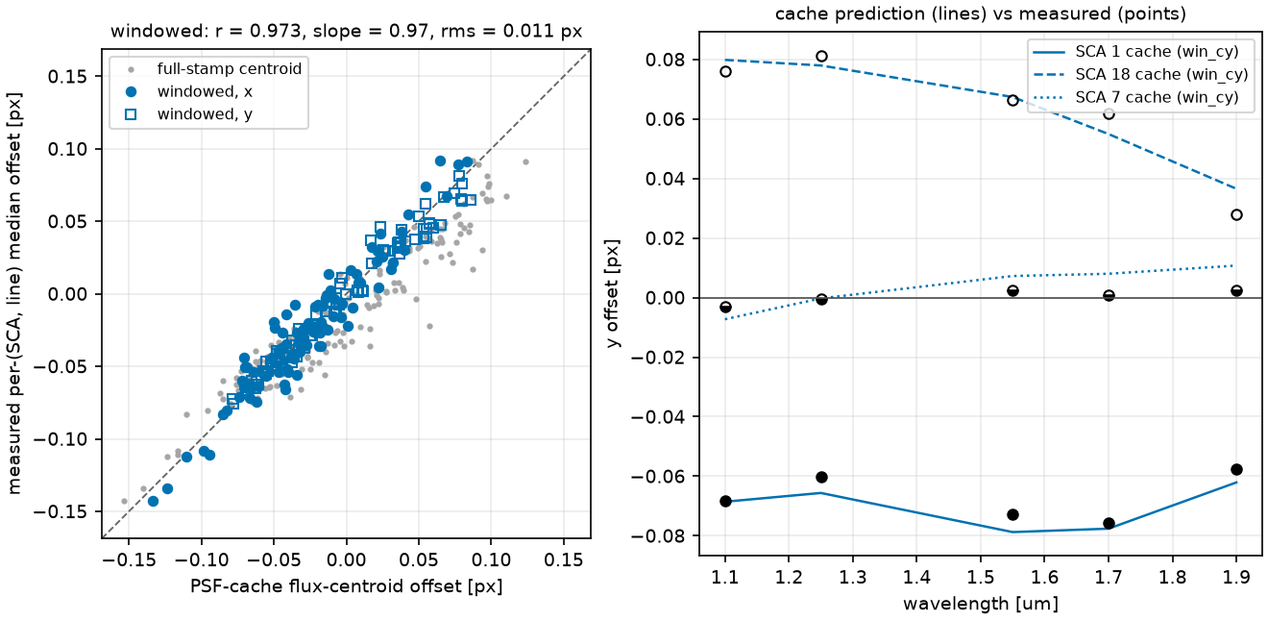
Results — comparison with PSF flux centroids
Measured per-(SCA, line) median offsets vs flux-weighted centroids computed directly from the PSF cache stamps with the same band/baseline/window procedure: r = 0.973, slope 0.97, rms 0.011 px. The Gaussian-cache centroids are zero to machine precision.

Slide 15
File guide — per-pointing contents
Inside each pointing directory (lines_{stpsf,gauss}/pointing_*/):
grism_*_detSCA{NN}.fits per-SCA image: MODEL (counts/s) + ISIM (counts)
grism_*_detSCA{NN}.png quicklook PNG per SCA (+ one focal-plane mosaic)
grism_*_sources.parquet manifest of every (source, SCA, order) rendered
grism_*_meta.yaml pointing, exposure, RNG keys, batching, git SHA
residuals.parquet measured vs predicted line positions (+1 order)
truth_lines.parquet float64 truth positions, all orders and lines
truth_lines_provenance.json writer script, commit, inputs, row counts
L2 trees (lines_*_l2/pointing_*/) hold one *_detSCA{NN}_l2.asdf per SCA.
catalog_lines/ holds the shared input catalog (next slides).
The following slides give the columns of each tabular file.

Slide 16
File: catalog_lines/metadata.parquet
One row per source (15,112 rows) — the simulation input catalog.
column | type | units | meaning
ra, dec | float64 | deg | source position (ICRS)
type | str | — | "PSF" for all rows (point sources)
n, half_light_radius, pa, ba | float32 | mixed | Sérsic morphology; trivial (0/0/0/1) for stars
F158 | float32 | maggies | apparent F158 flux, linear AB units; 3.0e-7 (mag 16.31) for every star
z_obs, z_cosmo | float32 | — | redshifts; 0 for stars
sed_index | int32 | — | row index into seds.zarr/star_seds
flux_scale | float32 | maggies | SED multiplier applied at dispersal; equals F158 for stars
sim | int16 | — | SED-storage partition; 0 for stars
src_index | int32 | — | row in the parent reference catalog — cross-run provenance key

Slide 17
Files: catalog_lines/seds.zarr and lines.ecsv
seds.zarr — the line-only SED, f_λ (FLAM) on a vacuum-wavelength grid 9000–21000 Å in 2 Å steps (6001 samples); one shared template, referenced by sed_index. Scale by flux_scale for physical flux.
lines.ecsv — the injected line list:
column | units | meaning
line_id | — | 0–4, blue to red; key used by residuals and truth tables
center_A | Å (vacuum) | 11000 / 12500 / 15500 / 17000 / 19000
fwhm_A | Å | 10.0 for all lines
amp_rel | — | line peak / local continuum at SED level: 5.0–10.0 (the continuum itself was removed; no_continuum = true)
provenance.json records the builder inputs: parent catalog, mag limit, continuum mag, line parameters, wavelength grid, build timestamp.

Slide 18
File: grism_*_detSCA{NN}.fits
extension | content
0 PRIMARY | header only (metadata below)
1 MODEL | noise-free count-rate image, counts/s, float32, 4088×4088
2 ISIM | Poisson-sampled counts at 190.22 s, float32, 4088×4088
Primary-header keywords:
keyword | meaning
WFICENRA / WFICENDEC / WFICENPA | pointing RA, Dec, PA [deg]
DETNUM | SCA number 1–18
EXPTIME | exposure time [s]
MA_TABLE | MA table number (1036)
SEED / RNDSEED0 / RNDSEED1 | top seed + per-SCA JAX RNG key words
GITSHA | pipeline git commit
PLAN, PASS, SEGMENT, OBS, VISIT, EXPOSURE | APT identifiers

Slide 19
File: grism_*_sources.parquet
The dispersal manifest: one row per (source, SCA, order) actually rendered.
column | type | meaning
catalog_index | int64 | row index into this run's catalog_lines/metadata.parquet
sca | int64 | SCA number 1–18
order | str | spectral order: "0", "1", or "2"
type | str | "PSF" (all rows)
xsca, ysca | float64 | undispersed source position on this SCA [1-indexed FITS px]
ra, dec | float64 | source position [deg]
flux_scale | float64 | SED multiplier applied at dispersal
F158 | float64 | F158 flux [maggies]; same on every row of a source

Slide 20
File: residuals.parquet
The closure measurement: one row per first-order (star, line) box — 8575 (PA 0) / 8465 (PA 10) rows.
column | type | meaning
sca | int64 | SCA number
catalog_index | int64 | source key (into catalog metadata)
xsca, ysca | float64 | undispersed position [1-indexed FITS px]
line_id, center_A | int64/float64 | which line (see lines.ecsv)
x_pred_jax, y_pred_jax | float32 | JAX optical-model prediction [px]; float32 path, ULP ~1e-3 px
x_pred_class, y_pred_class | float64 | reference-implementation prediction [px]
x_meas, y_meas | float64 | measured centroid [px]; NaN if box off-detector
dx, dy | float32 | x_meas − x_pred_jax, y_meas − y_pred_jax [px]
d_disp, d_cross | float64 | residual on local dispersion / cross-dispersion axes [px] — the science columns

Slide 21
File: truth_lines.parquet
The shipped truth table: one row per (source, SCA, order, line), orders 0/1/2 — 25,680 rows; positions evaluated in float64.
column | type | meaning
src_index | int32 | row in the parent reference catalog — cross-run provenance key
catalog_index | int64 | row in this run's catalog metadata
ra, dec | float64 | source position [deg]
sca | int16 | SCA number
order | str | "0", "1", "2"
xsca, ysca | float64 | undispersed position [1-indexed FITS px]
line_id, center_A | int64/float64 | which line [Å, vacuum]
fwhm_A, amp_rel | float64 | line width and relative amplitude
x_pred, y_pred | float64 | predicted dispersed line position [1-indexed FITS px]
on_detector | bool | prediction point inside [0.5, 4088.5]² (weaker than the residuals' box-fully-on-detector cut)

Slide 22
Files: L2 ASDF, meta YAML, audit records
*_detSCA{NN}_l2.asdf — romanisim L2 product per SCA (202 MB): roman.data / err / dq and var arrays (DN/s), full Roman metadata tree; MA table 1036, 11 resultants, effective exposure 190.22287 s.
grism_*_meta.yaml — pointing, exposure, seed and per-SCA JAX RNG keys (reconstructable via jax.random.wrap_key_data), wavelength step, batching, per-SCA source counts by order, pipeline git SHA, APT identifiers.
scripts/ — verbatim copy, at submission time, of the campaign driver, configs, pointing tables and truth-table writer.
slurm-meta/ — per-job audit: the exact task script plus an .env record (job id, stage, partition, resources, config paths, git commits, timestamp).
logs/ — per-file romanisim wrap logs.

