Slide 1

Bangladesh Army University of Science and Technology
Project Proposal Report
Course Title: Software Development Project II Course Code: CSE 2200 Supervised By:
Md. Toukir Ahmed
Lecturer,
Dept. of Computer Science and Engineering,
Bangladesh Army University of Science & Technology (BAUST), Saidpur Cantonment, Saidpur, Nilphamari.
Submitted by:
Student Name: Mim Shahria Siharth
Roll: 180201107 Batch: 8th
Level: 2 Term: II
Sec and Group: B Sec, G2 Dept. of CSE, BAUST.
Date of submission: 29-11-2020

Slide 2
Proposed Project
Project Name
CASINO: The Number Guessing Game
Proposed Project
CASINO: The Number Guessing Game
1

Slide 3
Introduction:
This is a Number Guessing Game. Player deposits an initial amount to start playing the game. He guess a number between 1 to 10 & enters betting amount. If he wins he will get 10 times of money he bets. If he bets on wrong number , he will lost his betting amount. Game continues till user wants to play.
2
CASINO: The Number Guessing Game

Slide 4
Software Requirements:
Windows XP, 7 or 10.
Code Block.
C++ language.
3
CASINO: The Number Guessing Game

Slide 5
Working Method:
In this game, you have to guess a number & if the number is matched with the Winning Number or Random Number than you will win a lots of money. Here in the programming language you have a random number instead of Guess the number in real life. Let explanation our code step by step. First, you will take a Username & total amount of Money in deposit. Now player can play the game but before playing the game, player need to bid for every time.
4
CASINO: The Number Guessing Game

Slide 6
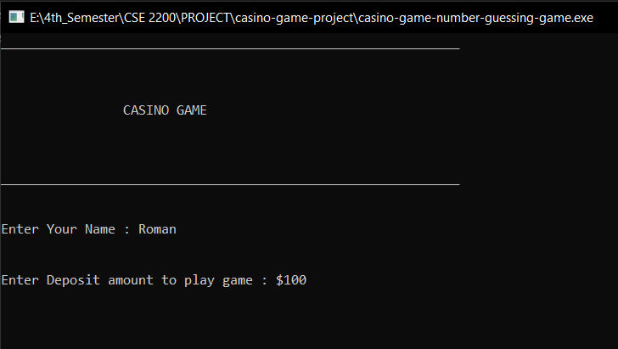
Output:
At first, you have to enter your name. Then you have to deposite your money to start the game.
5
CASINO: The Number Guessing Game

Slide 7
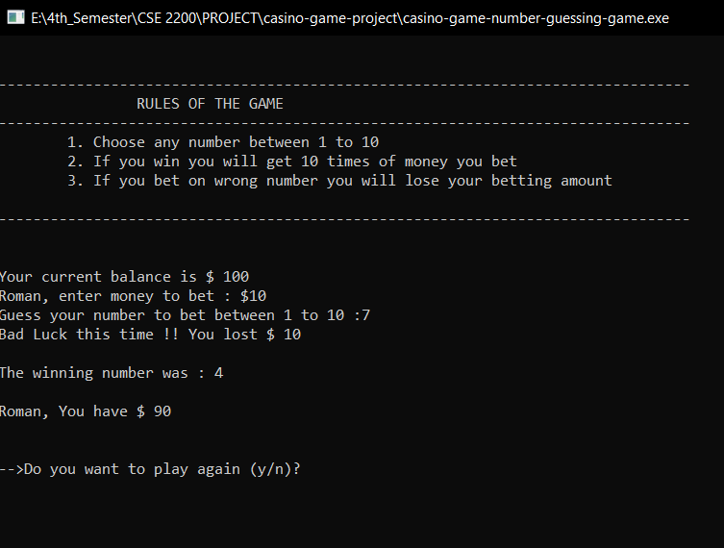
Output:
After that you have to enter your amount to bet. Then you have to guess a number between 1 to 10. If the number is wrong then you will lose your bet amount. If you want to play again then you have to type “ y “ to start the game.
6
CASINO: The Number Guessing Game

Slide 8
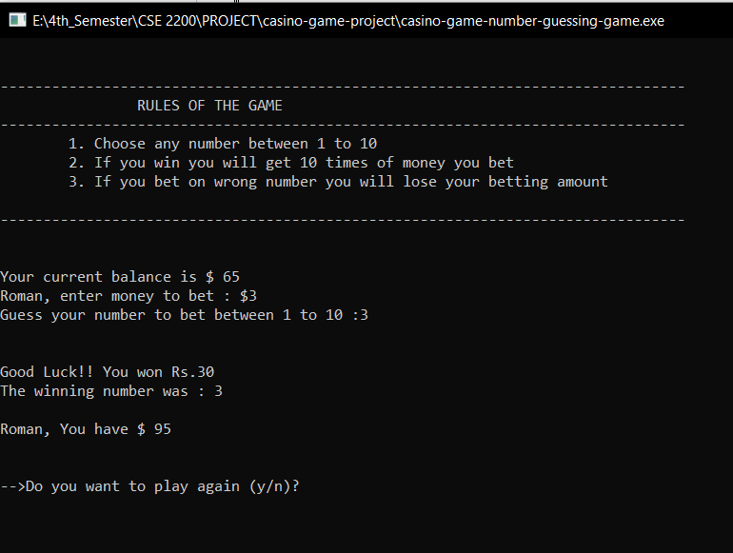
Output:
► If your guessing number is correct then you will win 10 times of your Bid amount.
7
CASINO: The Number Guessing Game

Slide 9
Link –
https://github.com/roman241/Casino-game-project

Slide 10


