Slide 1
Romana Networks
Cloud Native SDN

Slide 2
0.0.0.0 via Internet
10.0.0.0/10 via Leaf 1
10.64.0.0/10 via Leaf 2
10.128.0.0/10 via Leaf 3
10.192.0.0/10 via Leaf 4
0.0.0.0 via Internet
10.0.0.0/10 via Leaf 1
10.64.0.0/10 via Leaf 2
10.128.0.0/10 via Leaf 3
10.192.0.0/10 via Leaf 4
Spine 1
Spine 2
0.0.0.0 via Spine 1
10.0.0.0/16 via Port 1
10.1.0.0/16 via Port 2
10.2.0.0/16 via Port 3
10.3.0.0/16 via Port 4
…
10.63.0.0/16 via Port 64
0.0.0.0 via Spine 1
10.192.0.0/16 via Port 1
10.193.0.0/16 via Port 2
10.194.0.0/16 via Port 3
10.195.0.0/16 via Port 4
…
10.255.0.0/16 via Port 64
Leaf 1
Leaf 2
Leaf 3
Leaf 4
Port 8
Port 3
Host 8
10.7.16.34
0.0.0.0 via Leaf 1
Host
10.194.3.71
0.0.0.0 via Leaf 4
Spine splits full 10/8 CIDR across 4 Leaf devices (four /10 networks)
Leaf allocates /10 network across 64 ports assigning a /16 address block to each
Host on Leaf 1, Port 8 must get address within 10.7.0.0/16
Host on Leaf 4, Port 3 must get address within 10.194.0.0/16

Slide 3
Spine 1
0.0.0.0 via Internet
10.0.0.0/10 via Leaf 1
0.0.0.0 via Spine 1
10.6.0.0/16 via Port 7
10.7.0.0/16 via Port 8
10.8.0.0/16 via Port 9
Leaf gets full /10 network and allocates /16 to each Host
Host allocates /24 to up to 255 VMs
For Containers on VM get IP out of VM’s /24
Leaf 1
Romana
Host Agent
Host 7
Host 8
Host 9
0.0.0.0 via Leaf 1
G/W: 10.6.0.1/16
0.0.0.0 via Leaf 1
G/W: 10.7.0.1/16
0.0.0.0 via Leaf 1
G/W: 10.8.0.1/16
R7
R8
R9
10.6.1.1/24
10.6.255.1/24
10.7.1.1/24
10.7.255.1/24
10.8.1.1/24
10.8.255.1/24
VM 1
VM 2
VM 255
VM 1
VM 2
VM 255
VM 1
VM 2
VM 255
Kubernetes Pod IP: 10.6.1.18

Slide 4
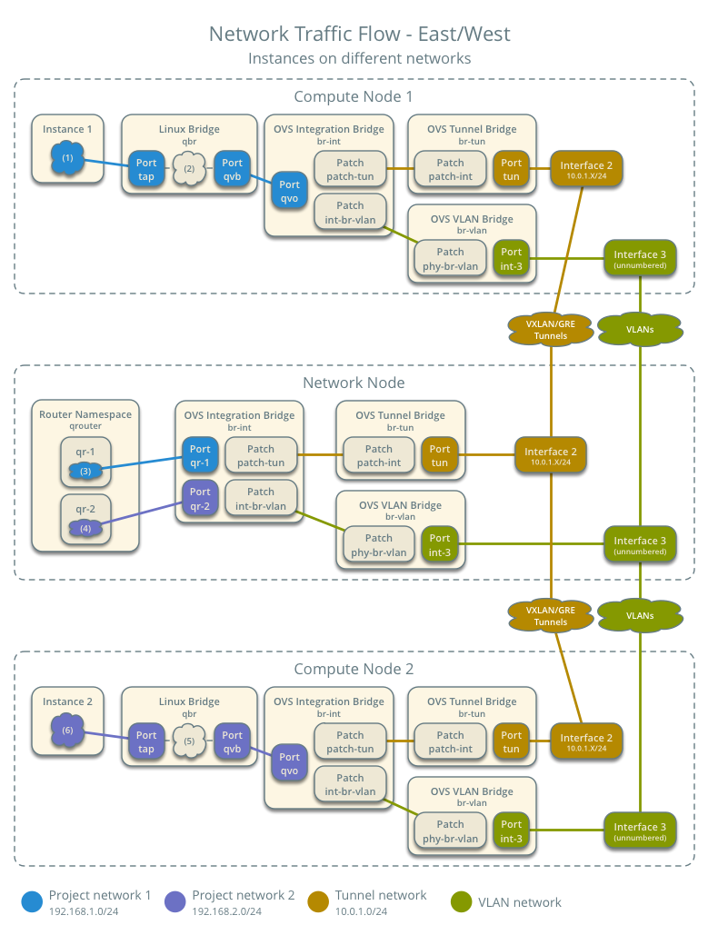
North/South Traffic
Bypassed
Latency dramatically reduced
No Network node
No encap
Identical path for East/West traffic
Host Routing
1 Top of Rack Round Trip
Eliminated
Per Network Security
Bypassed
Host Routing

Slide 5
192.168.0.10
192.168.0.10
10.1.0.1
GW
10.2.0.1
10.1.0.1
GW
10.2.0.1
10.1/16
10.2/16
10.1/16
10.2/16
Local Net
Local Net
Local Net
Local Net
10.1.0.1
10.1.0.1
10.1.0.1
10.2.0.1
10.1.1.129
10.1.0.1
10.1.0.1
10.2.0.1
10.1.1.2
10.1.2.2
10.1.1.129
10.2.1.3
10.1.1.2
10.1.2.2
10.1.1.129
10.2.1.3
S1
S2
F1
D1
S1
S2
F1
D1
Endpoint
Default Gateway IPs
Endpoint
Default Gateway IPs
Endpoint IPs
Endpoint IPs

Slide 6
Romana
CLI
Go
client
library
Neutron plugin
Python
client
library
Managers
Hypervisor Hosts
Root
Auth
IPAM
Topology
Routes
Tenant
Romana agent
Romana agent
Romana agent
Storage
Romana Agent
RDBMS
Key/Value store

Slide 7
Single Host L3 Service Insertion
Insert Service Function F1
Change S1 GW to F1 IP
SF IP has /25 ‘service bit’ set
S1 sends traffic to D1
S1 forwards to F1
F1 forwards to GW
GW forwards to D1
Works across Segments on same host
S1 sends traffic to D2
S1 forwards to F1
F1 forwards to GW
GW forwards to D2
Host 1
192.168.0.10
GW
10.1.0.1/16
IP Tables Rules
10.1.1.129
10.1.1.1
10.1.1.1
10.1.1.1
10.1.1.1
10.1.1.2
10.1.2.2
10.1.1.129
10.1.1.3
10.1.2.3
S1
S2
F1
D1
D2
Endpoint
Default Gateway IPs
Endpoint IPs
Key Point: Manipulating GW preserves destination IP in header

Slide 10
Route Aggregation
0.0.0.0 via Internet
10.0.0.0/9 via Leaf 1
10.128.0.0/9 via Leaf 2
R Spine
Simple example
8 Host bits
8 Segment bits
0.0.0.0 via Spine
10.1.0.0/16 via Node 1
10.2.0.0/16 via Node 2
10.3.0.0/16 via Node 3
Leaf gets full /9 network and allocates /16 to each Host
Romana IPAM assigns each Host an IP from /16
For Containers on Host, Host is allocated its own /24
Containers on VM get IP out of VM’s /24
R Leaf 1
Node 1
Node 2
Node 3
0.0.0.0 via Leaf 1
G/W: 10.1.0.1/16
0.0.0.0 via Leaf 1
G/W: 10.2.0.1/16
0.0.0.0 via Leaf 1
G/W: 10.3.0.1/16
R1
R2
R3
10.1.4.1/24
10.2.1.1/24
10.2.4.1/24
10.3.1.1/24
10.3.4.1/24
10.1.1.1/24
VM1
VM2
VM3
VM4
VM1
VM2
VM3
VM4
VM1
VM2
VM3
VM4
A1
B1
A2
C1
C2
B2
A3
C3
DNS
LB
FW
NAT
A1 POD IP: 10.1.1.18

Slide 11
L3 Tenancy Model
IPv6 Address
Tenant ID in IP address
IPv6 Preferred Deployment
IPv4 for Small/Typical Deployment Today
Contains tenant ID of source and destination
ACLs verified at both ends
Easily enforced by host at source or destination
Enables massive route aggregation
Static routing in physical infrastructure
Updating routes on host becomes familiar distributed app configuration management
Requirements:
Fully routed infrastructure
Intelligent IP address management (IPAM)
Route distribution
Integration with CMS (i.e. OpenStack, Kubernetes, etc.)
Prefix: Net Space/Location
IID: Host/Tenant ID
EUI-48 Expansion
Phys Host ID
FF-FE
Tenant, Segment, IID
0010
Host ID
Segment
RFC 1918 IPv4 Addresses
10/8 Offers Ample Room

Slide 12
Routed VXLANs
VXLAN Encap
Neutron Network node routes traffic between segments
Network node performs all L3 functions
East/West traffic encapsulated, but forwarded directly to destination host
2 Top of Rack
Round Trips
VXLAN Decap
Per Instance
Security
VXLAN Encap
In-Segment East/West
Traffic
VXLAN Decap

Slide 13
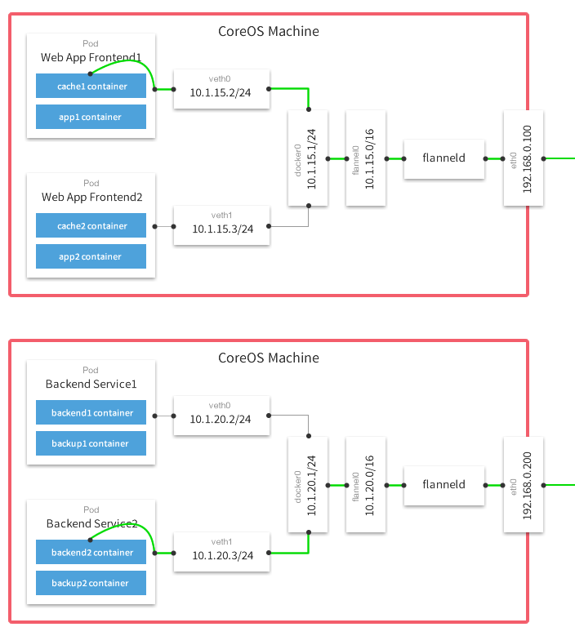
Kubernetes Pods Inside Instance
Host 1
Host 1
2nd Encap
Romana Router
Eliminated
Eliminated
VLAN (good)
or
VXLAN (2nd encap)
VLAN (good)
or
VXLAN (2nd encap?)
Instance 1
Instance 1
Tap Interface G/W to Pod IPs
Host 2
Host 2
Eliminated
Instance 2
Instance 2
Encap
Romana Router

Slide 14
 | North/South (Routed) |  | East/West (Switched)
Time (ms) | Local | Remote | Local | Remote
Native OpenStack | 1.51* | 1.51 | 0.24 | 0.85
Romana Networks | 0.24 | 0.77 | 0.24** | 0.77**
Relative Performance | Local | Remote | Local | Remote
Native OpenStack | 100% | 100% | 100% | 100%
Romana Networks | 16% | 51% | 100% | 90%
* All N/S OpenStack traffic
goes off host
** All Romana traffic is routed
North/South Latency reduced 50%-85%
10% improvement for East/West traffic between hosts (no encap)
No performance penalty for local on-host East/West traffic

