Slide 1
PhishGuard AI
AI-Powered Phishing URL Detection System
Presented by: Shaheer Siddiqui & Roman Adnan

Slide 2
The Problem & Solution
Why PhishGuard AI is needed to counter modern phishing threats
The Rising Threat Profile:
• Over 1.2 million monthly phishing attacks launched globally.
• Obfuscated URLs and perfect visual mimicry fool average users.
• Static blocklists suffer from high update latency.
• Phishing sites often disappear within 4 hours, rendering post-incident updates obsolete.
PhishGuard AI Solution:
• Multi-Layered Defense: Combines Machine Learning classifiers with protocol checkers.
• Pre-flight Checker: Verifies DNS and HTTP reachability instantly.
• Smart Whitelist: Subdomain-aware matching for verified root domains.
• Refined Scoring: Heuristic adjustments modify ML outputs using real SSL/TLS attributes.

Slide 3
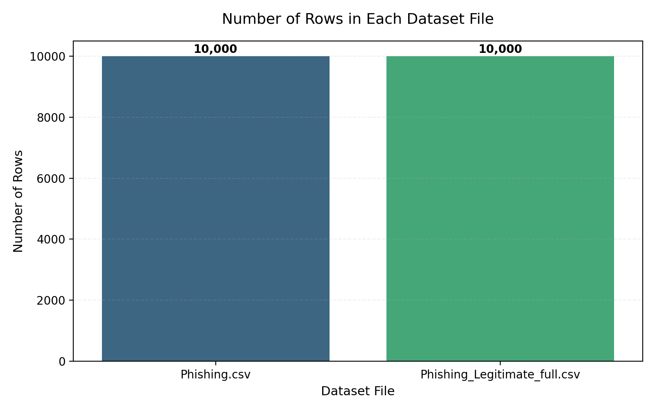
Dataset Details
Overview of the phishing detection dataset
Dataset Characteristics:
• Dataset Source: Research corpus of phishing and legitimate domains.
• Volume: 10,000 unique records.
• Class Balance: Perfect 50/50 split (5,000 legitimate, 5,000 phishing).
• Balanced datasets prevent classifiers from showing bias toward the majority class.
• Features: 50+ numeric signals extracted from URLs and web structures.

Slide 4
Preprocessing & Feature Engineering Pipeline
Clean data ingestion pipeline used for model training
1. ID Column Removal
Drops sequential database IDs to ensure decision trees do not overfit on indexing values.
2. Missing Value Resolution
Applies fillna(0) to mark absent optional variables (e.g. queries, sensitive words) safely.
3. Dropping Redundant / Unbalanced Columns
Removes columns with zero variance or threshold labels that cause data leakage.
4. StandardScaler Normalization
Scales features to zero-mean and unit-variance specifically for Logistic Regression model compatibility.

Slide 5
Model Comparison & Evaluation Metrics
Overall performance on the held-out 20% test set (2,000 samples)
Model | Accuracy | Precision | Recall | F1-Score | ROC-AUC
Random Forest | 98.40% | 98.23% | 98.62% | 98.42% | 99.83%
Logistic Regression | 93.55% | 93.33% | 93.97% | 93.65% | 97.93%
Key Observations:
• Random Forest dominates all criteria with 98.40% Accuracy and an outstanding 99.83% ROC-AUC.
• Logistic Regression provides competitive baseline metrics (93.55% Accuracy) while requiring normalized, scaled input data.
• GridSearchCV optimization correctly tuned forest depth and estimator size for peak output stability.

Slide 6
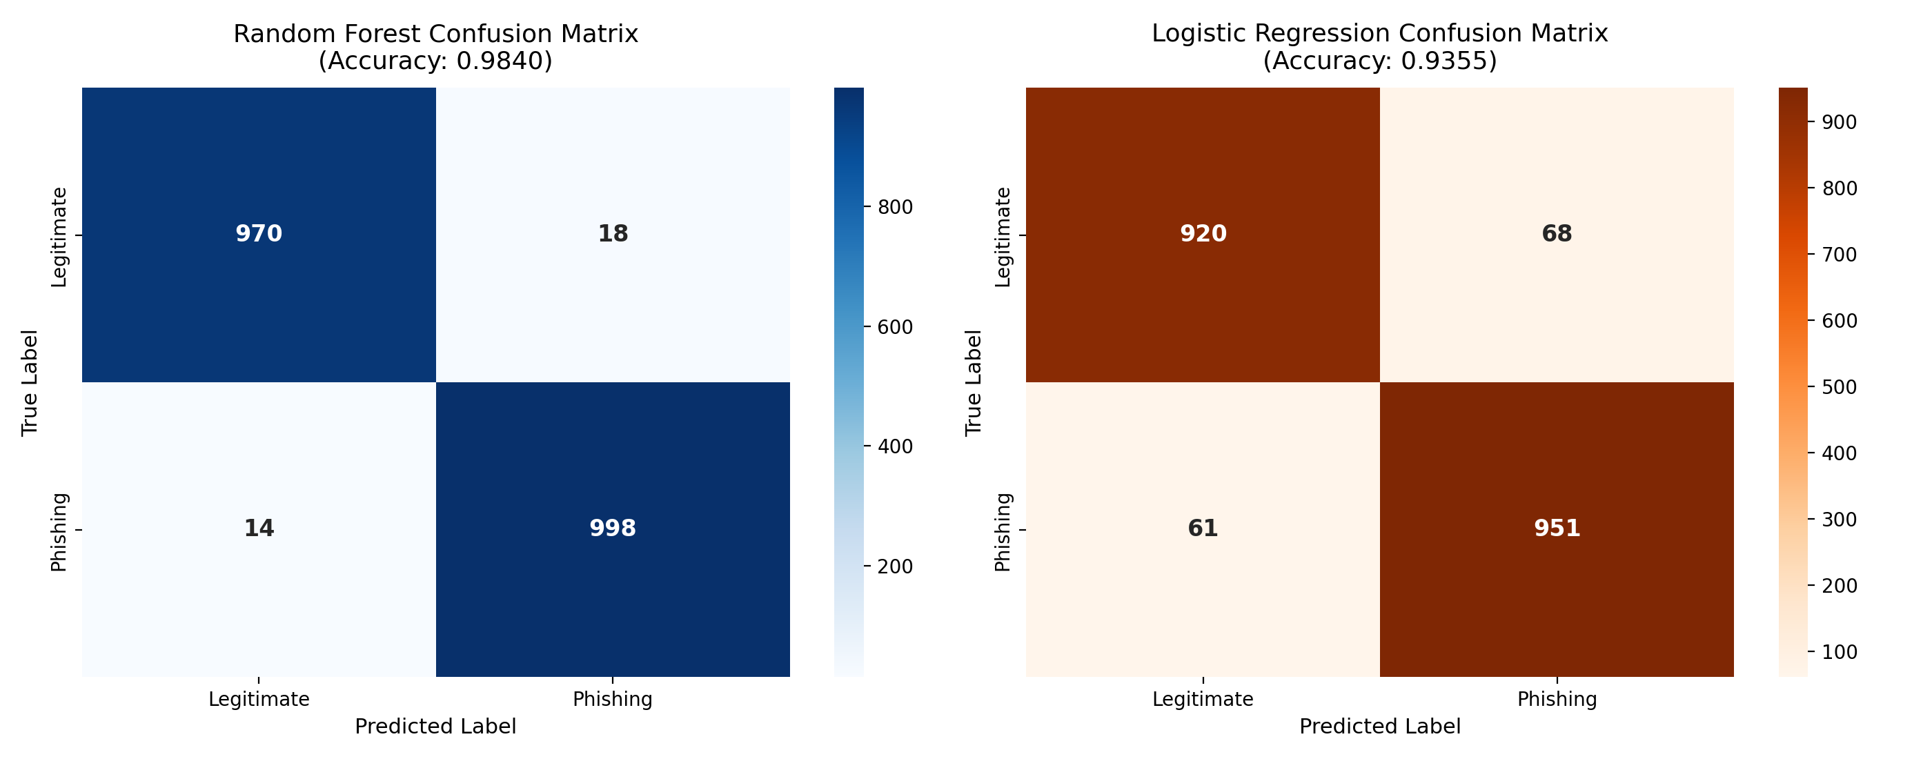
Model Evaluation: Confusion Matrix Comparison
Analyzing True/False Predictions on the Test Set
Error Breakdown Analysis:
• Confusion Matrix highlights classification errors (False Positives and False Negatives).
• Random Forest shows negligible errors (only 14 false negatives and 18 false positives out of 2,000 samples).
• Logistic Regression shows slightly higher dispersion, primarily due to linearly boundary limitations.
• Low False Negative rates are vital for cybersecurity models to avoid letting actual phishing URLs pass through unchecked.

Slide 7
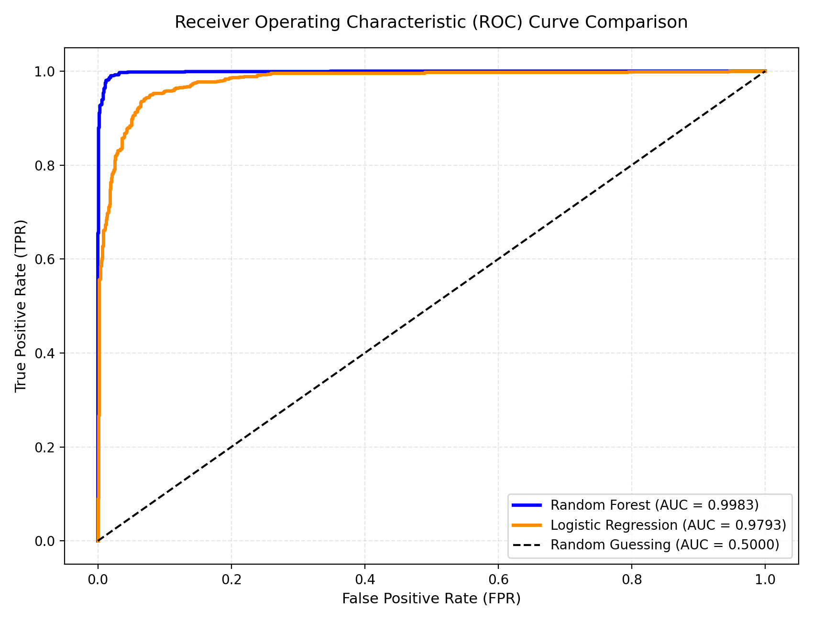
Model Evaluation: ROC Curve Comparison
Performance curve mapping True Positive vs. False Positive Rates
ROC-AUC Insights:
• ROC curve indicates classifier discriminative power.
• Random Forest reaches a near-perfect ROC-AUC score of 0.9983, maintaining top sensitivity at close to zero false-alarm rates.
• Logistic Regression shows a strong 0.9793 score, showing robust classification stability across different threshold bounds.

Slide 8
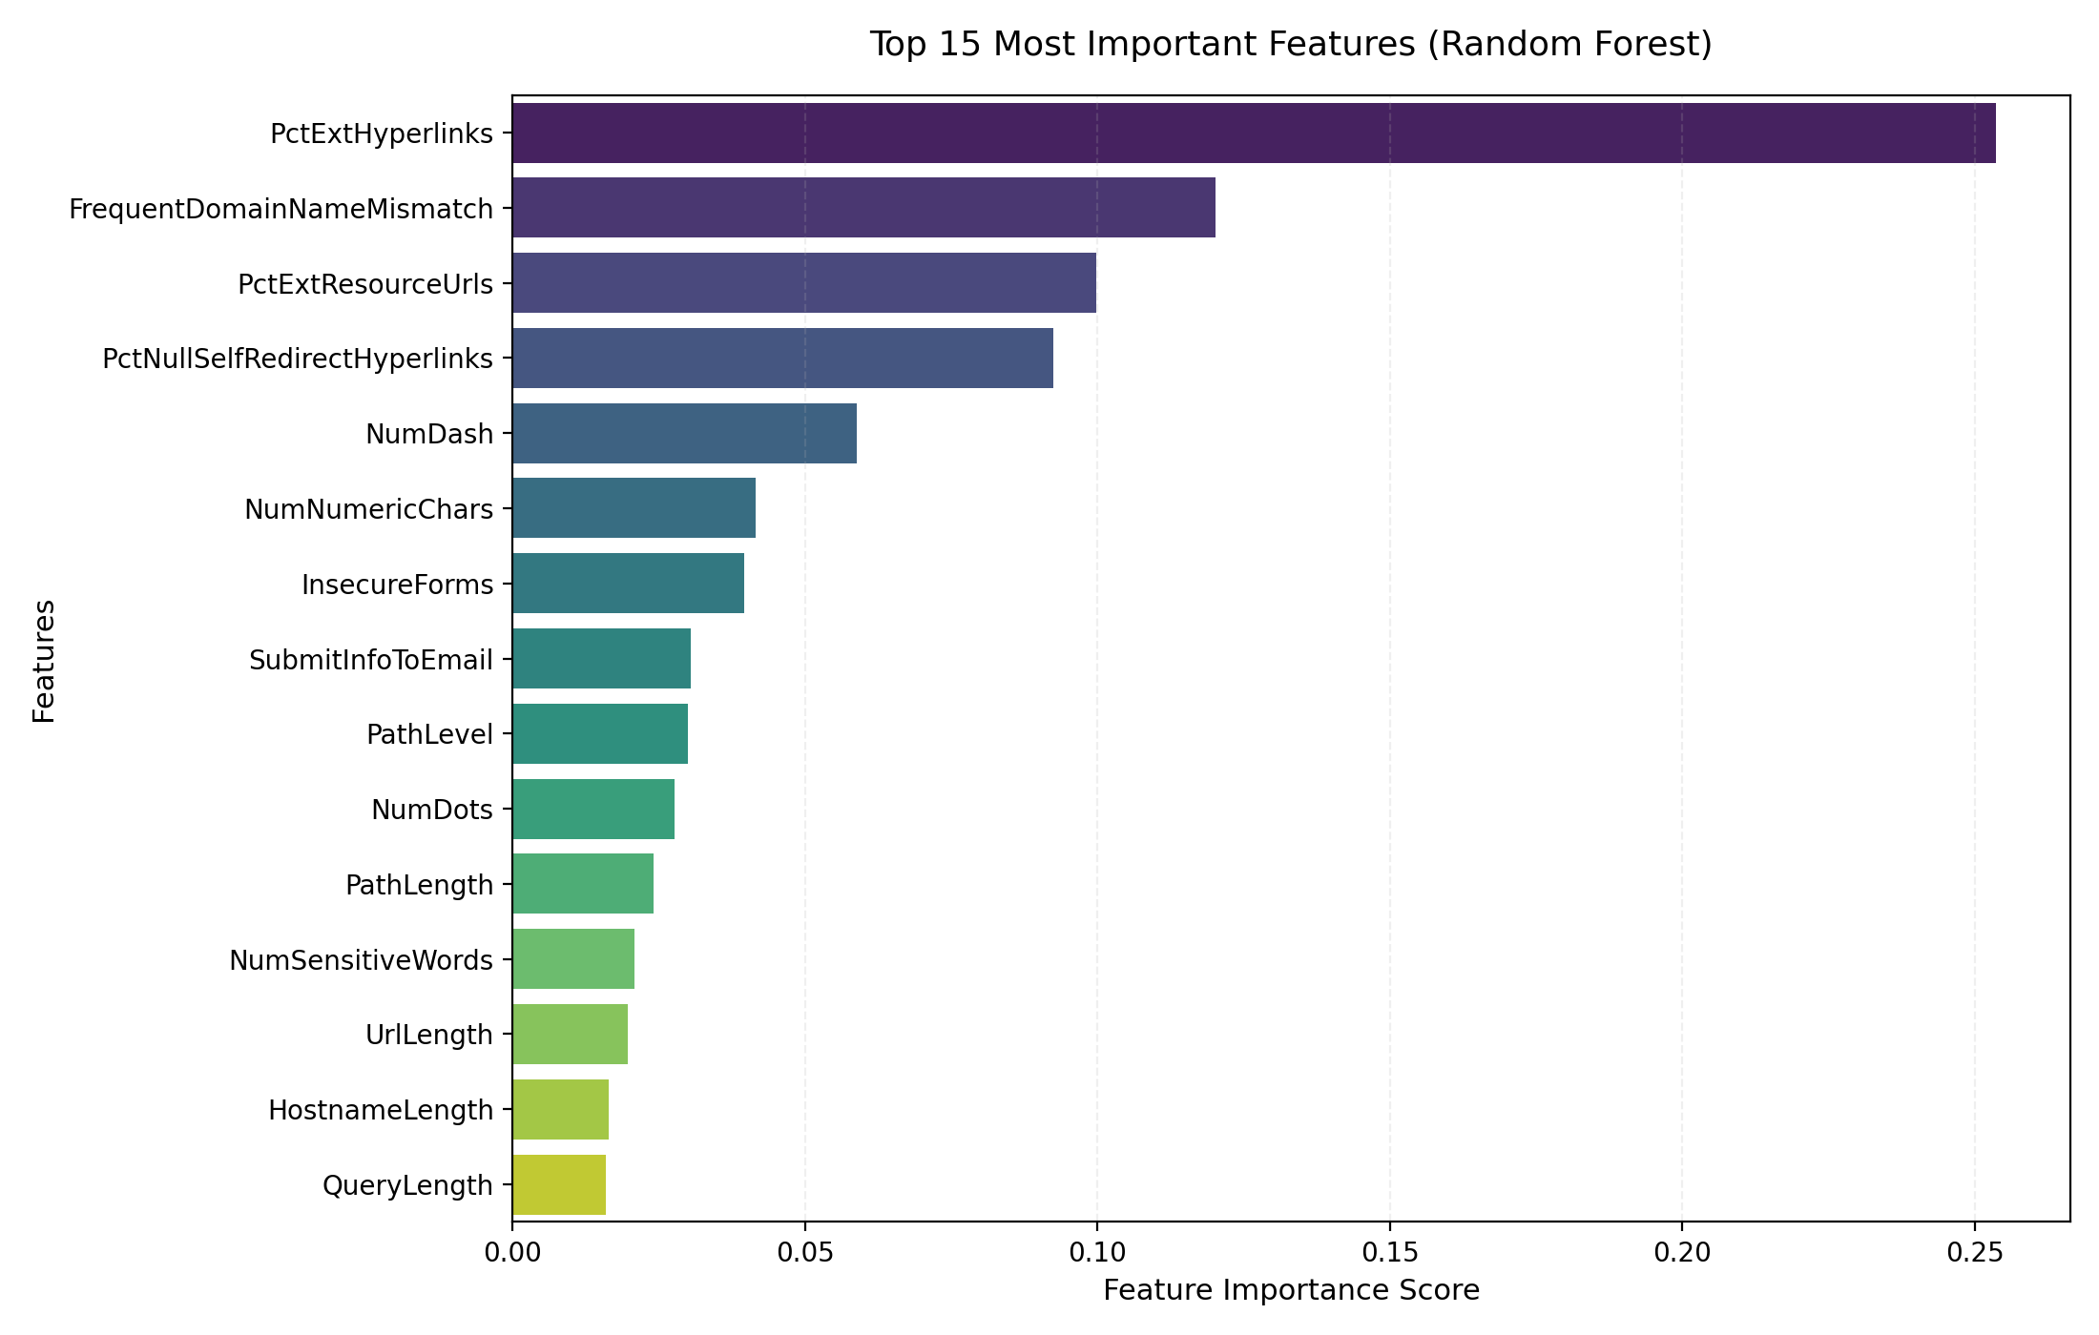
Feature Importance (Random Forest)
Top predictive indicators used by the ensemble trees
Dominant Threat Indicators:
• External hyperlink percentages (PctExtHyperlinks) score as the single most critical signal.
• FrequentDomainNameMismatch indicates spoofing attempts where target link domains do not match corporate identity metadata.
• Numeric counts and special characters in hostnames serve as strong secondary features.

Slide 9
Hybrid Security Pipeline & Score Adjuster Heuristics
Enhancing ML predictions with real-time protocol verification
Real-Time SSL/TLS Inspection:
• Verifies CA authority trust status and expiration ranges.
• Inspects Subject Alternative Names (SAN) mapping hostnames.
• Flags insecure protocol suites (TLS 1.0, TLS 1.1) with penalties.
• Performs HTTP-to-HTTPS redirect audits during existence pre-check.
Heuristic Scoring Rules:
• No SSL Certificate present: Adds 15% to ML Phishing score.
• Self-Signed Cert / Domain Mismatch: Adds 12% to 15% penalty.
• Valid SSL from Trusted CA: Grants a 5% safety bonus.
• Full Security Headers (HSTS, CSP, X-Frame): Grants a 5% bonus.
• Final probability score is clamped cleanly between 0.0 and 1.0.

Slide 10
Conclusion & Future Scope
Project accomplishments and future scalability goals
Key Accomplishments:
• Achieved 98.40% classification accuracy on test sets using optimized Random Forest models.
• Engineered a robust feature set mapping structural, statistical, and behavior-level URL signals.
• Pioneered a layered validator resolving DNS/HTTP existence and whitelists to save classifier resources.
• Integrated a real-time SSL/TLS socket inspector to check certificate integrity.
Future Roadmap:
• Client Browser Extension: Direct URL verification inside Chrome/Firefox extensions.
• Headless DOM Rendering: Use Playwright to capture elements loaded dynamically by JS.
• Online Active Retraining: Model fine-tuning using active feedback and telemetry reports.

Slide 11
Thank You!
Questions & Discussion
PhishGuard AI System

