Slide 1
Text Preprocessing

Slide 2
What is preprocessing
The transformations applied to data before feeding it to the algorithm.
The conversion of raw data into a clean usable data set.

Slide 3
What is text preprocessing
Transforming text into a numerical form, like word vectors and word count arrays
Why preprocess text
Computers are much better at interpreting and analyzing numbers

Slide 4
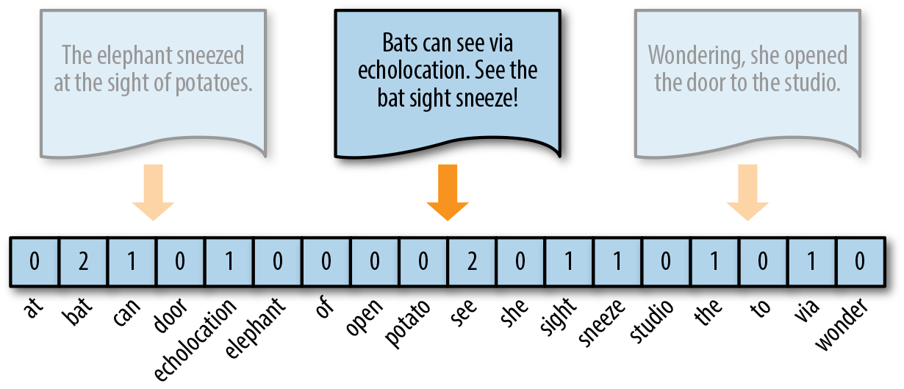

Slide 5
Tasks of text preprocessing
Tokenization
Removing punctuation
Lowercasing
Removing stopwords
Stemming (rooting words by removing inflection)
Lemmatization/POS tagging

Slide 6
Tokenization
The process of tokenizing or splitting a string (text) into a list of tokens (words)
Splitting by space, new lines and punctuation marks.

Slide 7
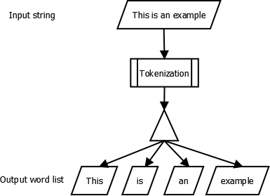

Slide 8
Tokenization
Some frequently used terms:
Corpus – Body of text, singular.
Corpora – plural of Corpus.
Lexicon – the list of words and vocabularies at use.
Token – Each “entity” that is a part of whatever was split up based on rules.

Slide 9
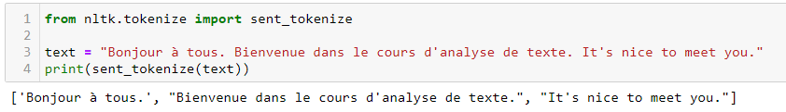
Tokenization
Types of tokenization
Text into Sentences

Slide 10
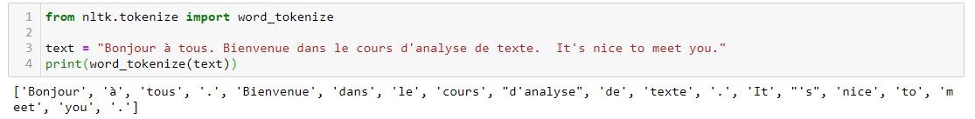
Tokenization
Types of tokenization
Sentence into Words

Slide 11
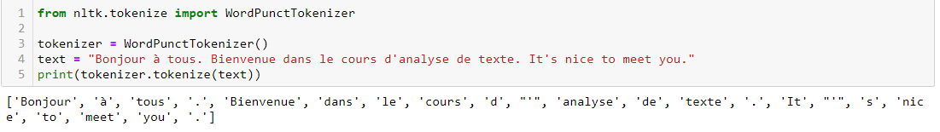
Tokenization
Types of tokenization
Sentence into Words with punctuations

Slide 12
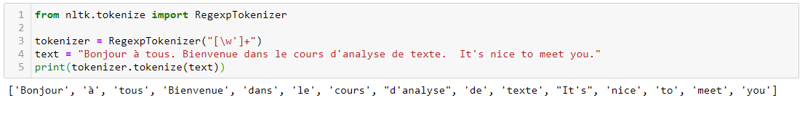
Tokenization
Types of tokenization
Regular Expression

Slide 13
Tokenization
Libraries to use
We’ll use NLTK
Others exist:
scikit learn (CountVectorizer)
Spacy (Tokenizer)
…

Slide 14
Removing punctuation
Punctuations have an importance in conveying meaning in a sentence:
I painted the wall, and you?
I painted the wall and you
Some approaches in machine learning take advantage of punctuations (like LSTM)

Slide 15
Removing punctuation
Bag-of-Words (bow) approaches don’t need punctuation.
On the contrary, punctuations obscure the meaning behind a sentence in a bow approach
We only need the individual tokens that hold meaning

Slide 16
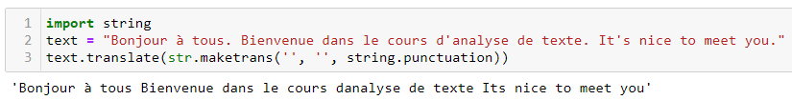
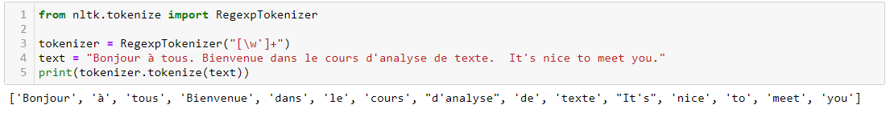
Removing punctuation
Methods
string.punctuation (python 3.*)
Regular expressions

Slide 17
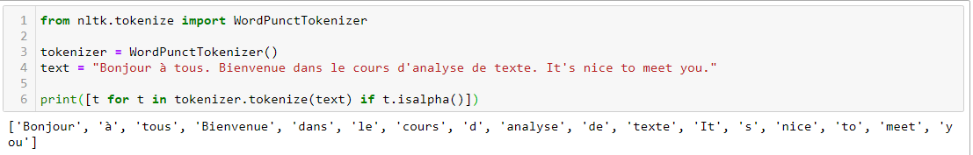
Removing punctuation
Methods
nltk Word Punctuation Tokenizer
And more…

Slide 18
Lowercasing
bow approaches are essentially count matrices.
One word repeated twice, but cased differently each time account for 2 different words
Play != play
Take the safe side and lowercase everything

Slide 19
Lowercasing
Simplest way is using str.lower()

Slide 20
Removing stop words
Stopwords are the most common words in any natural language.
Don’t add much meaning to the overall topic of a text
French: a, à, â, abord, afin
English: the, and, or, with …

Slide 21
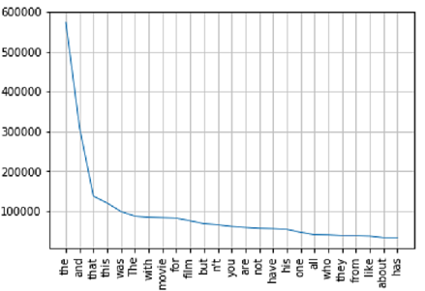
Removing stop words
Have high frequency
in text

Slide 22
Removing stopwords
Stopword removal is task dependent.
Bow approaches require removal, but not tasks like “Machine Translation” and “text Summarization”

Slide 23
Removing stopwords
We are in the library studying for the big exam
➔ library studying big exam

Slide 24
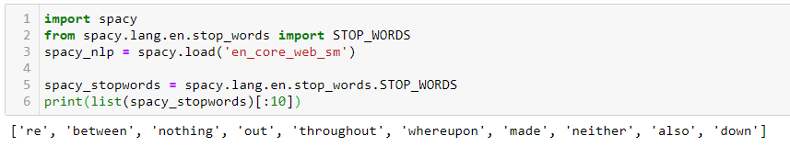
Removing stopwords
Libraries
nltk
SpaCy

Slide 25
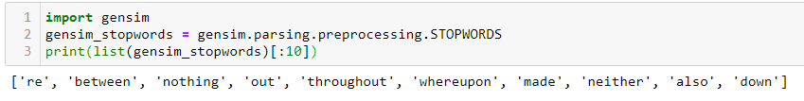
Removing stopwords
Libraries
gensim

Slide 26
Stemming
Stemming: reducing inflection in words to their root forms
organize, organizes, organizing, organization → organize
Why use stemming: makes it much easier to map texts to word-count dictionaries for text analysis in topics like: topic labeling, sentiment analysis, topic matching…

Slide 27
Stemming
OverStemming: words with different stems are stemmed to the same root
Universal, university, universe → univers
Understemming: words that should be stemmed to the same root are not.
alumnus, alumni, alumnae → should stem to alumna (student/pupil)

Slide 28
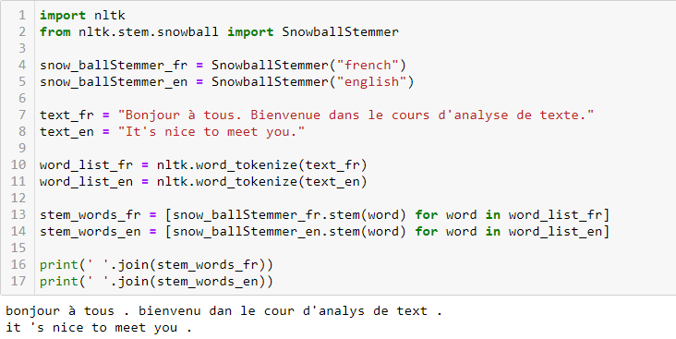
Stemming
Libraries
nltk Porter Stemmer: one of the most common and gentle stemmer, fast but not very precise.
nltk Snowball Stemmer: improved version of the porter stemmer.

Slide 29
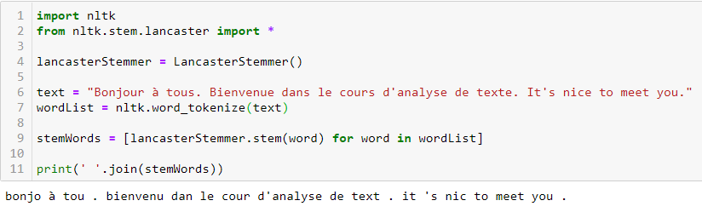
Stemming
Libraries
nltk Lancaster Stemmer: It is a very aggressive algorithm

Slide 30
Lemmatization/POS tagging
Lemmatization:
similar in concept to stemming, only takes words’ part of speech (POS) into consideration
Generally, better performance than stemming
Obviously, requires POS extraction of the text at hand before execution

Slide 31
Lemmatization/POS tagging
POS tagging:
Extracting the part-of-speech for tokens (words) in the text.
Needed for many nlp tasks, like named entity recognition (NER), building parse trees, lemmatization, …
POS tags are pre-defined
https://www.ling.upenn.edu/courses/Fall_2003/ling001/penn_treebank_pos.html

Slide 32
Lemmatization/POS tagging
Different techniques for POS Tagging:
Lexical Based Methods — Assigns the POS tag the most frequently occurring with a word in the training corpus.
Rule-Based Methods — Assigns POS tags based on rules (words ending with “ed” or “ing” must be assigned to a verb.)
Probabilistic Methods — assigning POS tags based on the probability of a particular tag sequence occurring.
Deep Learning Methods — Using recurrent Neural Networks.

Slide 33
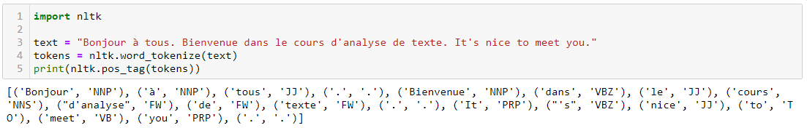
Lemmatization/POS tagging
Libraries:
nltk

Slide 34
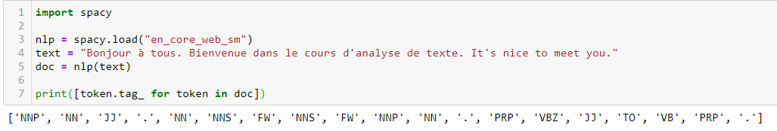
Lemmatization/POS tagging
Libraries :
spacy

Slide 35
Reminder: tasks of text preprocessing
Tokenization
Removing punctuation
Lowercasing
Removing stopwords
Stemming (rooting words by removing inflection)
Lemmatization/POS tagging

