Slide 1
Term Frequency – Inverse Document Frequency (TFI-DF)

Slide 2
Is a technique used in text mining to evaluate how important a word is to a document in a collection or corpus.
It empowers words with low frequencies in documents
It dampens the significance of words with high frequencies

Slide 3
Intuition:
if a term occurs multiple times in a document, it is more relevant to the message of the document than other terms.
if a term occurs many times in a document and in many other documents, this term is just a frequent word.

Slide 4
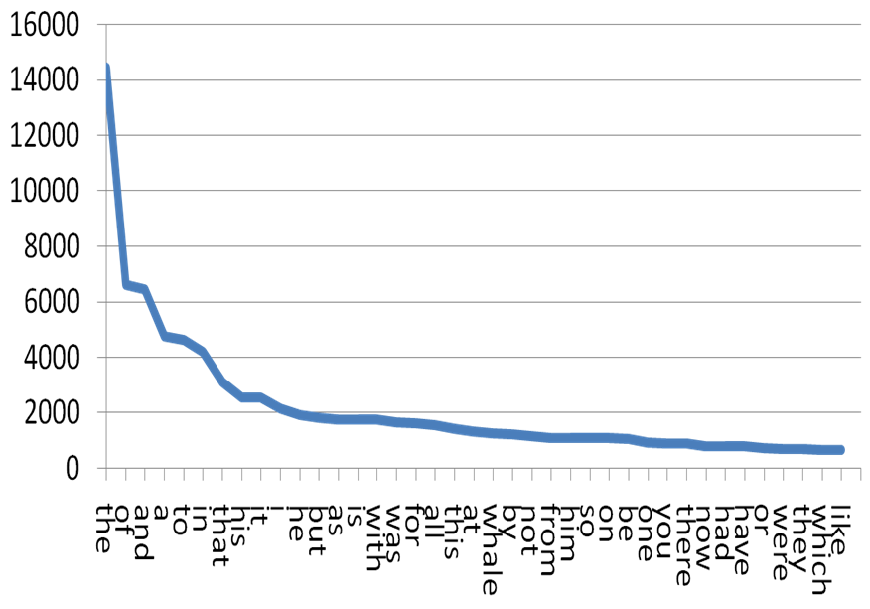

Slide 5
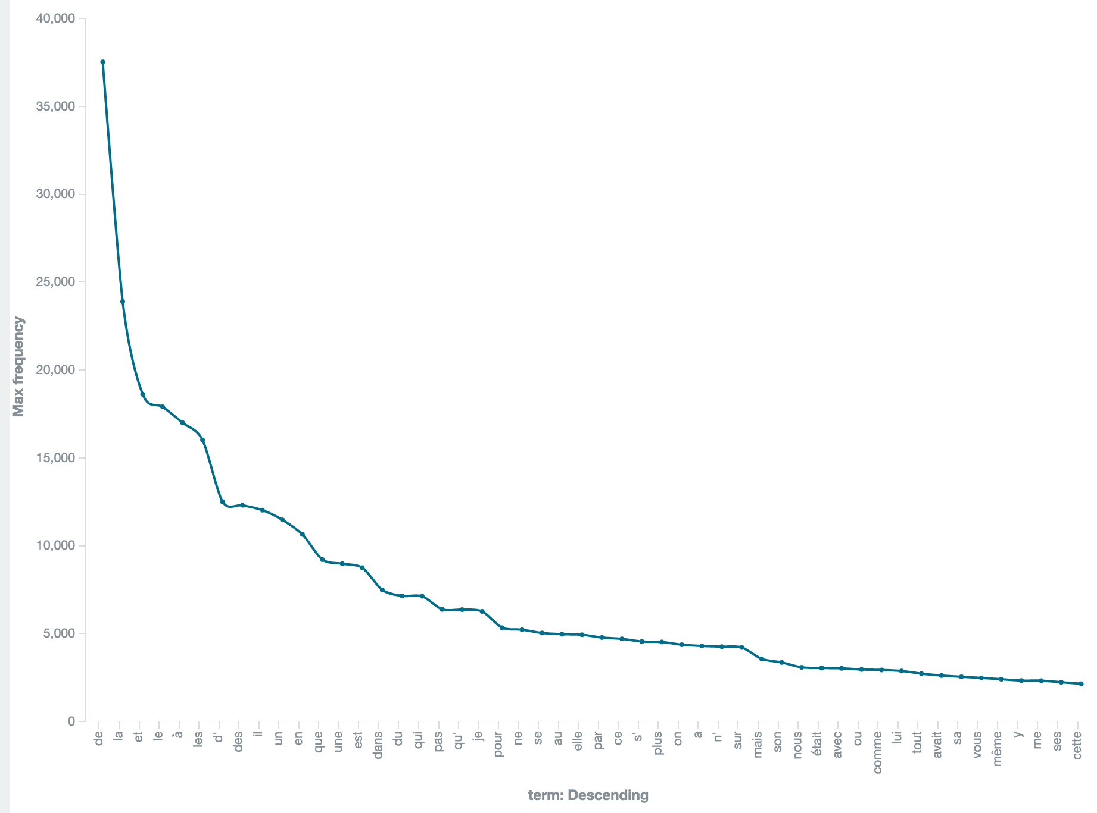

Slide 6

For a given term t in a set of N documents D
tf-idf(t) = tf(t) * idf(t)
tf: freq(t,d) for d in D
Idf(t,D):
is the total number of documents over the number of documents where term t occurs

Slide 7
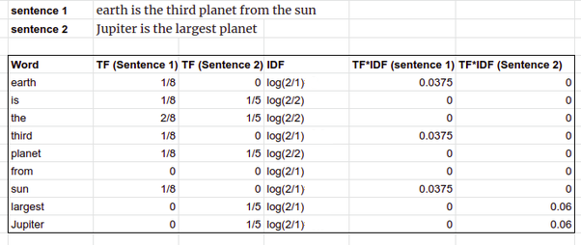

Slide 8
Usage

