Slide 1
Apache Spark: the rising star
AYEAH TITA Boris, FRAT LE PRINCE Maximilien,
OUDNI Alexandre, XU Léo

Slide 2

SPARK HISTORY
2009: Started as a CLASS project at the UC Berkeley AMPLab
2010: Open source
2013: Apache foundation
Main idea : Build a cluster management framework, which can support different kind of cluster computing systems.

Slide 3
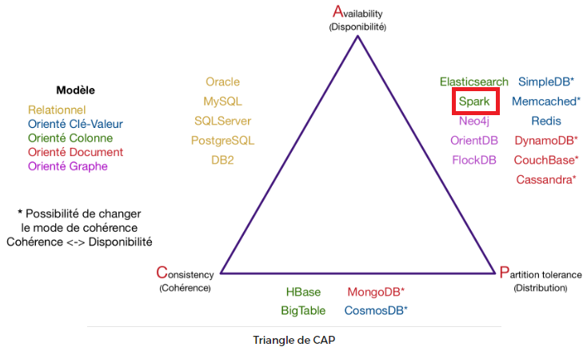
CAP THEOREM

Slide 4
WHAT IS SPARK ?
Open source parallel data processing engine coded in Scala that allows large-scale analyses.
It has libraries for SQL, machine learning, graph computation, and stream processing. Moreover, it’s compatible with Java, Python, Scala, and R. Thus, it has an object-oriented programming style that is easy to use and highly compatible.
Why people use SPARK ?
To rapidly query, analyze, and transform data at scale.

Slide 5
SPARK ADVANTAGES: SPEED
In-memory Processing: as there is no time spent in moving data/processes in and out of the disk, Spark is 100 times faster than MapReduce.
Real time Stream Processing: Apache Spark supports stream processing, which involves continuous input and output of data. You can analyze real time data.
Lazy Evaluation: Apache Spark starts evaluating only when it is absolutely needed. This plays an important role in contributing to its speed.
Less Latency: Spark caches most of the input data in memory by the Resilient Distributed Dataset (RDD). It’s where Spark does most of the operations such as transforming and managing the data. Moreover, each dataset on an RDD are partitioned and can be computed on different nodes of a cluster.

Slide 6
SPARK ADVANTAGES: EASY TO USE
Less Lines of Code: The implementation is in Scala, so the number of lines is relatively lesser in Spark when compared to Hadoop.
Multilingual: Apache Spark supports many languages for code writing such as Python, Java, Scala, etc. So, you can use any language you are familiar with (supported by Spark).
Integration with Hadoop: Spark’s framework is built on top of the Hadoop Distributed File System. those who are familiar with Hadoop won’t have any trouble with it.
Easy-to-use API: for operating on large datasets. It offers over 80 high-level operators that make it easy to build parallel apps.
Open-source community: It has a massive Open-source community behind it.

Slide 7
SPARK ADVANTAGES: POWERFULL
Advanced Analytics: Spark support Map and Reduce and also Machine learning (ML), Graph algorithms, Streaming data, SQL queries, etc.
Libraries: It has well-built libraries for graph analytics algorithms and machine learning.
Flexible: It can run independently or with Hadoop YARN cluster Manager so it can use existing Hadoop data. Spark also implement both batch and stream processing of data simultaneously, which allows simplified deployment, maintenance and application development.

Slide 8
SPARK DISADVANTAGES
Doesn’t have a distributed file system. Sparks isn’t really a standalone technology it relies on others platform like Hadoop or another cloud-based platform.
Problem with Small File Using Spark with Hadoop, HDFS provides a limited number of large files rather than a large number of small files.
If we are using a lot of gzipped file, it can be uncompressed only if the entire file is on one core. So, a large span of time will be spent in burning their core unzipping files in sequence.
Expensive Memory consumption is very high, so Apache Spark requires lots of RAM to run in-memory. And keeping data in memory is costly, thus the cost of Spark is quite high.
Multi-user environment: Spark is not capable of handling multi-user environment. You can’t use multiple user concurrently.
Optimization: You need to optimize your code manually whereas in other platform they are automated.

