Slide 1
Classification of Autism Spectrum Disorder on Functional Magnetic Resonance Imaging Using Convolutional Neural Networks
Aketza Romaniega Bilbao
Máster Universitario en Bioinformática y Bioestadística
Bioinformática Estadística y Aprendizaje Automático
Consultora: Romina Astrid Rebrij
Profesor responsable de la asignatura: Carles Ventura Royo

Slide 2
Index
Introduction
Autism Spectrum Disorder
State of art
Objectives
Methodology
Dataset
Data exploration and preprocessing
Model building, training and evaluation
Model improvement and evaluation
4. Results
Greyscale data
RGB data
Tunning of hyperparameters
Data augmentation
Batch normalization
Transfer learning
5. Conclusion

Slide 3
Introduction
Autism Spectrum Disorder
Diagnosed in about 2% of population ^{[1]}
4 times more frequently diagnosed in boys ^{[2]}
American Psychiatric Association’s 5th edition of the Diagnostic and Statistical Manual of Mental Disorders
Persistent deficits in social communication and interactions
Restricted and repetitive patterns of behaviour
Deficits that impair one’s functioning in society
Exclusion of other disorders
Early diagnosis and treatment
Improves language and cognitive abilities ^{[3]}
Increases likelihood of attending mainstream school ^{[4]}

Slide 4
Introduction
Magnetic Resonance Imaging and Deep Learning
MRI has been widely employed for the detection of brain related illnesses ^{[8-9]}
4 types of approaches to MRI usage in DL: 2D slice, 3D patch, ROI and 3D.
State of art
2018
Parison et al.: based in Graph Convolutional Networks
871 MRI, 70.4% accuracy
Heinsfeld et al.: based in ROI
1035 MRI, 70% accuracy
2019
Kong et al.: based in brain networks
182 MRI, 90.4% accuracy
2020
Shrivastava et al.: based in ROI
1035 MRI, 70% accuracy
Thomas et al.: based 3D MRI
2085 MRI, 66% accuracy
2021
Leming et al.: based in ROI
29288 MRI, up to 69.4% accuracy

Slide 5
Objectives
General objectives
To develop an algorithm that is able to correctly classify ASD from brain MRIs and to build a webpage in order to use the algorithm more user-friendly.
Specific objectives
Correctly classify ASD in brain MRIs.
Improve the accuracy of the algorithm compared to what has been developed
Develop a user-friendly webpage

Slide 6
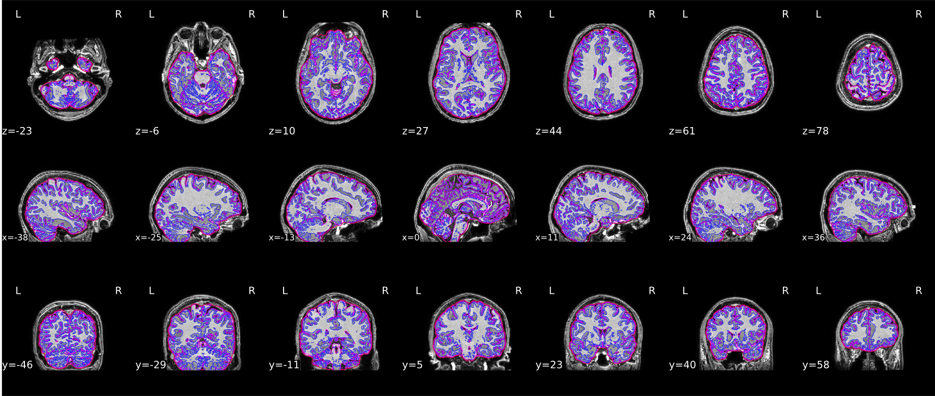
Methodology
Dataset
Released by Yang et al. From the Autism Brain Imaging Data Exchange (ABIDE)
Subjects are classified into controls (healthy) and patients (ASD)
Summary of the dataset:
1025 MRI:
537 healthy and 488 ASD
873 male and 152 female
Includes 259 teenagers and 96 children
Figure 1: Yang et al. released dataset example.

Slide 7
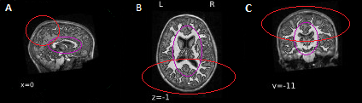
Methodology
Data exploration and preprocessing
Volumetry differences are shown in the corpus-callosum
Morphometry increasement in cortical thickness in the parietal lobes
Figure 2: areas of interest, where the corpus-callosum is highlighted in purple and the parietal lobes in red.
Model building, training and evaluation
Different architectures were tested and trained
The models were evaluated with new images
Model improvement and evaluation
The model was improved and evaluated

Slide 8
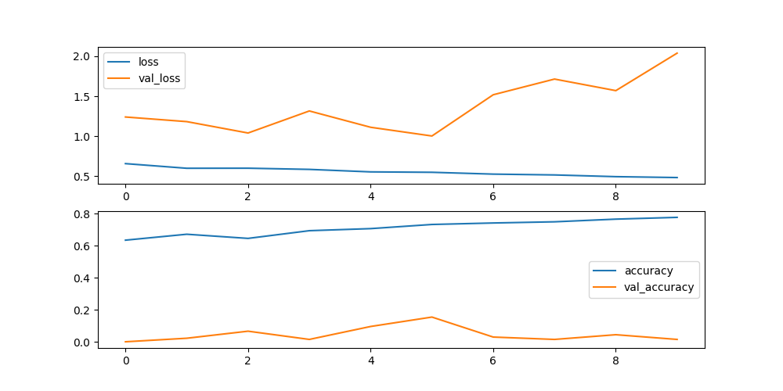
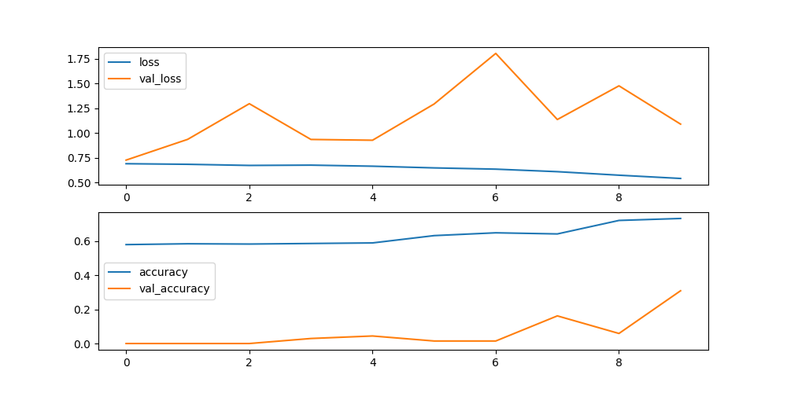
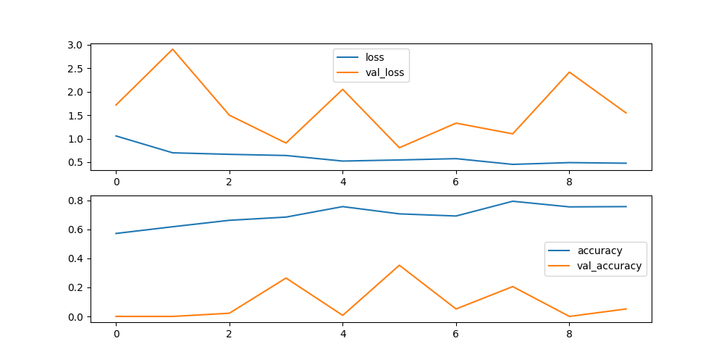
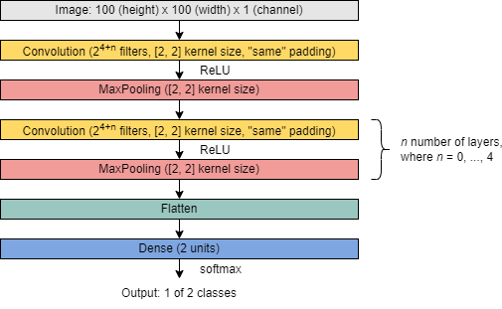
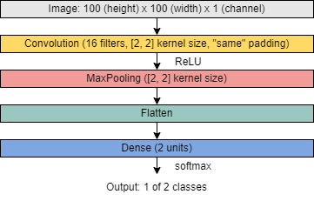
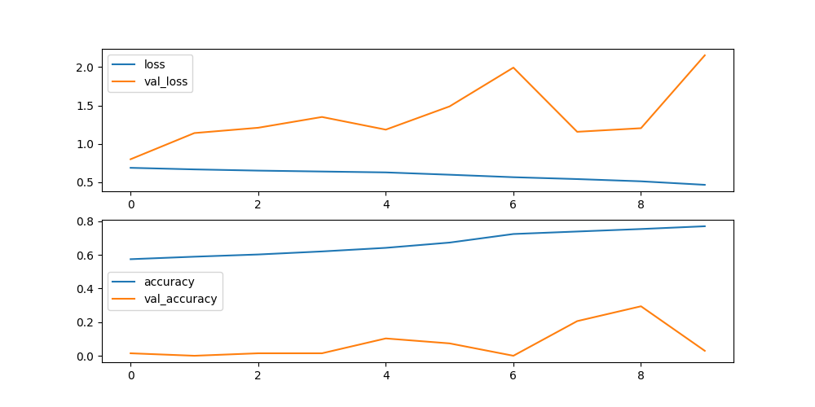
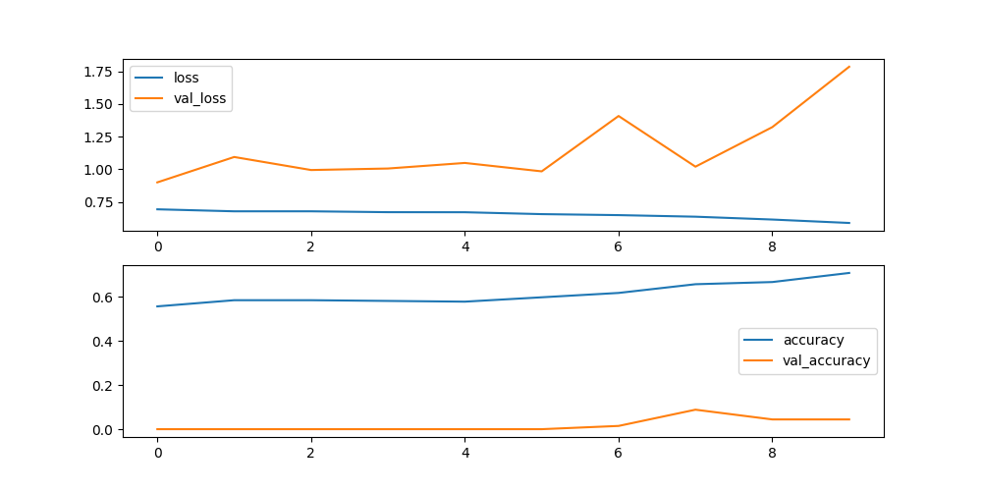
Results
Greyscale data
n = 3
n = 4
n = 1
n = 2
Training losses and accuracies
Architecture of the model
Training losses and accuracies

Slide 9
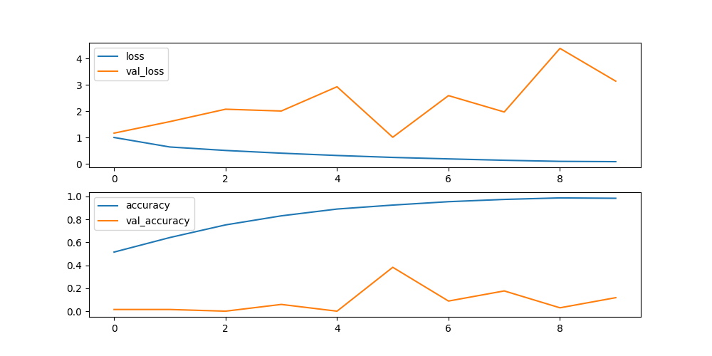
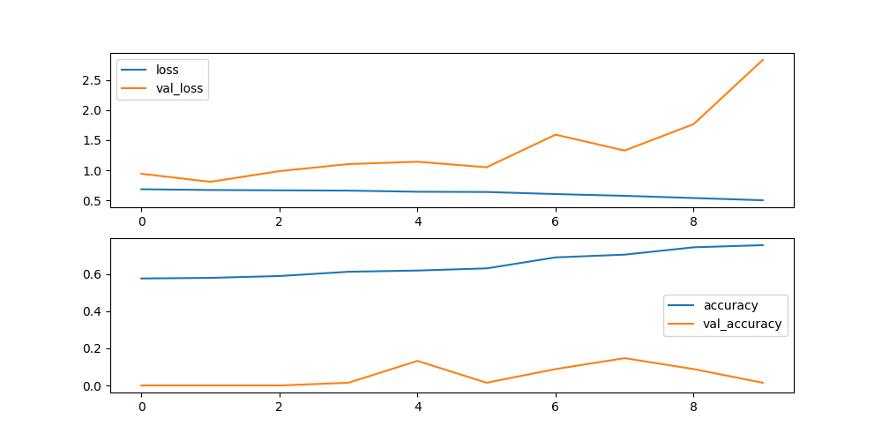
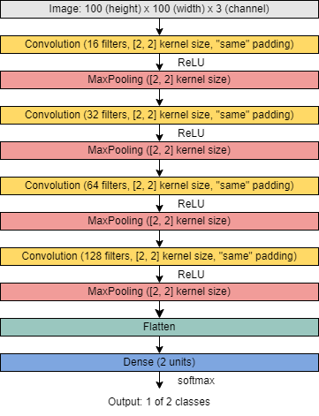
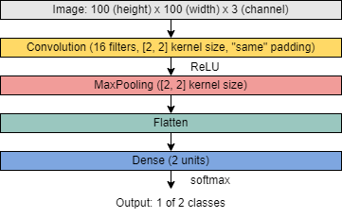
Results
RGB data
Training losses and accuracies
Architecture of the model

Slide 10
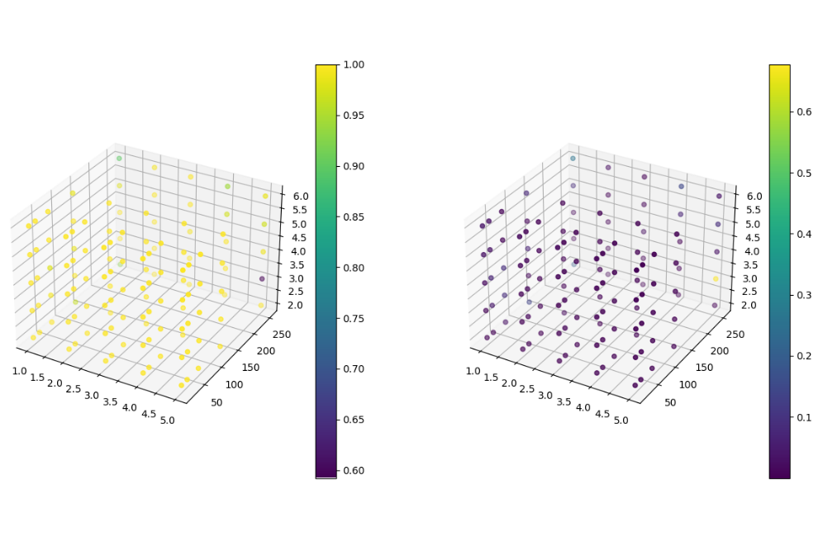
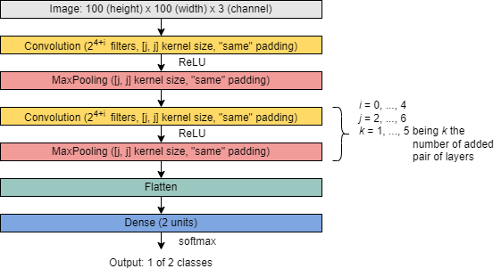
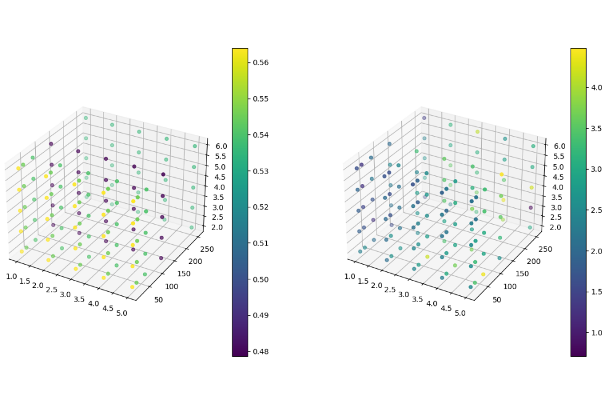
Results
Tunning of hyperparameters
Number of added pair of 2DConv and MaxPooling layers
Number of filters and kernel size of the 2D Conv layer
Addition of dropout layers and dropout rate
Addition of dense layers and units
Training losses and accuracies
Architecture of the model
Evaluation losses and accuracies

Slide 11
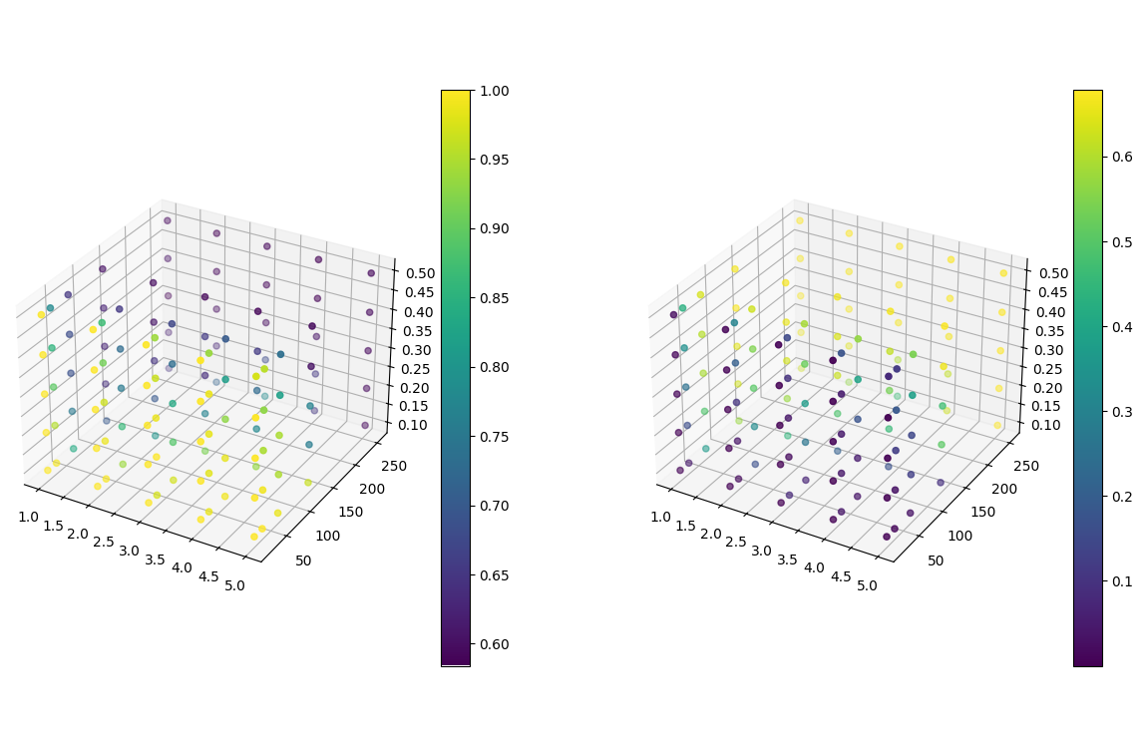
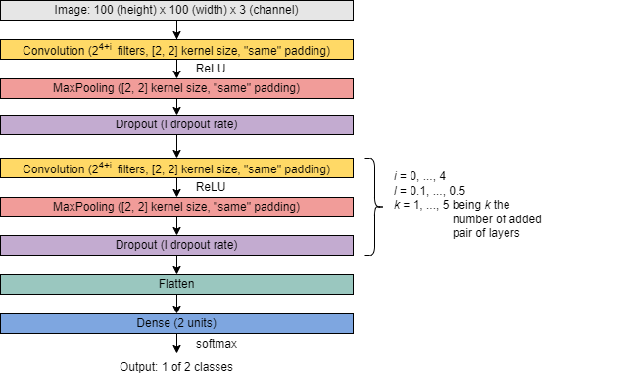
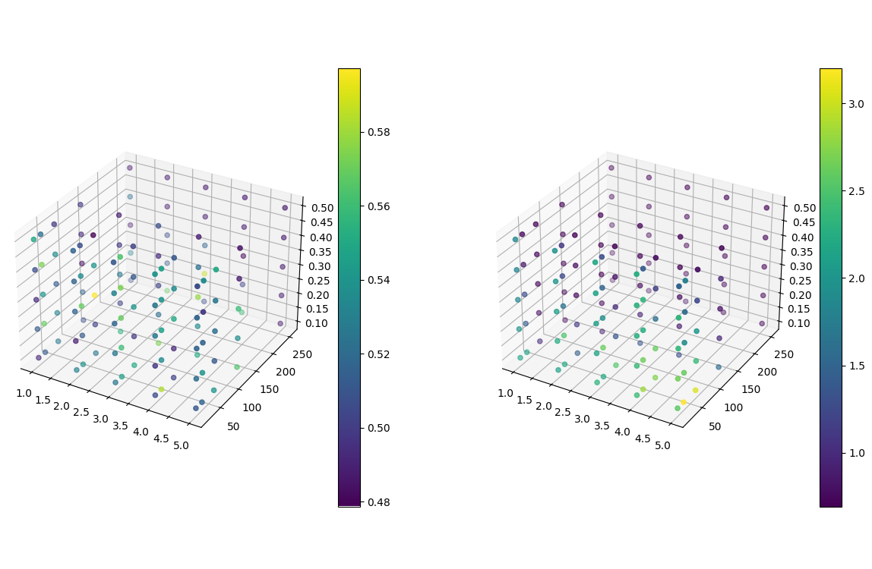
Results
Tunning of hyperparameters
Training losses and accuracies
Accuracy: 59.71%
Loss: 74.41%
Architecture of the model
Evaluation losses and accuracies

Slide 12
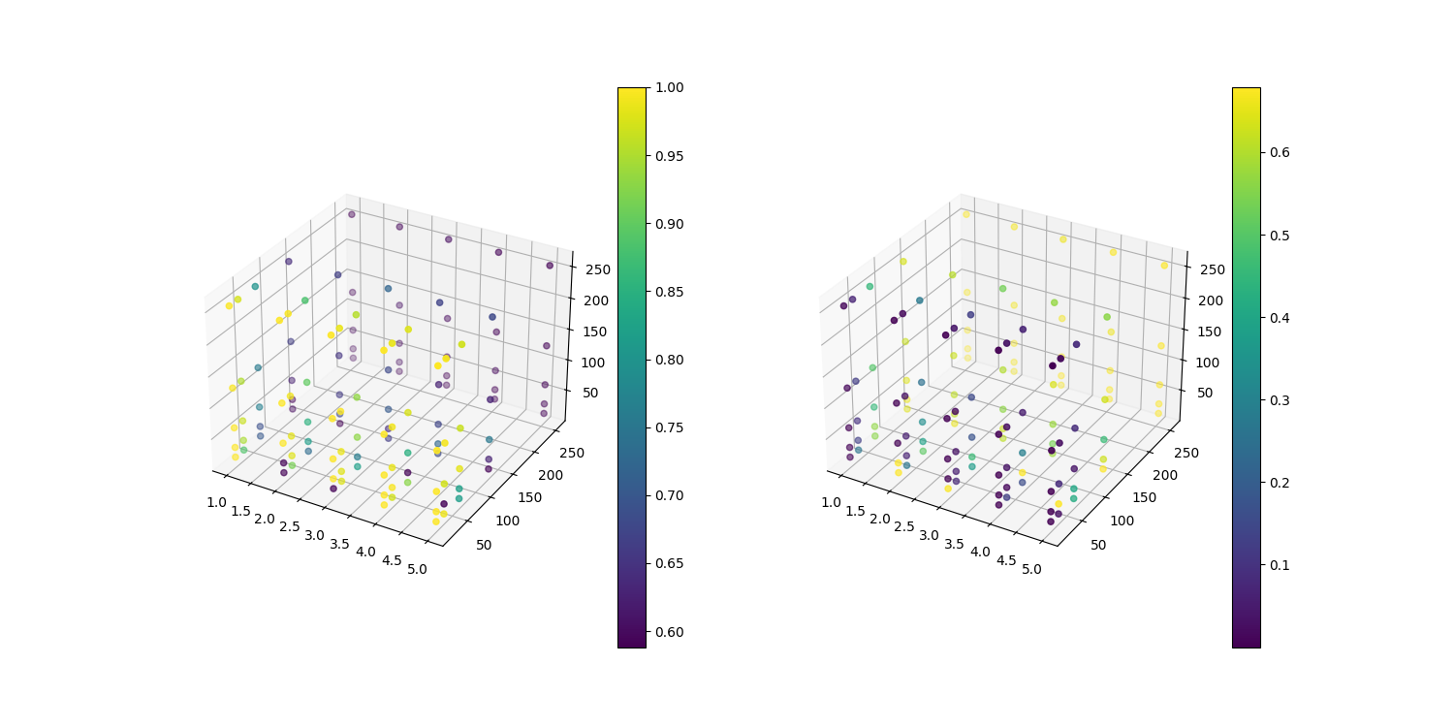
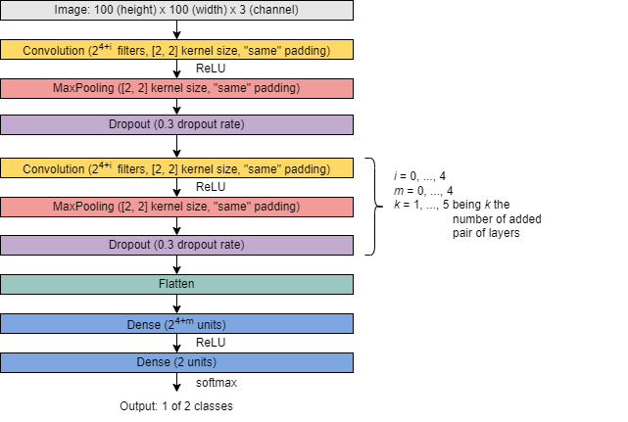
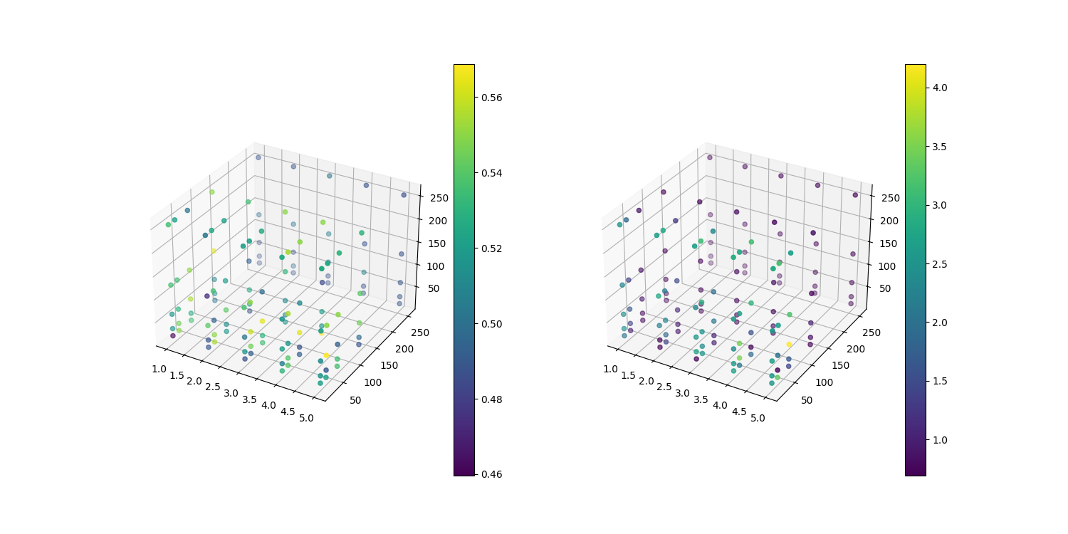
Results
Tunning of hyperparameters
Training losses and accuracies
Architecture of the model
Evaluation losses and accuracies

Slide 13
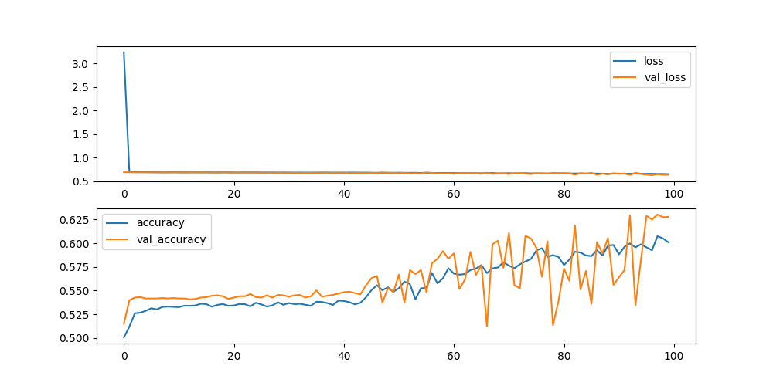

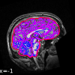
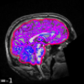
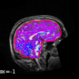
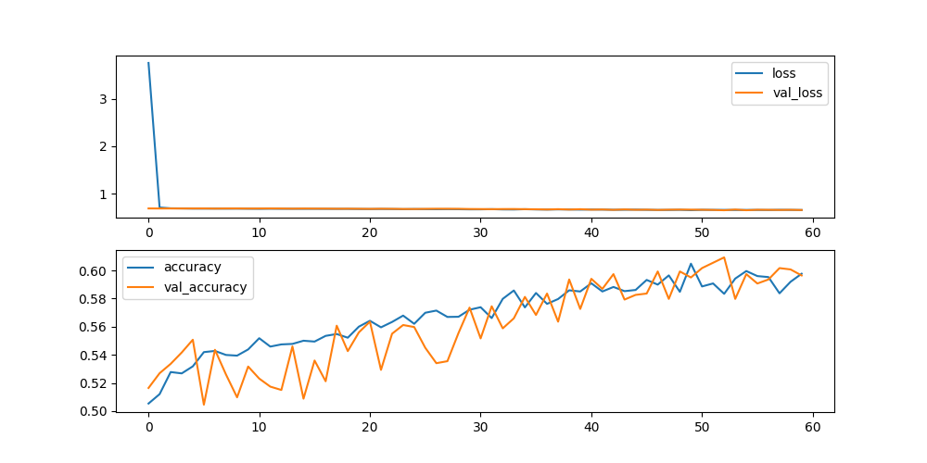
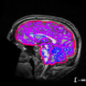
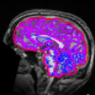
Results
j = 2
Data augmentation
Used architecture:
Accuracy: 58.17%
Loss: 68.23%
Data augmentation
20% zoom
20% shear range
Horizontal flip
ORIGINAL
j = 3
IMAGE | Accuracy | Loss
A | 0.5384 | 0.7244
B | 0.5433 | 0.6917
C | 0.4951 | 0.6952
Accuracy: 53.84%
Loss: 72.44%
AUGMENTED DATA

Slide 14
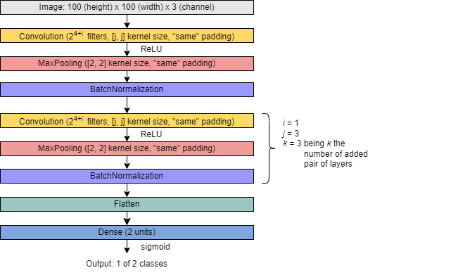
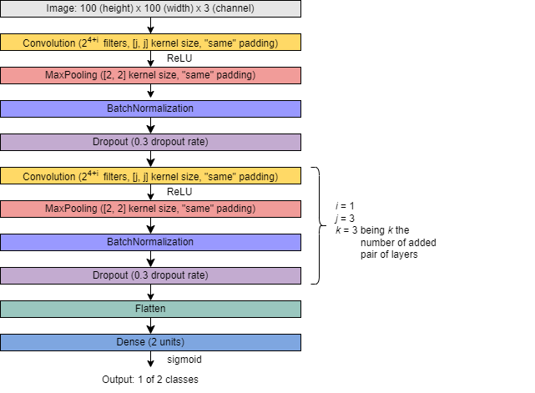
Results
Batch Normalization
IMAGE | Dropout | Accuracy | Loss
A |  | 0.6490 | 2.8565
 | + | 0.6779 | 0.7423
B |  | 0.5529 | 4.2097
 | + | 0.5288 | 1.0323
C |  | 0.5385 | 2.3216
 | + | 0.4519 | 0.7914

Slide 15
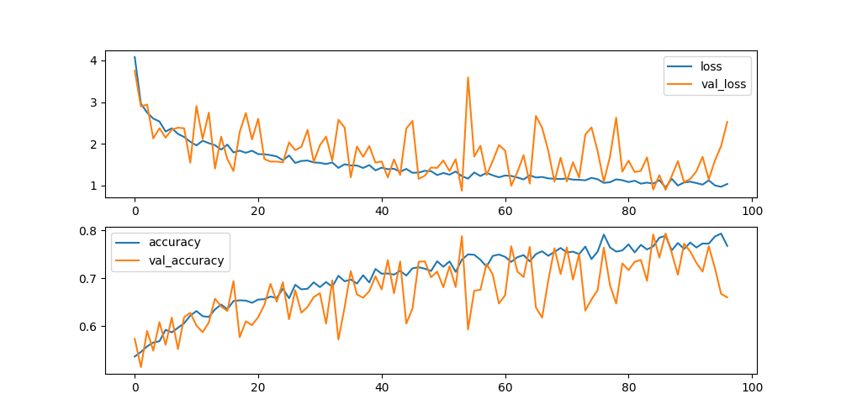
Results
Transfer learning
VGG16 model
- Pre-trained on ImageNet
Accuracy: 51.92%
Loss: 378.60%

Slide 16
Conclusion
A suitable model was found using a combination of batch normalization layers and dropout layers, yielding in an accuracy of 68% and a loss of 74%
Although the is room for improvement, decent accuracy has been achieved with easily obtainable data
Planning could not be carried out as expected due to the complexity of the proposed problem
Future work:
- Obtain more MRI data
- Improve the model
- Build the website for future use

Slide 17
Bibliography
[1] Maenner, M. et al. (2020). Prevalence of autism spectrum disorder among children aged 8 years – Autism and developmental disabilities monitoring network, 11 sites, United States, 2016. MMWR Surveill. Summ., 69 (4), 1-12.
[2] van’t Hof, M. et al. (2021). Age at autism spectrum disorder diagnosis: a systematic review and meta-analysis from 2012 to 2019. Autism, 25 (4), 862-873.
[3] Rogers, S. J. et al. (2014). Autism treatment in the first year of life: a pilot study of infant start, a parent-implemented intervention for symptomatic infants. J. Autism Dev. Disord., 44 (12), 2981-2995.
[4] Heinsfeld, A. S. et al. (2018). Identification of autism spectrum disorder using deep learning and the ABIDE dataset. Neuroimage Clin., 17, 16-23.
[5] Kong, Y. et al. (2019). Classification of autism spectrum disorder by combining brain connectivity and deep neural network classifier. Neurocomputing, 324, 63-68.
[6] Shrivastava, S. et al. (2020) “Control or Autism – Classification using Convolutional Neural Networks on Functional MRI”, 11th International Conference on Computing, Communication and Networking Technologies (ICCCNT), Kharagpur, 1-3 July.
[7] Sherkatghanad, Z. et al. (2019). Automated detection of autism spectrum disorder using a Convolutional Neural Network. Front. Neurosci., 13, 1325.
[8] Thomas, R. M. et al. (2020). Classifying autism spectrum disorder using the temporal statistics of resting state functional MRI data with 3D Convolutional Neural Networks. Front. Psychiatry, 11, 440.
[9] Leming, M. J. et al. (2021). Single-participant structural similarity matrices lead to greater accuracy in classification of participants than function in autism in MRI. Mol. Autism, 12, 34.

