Slide 1
Synthetic data in action: proof of concept in real-world scenario
Roman Murzac
November 2024

Slide 2
1. SCENARIO

Slide 3
SCENARIO
The client is BigDataNight, a Romanian Start-Up company that provide an on-line banking for Information Technology start-ups from Romania.
The client want to develop Analytic department that involve Analytics for daily reporting, Machine Learning for frauds and crime detection, Artificial Intelligence for own banking application.

Slide 4
2. INPUTS

Slide 5
INPUTS
Field: finance.
Type: start-up.
Location: Romania.
Data:
Volume: 1 TB.
Velocity: 101.100 – 303.303 records / day.
Variety: unique source.
Schema:
person_name, personal_number, birth_date, address,
phone_number, email, ip_address, card_provider,
card_number, iban, cvv, card_expire, currency_code,
transaction_currency, transacted_at, transaction_amount,
transaction_number, from_country, to_country, record_id.

Slide 6
3. REQUIREMENTS

Slide 7
REQUIREMENTS
Generate synthetic data.
Create dedicated database.
Create three schemas.
Create tables: one for raw zone, three for staging zone, five for trusted zone.
Extract raw data in raw zone.
Transform data in staging zone.
Load data and split between PII and Non-PII data in trusted zone.
Create business views for five business requirements:
Average transaction amount for each country where transactions originated.
Calculates the total transaction amount grouped by transaction currency.
Ranks card providers based on total transaction amount.
Counts the number of transactions per person.
Details of transactions made in the last 30 days.

Slide 8
4. IMPLEMENTATION

Slide 9
IMPLEMENTATION
Synthetic Data Generation:
Generate Synthetic data.
Create Database.
Ingest data.

Slide 10
IMPLEMENTATION
Data Built Tool:
Raw zone:
Schema: bronze_layer
Tables:
raw_data
Staging zone:
Schema: silver_layer
Tables:
dim_person
dim_card
fact_transaction
Trusted zone:
Schema: golden_layer
Tables:
dim_person_nonpii
dim_person_pii
dim_card_nonpii
dim_card_pii
fact_transactions

Slide 11
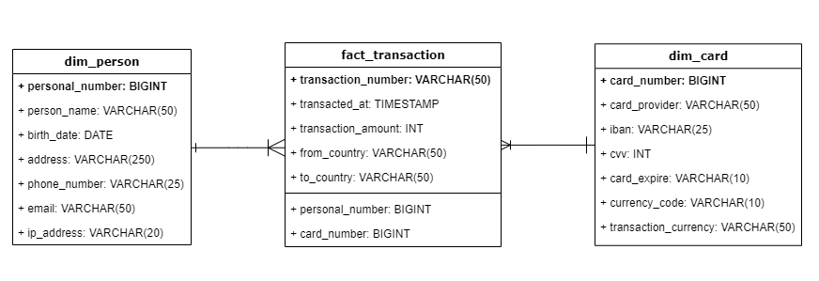
IMPLEMENTATION
Data Modeling:

Slide 12
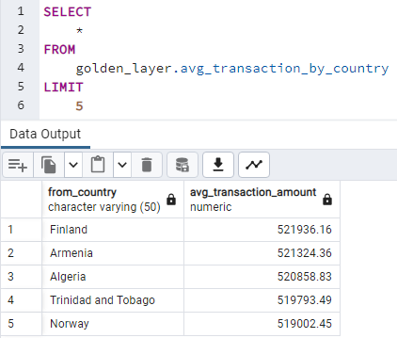
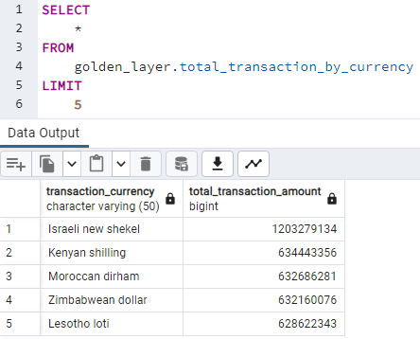
IMPLEMENTATION
Business answers:

Slide 13
5. OUTPUTS

Slide 14
OUTPUTS
Generated synthetic data → data_2024-11-12.csv.
Created dedicated database → bdn_db.
Created three schemas → bronze, silver, and golden layers.
Extracted raw data in raw zone → raw_data.
Transformed data in staging zone → dim_person, dim_card, fact_transaction.
Loaded data → dim_person_nonpii/pii, dim_card_nonpii/pii, fact_transactions.
Created business views for five business requirements:
Average transaction amount for each country where transactions originated.
Calculates the total transaction amount grouped by transaction currency.
Ranks card providers based on total transaction amount.
Counts the number of transactions per person.
Details of transactions made in the last 30 days.

Slide 15
6. RESOURCES

Slide 16
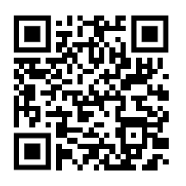
PRACTICE RESOURCES
GitHub Repository

Slide 17


