Slide 1
Roman Kazinnik Analysis (in R):
Preliminary steps: Work on outliers (log transformation) and transformation of categorical variables. Prepare the date for linear regression GLM and GBM (Caret), and DNN (h2o). PCA to visualize variance and collinearity of the target variable and predictors 8 predictors for dataset-1, 14 for dataset-2. 22+ for dataset-3 Introducing new predictors: log ratio of busy to available “dashers” rounded hour (rounded by minutes) of the order creation and weekday response continuous variables for categorical variables with aggregation by hour, weekday
I then use the following models:
GBM/Caret
GLM/Caret
Deep Neural Network/h2o
Finally, an ensemble of GBM, GLM, DNN as regression
I’ve done several iterations (dataset-1, dataset-2, dataset-3) in order to improve prediction accuracy (please see next slides).
Recommendations:
There are a few major factors that influence order waiting time. Regions market_id seem to be important predictor, and it would make sense to have an increased number of dashers (dashers_ratio variable) to vary with market_id in order to decrease waiting time. Another factor is store_category_id aggregated by time of the week and hour. The recommendation is the same – assign more dashers to categories and not uniformly.
We could build a model that sends more dashers to overwhelmed markets/categories based on weekday/hour in a dynamic way. This can be done in real time via Deep Learning Model that learn in real-time by refining some of its deep layers. Big data is crucial for the prediction accuracy, and Deep Learning is an excellent framework to utilize the big real-time data and not re-train from scratch. It can also be designed to learn new features through hierarchical multi-scale convolutions.
Potential Future Extensions:
Given some 200K data-points these data was too small to try to generate new features automatically rather than manually. More data would allow new features automation
Investigate and Impute missing values. Investigate inconsistent data (negative dashers, negative costs)

Slide 2
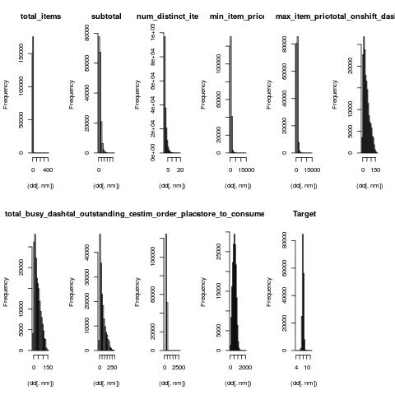
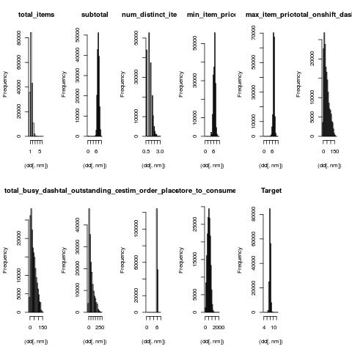
EDA: outliers
Resolve outliers (left): Log transform (Right) including Target
Should help with L2-based optimizations (logistic regression, NN)

Slide 3
EDA: outliers
replace_log_transformation <- function(dd)
{
col_num_outliers=c("total_items", "subtotal", "num_distinct_items",
"min_item_price", "max_item_price",
"estim_order_place_dt" ## estimates_order_place_duration,
)
for (nm in names(dd)) {
if ("integer" == class(dd[,nm]) | "numeric" == class(dd[,nm])) {
#print(nm)
hist( (dd[,nm]),main=nm) #log makes more gaussian
if (nm %in% col_num_outliers) {
nm1 = nm#paste(nm, "_log", sep="")
dd[, nm1] = log(1.0 + dd[, nm])
}
}
}
return (dd)
}

Slide 4
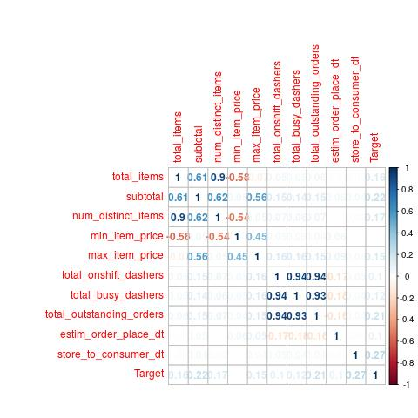
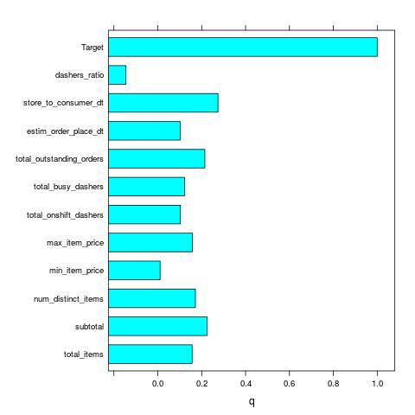
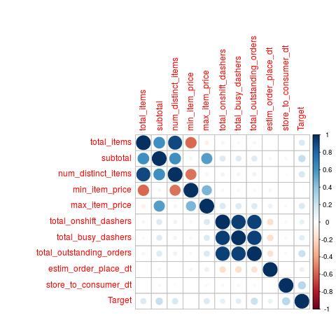
EDA: correlation
Target only weakly correlated to predictors
Some correlation with predictors (PCA can help remove collinearity)
Introduced new predictor: dashers_ratio = log total_busy/total_onshift

Slide 5
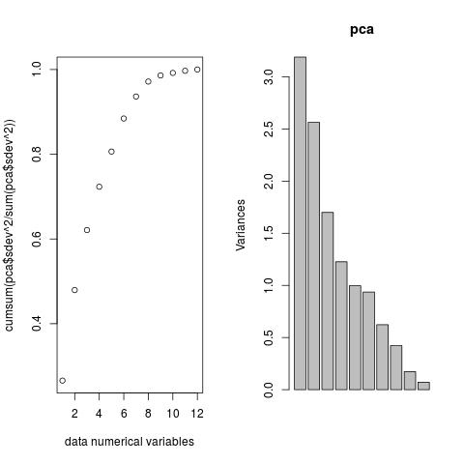
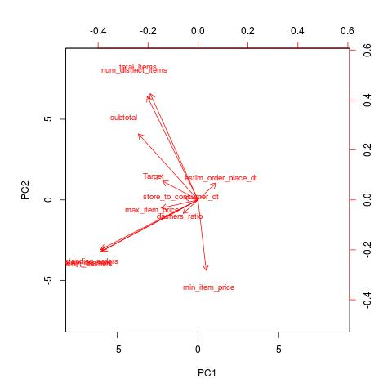
EDA: PCA 8 variables explain 98% of variance
Very few “useful” predictors (some 8)
A few collinear variables (right) in PC1-PC2 (Principal Components vectors)

Slide 6
Modeling dataset-1
GBM - (Caret, Gradient Boosted trees)
GLM - Linear regression (Caret)
h2o - Deep Neural Network regression (H2o)
Ensemble of GBM, GLM, NN as regression

Slide 7
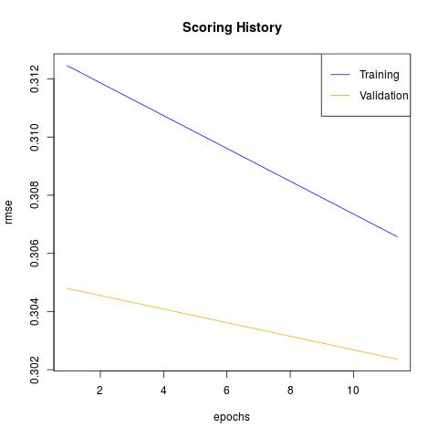
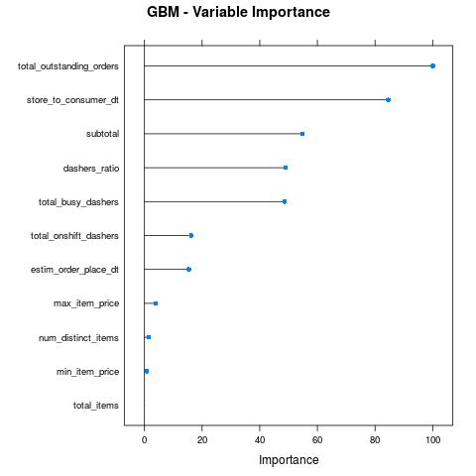
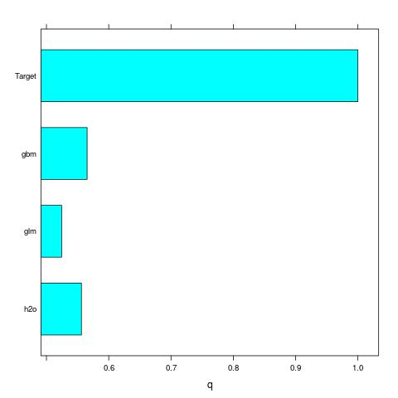
Modeling dataset-1
Similar accuracy GBM, GLM, h2o, ensemble:
mean error 673.558302135927 and median error 497.967708389097 (all secons)
Relative error 0.238163195638335 (23%)
Similar order Variables Importance
No overfitting (Right, h2o deep NN example)
Ensemble can not improve predictions due to correlated predictions from (GBM,GLM,NN)

Slide 8
Overall
gbm 100.00
h2o 11.51
glm 0.00
[1] "========= modeling ============"
[1] "========= gbm ============"
[1] "== h2o Test"
[1] "error: mean, median, relative= 673.558302135927 497.967708389097 0.238163195638335 log mean, median= 0.234829442495987 0.192730618992484"
[1] "== h2o Train"
[1] "error: mean, median, relative= 662.248817333096 496.181758663917 0.239064808308461 log mean, median= 0.234553167153605 0.193064089308893"
[1] "========= glm ============"
[1] "== h2o Test"
[1] "error: mean, median, relative= 673.558302135927 497.967708389097 0.238163195638335 log mean, median= 0.234829442495987 0.192730618992484"
[1] "== h2o Train"
[1] "error: mean, median, relative= 662.248817333096 496.181758663917 0.239064808308461 log mean, median= 0.234553167153605 0.193064089308893"
[1] "========= h2o ============"
[1] "== h2o Test"
[1] "error: mean, median, relative= 679.463701815849 488.040328075015 0.232952936935872 log mean, median= 0.236871452153389 0.193583591123897"
[1] "== h2o Train"
[1] "error: mean, median, relative= 669.853212272262 489.199631306591 0.234596992755707 log mean, median= 0.237258593880763 0.194129817198741"
[1] "========= ensemble ============"
[1] "== h2o Test"
[1] "error: mean, median, relative= 672.726569988133 496.656111083967 0.23761244729626 log mean, median= 0.234505691011558 0.192581545062357"
[1] "== h2o Train"
[1] "error: mean, median, relative= 661.76958422162 495.978100272441 0.238653609080249 log mean, median= 0.234356443775689 0.193197775991493"

Slide 9
Modeling dataset-1
Rescale, center (Right)
Hyper-parameters grid search (Below)
Cross-validation with repeats (Below)
model_gbm <- caret::train(Target ~ .,
data = dtrain
,method = method_name #"gbm"
,preProcess = c("scale", "center")
,trControl = ctrlGbm
, tuneGrid = gGrid ),
ctrlGbm <- trainControl(method = model_params$tr_is_repeatedcv_vs_oob,
number = model_params$tr_n,
repeats = model_params$tr_r,
verboseIter = FALSE
,allowParallel = TRUE
,savePredictions = TRUE
)
gbmGrid <- expand.grid( .interaction.depth = model_params$gbm.interaction.depth ,
, .n.trees = model_params$gbm.n.trees
, .shrinkage = model_params$gbm.shrinkage
, .n.minobsinnode = model_params$gbm.n.minobsinnode
)

Slide 10
Modeling: grid-search parameters for GBM and GLM
model_params0$tr_is_repeatedcv_vs_oob = "repeatedcv" #"oob"
model_params0$tr_n = 10
model_params0$tr_r = 2
# RMSE Rsquared MAE = 0.3,0.3,0.237
model_params0$gbm.interaction.depth = c(5) # c(3,5)#c(1,3)
model_params0$gbm.n.trees = c(100) # c(50,100) #c(25,50)
model_params0$gbm.n.minobsinnode = c(100, 500) # c(100,300) #c(10,100)
model_params0$gbm.shrinkage = c(0.2) # c(0.1, 0.2, 0.3)
model_params0$glm.parameter = c(0.1, 0.01, 1e-3, 1e-5, 1e-7, 1e-8) # c(0.1, 0.2, 0.3)
#model_params0$rf.mtry = c(2) # seq(2,8,4)
model_params0$rf.ntree = c(100)

Slide 11
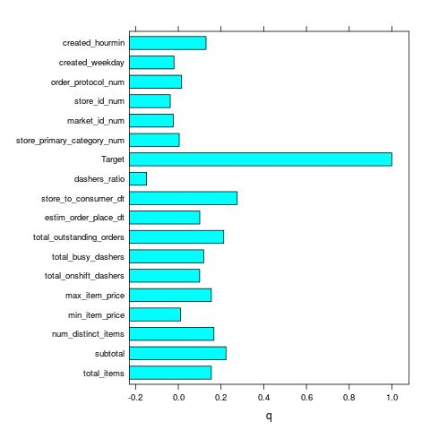
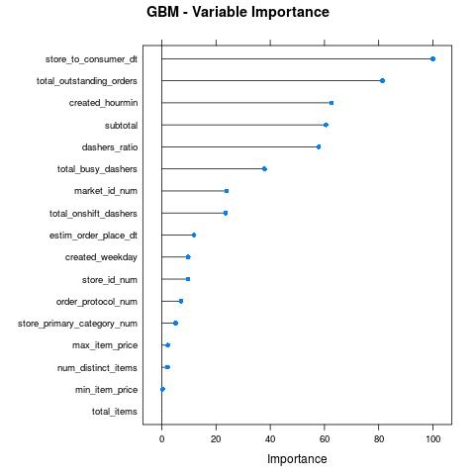
Dataset-2: new response variables
Four new variables:
frequencies of factors (categorical variables)
Hour of order created CREATED_HOURMIN (turns out to be Important!)
Now 14 variables explain 98% variance (some improvement)
New variables correspond to 4 factors
market_id_num, store_id_num, order_protocal_num, category_num (below)

Slide 12
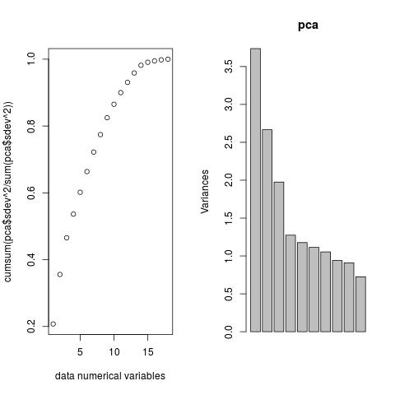
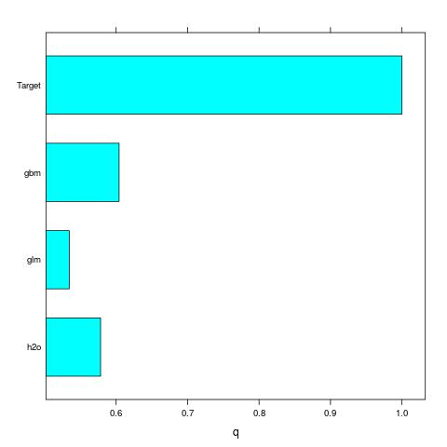
Dataset-2: response variables
Now 14 variables explain 98% variance (some improvement)
Some improvement in accuracy some 2%; almost no overfit; models are correlated and ensemble would not improve prediction
[1] "== h2o Test"
[1] "error: mean, median, relative= 650 482. 0.231556943775101
[1] "== h2o Train"
[1] "error: mean, median, relative= 637 477 0.228716989502569

Slide 13
Dataset-2: 4 new response variables
#store_primary_category
dfactor1 <- d0 %>%
dplyr::group_by(store_primary_category) %>%
dplyr::summarize(store_primary_category_num=n())
#store_primary_category_estim=mean(estim_order_place_dt,na.rm=TRUE))
#market_id
dfactor2 <- d0 %>%
dplyr::group_by(market_id) %>%
dplyr::summarize(market_id_num=n())
# store_id
dfactor3 <- d0 %>%
dplyr::group_by(store_id) %>%
dplyr::summarize(store_id_num=n())
# order_protocol
dfactor4 <- d0 %>%
dplyr::group_by(order_protocol) %>%
dplyr::summarize(order_protocol_num=n())

Slide 14
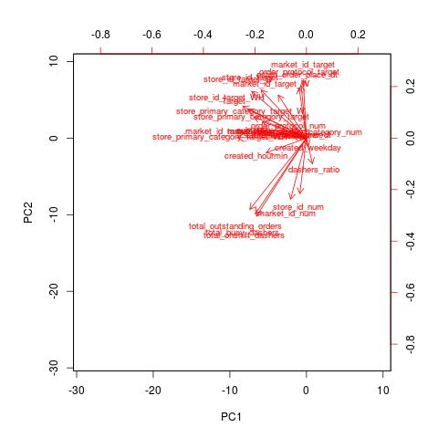
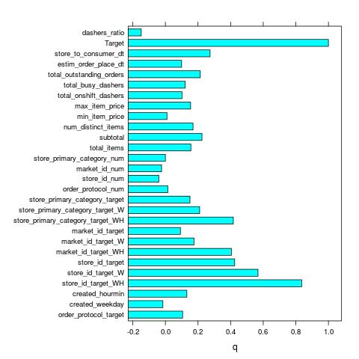
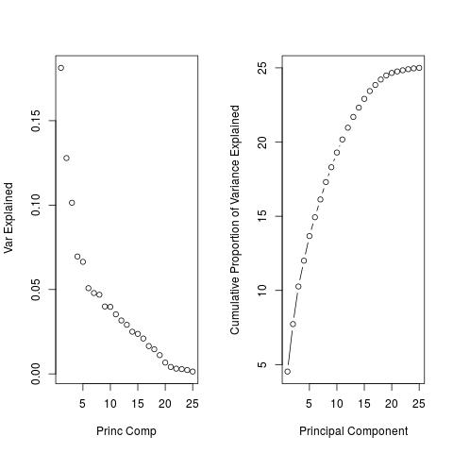
Dataset-3: response from Target
22 variables for 98% variance: PCA shows improved variance
Very small leak from Target:
Some new Variables with correlation to target greater 0.4
Variables Correlated over 0.4 introduced over-fitting and have been removed
Example: store_id_target_weekday_hour
For the four categorical variables:
add Target response: mean Target per label; per day; per hour

Slide 15
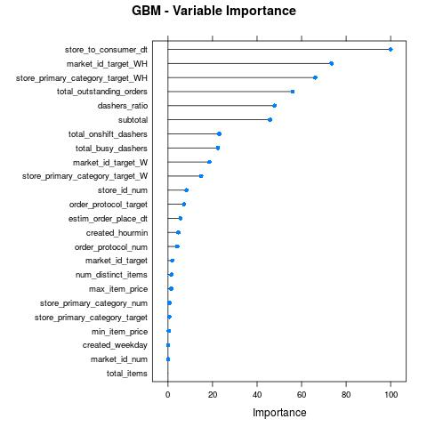

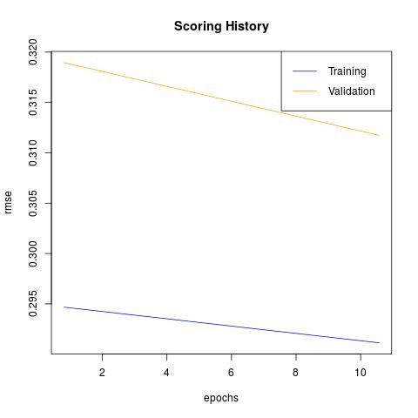
Dataset-3
New variables turned-out to be good predictors:
market_id aggregated by Weekday and Hour s.t. Target
Store-category aggregated by Weekday and Hour s.t. Target
No over-fitting (Below)
Left: GBM,GLM, h2o correlated

Slide 16
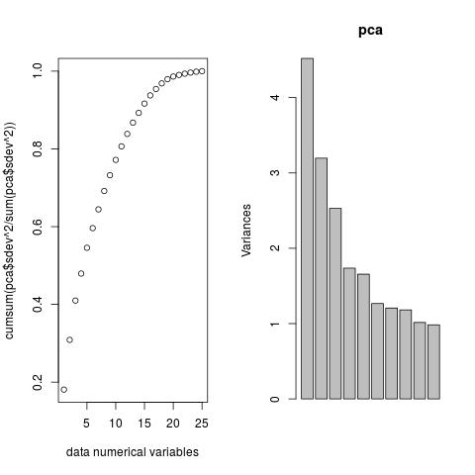
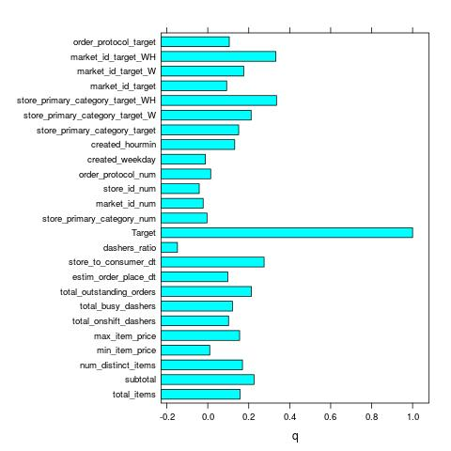
Dataset-3
Accuracy:
Test: mean 645 and median 488 seconds
Training: 646 and 487
No over-fitting
Remove some new variables
introduced over-fitting; no over-fitting after removal
Correlation to target below < 0.4
[1] "== h2o Test"
[1] "error: mean, median, relative=
645 488 0.234529379146965
log mean, median=
0.227790946218168 0.187043385345934"
[1] "== h2o Train"
[1] "error: mean, median, relative=
646 487 0.234541567573027
log mean, median=
0.227000522181445 0.187625382883077"

Slide 17
Recommendations and Future work
How to improve waiting times:
Improving Total_outstanding_orders and available Dashers_ratio should help improving waiting times
market_id aggregated by week-time is a good predictor
add more dashers not uniformly but based on market-id and category

Slide 18
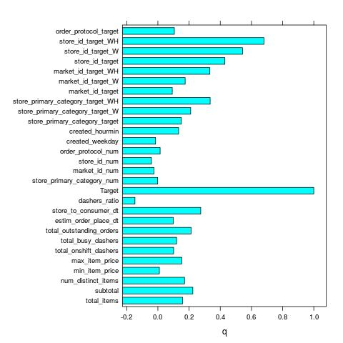
Dataset-4 (Right: correlation with Target)
Recommendation: How to increase Accuracy by 30%
Error Mean=500 and Median=360 (seconds, Below)
Introduce new response variables:
Target aggregated by (Weekday, Hour, store_id)
Target aggregated by (Weekday, store_id)
Notice high correlation with Target > 0.5
Challenge:
Leaking Target into predictors
Over-fitting due to small dataset (Below, Test vs. Train)
Solution:
Acquire more trip data for stores (some 6K stores)
More trips per individual stores will decrease over-fitting
[1] "========= h2o ============"
[1] "== h2o Test"
[1] "error: mean, median, relative= 676 484 0.240630325316577 log mean, median= 0.235026559539324 0.189521059163621"
[1] "== h2o Train"
[1] "error: mean, median, relative= 494 365 0.178004305142739 log mean, median= 0.176310044627073 0.141552361146277"
[1] "========= ensemble ============"

Slide 19
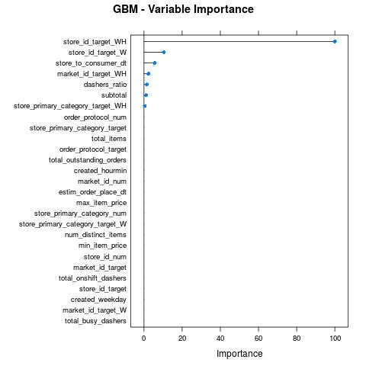
Dataset-4 (Left: predictors importance)
Recommendation: How to increase Accuracy by 30%: Error Mean=500 and Median=360 (seconds)
Introduce new response variables:
Target aggregated by (Weekday, Hour, store_id)
Target aggregated by (Weekday, store_id)
Over-fitting due to small dataset (Below, Test vs. Train)
Acquire more trip data for stores (some 6K stores) will improve over-fitting

Slide 20
Future work
New features automatic generation
With 200K data-points may be too small to try to generate features automatically rather then manually
Investigate and Impute missing values
I removed some 10% data-points having missing values
Investigate negative values
I removed in-consistent data

Slide 21
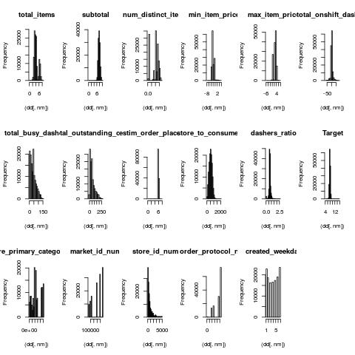
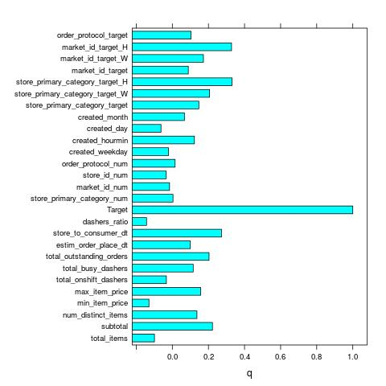
EDA: Train, validation, test
Train - validation: 80%-20%
Features transformation:
Determined by Train: group by factors mean(Target)
Same features transformation applied to Validation (with a Target), test (no Target):
Total features: 25+
FIGURES: Predictors correlation to Target (Left), Histogram (log applied to process outliers, right)

Slide 22
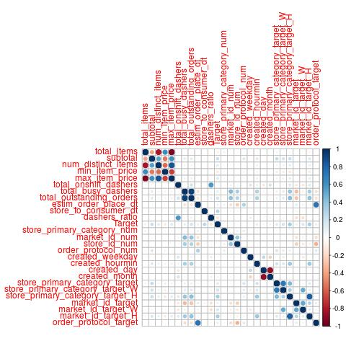
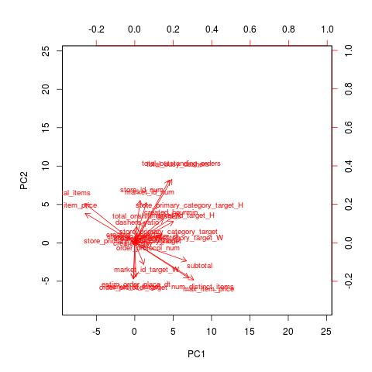
EDA: Train, validation, test
Train - validation: 80%-20%
PREDICTORS FIGURES: Correlations (Left), Variance (PCA, Center), PC1-PC2 (Target as color , Right)
Bottom: Some features correlated (standardize prior to modeling)
Right: 25 predictors explain 99% variance
Left: Predictors s.t. Principal components PC1-PC2

Slide 23
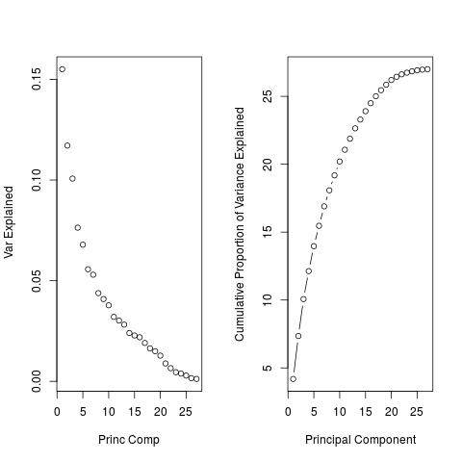
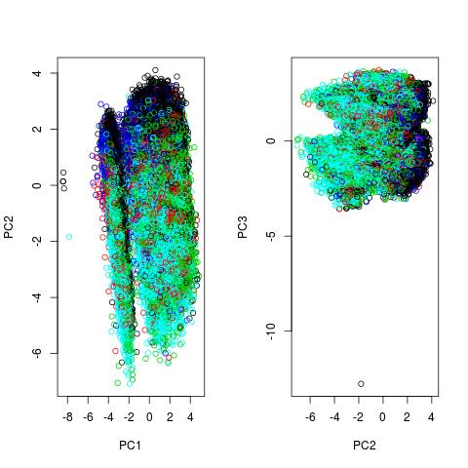
EDA: Train, validation, test
Train - validation: 80%-20%
PREDICTORS FIGURES: Correlations (Left), Variance (PCA, Center), PC1-PC2 (Target as color , Right)
Left: Some features correlated (standardize prior to modeling)
Center: 25 predictors explain 99% variance
Right: Target (as color) wellclustered PC1-PC2 principal components (apparently two clusters for before noon -after noon)

Slide 24
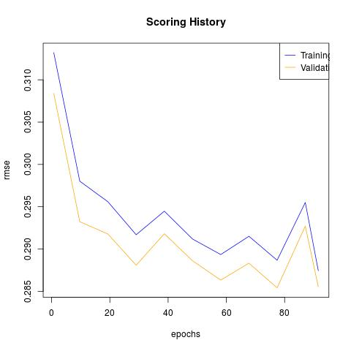
Modeling: Train, validation, test
GBM, GLM (Caret), DNN (h2o) , ensemble as GLM (GBM,GLM,DNN)
Regression accuracy:
Left: h2o convergence epochs
Right: predictors importance (GBM

Slide 25
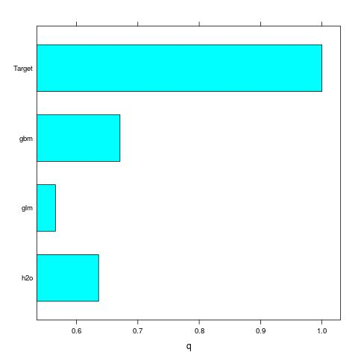
Modeling: Train, validation, test
GBM, GLM (Caret), DNN (h2o)
Ensemble as GLM (GBM,GLM,DNN)
Accuracy:
Right: GBM,GLM,DNN correlations (>0.6)
Below: accuracy in seconds
no overfitting (<2%)
Exp-Log-Target mean median (seconds) relative (ratio)
Log-Target MSE,mean and median
[1] "========= modeling ============"
[1] "== gbm Test"
[1] "error: mean, median, relative= 620 466 0.225 log mean, median= 0.22"
[1] "== gbm Train"
[1] "error: mean, median, relative= 664 444 0.21 log mean, median= 0.21 0.17"
[1] "== glm Test"
[1] "error: mean, median, relative= 668. 503 0.24 log mean, median= 0.236994782354311 0.19 "
[1] "== glm Train"
[1] "error: mean, median, relative= 734. 500. 0.24 log mean, median= 0.23 0.194 "
[1] "== h2o Test"
[1] "error: mean, median, relative= 630. 469. 0.227 log mean, median= 0.223 0.183 "
[1] "== h2o Train"
[1] "error: mean, median, relative= 688. 460. 0.22 log mean, median= 0.22 0.179"

Slide 26
Modeling: Train, validation, test
GBM, GLM (Caret), DNN (h2o)
Prediction for data-to-predict (test):
Below:
Three prediction results
Expected Error: MSE 630 seconds and Mean 470 seconds
"","delivery_id","prediction_gbm","prediction_glm","prediction_h2o"
"1","1b8016a8f04a857cf294faf9d74876c8",2117.32227056533,2065.08105558438,2198.45128418516
"2","f7cf0b8403dd310da0320e3d85066bb0",1743.55008056609,2330.93640637929,2664.40833665524
"3","5b3b4caa2c4a0505952a68bb3ffabf4f",1748.1656720945,1722.09790882929,1757.07637850143

