Slide 1
Implementing Model-View-ViewModel (MVVM) pattern
in Windows Presentation Foundation (WPF) applications

Slide 2
Contents
Model-View-ViewModel pattern overview
Data binding in WPF
Different approaches to implementing MVVM
Unit testing of user interfaces

Slide 3
Model-View-ViewModel pattern
Model-View-ViewModel pattern is a variation of Model-View-Controller (MVC)
The Model is the data or business logic, completely UI independent, that stores the state and does the processing of the problem domain.
  Doesn’t know anything about the ViewModel or the View.
The View is the structure, layout, and appearance of what a user sees on the screen.
  Defined declaratively, usually with a tool.
  Elements of the view are bound to properties of the ViewModel.
The ViewModel translates the model into a form that is easy to use for the view. It contains the interaction logic of the UI.
  Doesn’t know about the view (unlike the controller in MVC).
  Should not contain UI-specific elements like colors or font sizes

Slide 4
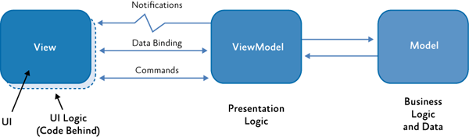
Model-View-ViewModel pattern
Notifications – INotifyPropertyChanged, INotifyCollectionChanged
Commands - ICommand

Slide 5
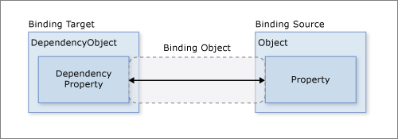
Data binding in WPF
Example:
  Binding Target – TextBox (must inherit from UIElement)
  Target Property – TextBox.Text
  Binding Source – SomeObject
  Source Property – SomeObject.SomeProperty (type string)
Code example: E01-DataBinding

Slide 6
Different approaches to implementing MVVM
View-first approach (E01-DataBinding)
  Use resources to define view models
  Requires parameterless view model constructors
ViewModel-first approach (E02-ViewModelFirst)
  Use resources to define data templates
  View models can have constructors
Use Prism’s Content Regions or other frameworks

Slide 7
Unit testing of user interfaces

Slide 8
Resources
Data binding overview in WPF
https://docs.microsoft.com/en-us/dotnet/desktop-wpf/data/data-binding-overview
Patterns - WPF Apps With The Model-View-ViewModel Design Pattern
https://docs.microsoft.com/en-us/archive/msdn-magazine/2009/february/patterns-wpf-apps-with-the-model-view-viewmodel-design-pattern
Introduction to Model/View/ViewModel pattern for building WPF apps
https://blogs.msdn.microsoft.com/johngossman/2005/10/08/introduction-to-modelviewviewmodel-pattern-for-building-wpf-apps/

