Slide 1
Computers and Society CPSC 430
Lecture 1 – Introduction
Giulia Toti
Original course material developed by Kevin Leyton-Brown: http://cs.ubc.ca/~kevinlb/teaching/cs430

Slide 2
Course Logistics
All the basics you need to know to get started

Slide 3
Course Organization
Class time:
Mon, Wed, Fri 1:30 – 4:00; SHRM B1009
Lead TA: Raymond Liu
TA team: Ross Tomita, Ch Muhammad Daud Virk, Heng Zhao
Office hours:
Instructor: Wednesday, 4:00PM - 5:00PM in ICCS 231, or by appointment
TAs:
Raymond, 4:00PM – 5:00PM, room TBA, for logistics/essays/peer reviews/accommodations
May add depending on demand

Slide 4
What if I’m on the wait list?
The waitlist is quite long – plan accordingly
Instructors are not involved, special cases are evaluated by undergrad advisors in the main office
Main office will prioritize the wait list by participation in the course
only highly active participants will be considered
if still oversubscribed, ordered by standard waitlist priority
No reduction in required course elements for having been on wait list
wait list registrants have access to MTA and CBTF; can be added to Piazza (ask)
if you have troubles, let us know!

Slide 5
Essays, peer review, and participation
Where will your grade come from? What will you need to do to succeed in the class?

Slide 6
Course Description
We’ll explore the interplay between information technology and society, emphasizing ethical issues.
You’ll come away with an increased:
understanding of the social and ethical implications of computer use and abuse;
ability to think critically and defend decisions logically;
appreciation for alternate points of view.
Our focus will be on reading, writing and discussion.
Each week students will complete an assigned reading, write a mini-essay in response, and evaluate the work of others.
Classes will emphasize discussion and debate.
The ability to speak, read and write fluently in English is essential for success in the class.

Slide 7
Grading Scheme
Weekly Essay Questions | 70 % | Due Mon & Fri at 1:30 PM
Weekly Peer Review | 20% | Due Mon & Wed at 6 PM
In-class participation | 10% | Every class
No exams, but the essay questions are mini-exams that you’ll write in the Computer Based Testing Facility
The course emphasizes making arguments and engaging with arguments made by your peers
We may change the exact percentage breakdowns shown here
This is not an easy course—something to hand in every class
Summer pace is particularly fast
On the other hand, you’ll learn a lot, and students who work hard throughout the term can expect to do well

Slide 8
In Class Attendance and Participation
Active participation in the class is a key element of this course
“Flipped classroom”: lectures don’t focus on transmitting information
Instead, they focus on interaction, discussion and critical analysis
Participating in class discussions contributes to your participation grade and reduces your peer grading workload:
We’ll use Agora to adjudicate in-class discussions
starting Wednesday, basis of participation grades
If you want to contribute to a discussion, you click a button to raise your hand
Every time I call on someone
one student with a raised hand will be randomly selected to respond
every student who had a hand raised will be recorded for participation purposes
Raising your hand reduces the number of peer reviews to 3 instead of 5 for the following deadline (typically, Friday for Monday and Monday for Wednesday).

Slide 9
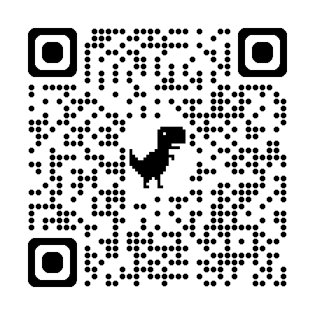
Let’s Take a Minute to Log Into Agora
Platform to manage in class discussions
log in at https://agora.students.cs.ubc.ca/ using your CWL; enroll code for first time access: 40993.

Slide 10
Calculating Your 10% Participation Grade
Raising your hand (even if you are not called to speak) counts as participating
If you’re chosen to speak
you will probably not be chosen to speak again during the same class
unless the only hands raised are from students who have already spoken
you’ll be counted as having raised your hand for the remainder of the class
But not if you leave right after having being called to answer! That cancels the points for the day
Raise your hand this many times | Get this many points
0 | 0
1 | 5
2 | 6
3 | 6.5
4 | 7
The median among students who participated at least once | 8
The maximum among students who participated at least once | 10
Linear interpolation (see Canvas)

Slide 11
How participation affects your grade
Severe consequences for trying to game the system
If you clearly just raised your hand for points rather than to contribute to the discussion, you’ll get zero points for the entire day
regardless of how many other points you might have been awarded earlier that day
If you use Agora to raise your hand while not physically present in the class, this will be treated as a case of academic misconduct and serious penalties will apply
TAs will always be able to see a real-time list of which students have put their hands up
The instructor has access to UBC Card photos via Workday
We reserve the right to verify physical attendance even for students who are not called upon.

Slide 12
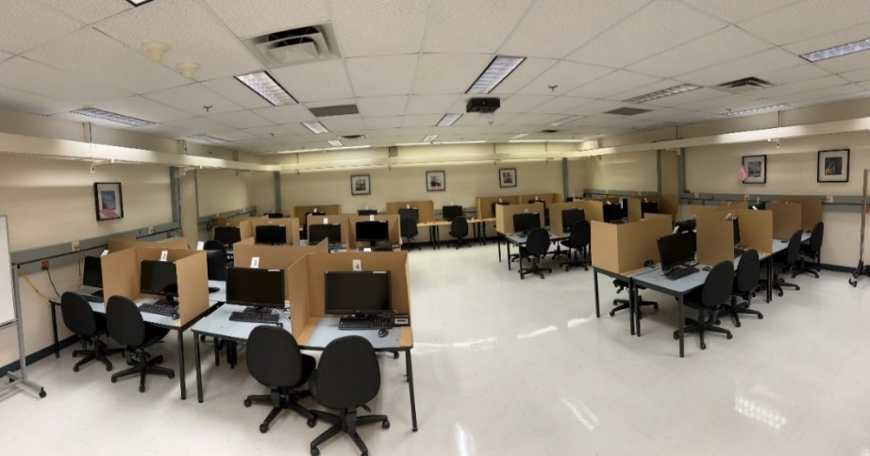
Essays in the CBTF
First, you need to enroll for 430 in PrairieTest. (Some of you may already be enrolled; you'll find out when you try.)
You will have to book a slot before you can use it. Slots are 50 minutes long. You can make these ~10 days in advance and can adjust your reservation time up to 30 mins before your reservation starts.
You'll need to bring your student ID for each reservation. You're not permitted any electronic devices during your exam.
If you have an accommodation through the Accessibility Center, you'll most likely receive your accommodation at the CBTF.
You will get the essay prompt in advance. I recommend writing an outline and planning what you intend to write before heading to the CBTF.
You're welcome to use ChatGPT (or a friend) to help you plan your essay, but you can't bring any materials with you into the CBTF, so you'll have to write in your own words.
Surveys of students in past offerings of the course indicate that they found 50 minutes long enough to write their essays. If you need more time, you can book a second slot and continue to edit (until the firm submission deadline).

Slide 13
Grading Your Essays
You’ll receive at least 3 peer reviews of your work, each week
These reviews will be double-blind (you won’t know who reviewed you)
You’ll be graded on a five-point scale on four dimensions:
Was the essay well structured, stating a thesis, supporting it with argument(s) that are clearly related to this point and (if relevant) distinct from one another, and linking these arguments in a logical way?
Did the essay do a good job of making its case, choosing relevant arguments, backing them up with evidence and examples at an appropriate level of detail, and responding to contrary views as appropriate?
Did the essay demonstrate a good understanding of the course’s subject matter, including both the topic and the wider context?
Was the essay presented clearly and in correct English?
Non-linear scale ([0] 25; 50; 65; 80; 100); elements unevenly weighted (English counts only 1/5 as much)
Reserve 0 for completely missing/off topic answers
You’ll also get comments on each item, and an outline of your essay
When you also receive a review by a TA: only the TA evaluation matters for your grade
When you are evaluated only by peers: each of your peer grades will be weighted in proportion to our estimates of your peers’ dependability as graders
If you disagree with your grade you can appeal, and a TA will re-grade your essay; this grade will be final
Essays are worth increasing amounts as the term goes on
your first 3 essay grades will be scaled by 0.6;
your next 3 essay grades will be scaled by 0.8;
your final 4 essays will be scaled by 1.0.

Slide 14
Peer Review: Reviewer Perspective
Do at least 3 calibrated reviews by each deadline if you’re required to do so
Week 1: this means everyone!
Week 2+: only if required
Complete the reading quiz to access peer reviews (same deadline as essays)
Do assigned reviews of others’ essays
How we’ll calculate your peer review grade (20% of the course):
Scaled dependability scores, snapshotted each week
We'll scale your peer review grades like your essay grades:
your first 3 peer review grades will be scaled by 0.6;
your next 3 peer review grades will be scaled by 0.8;
your final 4 peer review grades will be scaled by 1.0.
If you don’t do all required reviews (peer reviews; calibrations when required) your dependability-based grade will be scaled down; see Canvas for formulas
Notes:
ungraded reviews: you get the average across graded reviews plus 10%

Slide 15
Types of Peer Review
Calibrated peer review
Grading essays from previous years that we’ve graded already
Confirms that we all understand the grading scheme in the same way, and shows you examples of weak and strong essays
Supervised peer review
Grading essays from this year when you haven’t yet demonstrated proficiency at peer review
A TA will grade the same essays, and only the TA grade will count
The TA will also assess whether you made thoughtful comments
Unsupervised peer review
Grading essays from this year once you’ve demonstrated proficiency
Your review may be spot checked or appealed: checked by TA
Spot checks: very positive ratings; severe disagreements; random
We’ll update your dependability score based on your degree of agreement with peers (taking their own dependability into account) and, when available, degree of agreement with TAs

Slide 16
Estimating Dependability
We maintain estimates of each peer grader’s “dependability” via Bayesian inference
The key idea is that calibrations and assignments graded by TAs give us information about which graders are more reliable
we then bootstrap this knowledge to decide how much to trust each grader on assignments that were not graded by a TA
Your dependability score is our estimate of sensitivity * (1/variance)
sensitivity is (1 – prob that you assign some value near the class average without considering the essay)
variance is your tendency to differ from true grades
The system starts out with the assumption that all students have low dependability scores (specifically, low sensitivity and high variance)
As you grade assignments/calibrations, we update these beliefs
doing more calibrations both helps you get better at grading and gives us evidence to counteract the system’s pessimistic initial belief
if you always assign values close to the class average, we’ll conclude that you have low sensitivity
you need to properly identify both strong and weak assignments in order to achieve a high dependability score
if you grade too harshly or too generously, we’ll conclude that you have high variance

Slide 17
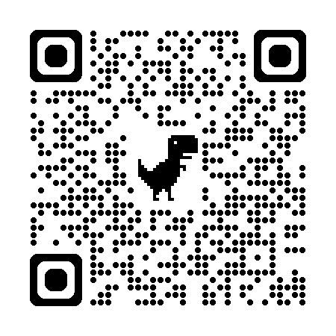
Let’s Take a Minute to Log Into MTA
Platform for quizzes, peer reviews and essays (the latter to be completed at the CBTF)
Log in at https://mta.students.cs.ubc.ca/ using your CWL; enroll code for first time access: 520809

Slide 18
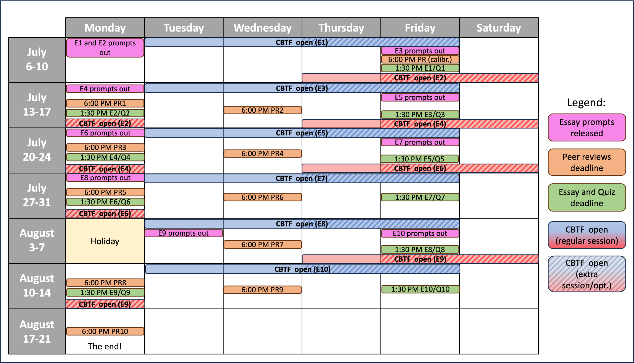
Summary of deadlines

Slide 19
“What if something goes wrong, and I can’t submit an essay/review?”
We’ll drop your worst 2 essay and peer review grades, allowing for cases where:
you miss the (firm) deadline
you’re sick, out of town, have a conflict with another course, …
you face hardships due to the pandemic
you register for the course late
you get a poor grade on one essay
(We’ll renormalize your grades accordingly)
We'll also drop the 2 classes in which you have the lowest participation grades
Other extensions or waivers will be granted only in truly exceptional circumstances
Unless you have an exceptional excuse, you’ll simply get a grade of zero
(Brief) illness isn’t an exceptional excuse, see above
Registering in the course late isn’t an exceptional excuse
If you’re on the waitlist, start actively participating now!

Slide 20
Academic Honesty
Students are expected to acknowledge ideas generated by others and to uphold the highest academic standards in all of their actions
Plagiarism is a serious offence and will be dealt with harshly
Plagiarism is the unattributed use of any external source (e.g., another student, a web site, a book, generative AI) in work for which a student takes credit, or the inappropriate use of any external source whether or not attribution is made
You must write in your own words
Any text that you take verbatim from another source must be in quotation marks and followed by a citation
Other violations of academic honesty:
using generative AI (or another person) to write your peer review
“Raising your hand” to participate in class while not physically present

Slide 21
This all starts right away!
Before next class:
read the assigned readings on essay writing (Additional resources 1-7)
Log into Agora
Join Piazza (through Canvas)
By Friday, 1:30 PM:
log in to “Mechanical TA” and:
complete the reading quiz (or you can’t do peer reviews later)
write an outline for your short essay of up to 150 characters
Write your essay in the CBTF; you have to book an appointment first
By Friday, 6 PM:
perform calibrated peer reviews; try to get into the independent pool
Don’t leave this to the last minute!
It might take you a bit of time to get your accounts set up, etc.
Not everyone can have a CBTF slot immediately before next class
For everything else, check Canvas

Slide 22
Course content
OK, I get where the room is and how you’ll compute my grade. What will we be learning?

Slide 23

Textbook
We will be using the textbook Ethics for the Information Age, 9th Ed, by Michael J. Quinn.
It’s important that you have a copy, because we’ll be reading the whole thing
Old editions exist, but you’re responsible for all material in the 9th edition.

Slide 24
Topics (pretty cool stuff, actually ☺)
Writing and argumentation, History of computing, storage, networking
Ethics & Argumentation
Social issues:
Networked communications – Computer & Network Security
Intellectual Property – Computer Reliability
Information Privacy – Professional Ethics
Privacy and the Government – Automation and Globalization
Artificial Intelligence
Rest of today:
break into 18 groups
get assigned a statement and a position for or against
develop arguments for your assigned position
present your arguments to the class; we’ll discuss briefly
everyone votes on the issue (you vote freely)
we’ll revisit these questions throughout the course. You’ll get to see if your opinions change.

Slide 25
Small Groups
Networked Communications “Social networks should be held legally liable for the content of any post promoted to the feeds of over 100,000 users.” 1: for; 10: against | Intellectual Property “The Canadian government should impose $50 fines per infraction for illegal streaming of movies and TV shows, charged directly to an internet subscriber’s account, after three warnings.” 2: for; 11: against | Information Privacy “It should be illegal for shopping malls to install cameras for tracking customer behavior.” 3: for; 12: against
Privacy and the Government “It should be illegal to sell a mobile phone that cannot be decrypted by the police if so ordered by a court.” 4: for; 13: against | Computer and Network Security “Canadians should be able to vote online in federal, provincial and municipal elections.” 5: for; 14: against | Computer Reliability “Chatbots should be prohibited from offering advice on any topic about which a human would not be allowed to offer similar advice without holding a professional license (e.g., drafting legal documents; diagnosing disease; psychotherapy.)” 6: for; 15: against
Professional Ethics “Computer scientists and data scientists should not aid in the development of autonomous weapon systems.” 7: for; 16: against | Automation and Globalization “The activity of a company's employees on their work computers, such as what applications they have opened and for how long, should be considered private and may not be tracked by the company.” 8: for; 17: against | Artificial Intelligence “Content generated by artificial intelligence systems (e.g., ChatGPT, DALL-E) that require minimal human input should not receive copyright protection.” 9: for; 18: against

Slide 26
If Time Permits…
Break into small groups
What topic at the interface of computers and society concerns you most?
How should we go about evaluating arguments about what should be done to address this issue?

