Slide 1
Privacy Lecture 5
Computers & Society (CPSC 430)
Giulia Toti

Slide 2
Getting Started with Privacy
What is Privacy?
Work in a group.
Come up with the best definition of the term you can.
Try to think of
The example least like privacy that is still captured by your definition
The example most like privacy that fails your definition
(We’re not worried at this point about whether privacy ought to be a right; that’s our next topic)

Slide 3
Defining Privacy
Privacy is related to the notion of access
Physical proximity to you
Knowledge about you
Byrne: Privacy is a “zone of inaccessibility”
your ability to deny others access to you
Bloustein: Privacy violations are an affront to human dignity
Too much individual privacy can harm society
Can you think of examples?
Key question: Where to draw the line?
Does the line change depending on our role in society?

Slide 4
Benefits and Harms
Harms of Privacy
Cover for illegal or immoral activities
Burden on the nuclear family
With less privacy comes more broadly shared responsibility
Relatedly, allows dysfunctional families to remain hidden
Ignored people on society’s fringes
cursed with too much privacy
Benefits of Privacy
Individual growth & responsibility
Individuation, a key psychological stage, requires privacy
Without privacy, you can’t be considered free, hence held responsible
Freedom to be yourself
not having to act as though others are watching, maintain a public persona
Focus your thoughts on a creative (or religious) task without interruption
Development of loving, trusting, caring, intimate relationships
inconceivable without the “moral capital” of privacy

Slide 5
Is There a Natural Right to Privacy?
Morton Levine: Privacy rights stem from property rights
“a man’s home is his castle”
Warren and Brandeis: An explicit “right to be let alone”
Noted that libel and slander laws don’t prevent people from saying mean, true things about you
Thomson: violations of “Privacy rights” are also violations of other rights
So, we don’t need to treat privacy separately
Benn and Reiman: Some amount of privacy is necessary for people to be autonomous, moral agents, to develop healthy relationships, and to act as free citizens.
Is privacy a right?
Is it nice to have?
worth recognizing for the good of society, though not a natural right
Or do we have no such right at all?

Slide 6
Privacy and Trust
Modern life more private
Challenge: living among strangers
Remedy: establishing reputations
Ordeal, such as lie detector test or drug test
Credential, such as driver’s license, key, ID card, college degree
Establishing reputation is done at the cost of reducing privacy

Slide 7
Ways Information Becomes Public
Rewards or loyalty programs
Body scanners
Digital video recorders
Automobile “black boxes”
RFIDs
Airtags
Tracking pixels
Cookies
Spyware
…can you think of others?

Slide 8
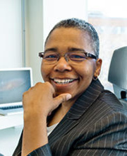
Breaking anonymized datasets
Zip Code | Birthday | Sex | Name | Address
12345 | 10-Jan-1958 | M | William Weld
Image from https://www.iq.harvard.edu/people/latanya-sweeney
MR1 | MR2 | Zip Code | Birthday | Sex
 |  | 12345 | 10-Jan-1958 | F
… | … | 12005 | 10-Jan-1958 | F
 |  | 10094 | 10-Jan-1958 | F
 |  | 12345 | 10-Jan-1958 | M
 |  | 11144 | 10-Jan-1958 | M
 |  | 18001 | 10-Jan-1958 | M
Material based on “The ethical algorithm”, by Kearns and Roth
Notes:
Mid 1990s, a government agency in Massachusetts (Group Insurance Commission, GIC) released summaries of hospital visit for every state employee.
Anonymous, but included zip code, birthday and sex.
Latanya Sweeney, a PhD student at MIT, proved that the data was identifiable. She paid $20 to purchase the voter rolls of Cambridge, where the governor (William Weld) lived. The voter roll include name, address, zip code, birthday and sex. By matching these data, she identified the records of the governor, and sent it to him.

Slide 9
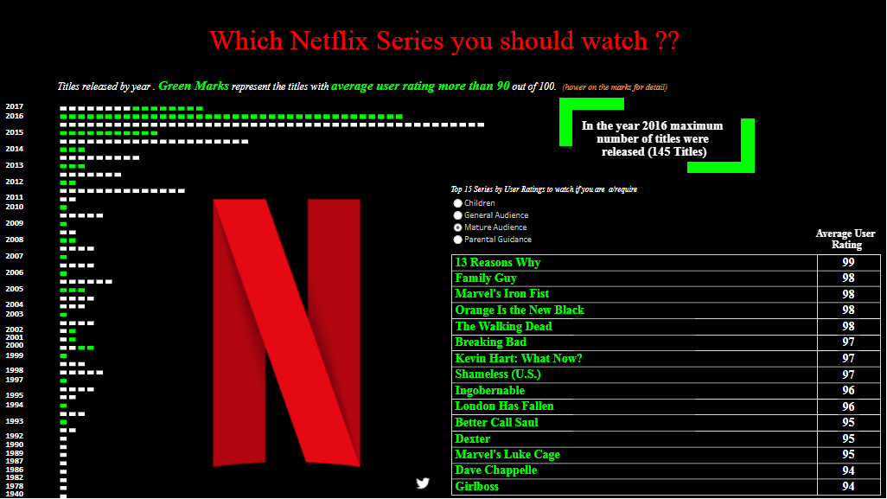
Breaking anonymized datasets
Netflix bumped into a similar problem, in a much less obvious way.
In 2006, they launched a competition to improve movie recommendations.
They shared more than 100 millions movie ratings, from about half a million users.
Arvind Narayanan, a PhD student at UT Austin, was able to identify this anonymous data using a small amount of imprecise information, often available on movie rating websites.
Movies I rated on Netflix
Movies I rated online
Material based on “The ethical algorithm”, by Kearns and Roth

Slide 10
Data Mining
Data mining
Searching for patterns or relationships in one or more databases
This info typically provided by the customer for another purpose
Many internet services provided as an opportunity to gather valuable data
Google; Facebook; free online courses
Also performed by the government
Efforts to detect terrorism via phone, bank, travel records
Tax audits
Questions:
Ownership: do you have any rights over info about transactions in which you participated?
Ethics: what data mining activities are unethical? Which are ethical?
Does it make a difference whether DM is opt-in or opt-out?
At what point does DM become “creepy”?
Should we worry about ending up in a “personalization bubble”?

Slide 11
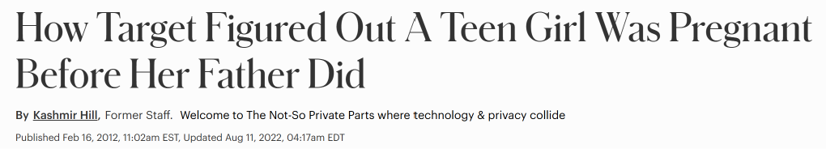
Targeting pregnant customers
https://www.forbes.com/sites/kashmirhill/2012/02/16/how-target-figured-out-a-teen-girl-was-pregnant-before-her-father-did/
Did Target act unethically?
Would your answer change if they were more explicit in their advertising?

Slide 12
LLMs training data extraction attack
LLMs are trained to generate text from hundreds of billions or trillions of tokens, largely collected from the internet
LLMs then have to be fine tuned to provide helpful and safe responses
Supervised Fine Tuning
Reinforcement Learning from Human Feedback
The information is not so much removed as it is hidden
When a model is pushed outside its normal conversational boundaries, it may revert to raw text completion
Token Repetition
True-Prefix Prompting
Special Characters Attacks (SCA)
https://arxiv.org/abs/2012.07805

Slide 13
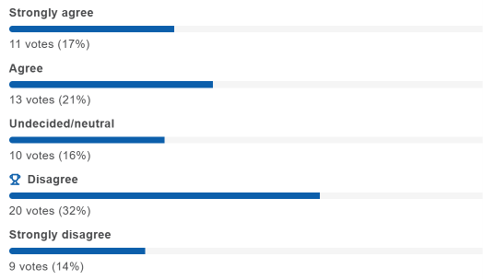
Information Privacy
“It should be illegal for shopping malls to install cameras for tracking customer behavior.”
Results of first voting

