Slide 1
More workable ethical frameworks Lecture 2-2
Computers & Society (CPSC 430)
Giulia Toti

Slide 2
Recap: Unworkable Ethical Theories
What is an ethical theory?
What do we mean by a workable theory?
What does each unworkable theory consist of?
subjective relativism
cultural relativism
divine command
ethical egoism

Slide 3
Recap: Kantianism
What is the categorical imperative?
“Speeding in traffic is unethical because if everyone did it driving would become terribly dangerous” – is this argument following either formulation of the categorical imperative?

Slide 4
Utilitarianism

Slide 5
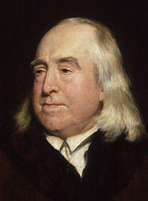
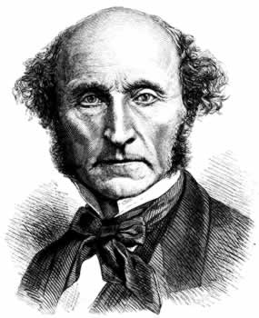
Principle of Utility
An action is good if it benefits someone
An action is bad if it harms someone
Utility: tendency of an outcome to produce happiness or prevent unhappiness for an individual or a community
Happiness = benefit = good = pleasure
Unhappiness = cost = evil = pain
Jeremy Bentham & John Stuart Mill

Slide 6
Principle of Utility (“Greatest Happiness Principle”)
An action is right (or wrong) to the extent
that it increases (or decreases) the
total happiness of the affected parties.

Slide 7
Utility Overview
A Consequentialist Theory
Morality of an action has nothing to do with intent or following rules (deontological theories)
Focuses on the consequences
We shouldn’t just randomly make up utility numbers
what matters is the relative magnitude of different utilities in a calculation
e.g., gains to person A are 10x larger than harms to person B
there’s actually a mathematical basis for coming up with these numbers: see von Neumann & Morgenstern Utility Theory
if we’re unsure about what numbers to pick, consider the smallest plausible ratio and the largest plausible ratio, then ask if the overall assessment changes
Utility still works when we’re unsure about what consequences will follow from the proposed action
assign each potential outcome a probability
compute expected utility: the sum of each outcome’s utility, weighted by its respective probability

Slide 8
Act Utilitarianism
Act utilitarianism
Add up change in happiness of all affected beings following from a given action
Sum > 0, action is good
Sum < 0, action is bad
How useful is act utilitarianism?
discuss with the person beside you
report back

Slide 9
Case for Act Utilitarianism
Focuses on happiness, which is intuitive
Down-to-earth (practical)
Straightforward to apply
Can therefore be helpful in resolving disputes
decomposes big issues into lots of little questions
Comprehensive
Allows an agent to trade off different aspects of a situation
Contrast with Kantianism: we needed to find one rule

Slide 10
Case Against Act Utilitarianism
Unclear whom to include in calculations
Utilitarians might say you should never exclude anyone…
Too much work
But it’s OK to follow a “rule of thumb” most of the time.
Ignores our innate sense of duty
Suppose I make a promise, but can get $1 for violating it.
Seems to miss the sense that I care about my word.
Quinn claims: “Note that it does no good for an act utilitarian to … say that the hard feelings caused by breaking my word to A will have a negative impact on total happiness of –N units, because then all I have to do is change the scenario so that breaking my promise to A enables me to produce 1,001 + N units of good for B. We’ve arrived at the same result.”
But is this a problem?
Susceptible to the problem of moral luck
Whether an action is moral depends on outcome, which can depend on circumstances beyond your control

Slide 11
Rule Utilitarianism
We ought to adopt moral rules which, if followed by everyone, will lead to the greatest increase in total happiness
Act utilitarianism applies Principle of Utility to individual actions
Rule utilitarianism applies Principle of Utility to moral rules
How is this different from Kantianism?

Slide 12
Case for Rule Utilitarianism
Not every moral decision requires utilitarian calculus
You only have to work out the morality of rules.
Moral rules survive exceptional situations
A rule utilitarian can reason (a bit like a Kantian) that it’s better for everyone to keep their promises than to lie, and so reject lying for a $1 gain
Avoids the problem of moral luck
We look at the overall usefulness of the rule, not individual outcomes

Slide 13
Case Against RU, and Utilitarianism in General
RU: need to identify a single rule to describe situation
All consequences must be measured on a single scale
All units must be the same in order to do the sum
In certain circumstances utilitarians must quantify the value of a human life
BUT: good arguments from utility theory
We have to figure out what this utility function is!
Utilitarianism ignores problem of unjust distribution
Utilitarianism (as defined here) doesn’t mean “the greatest good for the greatest number”
That requires a principle of justice
We can try to combine these ideas
However, what happens when a conflict arises between the Principle of Utility and our principle of justice?

Slide 14
An Example
Is it ethical to pay a ransomware attacker to unlock my data?
Discuss quickly with a partner
Act Utilitarianism:
for me: my data is worth more than the payment so I’m better off paying
for the attacker: prefers to be paid
for everyone else: me paying the attacker increases the risk of more attacks, but not by much
Rule Utilitarianism:
rule: people should pay ransomware attackers to unlock their data
if everyone followed the rule, attacks would be much more common
if nobody followed the rule, attacks wouldn’t succeed so attackers wouldn’t try
even though we’re individually better off by paying, we’re collectively better off if nobody pays

Slide 15
SOCIAL CONTRACT THEORY

Slide 16
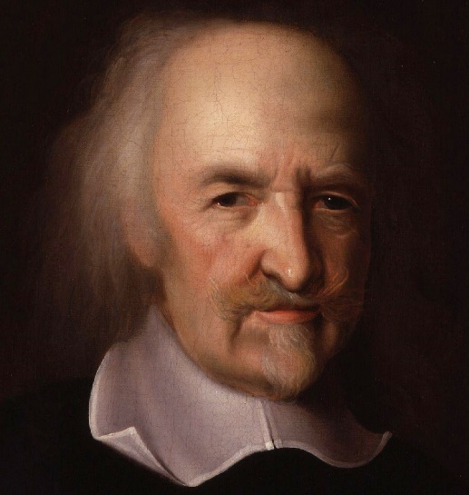
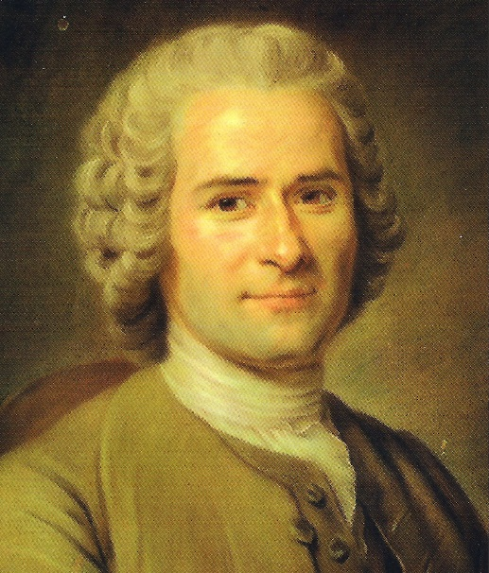
Social Contract Theory
Thomas Hobbes
“State of nature”
We implicitly accept a social contract
Establishment of moral rules to govern relations among citizens
Government capable of enforcing these rules
Jean-Jacques Rousseau
In ideal society, no one above rules
That prevents society from enacting bad rules
1588-1679
1712-1778

Slide 17
Social Contract Theory Definition of Morality
James Rachels:
“Morality consists in the set of rules, governing how people are to treat one another, that rational people will agree to accept, for their mutual benefit, on the condition that others follow those rules as well.”

Slide 18
Kinds of Rights
Negative right:
A right that another can guarantee by leaving you alone
Positive right:
A right obliging others to do something on your behalf
Absolute right:
A right guaranteed without exception
Limited right:
A right that may be restricted based on the circumstances
Positive rights tend to be more limited
Negative rights tends to be more absolute

Slide 19
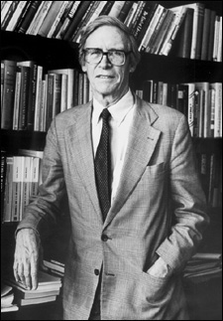
John Rawls’s Principles of Justice
Rawls argues that we can have preferences across different social contracts
Better for each person to be able to claim a “fully adequate” number of basic rights and liberties, so long as these claims are consistent with everyone else making the same claims
Any social and economic inequalities must
Be associated with positions that everyone has a fair and equal opportunity to achieve
Be to the greatest benefit of the least-advantaged members of society (the difference principle)

Slide 20
Rawls’s Difference Principle

Slide 21
Case for Social Contract Theory
Framed in language of rights
Intuitive and natural
Explains why people act in self-interest without common agreement
Logically, it’s the best thing to do
See “Tragedy of the commons”
Provides clear analysis of certain citizen/government problems
Why is it right to punish someone for a crime?
Why is civil disobedience justifiable?

Slide 22
Case Against Social Contract Theory
No one signed contract
Some actions have multiple characterizations. In such cases, we don’t learn how to make trade-offs between these conflicting rights.
Same problem we saw with Kantianism, though there it was phrased in terms of duties instead of rights.
May unjustly treat people who cannot uphold contract
In principle, we should distinguish between people who can’t follow the contract, and those who choose not to.
In practice, this can be hard to do.

Slide 23
Movie Streaming Scenario
InterMovies is a site that streams TV series and movies for a flat monthly fee
Collects information about media choices from customers
Constructs profiles of customers
Sells profiles to direct marketing firms
Some customers happy to receive more targeted marketing; others unhappy at loss of privacy

Slide 24
Evaluation (Social Contract Theory)
Consider rights of InterMovies, customers, and other companies
Do customers have the right to expect contact info to be kept confidential?
If customer watches a show using InterMovies, who owns information about transaction?

Slide 25
What do you think about InterMovies?
Let’s explore both scenarios. Working in groups of 3-4 consider whether each point of view can be justified using social contract theory.
OPTION A: Customer doesn’t have the right to privacy
OPTION B: Customer does have the right to privacy
Try to construct a set of rules that rational people would accept as beneficial, given that others would accept these ideas as well.
Does this system of rules meet Rawls’ conditions?

Slide 26
Let’s vote:
We can justify the no-privacy scenario
We can justify the privacy scenario
Which social contract would you prefer

Slide 27
VIRTUE ETHICS

Slide 28
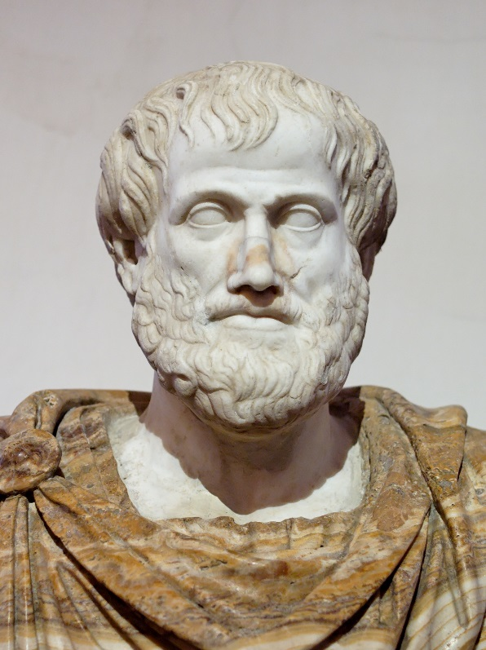
Virtue Ethics
Aristotle: true happiness and human flourishing lies in living a life of virtue
virtues are not just dispositions towards action, but towards feeling
you develop virtues by habitually repeating the relevant virtuous actions
e.g., develop honesty by telling the truth
“The virtues are those character traits human beings need in order to flourish and be truly happy. A virtuous person is a person who possesses and lives out the virtues. A right action is an action that a virtuous person, acting in character, would do in the same circumstances.”

Slide 29
What are the virtues?
Different virtues are emphasized in different cultures, but most cultures seem to prize the same things
Vices are the opposites of virtues
often there are two vices associated with the same virtue
e.g., courage lies between cowardice (too much fear) and rashness (too little fear)

Slide 30
Virtues and Vices according to Aristotle
Vice of Abstinence | Virtue | Vice of Excess
Being too afraid to act (cowardice) | Doing the right thing when necessary (courage) | Acting without thinking (rashness)
A lack of awareness or concern for others (insensibility) | Self-control and the ability to moderate one’s behaviour (temperance) | Lack of self-control, endangering others (intemperance)
Meanness/unwillingness to share with others (illiberality) | Giving and spending one’s money freely on others (generosity) | Being wasteful and focused on one’s own pleasure (prodigality)
Being small minded; concerned with trivial matters (pettiness) | Being open to ideas and free from prejudice (munificence) | Holding obscene and extremist views (vulgarity)
Being overly humble (humble-mindedness) | Having strong moral principles (high-mindedness) | Having excessive pride in oneself (vanity)
Being unmotivated/lacking ambition (want of ambition) | Having a just and good purpose to one’s actions (right ambition) | Seeking to put oneself above all others (over-ambition)
Not caring about life, lacking excitement, vigour, spirit (spiritlessness) | Enjoying life and sharing this with others (good temper) | Being too easily angered (irascibility)
Being unfriendly to others (surliness) | Being civil and kind to others (friendliness) | Being too obsessed with serving others (obsequiousness)
Being too self-deprecating (ironical deprecation) | Being sincere about yourself and others (sincerity) | Boasting about one’s own achievements (boastfulness)
Being a boring person (boorishness) | Being witty/funny/charming (wittiness) | Acting the fool to please others (buffoonery)
Having no shame when it comes to one’s actions (shamelessness) | Being modest about one’s achievements (modesty) | Being overly embarrassed about one’s behaviour (bashfulness)
Being uncaring about the feelings of others (callousness) | Wanting justice for those that deserve it (just resentment) | Choosing to hurt others (spitefulness)

Slide 31
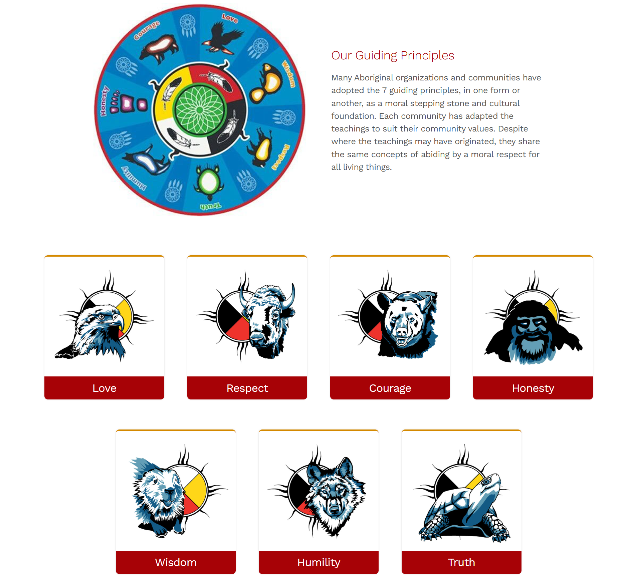
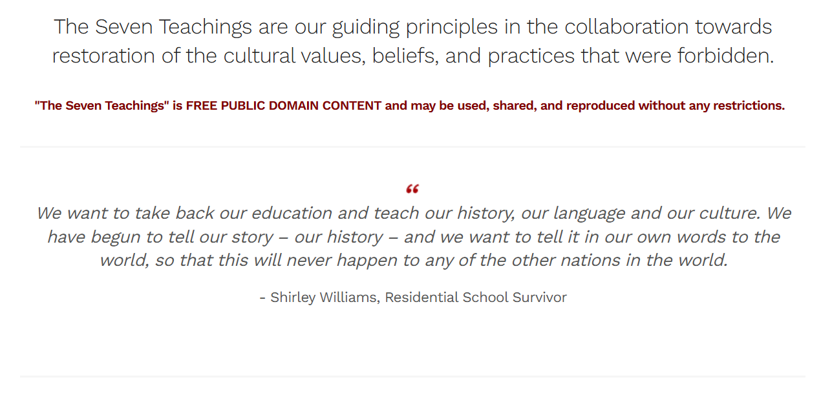
The Seven Teachings
Source: https://www.southernnetwork.org/site/seven-teachings (Manitoba)

Slide 32
Case for Virtue Ethics
Reasoning from virtue may be more intuitive
e.g., stealing is bad because it is dishonest, not because it decreases utility
We don’t have to treat all other people equally
we can be partial towards our friends, family
Recognizes that we mature morally over time
“There are no irresolvable moral dilemmas”
not entirely clear how we’re supposed to resolve everything
we’re told “the right action can always be determined by a person with sufficient moral wisdom”
Recognizes the importance of emotion

Slide 33
Case Against Virtue Ethics
Disagreement over the virtues
our other workable theories are universal
virtue ethics can only be applied given a set of virtues—and reasonable people disagree
Cannot be used to guide government policy
focus on moral actors, not on making good decisions
e.g., should we build a highway?
Undermines attempts to hold people responsible
we develop over time, and we’re the product of our environments
how can we say someone’s responsible for acquiring vices instead of virtues?

Slide 34
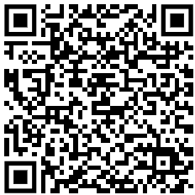
Exercise
The British government has placed hundreds of thousands of cameras in public places and runs face recognition software that allows the tracking of individuals across cities. The resulting data is used by police to deter and prosecute crimes, and also by the intelligence services for purposes that are not disclosed publicly. The British public is broadly supportive of this initiative, but a substantial minority disagrees.
Is this initiative ethical from the following perspective:
act utilitiarian
rule utilitarian
social contract theory
virtue ethics
https://www.theguardian.com/uk-news/2017/mar/14/public-faces-mass-invasion-of-privacy-as-big-data-and-surveillance-merge

Slide 35
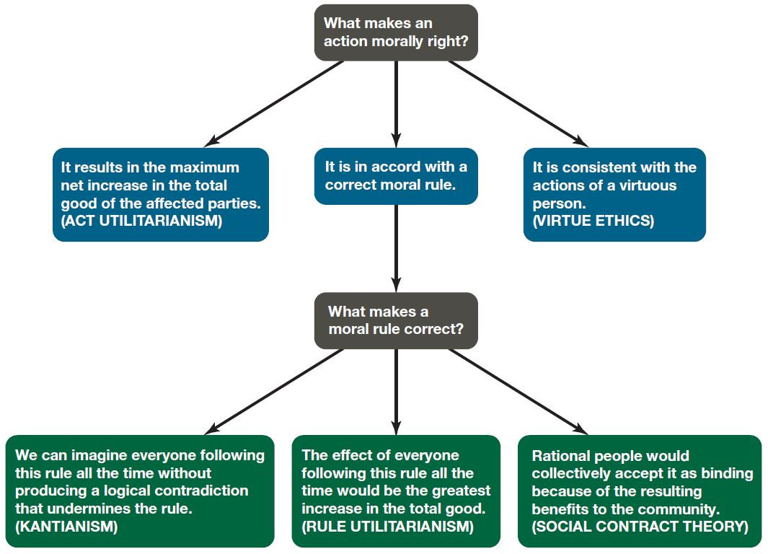
Comparing Workable Ethical Theories

