Slide 1
Analyzing Police Misconduct in North vs. South of Chicago
The Wise Kingfishers:
Roman Svintitskyy and Shalini Roy

Slide 2
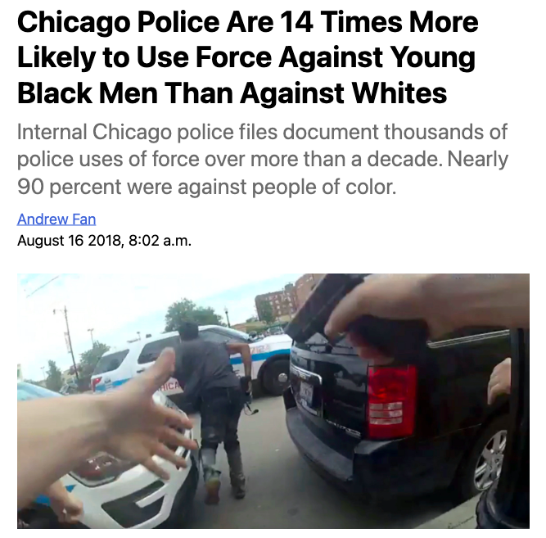
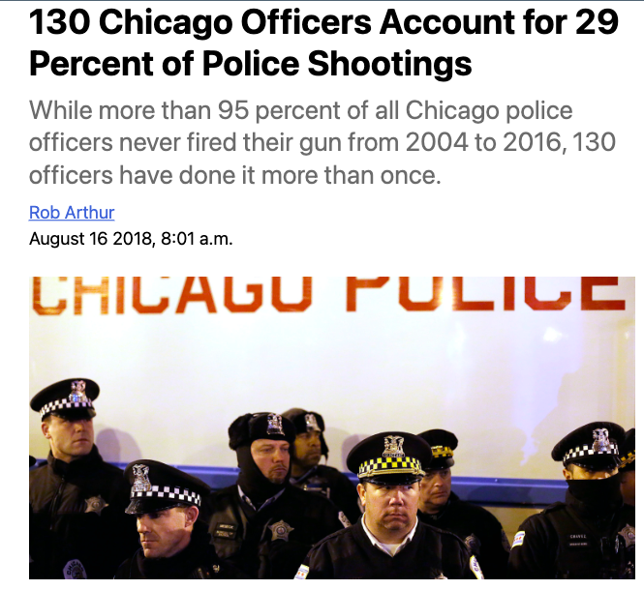
Background
Notes:
Police articles : Roman

Slide 3
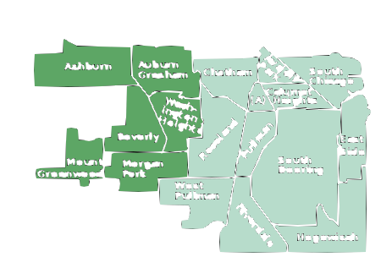
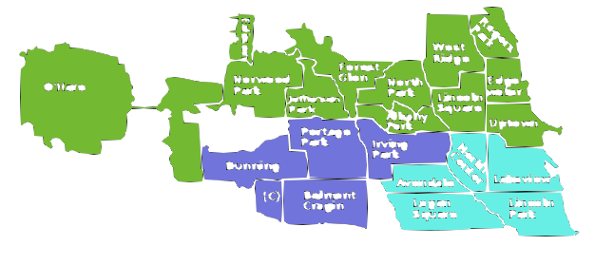


Objectives
Study a pattern of allegations of procedural misconduct by police officers in North vs. South sides of Chicago, while paying special attention to the racial, gender, and economic aspects.

Slide 4
SQL

Slide 5
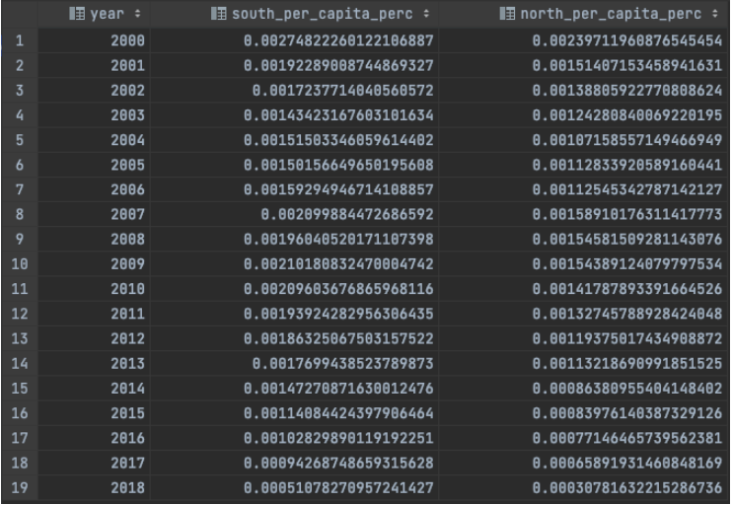
Q1: How many complaint reports are filed per capita on the north and south sides annually?
Complaints per capita south greater for every single year.

Slide 6
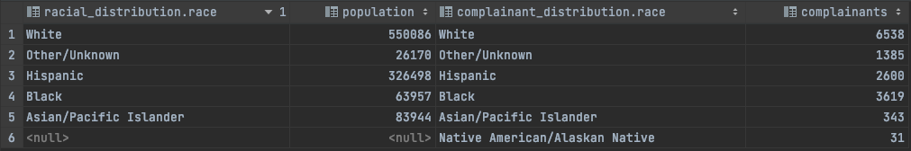
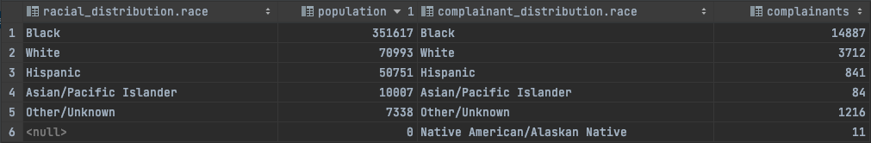
Q2: What is the racial distribution of the complainants and the general population in the North vs. South sides of Chicago?

Slide 7

~ 1% total white pop.
~ 5% total resp. pop.
~ 4% total black pop. (3 times more on average than hispanics)
~ 5% total white pop.
~ 16% total o/u pop.
What other factors apart from race are contributing to police misconduct on both sides of Chicago?

Slide 8
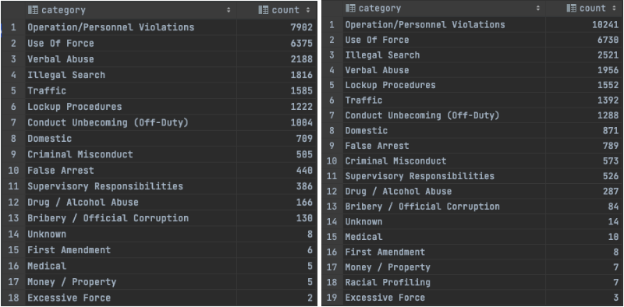
Q3: What is the distribution of complaint categories in the North vs. South sides of Chicago?

Slide 9

Q4: What is the median income of the population on the North vs. South sides of Chicago?

Slide 10
D3 Data Visualizations

Slide 11
Q1: What is the distribution of complaint categories across the North and South of the city? Within those categories, how many complaints involved using weapons or firearms by police officers?

Slide 12
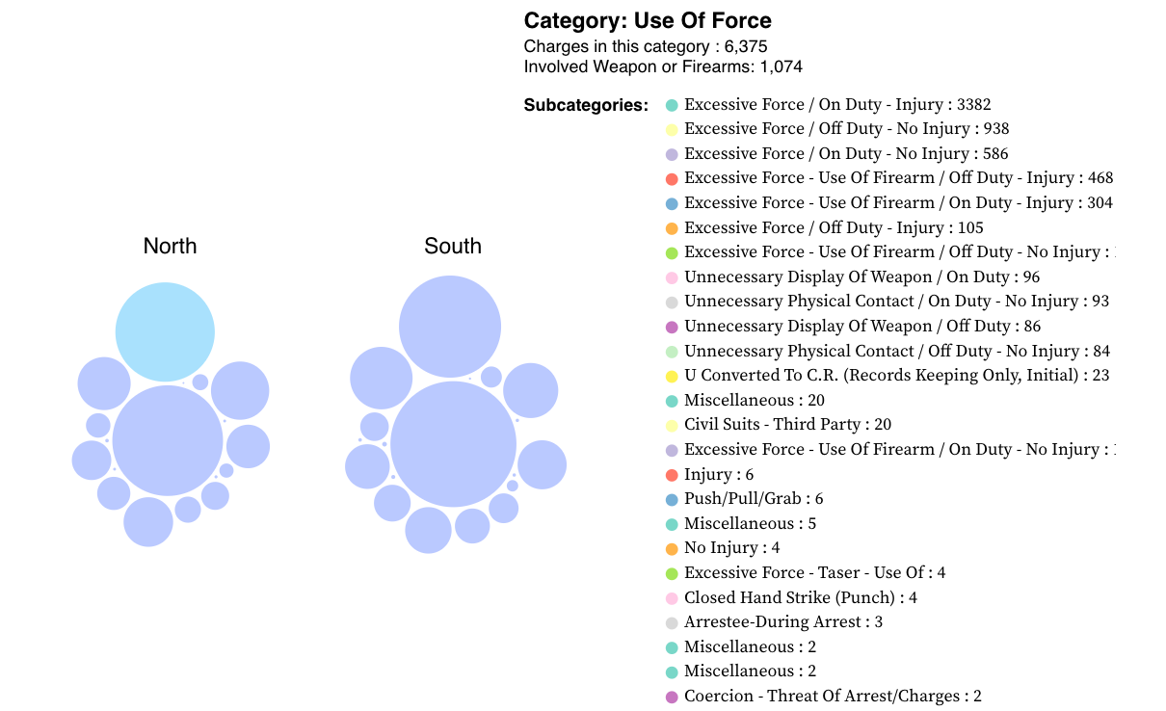
Top 3: Operation/Personnel Violations, Use of Force, and Verbal Abuse

Slide 13
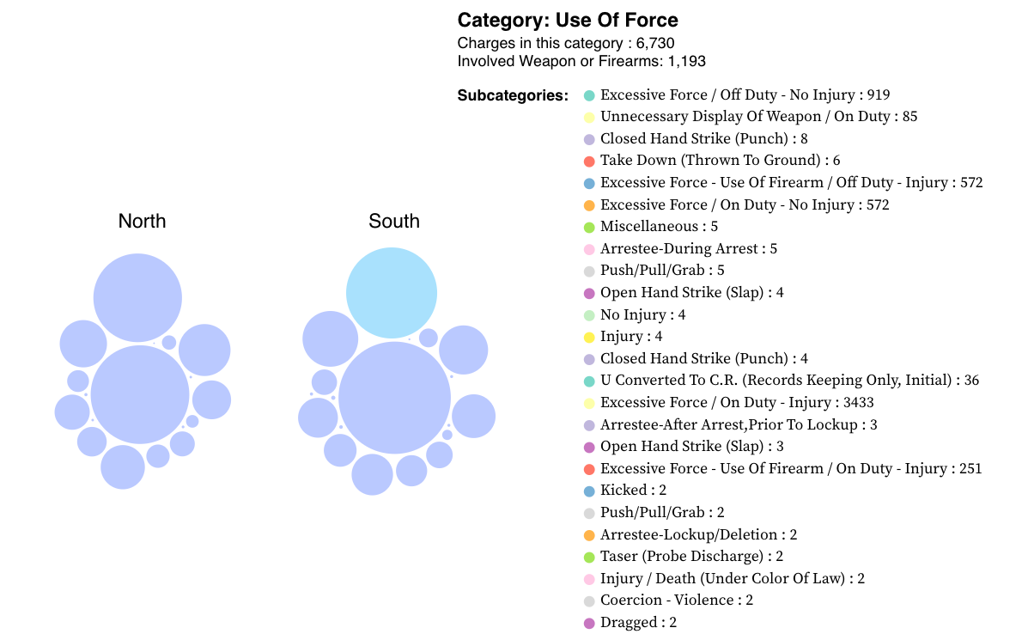
Top 3: Operation/Personnel Violations, Use of Force, and Illegal Search

Slide 14
Q2: What is the distribution of police misconduct allegations (total count and per capita values) per police district across the North and South of the city? Then, what is the racial distribution of the civilian community and police officers per given police district?

Slide 15
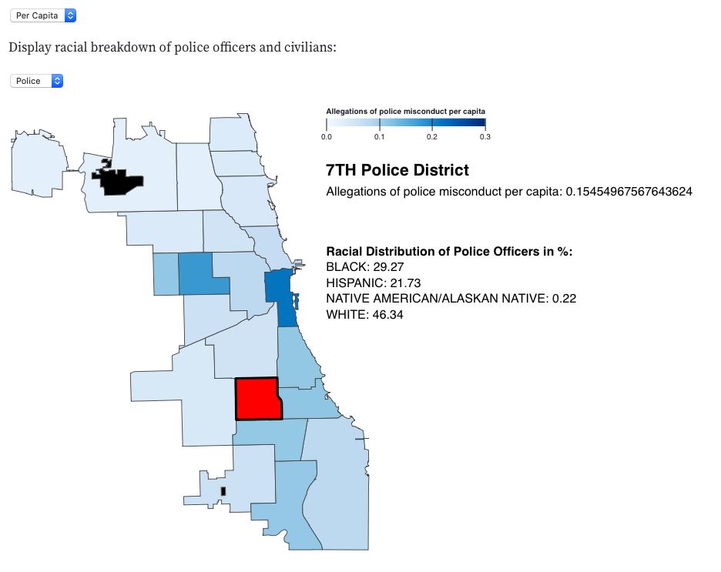
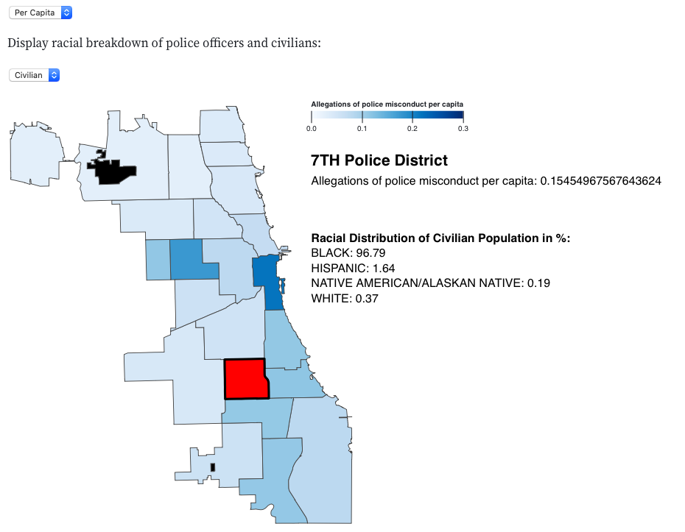

Slide 16
ML

Slide 17
Q1: Two time-series predictive models that predict the number of police officers for the North and South side of Chicago, respectively, while accounting for the number of allegations per 10,000 people.

Slide 18
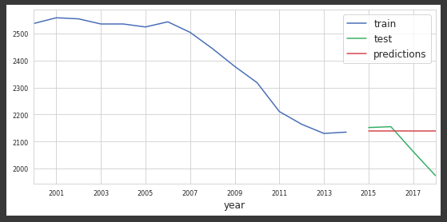
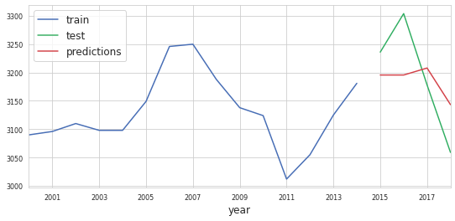


Predictions
Predictions

Slide 19
Q2: A machine learning model predicting the number of TRRs per year in the north and south sides of Chicago, accounting for such features as demographics of the officers and the communities we serve + hyperparameter tuning.

Slide 20
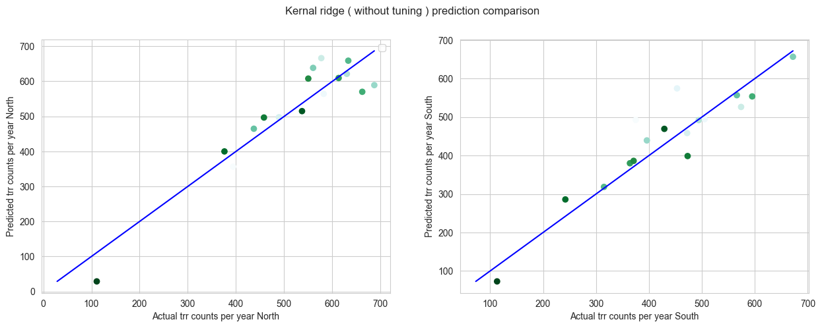
*Colormap : years
2020
2020

Slide 21
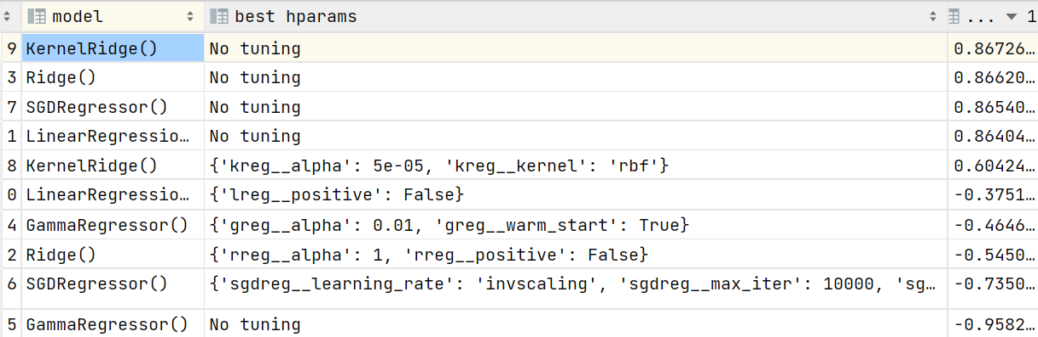
Later we used XGBoost for good results (99% score)as it operates on a powerful gradient boosting framework

Slide 22
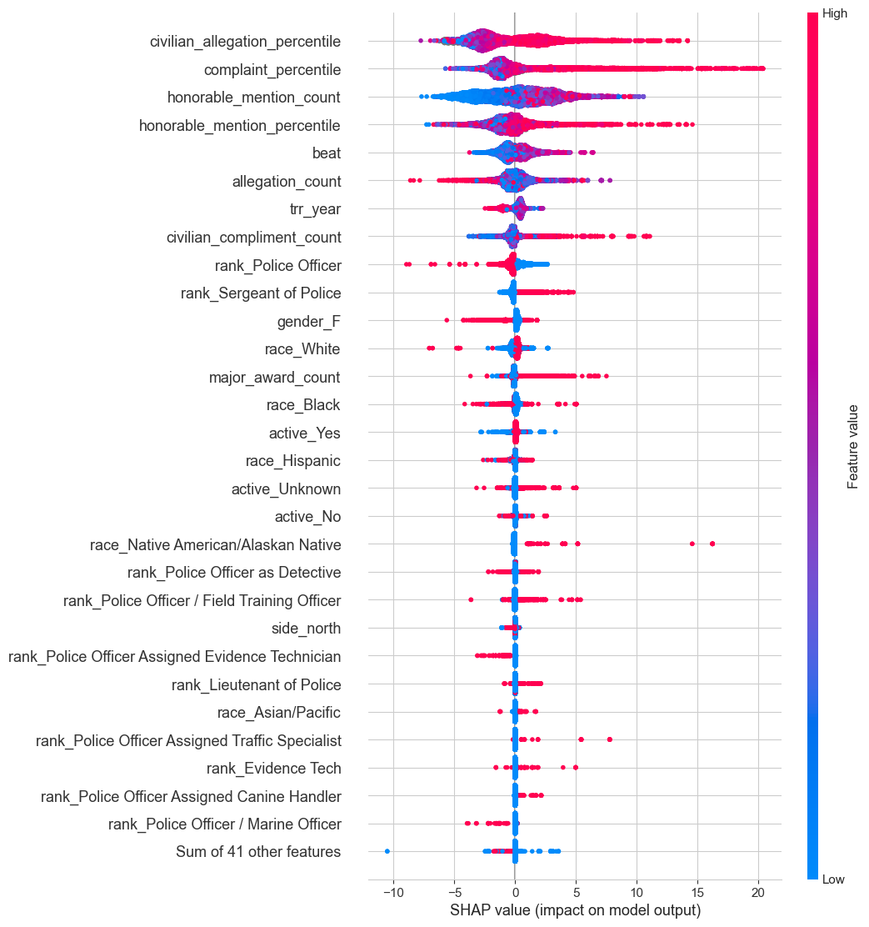
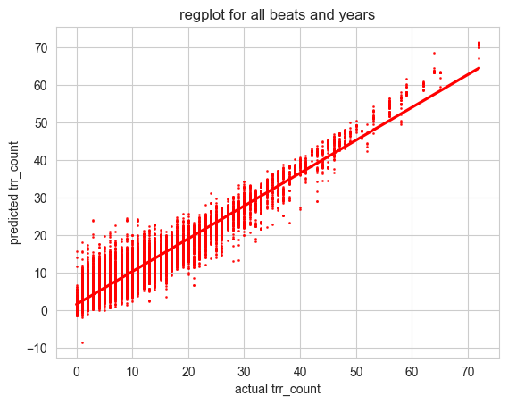

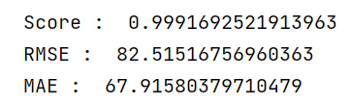
Extra
Group by beats + years
Group by sides + years

Slide 23
Conclusions
More alleged police misconduct on the south side per capita
Correlation ≠ Causation ⇒ More research is needed

Slide 24
THANK YOU FOR ATTENTION!
ANY QUESTIONS?

