Slide 1
RevConnect
Full-Stack Social Media Web App
Presented By
Vaibhav Roman

Slide 2
Application Overview
What RevConnect does
RevConnect is a full-stack monolithic social media web application designed for
personal users, creators, and businesses to connect and interact.
The platform enables users to create posts, engage through likes and comments,
follow other users, and manage their profiles through a responsive web interface.
The system focuses on secure authentication, structured backend design, and
smooth frontend user experience.

Slide 3
Key Features
RevConnect provides essential social networking functionalities on a single platform.
• Secure user registration and login system • Create, edit, and delete posts • Like, comment, and interact with posts • Follow / Unfollow users and manage connections • Personalized feed based on user activity • Real-time notifications for interactions
This ensures smooth user engagement and structured system functionality.

Slide 4
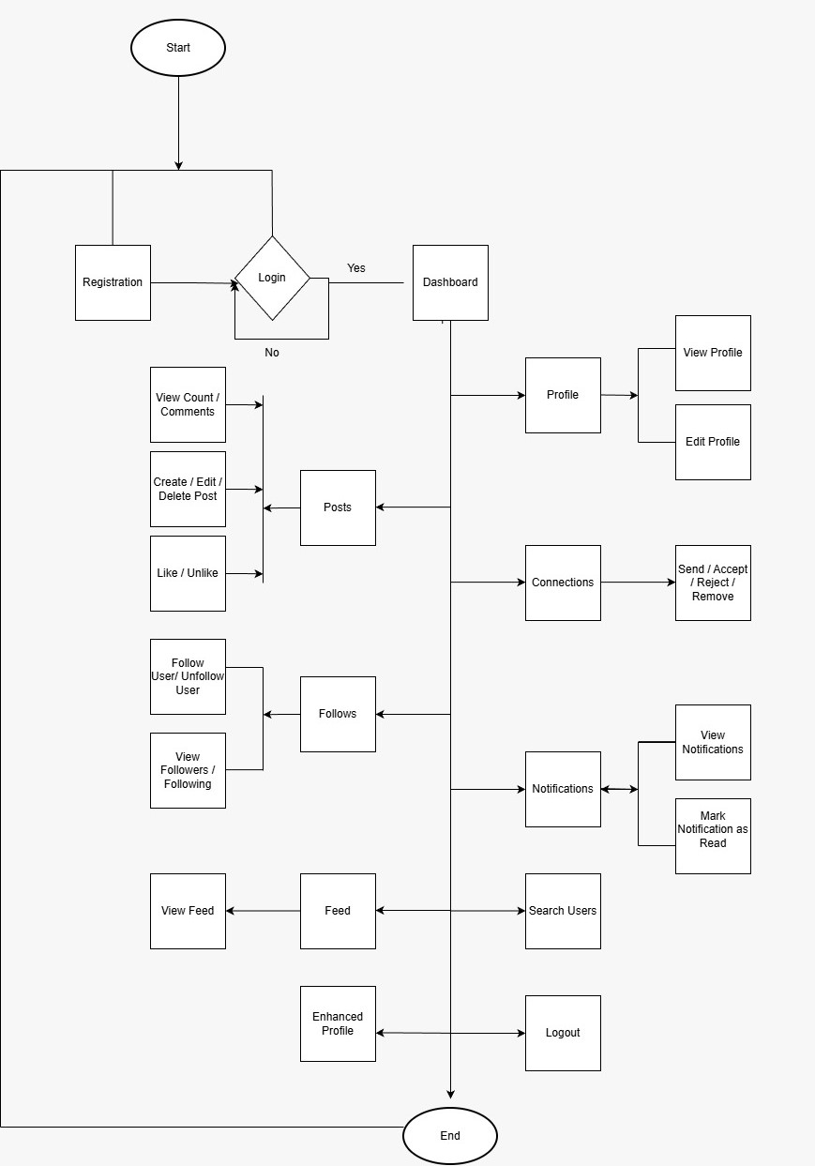
System Architecture

Slide 5
System Architecture Overview
3-Tier Architecture
Presentation Layer (Frontend)
Built using Angular (localhost:4200)
Handles UI rendering (Feed, Profile,
Network, Notifications)
Sends API requests to backend
Manages user session & tokens
Application Layer (Backend)
REST APIs (Swagger integrated)
Handles:
Authentication & Authorization
Post Management
Like/Comment Logic
Follow & Connection System
Notification Triggers
Data Layer (Database)
Stores all persistent data:
Users
Posts
Likes
Comments
Followers
Connections
Notifications
Ensures data consistency & relationships

Slide 6
System Flow
Step-by-Step Flow
1. User logs in → Token generated 2. Frontend stores token → Sends with every request 3. Backend validates token → Processes request 4. Database performs CRUD operations 5. Response sent back → UI updates dynamically

Slide 7
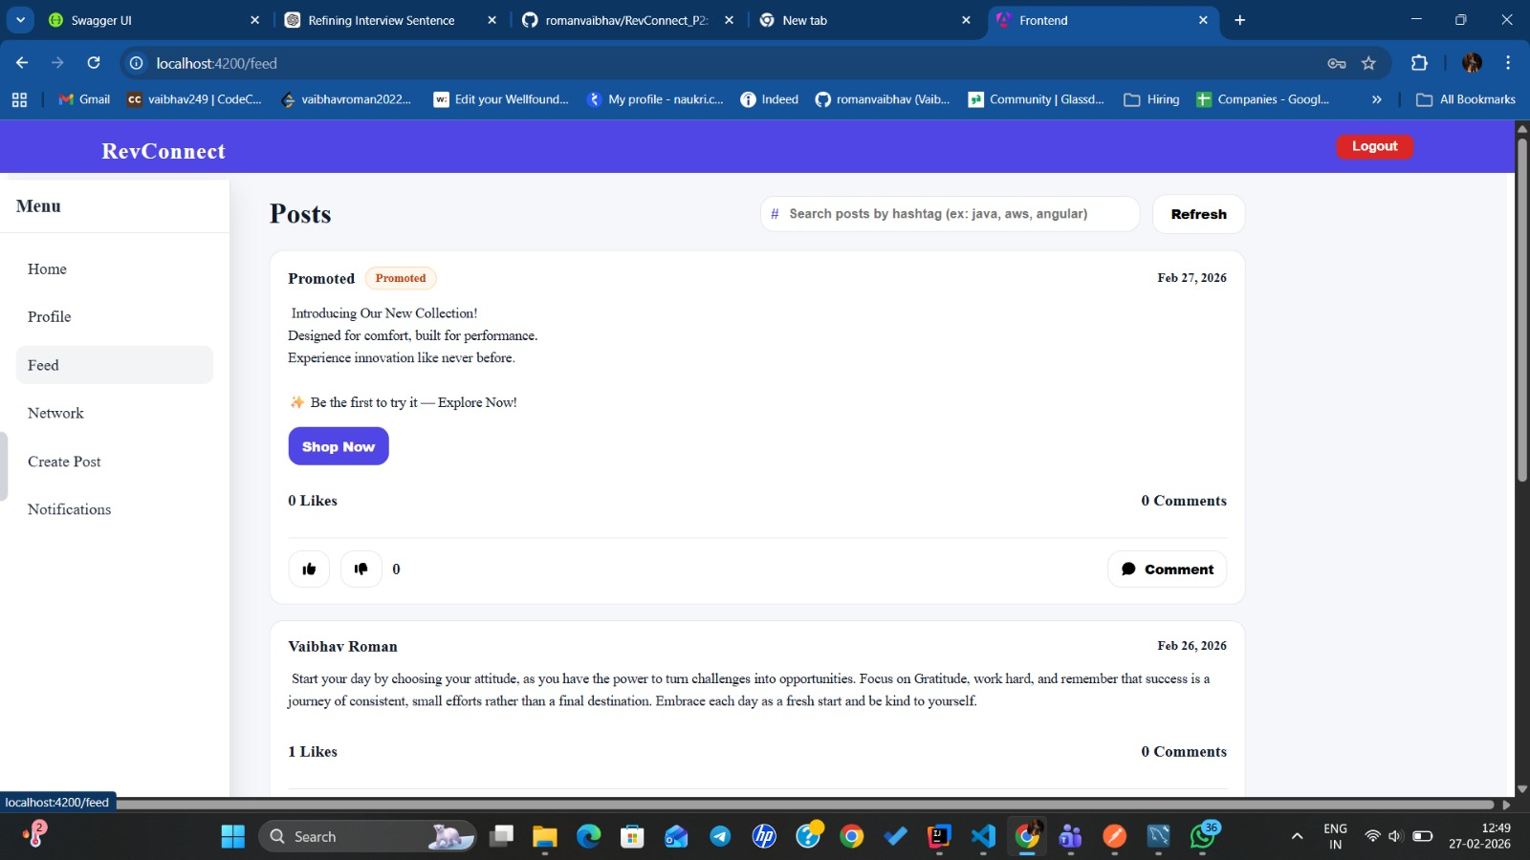
UI Overview

Slide 8
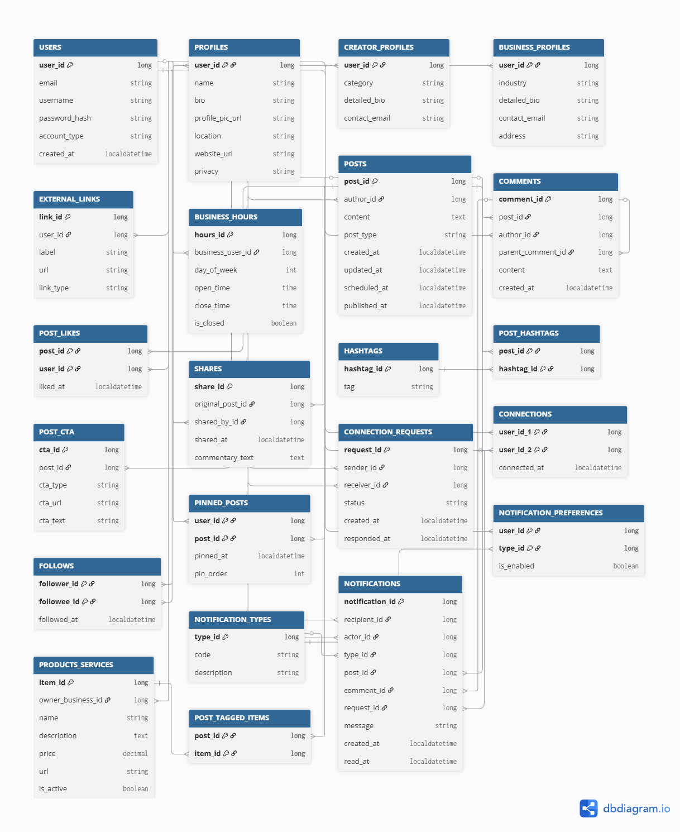
Database Design (ERD)
Key Entities :
Users
Profiles
Posts
Comments
Connections
Notifications
Entity Relation :
Users ↔ Profiles (1-1)
Users ↔ Posts (1- M)
Posts ↔ Comments
(1-M)
Users ↔ Connections/
Follows (M : M)
Users ↔ Notifications
(1-M )

Slide 9
Tech Stack
Frontend
HTML/ CSS/ Javascript
Angular
Backend
Java
Spring Boot
Spring Data JPA (Hibernate)
RESTful APIs
Maven (Build Tool)
Database
MySQL
Tools
Git
VS Code / IntelliJ IDEA
Postman
Swagger

Slide 10
Conclusion
Conclusion
RevConnect is a social networking web application that connects users on a
single interactive platform.
Through this project:
• Users can create posts, interact through likes and comments. • Users can follow others and manage connections. • Personalized feed displays relevant content. • The system is secure and well-structured using a 3-tier architecture.
This project helped us understand real-world social media system design and full-
stack application development.

Slide 11
Future Enhancements
• Add real-time chat functionality • Implement role-based admin panel • Deploy on cloud for scalability • Add real-time updates using WebSockets

Slide 12
THANK YOU

