Slide 1
DIGITAL EGYPT PIONEERS INITIATIVE · DEPI
QA Mastery
Graduation Project
Group: ONL4_SWD6_G3
A comprehensive quality assurance project covering Manual Testing, API Validation,
Database Integrity, and Selenium/Automation on Bstackdemo.
Manual Testing
Jira
SQL Database
API
Automation
205
43
6
Test Cases
Bugs Found
Engineers

Slide 2
THE ENGINEERS
the QA Team
FM
Fatma Mostafa Ali
AA
Aya Ahmed Mohammad
QA Engineer
QA Engineer
ME
Mohamed Essam Abdelrahim
SN
Sandy Nady Ayad
QA Engineer
QA Engineer
RM
Romany Morad Ezzat
AG
Assem Ghareb Mohammed
QA Engineer
QA Engineer
Jira
Selenium
Postman
MySQL
GitHub

Slide 3
PROJECT OVERVIEW
What We Tested
205
43
6
Total Test Cases
Bugs Discovered
Team Members
Bstackdemo
Automation Exercise API
Librarydb SQL Database
Primary SUT
API Layer
DB Layer
A sample e-commerce platform used as the primary system under test for manual and automation testing.
RESTful endpoints — user accounts, authentication, product search & management.
MySQL schema integrity, business-rule constraints, referential data validation.
TESTING APPROACH
Black-box functional testing across UI, API, and database tiers. Equivalence partitioning and boundary value analysis on input fields. Negative testing for error handling. SQL integrity checks for business rules. Selenium/ for repeatable E2E regression coverage.

Slide 4
TESTING STRATEGY
QA Framework
Manual Testing
API Testing
TEST CASES
BUG REPORTS
TEST CASES
BUG REPORTS
65
32
69
6
User-facing UI flows, exploratory testing, UX defects
REST endpoints, schema validation, status codes, edge cases
Database Testing
Automation
TEST CASES
BUG REPORTS
TEST CASES
BUG REPORTS
65
5
6
0
SQL integrity, referential constraints, business-rule gaps
Selenium/ Automation— regression safety net
Test Environment
Test Management
SUT
Chrome · Firefox · Windows 10/11
Jira · GitHub
Bstackdemo.com

Slide 5
MANUAL TESTING
Comprehensive functional testing of bstackdemo platform covering all user flows, UI validation, and end-to-end scenarios.
65
32
74%
Test Cases
Bug Reports
Bug Share
REPRESENTATIVE DEFECT FINDINGS
B1
Password visible while typing in login / register forms
B2
Product images fail to load for specific user accounts
B3
Cart sidebar overlaps and obscures page body content
B4
Sort state is lost upon page refresh — no persistence
B5
Filter returns empty results instead of graceful fallback
15
10
7
Functional Bugs
UI/UX Defects
Edge Case Fails

Slide 6
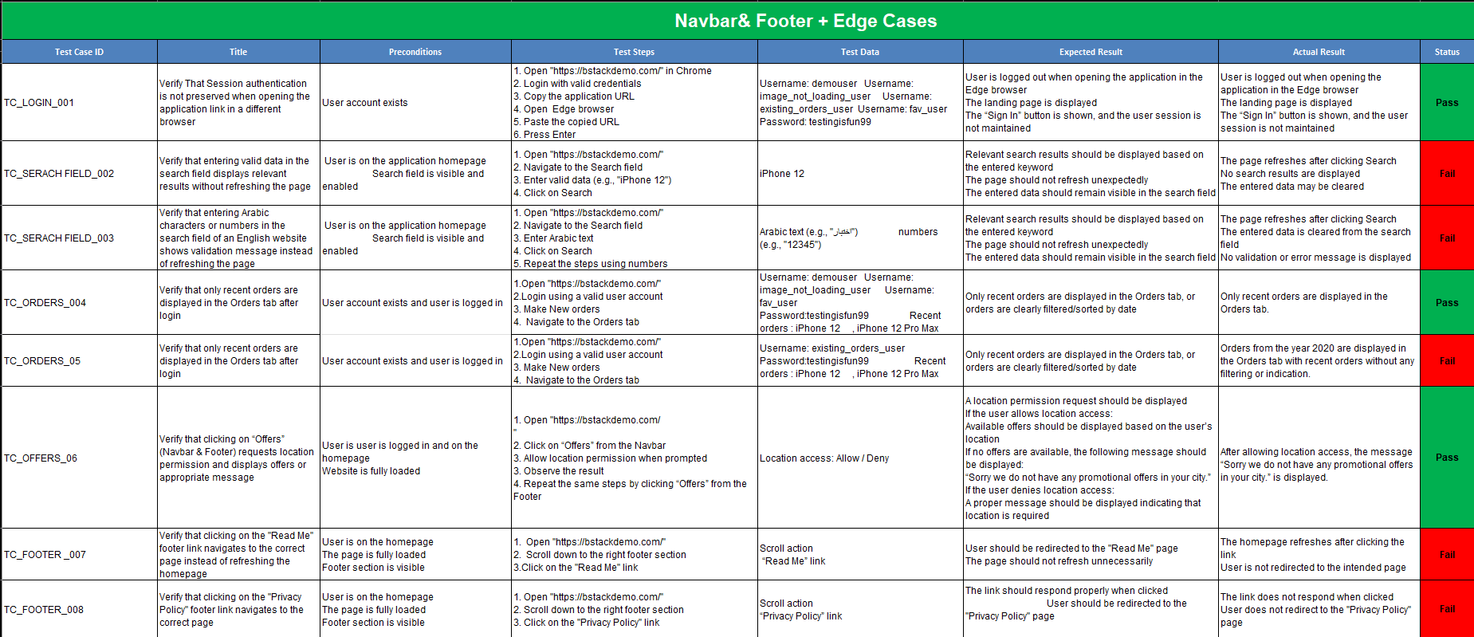
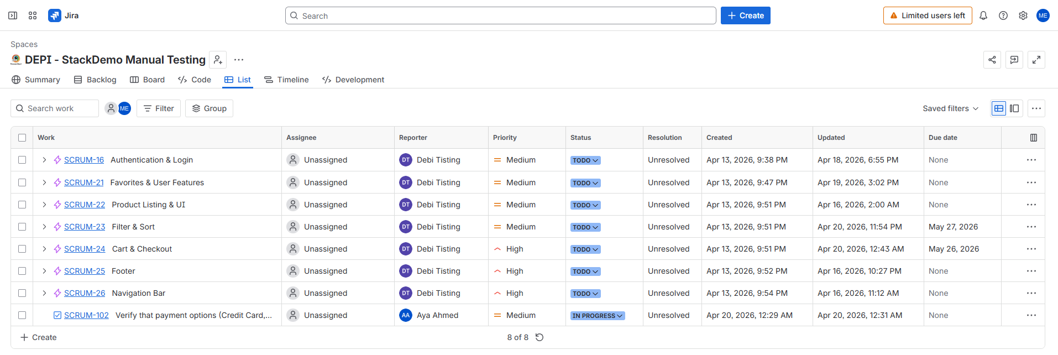
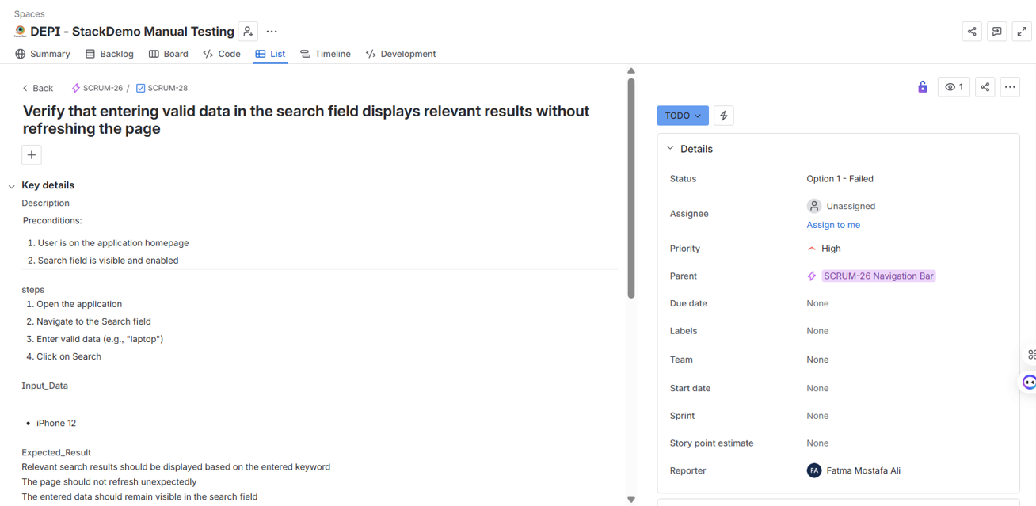
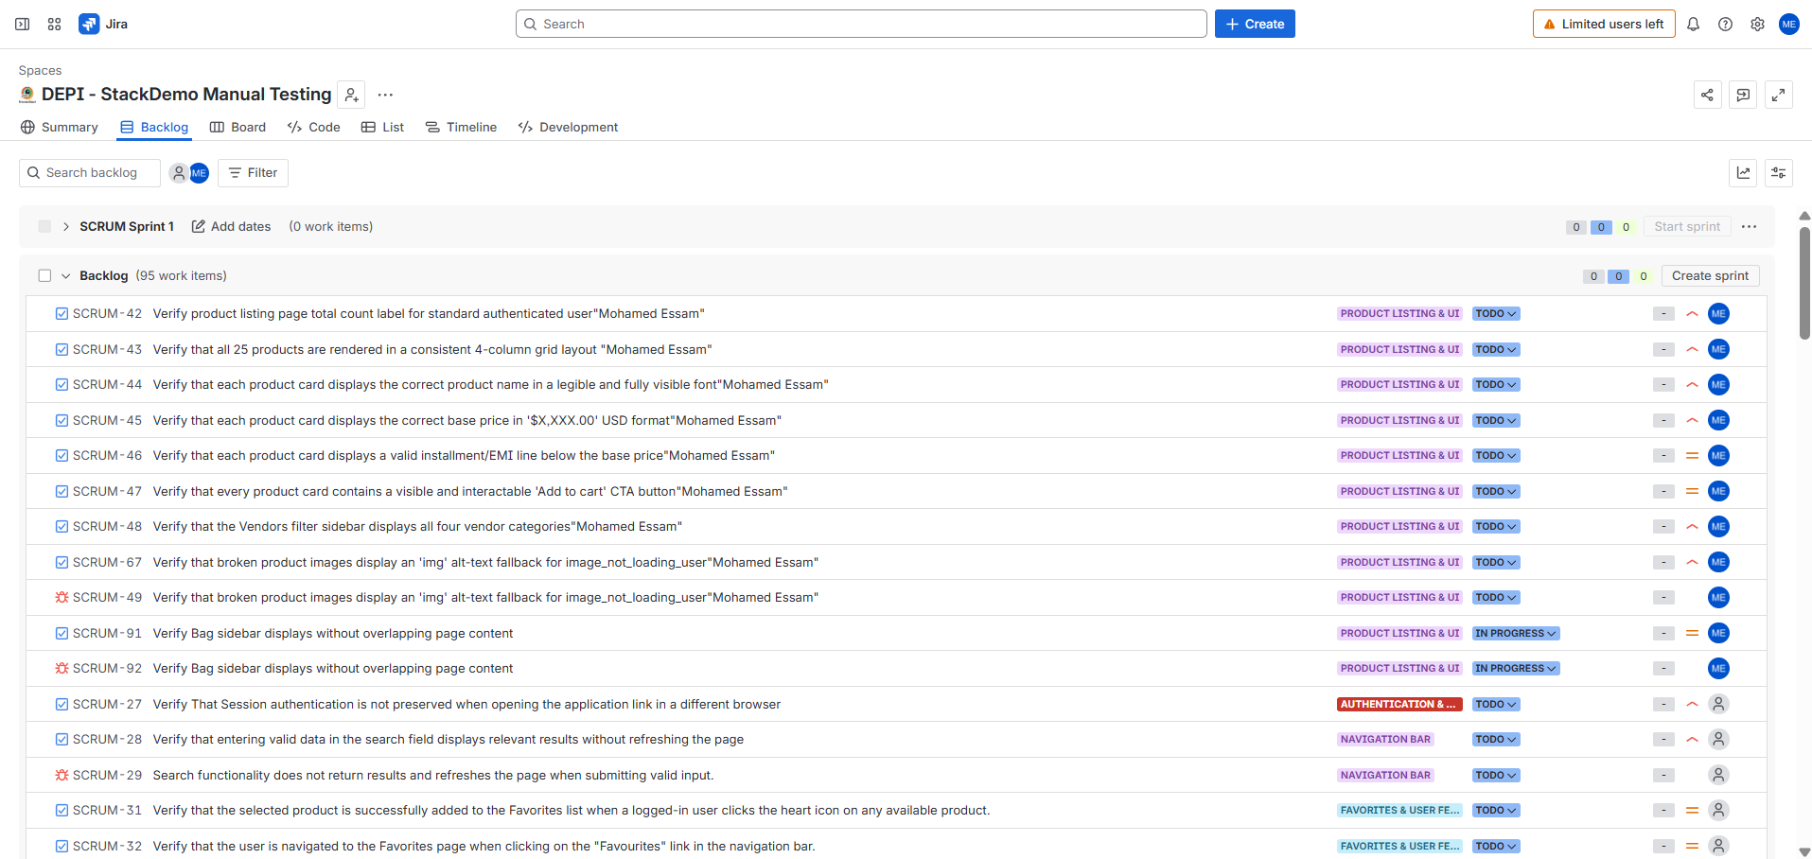
MANUAL TESTING ScreenShot

Slide 7
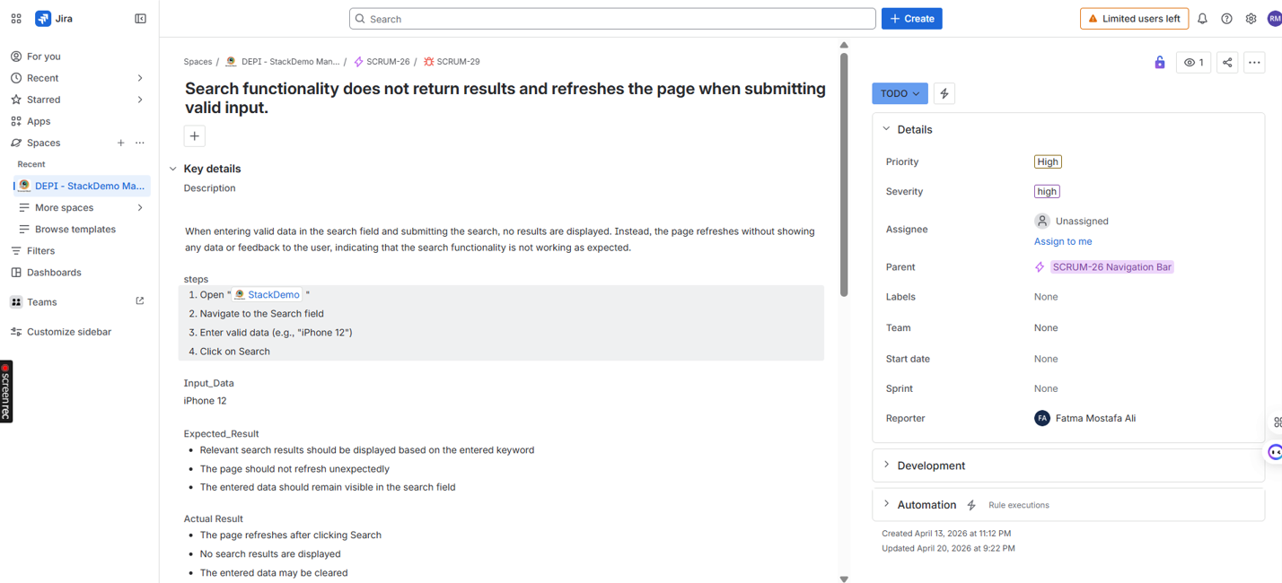
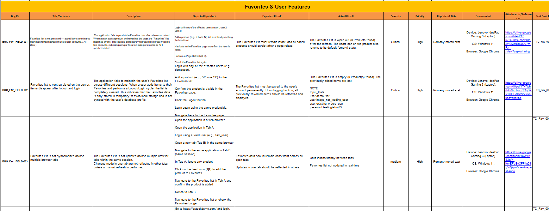
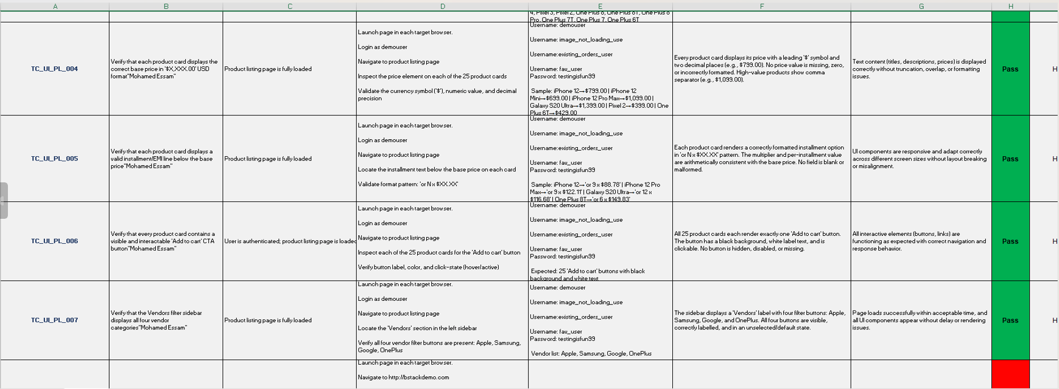
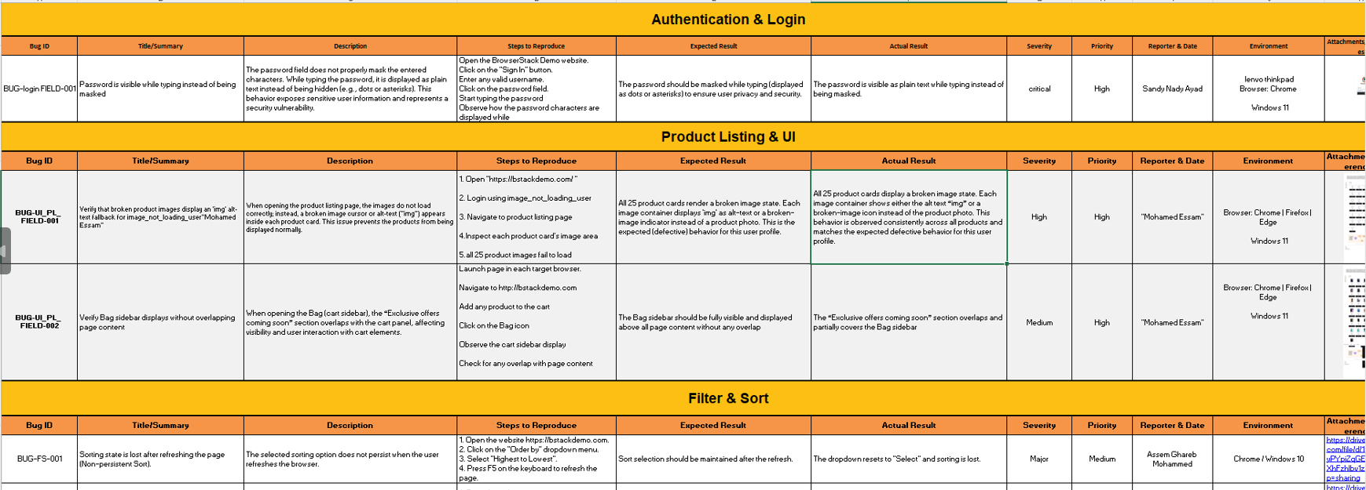
MANUAL TESTING ScreenShot

Slide 8
DATABASE TESTING
SQL integrity checks found business-rule gaps Librarydb
65
5
60
5
Test Cases
Bug Reports
Pass
Fail
ROOT CAUSE PATTERN
Deep database integrity testing across 5 tables.Execution: Designed and executed 65 detailed test cases.Results: Uncovered 5 critical bugs related to schema constraints and referential integrity.
CRITICAL DATABASE DEFECTS
DB-01
BORROW accepts due_date earlier than borrow_date — no constraint
DB-02
Duplicate active borrow records allowed for same book/user
DB-03
available_quantity does not decrement after successful borrow
DB-04
Book can be borrowed when available_quantity equals zero
DB-05
return_date earlier than borrow_date accepted without validation

Slide 9
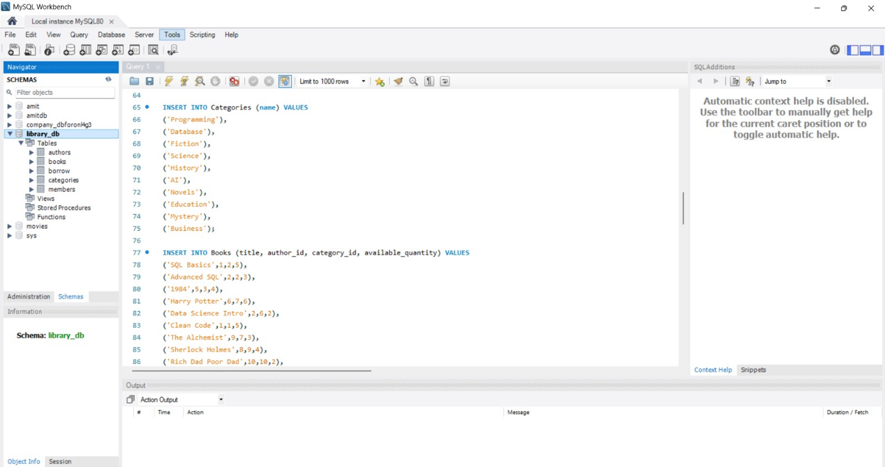
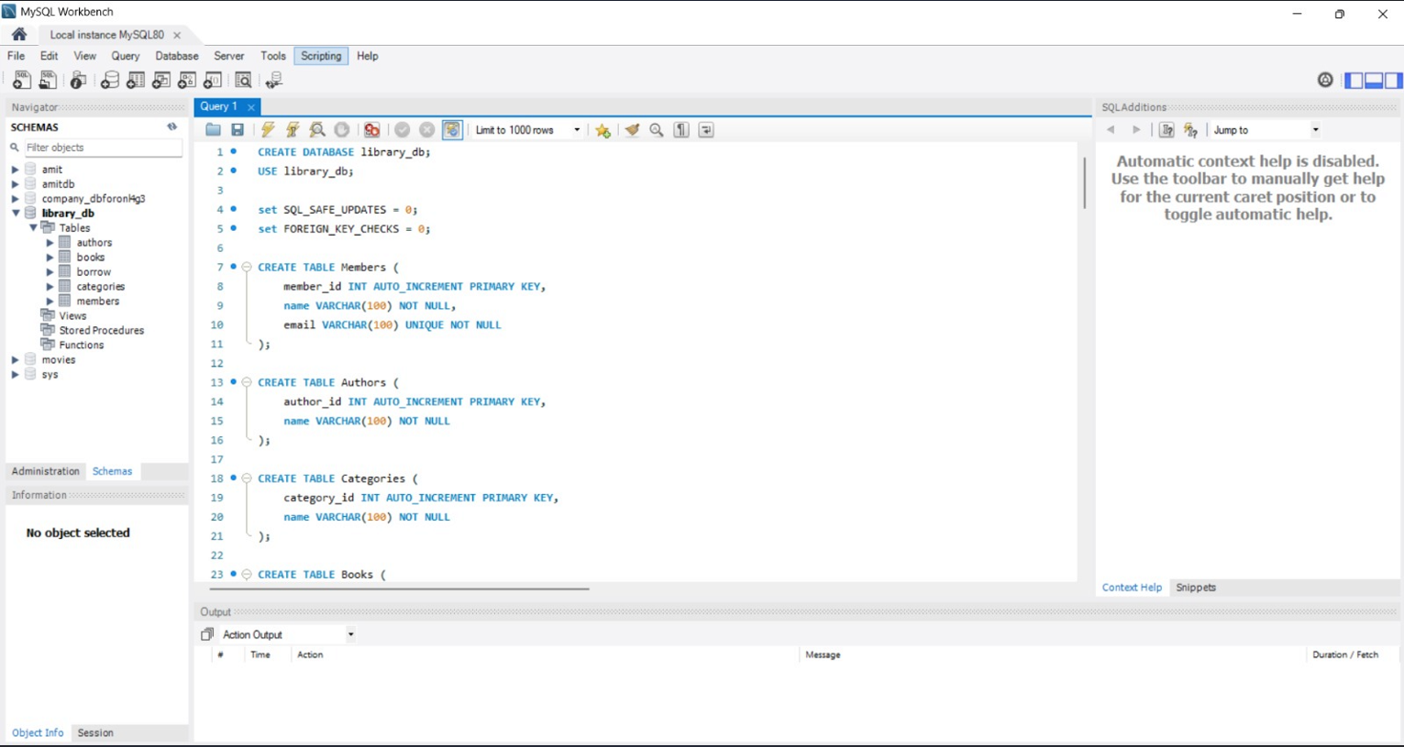
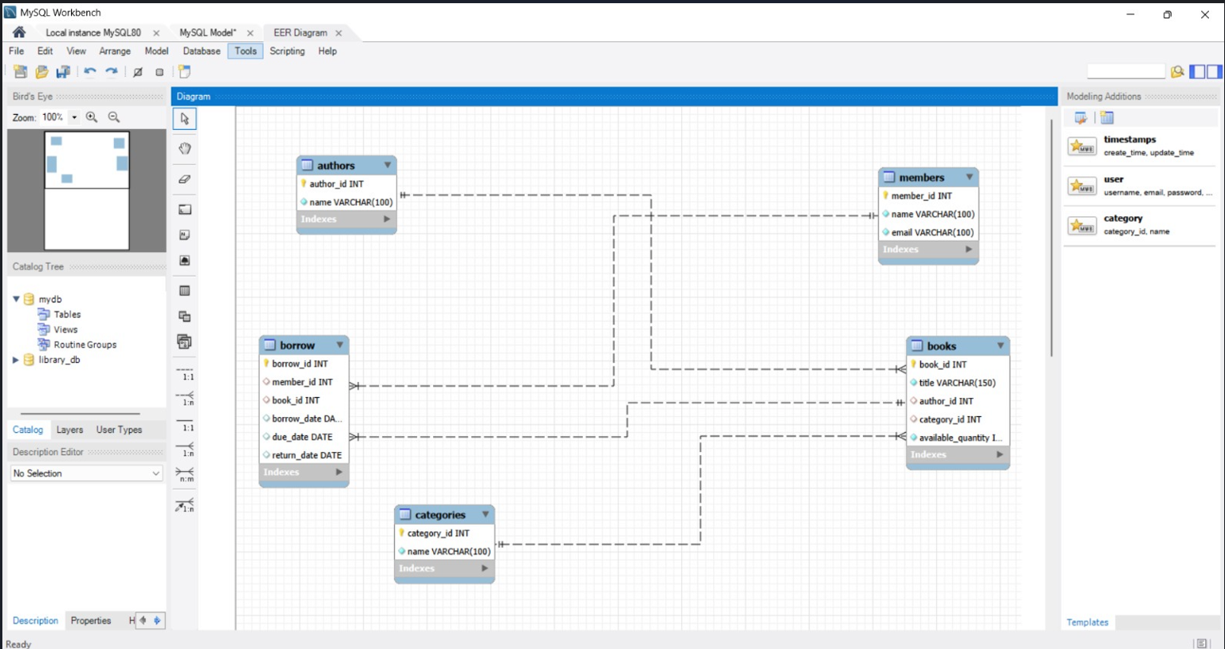
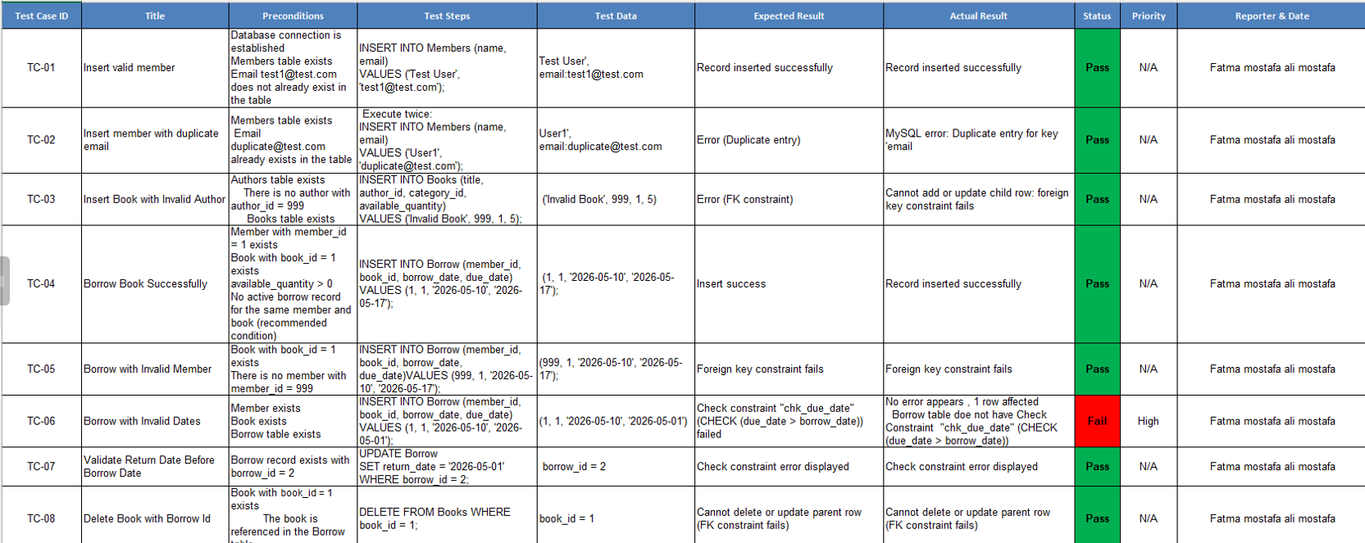
DATABASE TESTING

Slide 10
API TESTING
API validation
69
63
6
6
Test Cases
Pass
Fail
Bug Reports
API MODULES TESTED
VALIDATION CHECKS
1
User Account
Request Validation
2
Create Account
Required params, type checks, boundary values
3
Authentication
HTTP Status Codes
4
Products API
200/201/400/401/404/422/500 coverage
5
Search Product
Edge Cases
6
Verify Login
Empty payload, missing auth, duplicate entries

Slide 11
API TESTING - COLLECTION RUNNER
Automatiom Exercise — Run Results
#
Method
Request Name
Result
1
GET
Get All Products List
PASS
2
POST
POST To All Products List
PASS
3
GET
Get All Brands List
PASS
4
PUT
PUT To All Brands List
PASS
5
POST
POST To Search Product
PASS
6
POST
POST To Search Product without search_product param
PASS
7
POST
POST To Verify Login with valid details
PASS
8
POST
API 8: POST To Verify Login without email param
PASS
9
DEL
API 9: DELETE To Verify Login
PASS
10
POST
API 10: POST To Verify Login with invalid details
PASS
11
POST
API 11: POST To Create/Register User Account
PASS
12
PUT
API 13: PUT METHOD To Update User Account
PASS
13
GET
API 14: GET user account detail by email
PASS
14
GET
API 12: DELETE METHOD To Delete User Account
PASS

Slide 12
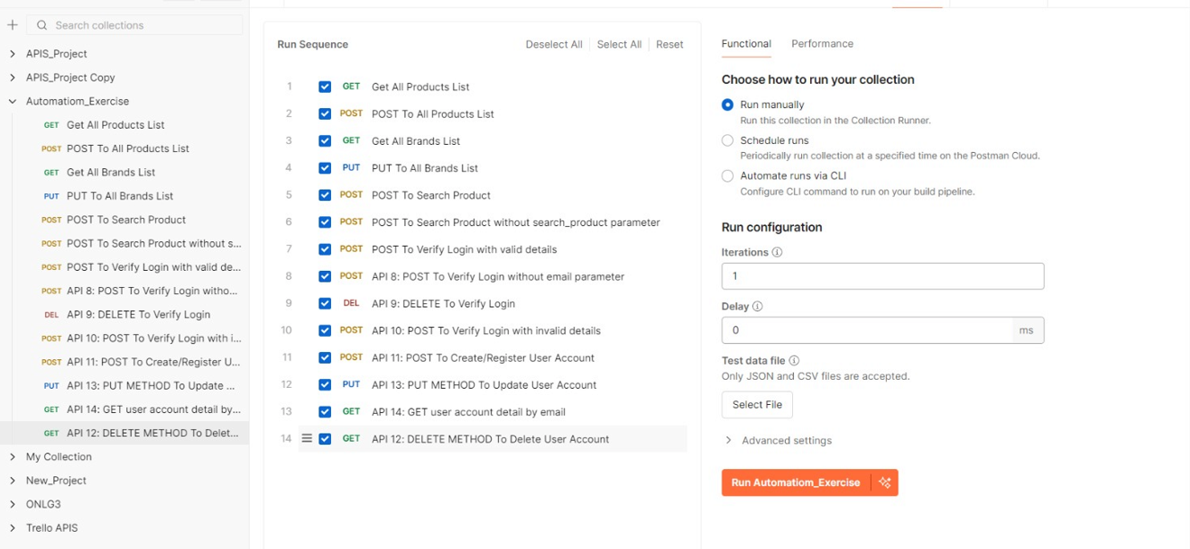
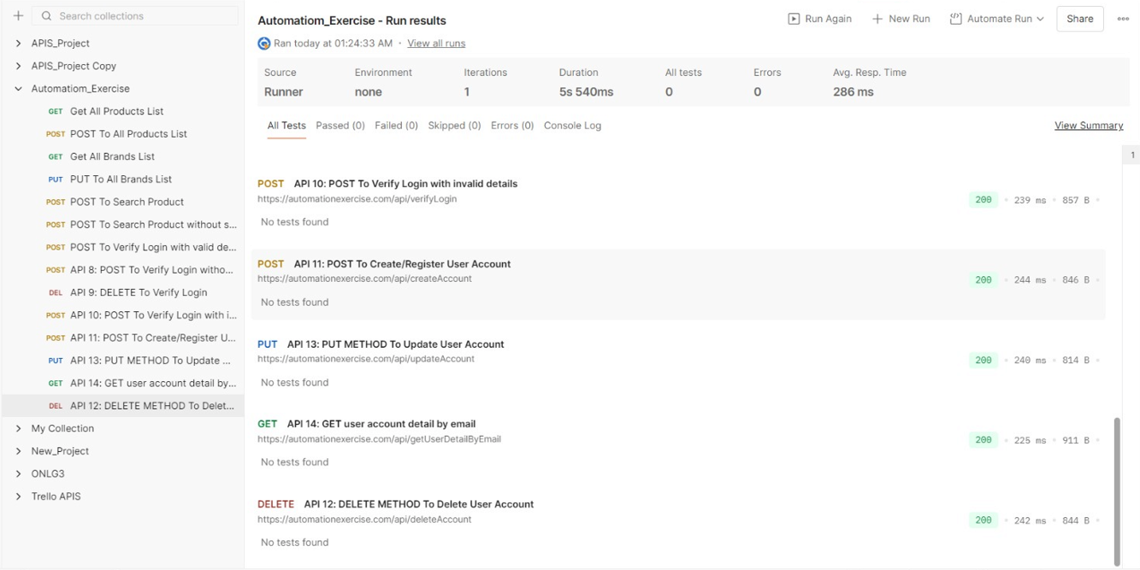
API TESTING Screenshot
API validation
Video link
https://drive.google.com/file/d/1kqtmFzRvuBtiYwhve3bUmz441Hy3wfYa/view?usp=sharing
Screenshot from the API project

Slide 13
AUTOMATION TESTING
6
Automation / Selenium
Test Cases
AUTOMATED TEST FLOW
Login
→
Browse Products
→
Add to Cart
→
Checkout
→
Order Confirm
Page Object Model
Base Test Setup
E2E Scenario
Decoupled locators from test logic
WebDriver lifecycle management
Full user journey validation
Regression Suite
Maven Dependencies
CI/CD Ready
TestNG XML suite runner
Dependency management & build
GitHub Actions integration
Language
Framework
Pattern
Build
VCS
Java
Selenium WebDriver
Page Object Model
Maven
GitHub

Slide 14
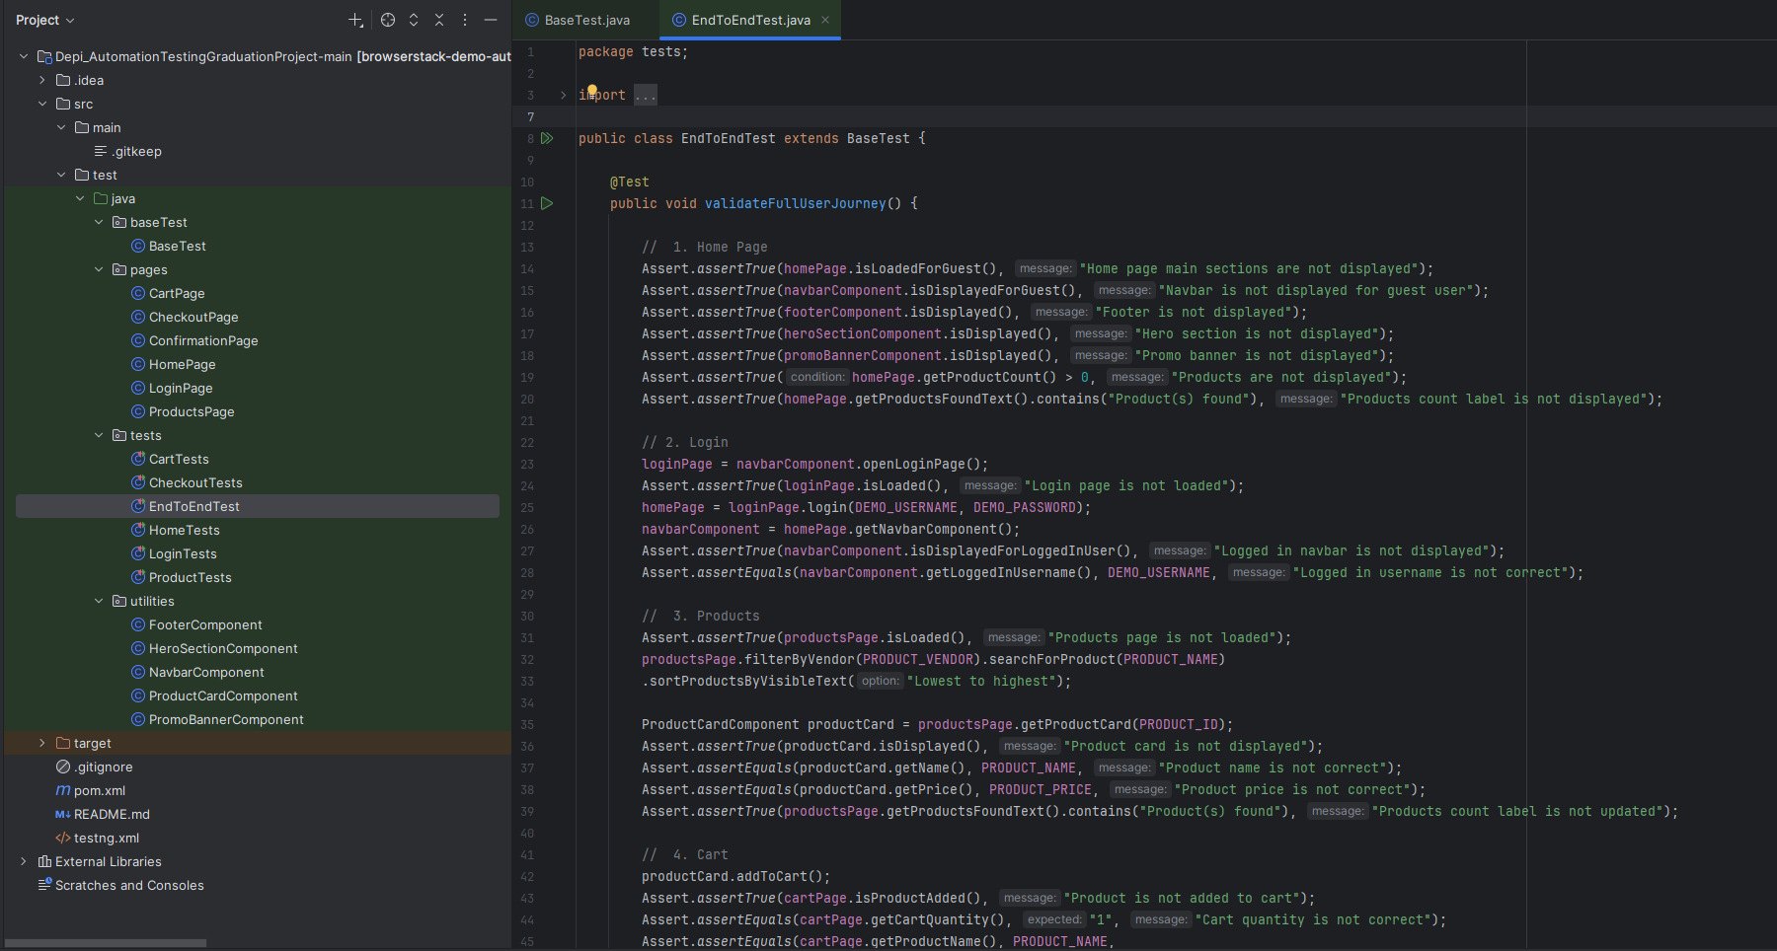
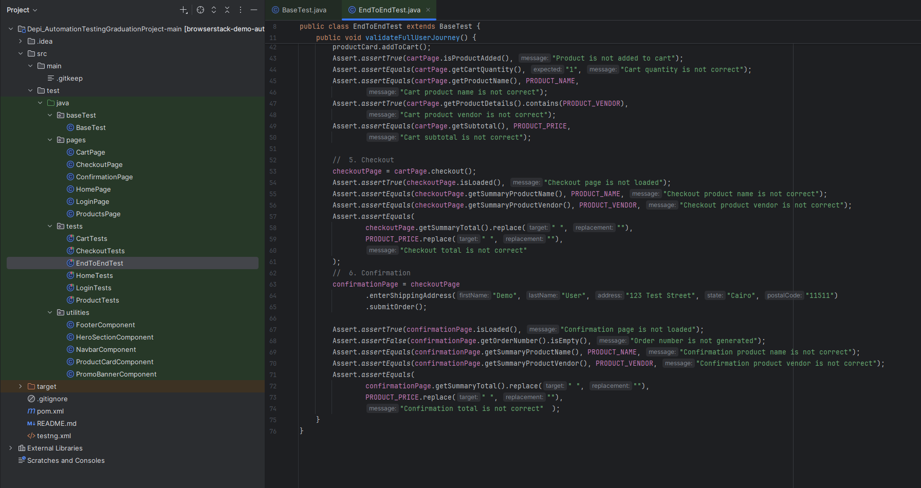
AUTOMATION TESTING
Automation E2E Scenario
Developed an End-to-End Automation Framework for the BrowserStack Demo Store using Selenium WebDriver, Java, TestNG, and Maven.The framework includes 6 automated test cases covering the complete user journey from login to successful checkout, ensuring the application's core functionalities work as expected.
AUTOMATED TEST FLOW
Project Overview
Testing Scope
Login Validation
Home Page Verification
Product Selection
Product Details Validation
Cart Functionality
Checkout & Order Confirmation

Slide 15
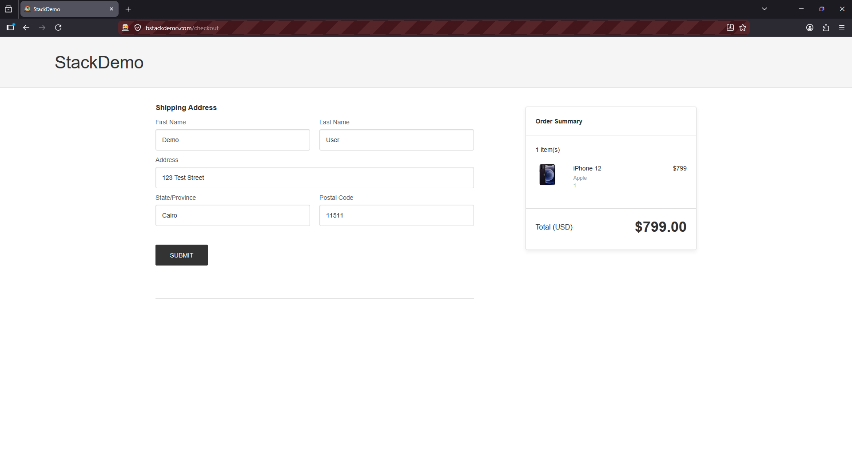
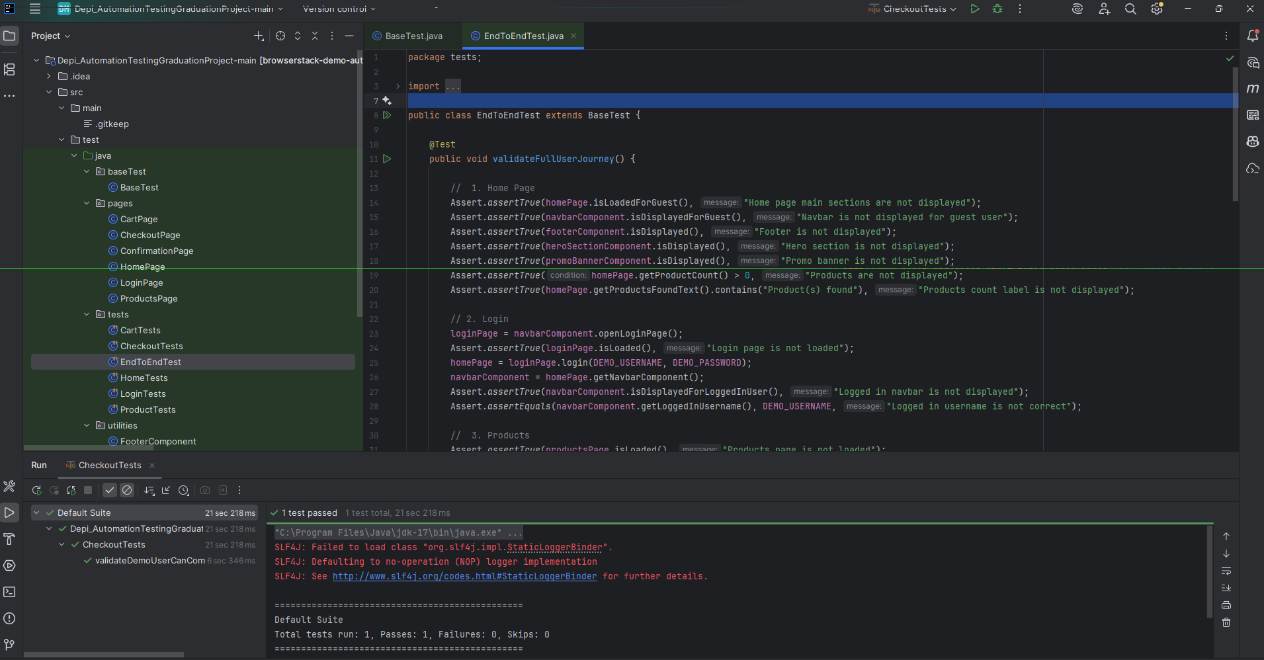
AUTOMATION TESTING
Automation E2E Scenario
Video link
https://drive.google.com/file/d/1r98A69QAFL_m5tMrATT3nkAO4Vm7DQq2
Screenshot from the Automation project

Slide 16
PROJECT SUMMARY
Outcomes & Key Learnings
205
43
6
Total TCs
Total Bugs
Engineers
Manual tests surface user defects
UI/UX issues invisible to automated checks
API validation prevents integration failures
Schema drift caught before deployment
Database integrity requires DB-level constraints
App-layer validation alone is insufficient
Automation creates repeatable regression safety net
Selenium/TestNG for fast regression feedback
PROJECT ACHIEVEMENTS
Manual Testing
API Testing
Database Testing
Test Automation
Project Management
Jira Workflows
GitHub VCS

Slide 17
Thank You
Presented by ONL4_SWD6_G3 · Digital Egypt Pioneers Initiative
FM
Fatma Mostafa Ali
AA
Aya Ahmed Mohammad
ME
Mohamed Essam Abdelrahim
SN
Sandy Nady Ayad
RM
Romany Morad Ezzat
AG
Assem Ghareb Mohammed
Questions & Discussion Welcome
🔗 bstackdemo.com 🐙 github.com/romanymorad1/Depi_TestingGraduationProject

