Slide 1
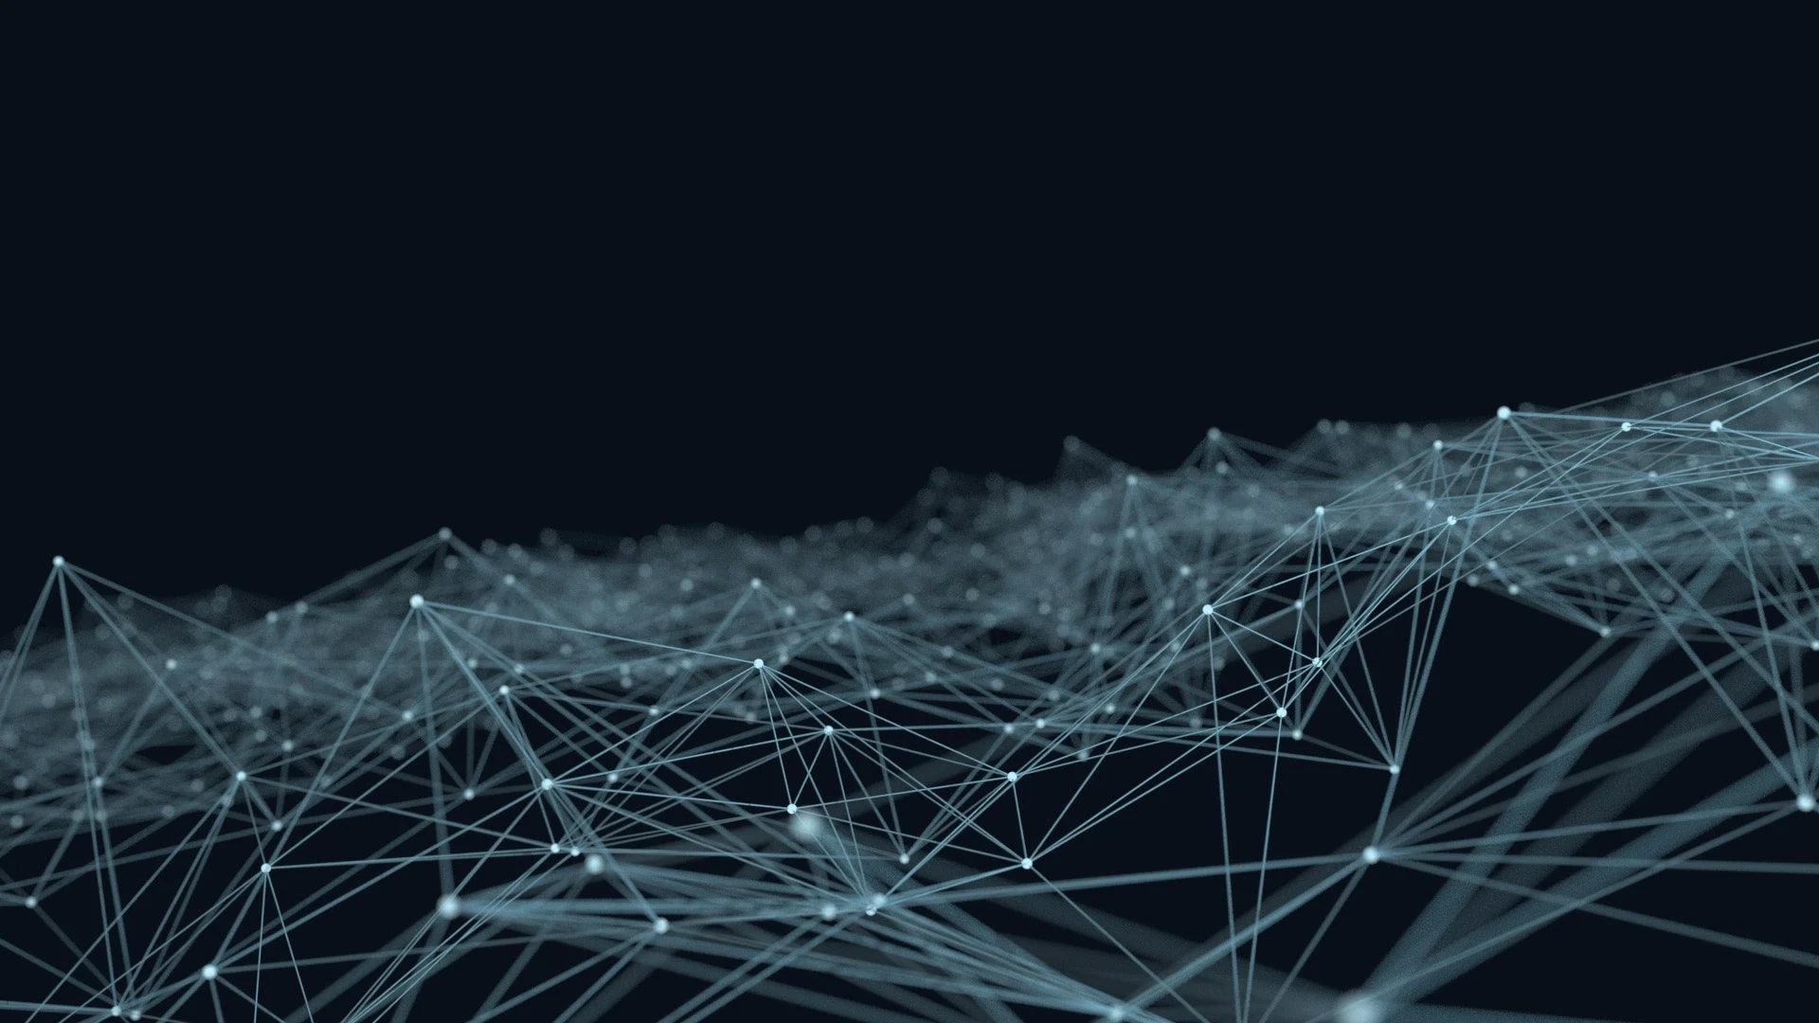
Detection AI-Generated

Slide 2
CONTENTS
Introduction
Overview
Key Features
Datasets

Slide 3
Intruduction
Artificial intelligence (AI) has become a powerful tool in diverse areas such as voice generation, content creation, and facial image synthesis. While its capabilities hold vast potential for various applications, there is a dual perspective on its impact. Concerns arise regarding the potential misuse of AI for malicious purposes, posing threats to individuals. Simultaneously, within educational settings, students are increasingly turning to AI for scientific tasks, prompting worries about the potential negative effects on their learning experiences.

Slide 4
Considering the broader implications of AI in the context of human behavior, it becomes evident that some individuals may exploit this technology for harmful purposes. Recognizing the need for safeguards, it is crucial to establish limits on the applications of generative AI. One primary focus is the initial stage of determining the authenticity of generated content, whether it be in the form of audio, images, or text. The overarching goal of such initiatives is to strike a balance between harnessing the benefits of AI and mitigating potential risks to ensure responsible and ethical use.

Slide 5
Project Overview
Probem definition:
The core issue involves the rapid and powerful advancements in artificial intelligence, particularly in generating voice, articles, and lifelike images. The misuse of this technology poses significant threats, including potential harm to individuals. Furthermore, the widespread adoption of AI by students for scientific tasks is negatively impacting education. To address these concerns, there is a critical need to thoroughly examine AI's capabilities and establish boundaries for its usage. A key focus is on developing methods to discern whether audio, imagery, or text is genuinely created or artificially generated by AI, forming the initial step in a broader project objective.

Slide 6
Key Features
key features of our web application system for detecting AI-generated
Detection of Ai generated
regestration functionalities
Feedback Mechanism
Contribution of the user to collect data

Slide 7

Datasets
Real vs AI generated human facese
01
AI-ArtBench
02
AI-ArtBench is a dataset that contains 180,000+ art images. 60,000 of them are human-drawn art that was directly taken from ArtBench-10 dataset
DAIGT | External Dataset
03
dataset for real and ai generated text

Slide 8

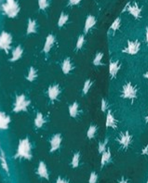
THANKS

