Slide 1
What is driving churn at Fit.ly?
Plan
Support
Engagement
Churn Analysis at Fit.ly
What patterns are linked to customer cancellations?
Notes:
Hello, today I will present my analysis of customer churn at Fit.ly.
The main goal of this project was to understand which patterns in the data are associated with customers leaving the service.
I focused on three main areas: subscription plans, customer support, and user engagement.
I wanted to identify differences between customers who were marked as churned and those who were not.
The analysis does not prove what causes churn. However, it helps us identify areas that may require attention and suggests possible actions to improve customer retention.

Slide 2
Why this matters?
Retention is becoming more important for Fit.ly
rising churn
pressure on marketing/ product
need actionable insights
Notes:
Fit.ly is facing a problem with customer cancellations.
When customers leave, the company needs to attract new users or find ways to keep its existing customers. This creates challenges for both the Marketing and Product teams.
To address this problem, Fit.ly needs to understand which customer groups show higher churn and which aspects of the customer experience may be connected to it.
Instead of making decisions based only on assumptions, we can use data to identify important patterns.
My goal was to turn these findings into practical recommendations that the company can test.

Slide 3
Data source and preparation proces
Integrated customer-level dataset
400 customers, 22 columns
Account information
400 customers
Customer support
918 support tickets
User activity
445 events
1. Validation of each column
2. Standardization of customer identifiers
3. Aggregation at the customer level
Notes:
The analysis was based on three datasets.
The first contained information about 400 customer accounts, including their subscription plans and churn status.
The second contained 918 customer support tickets, while the third contained 445 recorded activity events.
Before starting the analysis, I checked the data for missing values, duplicates, and inconsistent formats.
I also standardized customer identifiers and combined the datasets into one analytical table.
The final dataset contains 400 customers and 22 variables, with one row representing one customer. This allowed me to compare customer characteristics, support experiences, and activity patterns.

Slide 4
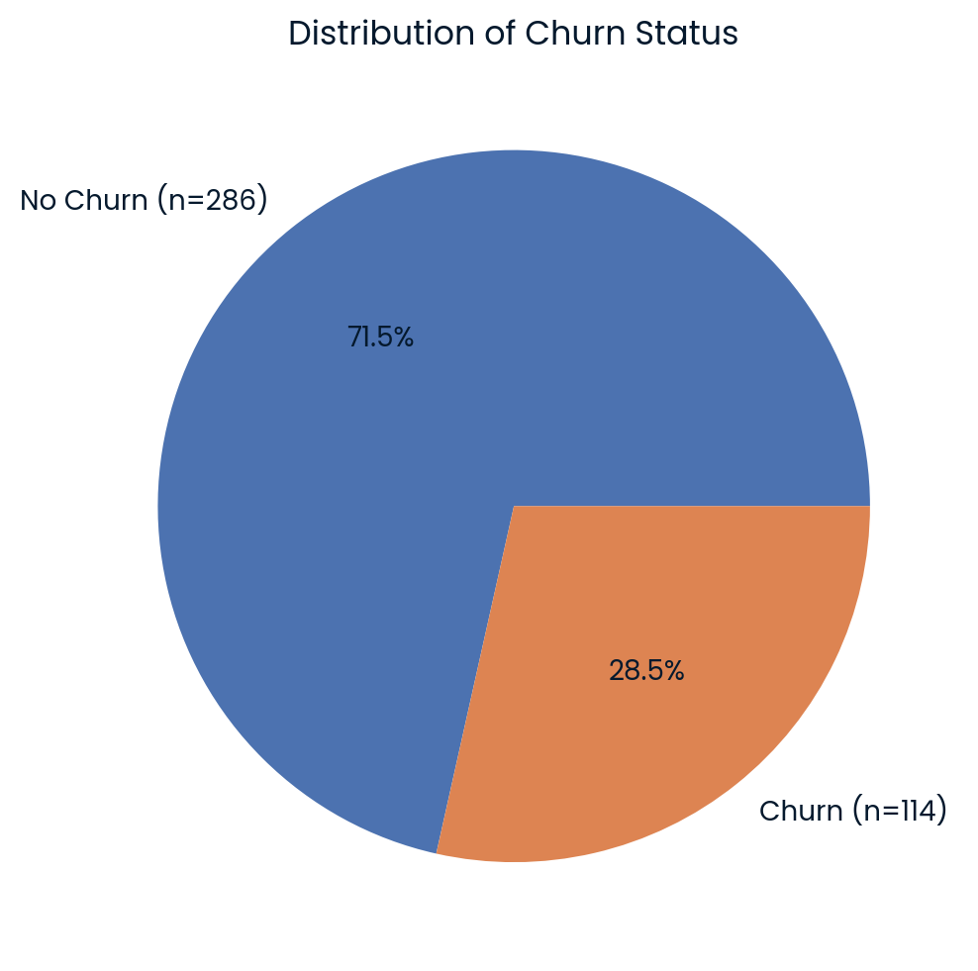
Where Does Fit.ly Stand Today?
28,5%
Customers marked as churned
114 out of 400 customers
Current measure: Churn-flagged customer share
Future KPI: Monthly Customer Churn Rate
Notes:
“Let’s start with the current picture of customer churn.
In the dataset, 114 out of 400 customers were marked as churned. This represents 28.5% of the customer base.
However, this number needs to be interpreted carefully.
In the original data, the remaining 286 churn statuses were missing. For this analysis, I assumed that missing values meant No Churn.
Also, 28.5% is not a monthly churn rate. It is simply the proportion of customers marked as churned in the available dataset.
In the future, Fit.ly should monitor a proper monthly churn rate to measure changes in customer retention over time.

Slide 5
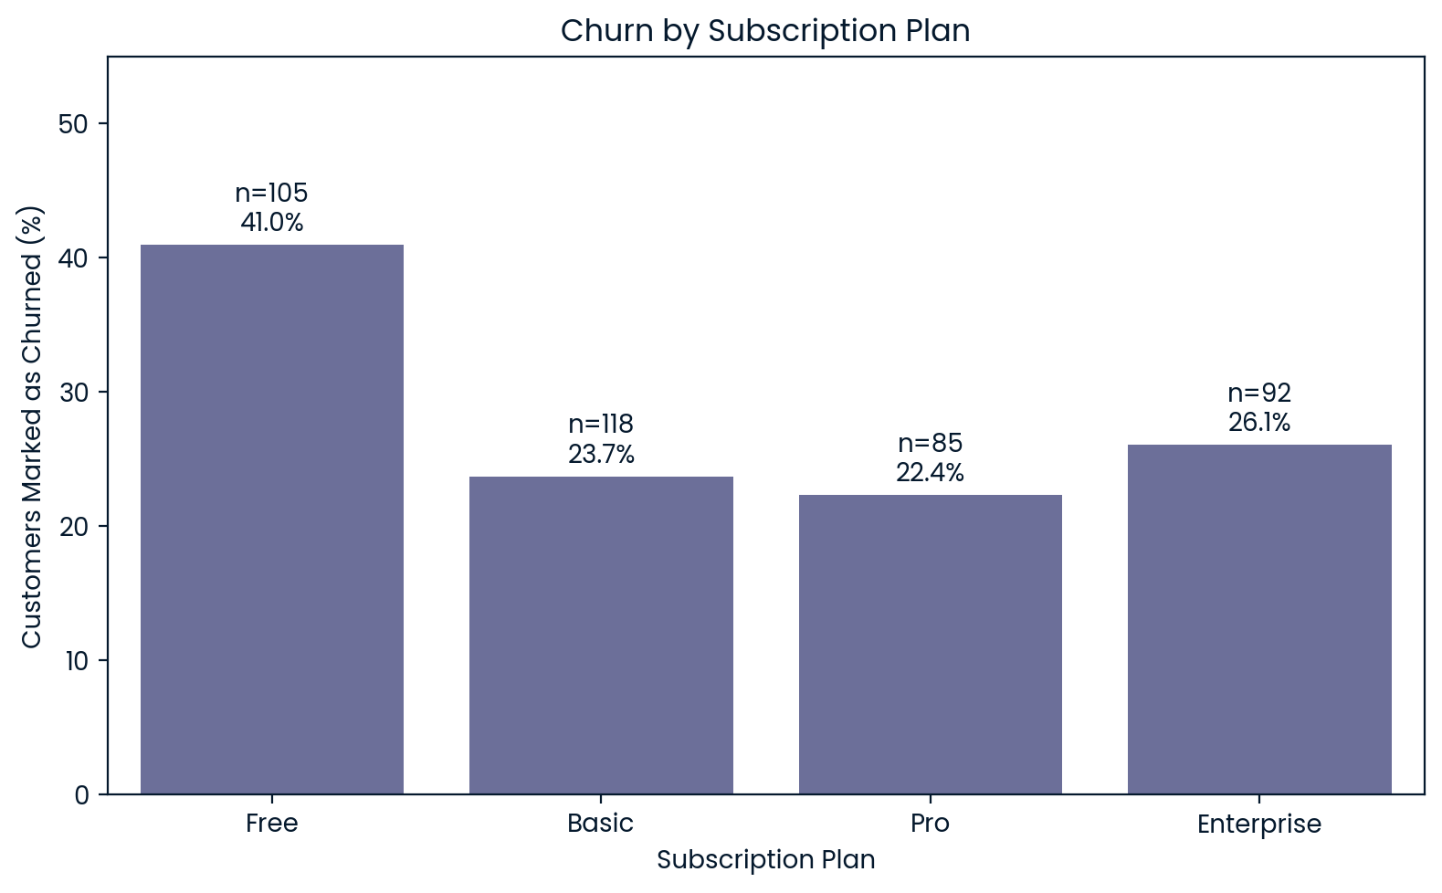
Free plan customers show the highest churn share
Notes:
The first finding concerns subscription plans.
The Free plan had the highest proportion of customers marked as churned, at 41%.
For comparison, the proportion was approximately 24% for Basic, 22% for Pro, and 26% for Enterprise.
This suggests that churn patterns differ across subscription plans.
However, we cannot conclude that the Free plan itself causes customers to leave. Other factors, such as user engagement, may also play a role.

Slide 6
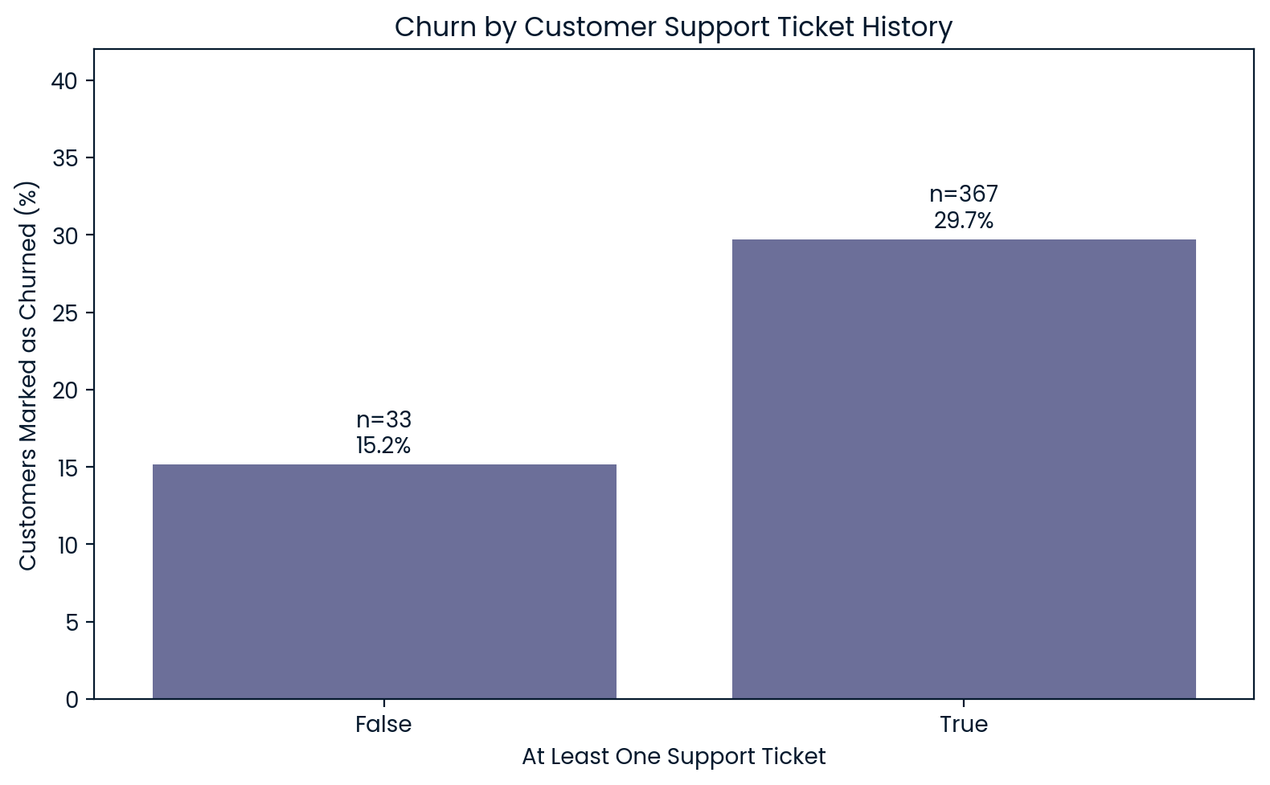
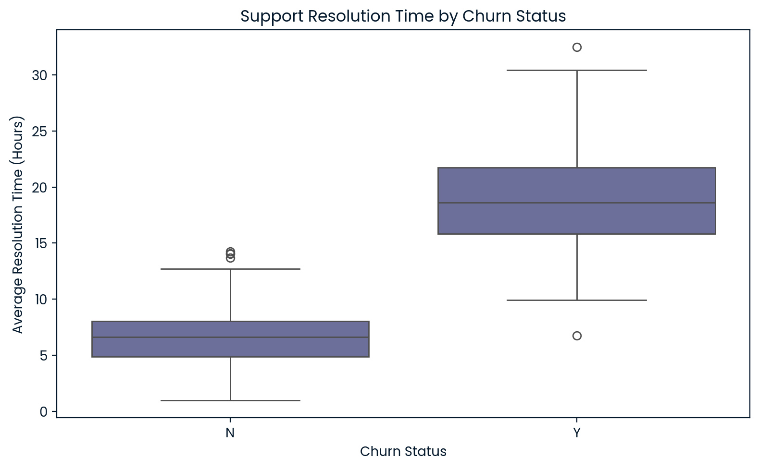
Support resolution time
stands out
Support ticket history
Having a ticket alone was not a clear signal
Resolution time
Churn: 18.69 h
No Churn: 6.66 h
Notes:
I examined two aspects of customer support.
First, I compared customers who had contacted support with those who had not. Although the observed churn proportion was higher among customers with support tickets, the analysis did not provide strong enough evidence to confirm this association.
The second finding was much clearer.
Among customers with support tickets, those marked as churned had an average resolution time of almost 19 hours.
For customers not marked as churned, the average was less than 7 hours.
This suggests that resolution time is an important area to investigate further.

Slide 7
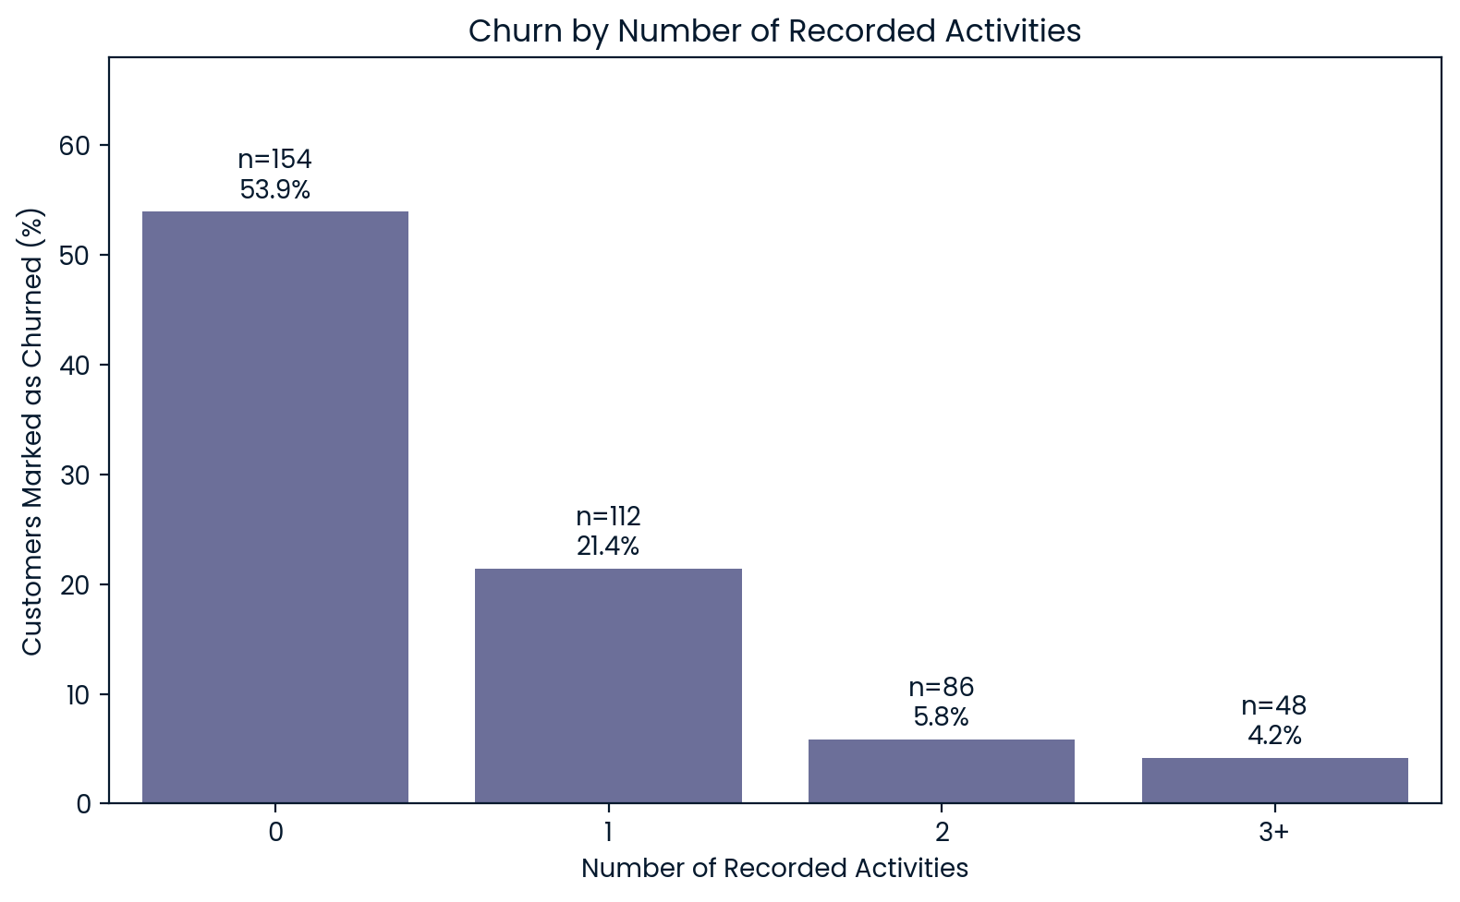
Customers with no recorded activity are the highest-risk group.
Notes:
One of the clearest patterns in the analysis was related to user activity.
Among customers with no recorded activity, approximately 54% were marked as churned.
This proportion decreased to about 21% for customers with one recorded activity, and to around 4% for customers with three or more activities.
This shows a strong relationship between recorded engagement and churn status.
However, there is an important limitation. The activity tracking system experienced downtime, so zero recorded activities does not always mean that a customer never used the app.
Even with this limitation, engagement is an important area for Fit.ly to monitor.

Slide 8
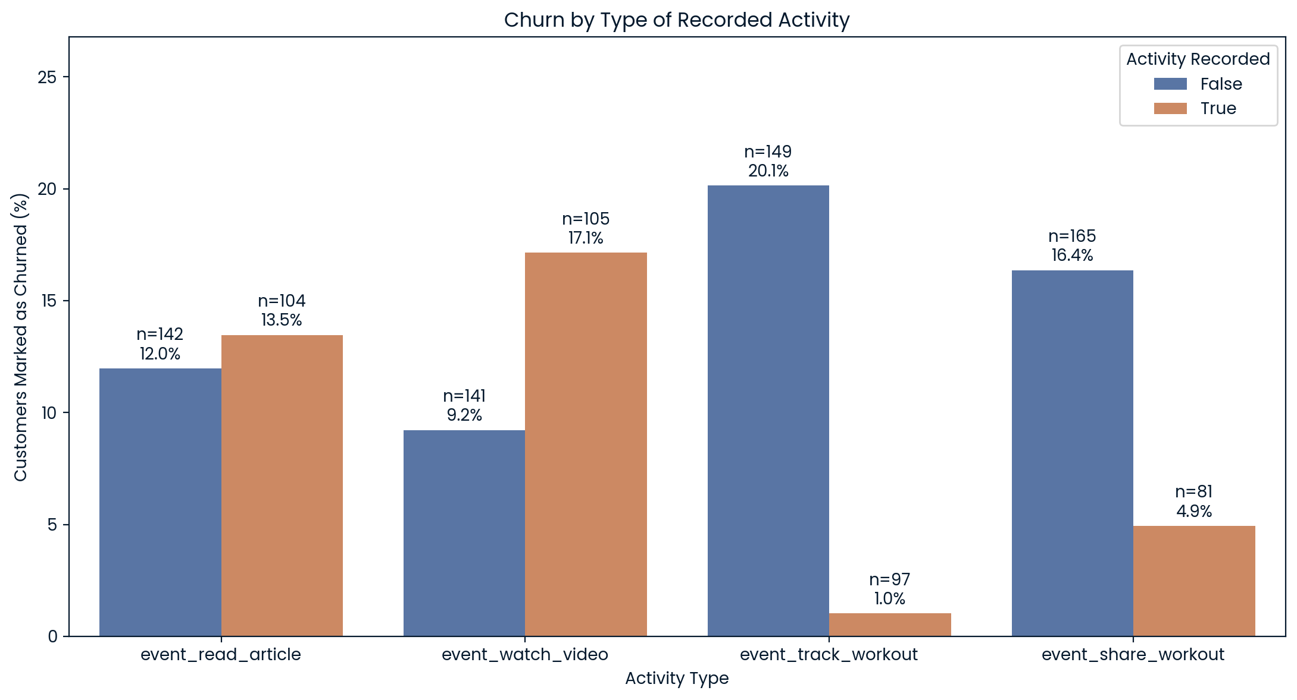
Workout-related features are promising areas to test.
Notes:
I also looked at the types of activities customers performed.
For this analysis, I focused only on customers who had at least one recorded activity.
Two features stood out: tracking workouts and sharing workouts.
Among customers who tracked workouts, only 1% were marked as churned, compared with about 20% among other active customers.
A similar pattern appeared for workout sharing, where the proportions were about 5% and 16%.
This does not mean that these features directly prevent churn. They may simply be more popular among highly engaged users.
However, they provide a useful starting point for testing ways to increase engagement.

Slide 9
What Fit.ly should do next?
1
Improve support efficiency
Reduce resolution times.
2
Increase workout-related engagement
Promote tracking and sharing workouts.
3
Monitor churn by plan
Especially Free users.
Notes:
Based on these findings, I recommend three main business actions.
First, We should focus on improving customer support efficiency, mainly by reducing the time needed to resolve tickets.
Second, the company should test ways to encourage regular app usage. Features such as workout tracking and workout sharing are promising areas to explore.
Third, We should monitor customer retention for each subscription plan, especially the Free plan.
It is important to remember that these are recommendations based on observed relationships, not proven causes of churn.
Therefore, we should test each idea and measure its results before making bigger changes.

Slide 10
How should Fit.ly measure progress?
Collect better data
Monitor monthly churn
Test retention actions
Cancellation dates
Monthly active customer counts
Reliable activity logs
Regular data validation
Monthly churn rate (%)
Customers active at month start
× 100
=
Monthly cancellations
Pilot faster support resolution
Test workout tracking and sharing initiatives
Compare results with control groups
/
Notes:
To measure progress, I recommend a three-step approach.
First, We need to improve data collection. The company should record cancellation dates, maintain monthly customer counts, and make sure activity logs are complete and reliable.
Second, We should calculate the monthly customer churn rate. This means dividing the number of customers who cancel during a month by the number of active customers at the beginning of that month, and multiplying by 100.
Finally, the company should test ways to keep customers, such as faster customer support and better workout features.
By comparing results over time, and with control groups, where it possible, we can evaluate which actions actually help reduce churn.
Thank you for your attention.

