Slide 1


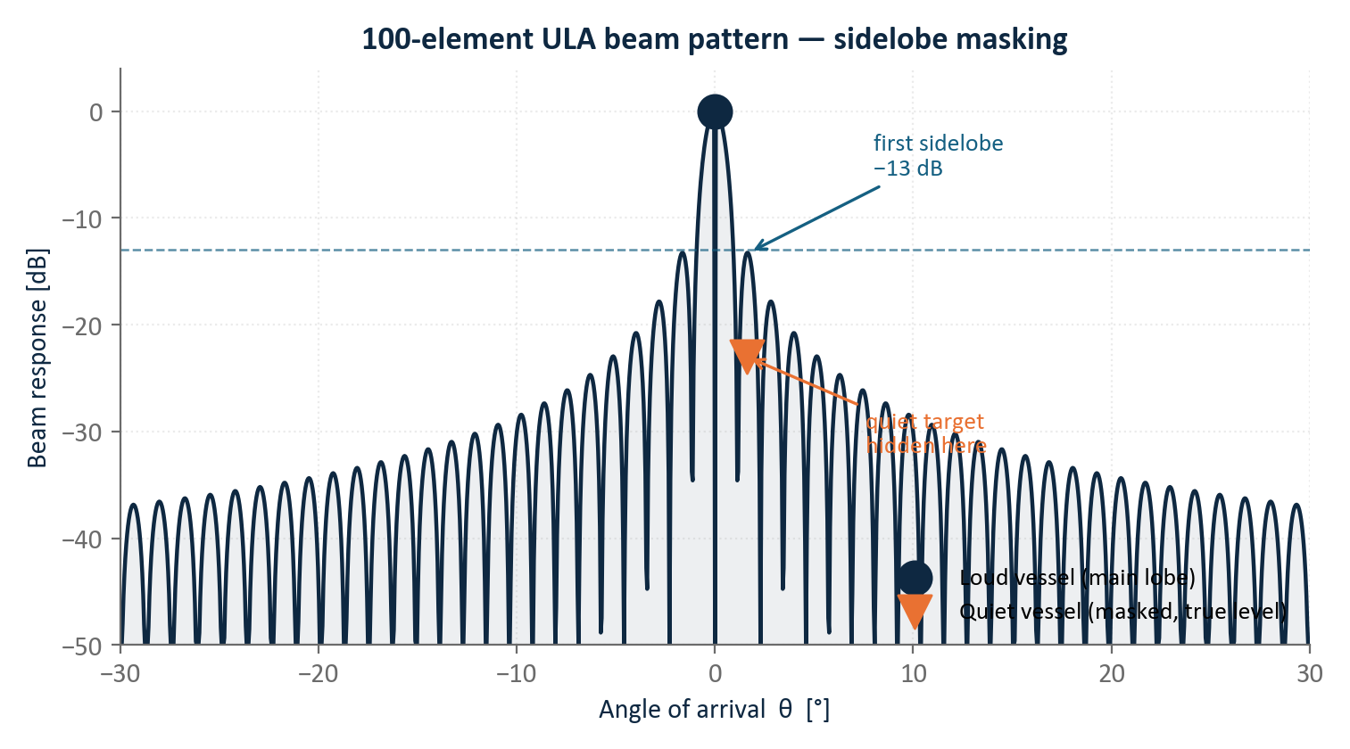
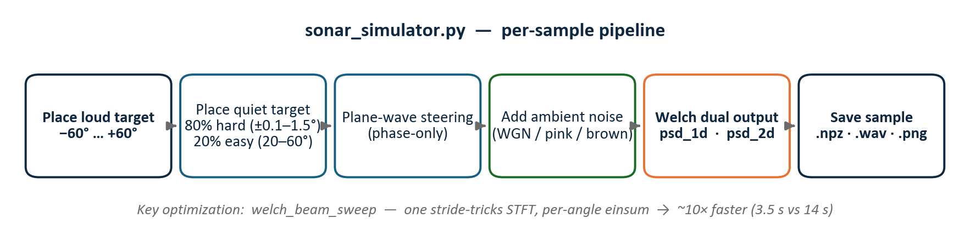
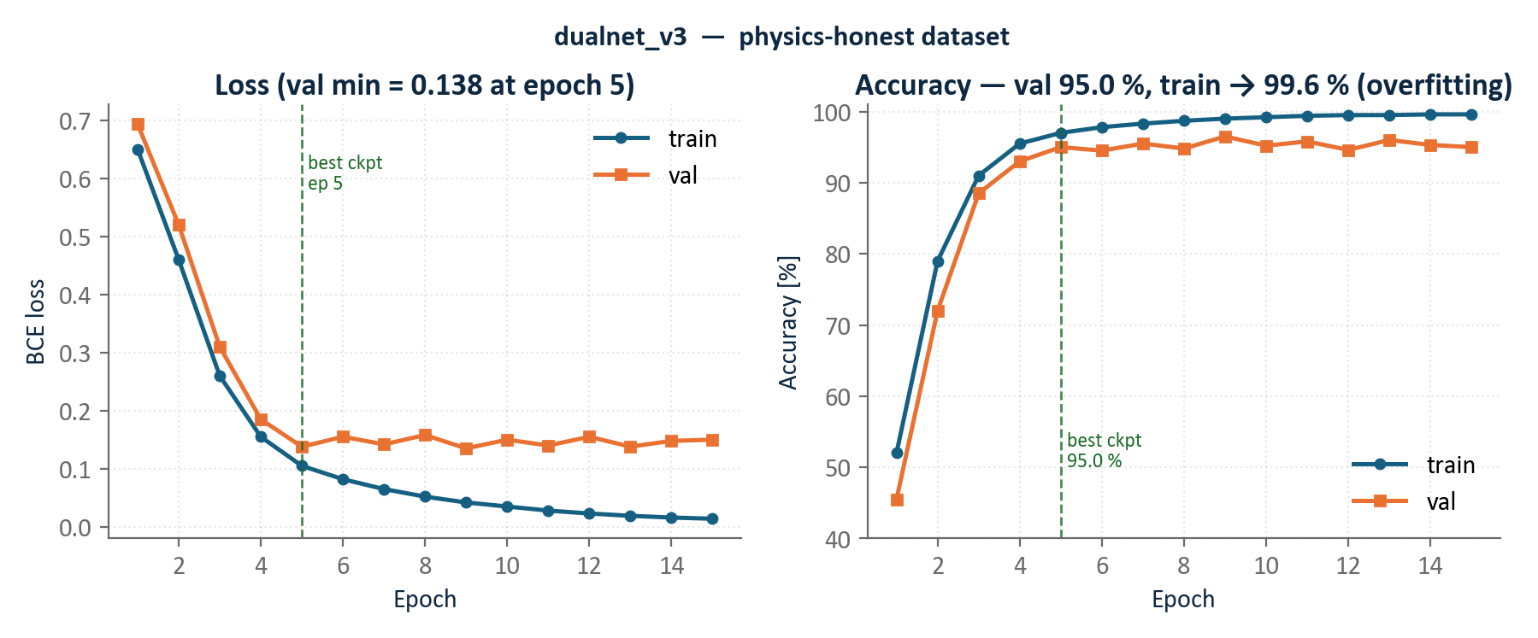
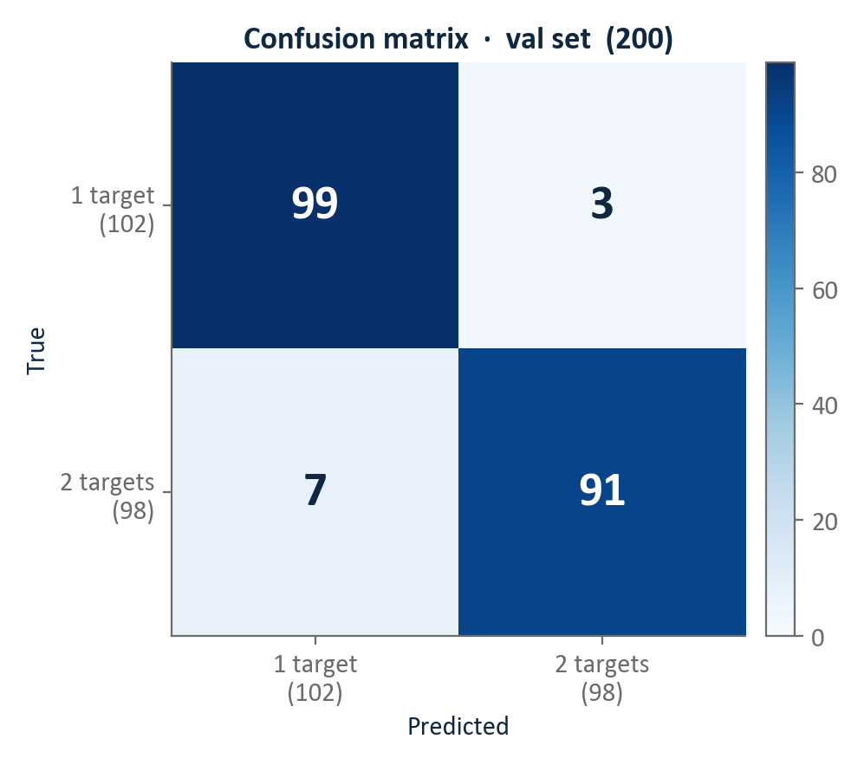
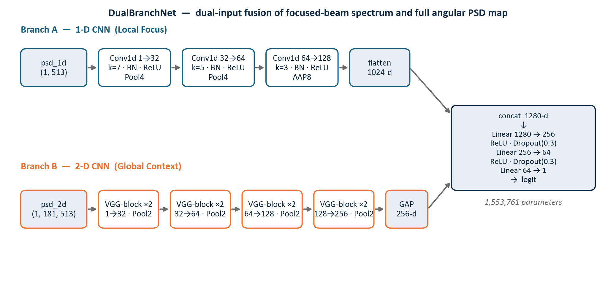
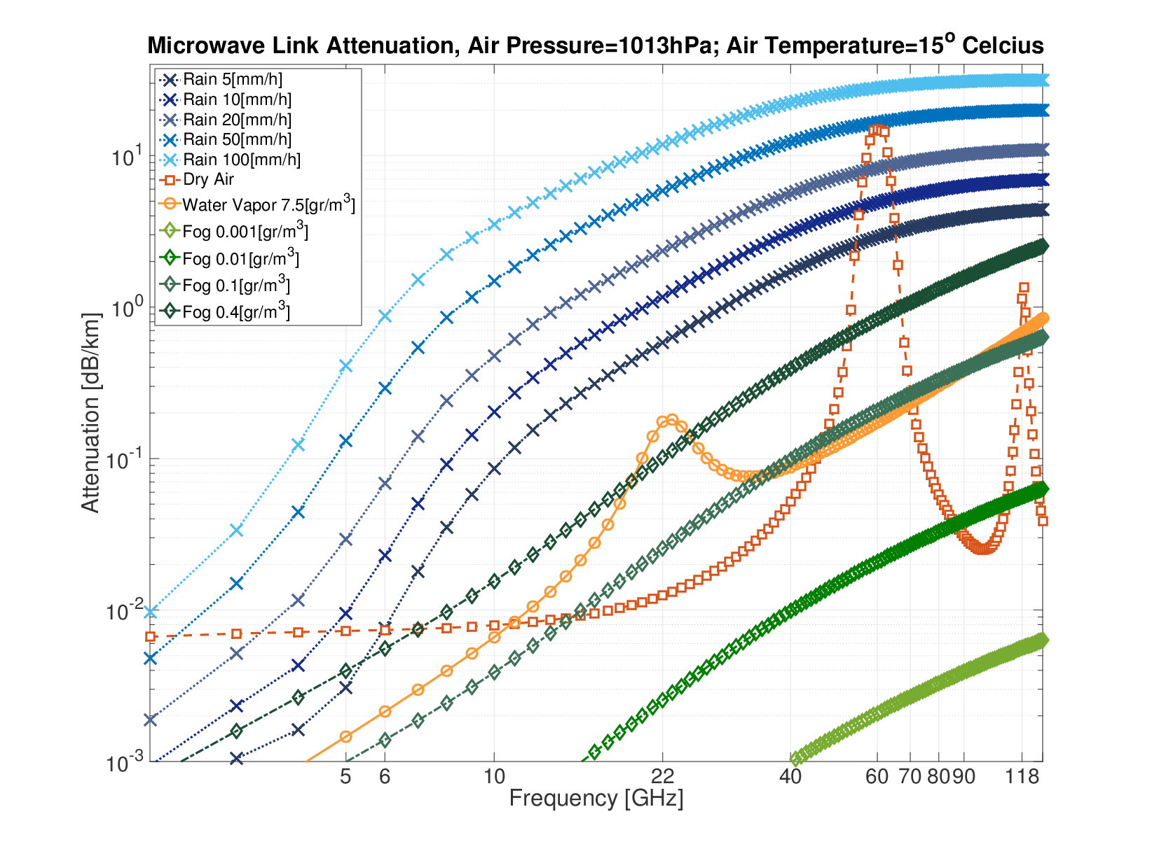
Hearing the Quiet Vessel
A Dual-Branch CNN for Sub-Sidelobe Target Detection in Passive Sonar
[Student 1], [Student 2]
Advisor: [Advisor Name, Title]
Project Number: [XX-X-X-XXXX] · [Institution / Lab]
Introduction
Methods
Results
Passive sonar arrays localise underwater acoustic sources through Delay-and-Sum (DAS) beamforming, a technique that steers a virtual listening beam by introducing time delays across array elements proportional to their positions relative to the incoming wavefront.
A fundamental limitation arises when multiple sources with disparate intensities are present simultaneously. The beam pattern of a 100-element uniform linear array (ULA) exhibits a first sidelobe only 13 dB below the main lobe. When a loud vessel dominates the scene, its sidelobes radiate energy into surrounding bearings and can exceed the direct contribution of a quieter vessel by 10 dB or more, causing a conventional energy-threshold detector to miss the quieter target entirely.
This project proposes a dual-branch convolutional neural network (CNN) that addresses this sub-sidelobe detection problem by jointly exploiting the focused-beam power spectrum and the full angular frequency heatmap, learning to identify the faint target ridge against the dominant sidelobe background.
Dataset Generator (sonar_simulator.py)
95.0 %
Accuracy
96.8 %
Precision
92.9 %
Recall
94.8 %
F1 Score
A total of 1 000 synthetic samples were generated per dataset version using sonar_simulator.py. Each sample represents a 3-second acoustic scene containing one or two vessels. In two-target scenes the quiet vessel is placed within the main lobe or first sidelobe of the loud vessel with 80 % probability, constituting the hard detection regime, and at a well-separated bearing with 20 % probability as the easy baseline. Source intensities are drawn from the Signal-to-Interference Ratio range specified for each dataset version.
Two complementary representations are computed per sample via a vectorised Welch sweep: psd_1d, a 513-bin focused-beam power spectral density at the estimated target bearing, and psd_2d, a full 181 × 513 angular heatmap. In v3 all samples share a global fixed-range dB → [0, 1] normalisation, preserving true inter-sample amplitude differences and preventing the model from exploiting within-sample normalisation artefacts.
The model was trained with AdamW (lr = 10⁻³, weight decay = 10⁻⁴) and BCEWithLogitsLoss, with the learning rate halved whenever validation loss plateaued. The best checkpoint was saved at epoch 5 (val loss = 0.138). Training and validation dynamics are shown below.
Fig. 2. Per-sample simulation pipeline. Hard cases (80 %) position the quiet vessel inside the main lobe or first sidelobe of the louder interferer.
DualBranchNet Architecture
Fig. 3. Training dynamics on the v3 dataset. Validation accuracy peaked at 95.0 % at epoch 5; subsequent divergence (train → 99.6 %, val ≈ 95 %) indicates overfitting on the 1 000-sample training set.
The dual-branch architecture processes psd_1d and psd_2d in parallel and fuses the resulting feature vectors through a shared classification head, producing a single detection logit that indicates whether the scene contains one or two vessels.
Branch A (Local Focus) applies three Conv1d blocks with progressively increasing channel depth (1 → 32 → 64 → 128, kernels k = 7 / 5 / 3), each followed by batch normalisation, ReLU activation, and max-pooling. Adaptive average pooling yields a 1 024-d feature vector tuned to narrow tonal signatures in the focused beam.
Branch B (Global Context) applies four VGG-style double-convolution blocks (1 → 32 → 64 → 128 → 256 channels) with 2×2 max-pooling to psd_2d, followed by global average pooling to a 256-d vector encoding the full sidelobe angular pattern. The 1 280-d concatenation is passed through three linear layers (1 280 → 256 → 64 → 1) with ReLU and Dropout (p = 0.3). Total: 1 553 761 parameters.
Fig. 1. Beam pattern of a 100-element ULA steered to 0°. The quiet vessel (orange marker) is hidden under the −13 dB first sidelobe of the loud vessel, making it invisible to a simple energy detector.
The confusion matrix records 3 false alarms and 7 missed detections on the 200-sample balanced validation set.
The 7 missed detections correspond to the hardest physical regime: SIR ≥ 30 dB combined with element SNR = −5 dB, placing the quiet vessel at an output SNR of −20 dB — below the thermal noise floor. These cases are physically marginal and are not expected to be resolved without additional data or a larger array.
The T1 objective is satisfied: 92.9 % recall was achieved on a dataset in which 58 % of two-target scenes exercise the SIR ≥ 23 dB sub-sidelobe regime.
Objectives
The system is evaluated against three quantitative performance targets. The primary objective (T1) is to detect a quiet vessel when the interferer's sidelobe at the target direction is at least 10 dB stronger than the target's direct contribution. This corresponds physically to a Signal-to-Interference Ratio of at least 23 dB, a demanding regime in which the sidelobe alone can completely mask the quiet vessel. The v3 dataset was designed so that 58 % of two-target samples fall within this T1 regime, ensuring the evaluation reflects realistic sub-sidelobe detection difficulty.
The second objective (T2) requires the network to reliably distinguish between one and two vessels when their intensities differ by only 3–5 dB. In this regime, the targets are nearly equal in perceived loudness and the beamformed output alone provides little discriminating power, making spectral and spatial cue fusion essential.
The third objective (T3) extends the problem to source separation, requiring that distinct audio channels be produced for two overlapping targets whose intensities differ by no more than 3 dB. Together, T1–T3 span the continuum from gross detection to fine-grained source separation in acoustically challenging multi-vessel scenarios.
Conclusions
DualBranchNet achieves 92.9 % recall on the physics-honest v3 dataset where 58 % of two-target scenes require sub-sidelobe detection at SIR ≥ 23 dB, demonstrating that joint spectral and angular fusion succeeds where energy thresholding fails.
Global fixed-range dB normalisation is essential: per-sample Z-score standardisation destroys inter-sample amplitude contrast, inflating v1/v2 validation accuracy to a trivial 100 % with no genuine generalisation.
Larger training datasets and augmentation are the key next step to close the train–validation gap (99.6 % vs. 95.0 %) and push recall toward 100 %.
References
[1] Van Trees, Optimum Array Processing, 2002. [2] Welch, IEEE Trans. Audio Electroacoust., 1967. [3] Simonyan & Zisserman, ICLR, 2015.

