Slide 1
So how do I test my Sling Application?
Robert Munteanu, Adobe Systems Romania

Slide 2
About the speaker
Apache Sling PMC member
Long-time Open Source contributor
Working with Adobe on AEM

Slide 3
Agenda
How do I test my application?
What about Sling?
Demo

Slide 4
Speaker.getInstance().interrupt()

Slide 5
How do I test my application?

Slide 6
Unit testing
@Test public void isNull() {
assertThat( StringUtils.isNull( null ), is(true));
}

Slide 7
Unit testing with mocks
@Test public void persist() {
MyDao dao = mock(MyDao.class);
MyService service = new MyService(dao);
service.persist(new ServiceObject()); // must not fail
}

Slide 8
Unit testing with mocks
@Test(expected=ServiceException.class) public void persist() {
MyDao dao = mock(MyDao.class);
MyService service = new MyService(dao);
when(dao.persist(anyObject)).thenThrow(new DaoUnavailableException("mocked"));
service.persist(new ServiceObject());
}

Slide 9
Integration testing
@Test public void persist() {
MyDao dao = new MyRealDao(/* config */);
MyService service = new MyService(dao);
service.persist(newServiceObject()); // must not fail
}

Slide 10
Integration testing - clean slate
@Before public void ensureCleanSlate() {
MyDao dao = new MyRealDao(/* config */);
dao.deleteAll();
}

Slide 11
End-to-end testing
@Test public void login() {
Client client = new MyBrowserBasedClient();
AuthResult result = client.login("admin", "admin");
assertThat(result.isLoggedIn(), is(true));
}

Slide 12
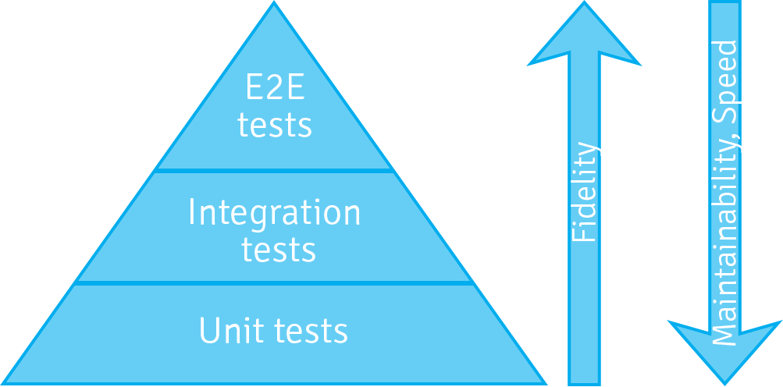
Testing pyramid

Slide 13
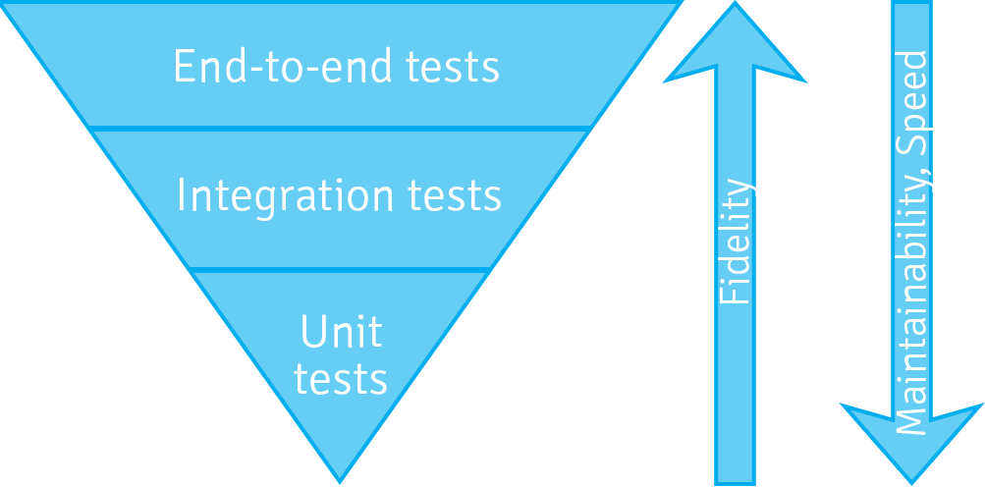
... or the testing icecream cone?

Slide 14
What about Sling?

Slide 15
Unit testing with Sling

Slide 16
Unit testing
@Test public void test_isRedirectValid_null_empty() {
TestCase.assertFalse(AuthUtil.isRedirectValid(null, null));
TestCase.assertFalse(AuthUtil.isRedirectValid(null, ""));
}
Actual code from AuthUtilTest.java

Slide 17
Unit testing with ad-hoc mocking
@RunWith(JMock.class) public class AuthUtilTest {
final Mockery context = new JUnit4Mockery();
final ResourceResolver resolver = context.mock(ResourceResolver.class);
final HttpServletRequest request = context.mock(HttpServletRequest.class);
@Test public void test_isRedirectValid_invalid_characters() {
context.checking(new Expectations() { /* 8 lines of code */ })
TestCase.assertFalse(AuthUtil.isRedirectValid(request, "/illegal/</x"));
}
}
Actual code also from AuthUtilTest.java

Slide 18
Unit testing with ad-hoc mocking
context.checking(new Expectations() {
{
allowing(request).getContextPath();
will(returnValue("/ctx"));
allowing(request).getAttribute(with(any(String.class)));
will(returnValue(null));
}
});

Slide 19
Unit testing with Sling mocks
public class ModelAdapterFactoryUtilTest {
@Test public void testRequestAttribute() {
MockSlingHttpServletRequest request = new MockSlingHttpServletRequest();
request.setAttribute("prop1", "myValue");
RequestAttributeModel model = request.adaptTo(RequestAttributeModel.class);
assertNotNull(model);
assertEquals("myValue", model.getProp1());
}
}
Actual code from ModelAdapterFactoryUtilTest.java.

Slide 20

OSGi

Slide 21
Unit testing OSGi code with Sling mocks
public class ExampleTest {
@Rule
public final OsgiContext context = new OsgiContext();
@Test
public void testSomething() {
// register and activate service
MyService service1 = context.registerInjectActivateService(new MyService(),
ImmutableMap.<String, Object>of("prop1", "value1"));
// get service instance
OtherService service2 = context.getService(OtherService.class);
}
}
Picked up from the OSGi mocks documentation.

Slide 22
Sling OSGi mocks
TODO - a little picture or some concepts about how Sling mocks works

Slide 23
The humble object pattern with OSGi
public interface RouterAdmin {
void doStuff();
}
public class RouterAdminImpl implements RouterAdmin {
// constructor and field elided
public void doStuff() {
// implementation
}
}
@Component
@Properties({ @Property(name="url") })
public class RouterAdminComponent implements RouterAdmin {
private RouterAdmin delegate;
protected void activate(ComponentContext ctx) throws Exception {
delegate = new RouterAdminImpl(new URL(requireString(ctx, "url")));
}
public void doStuff() {
delegate.doStuff();
}
}
See Humble Object at xUnit patterns for more details.

Slide 24

JCR

Slide 25
Testing JCR code with Sling mocks
public class FindResourcesTest {
@Rule public SlingContext context = new SlingContext(ResourceResolverType.JCR_MOCK);
@Before public void setUp() {
Resource resource = context.create().resource("test",
ImmutableMap.<String, Object> builder().put("prop1", "value1")
.put("prop2", "value2").build());
// snip ...
MockJcr.setQueryResult(session, Collections.singletonList(node));
}
@Test public void testFindResources() {
Resource resource = context.resourceResolver().getResource("/test");
Assert.assertNotNull("Resource with name 'test' should be there", resource);
Iterator<Resource> result = context.resourceResolver().findResources("/test", Query.XPATH);
Assert.assertTrue("At least one result expected", result.hasNext());
Assert.assertEquals("/test", result.next().getPath());
Assert.assertFalse("At most one result expected", result.hasNext());
}
}
Code taken from FindResourceTest.java.

Slide 26

Sling

Slide 27
Sling Mocks for unit testing
public class SimpleNoSqlResourceProviderQueryTest {
@Rule public SlingContext context = new SlingContext(ResourceResolverType.JCR_MOCK);
@Before public void setUp() throws Exception {
context.registerInjectActivateService(new SimpleNoSqlResourceProviderFactory(), ImmutableMap.<String, Object>builder()
.put(ResourceProvider.ROOTS, "/nosql-simple")
.build());
// prepare some test data using Sling CRUD API ( not shown here )
}
@Test
public void testFindResources_ValidQuery() {
Iterator<Resource> result = context.resourceResolver().findResources("all", "simple");
assertEquals("/nosql-simple", result.next().getPath());
assertEquals("/nosql-simple/test", result.next().getPath());
assertEquals("/nosql-simple/test/node1", result.next().getPath());
assertEquals("/nosql-simple/test/node2", result.next().getPath());
assertFalse(result.hasNext());
}
}
Code from SimpleNoSqlResourceProviderQueryTest

Slide 28
Pax-Exam
@RunWith(PaxExam.class) public class FileNameExtractorImplIT {
@Inject private FileNameExtractor fileNameExtractor;
@Test public void testFileNameExtractor(){
String rawPath = "http://midches.com/images/uploads/default/demo.jpg#anchor?query=test";
String expectedFileName = "demo.jpg";
assertEquals(expectedFileName, fileNameExtractor.extract(rawPath));
}
@Configuration public Option[] config() {
return U.paxConfig();
}
}
Taken from FileNameExtractorImplIT.java.

Slide 29
Sling mocks with a JCR backend
Unit testing with JCR Mocks
  JCR_MOCK
  SLING_MOCK
Integration testing with JCR Mocks
  JCR_JACKRABBIT
  JCR_OAK

Slide 30
Server-side JUnit tests
public class ServerSideInstallerTest {
@Rule public final TeleporterRule teleporter = TeleporterRule.forClass(getClass(), "Launchpad");
@Before
public void setup() throws LoginException {
ip = teleporter.getService(InfoProvider.class);
is = ip.getInstallationState();
}
@Test
public void noUntransformedResources() {
final List<?> utr = is.getUntransformedResources();
if(utr.size() > 0) {
fail("Untransformed resources found: " + utr);
}
}
}

Slide 31
Scriptable server-side tests
// test imports that fail on Java 8, SLING-3405
%><%@page import="java.util.Arrays"%><%
%><%@page import="java.lang.CharSequence"%><%
%>TEST_PASSED
Actual code from installer-duplicate.jsp.

Slide 32
End-to-end testing with Sling

Slide 33
HTTP utilities from the Sling testing tools
public class HttpPingTest extends HttpTestBase {
public void testWebServerRoot() throws Exception {
// by default, the Launchpad default servlet redirects / to index.html
final String url = HTTP_BASE_URL + "/";
final GetMethod get = new GetMethod(url);
get.setFollowRedirects(false);
final int status = httpClient.executeMethod(get);
assertEquals("Status must be 302 for " + url, 302, status);
final Header h = get.getResponseHeader("Location");
assertNotNull("Location header must be provided",h);
assertTrue("Location header must end with index.html", h.getValue().endsWith("index.html"));
}
}
And finally, if you are looking to write some end-to-end tests,

Slide 34
Code time

Slide 35

Slingshot

Slide 36
Colophon
Presentation crafted with Eclipse, GNU Make and odpdown
Photo credits
  Slingshots by Anne and Tim on Flickr
  Wall by Bart Lumber on Flickr
  HTML code by Marjan Krebelj on Flickr

Slide 37
Final thoughts
Sling provides a lot of specialised testing tools
Lots of effort recently invested in the unit testing layer
Experiment and provide feedback

Slide 38
Resources
Sling mocks
AEM mocks
Slingshot
And also the links spread throughout the presentation.

