Slide 1
So how do I test my Sling Application?
Robert Munteanu, Adobe Systems Romania

Slide 2
About the speaker
Apache Sling PMC member
Long-time Open Source contributor
Working with Adobe on AEM

Slide 3
Agenda
How do I test my application?
What about Sling?
Demo

Slide 4
How do I test my application?

Slide 5
Tools of the trade
Unit testing
Integration testing
End-to-End testing

Slide 6
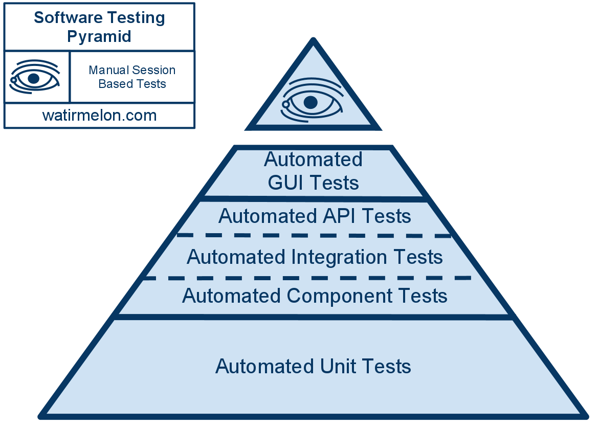
The testing pyramid

Slide 7
Unit testing
@Test public void isNull() {
assertThat(StringUtils.isNull(null), is(true));
}

Slide 8
Integration testing
@Test public void persist() {
MyDao dao = mock(MyDao.class);
MyService service = new MyService(dao);
service.persist(new ServiceObject()); // must not fail
}

Slide 9
End-to-end testing
@Test public void login() {
Client client = new MyAppHttpClient();
AuthResult result = client.login("admin", "admin");
assertThat(result.isLoggedIn(), is(true));
}

Slide 10
Testing tools galore
Unit testing
  Frameworks: JUnit, TestNG
  Mocks: JMock, EasyMock, Mockito, Powermock
Integration testing: Spring Testing, WireMock, Dumbster
End-to-end testing: Selenium/WebDriver, REST-assured

Slide 11
What about Sling?

Slide 12
Sling oddities^W particularities
OSGi
JCR
Sling APIs (Java, HTTP)

Slide 13
Unit testing with Sling

Slide 14
Unit testing
@Test public void test_isRedirectValid_null_empty() {
TestCase.assertFalse(AuthUtil.isRedirectValid(null, null));
TestCase.assertFalse(AuthUtil.isRedirectValid(null, ""));
}
Actual code from AuthUtilTest.java

Slide 15
Unit testing with ad-hoc mocking
@RunWith(JMock.class) public class AuthUtilTest {
final Mockery context = new JUnit4Mockery();
final ResourceResolver resolver = context.mock(ResourceResolver.class);
final HttpServletRequest request = context.mock(HttpServletRequest.class);
@Test public void test_isRedirectValid_invalid_characters() {
context.checking(new Expectations() { /* code */ })
TestCase.assertFalse(AuthUtil.isRedirectValid(request, "/illegal/</x"));
}
}
Actual code also from AuthUtilTest.java

Slide 16
Unit testing with Sling mocks
public class ModelAdapterFactoryUtilTest {
@Test
public void testRequestAttribute() {
MockSlingHttpServletRequest request = new MockSlingHttpServletRequest();
request.setAttribute("prop1", "myValue");
RequestAttributeModel model = request.adaptTo(RequestAttributeModel.class);
assertNotNull(model);
assertEquals("myValue", model.getProp1());
}
}
Actual code from ModelAdapterFactoryUtilTest.java.

Slide 17
Unit testing OSGi code with Sling mocks
public class ExampleTest {
@Rule
public final OsgiContext context = new OsgiContext();
@Test
public void testSomething() {
// register and activate service
MyService service1 = context.registerInjectActivateService(new MyService(),
ImmutableMap.<String, Object>of("prop1", "value1"));
// get service instance
OtherService service2 = context.getService(OtherService.class);
}
}
Picked up from the OSGi mocks documentation.

Slide 18
Sling Mocks for unit testing
public class SimpleNoSqlResourceProviderQueryTest {
@Rule public SlingContext context = new SlingContext(ResourceResolverType.JCR_MOCK);
@Before public void setUp() throws Exception {
context.registerInjectActivateService(new SimpleNoSqlResourceProviderFactory(), ImmutableMap.<String, Object>builder()
.put(ResourceProvider.ROOTS, "/nosql-simple")
.build());
// prepare some test data using Sling CRUD API ( not shown here )
}
@Test
public void testFindResources_ValidQuery() {
Iterator<Resource> result = context.resourceResolver().findResources("all", "simple");
assertEquals("/nosql-simple", result.next().getPath());
assertEquals("/nosql-simple/test", result.next().getPath());
assertEquals("/nosql-simple/test/node1", result.next().getPath());
assertEquals("/nosql-simple/test/node2", result.next().getPath());
assertFalse(result.hasNext());
}
}
Code from SimpleNoSqlResourceProviderQueryTest

Slide 19
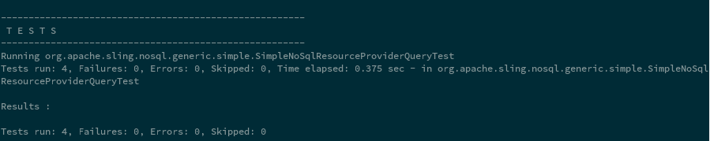
Sling Mocks for unit testing

Slide 20
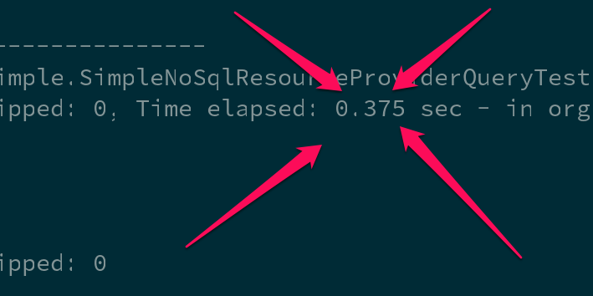
Sling Mocks for unit testing

Slide 21
Testing JCR code with Sling mocks
public class FindResourcesTest {
@Rule public SlingContext context = new SlingContext(ResourceResolverType.JCR_MOCK);
@Before public void setUp() {
Resource resource = context.create().resource("test",
ImmutableMap.<String, Object> builder().put("prop1", "value1")
.put("prop2", "value2").build());
// snip ...
MockJcr.setQueryResult(session, Collections.singletonList(node));
}
@Test public void testFindResources() {
Resource resource = context.resourceResolver().getResource("/test");
Assert.assertNotNull("Resource with name 'test' should be there", resource);
Iterator<Resource> result = context.resourceResolver().findResources("/test", Query.XPATH);
Assert.assertTrue("At least one result expected", result.hasNext());
Assert.assertEquals("/test", result.next().getPath());
Assert.assertFalse("At most one result expected", result.hasNext());
}
}

Slide 22
The humble object pattern with OSGi
public interface RouterAdmin {
void doStuff();
}
public class RouterAdminImpl implements RouterAdmin {
// constructor and field elided
public void doStuff() {
// implementation
}
}
@Component
@Properties({ @Property(name="url") })
public class RouterAdminComponent implements RouterAdmin() {
private RouterAdmin delegate;
protected void activate(ComponentContext ctx) throws Exception {
delegate = new RouterAdminImpl(new URL(requireString(ctx, "url")));
}
public void doStuff() {
delegate.doStuff();
}
}
See Humble Object at xUnit patterns for more details.

Slide 23
Integration testing with Sling

Slide 24
Pax-Exam
public abstract class AbstractJobHandlingTest {
@Inject protected EventAdmin eventAdmin;
@Inject protected ConfigurationAdmin configAdmin;
@Inject protected BundleContext bc;
@Configuration public Option[] config() {
return options(
frameworkProperty("sling.home").value(new File(...),
mavenBundle("org.apache.sling", "org.apache.sling.fragment.xml", "1.0.2"),
mavenBundle("org.apache.sling", "org.apache.sling.fragment.transaction", "1.0.0"),
mavenBundle("org.apache.sling", "org.apache.sling.fragment.activation", "1.0.2"),
mavenBundle("org.apache.sling", "org.apache.sling.fragment.ws", "1.0.2"),
mavenBundle("org.apache.sling", "org.apache.sling.commons.log", "4.0.0"),
mavenBundle("org.apache.sling", "org.apache.sling.commons.logservice", "1.0.2"),
mavenBundle("org.slf4j", "slf4j-api", "1.6.4"),
mavenBundle("org.slf4j", "jcl-over-slf4j", "1.6.4"),
mavenBundle("org.slf4j", "log4j-over-slf4j", "1.6.4"),
mavenBundle("commons-io", "commons-io", "1.4"),
mavenBundle("commons-fileupload", "commons-fileupload", "1.3.1"),
mavenBundle("commons-collections", "commons-collections", "3.2.1"),
mavenBundle("commons-codec", "commons-codec", "1.9"),
mavenBundle("commons-lang", "commons-lang", "2.6"),
mavenBundle("commons-pool", "commons-pool", "1.6"),
mavenBundle("org.apache.servicemix.bundles", "org.apache.servicemix.bundles.concurrent", "1.3.4_1"),
// SNIP ...
mavenBundle("org.apache.sling", "org.apache.sling.api", "2.8.0"),
mavenBundle("org.apache.sling", "org.apache.sling.settings", "1.3.4"),
mavenBundle("org.apache.sling", "org.apache.sling.resourceresolver", "1.1.6"),
mavenBundle("org.apache.sling", "org.apache.sling.adapter", "2.1.2"),
// SNIP ...
}

Slide 25
Sling mocks with a JCR backend
ResourceResolverType.JCR_MOCK ?
JCR_OAK or JCR_JACKRABBIT are also possible

Slide 26
Server-side JUnit tests
@RunWith(SlingAnnotationsTestRunner.class)
public class OsgiAwareTest {
@TestReference private ConfigurationAdmin configAdmin;
@TestReference private BundleContext bundleContext;
@Test public void testConfigAdmin() throws Exception {
assertNotNull( "Expecting ConfigurationAdmin to be injected by Sling test runner", configAdmin);
}
}
Actual code from OsgiAwareTest

Slide 27
Scriptable server-side tests
%><sling:defineObjects/><%
// we don't check for null etc to make the test fail if the service is not available!
final InfoProvider ip = sling.getService(InfoProvider.class);
final InstallationState is = ip.getInstallationState();
String output = "";
// check 01 : no untransformed resources
if ( is.getUntransformedResources().size() > 0 ) {
output += "Untransformed resources: " + is.getUntransformedResources() + "\n";
}
// check 02 : no active resources
if ( is.getActiveResources().size() > 0 ) {
output += "Active resources: " + is.getActiveResources() + "\n";
}
if ( output.length() > 0 ) {
%><%= output %><%
} else {
%>TEST_PASSED<%
}
%>
Actual code from installer-duplicate.jsp.

Slide 28
End-to-end testing with Sling

Slide 29
HTTP utilities from the Sling testing tools
public class HttpPingTest extends HttpTestBase {
public void testWebServerRoot() throws Exception {
// by default, the Launchpad default servlet redirects / to index.html
final String url = HTTP_BASE_URL + "/";
final GetMethod get = new GetMethod(url);
get.setFollowRedirects(false);
final int status = httpClient.executeMethod(get);
assertEquals("Status must be 302 for " + url, 302, status);
final Header h = get.getResponseHeader("Location");
assertNotNull("Location header must be provided",h);
assertTrue("Location header must end with index.html", h.getValue().endsWith("index.html"));
}
}

Slide 30
Final thoughts
Sling provides a lot of specialised testing tools
Lots of effort recently invested in the unit testing layer
Experiment and provide feedback

Slide 31
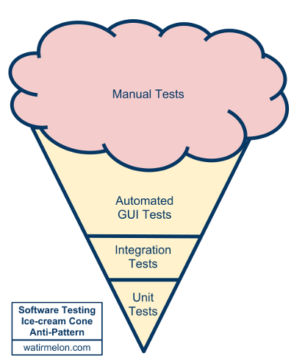
And ensure your tests are properly structured

