Slide 1
Dummy Talk
D. Ummy, ACME Corp.

Slide 2
Section 1

Slide 3
My textbased slide
Textbased slides…
  …should optimally…
    … not contain more then 6 lines of text …
    … not more then 2 levels of depth
    … only make rare use of Highlights

Slide 4
Code (1/2)
Only few lines with bold highlighting
public void doFilter(ServletRequest pRequest, ServletResponse pResponse, FilterChain pChain) throws IOException, ServletException {
if (!(pRequest instanceof SlingHttpServletRequest)) {
throw new ServletException("Request is not a Sling HTTP request.");
}
if (isFilterEnabled(slingRequest)) {
// Implement Filter-Logic
} else {
// continue with filter chaining
pChain.doFilter(pRequest, pResponse);
}
}

Slide 5
Code (2/2)
Focus on further details in further slides
if (isFilterEnabled(slingRequest)) {
Resource resource = slingRequest.getResource(); // already resolved
if (null != resource) {
PrintWriter writer = pResponse.getWriter();
writer.write("<component resourceType=\"" + resource.getResourceType() + "\">");
pChain.doFilter(pRequest, pResponse);
writer.write("</component>");
return;
}
}

Slide 6
Icons
Colors for Icons / Vector graphics
  #00ADEE (RGB 0, 173, 238)
  #FF9D32 (RGB 255, 157, 50)
  #666666 (RGB 102, 102, 102)
Additionally for use on dark backgrounds
  #66CEF5 (RGB 102, 206, 245)

Slide 7
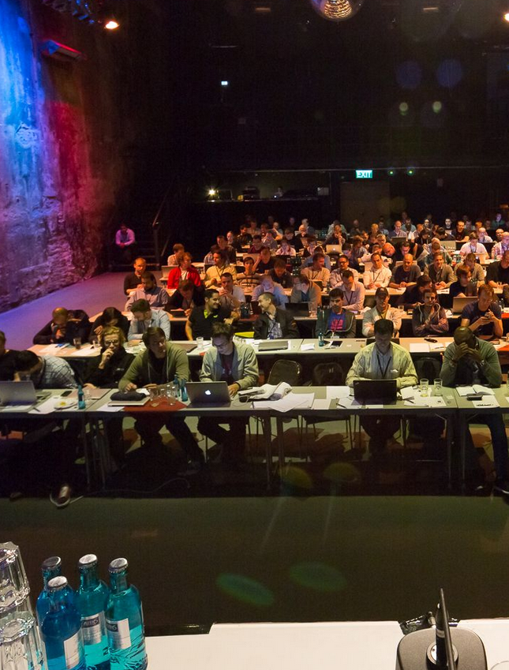
My slide with image
For slides with images…
  … try to horizontally align blocks (16: 9 widescreen)

Slide 8

My background slide
When using background images
  … assume reducing
    Saturation, Brightness & Contrast
  … use WHITE font color on darkened image
  You can try the other way around for bright images.

Slide 9
Appendix

Slide 10
Slides for download
your slides only support your talk – don’t fill them with details
You can use the notes section to guide yourself through your talk
You have two options to provide additional info that makes your slides usable standalone:
  Backupslides in the appendix
  An alternative slide deck for download
These slides can contain a lot more content and should not require additional comments.

Slide 11
Send us your slides and code!
Please send us your final slides and code before the conference starts!
This way we can prepare slides and code for download right after you finished your talk. (…we can replace them if you have last minute changes…)
We’ll try to setup an infrastructure to optimize availability and usability of your code for attendees during the conference

