Slide 1



Cost-Benefit Analysis (L10)
❑
Cost-Benefit Analysis - Software Presentation
Opção UMinho: Asset Management
UNIVERSIDADE DO MINHO - Departamento de Engenharia Civil
Jose Matos

Slide 2
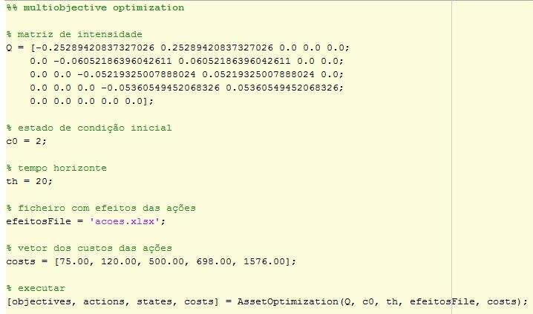
Cost-Benefit Analysis (L10)
❑
Cost-Benefit Analysis - Software Presentation
Maintenance
Actions Effects
Maintenance
Actions Costs
Run
Opção UMinho: Asset Management
UNIVERSIDADE DO MINHO - Departamento de Engenharia Civil
Jose Matos

Slide 3
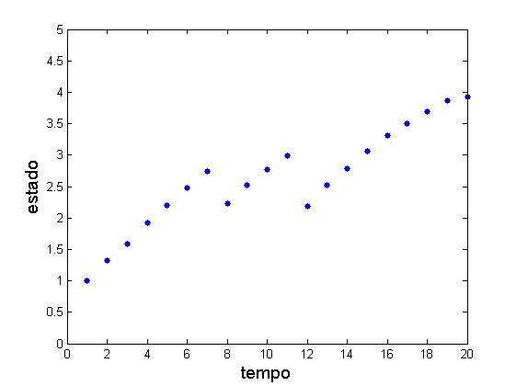
Cost-Benefit Analysis (L10)
❑
Cost-Benefit Analysis - Software Presentation
Performance
Time
Opção UMinho: Asset Management
UNIVERSIDADE DO MINHO - Departamento de Engenharia Civil
Jose Matos

Slide 4
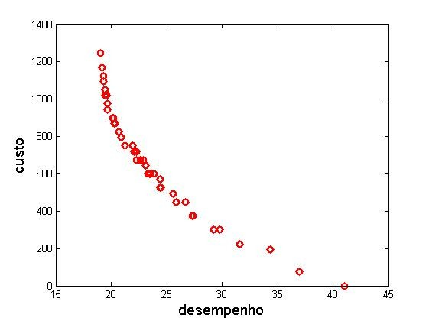
Cost-Benefit Analysis (L10)
❑
Cost-Benefit Analysis - Software Presentation
Cost
Performance
Opção UMinho: Asset Management
UNIVERSIDADE DO MINHO - Departamento de Engenharia Civil
Jose Matos

