Slide 1


PyGame Project:
made by Suftin Roman

Slide 2


PyGame Project:
Instruments
made by Suftin Roman

Slide 3
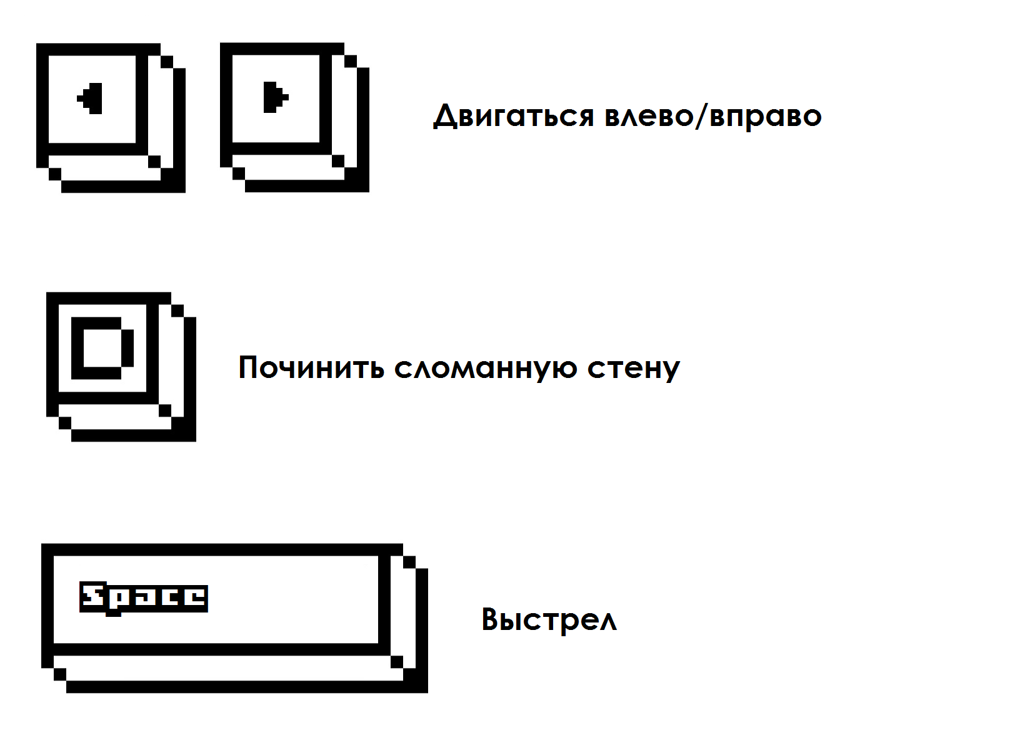
PyGame Project:
Instruction
made by Suftin Roman

Slide 4


